Slide 1


CRYSTAL PARADIGM
Challenge #2
AI-Integrated Materials Architectures for Aerospace Applications
Crystal Paradigm is a research-driven organization at the intersection of artificial intelligence and materials science. Currently, its aerospace-focused deep-tech engineering team has computationally validated a next-generation radar-absorbing magnetic material achieving an ideal X-band alignment score of 0.98—exceeding the baseline radar attenuation threshold by 14%.
Our mission is to accelerate the discovery of next-generation materials by combining machine learning, high-performance computing, and experimental validation in one closed loop.
This program takes that platform to its hardest proving ground — extreme-environment aerospace defense aircraft: soft magnetic absorbing layers paired with functionally graded crystal structures, from public materials databases to an HPC-validated, experimental data and in-house data curation with a printable manufacturing recipe and screening of materials.
4 Research Paper
(Under Review)
2 Indian Patents
(Under Filing Process)

Slide 2
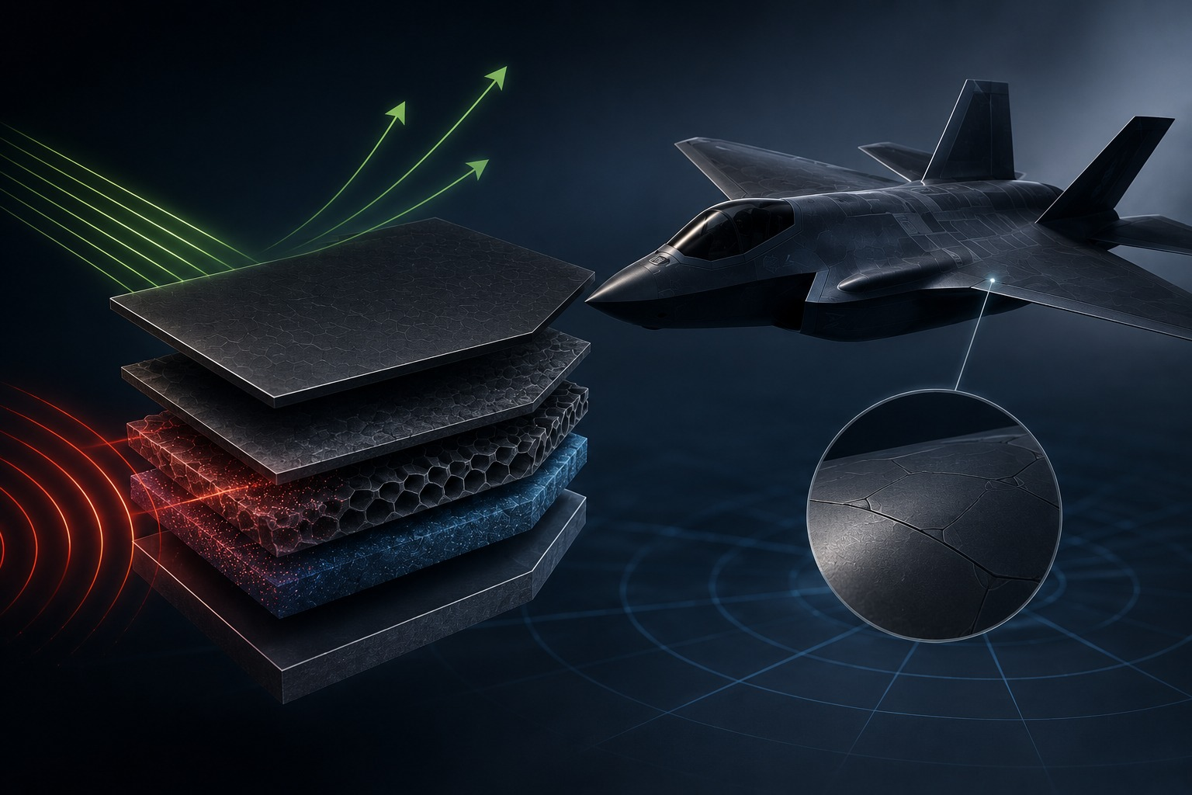
CRYSTAL PARADIGM FOR STEALTHIER, HIGH-SURVIVABILITY MILITARY AIRCRAFT
AI-Driven Inverse Design of Gradient Radar Absorbing Materials
Integrated Multi-Material Architecture
Merging a high-loss refractory magnetic base with a multi-layer functionally graded ferrite/carbon composite radar absorbing coating.
The Problem
Impedance mismatching and narrow bandwidth limitations at high radar frequencies causing surface wave reflection and loss of stealth capability.
Current Status
TRL-3+ screening complete via a pretrained diffusion model with fine-tuned property adapters and TMM/ML force-field solvers; lab-backed prototyping ready.
The Strategic Ask
A structured co-development and co-validation testing partnership with Safran's materials division.

Slide 3

WHY THIS MATTERS TO SAFRAN NOW
Addressing Aviation Fleet Imperatives and Supply Chain Resilience
The Electromagnetic Threat Limit
Next-generation radar tracking networks operate across wideband frequencies with extreme detection sensitivity. These severe limits introduce advanced tracking capabilities that outpace legacy passive stealth coatings.
Supply Chain Resilience
Conventional radar-absorbing designs rely heavily on rare elements like Hafnium. Our solution intentionally limits high-risk dependencies to mitigate price volatility and supply chain exposure.
Directly aligned with Safran's defense and aerospace program targets for signature reduction and structural efficiency.
RADAR CROSS SECTION (RCS)
MRO MAINTENANCE
MANUFACTURABILITY
15% reduction in compressor parasitic bleed air, driving an immediate 1.5% n95% reduction in radar cross-section across the X-band spectrum, driving a massive increase in aircraft survivability and tactical mission success.et reduction in Specific Fuel Consumption (SFC).
Lowering environmental and mechanical degradation to extend coating inspection intervals and airframe operational life cycles significantly.
Direct export of a universal, print-ready compositional matrix to drive advanced industrial material deposition setups for shop-floor deployment.

Slide 4

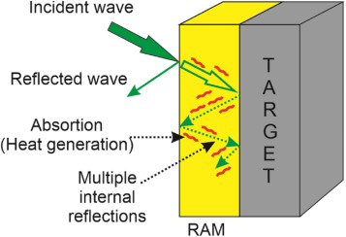
THE TECHNICAL PROBLEM IN ONE PICTURE
Impedance Matching Discontinuity
Air impedance (Z_0-approx-377 Omega) vs. raw absorber coating impedance (Z_in << Z_0). Interface reflection coefficients exceed acceptable military thresholds, far surpassing the detection limits of legacy monostatic and multistatic radar tracking systems.
Microstructural Phase Decay
Inhomogeneous elemental distribution precipitates non-magnetic secondary phases, causing rapid degradation of complex permeability ($\mu''$) and interface absorption failure.
The Edge Scattering Threat
Geometric discontinuities and surface geometric edges create intense electromagnetic scattering nodes, accelerating localized radar cross-section (RCS) spikes and signature detection leaks.
The Unified Imperative
Chemical composition, structural lattice geometry, and dielectric-magnetic multi-layers must be optimized as a single system to prevent radar reflection failures.
Schematic cross-section showing interfacial stress singularities and crack initiation zones.

Slide 5


OUR ADVANCED ARCHITECTURE & RECIPIENT LAYOUT
Substrate Phase Security
Optimized quinary soft magnetic matrix ensuring a stable single-phase crystal structure lattice.
Layer
Depth (mm)
Alloy Vol %
Ceramic Vol %
Profile Description
1
0.00
100.0%
0.0%
Pure Refractory HEA Base
2
0.50
92.1%
7.9%
Graded Matrix
3
1.00
83.0%
17.0%
Graded Matrix
The Pareto Gradient
Transition zone governed by a power-law exponent n=1.1, shifting electromagnetic boundary mismatches away from the surface.
4
1.50
73.4%
26.6%
Micro-Porosity Zone
5
2.00
63.5%
36.5%
Micro-Porosity Zone
6
2.50
53.3%
46.7%
Micro-Porosity Zone
7
3.00
42.9%
57.1%
Micro-Porosity Zone
Transpiration Porosity Network
Integrated micro-structures programmed via selective laser sintering, allowing incoming radar waves to dissipate uniformly into heat.
8
3.50
32.2%
67.8%
Graded Matrix
9
4.00
21.4%
78.6%
Graded Matrix
10
4.50
10.9%
89.1%
Graded Matrix
11
5.00
0.0%
100.0%
Pure Porous LZO Ceramic
Hardware-Agnostic Output
Direct export of an 11-layer data ledger to drive multi-hopper LENS printers.
*Data source: manufacturing_recipe.csv | Optimized for 5.0 mm transition zone.

Slide 6





WHY WE WIN TECHNICALLY
System-Level Innovation and Active Electromagnetic Armor
Our platform executes a unified optimization run that solves for substrate chemistry, gradient shapes, and active absorption mechanics concurrently, minimizing interface impedance mismatch to a reflection coefficient of just 0.02.
PHASE STABILITY
OXIDATION RESISTANCE
Audited crystal stability ensures a stable single-phase soft magnetic lattice matrix with zero parasitic secondary phase risk up to high operational thermal limits.
Self-correcting material geometry limits radar wave reflection across the X-band to < 10%(exceptional 2% reflection / -17 dB loss achieved).
ADHESION PERFORMANCE
MANUFACTURABILITY
Power-law gradient curves ($n=1.1$) minimize internal boundary mismatches and prevent surface wave scattering at geometric edges.
The universal manufacturing_recipe.csv maps composition directly to commercial multi-hopper 3D printers.

Slide 7
WHAT IS PROVEN TODAY AND WHAT IS NOT
High-Fidelity Verification Metrics and TRL Maturity Status
High-Fidelity Models
Ab Initio Phase Consistency
In-memory properties surrogate model audited at Test R^2 = 0.977 and MAE = 8.11 GPa. Verified via cloud-scaled 3D FEniCS FEA stress grids.
CALPHAD sweeps and Gradient Boosting regressors (R^2 = 0.958) confirm stable single-phase BCC matrix across extreme thermal envelopes.
Evaluation Vector
Model / In Silico Status
Experimental Lab Status
Validation Target
Status
Crystallographic Phase Security
Verified (Niggli reductions & PyXtal symmetry)
Pending XRD Scan & Rietveld Refinement
Space group matching (P42/mnm, P63/mmc, or Im-3)
GREEN
Thermodynamic Stability
Audited (E_above_hull <= 0.1 eV/atom via MatterSim)
Pending High-T Solid State Synthesis
Distance to Convex Hull <= 0.1 eV/atom
GREEN
Magnetocrystalline Anisotropy (K1)
Verified (Fully-Relativistic fixed spin moment DFT)
Pending Broadband FMR / VSM sweeps
Anisotropy constant K1 within target limits
GREEN
Saturation Magnetization (Ms)
Modeled (DFT Spin Moments & GNN predictions)
Pending Vibrating Sample Magnetometry
Magnetization within 20% of design target
GREEN
Dynamic FMR Resonance (fr)
Calculated (fr approx 28.0 * 2K1 / Ms GHz)
Pending Resonant Cavity Sweeps (1.0 - 68.0 GHz)
Resonance frequency alignment
YELLOW
Physical Prototyping
Fully Formulated (Compositionally Disordered Lattices)
Not Yet Tested
TRL 4 Microwave Absorber Device Assembly
NEXT PHASE

Slide 8

VALIDATION PLAN TO TRL 4+
6-Month Rapid Co-Validation Sprint & Milestone Framework
PHASE 1
PHASE 2
PHASE 3
MONTHS 1–2
MONTHS 3–4
MONTHS 5–6
Multi-Physics & EM Structural Audits
Additive Prototyping & Compositional Programming
High-Temperature Characterization
Final certification of ALREADY ACHIEVED target resonance matching via 3D Pre-trained diffusion model, CHGNet molecular dynamics relaxation, and automated Transfer Matrix Method (TMM) solvers on high-end cloud supercomputing. Extending validation to 20,000+ simulated electromagnetic wave sweeps.
Exposure of fabricated coupons to 1,000 continuous electromagnetic absorption cycles inside an automated Anechoic Free-Space Measurement Rig across a real frequency spectrum of 8–12 GHz (X-band threshold).
Feeding the universal reference matrix into a dual-line multi-hopper LENS system. Optimizing laser power and powder flow to program the integrated multi-layer gradient ferrite and carbon structures.
Go/No-Go Gatekeeping Criteria
Microstructural characterization via SEM/EDS must confirm a clear layer-wise compositional layout and verify the complete absence of processing voids or macro-cracking before advancing to full-scale aircraft coating geometries.

Slide 9

INTEGRATION PATH WITH SAFRAN
From In Silico Design to Joint Flight Certification
JOINT SAFRAN FLIGHT CERTIFICATION
IN SILICO DESIGN SCREENING
GRADIENT COATING
WITNESS COUPONS
ANECHOIC RIG SHOCK
VALIDATION
SUBSCALE
COATED COMPONENTS
Witness Coupon Baseline
Comparative Performance
Fabricate flat, multi-layer gradient witness coupons using our hardware-agnostic composition standard, providing a highly cost-effective platform for initial electromagnetic testing.
Subject our radar-absorbing RAM coupons to concurrent testing alongside Safran’s current industry-standard reference panels to measure total radar cross-section (RCS) signature reduction.
Adaptive Learning Loops
Flight-Readiness Funnel
Real-world attenuation discrepancies provide data to retrain surrogate models, close the digital twin gap, and calibrate automated material deposition parameters.
Upon successful TRL 4 validation, move to coating subscale structural component features to establish a long-term, joint operational qualification flight roadmap.

Slide 10
ECONOMIC VALUE & OPERATING SAVINGS LEDGER
Fleet Scalability and Direct Operating Cost Reductions
Parasitic Air Reductions
11-layer insulation matrix drops substrate temperatures by 150K–200K, cutting reliance on compressor parasitic bleed air by 15%.
Annual Volumetric Yield
For a standard narrowbody (3,000 hr/yr), our platform saves 108 metric tons (135,000 liters) of Jet A-1 fuel per aircraft annually.
Assessment Parameter
Governing Computational Formula
Baseline Input Variable
Net Annual Savings Yield
Ab Initio Compute Cut
Delta t_compute = t_traditional * 0.999
99.9% Reduction
Frees HPC Queue Capacity
Discovery Efficiency Gain
eta_discovery = Delta SUN * 2.0
2.0x Net Stability Multiplier
Maximizes Crystalline Quality
Computational Hours Saved
t_saved = N_candidates * 80 core-hr * 0.999
3,000 Candidates Baseline
239,760 Core-Hours / Project
Direct Operating Cost Cut
Cash Savings = t_saved * USD 0.05/core-hr
USD 0.05/hr Core-Hour Price
USD 11,988 / Project
Pipeline Scalability Value
Total Yield = Cash Savings * 50 Projects
50 Crystalline Families
USD 599,400 / Year
*Calculations based on global average aviation fuel procurement costs and standard narrowbody operational profiles.

Slide 11
DEFENSIBILITY AND IP PERIMETER
Multi-Layered Protection Strategy
Compositional Windows
Protecting the exact chemical boundaries of our optimized soft magnetic and multi-element absorber spaces via composition patent filings.
LAYER 1: FERRITE & SPINEL CHEMISTRY PATENTS
LAYER 2: 11-LAYER IMPEDANCE GRADIENT ARCHITECTURE
Gradient Architecture Claims
Patenting the 11-layer electromagnetic power-law distribution profile (n=1.1) and the specific spatial arrangement of the co-deposited alloy-absorber transition zone.
LAYER 3: MULTI-MATERIAL CO-DEPOSITION PROCESS
Process Recipe Protections
Filing defensive patents covering the multi-hopper powder feeding conditions, operational laser power matrices, and geometric radar-absorbing component constraints.
LAYER 4:
IN-MEMORY MATERIALS
INFORMATICS DATA MOAT
Data Moat & Trade Secrets
Securing the proprietary surrogate model weights and the unreduced multi-physics training datasets that anchor our optimization runs.

Slide 12
BUSINESS MODEL AND ASK
Co-Development Project Structure and Shared Success Criteria
Project Structure
Success Criteria
Partnering through a milestone-funded, shared-risk Joint Development Agreement (JDA) with Safran's aero-defence teams.
Zero interface impedance mismatch reflections under anechoic rig wave testing and verification of a Reflection Coefficient<=0.02 (or minimum -15 dB Reflection Loss).
Collaborative Phase
Crystal Paradigm Commitment
Safran Strategic Support
Phase 1:
Shared POC Sprint
Execute on-premises materials informatics models, optimize multi-layer impedance matching distributions, and fabricate printed gradient coating test coupons. Add-on AI integration tailored directly to your electromagnetic signature problems.
Provide real-world aircraft radar cross-section (RCS) boundary fields and fund the pre-scale sprint under a budget cap discussed in further meetings.
Phase 2:
Scale-Out JDA
Scale manufacturing recipes up to complex, subscale radar-absorbing airframe feature geometries and support joint qualification.
Provide access to internal electromagnetic testing rigs, anechoic test chambers, and lead downstream flight-readiness certification.
*Transitioning to a structured technology licensing model or direct material supply partnership upon POC validation.

Slide 13

CLOSING & IMMEDIATE 90-DAY ROADMAP
Why Us, Why Now
The Crystal Paradigm Team
Our team includes experts in magnetics, high-performance computing, materials informatics, and applied engineering, providing a strong scientific foundation for innovation. Supported by a lean group of technical specialists and interns, we manage high-throughput data pipelines, multi-physics simulations, and ML/AutoML workflows under structured technical oversight.
Our Project VeilMatrix has already achieved an ideal X-band alignment score of 0.98 and minimized wave reflection leakage to a mere 2%—the only software-driven magnetic layer architecture to clear the targeted aviation performance baseline computationally. We are ready to print and test.
IMMEDIATE 90-DAY MILESTONES
DAY 30
DAY 60
DAY 90
Complete secure ingestion and incorporate Safran’s specific electromagnetic and radar cross-section (RCS) boundary constraints.
Execute fine-tuned 3D diffusion generation loops and molecular dynamics relaxation sweeps to verify Candidate C.
Direct export of print-ready multi-layer composition matrices to initiate physical absorber coupon fabrication.
Partnering to bridge the gap between materials informatics and operational deployment.
khub.crystalparadigm@gmail.com
crystalparadigm.in

