Slide 1
🏪
DukanYar
“Aapki awaaz, aapka khata.”
Your voice is your ledger — record-keeping for Pakistan's corner-store shopkeepers.
Team DukanYar
Bano Qabil × Alibaba Cloud AI Hackathon 2026 • Financial Inclusion Track

Slide 2
D
DukanYar
THE PROBLEM
FINANCIAL INCLUSION TRACK
Every small shop keeps running — but the books never do.
01
Credit lives in memory
Informal credit is tracked on trust and scraps of paper — money quietly leaks away and disputes follow.
02
Writing is too slow
Recording every sale by hand can't keep up with a busy counter full of waiting customers.
Shopkeepers like Rasheed run all day on memory — and lose money to it.
Kiryana (corner-store) shopkeepers are the backbone of Pakistan's retail — yet most keep no reliable record of sales, credit, stock or expenses. Writing is too slow at a busy counter, and existing software demands reading, typing and navigation that doesn't fit their day — or their literacy level.
03
Apps assume literacy
POS software is built for reading, typing and English — not for a voice-first shopkeeper.
1M+
kiryana & small retail shops across Pakistan
~90%
of grocery retail flows through these small shops
0
typing a shopkeeper should need at the counter
04
Flying blind
No visibility into daily profit, low stock or outstanding credit — decisions run on guesswork.
“Better records today, for a better tomorrow.”
— DukanYar
Bano Qabil × Alibaba Cloud AI Hackathon 2026 • Financial Inclusion Track
02

Slide 3
D
DukanYar
WHO IT'S FOR
Meet Rasheed.
A DAY AT HIS COUNTER
R
Rasheed, 45
Rasheed General Store — Lahore
7:00 AM
Shutter up. First sales before he has had his chai.
– Runs the counter alone, ~12 hours a day, ~200 customers.
– Reads a little Urdu; never types.
– Sends WhatsApp voice notes daily — voice is natural to him, screens are not.
– His khata: memory, plus a paper notebook nobody reconciles.
12:30 PM
Rush hour: three customers, one pair of hands. A neighbour takes goods on credit — noted nowhere.
4:00 PM
The supplier asks what's running low. He guesses.
9:00 PM
He tries to recall the day's credit. Some of it is already gone.
“Who has time to write it all down?”
11:00 PM
Shutter down — with no idea what today's profit was.
Bano Qabil × Alibaba Cloud AI Hackathon 2026 • Financial Inclusion Track
03

Slide 4
D
DukanYar
THE SOLUTION
DukanYar turns spoken words at the counter into a complete shop ledger — with zero typing.
01
Record by voice
Speak a sale as it happens; it's parsed, confirmed on screen, and logged — stock adjusts automatically.
Rasheed ends his day knowing his profit, his stock, and who owes him what — without writing a word.
02
Track udhaar (credit)
A per-customer credit ledger: give, repay, and look up any balance by name or khata number.
03
Know your shop
Today's sales, profit, low stock and outstanding credit — on screen at a glance.
Sale Udhaar · Kharcha
Bano Qabil × Alibaba Cloud AI Hackathon 2026 • Financial Inclusion Track
04

Slide 5
D
DukanYar
WHY DUKANYAR
Why not the paper khata — or a POS app?
 | Paper khata | Generic POS apps | DukanYar
Voice-first | ✗ | ✗ | ✓ Speak it
No reading or typing needed | ✗ | ✗ | ✓ Voice in, voice out
Urdu-native | ✓ | Rarely | ✓ Built in Urdu
Credit (udhaar) ledger | Manual, error-prone | Partial | ✓ Per-customer, with lookup
Inventory awareness | ✗ | ✓ | ✓ Auto stock update
Cost | Free — until mistakes | $10–30 / month | Near-zero infra today
Built for how a Pakistani shopkeeper actually works — not how software wishes he worked.
Bano Qabil × Alibaba Cloud AI Hackathon 2026 • Financial Inclusion Track
05

Slide 6
D
DukanYar
HOW IT WORKS
From spoken sentence to saved record — seven steps, one tap.
1 Tap an action
Sale · Udhaar · Kharcha
2 Hold the mic & speak
Plain spoken Urdu
3 Agent extracts details
Asks one question if unclear
4 Confirmation card
Items, amount, customer
7 Spoken reply
Hands stay free
6 Ledger & stock update
Sale, khata or expense
5 One tap to confirm
Nothing saves without it
ONE SENTENCE, FULLY RECORDED
Rasheed taps Sale and says: “Sold 2 Coke and 1 Lays.”
The card shows Coke ×2, Lays ×1 — Total Rs 310. One tap: sale logged, stock reduced, and DukanYar speaks the confirmation back.
Bano Qabil × Alibaba Cloud AI Hackathon 2026 • Financial Inclusion Track
06

Slide 7
D
DukanYar
INNOVATION & TECH
Accuracy by architecture, not prompt luck.
THE STACK
Speech-to-text
Speechmatics — Urdu, enhanced model, custom shop vocabulary
Mode-scoped agent. The shopkeeper picks the action; the model only extracts structured fields for that one tool — no free-form intent guessing in a noisy, code-switched counter environment. A deliberate design decision, not a limitation.
Confirm-then-commit. Every write shows a confirmation card first; nothing touches the ledger without explicit approval, and every record type has a reversal path.
Reasoning
Groq · gpt-oss-120b — structured extraction + clarifying questions
Ledger
Supabase Postgres — triggers auto-adjust stock; per-shop isolation
WHY VOICE-FIRST + LOW-LITERACY IS HARD
Speech out
Edge / Azure neural ur-PK voices, with a transliteration pass
– STT hears Urdu script; the model's strong register is Roman-Urdu — the pipeline bridges the two.
– Natural Urdu speech output needs a transliteration pass before synthesis.
– Errors are fixed by re-speaking, not re-typing — recovery designed for non-typists.
Application
Next.js frontend · FastAPI backend
Every AI component sits behind a config-swappable adapter — chosen on quality, latency and cost; replaceable without code changes.
Bano Qabil × Alibaba Cloud AI Hackathon 2026 • Financial Inclusion Track
07

Slide 8
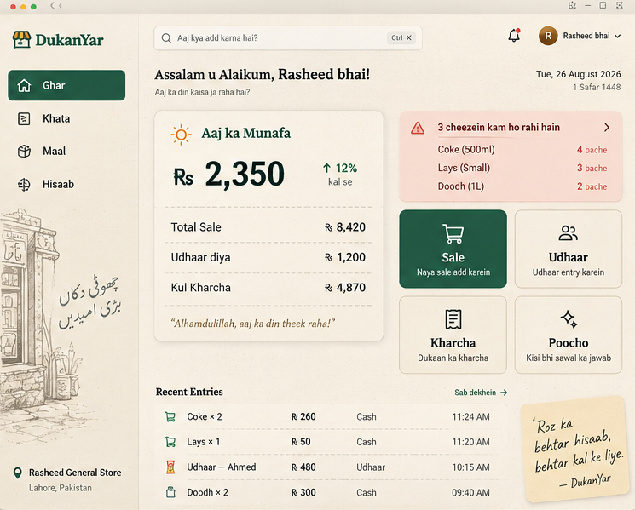
D
DukanYar
WHAT'S BUILT
Working end-to-end, today.
Log in → dashboard → pick an action → speak → confirm → recorded in the khata.
✓ Sales with automatic stock decrement and a low-stock report
✓ Udhaar: give, repay, balance lookup, inline customer registration
✓ Expenses with automatic category inference
✓ Voice in and voice out — interchangeable with text in one thread
✓ Today's sales, profit and outstanding credit on the dashboard
~86 backend tests passing
Full schema + migrations
Production frontend build
Product design — the home dashboard (Ghar)
In progress: cloud deployment · undo controls · voice reporting queries.
Next: “Poocho” — a RAG assistant for shop-specific questions · voice catalog building.
Bano Qabil × Alibaba Cloud AI Hackathon 2026 • Financial Inclusion Track
08

Slide 9
D
DukanYar
IMPACT & COST
Financial inclusion starts with a written record.
Recovered credit
Udhaar that used to evaporate from memory becomes a ledger both sides can trust.
Daily clarity
For the first time, a shopkeeper closes the day knowing his profit, stock and dues.
A financial footprint
A digital ledger is evidence of income — a first step toward formal credit access for 1M+ undocumented shops.
Cost to run: near-zero at current scale (free-tier services) — pricing model TBD.
Projected ≈ $2–3 per shop / month at scale (not final).
Bano Qabil × Alibaba Cloud AI Hackathon 2026 • Financial Inclusion Track
09

Slide 10
🏪
DukanYar
“Aapki awaaz, aapka khata.”
Shukriya — thank you.
Bano Qabil × Alibaba Cloud AI Hackathon 2026 • Financial Inclusion Track

