Slide 1
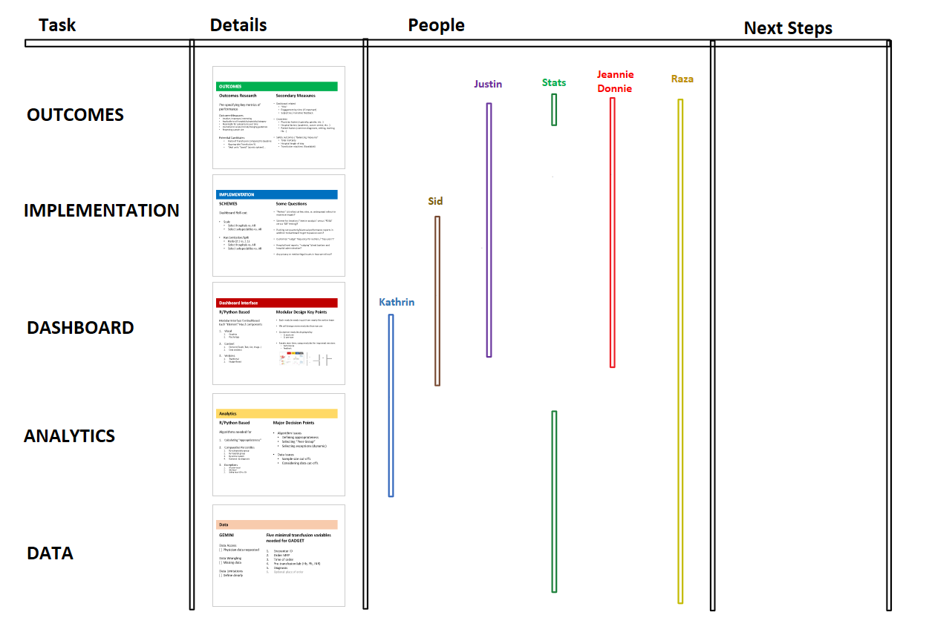
High Level Overview

Slide 2
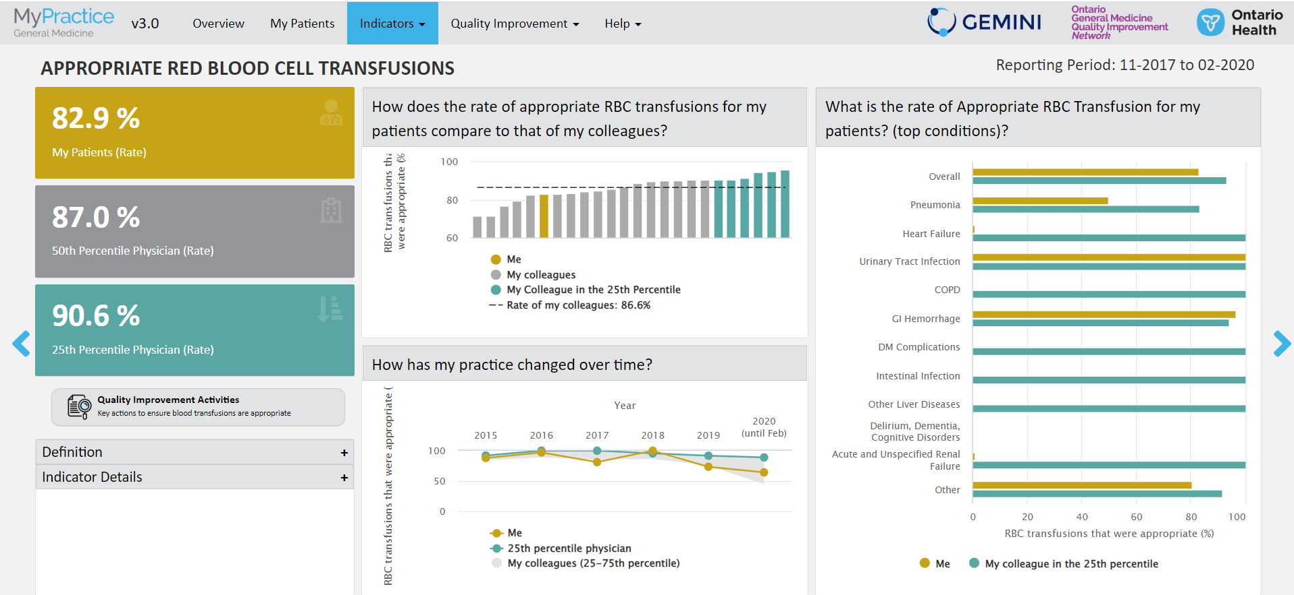

Slide 3
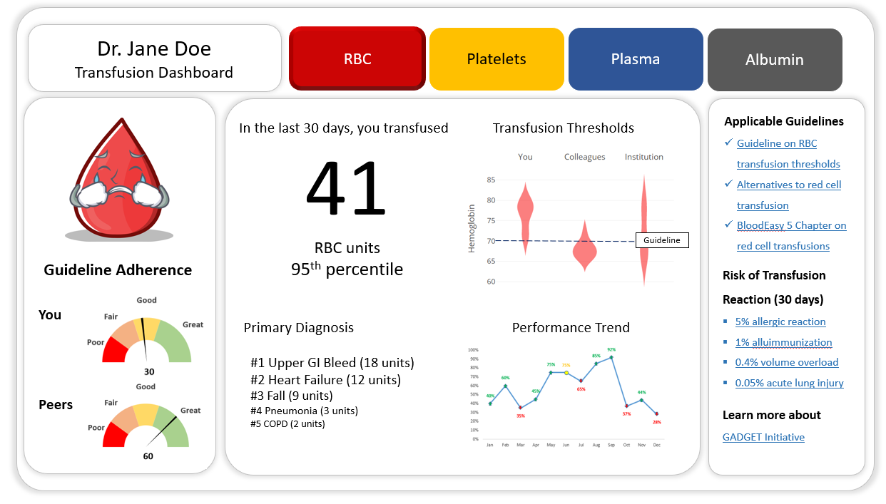

Slide 4
High Level Overview

Slide 5
Data
GEMINI
Data Access
[ ] Physician data (requested)
Data Wrangling
Data Limitations
[ ] Missing data
[ ] Site selection
[ ] Data validation
Five minimal transfusion variables needed for GADGET
Encounter ID
Ordering MRP (+ physician_table details)
Time of order
Product (type and quantity)
Pre-transfusion labs (Hb, Plt, INR, Albumin)
Diagnosis
Optional: place of order
Patient outcomes
Notes:
Q. are ICU docs included? Do we know setting of practice?
Q. Available physician characteristics

Slide 6
High Level Overview

Slide 7
Analytics
Analytics
Algorithms needed for
Calculating “Appropriateness”
Comparative Percentiles
By subspecialty group
By hospital group
By entire system
Optional: by diagnosis (DAD based)
Optional: by clinical indices (eg Charlson)
Detecting Clinical Events
Bleeding, Massive hemorrhage protocol
Building Flexible Exceptions
Physician-based
Site-based
Setting based (OR vs ED)
Major Decision Points
R or Python? Kathryn prefers Python
Algorithm Choices
Defining appropriateness
Selecting “Peer Group”
Selecting exceptions (dynamic)
Data Issues
Sample size cut-offs
Considering data cut-offs
Analysis of Transfusions Per Days vs. Physician Service Per Patient
Notes:
Q. Ask Yang about using Python
Q. Derived scores from GEMINI (e.g. Charlston)
Report elements of appropriateness (transparent algorithms; guideline citation)

Slide 8
High Level Overview

Slide 9
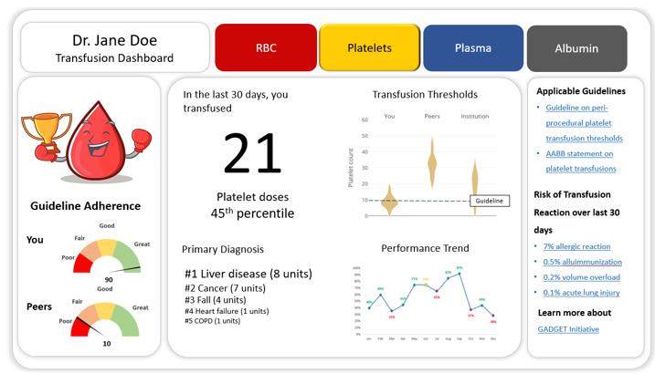
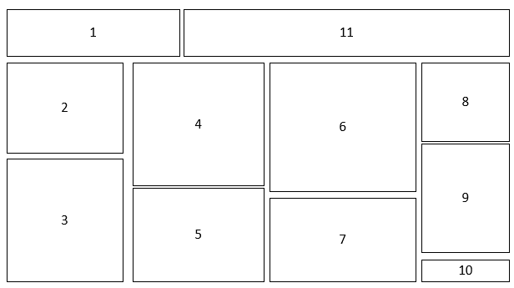
Dashboard Interface
R/Python Based
Modular Interface for Dashboard
Each “Element” Has 2 components
Visual
Graphics
Psychology
Content
Element (Graph, Text, List, Image..)
Data analytics
Versions
Traditional
Nudge-Based
Global
Modular Design Key Points
Each module needs input from nearly the entire team
+ Pilot User study (5-10 clinician pilot)
We will design more modules than we use
Customize modules displayed by
1) study arm
2) user type
Iterate over time, swap modules for improved versions
Performance
Feedback (feedback button/textbox)
Engagement (+clicks, time spent, a/b testing)
Notes:
1. Pilot user study of 5-6 clinicians to see difficulties/complaints/backlash
2. Promoting engagement (+physician champions/leads, comm)
3. Tracking engagement (clicks, time spent, a/b testing)
4. Give feedback button / textbox

Slide 10
High Level Overview

Slide 11
IMPLEMENTATION
SCHEME
Dashboard Roll-out
Some Questions
“Perfect” (v) rollout at few sites, or, widespread rollout to maximize impact?
Scheme for iteration (“interim analysis” versus “PDSA” versus “AB” testing)?
Pushing out quarterly/biannual performance reports in addition to dashboard to get to passive users?
Customize “nudge” frequency for outliers / “top users”?
Hospital level reports, “nudging” blood bankers and hospital administration?
Any privacy or medico-legal issues in how we roll out?
Scale
Select hospitals vs. All
Select subspecialties vs. All
Randomization/Split
Ratio (1:2:1 vs. 1:1:1)
Select hospitals vs. All
Select subspecialties vs. All available
Engagement
Physician champions/leads

Slide 12
High Level Overview

Slide 13
OUTCOMES
Outcomes Research
Pre-specifying key metrics of performance
Secondary Measures
Units of Analysis
Analysis of Transfusions Per Days of Physician Service Per Patient
Dashboard related
“Hits”
Engagement / time spent (if important)
Subjective / narrative feedback
Covariates
Physician factors (specialty, gender, etc…)
Hospital factors (academic, cancer center, etc…)
Patient factors (common diagnoses, setting, starting Hb…)
Safety outcomes / “Balancing measures”
Total mortality
Hospital length of stay
Transfusion reactions (?available ?inferred)
Outcome Measures
Intuitive, Important, Interesting
Applicable to all hospital/subspecialty/category
Meaningful for comparisons over time
Insensitive to secular trends/changing guidelines
Respecting sample size
Potential Candidates
Crude/adjusted Ratio of Transfusion compared to baseline
Appropriate Transfusion %
Total units “saved” (across system) …

