Slide 1
GADGET Dashboard Randomization and Layout

Slide 2
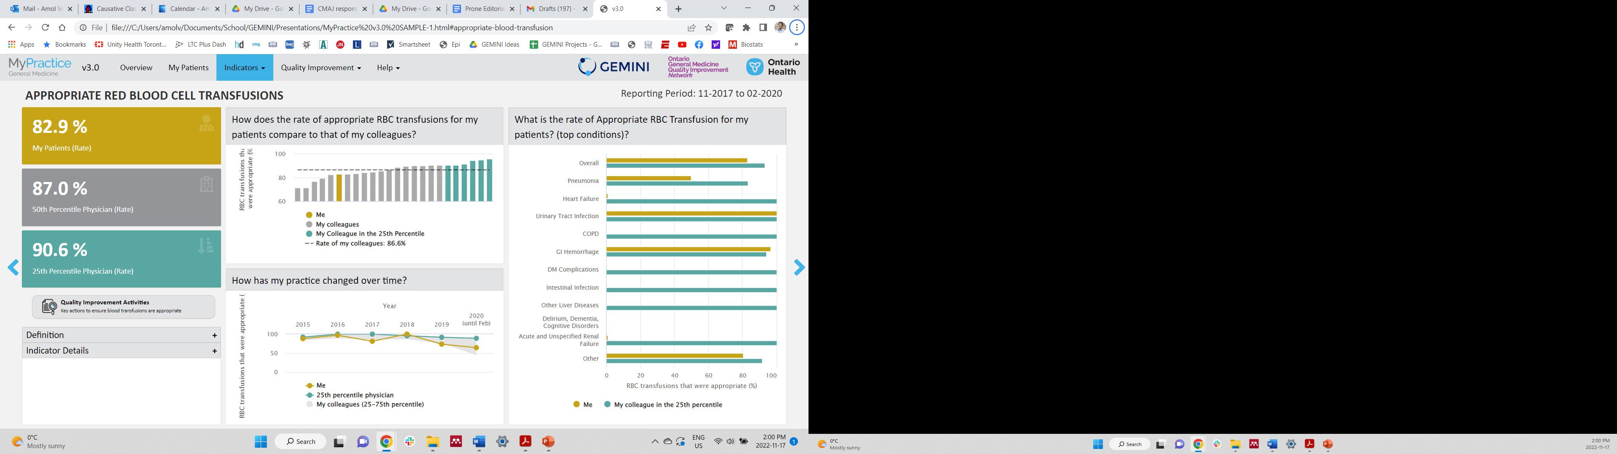
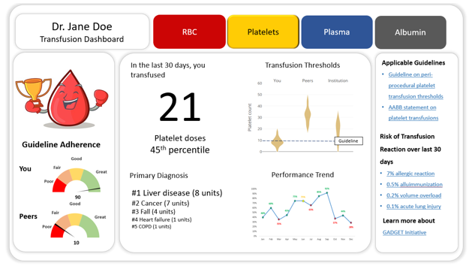
Randomization
*Design Notes
User
*Programming Notes
1:1:1
Randomization
We could consider 1 (nothing): 1 : 2 randomization here
Initial Dashboard will be RBC only?
+
Push data/screenshot of dashboard to hospitals for top transfusers
Some people might not engage dashboard after initial negative impression (Ostrich effect…)
For the top users/offenders, we might consider pushing reports
We could also push to everyone in the organization
We could also randomize to receiving vs. not receiving report
1:1
Usual GEMINI report
Nudge-based report

Slide 3
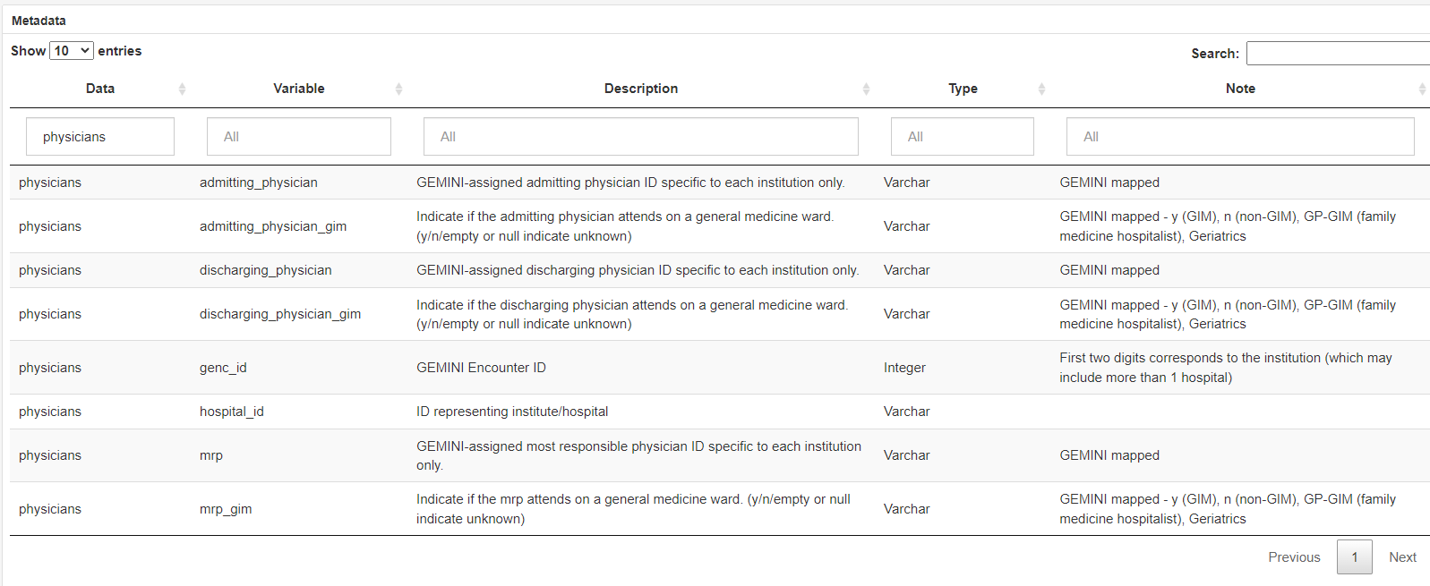
Randomization
*Design Notes
*Programming Notes
Has to be at the MRP physician level
Limitations of the GEMINI database
This will limit us to GIM, I’m not sure full physician data are available for non-GIM services
Resident orders reflected in MRP number | Not an issue
MRPs with very few weeks of service/transfusion | May have to be excluded pre-randomization
Looking at physician level data, it also doesn’t look like subspeciality data are available within GEMINI
This needs clarification, will we have any subspecialty data for the medicine wards, or only GIM?

Slide 4
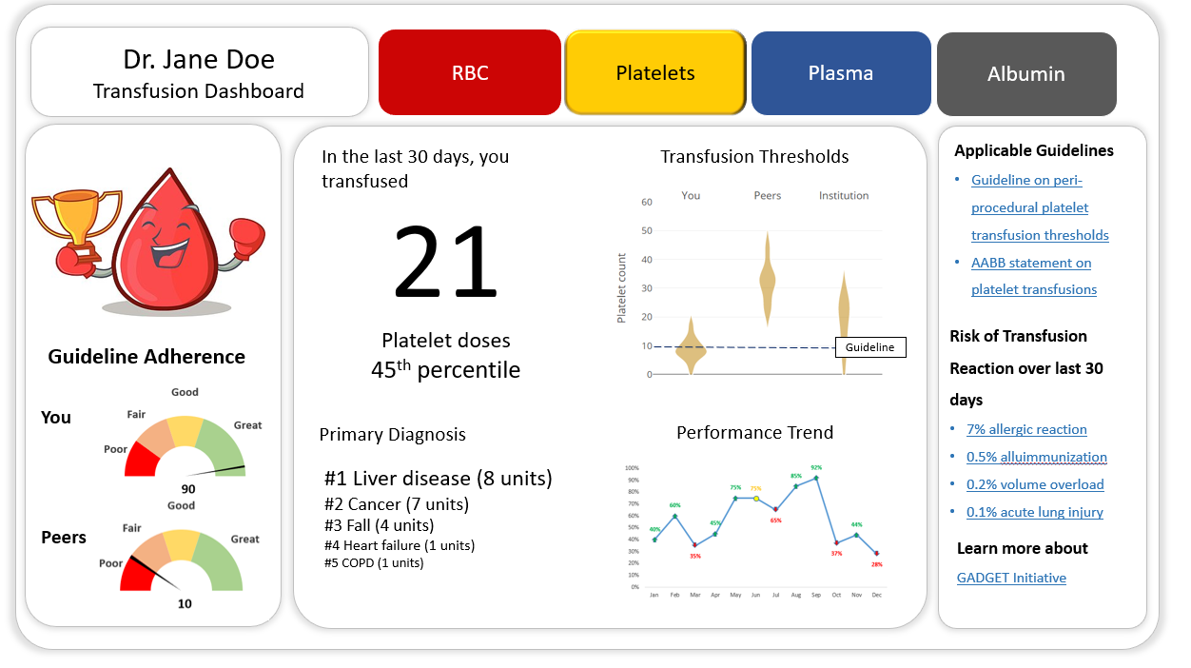
Design

Slide 5
Design
1
11
We can think of different parts of the dashboard as individual modules which we can add/remove/modify depending on needs/feedback
Column layout outlined shown
Treat each element as an individual component, we may swap these out later
2
4
6
8
9
3
5
7
10

Slide 6
Design
*Design Notes
*Programming Notes
1
11
We can think of different parts of the dashboard as individual modules which we can add/remove/modify depending on needs/feedback
Column layout outlined shown
Treat each element as an individual component, we may swap these out later
2
4
6
8
9
3
5
7
10

Slide 7
1
11
2
4
6
8
9
3
5
7
10

Slide 8
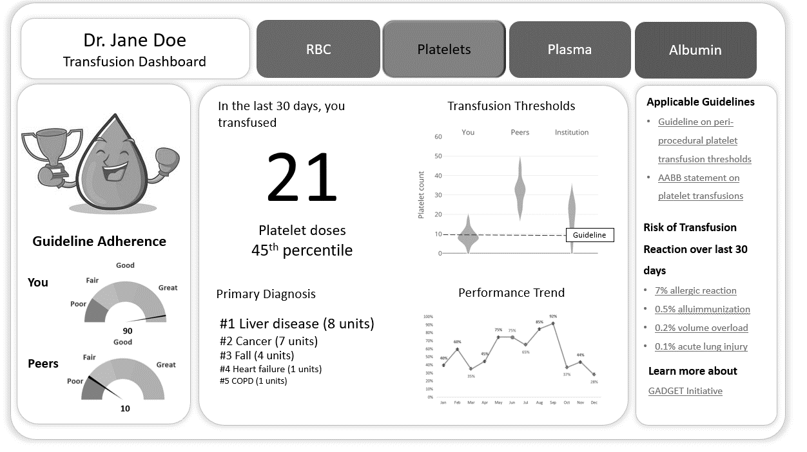
Design
Pull from list of MRP names
*Design Notes
*Programming Notes

Slide 9
1
11
2
4
6
8
9
3
5
7
10

Slide 10
Design
*Design Notes
*Programming Notes
Image icon will be determined conditionally on a pre-calculated performance metric, which is the estimated Percent appropriateness of red cell transfusions (PAR)
PAR calculation
Based on a table of indications (pulled from ipdiagnosis_subset) x an evidence-based transfusion cut off (e.g. gastrointestinal bleed -> 70), each transfusion gets assigned a binary 0/1 for appropriateness, and those values are averaged across all transfusions by a physician (0.5 for rare/uncategorized diagnoses)
The PAR is inherently limited because we won’t know everything about the patient, e.g. threshold won’t apply to someone actively exsanguinating Hence it will be crucial we provide a link within the dashboard (addressed later) to a page where we transparently explain how this is calculated, and are up front about limitations to pre-empt any backlash from clinicians
PAR cut offs
Where we set the PAR is up to our discretion, factors to consider:
A higher PAR will be more effective but a trade off with being more strict/discouraging (e.g. 80% before you get the ‘happy’ icon, vs 60%)
How we set the PAR cut off
We could either set a) one-size-fits-all cut-off, OR, b) a flexible cut-off based on other physicians within a hospital or sub-specialty
a) Has the advantage of enforcing guidelines more uniformly b) has the advantage of passively accounting for several unmeasured variables such as local acuity
Image Icon
We can start binary PNG images, which I can create and run by our group

Slide 11
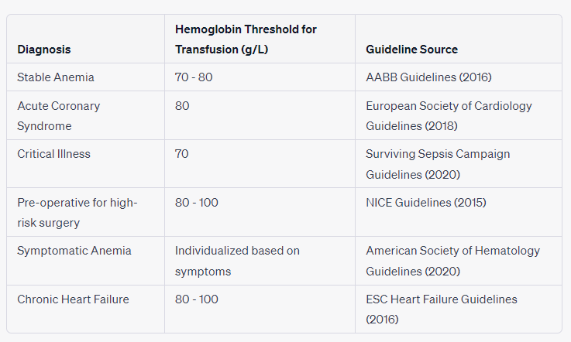
Design
Sample Table of Indications with Guidelines (we will create this data frame for GADGET, I don’t believe there’s one within GEMINI / unsure how they currently define appropriateness)
This eventually gets used for 1 )Appropriateness calculations 2) Guidelines module (#8)
*Design Notes
*Programming Notes

Slide 12
1
11
2
4
6
8
9
3
5
7
10

Slide 13
Design
These are called “Dial Plots” and more programming languages, including R, have packages for it
Once we have calculated our PAR values for the entire database, we can create these visualizations
The definition of “Peer” group will be important
I think it would be ideal to define it by subspecialty group (ideally across hospitals, for places with e.g. only 1 or 2 cardiologists)
I favor either subspecialty across hospitals (because some hospitals will only have 1-2 cardiologists) [more lenient] or across all physicians (because entire subspeciality groups of physicians might be “bad” transfusers) [more strict]
*Design Notes
*Programming Notes

Slide 14
1
11
2
4
6
8
9
3
5
7
10

Slide 15
Design
We might change 30 days to 3 months to increase sample size (for quarterly reports)
The percentile here gives physicians a sense of how much they transfuse overall
This can be pulled from a distribution of their peer group as defined on the previous slide
*Design Notes
*Programming Notes

Slide 16
1
11
2
4
6
8
9
3
5
7
10

Slide 17
Design
Primary diagnosis based on frequencies via ipdiagnosis_subset and transfusion_subset (linkage via encounter ID) in GEMINI
I suggest we limit this to 3 diagnoses, both for sample size reasons, and for simplicity/higher impact
I also suggest we only feature diagnoses within our table of indications as for these we will have populated our guidelines tab with recommended resources (i.e. it’s not useful to have ‘other’ or rare diagnoses here as the primary diagnosis, if there are no guidelines?)
*Design Notes
*Programming Notes

Slide 18
1
11
2
4
6
8
9
3
5
7
10

Slide 19
Design
Straightforward distributions of pre-transfusion hemoglobin values
We can use either violin or boxplots here
*Design Notes
*Programming Notes

Slide 20
1
11
2
4
6
8
9
3
5
7
10

Slide 21
Design
Trend of percentage appropriate transfusions over time
Regular line chart
*Design Notes
*Programming Notes

Slide 22
1
11
2
4
6
8
9
3
5
7
10

Slide 23
Design
Based on “primary diagnosis” module
Data pulled from primary diagnosis module + Table of Indications
*Design Notes
*Programming Notes

Slide 24
1
11
2
4
6
8
9
3
5
7
10

Slide 25
Design
Based on last 3 months of transfusions
May modify this to reflect absolute numbers of patients at risk of transfusion reactions (a number-needed-to-harm type metric), since %’s are less relevant
Data pulled from transfusions module
*Design Notes
*Programming Notes

Slide 26
1
11
2
4
6
8
9
3
5
7
10

Slide 27
Design
Link to page laying out our appropriateness calculations, study rationale, and some resources about GEMINI
May add a GEMINI logo here
Static element with a hyperlink
*Design Notes
*Programming Notes

Slide 28
1
11
2
4
6
8
9
3
5
7
10

Slide 29
Initially we will only have a button for RBCs
Later on, we can add other buttons for platelets/plasma etc
These buttons will eventually switch the layout to reflect different products
*Design Notes
*Programming Notes

Slide 30
Other Potential Modules
Blood lost by performing bloodwork (pulled from GEMINI lab data)
Time spent by blood donors (calculated)
Cost of blood products (calculated)

