Slide 1

On enhancement of Self-Ensembling Vision Transformer (SEViT) in Chest XRay Classification using Defensive Distillation & Adversarial Training 2023 Salma Alrashdi, Raza Imam, Baketah Alrashdi
mbzuai.ac.ae
HC701 Final Project presentation

Slide 2
Outline
Introduction
Motivation
SEVIT
Problem Statement
Proposed Solution
Experiments
Results
Discussion
Contribution

Slide 3
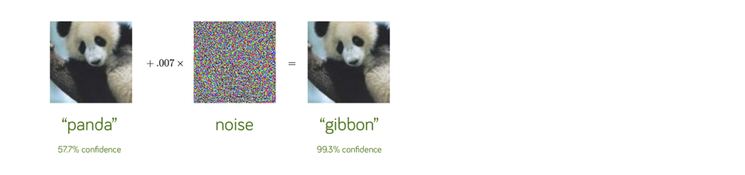
Introduction
This paper, is propose a novel self-ensembling method to enhance the robustness of ViT in the presence of adversarial attacks.
Notes:
What is adversarial attack?
How its done?

Slide 4
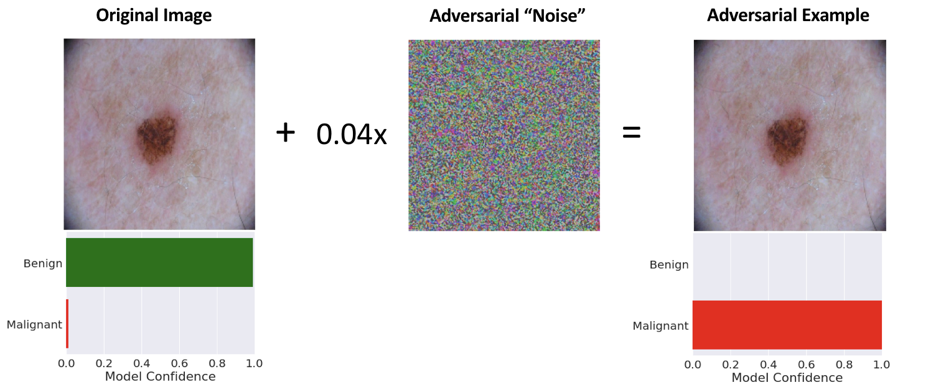
Motivations
The motivation for studying the adversarial robustness of deep learning-based medical imaging systems has been discussed :
(i) Automated systems deployed by insurance companies to process reimbursement claims.
(ii) Automated systems deployed by regulators to confirm results of clinical trials.
Notes:
Why its an important research direction?

Slide 5
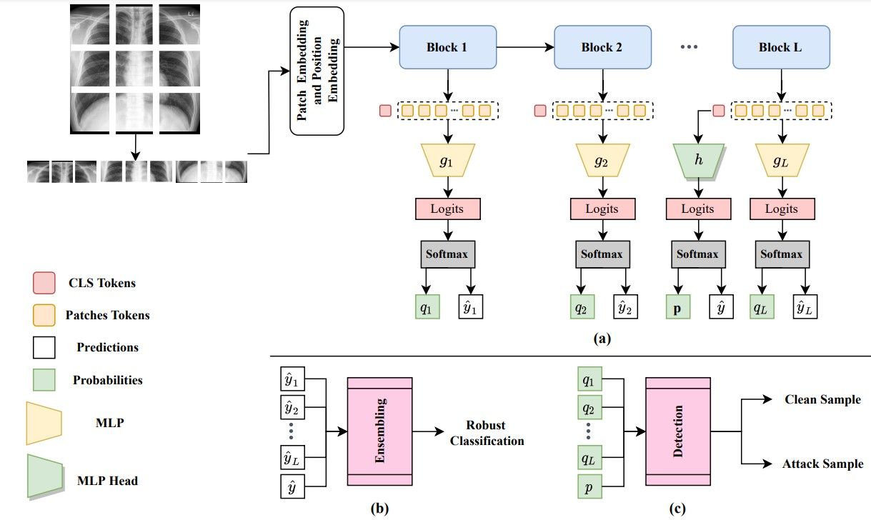
SEVIT Architecture

Slide 6
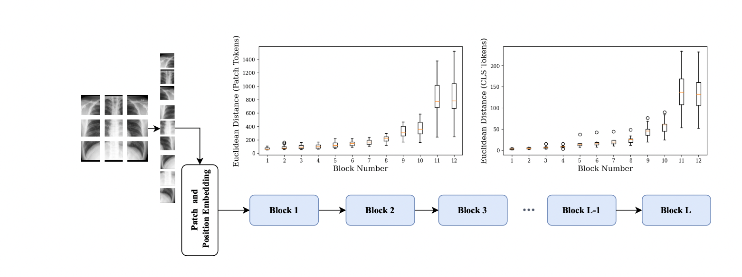
SEVIT
Notes:
The proposed method + what we have done
MLP > CNN
Majority voting > average rating and average weighted
MLP has significant more parameters than CNN so MLP it more complex + using CNN gives equal/more accuracy than using MLP for classification

Slide 7
Problem Statement
Not really robust against Model Extraction attacks, which can reveal major vulnerability in Medical Imaging
Computationally inefficient solutions are not really practically deployable
Ensembling via Majority Voting is not always the best approach
Notes:
Why ViT vulnerable?
Why are the last blocks being more sensitive to small perturbations

Slide 8
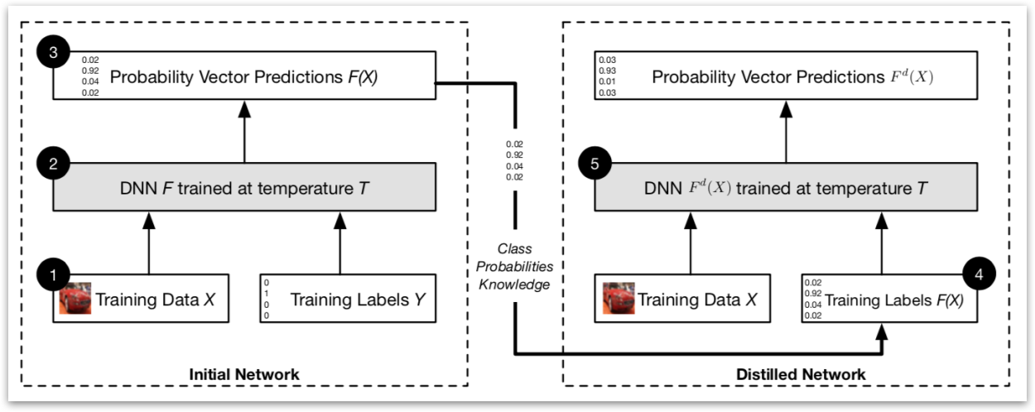
Defenses
Defensive distillation.
Involves training a model with soft probabilities.
Soft Probabilities makes the model more resistant to small perturbations in the input data, which are a common characteristic of adversarial examples.
Because small perturbations in the input data are less likely to cause large changes in the output probabilities when they are "softened" than when they are not.

Slide 9
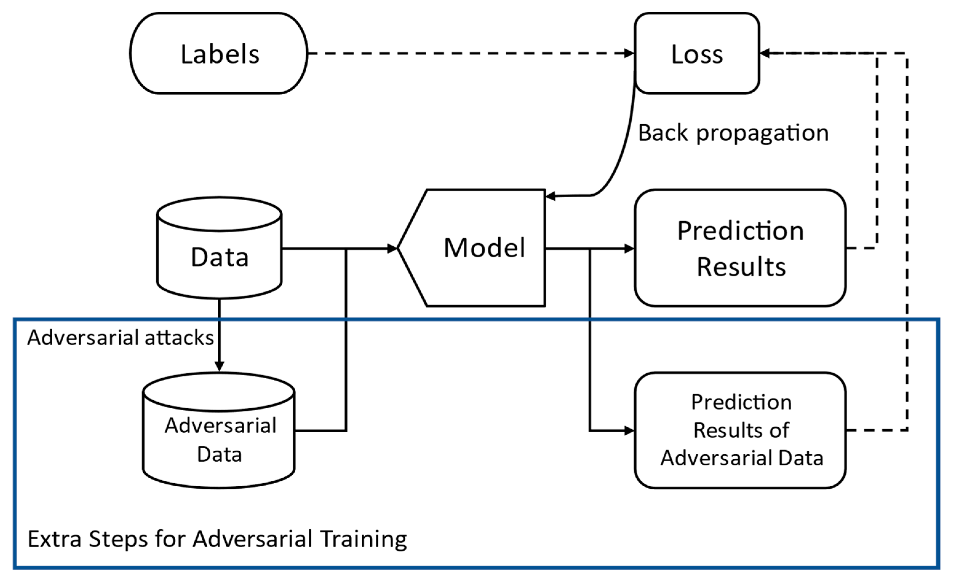
Defenses 2
Adversarial Training.
Involves training a model on both clean and adversarial examples.
Improve model’s ability to withstand such adversarial attacks.
Helps the model learn to generalize better to new and unseen examples, including those that may be adversarially crafted.

Slide 10
Proposed Method
Instead of using MLP blocks, use CNN or Fine-Tuned Model with additional CNN layers
Adversarial Training increases the overall robust accuracy
Surrogate Model generated using Defensive Distillation can be deployed against Extraction

Slide 11
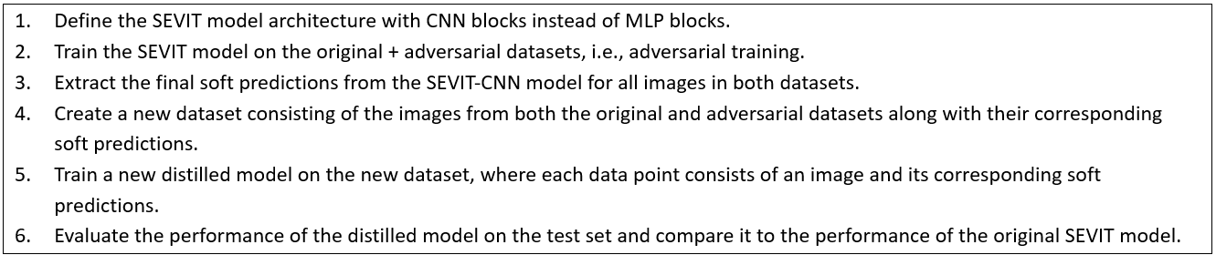
Proposed Method - Details
Hypothesis
Defensive Distillation when performed with Adversarial training would make SEVIT more robust against Adversarial attacks and Model Extraction Attacks
Pseudocode for our approach

Slide 12
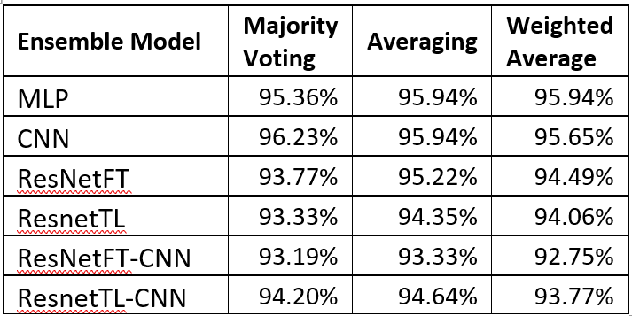
Experiments- Ensembling Criterias
Clean Performance of MLP alts with different ensembling criterias
Majority voting works well when the number of models in the ensemble is small, typically 2 or 3. It is because it is easier to reach a consensus among fewer models.
Averaging allows more diverse opinions to be combined.
Weighted averaging can lead to overfitting if the weights are not selected carefully, especially when the number of models is large. Therefore, it may not work well when there are too many models in the ensemble.
Notes:
Majority voting works well when the number of models in the ensemble is small, typically 2 or 3. It is because it is easier to reach a consensus among fewer models. On the other hand, averaging works well when there are more models in the ensemble, typically more than 3, as it allows more diverse opinions to be combined. Weighted averaging is a variation of averaging where the contribution of each model is weighted based on their performance. However, it can lead to overfitting if the weights are not selected carefully, especially when the number of models is large. Therefore, it may not work well when there are too many models in the ensemble.

Slide 13
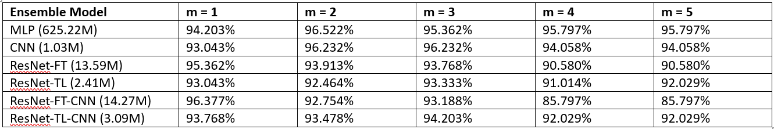

Experiments-Computational Efficient
Clean Performance of MLP alts Before Adv training
Clean Performance of MLP alts After Adv training
Notes:
Q. why CNN is performing better at m=3 than other models?
A1. One possible reason for this is that the CNN model is better at capturing spatial features in the image, which is important for detecting and classifying adversarial examples. Adversarial examples are designed to deceive the model by making small, imperceptible changes to the image that can cause it to misclassify the image. The CNN model may be better at detecting these changes and classifying the image correctly as a result.
A2. Another reason may be that the CNN model has fewer parameters than some of the other models, making it less susceptible to overfitting and better able to generalize to new, unseen examples. This can be especially important when dealing with adversarial examples, which are designed to exploit weaknesses in the model's decision boundaries.

Slide 14
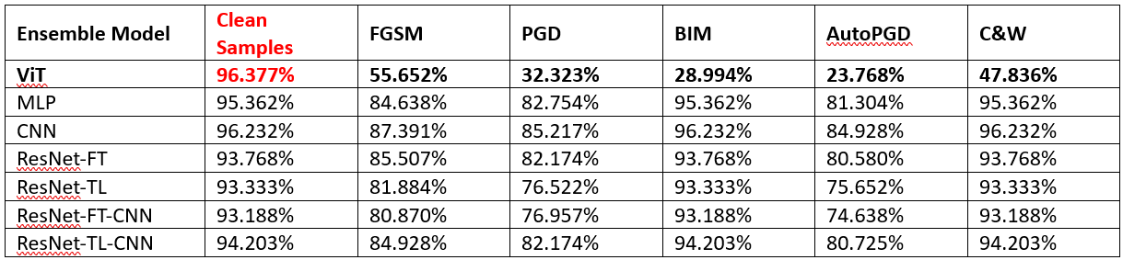
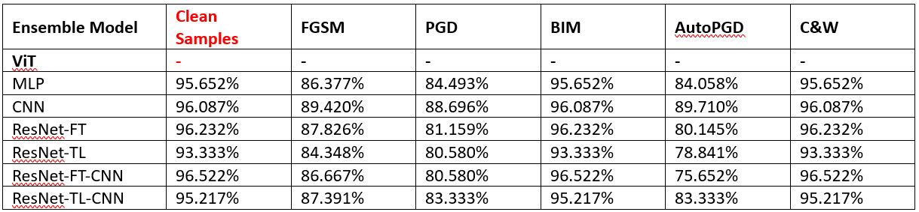
Experiments- Adversarial Performance
Adversarial Performance of MLP alts Before Adv training
Adversarial Performance of MLP alts After Adv training

Slide 15
Experiments- Distillation & Extraction
Distilled Model from SEVIT-CNN (Testing is on Attack Samples generated by SEVIT-CNN) (Before Adv Training)
*Model Extraction Attack on Distilled Model and Original Model (Before Adversarial Training)

Slide 16
Experiments- Distillation & Extraction 2
Distilled Model from SEVIT-CNN (Testing is on Attack Samples generated by SEVIT-CNN) (After Adv Training)
*Model Extraction Attack on Distilled Model and Original Model (After Adversarial Training)
Model Extraction Before Adersarial Training →
Model Extraction After Adversarial Training →

Slide 17
Results
Among several alternatives for MLP modules in SEVIT, CNN performed the best in terms of clean and adversarial performance (Efficiency)
It’s a better choice to ensemble using different voting criteria based on the no. of ensembling models.
Notes:
Q. why CNN is performing better at m=3 than other models?
A1. One possible reason for this is that the CNN model is better at capturing spatial features in the image, which is important for detecting and classifying adversarial examples. Adversarial examples are designed to deceive the model by making small, imperceptible changes to the image that can cause it to misclassify the image. The CNN model may be better at detecting these changes and classifying the image correctly as a result.
A2. Another reason may be that the CNN model has fewer parameters than some of the other models, making it less susceptible to overfitting and better able to generalize to new, unseen examples. This can be especially important when dealing with adversarial examples, which are designed to exploit weaknesses in the model's decision boundaries.

Slide 18
Results
Against Model Extraction attack, we notice a trade-off between clean accuracy and robust accuracy (in both case of pre-adv. training and post-adv. training)
Trade-off is the result of competing objectives of the attacker and defender.
Better to deploy Distilled version of SEVIT-CNN as it will more robust than SEVIT to adv. attacks.
Notes:
The trade-off between clean accuracy and robust accuracy in the context of model extraction attacks is a result of the competing objectives of the attacker and defender.
The attacker aims to extract a high-quality model that mimics the original model's behavior as closely as possible, regardless of whether the model is accurate on clean or adversarial examples. In contrast, the defender aims to protect the original model's intellectual property and maintain high accuracy on both clean and adversarial examples.
To achieve this, the defender may employ techniques such as defensive distillation or adversarial training to make the model more resistant to extraction attacks. However, these techniques can also have a negative impact on the model's clean accuracy, as the model is trained on a more limited and potentially biased set of examples.
As a result, there is often a trade-off between clean accuracy and robust accuracy in defending against model extraction attacks. The defender must carefully balance these competing objectives to achieve the best possible performance on both clean and adversarial examples.

Slide 19
Conclusion
MLP alternatives will be a better choice for computational efficiency
Enhanced the overall robustness of SEVIT using the combination of Defensive Distillation and Adversarial Training
Different voting criteria based on the no. of ensembling models
Future goals
Evaluate enhanced SEViT in the context of natural images
Explore the possibility for mobile deployment
Notes:
Defensive distillation is a technique that can be used to make a machine learning model more resistant to model extraction attacks. It involves training a distilled model that is similar to the original model, but with increased temperature during training, which effectively smooths out the decision boundaries and makes it harder to learn the underlying structure of the model.
To apply defensive distillation, you can follow these steps:
Train the original model on the training data as usual.
Train a new model using the outputs of the original model as labels, with a higher temperature setting during training. This will result in a softer probability distribution for the new model's outputs.
Use the distilled model for inference instead of the original model.
During deployment, restrict access to the distilled model's internal workings, such as the weights, activations, and gradients, to prevent attackers from using them to perform model extraction.
Note that while defensive distillation can increase the resilience of a model to model extraction attacks, it is not a foolproof solution, and other defensive techniques may also be necessary to fully protect against attacks. Additionally, defensive distillation can come at a cost of increased computational and memory requirements, so it may not be appropriate for all use cases.

Slide 20
Team Member Contribution
Raza: final report, organized meets, defensive experiments, presentation
Salma: final report, defensive experiment, literature review, presentation
Baketah: contribute on the final report, extraction experiments, presentation

