Slide 1
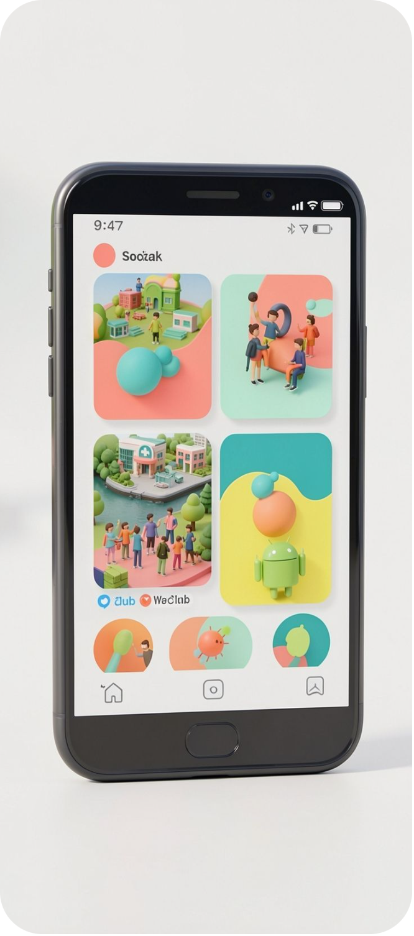
Viragram
Your Campus. Your Community.
A private university social networking and media-sharing Android application developed using object-oriented technology principles.
VISHAL VELIP · ROLL NO. 2663
RAZAK NADAF · ROLL NO. 2638

Slide 2



THE PRODUCT
Viragram brings the campus into one place
Share
Discover
Posts, feeds, stories, likes and comments.
Follow, search, explore, messaging and notifications.
A university-focused social networking and media-sharing app that connects students and campus activities.
Participate
Profiles, College Hub, clubs, events and admin portal.

Slide 3
Viragram combines what campus tools keep separate
Compare the campus-focused experience with general social, messaging and learning platforms.
Feature | Viragram | Instagram | WhatsApp | LMS
Campus Focus | ✓ | ✗ | Partial | ✓
Social Feed | ✓ | ✓ | Limited | ✗
Campus Stories | ✓ | ✓ | ✓ | ✗
Clubs & Events | ✓ | Generic | Scattered | Partial
College Announcements | ✓ | ✗ | Scattered | ✓
Direct Messaging | ✓ | ✓ | ✓ | Limited
College Hub | ✓ | ✗ | ✗ | Partial
Admin Management | ✓ | ✗ | Limited | ✓
Key advantage: one platform for social interaction and official campus information.

Slide 4
THE OPPORTUNITY
Student demand is already distributed
Students use digital platforms for communication and social interaction, while campus information is scattered across platforms and groups.
1
TAM
2
SAM
3
SOM
TAM
Higher-education students using digital communication and social platforms.
SAM
Smartphone-active university students.
SOM
Individual universities and their student communities.

Slide 5



THE CORE PROBLEM
Viragram turns scattered campus activity into one connected community
Problem
Viragram solution
Goal
Students depend on multiple platforms for social networking, communication, events, clubs, announcements and media sharing.
Connect students, social feed, clubs, events, announcements and messaging in one university-focused platform.
Create a connected digital campus community.

Slide 6





The stack connects Android, cloud data and media delivery
 | Android Application | Java · XML · Android Studio · Material Components
 | ↓ Firebase Authentication | Identity and university email validation
 | ↓ Cloud Firestore | Connected campus data
 | ↓ Node.js / Express Backend | Node.js · Express.js · Firebase Admin SDK
 | ↓ ImageKit | ImageKit · Glide
Development and deployment: GitHub and Render.

Slide 7
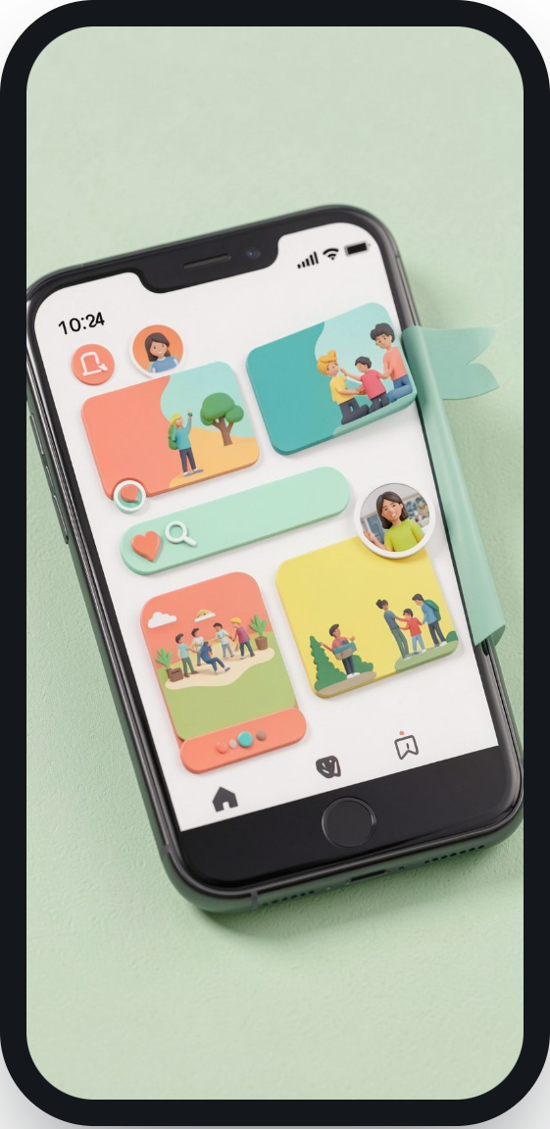
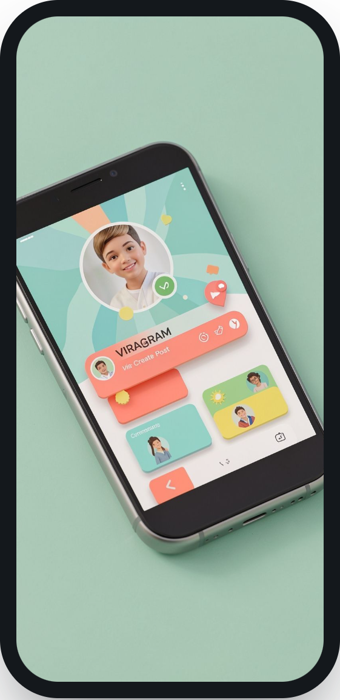
STUDENT JOURNEY
The student journey moves from identity to interaction
Register / Login
Home Feed
Search
Create Post
Notifications
Profile
University email registration and verification lead into posts, stories, likes, comments, follows, messaging, profile management and dark mode.
HOME FEED
INTERACT

Slide 8


COLLEGE HUB
College Hub makes official campus activity discoverable
Admin creates
Firestore stores
Students discover
Official announcements, events, clubs and images are managed by admins.
“Viragram Tech Fest 2026” moves into the connected campus data layer.
College Hub surfaces the event alongside clubs, announcements and trending activity.

Slide 9
DATA LAYER
Firebase keeps identity and campus data connected in real time
Authentication
University email validation using @unigoa.ac.in leads to Firebase Authentication and a unique user UID.
Firestore collections
users · posts · stories · comments · events · announcements · clubs
Example paths
Real-time flow
users/{uid}
posts/{postId}
events/{eventId}
clubs/{clubId}
Firestore → listener → Android UI, without manually refreshing.

Slide 10



OOP keeps Viragram modular and maintainable
Encapsulation
Inheritance
User, Post and Event classes control data through methods.
BaseActivity supports LoginActivity, ProfileActivity and SettingsActivity.
Polymorphism
Abstraction
Overridden Android lifecycle methods such as onCreate() adapt behavior.
FirebaseAuthManager and FirestoreManager hide backend complexity from the UI.
Takeaway: object-oriented principles support reusable, modular application development.

Slide 11
Testing & Problems Solved
Application Testing: Viragram was tested on an Android emulator with major application workflows.
Registration & Login · University Email Verification · Create Post · Image Upload using ImageKit · Firebase / Firestore Integration · Likes & Comments · Follow / Unfollow · Search & Profiles · College Hub · Admin Events · Announcements & Clubs · Dark Mode
Firestore Permission Error
Admin Event Crash
Blank Post Detail Image
Blank Event Detail Image
Create Event caused the application to stop.
Solution: Missing Activity registration in AndroidManifest was fixed.
Post uploads succeeded, but Firestore rejected the post.
Solution: Firestore security rules were corrected.
ImageKit URL was not being passed to Post Detail.
Solution: Image URL passing and Glide loading were fixed.
Event image URL was not passed through the adapters.
Solution: Remote image loading was corrected.
Final result: BUILD SUCCESSFUL. Major application workflows tested and working.

Slide 12
Conclusion & Future Scope
Viragram successfully brings university social networking and campus information together in one platform.
Social Networking
Campus Discovery
Technology
Posts, Stories, Likes, Comments, Messaging
College Hub, Events, Clubs, Announcements
Java, Android, Firebase, Firestore, ImageKit, Node.js
Future scope: Real-time Firebase chat · Push notifications · Event registration · Club membership · Event attendance · Advanced content moderation · Campus analytics · Recommendation system · Google Play Store deployment
Viragram. Your Campus. Your Community.
Thank You
Vishal Velip — 2663 · Razak Nadaf — 2638

