Slide 1

EVER FACED PROBLEMS WHILE LEARNING A NEW LANGUAGE OR WORKING WITH DIFFERENT PROJECTS?

Slide 2

Nisha, a 2nd year Btech student, recently started learning web development

Slide 3
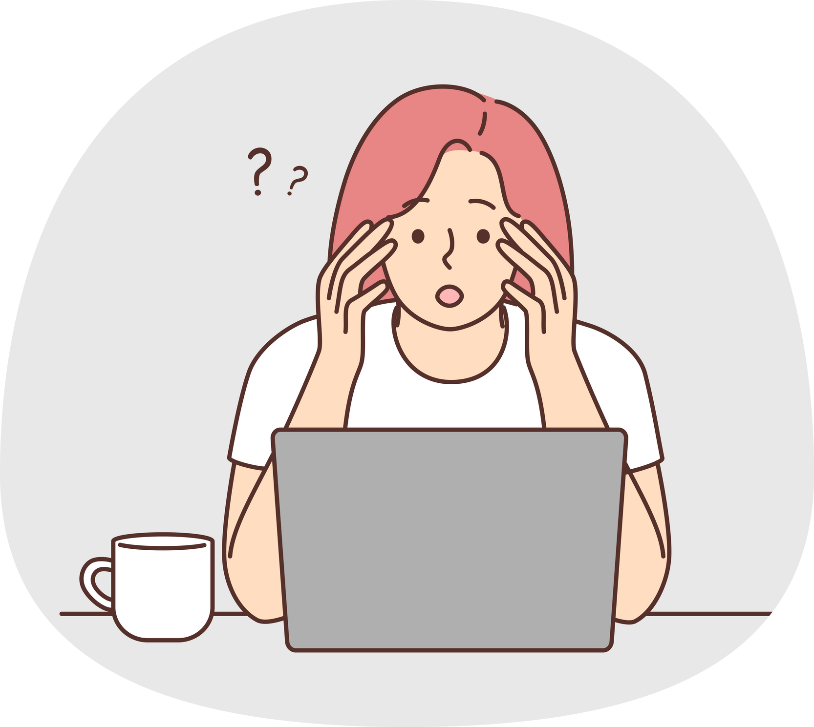
Facing issues while working on a project with database connectivity

Slide 4
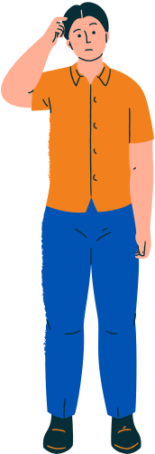
Now she has few options

Slide 5

search on the internet for the solution and try different ways..
(or)
search for the latest video or the video with the highest view count on you tube..

Slide 6
BUT WHAT

Slide 7

if she has a person or a group who will help her solving the bug..

Slide 8
forkIt
A community of peers ready to connect, collaborate,
and create together

Slide 9
Presented by:
Mohammed Raza (23MCA1029)
Amit Meerchandani (23MCA1042)
Neha Singh (23MCA1049)
Vinayak Singh(23MCA1030)
Error 404

Slide 10
WHAT WE ARE DOING?

Slide 11

look for project partner
KEY FEATURES
real-time chat
share resources
find pair programmer

Slide 12
LET’S EXPLORE

Slide 13
THANK YOU

