Slide 1


Chapter 2
Basics of Algorithm Analysis
Slides by Kevin Wayne.
Copyright © 2005 Pearson-Addison Wesley. All rights reserved.

Slide 2
2.1 Computational Tractability
"For me, great algorithms are the poetry of computation. Just like verse, they can be terse, allusive, dense, and even mysterious. But once unlocked, they cast a brilliant new light on some aspect of computing." - Francis Sullivan

Slide 3
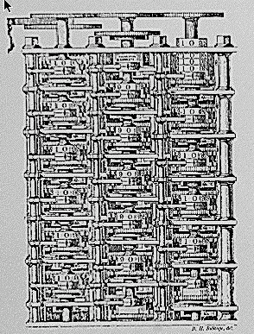
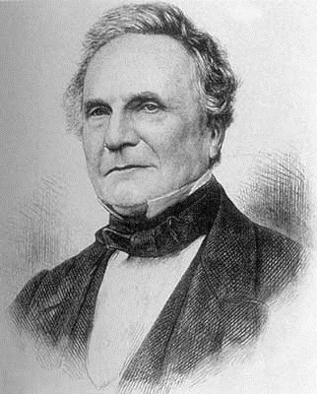
Computational Tractability
As soon as an Analytic Engine exists, it will necessarily guide the future course of the science. Whenever any result is sought by its aid, the question will arise - By what course of calculation can these results be arrived at by the machine in the shortest time? - Charles Babbage
Charles Babbage (1864)
Analytic Engine (schematic)
3

Slide 4
Polynomial-Time
Brute force. For many non-trivial problems, there is a natural brute force search algorithm that checks every possible solution.
Typically takes 2^{N} time or worse for inputs of size N.
Unacceptable in practice.
n ! for stable matching
with n men and n women
Desirable scaling property. When the input size doubles, the algorithm should only slow down by some constant factor C.
There exists constants c > 0 and d > 0 such that on every input of size N, its running time is bounded by c N^{d} steps.
Def. An algorithm is poly-time if the above scaling property holds.
choose C = 2^{d}
3

Slide 5
Worst-Case Analysis
Worst case running time. Obtain bound on largest possible running time of algorithm on input of a given size N.
Generally captures efficiency in practice.
Draconian view, but hard to find effective alternative.
Average case running time. Obtain bound on running time of algorithm on random input as a function of input size N.
Hard (or impossible) to accurately model real instances by random distributions.
Algorithm tuned for a certain distribution may perform poorly on other inputs.
3

Slide 6
Worst-Case Polynomial-Time
Def. An algorithm is efficient if its running time is polynomial.
Justification: It really works in practice!
Although 6.02 × 10²³ × N²⁰ is technically poly-time, it would be useless in practice.
In practice, the poly-time algorithms that people develop almost always have low constants and low exponents.
Breaking through the exponential barrier of brute force typically exposes some crucial structure of the problem.
Exceptions.
Some poly-time algorithms do have high constants and/or exponents, and are useless in practice.
Some exponential-time (or worse) algorithms are widely used because the worst-case instances seem to be rare.
simplex method
Unix grep
3

Slide 7
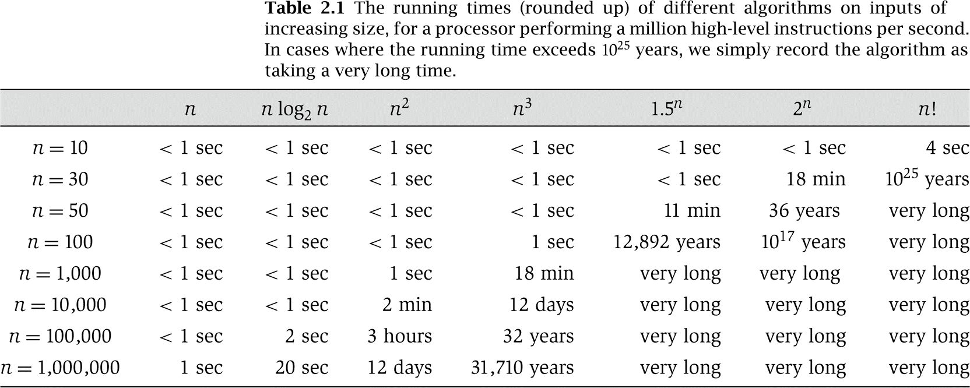
Why It Matters
3

Slide 8
2.2 Asymptotic Order of Growth

Slide 9
Asymptotic Order of Growth
Upper bounds. T(n) is O(f(n)) if there exist constants c > 0 and n₀ ≥ 0 such that for all n ≥ n₀ we have T(n) ≤ c · f(n).
Lower bounds. T(n) is Ω(f(n)) if there exist constants c > 0 and n₀ ≥ 0 such that for all n ≥ n₀ we have T(n) ≥ c · f(n).
Tight bounds. T(n) is Θ(f(n)) if T(n) is both O(f(n)) and Ω(f(n)). Ex: T(n) = 32n² + 17n + 32.
T(n) is O(n²), O(n³), Ω(n²), Ω(n), and Θ(n²) .
T(n) is not O(n), Ω(n³), Θ(n), or Θ(n³).

Slide 10
Notation
Slight abuse of notation. T(n) = O(f(n)).
Not transitive:
– f(n) = 5n³; g(n) = 3n²
– f(n) = O(n³) = g(n)
– but f(n) ≠ g(n).
Better notation: T(n) ∈ O(f(n)).
Meaningless statement. Any comparison-based sorting algorithm requires at least O(n log n) comparisons.
Statement doesn't "type-check."
Use Ω for lower bounds.

Slide 11
Properties
Transitivity.
If f = O(g) and g = O(h) then f = O(h).
If f = Ω(g) and g = Ω(h) then f = Ω(h).
If f = Θ(g) and g = Θ(h) then f = Θ(h).
Additivity.
If f = O(h) and g = O(h) then f + g = O(h).
If f = Ω(h) and g = Ω(h) then f + g = Ω(h).
If f = Θ(h) and g = O(h) then f + g = Θ(h).

Slide 12
Asymptotic Bounds for Some Common Functions
Polynomials. a₀ + a₁n + … + a_{d}n^{d} is Θ(n^{d}) if a_{d} > 0.
Polynomial time. Running time is O(n^{d}) for some constant d independent of the input size n.
Logarithms. O(log _{a} n) = O(log _{b} n) for any constants a, b > 0.
can avoid specifying the base
Logarithms. For every x > 0, log n = O(n^{x}).
log grows slower than every polynomial
Exponentials. For every r > 1 and every d > 0, n^{d} = O(r^{n}).
every exponential grows faster than every polynomial

Slide 13
2.4 A Survey of Common Running Times

Slide 14
Linear Time: O(n)
Linear time. Running time is proportional to input size.
Computing the maximum. Compute maximum of n numbers a₁, …, a_{n}.
max ← a₁
for i = 2 to n { if (a_{i} > max)
max ← a_{i}
}

Slide 15
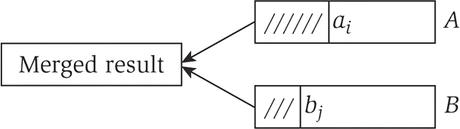
Linear Time: O(n)
Merge. Combine two sorted lists A = a₁,a₂,…,a_{n} with B = b₁,b₂,…,b_{n}
into sorted whole.
i = 1, j = 1
while (both lists are nonempty) {
if (a_{i} ≤ b_{j}) append a_{i} to output list and increment i else append b_{j} to output list and increment j
}
append remainder of nonempty list to output list
Claim. Merging two lists of size n takes O(n) time.
Pf. After each comparison, the length of output list increases by 1.

Slide 16
O(n log n) Time
O(n log n) time. Arises in divide-and-conquer algorithms.
also referred to as linearithmic time
Sorting. Mergesort and heapsort are sorting algorithms that perform O(n log n) comparisons.
Largest empty interval. Given n time-stamps x₁, …, x_{n} on which copies of a file arrive at a server, what is largest interval of time when no copies of the file arrive?
O(n log n) solution. Sort the time-stamps. Scan the sorted list in order, identifying the maximum gap between successive time-stamps.

Slide 17
Quadratic Time: O(n²)
Quadratic time. Enumerate all pairs of elements.
Closest pair of points. Given a list of n points in the plane (x₁, y₁), …, (x_{n}, y_{n}), find the pair that is closest.
O(n²) solution. Try all pairs of points.
min ← (x₁ - x₂)² + (y₁ - y₂)² for i = 1 to n {
for j = i+1 to n {
d ← (x_{i} - x_{j})² + (y_{i} - y_{j})² if (d < min)
min ← d
}
}
don't need to take square roots
Remark. Ω(n²) seems inevitable, but this is just an illusion.
see chapter 5

Slide 18
Cubic Time: O(n³)
Cubic time. Enumerate all triples of elements.
Set disjointness. Given n sets S₁, …, S_{n} each of which is a subset of 1, 2, …, n, is there some pair of these which are disjoint?
O(n³) solution. For each pairs of sets, determine if they are disjoint.
foreach set S_{i} {
foreach other set S_{j} { foreach element p of S_{i} {
determine whether p also belongs to S_{j}
}
if (no element of S_{i} belongs to S_{j}) report that S_{i} and S_{j} are disjoint
}
}

Slide 19
Polynomial Time: O(n^{k}) Time
Independent set of size k. Given a graph, are there k nodes such that no two are joined by an edge?
k is a constant
O(n^{k}) solution. Enumerate all subsets of k nodes.
foreach subset S of k nodes {
check whether S in an independent set if (S is an independent set)
report S is an independent set
}
}
Check whether S is an independent set = O(k²).
_{n}k
k!
Number of k element subsets = ″n⎞
n (n −1) (n − 2) L (n − k +1)
k (k −1) (k − 2) L (2) (1)
⎮
⎮ =
)
O(k n / k!) = O(n ).
2 k k
⎛k ⎠
poly-time for k=17, but not practical

Slide 20
Exponential Time
Independent set. Given a graph, what is maximum size of an independent set?
O(n² 2^{n}) solution. Enumerate all subsets.
S* ← φ
foreach subset S of nodes {
check whether S in an independent set
if (S is largest independent set seen so far) update S* ← S
}
}

