Slide 1


Chapter 5
Divide and Conquer
Slides by Kevin Wayne.
Copyright © 2005 Pearson-Addison Wesley. All rights reserved.

Slide 2
Divide-and-Conquer
Divide-and-conquer.
Break up problem into several parts.
Solve each part recursively.
Combine solutions to sub-problems into overall solution.
Most common usage.
Break up problem of size n into two equal parts of size ½n.
Solve two parts recursively.
Combine two solutions into overall solution in linear time.
Consequence.
Brute force: n².
Divide-and-conquer: n log n.
Divide et impera. Veni, vidi, vici.
- Julius Caesar
2

Slide 3
5.1 Mergesort

Slide 4
Sorting
Sorting. Given n elements, rearrange in ascending order.
Applications.
Sort a list of names.
Organize an MP3 library.
Display Google PageRank results.
obvious applications
Find the median.
Find the closest pair.
Binary search in a database.
problems become easy once items are in sorted order

Slide 5
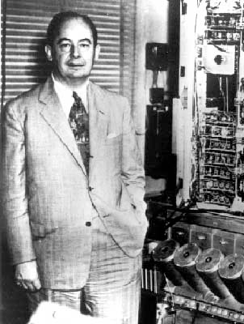
Mergesort
Mergesort.
Divide array into two halves.
Recursively sort each half.
Merge two halves to make sorted whole.
Jon von Neumann (1945)
A L G O R I T H M S
A L G O R
I T H M S
divide
O(1)
A G L O R
H I M S T
sort
2T(n/2)
A G H I L M O R S T
merge
O(n)

Slide 6






Merging
Merging. Combine two pre-sorted lists into a sorted whole.
How to merge efficiently?
Linear number of comparisons.
Use temporary array.
A
G L
O R
H
I
M S T
A G H I
Challenge for the bored. In-place merge. [Kronrud, 1969]
using only a constant amount of extra storage

Slide 7
Proof by Recursion Tree
⎧
⎮
0
if n = 1
n otherwise
T(n) = ⎨
⎮⎩
2T(n / 2)
⏟
1–2–3
sorting both halves
merging
T(n)
n
T(n/2)
T(n/2)
2(n/2)
T(n/4)
T(n/4)
T(n/4)
T(n/4)
4(n/4)
. . .
2^{k} (n / 2^{k})
. . .
n/2 (2)
log₂n
T(n / 2^{k})
T(2)
T(2)
T(2)
T(2)
T(2)
T(2)
T(2)
T(2)
n log₂n

Slide 8
Assignment
Implement Merge Sort and in the code try to count the number of comparisions and show that it is aproximately n log n

