Slide 1
Solving problems by searching
Chapter 2

Slide 2
Outline
Problem-solving agents
Problem types
Problem formulation
Example problems
Basic search algorithms

Slide 3
Agents
An agent is anything that can be viewed as perceiving its environment through sensors and acting upon that environment through actuators
Human agent: eyes, ears, and other organs for sensors; hands,
legs, mouth, and other body parts for actuators
Robotic agent: cameras and infrared range finders for sensors;
various motors for actuators

Slide 4
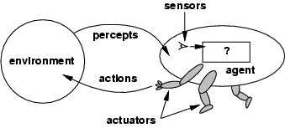
Agents and environments
The agent function maps from percept histories to actions:
[f: P* → A]
The agent program runs on the physical architecture to produce f
agent = architecture + program

Slide 5
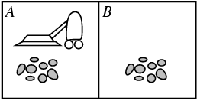
Vacuum-cleaner world
Percepts: location and contents, e.g., [A,Dirty]
Actions: Left, Right, Suck, NoOp

Slide 6
Rational agents
An agent should strive to "do the right thing", based on what it can perceive and the actions it can perform. The right action is the one that will cause the agent to be most successful
Performance measure: An objective criterion for success of an agent's behavior
E.g., performance measure of a vacuum-cleaner agent could be amount of dirt cleaned up, amount of time taken, amount of electricity consumed, amount of noise generated, etc.

Slide 7
Rational agents
For each possible percept sequence, a rational agent should
select an action that is expected to maximize its performance measure,
given the evidence provided by the percept sequence and whatever built-in knowledge the agent has.

Slide 8
Rational agents
Rationality is distinct from omniscience (all-knowing with infinite knowledge)
Agents can perform actions in order to modify future percepts so as to obtain useful information (information gathering, exploration)
An agent is autonomous if its behavior is determined by its own experience (with ability to learn and adapt)

Slide 9
PEAS
PEAS: Performance measure, Environment, Actuators, Sensors
Must first specify the setting for intelligent agent design
Consider, e.g., the task of designing an automated taxi driver:
Performance measure
Environment
Actuators
Sensors

Slide 10
PEAS
Must first specify the setting for intelligent agent design
Consider, e.g., the task of designing an automated taxi driver:
Performance measure: Safe, fast, legal, comfortable trip, maximize profits
Environment: Roads, other traffic, pedestrians, customers
Actuators: Steering wheel, accelerator, brake, signal, horn
Sensors: Cameras, sonar, speedometer, GPS, odometer, engine sensors, keyboard

Slide 11
PEAS
Agent: Medical diagnosis system
Performance measure: Healthy patient, minimize costs, lawsuits
Environment: Patient, hospital, staff
Actuators: Screen display (questions, tests, diagnoses, treatments, referrals)
Sensors: Keyboard (entry of symptoms, findings, patient's answers)

Slide 12
PEAS
Agent: Part-picking robot
Performance measure: Percentage of parts in correct bins
Environment: Conveyor belt with parts, bins
Actuators: Jointed arm and hand
Sensors: Camera, joint angle sensors

Slide 13
PEAS
Agent: Interactive English tutor
Performance measure: Maximize student's score on test
Environment: Set of students
Actuators: Screen display (exercises, suggestions, corrections)
Sensors: Keyboard

Slide 14
Environment types
Fully observable (vs. partially observable): An agent's sensors give it access to the complete state of the environment at each point in time.
Deterministic (vs. stochastic): The next state of the environment is completely determined by the current state and the action executed by the agent. (If the environment is deterministic except for the actions of other agents, then the environment is strategic)
Episodic (vs. sequential): The agent's experience is divided into atomic "episodes" (each episode consists of the agent perceiving and then performing a single action), and the choice of action in each episode depends only on the episode itself.

Slide 15
Environment types
Static (vs. dynamic): The environment is unchanged while an agent is deliberating. (The environment is semidynamic if the environment itself does not change with the passage of time but the agent's performance score does)
Discrete (vs. continuous): A limited number of distinct, clearly defined percepts and actions.
Single agent (vs. multiagent): An agent operating by itself in an environment.

Slide 16
Environment types
Chess with Chess without Taxi driving
a clock a clock
Fully observable Yes Yes No
Deterministic Strategic Strategic No
Episodic No No No
Static Semi Yes No
Discrete Yes Yes No
Single agent No No No
The environment type largely determines the agent design
The real world is (of course) partially observable, stochastic, sequential, dynamic, continuous, multi-agent

Slide 17
Agent functions and programs
An agent is completely specified by the agent function mapping percept sequences to actions
One agent function (or a small equivalence class) is rational
Aim: find a way to implement the rational agent function concisely

Slide 18
The search space

Slide 19
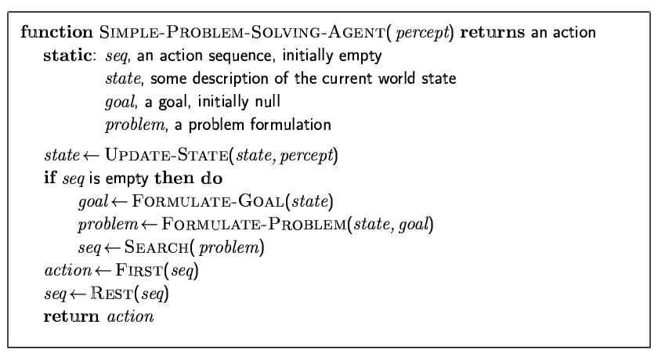
Problem-solving agents

Slide 20
Example: Romania
On holiday in Romania; currently in Arad.
Flight leaves tomorrow from Bucharest
Formulate goal:
be in Bucharest
Formulate problem:
states: various cities
actions: drive between cities
Find solution:
sequence of cities, e.g., Arad, Sibiu, Fagaras, Bucharest

Slide 21
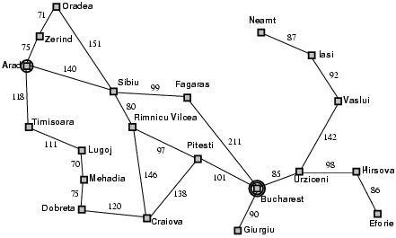
Example: Romania

Slide 22
Problem types
Deterministic, fully observable → single-state problem
Agent knows exactly which state it will be in; solution is a sequence
Non-observable → sensorless problem (conformant problem)
Agent may have no idea where it is; solution is a sequence
Nondeterministic and/or partially observable → contingency problem
percepts provide new information about current state
often interleave} search, execution
Unknown state space → exploration problem

Slide 23
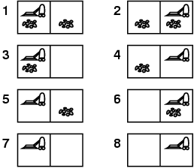
Example: vacuum world
Single-state, start in #5. Solution?

Slide 24
Example: vacuum world
Single-state, start in #5. Solution? [Right, Suck]
Sensorless, start in {1,2,3,4,5,6,7,8} e.g., Right goes to {2,4,6,8} Solution?

Slide 25
Example: vacuum world
Sensorless, start in {1,2,3,4,5,6,7,8} e.g., Right goes to {2,4,6,8} Solution? [Right,Suck,Left,Suck]
Contingency
Nondeterministic: Suck may dirty a clean carpet
Partially observable: location, dirt at current location.
Percept: [L, Clean], i.e., start in #5 or #7 Solution?

Slide 26
Example: vacuum world
Sensorless, start in {1,2,3,4,5,6,7,8} e.g., Right goes to {2,4,6,8} Solution? [Right,Suck,Left,Suck]
Contingency
Nondeterministic: Suck may dirty a clean carpet
Partially observable: location, dirt at current location.
Percept: [L, Clean], i.e., start in #5 or #7 Solution? [Right, if dirt then Suck]

Slide 27
Single-state problem formulation
A problem is defined by four items:
initial state e.g., "at Arad"
actions or successor function S(x) = set of action–state pairs
e.g., S(Arad) = {<Arad → Zerind, Zerind>, … }
goal test, can be
explicit, e.g., x = "at Bucharest"
implicit, e.g., Checkmate(x)
path cost (additive)
e.g., sum of distances, number of actions executed, etc.
c(x,a,y) is the step cost, assumed to be ≥ 0
A solution is a sequence of actions leading from the initial state to a goal state

Slide 28
Selecting a state space
Real world is absurdly complex
→ state space must be abstracted for problem solving
(Abstract) state = set of real states
(Abstract) action = complex combination of real actions
e.g., "Arad → Zerind" represents a complex set of possible routes, detours, rest stops, etc.
For guaranteed realizability, any real state "in Arad“ must get to some real state "in Zerind"
(Abstract) solution =
set of real paths that are solutions in the real world
Each abstract action should be "easier" than the original problem

Slide 29
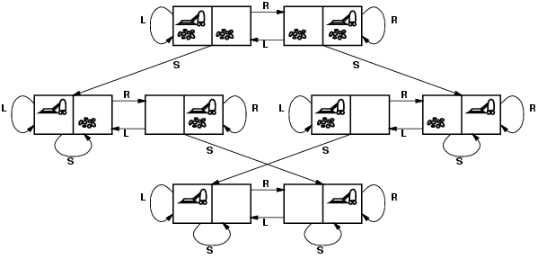
Vacuum world state space graph
states?
actions?
goal test?
path cost?

Slide 30
Vacuum world state space graph
states? integer dirt and robot location
actions? Left, Right, Suck
goal test? no dirt at all locations
path cost? 1 per action

Slide 31
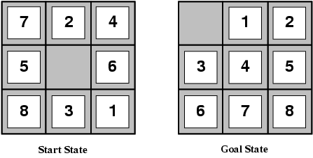
Example: The 8-puzzle
states?
actions?
goal test?
path cost?

Slide 32
Example: The 8-puzzle
states? locations of tiles
actions? move blank left, right, up, down
goal test? = goal state (given)
path cost? 1 per move
[Note: optimal solution of n-Puzzle family is NP-hard]

Slide 33
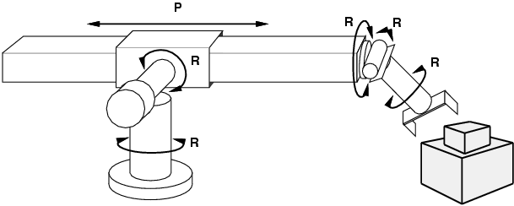
Example: robotic assembly
states?: real-valued coordinates of robot joint angles parts of the object to be assembled
actions?: continuous motions of robot joints
goal test?: complete assembly
path cost?: time to execute

Slide 34
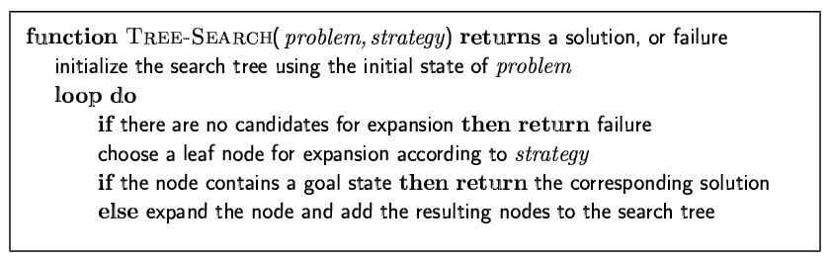
Tree search algorithms
Basic idea:
offline, simulated exploration of state space by generating successors of already-explored states (a.k.a.~expanding states)

Slide 35
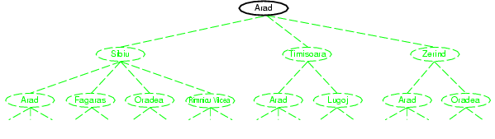
Tree search example

Slide 36
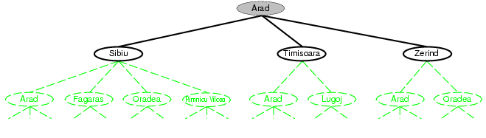
Tree search example

Slide 37
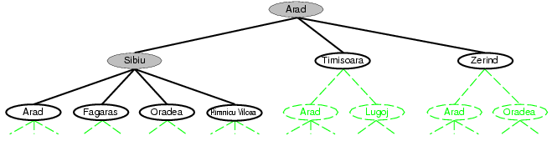
Tree search example

Slide 38
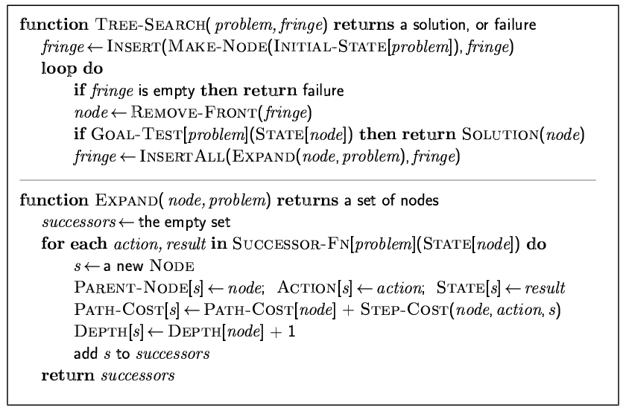
Implementation: general tree search

Slide 39
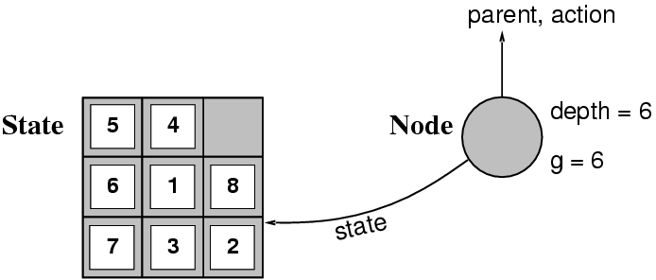
Implementation: states vs. nodes
A state is a (representation of) a physical configuration
A node is a data structure constituting part of a search tree includes state, parent node, action, path cost g(x), depth
The Expand function creates new nodes, filling in the various fields and using the SuccessorFn of the problem to create the corresponding states.

Slide 40
Search strategies
A search strategy is defined by picking the order of node expansion
Strategies are evaluated along the following dimensions:
completeness: does it always find a solution if one exists?
time complexity: number of nodes generated
space complexity: maximum number of nodes in memory
optimality: does it always find a least-cost solution?
Time and space complexity are measured in terms of
b: maximum branching factor of the search tree
d: depth of the least-cost solution
m: maximum depth of the state space (may be ∞)

Slide 41
Uninformed search strategies
Uninformed search strategies use only the information available in the problem definition
Breadth-first search
Uniform-cost search
Depth-first search
Depth-limited search
Iterative deepening search

Slide 42
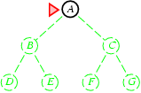
Breadth-first search
Expand shallowest unexpanded node
Implementation:
fringe is a FIFO queue, i.e., new successors go at end

Slide 43
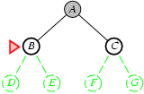
Breadth-first search
Expand shallowest unexpanded node
Implementation:
fringe is a FIFO queue, i.e., new successors go at end

Slide 44
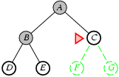
Breadth-first search
Expand shallowest unexpanded node
Implementation:
fringe is a FIFO queue, i.e., new successors go at end

Slide 45
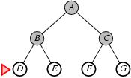
Breadth-first search
Expand shallowest unexpanded node
Implementation:
fringe is a FIFO queue, i.e., new successors go at end

Slide 46
Properties of breadth-first search
Complete? Yes (if b is finite)
Time? 1+b+b²+b³+… +b^{d} + b(b^{d}-1) = O(b^{d+1})
Space? O(b^{d+1}) (keeps every node in memory)
Optimal? Yes (if cost = 1 per step)
Space is the bigger problem (more than time)

Slide 47
Uniform-cost search
Expand least-cost unexpanded node
Implementation:
fringe = queue ordered by path cost
Equivalent to breadth-first if step costs all equal
Complete? Yes, if step cost ≥ ε
Time? # of nodes with g ≤ cost of optimal solution, O(b^{ceiling(C*/ ε)}) where C* is the cost of the optimal solution
Space? # of nodes with g ≤ cost of optimal solution, O(b^{ceiling(C*/ ε)})
Optimal? Yes – nodes expanded in increasing order of g(n)

Slide 48
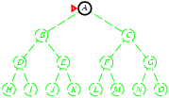
Depth-first search
Expand deepest unexpanded node
Implementation:
fringe = LIFO queue, i.e., put successors at front

Slide 49
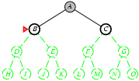
Depth-first search
Expand deepest unexpanded node
Implementation:
fringe = LIFO queue, i.e., put successors at front

Slide 50
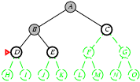
Depth-first search
Expand deepest unexpanded node
Implementation:
fringe = LIFO queue, i.e., put successors at front

Slide 51
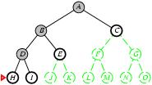
Depth-first search
Expand deepest unexpanded node
Implementation:
fringe = LIFO queue, i.e., put successors at front

Slide 52
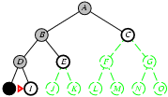
Depth-first search
Expand deepest unexpanded node
Implementation:
fringe = LIFO queue, i.e., put successors at front

Slide 53
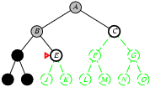
Depth-first search
Expand deepest unexpanded node
Implementation:
fringe = LIFO queue, i.e., put successors at front

Slide 54
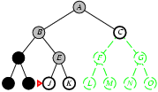
Depth-first search
Expand deepest unexpanded node
Implementation:
fringe = LIFO queue, i.e., put successors at front

Slide 55
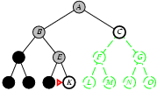
Depth-first search
Expand deepest unexpanded node
Implementation:
fringe = LIFO queue, i.e., put successors at front

Slide 56
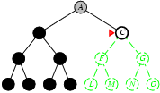
Depth-first search
Expand deepest unexpanded node
Implementation:
fringe = LIFO queue, i.e., put successors at front

Slide 57
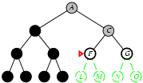
Depth-first search
Expand deepest unexpanded node
Implementation:
fringe = LIFO queue, i.e., put successors at front

Slide 58
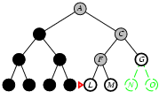
Depth-first search
Expand deepest unexpanded node
Implementation:
fringe = LIFO queue, i.e., put successors at front

Slide 59
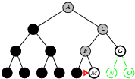
Depth-first search
Expand deepest unexpanded node
Implementation:
fringe = LIFO queue, i.e., put successors at front

Slide 60
Properties of depth-first search
Complete? No: fails in infinite-depth spaces, spaces with loops
Modify to avoid repeated states along path
→ complete in finite spaces
Time? O(b^{m}): terrible if m is much larger than d
but if solutions are dense, may be much faster than breadth-first
Space? O(bm), i.e., linear space!
Optimal? No

Slide 61
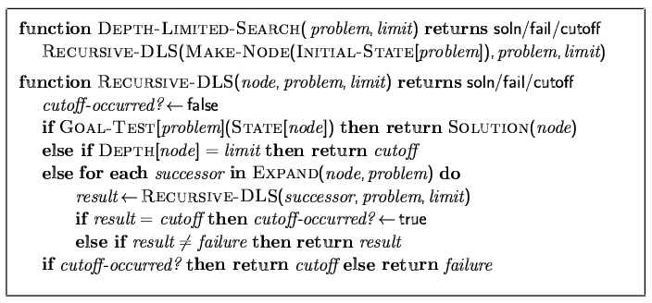
Depth-limited search
= depth-first search with depth limit l,
i.e., nodes at depth l have no successors
Recursive implementation:

Slide 62
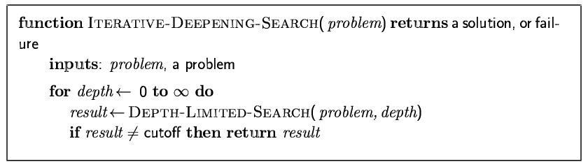
Iterative deepening search

Slide 63
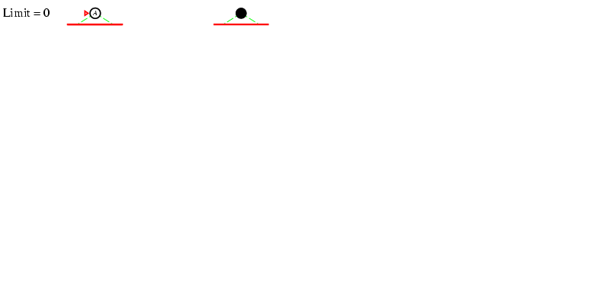
Iterative deepening search l =0

Slide 64
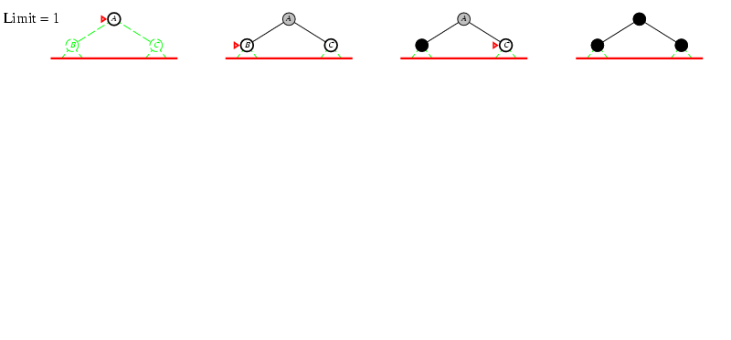
Iterative deepening search l =1

Slide 65
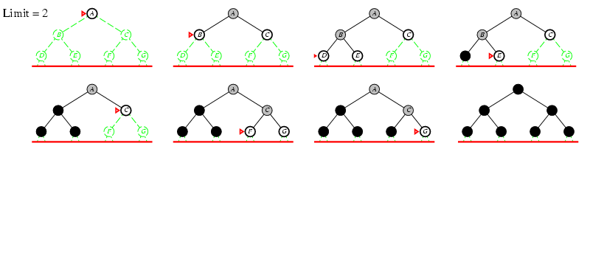
Iterative deepening search l =2

Slide 66
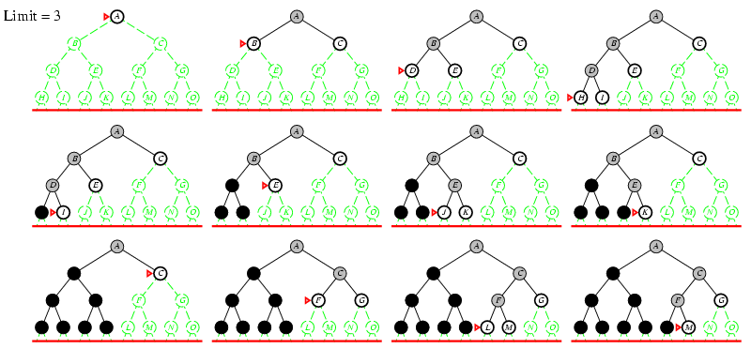
Iterative deepening search l =3

Slide 67
Iterative deepening search
Number of nodes generated in a depth-limited search to depth d with branching factor b:
N_{DLS} = b⁰ + b¹ + b² + … + b^{d-2} + b^{d-1} + b^{d}
Number of nodes generated in an iterative deepening search to depth d with branching factor b:
N_{IDS} = (d+1)b⁰ + d b^¹ + (d-1)b^² + … + 3b^{d-2} +2b^{d-1} + 1b^{d}
For b = 10, d = 5,
N_{DLS} = 1 + 10 + 100 + 1,000 + 10,000 + 100,000 = 111,111
N_{IDS} = 6 + 50 + 400 + 3,000 + 20,000 + 100,000 = 123,456
Overhead = (123,456 - 111,111)/111,111 = 11%

Slide 68
Properties of iterative deepening search
Complete? Yes
Time? (d+1)b⁰ + d b¹ + (d-1)b² + … + b^{d} = O(b^{d})
Space? O(bd)
Optimal? Yes, if step cost = 1

Slide 69
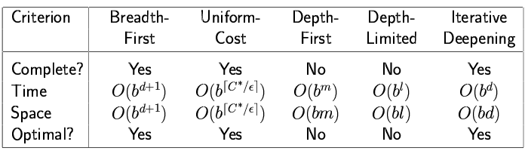
Summary of algorithms

Slide 70
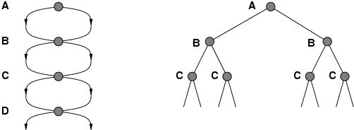
Repeated states
Failure to detect repeated states can turn a linear problem into an exponential one!

Slide 71
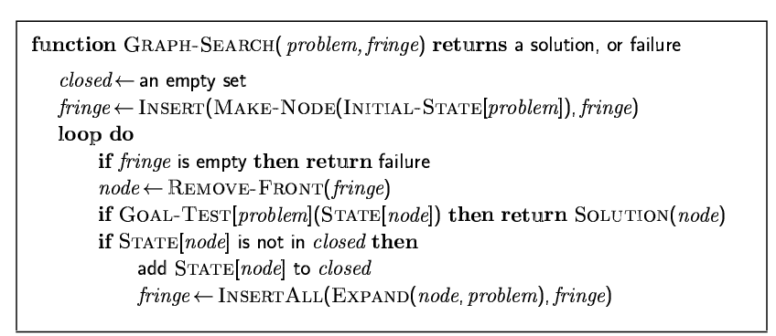
Graph search

Slide 72
Summary
Problem formulation usually requires abstracting away real-world details to define a state space that can feasibly be explored
Variety of uninformed search strategies
Iterative deepening search uses only linear space and not much more time than other uninformed algorithms

