Slide 1
Chapter 1: Introduction

Slide 2
Chapter 1: Introduction
What Operating Systems Do
Computer-System Organization
Computer-System Architecture
Operating-System Operations
Resource Management
Security and Protection
Virtualization
Distributed Systems
Kernel Data Structures
Computing Environments
Free/Libre and Open-Source Operating Systems

Slide 3
Objectives
Describe the general organization of a computer system and the role of interrupts
Describe the components in a modern, multiprocessor computer system
Illustrate the transition from user mode to kernel mode
Discuss how operating systems are used in various computing environments
Provide examples of free and open-source operating systems

Slide 4
Process Management
A process is a program in execution. It is a unit of work within the system. Program is a passive entity; process is an active entity.
Process needs resources to accomplish its task
CPU, memory, I/O, files
Initialization data
Process termination requires reclaim of any reusable resources
Single-threaded process has one program counter specifying location of next instruction to execute
Process executes instructions sequentially, one at a time, until completion
Multi-threaded process has one program counter per thread
Typically system has many processes, some user, some operating system running concurrently on one or more CPUs
Concurrency by multiplexing the CPUs among the processes / threads

Slide 5
Process Management Activities
The operating system is responsible for the following activities in connection with process management:
Creating and deleting both user and system processes
Suspending and resuming processes
Providing mechanisms for process synchronization
Providing mechanisms for process communication
Providing mechanisms for deadlock handling

Slide 6
Memory Management
To execute a program all (or part) of the instructions must be in memory
All (or part) of the data that is needed by the program must be in memory
Memory management determines what is in memory and when
Optimizing CPU utilization and computer response to users
Memory management activities
Keeping track of which parts of memory are currently being used and by whom
Deciding which processes (or parts thereof) and data to move into and out of memory
Allocating and deallocating memory space as needed

Slide 7
File-system Management
OS provides uniform, logical view of information storage
Abstracts physical properties to logical storage unit - file
Each medium is controlled by device (i.e., disk drive, tape drive)
Varying properties include access speed, capacity, data-transfer rate, access method (sequential or random)
File-System management
Files usually organized into directories
Access control on most systems to determine who can access what
OS activities include
Creating and deleting files and directories
Primitives to manipulate files and directories
Mapping files onto secondary storage
Backup files onto stable (non-volatile) storage media

Slide 8
Caching
Important principle, performed at many levels in a computer (in hardware, operating system, software)
Information in use copied from slower to faster storage temporarily
Faster storage (cache) checked first to determine if information is there
If it is, information used directly from the cache (fast)
If not, data copied to cache and used there
Cache smaller than storage being cached
Cache management important design problem
Cache size and replacement policy

Slide 9
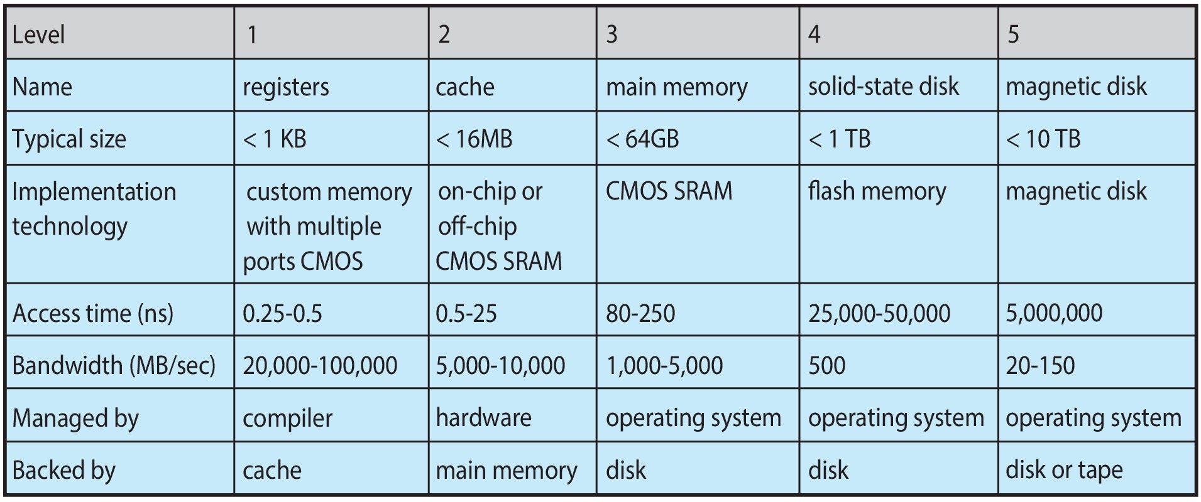
Characteristics of Various Types of Storage
Movement between levels of storage hierarchy can be explicit or implicit

Slide 10
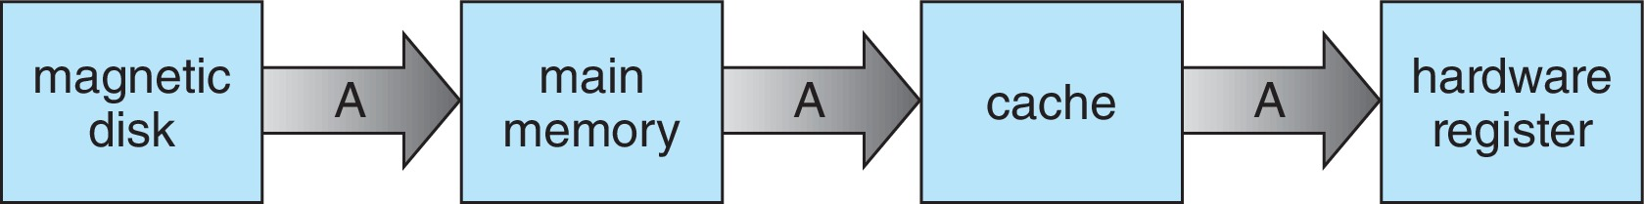
Migration of data “A” from Disk to Register
Multitasking environments must be careful to use most recent value, no matter where it is stored in the storage hierarchy
Multiprocessor environment must provide cache coherency in hardware such that all CPUs have the most recent value in their cache
Distributed environment situation even more complex
Several copies of a datum can exist
Various solutions covered in Chapter 19

Slide 11
I/O Subsystem
One purpose of OS is to hide peculiarities of hardware devices from the user
I/O subsystem responsible for
Memory management of I/O including buffering (storing data temporarily while it is being transferred), caching (storing parts of data in faster storage for performance), spooling (the overlapping of output of one job with input of other jobs)
General device-driver interface
Drivers for specific hardware devices

Slide 12
Protection and Security
Protection – any mechanism for controlling access of processes or users to resources defined by the OS
Security – defense of the system against internal and external attacks
Huge range, including denial-of-service, worms, viruses, identity theft, theft of service
Systems generally first distinguish among users, to determine who can do what
User identities (user IDs, security IDs) include name and associated number, one per user
User ID then associated with all files, processes of that user to determine access control
Group identifier (group ID) allows set of users to be defined and controls managed, then also associated with each process, file
Privilege escalation allows user to change to effective ID with more rights

Slide 13
Virtualization
Allows operating systems to run applications within other OSes
Vast and growing industry
Emulation used when source CPU type different from target type (i.e. PowerPC to Intel x86)
Generally slowest method
When computer language not compiled to native code – Interpretation
Virtualization – OS natively compiled for CPU, running guest OSes also natively compiled
Consider VMware running WinXP guests, each running applications, all on native WinXP host OS
VMM (virtual machine Manager) provides virtualization services

Slide 14
Computing Environments - Virtualization

Slide 15
Computer System Architecture

Slide 16
Computer-System Architecture
Most systems use a single general-purpose processor
Most systems have special-purpose processors as well
Multiprocessors systems growing in use and importance
Also known as parallel systems, tightly-coupled systems
Advantages include:
Increased throughput
Economy of scale
Increased reliability – graceful degradation or fault tolerance
Two types:
Asymmetric Multiprocessing – each processor is assigned a specie task.
Symmetric Multiprocessing – each processor performs all tasks

Slide 17
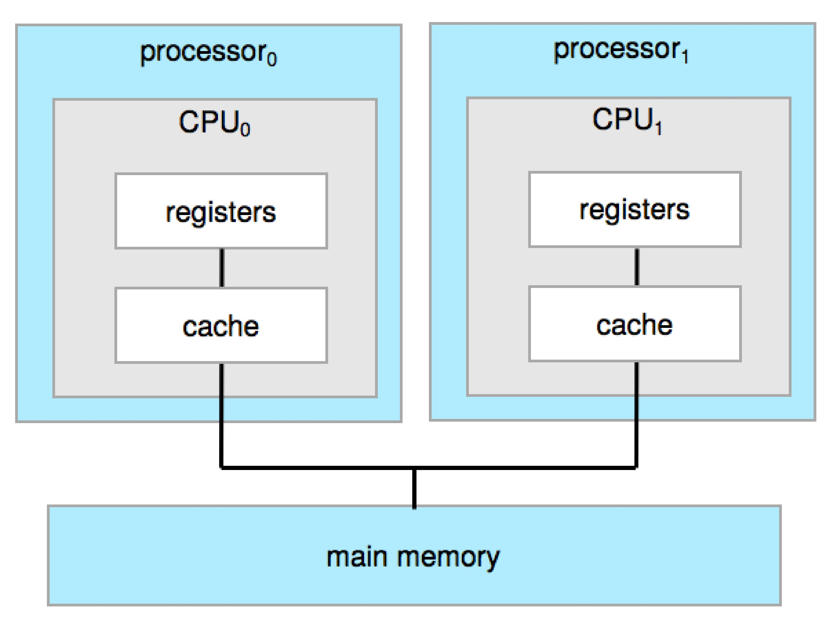
Symmetric Multiprocessing Architecture

Slide 18
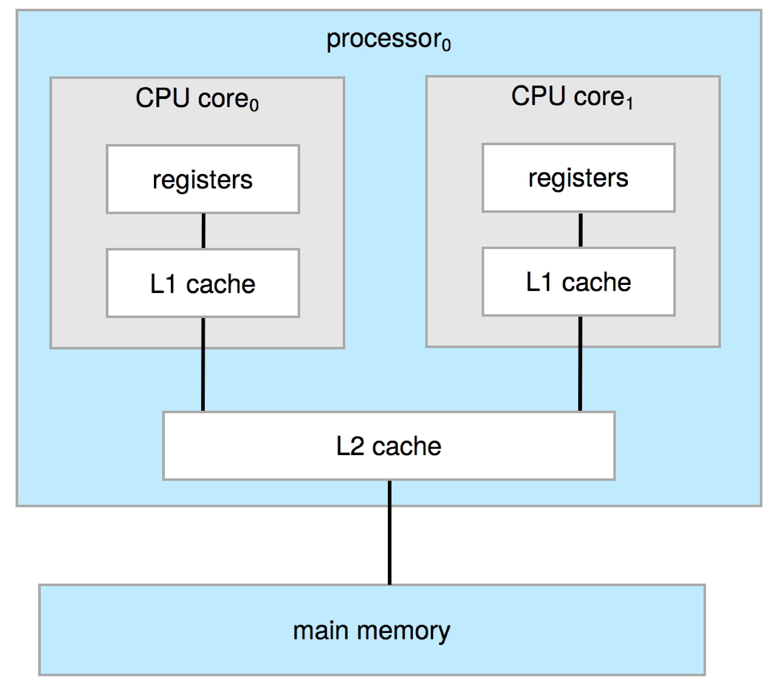
Dual-Core Design
Multi-chip and multicore
Systems containing all chips
Chassis containing multiple separate systems

Slide 19
Clustered Systems
Like multiprocessor systems, but multiple systems working together
Usually sharing storage via a storage-area network (SAN)
Provides a high-availability service which survives failures
Asymmetric clustering has one machine in hot-standby mode
Symmetric clustering has multiple nodes running applications, monitoring each other
Some clusters are for high-performance computing (HPC)
Applications must be written to use parallelization
Some have distributed lock manager (DLM) to avoid conflicting operations

Slide 20
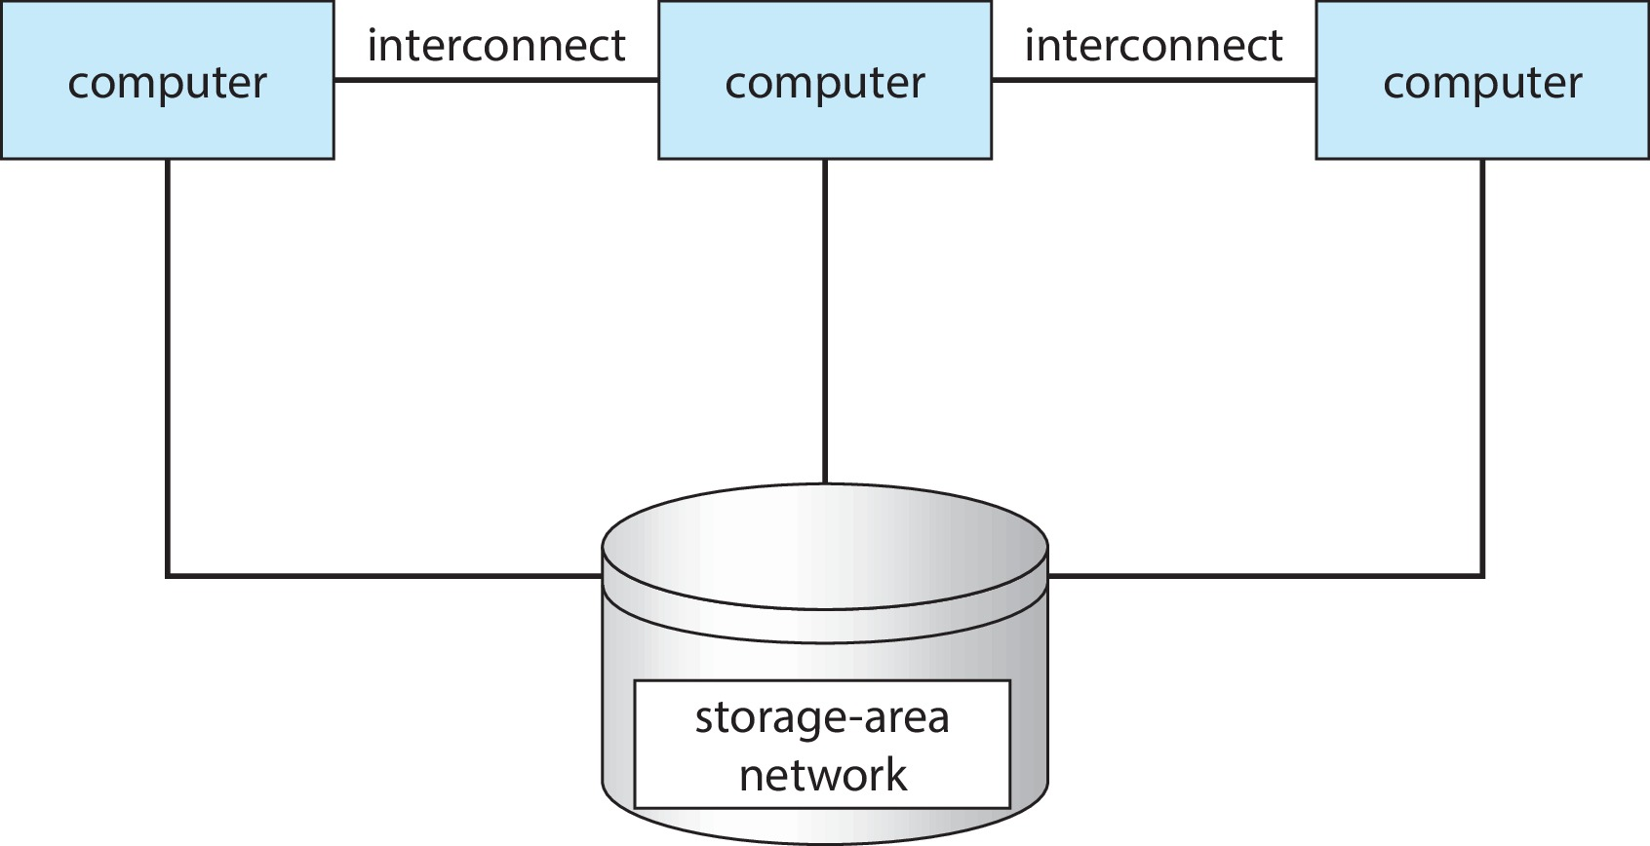
Clustered Systems

Slide 21
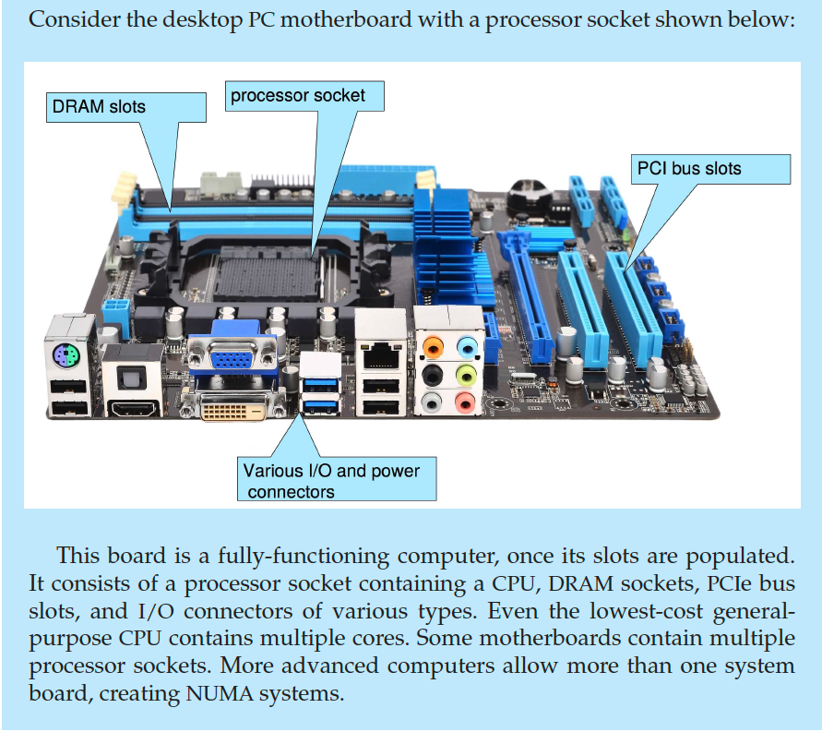
PC Motherboard

Slide 22
Computer System Environments

Slide 23
Computing Environments
Traditional
Mobile
Client Server
Peer-to-Peer
Cloud computing
Real-time Embedded

Slide 24
Traditional
Stand-alone general-purpose machines
But blurred as most systems interconnect with others (i.e., the Internet)
Portals provide web access to internal systems
Network computers (thin clients) are like Web terminals
Mobile computers interconnect via wireless networks
Networking becoming ubiquitous – even home systems use firewalls to protect home computers from Internet attacks

Slide 25
Mobile
Handheld smartphones, tablets, etc.
What is the functional difference between them and a “traditional” laptop?
Extra feature – more OS features (GPS, gyroscope)
Allows new types of apps like augmented reality
Use IEEE 802.11 wireless, or cellular data networks for connectivity
Leaders are Apple iOS and Google Android

Slide 26
Client Server
Client-Server Computing
Dumb terminals supplanted by smart PCs
Many systems now servers, responding to requests generated by clients
Compute-server system provides an interface to client to request services (i.e., database)
File-server system provides interface for clients to store and retrieve files

Slide 27
Peer-to-Peer
Another model of distributed system
P2P does not distinguish clients and servers
Instead all nodes are considered peers
May each act as client, server or both
Node must join P2P network
Registers its service with central lookup service on network, or
Broadcast request for service and respond to requests for service via discovery protocol
Examples include Napster and Gnutella, Voice over IP (VoIP) such as Skype

Slide 28
Cloud Computing
Delivers computing, storage, even apps as a service across a network
Logical extension of virtualization because it uses virtualization as the base for it functionality.
Amazon EC2 has thousands of servers, millions of virtual machines, petabytes of storage available across the Internet, pay based on usage

Slide 29
Cloud Computing (Cont.)
Many types
Public cloud – available via Internet to anyone willing to pay
Private cloud – run by a company for the company’s own use
Hybrid cloud – includes both public and private cloud components
Software as a Service (SaaS) – one or more applications available via the Internet (i.e., word processor)
Platform as a Service (PaaS) – software stack ready for application use via the Internet (i.e., a database server)
Infrastructure as a Service (IaaS) – servers or storage available over Internet (i.e., storage available for backup use)

Slide 30
Cloud Computing (cont.)
Cloud computing environments composed of traditional OSes, plus VMMs, plus cloud management tools
Internet connectivity requires security like firewalls
Load balancers spread traffic across multiple applications

Slide 31
Real-Time Embedded Systems
Real-time embedded systems most prevalent form of computers
Vary considerable, special purpose, limited purpose OS, real-time OS
Use expanding
Many other special computing environments as well
Some have OSes, some perform tasks without an OS
Real-time OS has well-defined fixed time constraints
Processing must be done within constraint
Correct operation only if constraints met

Slide 32
Free and Open-Source Operating Systems
Operating systems made available in source-code format rather than just binary closed-source and proprietary
Counter to the copy protection and Digital Rights Management (DRM) movement
Started by Free Software Foundation (FSF), which has “copyleft” GNU Public License (GPL)
Free software and open-source software are two different ideas championed by different groups of people
https://www.gnu.org/philosophy/open-source-misses-the-point.en.html
Examples include GNU/Linux and BSD UNIX (including core of Mac OS X), and many more
Can use VMM like VMware Player (Free on Windows), Virtualbox (open source and free on many platforms - http://www.virtualbox.com)
Use to run guest operating systems for exploration

Slide 33
The Study of Operating Systems
There has never been a more interesting time to study operating systems, and it has never been
easier. The open-source movement has overtaken operating systems, causing many of them to be
made available in both source and binary (executable) format. The list of operating
systems available in both formats includes Linux, BUSD UNIX, Solaris, and part of macOS.
The availability of source code allows us to study operating systems from the inside out.
Questions that we could once answer only by looking at documentation or the behavior of an
operating system we can now answer by examining the code itself.
Operating systems that are no longer commercially viable have been open-sourced as well, enabling
us to study how systems operated in a time of fewer CPU, memory, and storage resources.
An extensive but incomplete list of open-source operating-system projects is available
from https://curlie.org/Computers/Software/Operating_Systems/Open_Source/
In addition, the rise of virtualization as a mainstream (and frequently free) computer function
makes it possible to run many operating systems on top of one core system. For example, VMware
(http://www.vmware.com) provides a free “player” for Windows on which hundreds of free
“virtual appliances” can run. Virtualbox (http://www.virtualbox.com) provides a free, open-source
virtual machine manager on many operating systems. Using such tools, students can try out
hundreds of operating systems without dedicated hardware.
The advent of open-source operating systems has also made it easier to make the move from
student to operating-system developer. With some knowledge, some effort, and an Internet
connection, a student can even create a new operating-system distribution. Just a few years ago,
it was difficult or impossible to get access to source code. Now, such access is limited only by
how much interest, time, and disk space a student has.

Slide 34
End of Chapter 1

