Slide 1
Chapter 3: Processes

Slide 2
Outline
Process Concept
Process Scheduling
Operations on Processes
Interprocess Communication
IPC in Shared-Memory Systems
IPC in Message-Passing Systems
Examples of IPC Systems
Communication in Client-Server Systems

Slide 3
Objectives
Identify the separate components of a process and illustrate how they are represented and scheduled in an operating system.
Describe how processes are created and terminated in an operating system, including developing programs using the appropriate system calls that perform these operations.
Describe and contrast interprocess communication using shared memory and message passing.
Design programs that uses pipes and POSIX shared memory to perform interprocess communication.
Describe client-server communication using sockets and remote procedure calls.
Design kernel modules that interact with the Linux operating system.

Slide 4
Process Concept
An operating system executes a variety of programs that run as a process.
Process – a program in execution; process execution must progress in sequential fashion. No parallel execution of instructions of a single process
Multiple parts
The program code, also called text section
Current activity including program counter, processor registers
Stack containing temporary data
Function parameters, return addresses, local variables
Data section containing global variables
Heap containing memory dynamically allocated during run time

Slide 5
Process Concept (Cont.)
Program is passive entity stored on disk (executable file); process is active
Program becomes process when an executable file is loaded into memory
Execution of program started via GUI mouse clicks, command line entry of its name, etc.
One program can be several processes
Consider multiple users executing the same program

Slide 6
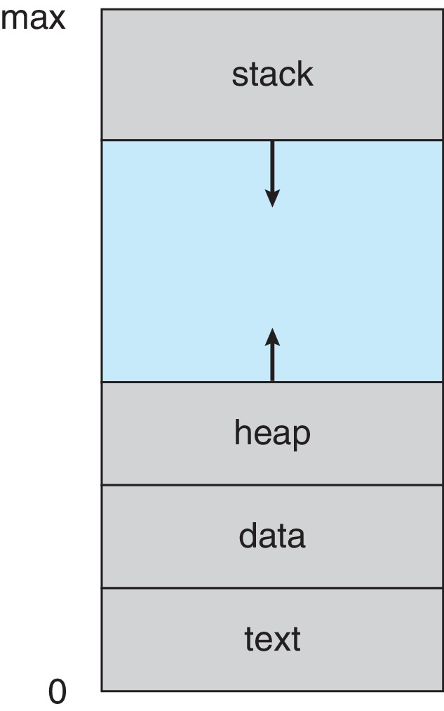
Process in Memory

Slide 7
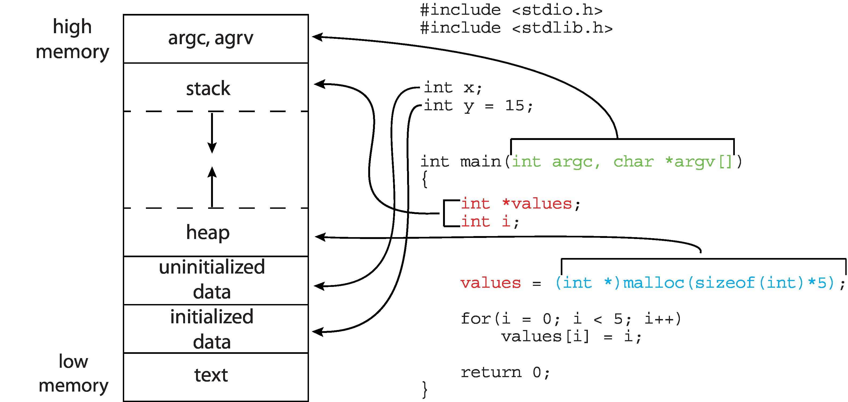
Memory Layout of a C Program

Slide 8
Process State
As a process executes, it changes state
New: The process is being created
Running: Instructions are being executed
Waiting: The process is waiting for some event to occur
Ready: The process is waiting to be assigned to a processor
Terminated: The process has finished execution

Slide 9
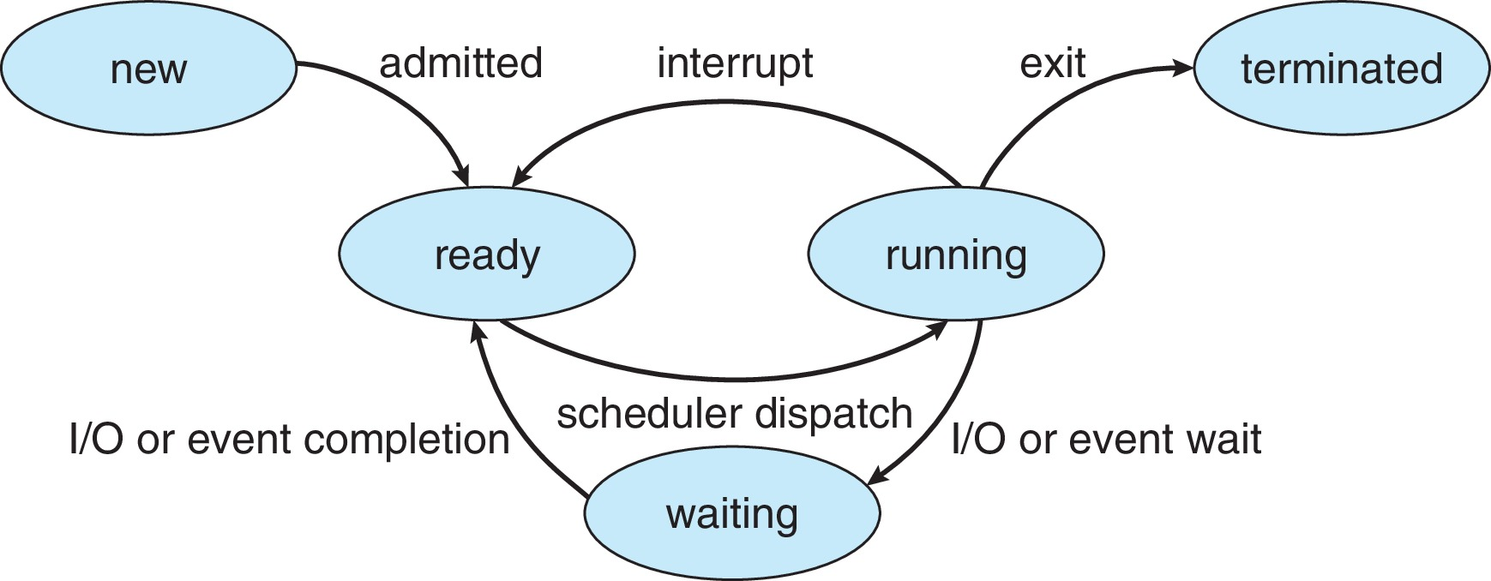
Diagram of Process State

Slide 10
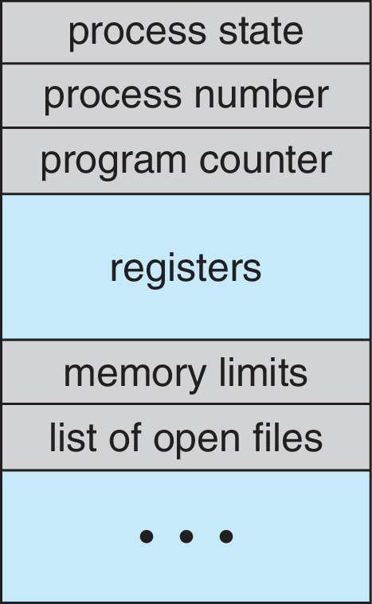
Process Control Block (PCB)
Information associated with each process(also called task control block)
Process state – running, waiting, etc.
Program counter – location of instruction to next execute
CPU registers – contents of all process-centric registers
CPU scheduling information- priorities, scheduling queue pointers
Memory-management information – memory allocated to the process
Accounting information – CPU used, clock time elapsed since start, time limits
I/O status information – I/O devices allocated to process, list of open files

Slide 11
Threads
So far, process has a single thread of execution
Consider having multiple program counters per process
Multiple locations can execute at once
Multiple threads of control -> threads
Must then have storage for thread details, multiple program counters in PCB
Explore in detail in Chapter 4

Slide 12
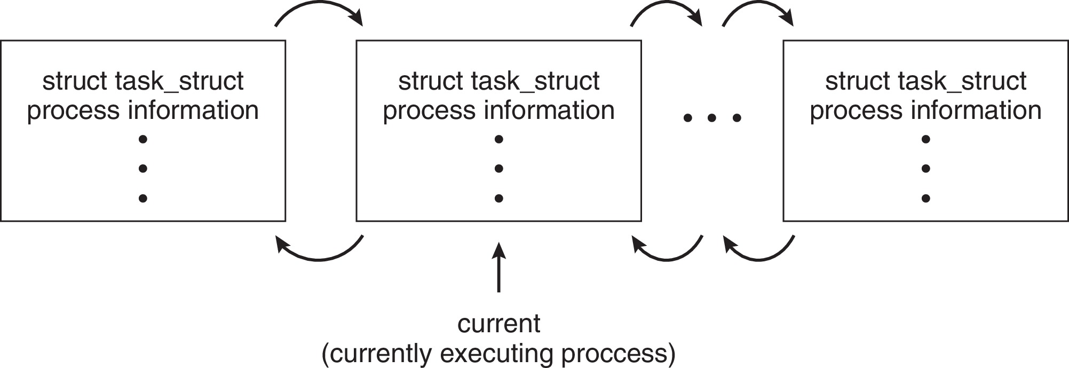
Process Representation in Linux
Represented by the C structure task_struct
pid t_pid; /* process identifier */ long state; /* state of the process */ unsigned int time_slice /* scheduling information */ struct task_struct *parent;/* this process’s parent */ struct list_head children; /* this process’s children */ struct files_struct *files;/* list of open files */ struct mm_struct *mm; /* address space of this process */

Slide 13
Process Scheduling
Process scheduler selects among available processes for next execution on CPU core
Goal -- Maximize CPU use, quickly switch processes onto CPU core
Maintains scheduling queues of processes
Ready queue – set of all processes residing in main memory, ready and waiting to execute
Wait queues – set of processes waiting for an event (i.e., I/O)
Processes migrate among the various queues

Slide 14
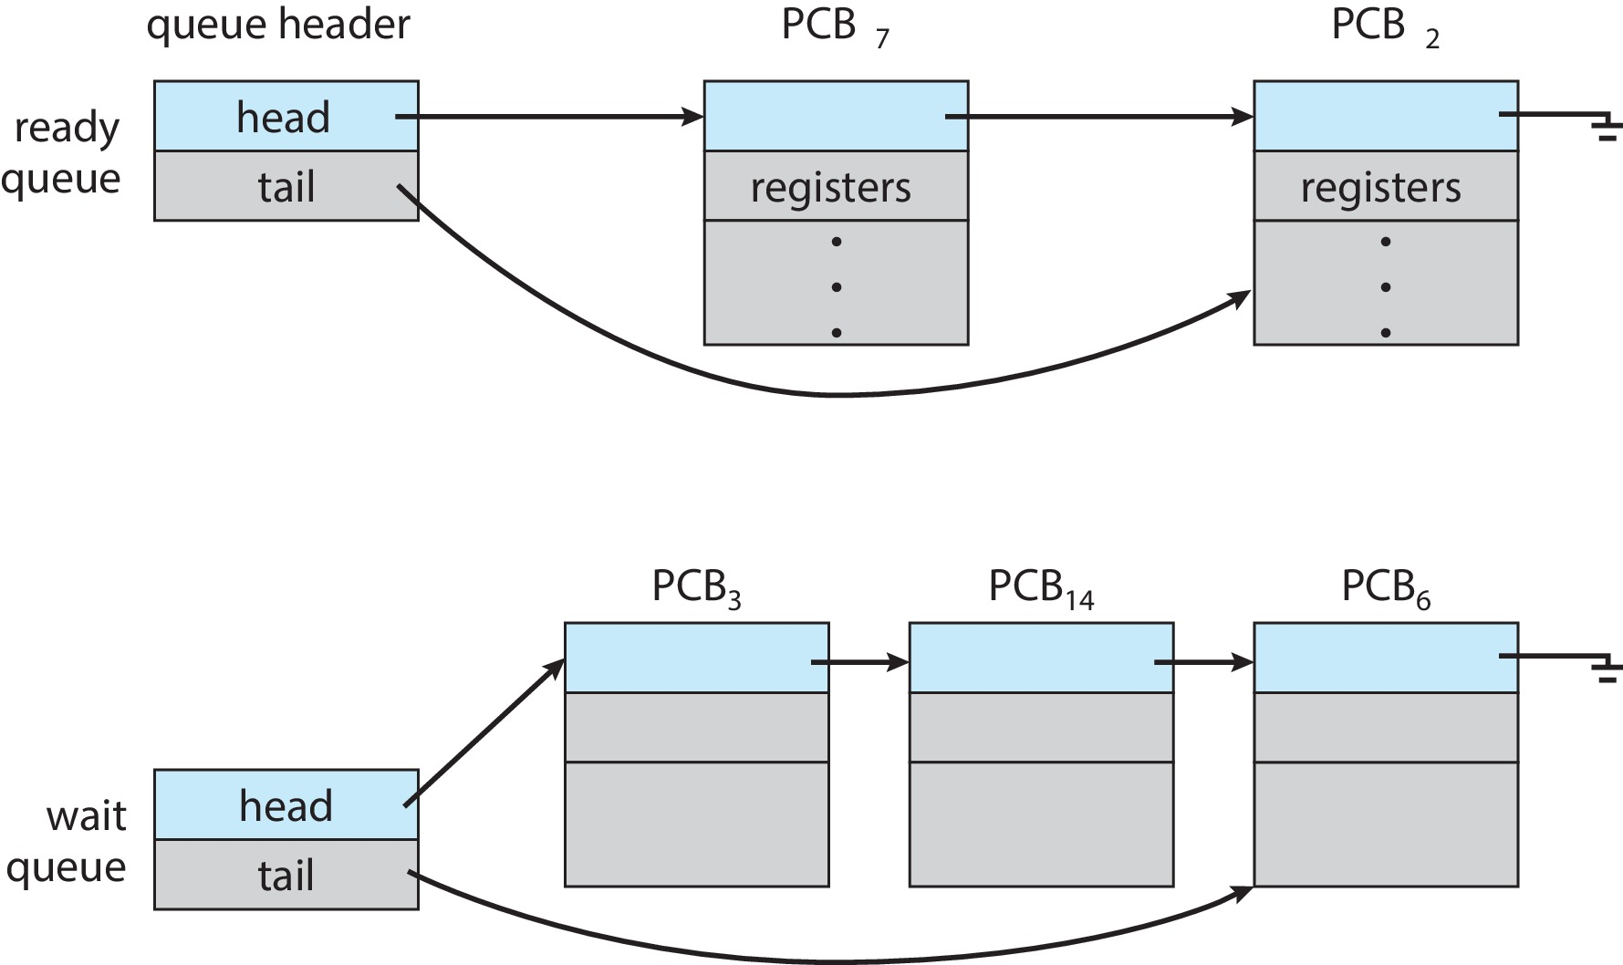
Ready and Wait Queues

Slide 15
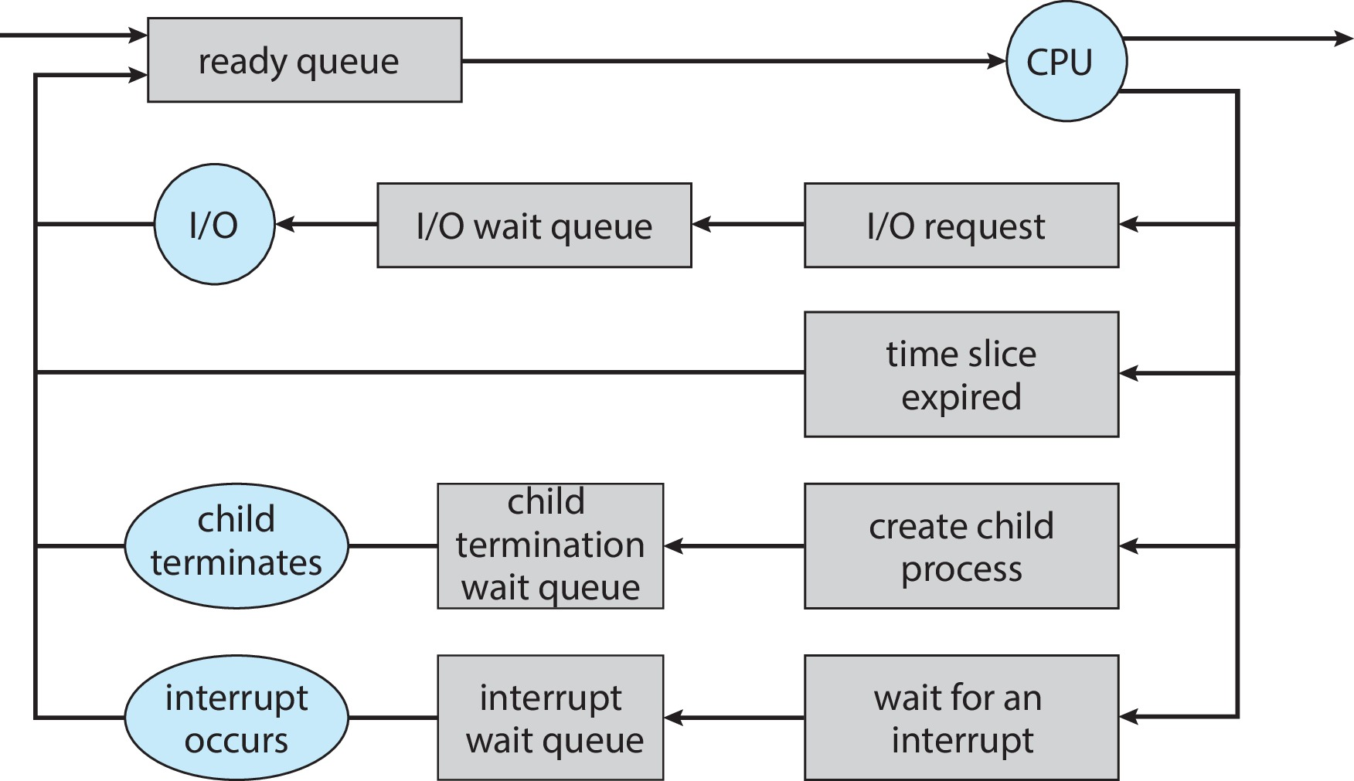
Representation of Process Scheduling

Slide 16
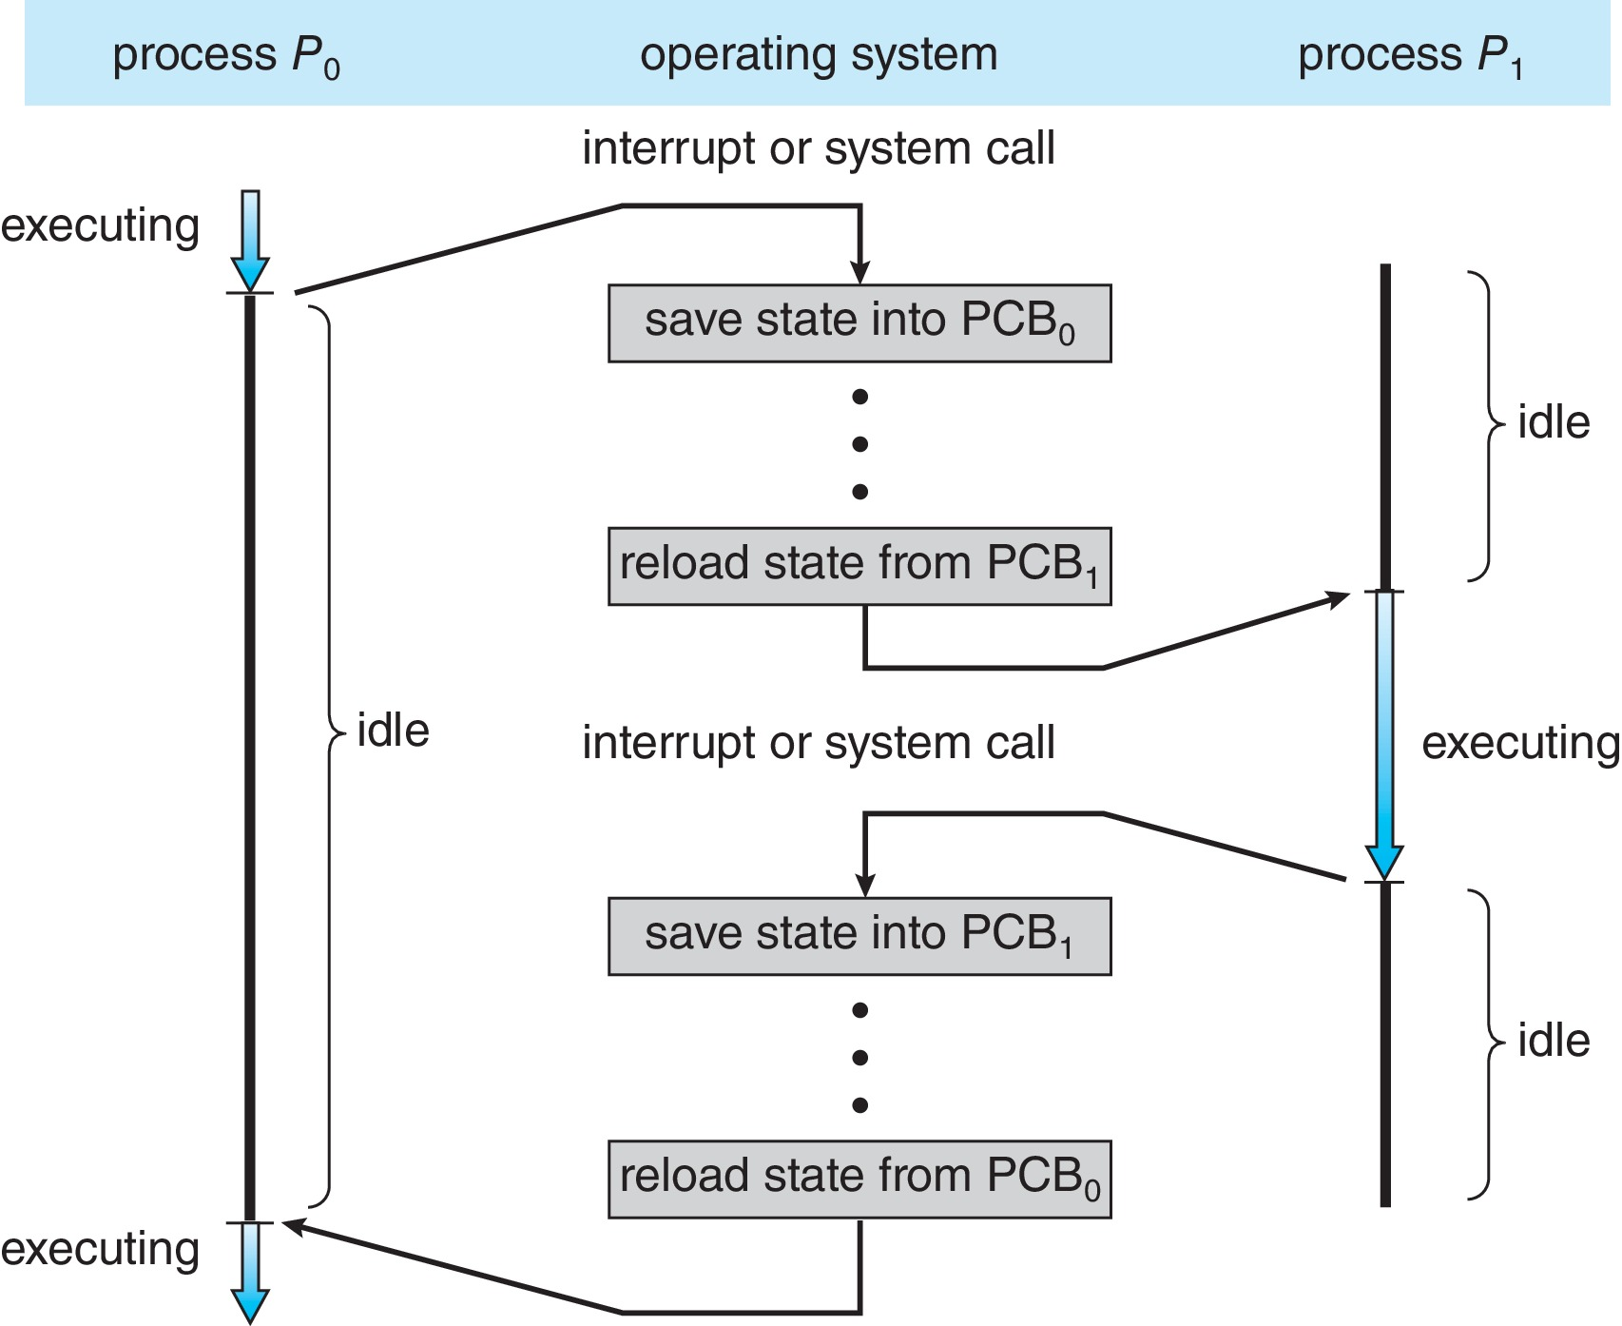
CPU Switch From Process to Process
A context switch occurs when the CPU switches from one process to another.

Slide 17
Context Switch
When CPU switches to another process, the system must save the state of the old process and load the saved state for the new process via a context switch
Context of a process represented in the PCB
Context-switch time is pure overhead; the system does no useful work while switching
The more complex the OS and the PCB ➔ the longer the context switch
Time dependent on hardware support
Some hardware provides multiple sets of registers per CPU ➔ multiple contexts loaded at once

Slide 18
Multitasking in Mobile Systems
Some mobile systems (e.g., early version of iOS) allow only one process to run, others suspended
Due to screen real estate, user interface limits iOS provides for a
Single foreground process- controlled via user interface
Multiple background processes– in memory, running, but not on the display, and with limits
Limits include single, short task, receiving notification of events, specific long-running tasks like audio playback
Android runs foreground and background, with fewer limits
Background process uses a service to perform tasks
Service can keep running even if background process is suspended
Service has no user interface, small memory use

Slide 19
Operations on Processes
System must provide mechanisms for:
Process creation
Process termination

Slide 20
Process Creation
Parent process create children processes, which, in turn create other processes, forming a tree of processes
Generally, process identified and managed via a process identifier (pid)
Resource sharing options
Parent and children share all resources
Children share subset of parent’s resources
Parent and child share no resources
Execution options
Parent and children execute concurrently
Parent waits until children terminate

Slide 21
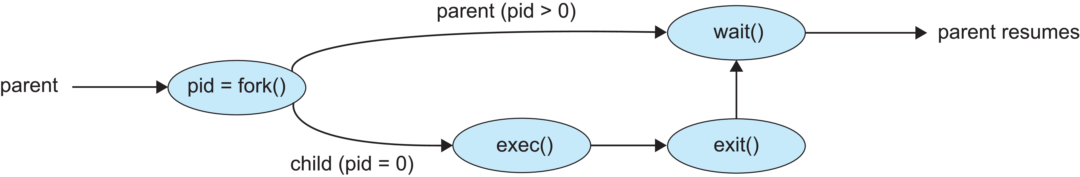
Process Creation (Cont.)
Address space
Child duplicate of parent
Child has a program loaded into it
UNIX examples
fork() system call creates new process
exec() system call used after a fork() to replace the process’ memory space with a new program
Parent process calls wait()waiting for the child to terminate

Slide 22
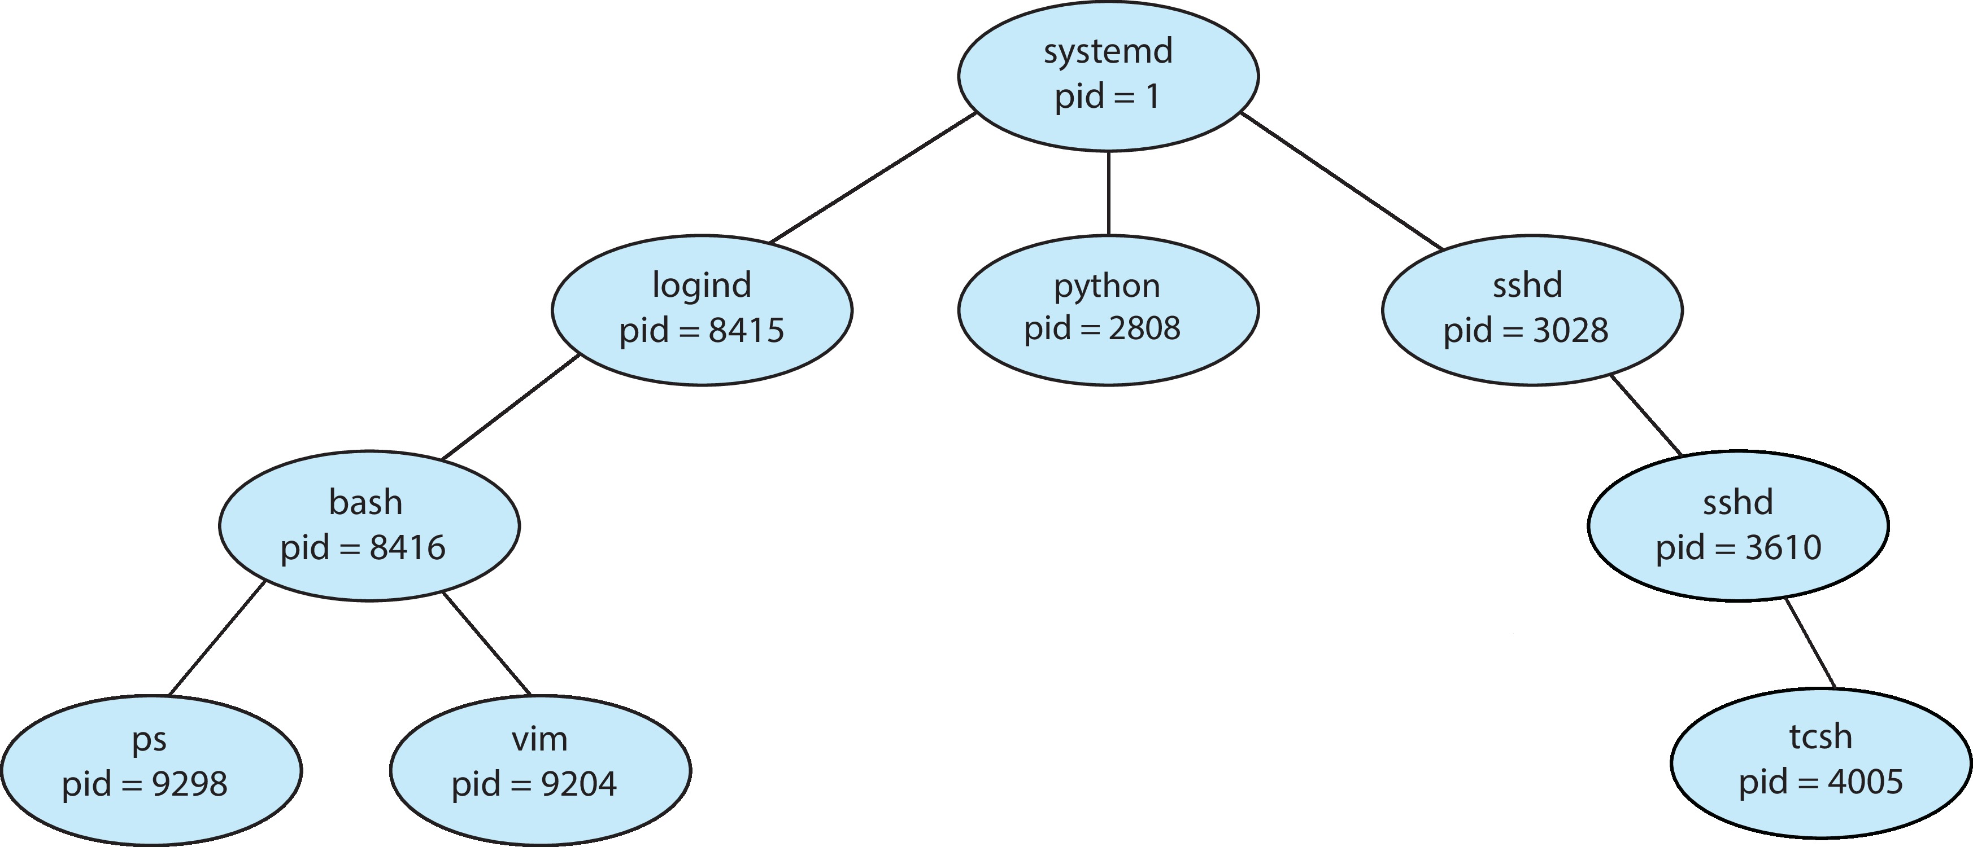
A Tree of Processes in Linux

Slide 23
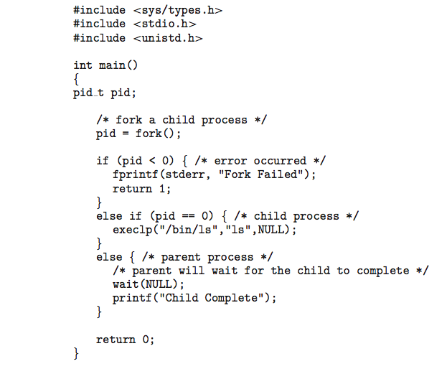
C Program Forking Separate Process

Slide 24
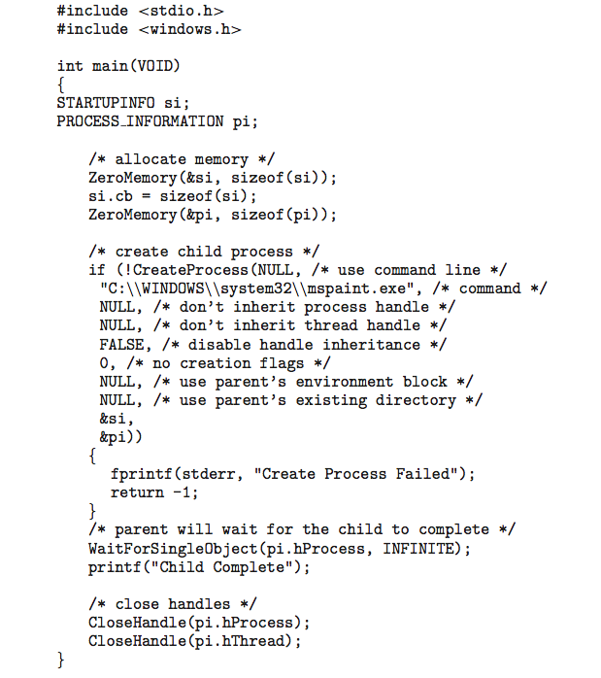
Creating a Separate Process via Windows API

Slide 25
Process Termination
Process executes last statement and then asks the operating system to delete it using the exit() system call.
Returns status data from child to parent (via wait())
Process’ resources are deallocated by operating system
Parent may terminate the execution of children processes using the abort() system call. Some reasons for doing so:
Child has exceeded allocated resources
Task assigned to child is no longer required
The parent is exiting, and the operating systems does not allow a child to continue if its parent terminates

Slide 26
Process Termination
Some operating systems do not allow child to exists if its parent has terminated. If a process terminates, then all its children must also be terminated.
cascading termination. All children, grandchildren, etc., are terminated.
The termination is initiated by the operating system.
The parent process may wait for termination of a child process by using the wait()system call. The call returns status information and the pid of the terminated process
pid = wait(&status);
If no parent waiting (did not invoke wait()) process is a zombie
If parent terminated without invoking wait(), process is an orphan

Slide 27
Android Process Importance Hierarchy
Mobile operating systems often have to terminate processes to reclaim system resources such as memory. From most to least important:
Foreground process
Visible process
Service process
Background process
Empty process
Android will begin terminating processes that are least important.

Slide 28

Multiprocess Architecture – Chrome Browser
Many web browsers ran as single process (some still do)
If one web site causes trouble, entire browser can hang or crash
Google Chrome Browser is multiprocess with 3 different types of processes:
Browser process manages user interface, disk and network I/O
Renderer process renders web pages, deals with HTML, Javascript. A new renderer created for each website opened
Runs in sandbox restricting disk and network I/O, minimizing effect of security exploits
Plug-in process for each type of plug-in

Slide 29
End of Chapter 3 Part1

