Slide 1
Chapter 3: Processes

Slide 2
Outline
Process Concept
Process Scheduling
Operations on Processes
Interprocess Communication
IPC in Shared-Memory Systems
IPC in Message-Passing Systems
Examples of IPC Systems
Communication in Client-Server Systems

Slide 3
Objectives
Identify the separate components of a process and illustrate how they are represented and scheduled in an operating system.
Describe how processes are created and terminated in an operating system, including developing programs using the appropriate system calls that perform these operations.
Describe and contrast interprocess communication using shared memory and message passing.
Design programs that uses pipes and POSIX shared memory to perform interprocess communication.
Describe client-server communication using sockets and remote procedure calls.
Design kernel modules that interact with the Linux operating system.

Slide 4
Interprocess Communication
Processes within a system may be independent or cooperating
Cooperating process can affect or be affected by other processes, including sharing data
Reasons for cooperating processes:
Information sharing
Computation speedup
Modularity
Convenience
Cooperating processes need interprocess communication (IPC)
Two models of IPC
Shared memory
Message passing

Slide 5
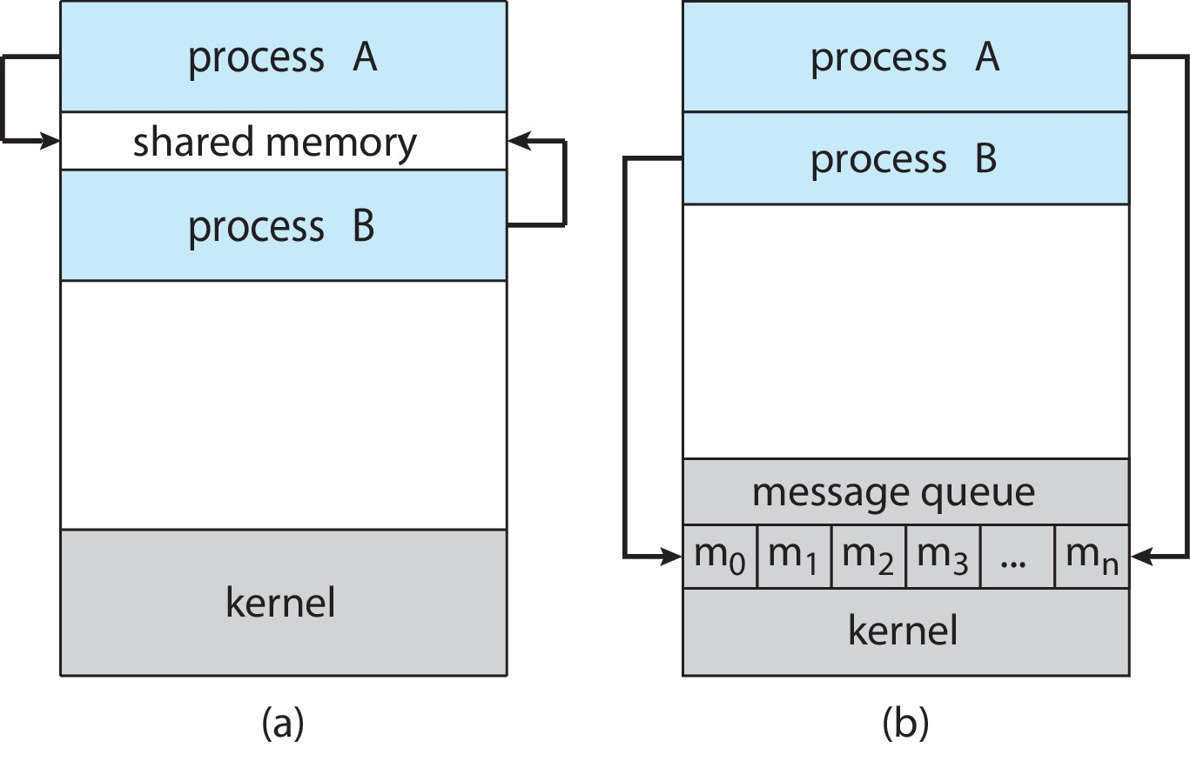
Communications Models
(a) Shared memory. (b) Message passing.

Slide 6
IPC – Shared Memory
An area of memory shared among the processes that wish to communicate
The communication is under the control of the users processes not the operating system.
Major issues is to provide mechanism that will allow the user processes to synchronize their actions when they access shared memory.
Synchronization is discussed in great details in Chapters 6 & 7.

Slide 7
Producer-Consumer Problem
Paradigm for cooperating processes:
producer process produces information that is consumed by a consumer process
For example: a compiler produces assembly code that is consumed by an assembler, which in turn, may produce object modules that are consumed by the loader.
Two variations:
unbounded-buffer places no practical limit on the size of the buffer:
Producer never waits
Consumer waits if there is no buffer to consume
bounded-buffer assumes that there is a fixed buffer size
Producer must wait if all buffers are full
Consumer waits if there is no buffer to consume

Slide 8
IPC – Message Passing
Processes communicate with each other without resorting to shared variables
IPC facility provides two operations:
send(message)
receive(message)
The message size is either fixed or variable

Slide 9
Message Passing (Cont.)
If processes P and Q wish to communicate, they need to:
Establish a communication link between them
Exchange messages via send/receive
Implementation issues:
How are links established?
Can a link be associated with more than two processes?
How many links can there be between every pair of communicating processes?
What is the capacity of a link?
Is the size of a message that the link can accommodate fixed or variable?
Is a link unidirectional or bi-directional?

Slide 10
Implementation of Communication Link
Physical:
Shared memory
Hardware bus
Network
Logical:
Direct or indirect
Synchronous or asynchronous
Automatic or explicit buffering

Slide 11
Synchronization
Message passing may be either blocking or non-blocking
Blocking is considered synchronous
Blocking send -- the sender is blocked until the message is received
Blocking receive -- the receiver is blocked until a message is available
Non-blocking is considered asynchronous
Non-blocking send -- the sender sends the message and continue
Non-blocking receive -- the receiver receives:
A valid message, or
Null message
Different combinations possible
If both send and receive are blocking, we have a rendezvous

Slide 12
Pipes
Acts as a conduit allowing two processes to communicate
Issues:
Is communication unidirectional or bidirectional?
In the case of two-way communication, is it half or full-duplex?
Must there exist a relationship (i.e., parent-child) between the communicating processes?
Can the pipes be used over a network?
Ordinary pipes – cannot be accessed from outside the process that created it. Typically, a parent process creates a pipe and uses it to communicate with a child process that it created.
Named pipes – can be accessed without a parent-child relationship.

Slide 13
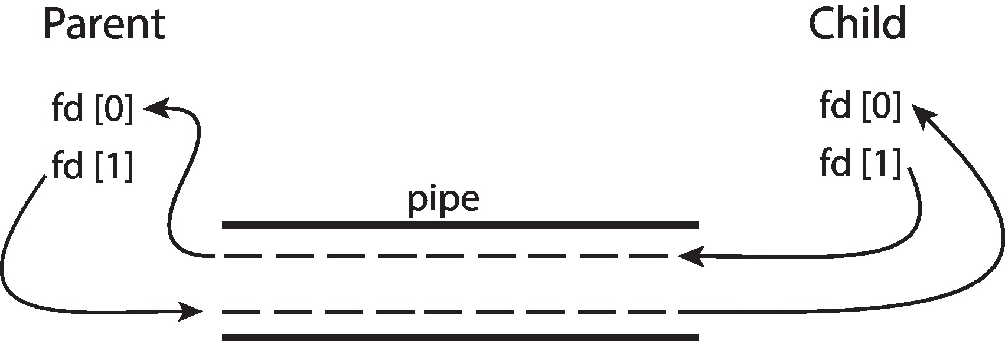
Ordinary Pipes
Ordinary Pipes allow communication in standard producer-consumer style
Producer writes to one end (the write-end of the pipe)
Consumer reads from the other end (the read-end of the pipe)
Ordinary pipes are therefore unidirectional
Require parent-child relationship between communicating processes
Windows calls these anonymous pipes

Slide 14
Named Pipes
Named Pipes are more powerful than ordinary pipes
Communication is bidirectional
No parent-child relationship is necessary between the communicating processes
Several processes can use the named pipe for communication
Provided on both UNIX and Windows systems

Slide 15
Communications in Client-Server Systems
A socket is defined as an endpoint for communication
Concatenation of IP address and port – a number included at start of message packet to differentiate network services on a host
The socket 161.25.19.8:1625 refers to port 1625 on host 161.25.19.8
Communication consists between a pair of sockets
All ports below 1024 are well known, used for standard services
Special IP address 127.0.0.1 (loopback) to refer to system on which process is running

Slide 16
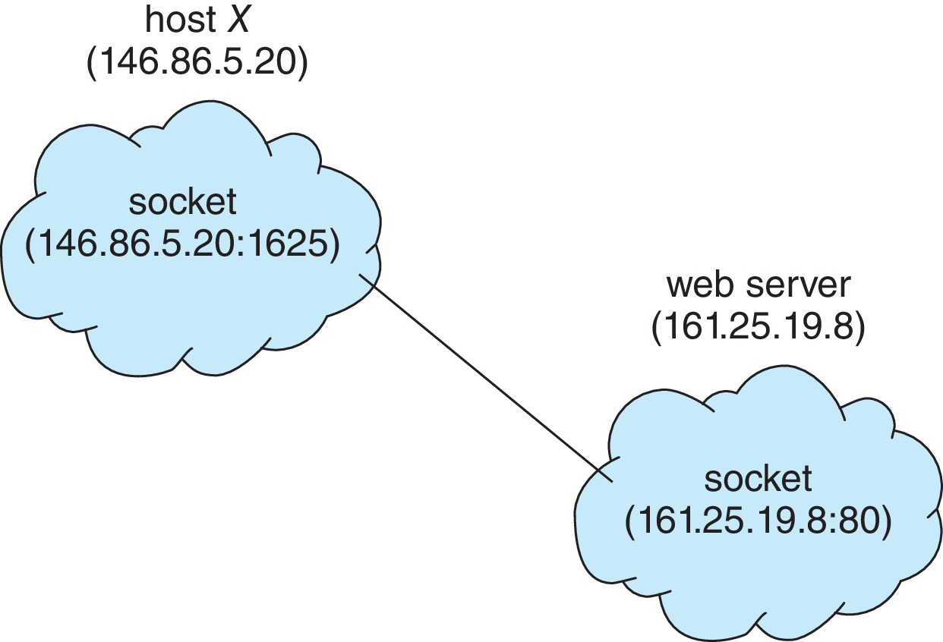
Socket Communication

Slide 17
End of Chapter 3

