Slide 1
Chapter 6: Synchronization Tools

Slide 2
Background
Processes can execute concurrently
May be interrupted at any time, partially completing execution
Concurrent access to shared data may result in data inconsistency
Maintaining data consistency requires mechanisms to ensure the orderly execution of cooperating processes
We illustrated in chapter 4 the problem when we considered the Bounded Buffer problem with use of a counter that is updated concurrently by the producer and consumer,. Which lead to race condition.

Slide 3
Race Condition
counter++ could be implemented as register1 = counter register1 = register1 + 1 counter = register1
counter-- could be implemented as register2 = counter register2 = register2 - 1 count = register2
Consider this execution interleaving with “count = 5” initially:
S0: producer execute register1 = counter {register1 = 5} S1: producer execute register1 = register1 + 1 {register1 = 6} S2: consumer execute register2 = counter {register2 = 5} S3: consumer execute register2 = register2 - 1 {register2 = 4} S4: producer execute counter = register1 {count = 6 } S5: consumer execute counter = register2 {count = 4}
Final value is 4 but it should have been _____?

Slide 4
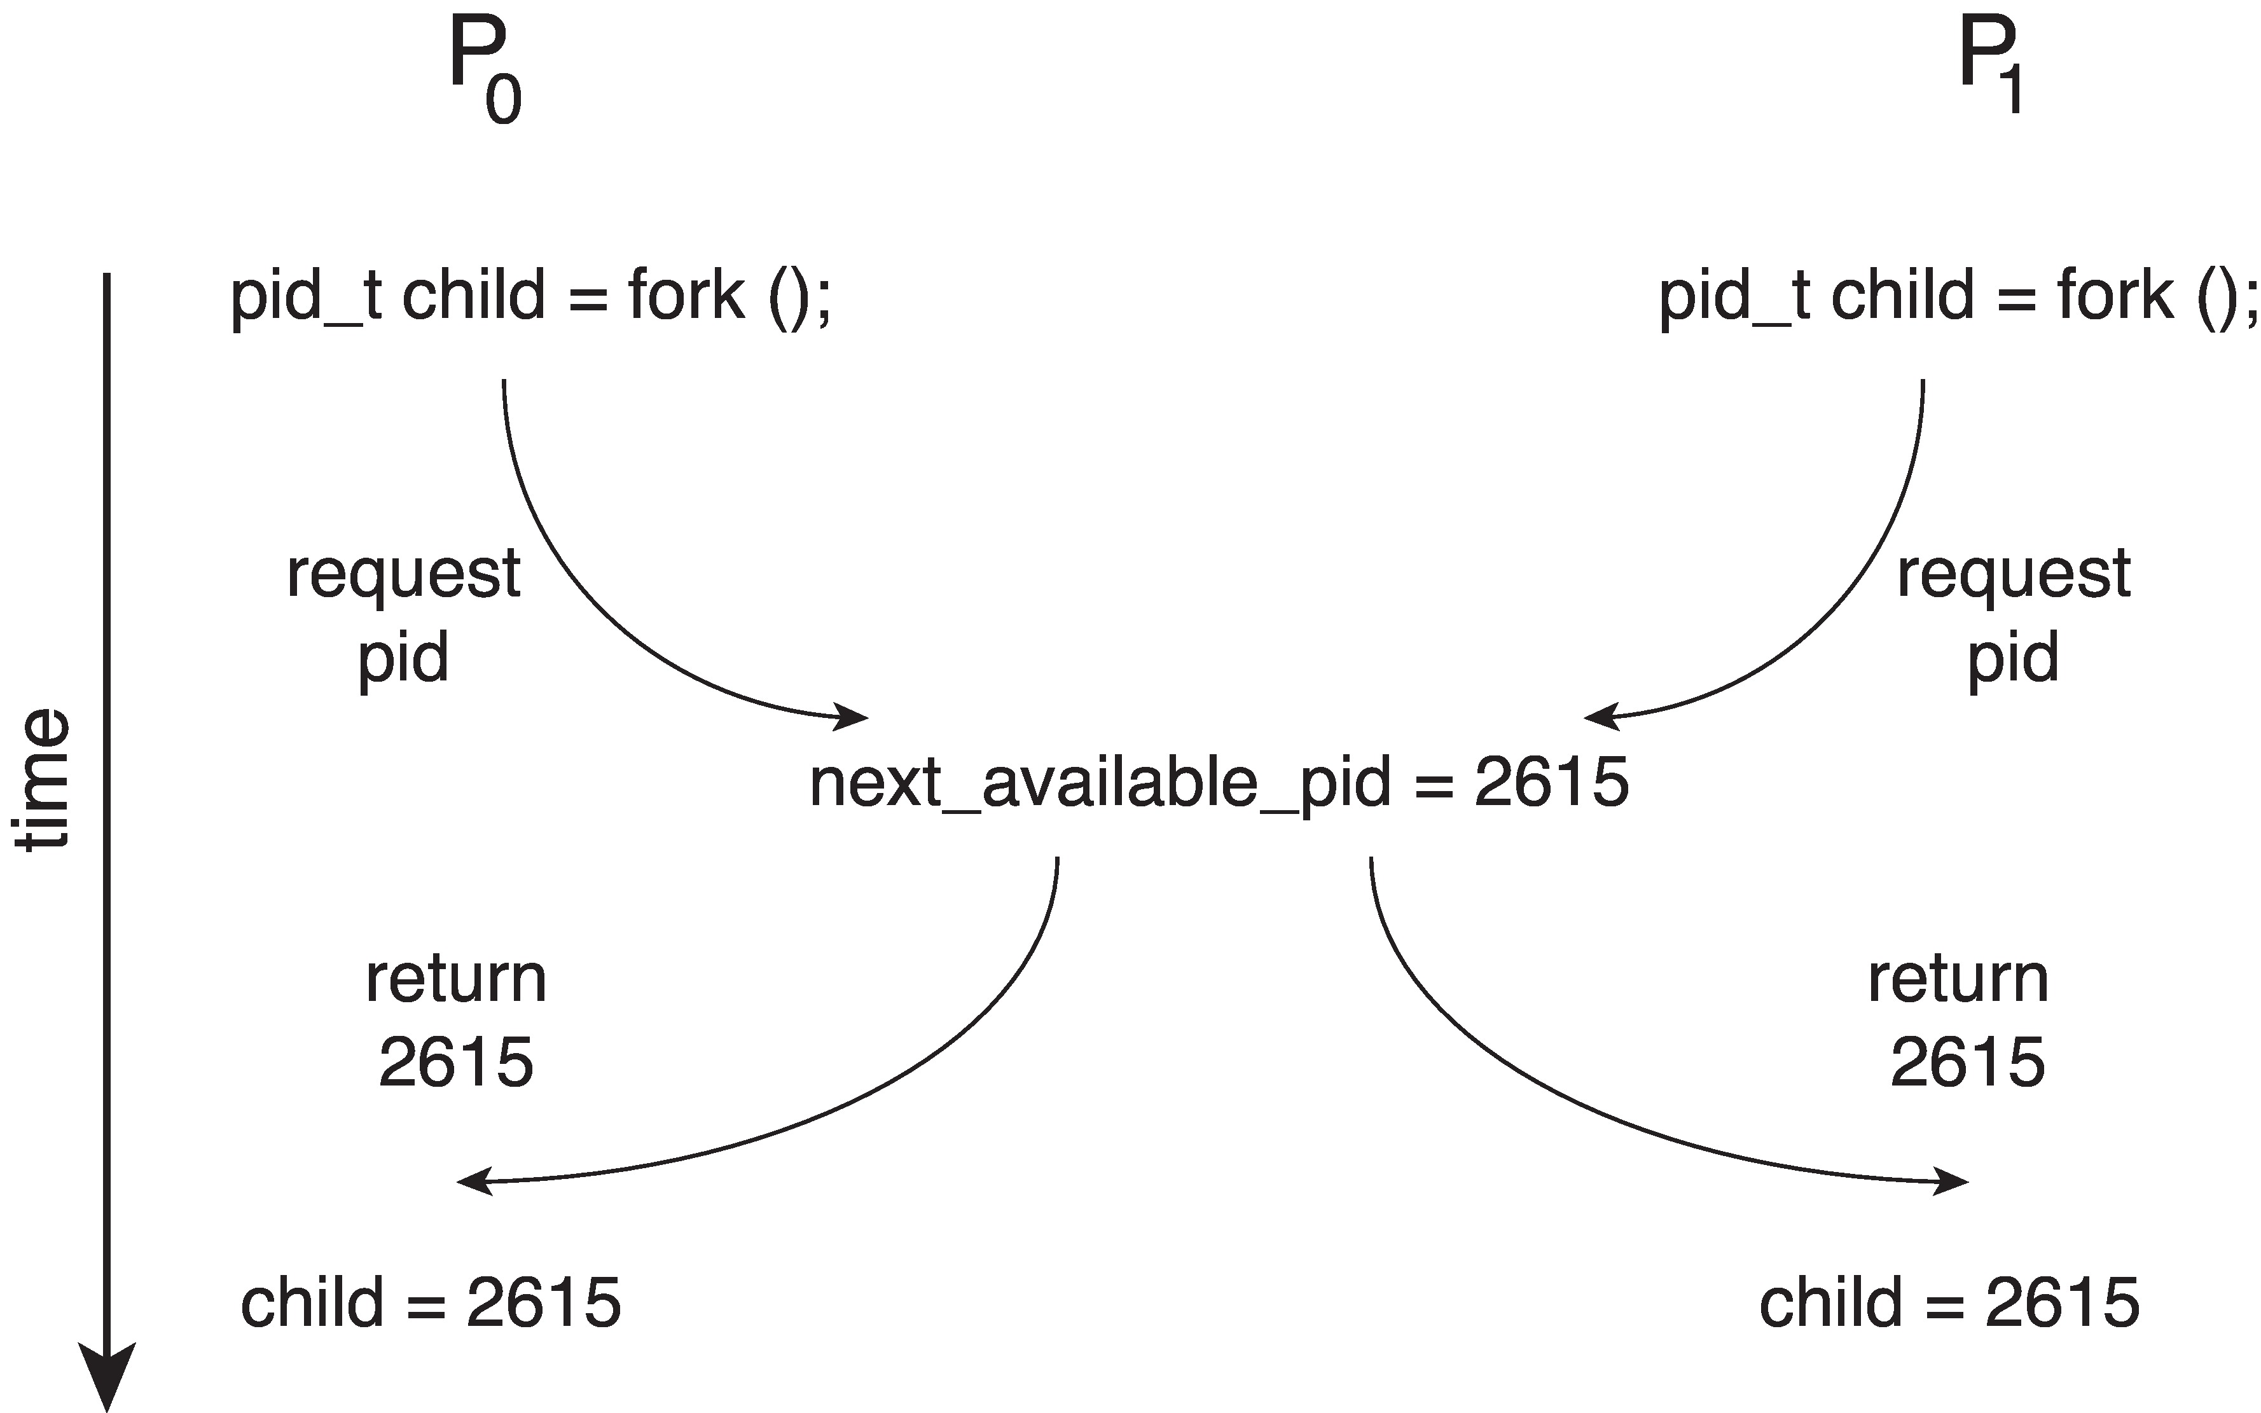
Race Condition
Processes P₀ and P₁ are creating child processes using the fork() system call
Race condition on kernel variable next_available_pid which represents the next available process identifier (pid)
Unless there is a mechanism to prevent P₀ and P₁ from accessing the variable next_available_pid the same pid could be assigned to two different processes!

Slide 5
Critical Section Problem
Consider system of n processes {p₀, p₁, … p_{n-1}}
Each process has critical section segment of code
Process may be changing common variables, updating table, writing file, etc.
When one process in critical section, no other may be in its critical section
Critical section problem is to design protocol to solve this
Each process must ask permission to enter critical section in entry section, may follow critical section with exit section, then remainder section

Slide 6
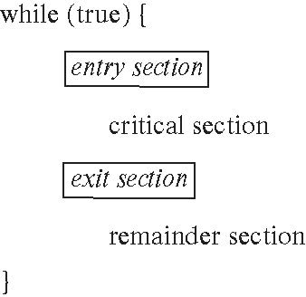
Critical Section
General structure of process P_{i}

Slide 7
Synchronization Hardware
Many systems provide hardware support for implementing the critical section code.
Uniprocessors – could disable interrupts
Currently running code would execute without preemption
Generally too inefficient on multiprocessor systems
Operating systems using this not broadly scalable
Modern machines provide special atomic hardware instructions
Atomic = non-interruptable
Either test memory word and set value
Or swap contents of two memory words

Slide 8
Mutex Locks
Previous solutions are complicated and generally inaccessible to application programmers
OS designers build software tools to solve critical section problem
Simplest is mutex lock
Boolean variable indicating if lock is available or not
Protect a critical section by
First acquire() a lock
Then release() the lock
Calls to acquire() and release() must be atomic
Usually implemented via hardware atomic instructions such as compare-and-swap.
But this solution requires busy waiting
This lock therefore called a spinlock

Slide 9
Solution to CS Problem Using Mutex Locks
while (true) {
acquire lock
critical section
release lock
remainder section
}

Slide 10
Process Synchronization
Process Synchronization is the coordination of execution of multiple processes in a multi-process system to ensure that they access shared resources in a controlled and predictable manner. It aims to resolve the problem of race conditions and other synchronization issues in a concurrent system.
The main objective of process synchronization is to ensure that multiple processes access shared resources without interfering with each other, and to prevent the possibility of inconsistent data due to concurrent access. To achieve this, various synchronization techniques are used.

Slide 11
Semaphore
Synchronization tool that provides more sophisticated ways (than Mutex locks) for processes to synchronize their activities.
Semaphore S – integer variable
Can only be accessed via two indivisible (atomic) operations
wait() and signal()
Originally called P() and V()
Definition of the wait() operation
wait(S) {
while (S <= 0)
; // busy wait
S--;
}
Definition of the signal() operation
signal(S) {
S++;
}

Slide 12
Semaphore (Cont.)
Counting semaphore – integer value can range over an unrestricted domain
Binary semaphore – integer value can range only between 0 and 1
Same as a mutex lock
Can implement a counting semaphore S as a binary semaphore
With semaphores we can solve various synchronization problems

Slide 13
Semaphore Usage Example
Solution to the CS Problem
Create a semaphore “mutex” initialized to 1
wait(mutex);
CS
signal(mutex);
Suppose there are two processes P1 and P2 that share a common resource R.
Both processes need to access R at the same time.
However, only one process can access R at any given time.

Slide 14
Semaphore Usage Example
To solve this problem, we can use a semaphore S with an initial value of 1.
When P1 wants to access R, it checks if S is greater than 0 (i.e., if S = 1).
If S is greater than 0, P1 decrements S (i.e., S = 0) and accesses R.
When P1 finishes accessing R, it increments S (i.e., S = 1).
Similarly, when P2 wants to access R, it checks if S is greater than 0 (i.e., if S = 1).
If S is greater than 0, P2 decrements S (i.e., S = 0) and accesses R.
When P2 finishes accessing R, it increments S (i.e., S = 1)

Slide 15
Semaphore Implementation
Must guarantee that no two processes can execute the wait() and signal() on the same semaphore at the same time
Thus, the implementation becomes the critical section problem where the wait and signal code are placed in the critical section
Could now have busy waiting in critical section implementation
But implementation code is short
Little busy waiting if critical section rarely occupied
Note that applications may spend lots of time in critical sections and therefore this is not a good solution

Slide 16
Semaphore Implementation with no Busy waiting
With each semaphore there is an associated waiting queue
Each entry in a waiting queue has two data items:
Value (of type integer)
Pointer to next record in the list
Two operations:
block – place the process invoking the operation on the appropriate waiting queue
wakeup – remove one of processes in the waiting queue and place it in the ready queue

Slide 17
Implementation with no Busy waiting (Cont.)
wait(semaphore *S) {
S->value--;
if (S->value < 0) { add this process to S->list;
block();
}
}
signal(semaphore *S) {
S->value++;
if (S->value <= 0) { remove a process P from S->list;
wakeup(P);
}
}

Slide 18
End of Chapter 6

