Slide 1
Chapter 9: Main Memory

Slide 2
Background
Program must be brought (from disk) into memory and placed within a process for it to be run
Main memory and registers are only storage CPU can access directly
Memory unit only sees a stream of:
addresses + read requests, or
address + data and write requests
Register access is done in one CPU clock (or less)
Main memory can take many cycles, causing a stall
Cache sits between main memory and CPU registers
Protection of memory required to ensure correct operation

Slide 3
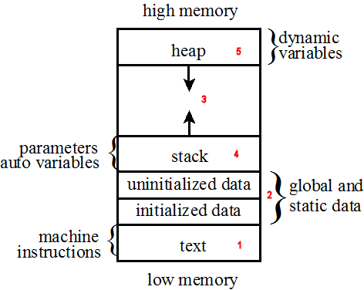
Memory Segment

Slide 4
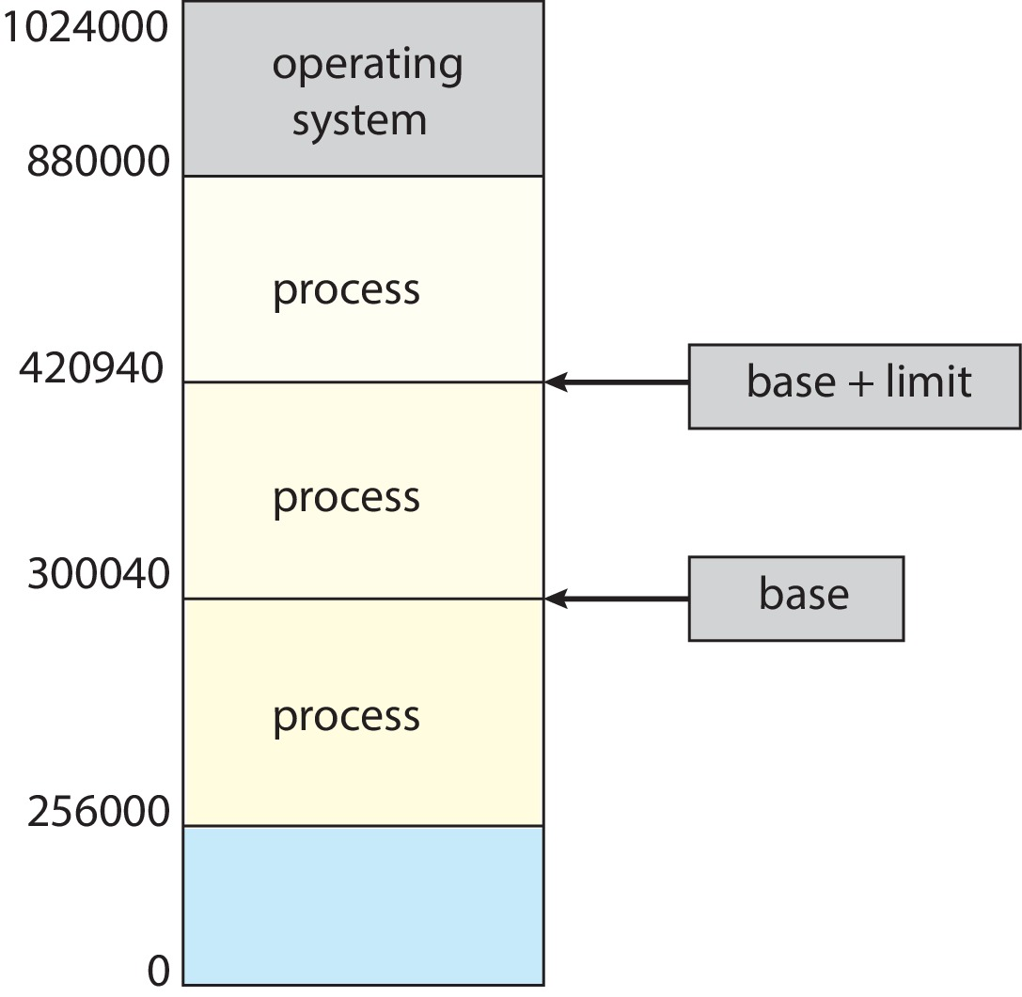
Protection
Need to ensure that a process can access only those addresses in its address space.
We can provide this protection by using a pair of base and limit registers define the logical address space of a process

Slide 5
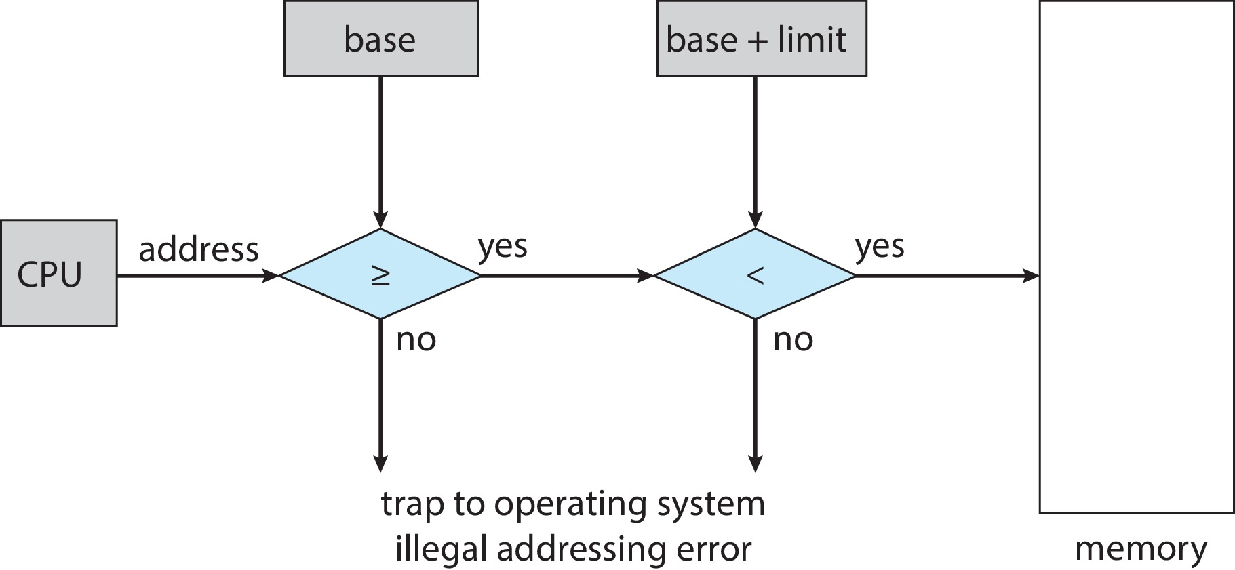
Hardware Address Protection
CPU must check every memory access generated in user mode to be sure it is between base and limit for that user
the instructions to loading the base and limit registers are privileged

Slide 6
Address Binding
Programs on disk, ready to be brought into memory to execute form an input queue
Without support, must be loaded into address 0000
Inconvenient to have first user process physical address always at 0000
How can it not be?
Addresses represented in different ways at different stages of a program’s life
Source code addresses usually symbolic
Compiled code addresses bind to relocatable addresses
Linker or loader will bind relocatable addresses to absolute addresses
Each binding maps one address space to another

Slide 7
Logical vs. Physical Address Space
The concept of a logical address space that is bound to a separate physical address space is central to proper memory management
Logical address – generated by the CPU; also referred to as virtual address
Physical address – address seen by the memory unit
Logical and physical addresses are the same in compile-time and load-time address-binding schemes; logical (virtual) and physical addresses differ in execution-time address-binding scheme
Logical address space is the set of all logical addresses generated by a program
Physical address space is the set of all physical addresses corresponding to these logical addresses is a

Slide 8
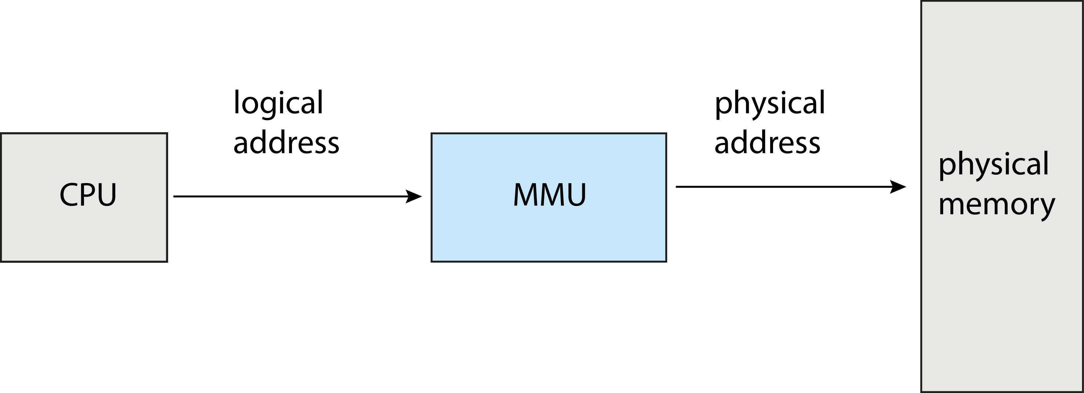
Memory-Management Unit (MMU)
Hardware device that at run time maps virtual to physical address
Many methods possible, covered in the rest of this chapter

Slide 9
Memory-Management Unit (Cont.)
Consider simple scheme. which is a generalization of the base-register scheme.
The base register now called relocation register
The value in the relocation register is added to every address generated by a user process at the time it is sent to memory
The user program deals with logical addresses; it never sees the real physical addresses
Execution-time binding occurs when reference is made to location in memory
Logical address bound to physical addresses

Slide 10
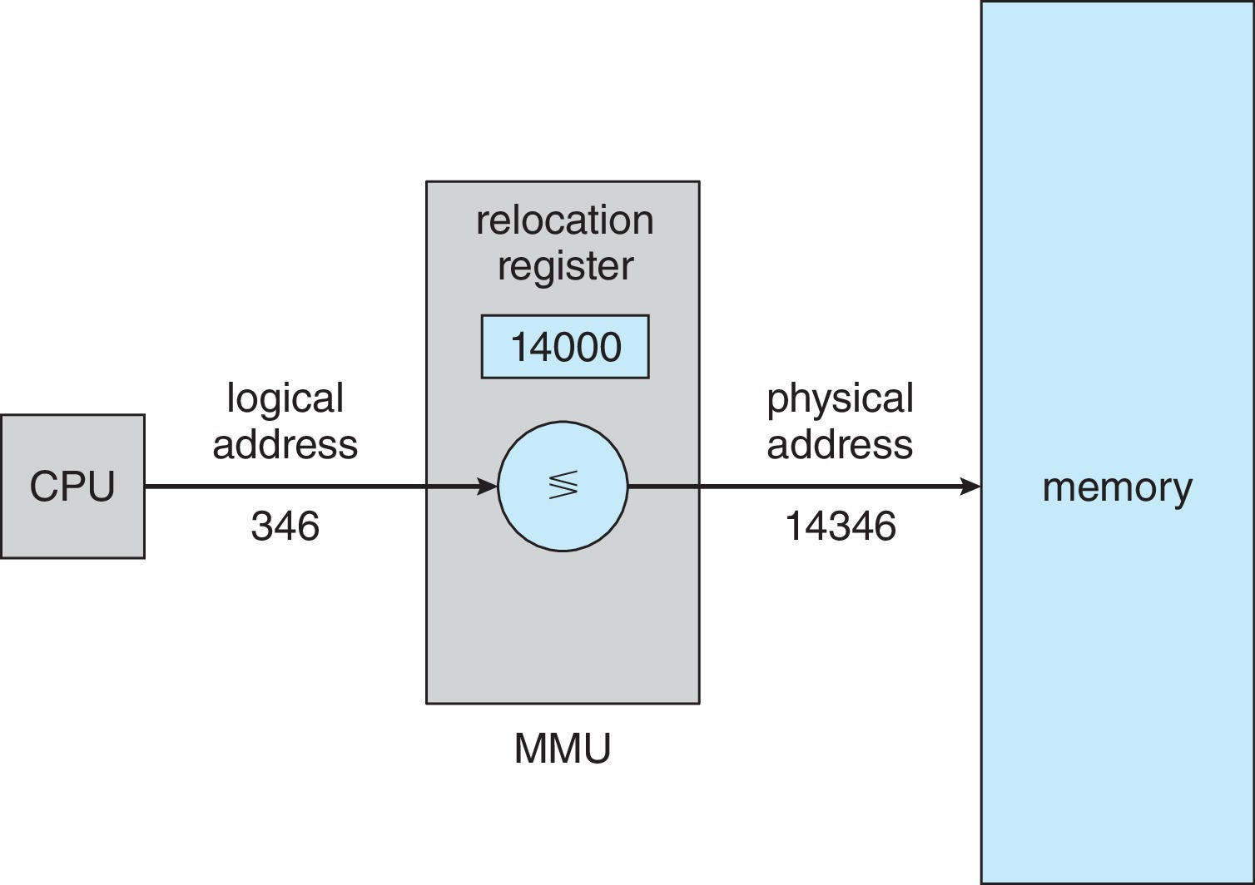
Memory-Management Unit (Cont.)
Consider simple scheme. which is a generalization of the base-register scheme.
The base register now called relocation register
The value in the relocation register is added to every address generated by a user process at the time it is sent to memory

Slide 11
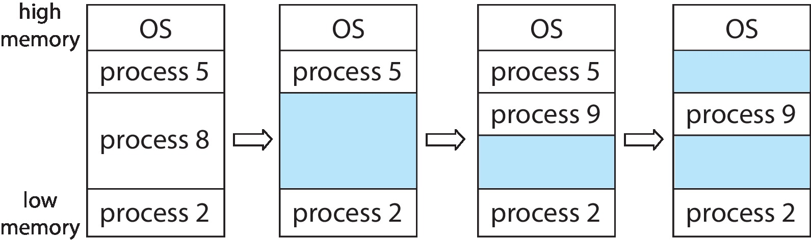
Variable Partition
Multiple-partition allocation
Degree of multiprogramming limited by number of partitions
Variable-partition sizes for efficiency (sized to a given process’ needs)
Hole – block of available memory; holes of various size are scattered throughout memory
When a process arrives, it is allocated memory from a hole large enough to accommodate it
Process exiting frees its partition, adjacent free partitions combined
Operating system maintains information about: a) allocated partitions b) free partitions (hole)

Slide 12
Dynamic Storage-Allocation Problem
How to satisfy a request of size n from a list of free holes?
First-fit: Allocate the first hole that is big enough
Best-fit: Allocate the smallest hole that is big enough; must search entire list, unless ordered by size
Produces the smallest leftover hole
Worst-fit: Allocate the largest hole; must also search entire list
Produces the largest leftover hole
First-fit and best-fit better than worst-fit in terms of speed and storage utilization

Slide 13
Fragmentation
As processes are loaded and removed from memory, the free memory space is broken into little pieces.
External Fragmentation – total memory space exists to satisfy a request, but it is not contiguous
Both the first-fit and best-fit strategies for memory allocation suffer from external fragmentation.
Internal Fragmentation – allocated memory may be slightly larger than requested memory; this size difference is memory internal to a partition, but not being used
First fit analysis reveals that given N blocks allocated, 0.5 N blocks lost to fragmentation
1/3 may be unusable -> 50-percent rule

Slide 14
Fragmentation (Cont.)
Reduce external fragmentation by compaction
Shuffle memory contents to place all free memory together in one large block
Compaction is possible only if relocation is dynamic, and is done at execution time
I/O problem
Latch job in memory while it is involved in I/O
Do I/O only into OS buffers
Now consider that backing store has same fragmentation problems

Slide 15
Paging
Physical address space of a process can be noncontiguous; process is allocated physical memory whenever the latter is available
Avoids external fragmentation
Avoids problem of varying sized memory chunks
Divide physical memory into fixed-sized blocks called frames
Size is power of 2, between 512 bytes and 16 Mbytes
Divide logical memory into blocks of same size called pages
Keep track of all free frames
To run a program of size N pages, need to find N free frames and load program
Set up a page table to translate logical to physical addresses
Backing store likewise split into pages
Still have Internal fragmentation

Slide 16
Address Translation Scheme
Address generated by CPU is divided into:
Page number (p) – used as an index into a page table which contains base address of each page in physical memory
Page offset (d) – combined with base address to define the physical memory address that is sent to the memory unit
For given logical address space 2^{m} and page size 2^{n}

Slide 17
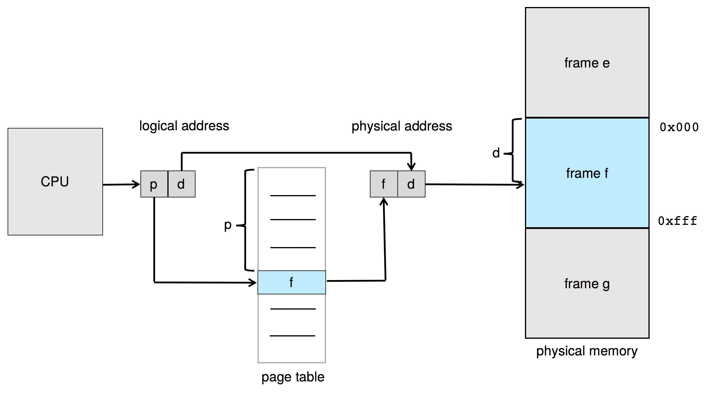
Paging Hardware

Slide 18
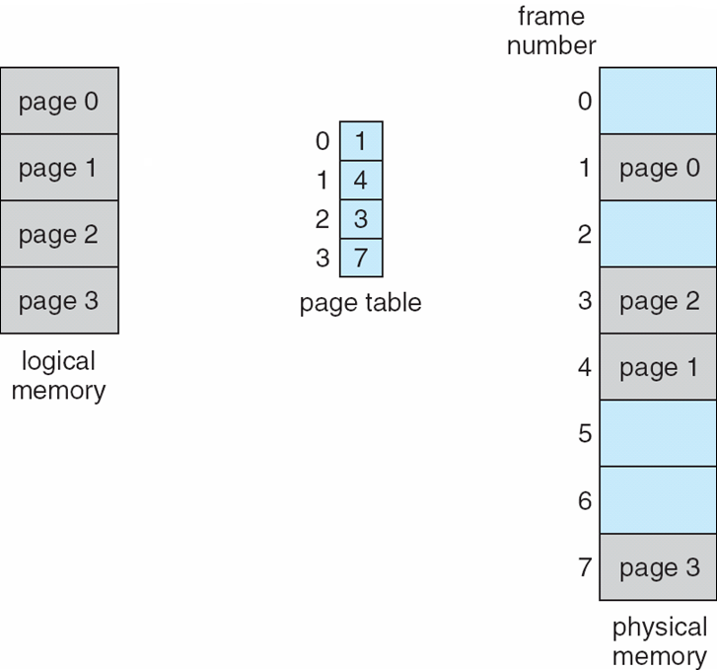
Paging Model of Logical and Physical Memory

Slide 19
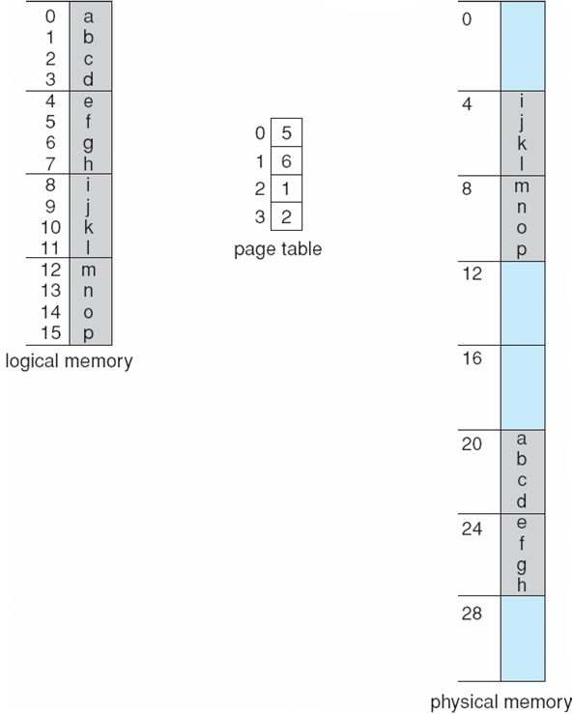
Paging Example
Logical address: n = 2 and m = 4. Using a page size of 4 bytes and a physical memory of 32 bytes (8 pages)

Slide 20
Paging -- Calculating internal fragmentation
Page size = 2,048 bytes
Process size = 72,766 bytes
35 pages + 1,086 bytes
Internal fragmentation of 2,048 - 1,086 = 962 bytes
Worst case fragmentation = 1 frame – 1 byte
On average fragmentation = 1 / 2 frame size
So small frame sizes desirable?
But each page table entry takes memory to track
Page sizes growing over time
Solaris supports two page sizes – 8 KB and 4 MB

Slide 21
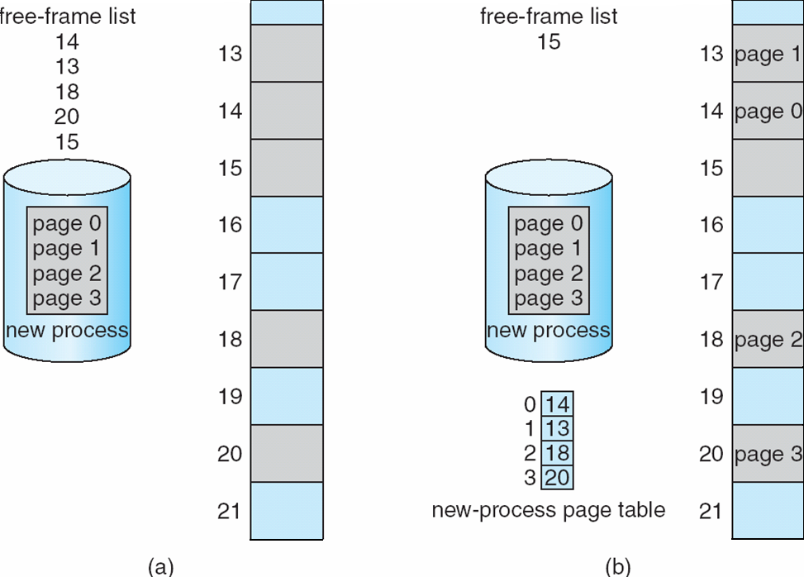
Free Frames
Before allocation
After allocation

Slide 22
Implementation of Page Table
Page table is kept in main memory
Page-table base register (PTBR) points to the page table
Page-table length register (PTLR) indicates size of the page table
In this scheme every data/instruction access requires two memory accesses
One for the page table and one for the data / instruction
The two-memory access problem can be solved by the use of a special fast-lookup hardware cache called translation look-aside buffers (TLBs) (also called associative memory).

Slide 23
Translation Look-Aside Buffer
Some TLBs store address-space identifiers (ASIDs) in each TLB entry – uniquely identifies each process to provide address-space protection for that process
Otherwise need to flush at every context switch
TLBs typically small (64 to 1,024 entries)
On a TLB miss, value is loaded into the TLB for faster access next time
Replacement policies must be considered
Some entries can be wired down for permanent fast access

Slide 24
Hardware
Associative memory – parallel search
Address translation (p, d)
If p is in associative register, get frame # out
Otherwise get frame # from page table in memory

Slide 25
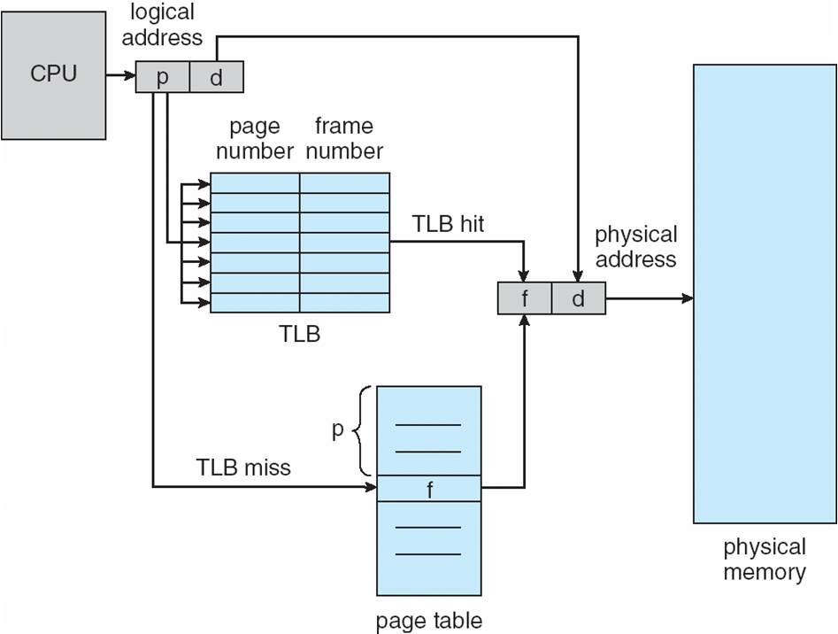
Paging Hardware With TLB

Slide 26
Memory Protection
Memory protection implemented by associating protection bit with each frame to indicate if read-only or read-write access is allowed
Can also add more bits to indicate page execute-only, and so on
Valid-invalid bit attached to each entry in the page table:
“valid” indicates that the associated page is in the process’ logical address space, and is thus a legal page
“invalid” indicates that the page is not in the process’ logical address space
Or use page-table length register (PTLR)
Any violations result in a trap to the kernel

Slide 27
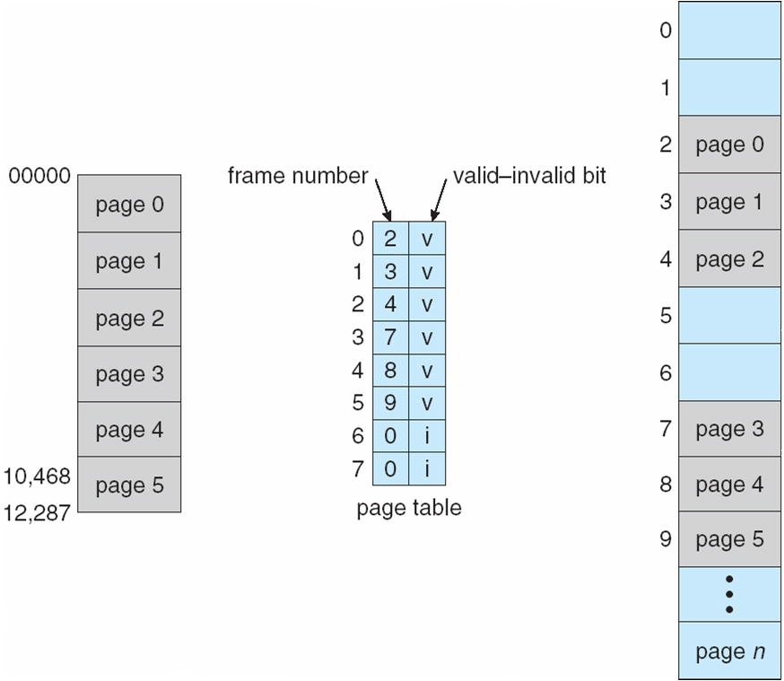
Valid (v) or Invalid (i) Bit In A Page Table

Slide 28
Shared Pages
Shared code
One copy of read-only (reentrant) code shared among processes (i.e., text editors, compilers, window systems)
Similar to multiple threads sharing the same process space
Also useful for interprocess communication if sharing of read-write pages is allowed
Private code and data
Each process keeps a separate copy of the code and data
The pages for the private code and data can appear anywhere in the logical address space

Slide 29
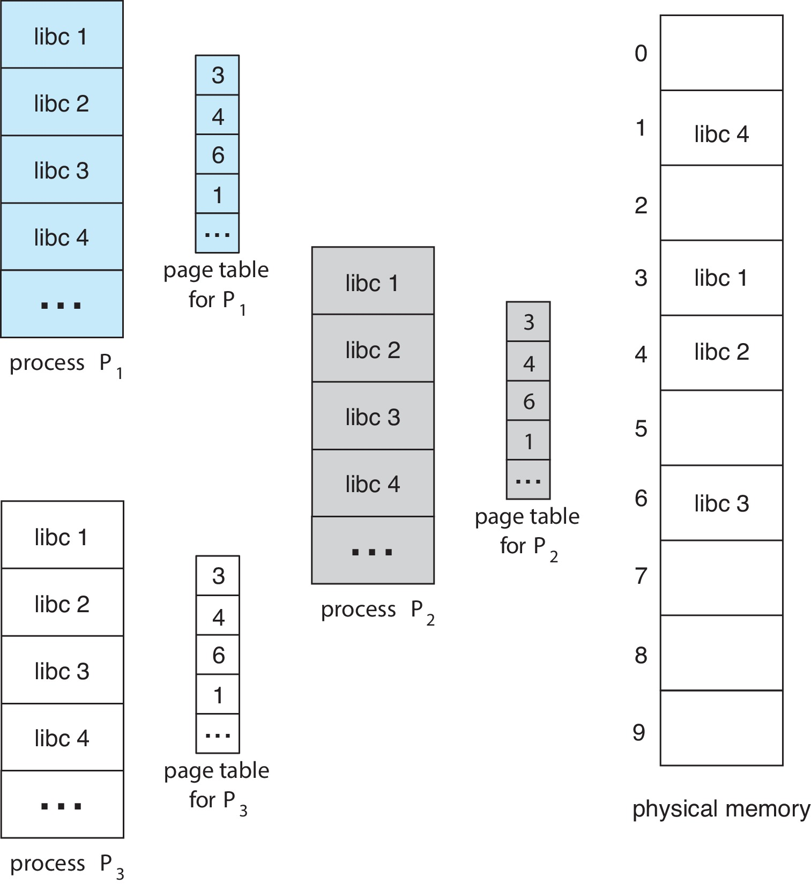
Shared Pages Example

Slide 30
Swapping
A process can be swapped temporarily out of memory to a backing store, and then brought back into memory for continued execution
Total physical memory space of processes can exceed physical memory
Backing store – fast disk large enough to accommodate copies of all memory images for all users; must provide direct access to these memory images
Roll out, roll in – swapping variant used for priority-based scheduling algorithms; lower-priority process is swapped out so higher-priority process can be loaded and executed
Major part of swap time is transfer time; total transfer time is directly proportional to the amount of memory swapped
System maintains a ready queue of ready-to-run processes which have memory images on disk

Slide 31
Swapping (Cont.)
Does the swapped out process need to swap back in to same physical addresses?
Depends on address binding method
Plus consider pending I/O to / from process memory space
Modified versions of swapping are found on many systems (i.e., UNIX, Linux, and Windows)
Swapping normally disabled
Started if more than threshold amount of memory allocated
Disabled again once memory demand reduced below threshold

Slide 32
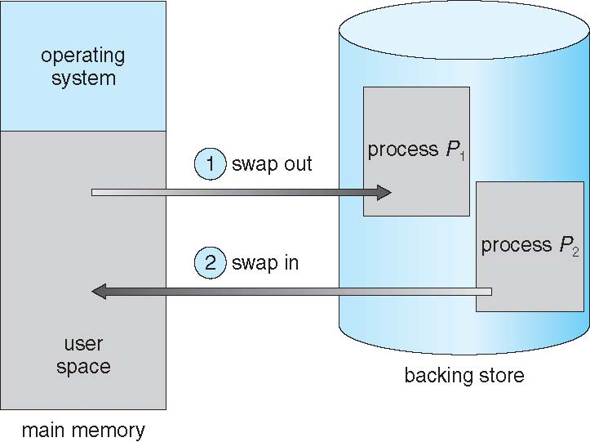
Schematic View of Swapping

Slide 33
Context Switch Time including Swapping
If next processes to be put on CPU is not in memory, need to swap out a process and swap in target process
Context switch time can then be very high
100MB process swapping to hard disk with transfer rate of 50MB/sec
Swap out time of 2000 ms
Plus swap in of same sized process
Total context switch swapping component time of 4000ms (4 seconds)
Can reduce if reduce size of memory swapped – by knowing how much memory really being used
System calls to inform OS of memory use via request_memory() and release_memory()

Slide 34
Context Switch Time and Swapping (Cont.)
Other constraints as well on swapping
Pending I/O – can’t swap out as I/O would occur to wrong process
Or always transfer I/O to kernel space, then to I/O device
Known as double buffering, adds overhead
Standard swapping not used in modern operating systems
But modified version common
Swap only when free memory extremely low

Slide 35
End of Chapter 9

