Slide 1
Product Sales For Electronic company
analyze sales performance
and how to improve sales in one month?

Slide 2
Company Background (Scenario)
Electronics company (E) is Saudi Arabia-company based on sales different types of electronics such as Apple Air pods Headphones, Batteries, USB-C Charging Cable and laptops etc..

Slide 3
Describe Problem
Electronic company want to do analyze sales performance for improving sales in one month.
To solve this problem, we need to answer to three questions:
Q1. What product ordered the most?
Q2. At any day orders are increased?
Q3. what day have the highest earning in this month?

Slide 4
Data description
data base that has been used is (Sales Product Data ) and it's provided by Kaggle. this data provided in .CSV format. it contains of 17539 rows and set of columns:
● Order ID - An Order ID is the number system that uses to keep track of orders (unique number).
● Product - The product that have been sold.
● Quantity Ordered - Ordered Quantity is the total item quantity ordered in the initial order. ● Price Each - The price of each product .
● Order Date - This is the date the customer is requesting the order be shipped.
● Purchase Address – is shipping address.
And we added two more columns date and total .

Slide 5
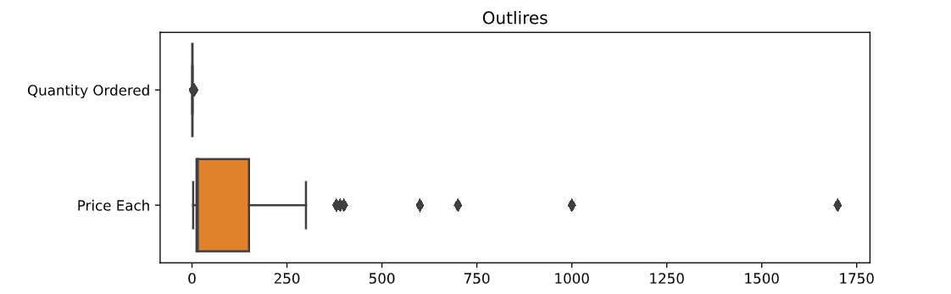
Outliers
Based on dataset we have 1700 as price for Macbook Pro Laptop product .

Slide 6
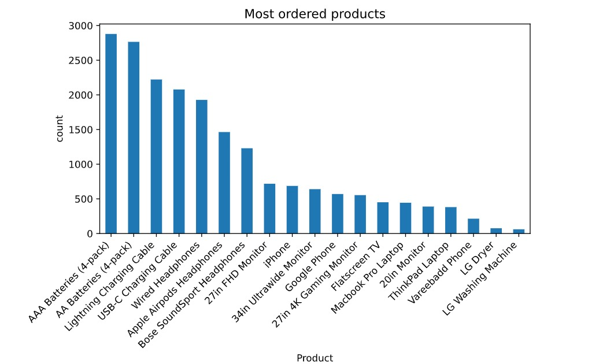
What product ordered the most?

Slide 7
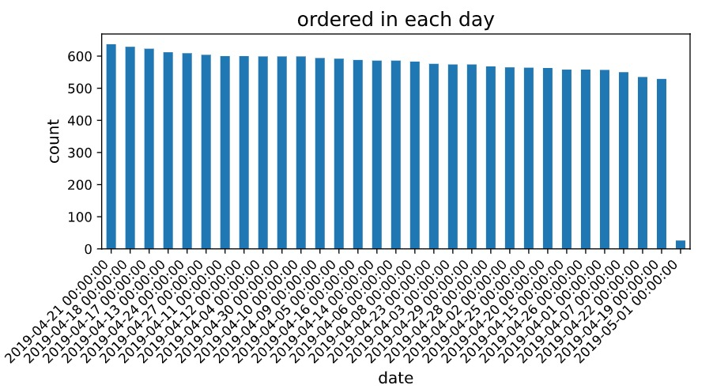
At any day orders are increased?

Slide 8
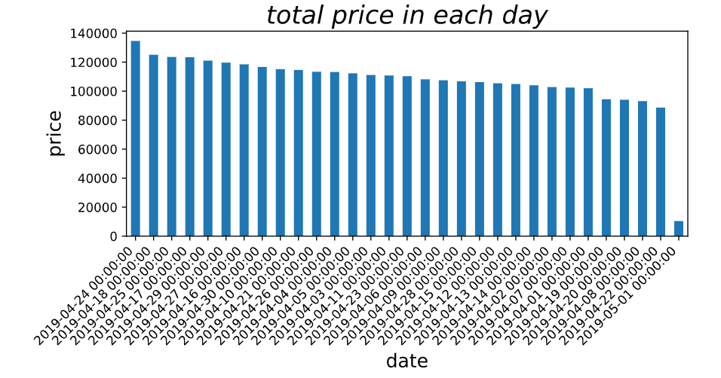
what day have the highest earning in this month?
plplpp

Slide 9
Conclusion
After analyze the data we notice that orders increased on 21/4/2019 but earning increased on 24/4/2019 that mean earnings does not depend on how many orders in that day ! It depends on orders total price .

Slide 10
Thak you!

