Slide 1
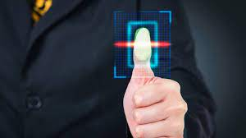

Project On:
Arduino based - Fingerprint Attendance system

Slide 2
CERTIFICATION OF PROJECT
This project is for the department of Computer Science & Engineering, under the faculty of Engineering & Technology at Bangladesh University of Business & Technology, in partial fulfillment of the requirements for the degree of Bachelor of Science in Engineering in Computer.
……SUBMITTED BY:….
…………………………………. .
Md. Rakib Rahian(ID:17182203010)
Md Razaul Haque (ID:17182203035)
Shahida Akter Moon (17182203050)
Parvin akter (ID: 17182203006)
Arnest Bandhan Biswas(ID: 17182203022) ……SUBMITTED TO:….
Amir-Ul Haque Bhuiyan
Assistant Professor,
Department of Computer Science and Engineering
Bangladesh University of Business and Technology
Dhaka, Bangladesh

Slide 3
Introduction
Biometrics refers to the automatic Identification, verification & Registration of a person based on his or her physiological or behavioral characteristics.

Slide 4
What is Biometric Attendance System? It is the process of automatically matching one or many unknown fingerprints against a database of known and unknown prints.

Slide 5
Project Requirements
Arduino Uno R3 microcontroller.
Xbee Trans receiver (series 2).
Fingerprint module (R305).
LCD screen.
Battery.
Switch.
RS232 cable & other male-female wires.

Slide 6
Arduino
Arduino is a single-board microcontroller, intended to make the application of interactive objects or environments more accessible.

Slide 7
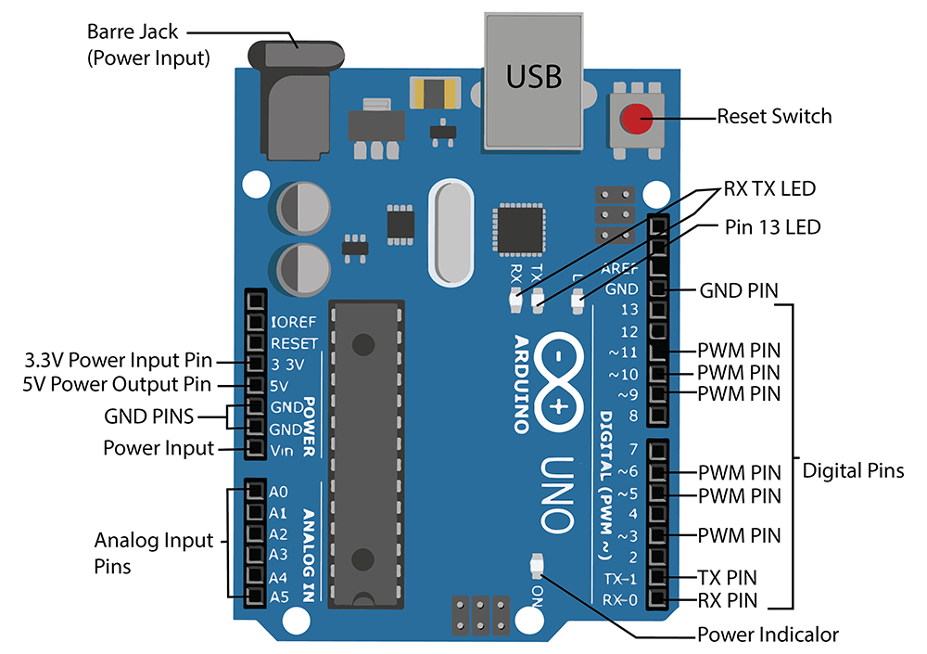
The Arduino UNO Anatomy

Slide 8
XBee/ Zigbee series 2 Module
This is the XB24-Z7WIT-004 module that allow a very reliable and simple communication between microcontrollers. Computers, systems , really anything with a serial port.

Slide 9
Fingerprint module R305
This is a finger print sensor module with TTL UART interface.
The user can store the finger print data in the module and can configure it in 1:1 or 1:N mode for identifying the person.

Slide 10
LCD Display
This is a LCD Display module with 4x20 characters and yellow/green LED backlight.
LCD display users STN technology so it has a great contrast a wide viewing angle.

Slide 11
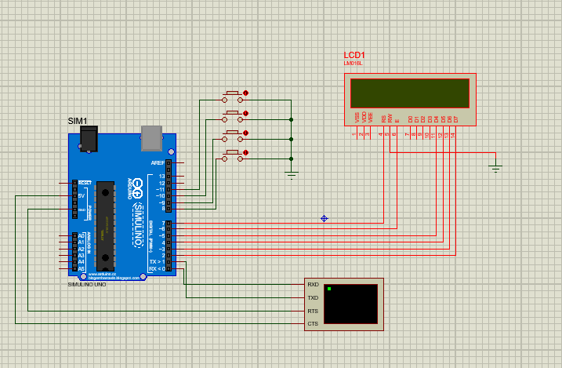
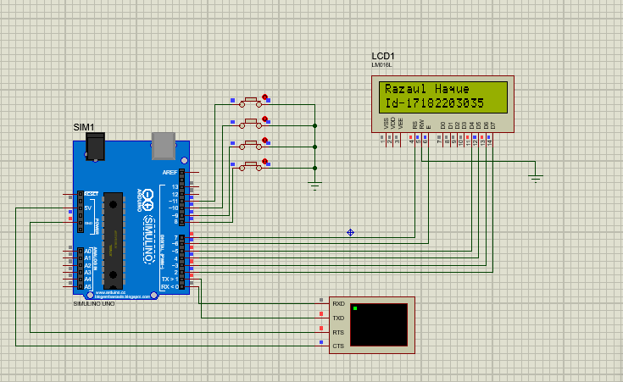
Enrollment Process:

Slide 12
CONCLUSION
The application will be coded using languages such as: C
And convert HEX file

Slide 13
THANK YOU

