Slide 1
Computer Networks (Graduate level)
Projects
University of Tehran
Dept. of EE and Computer Engineering
By:
Dr. Nasser Yazdani

Slide 2
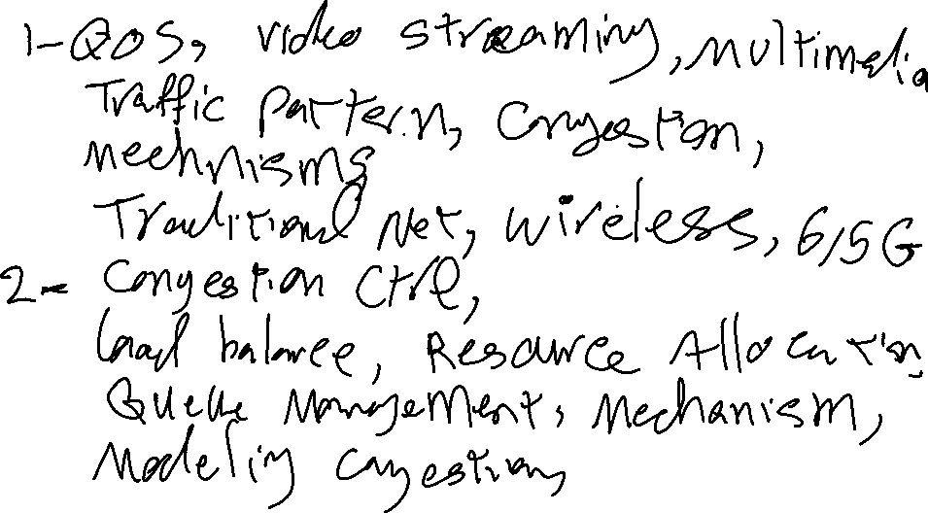
Projects ideas

Slide 3
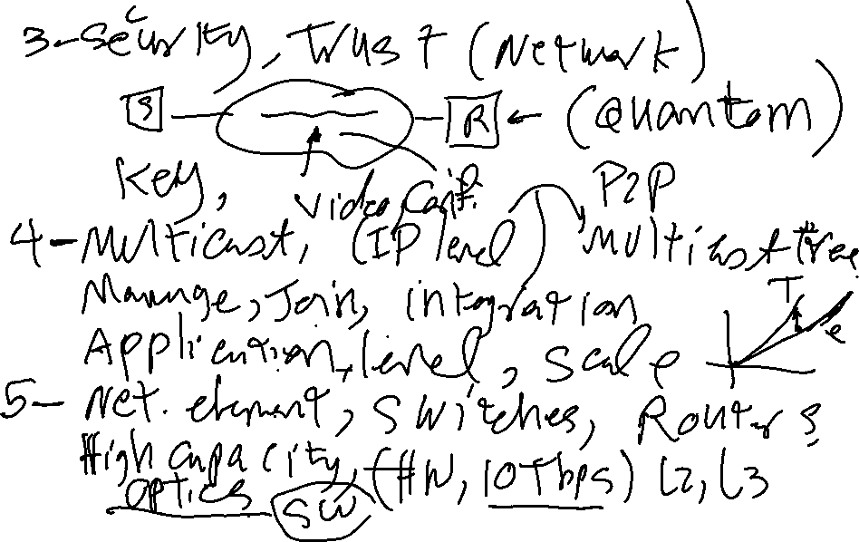
Projects ideas

Slide 4
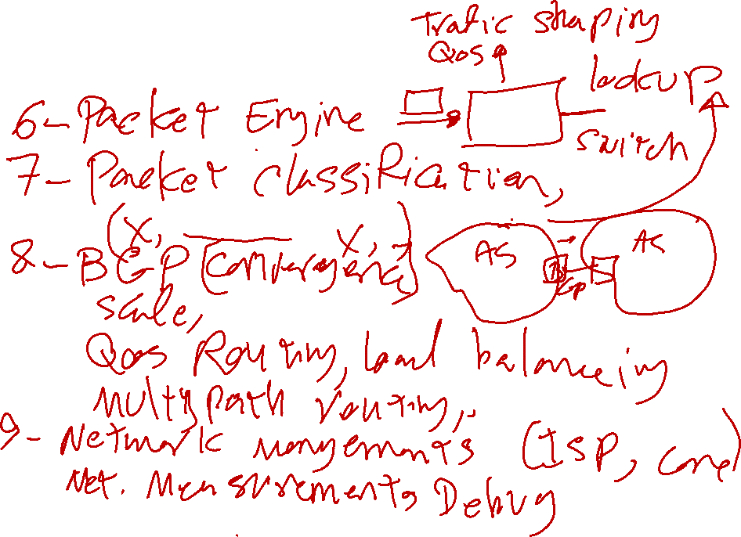
Projects ideas

Slide 5
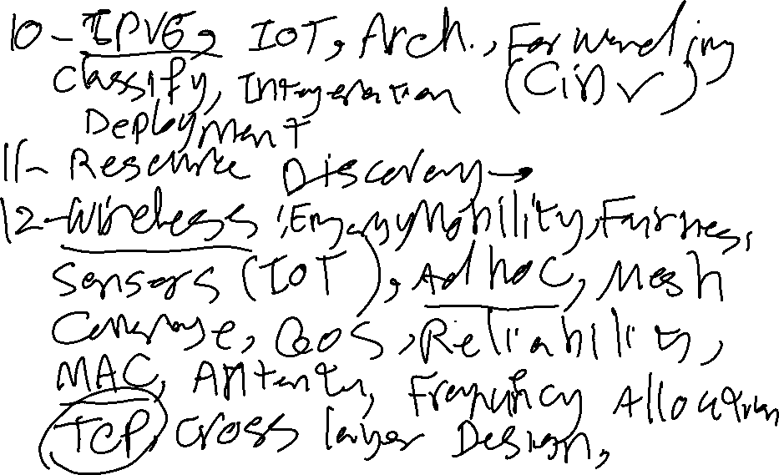
Projects ideas

Slide 6
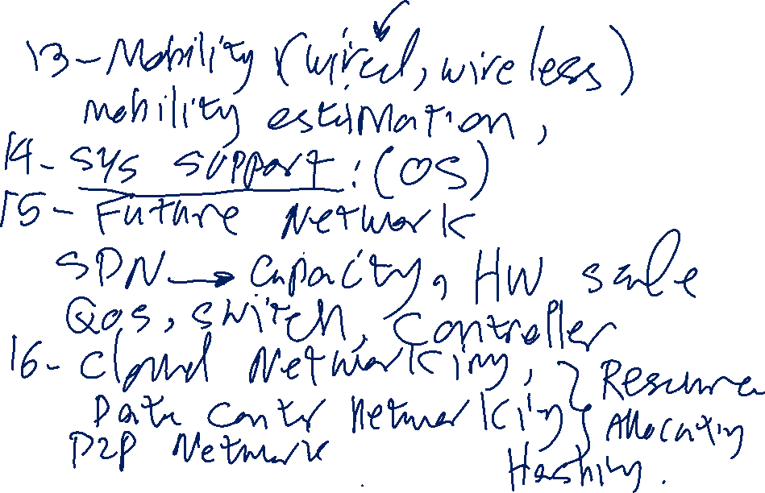
Projects ideas

Slide 7
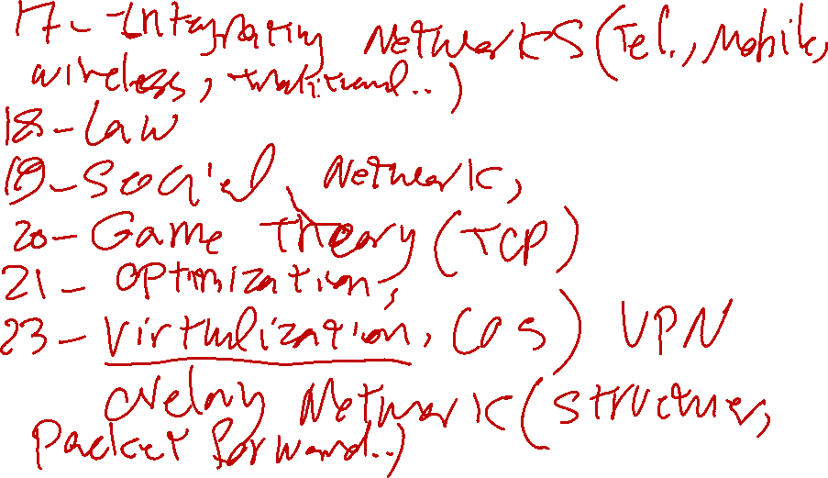
Projects ideas

Slide 8
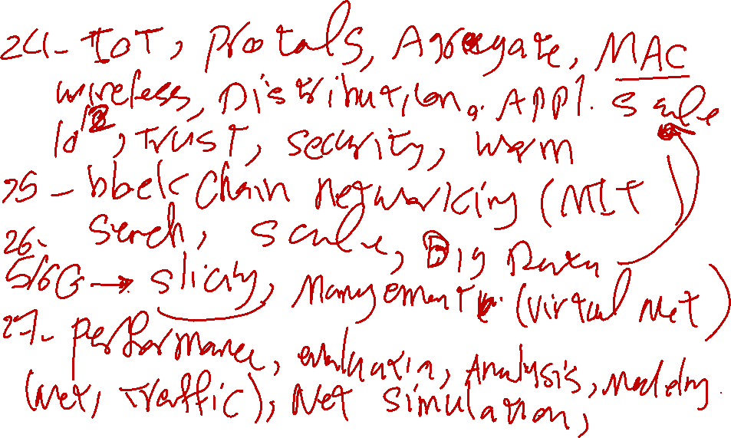
Projects ideas

Slide 9
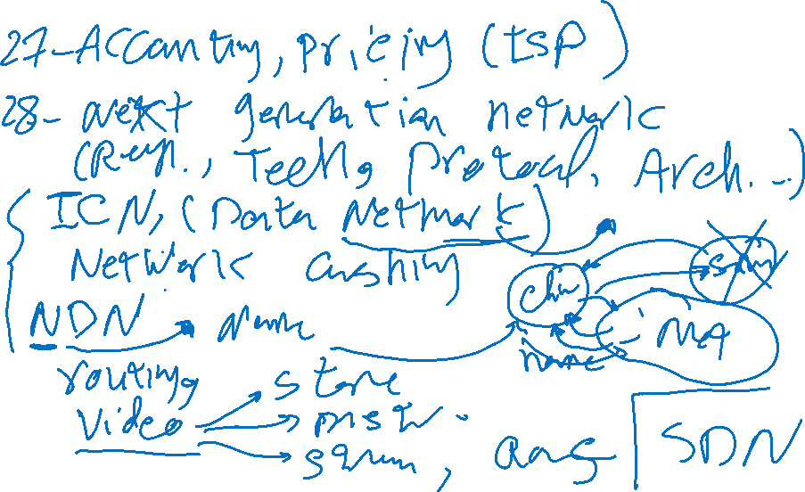
Projects ideas

