Slide 1
Wireless Sensor Networks and IOT
Mohsen Eslampanah
Mahdi Razavi

Slide 2
WSN Protocols (ESP32)
ESP-NOW
Traditional Wi-Fi Network
ESP-MESH Network

Slide 3
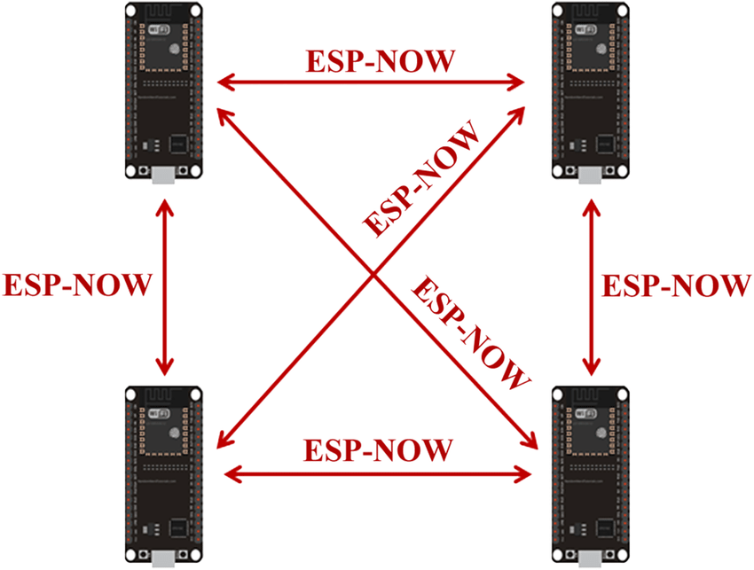
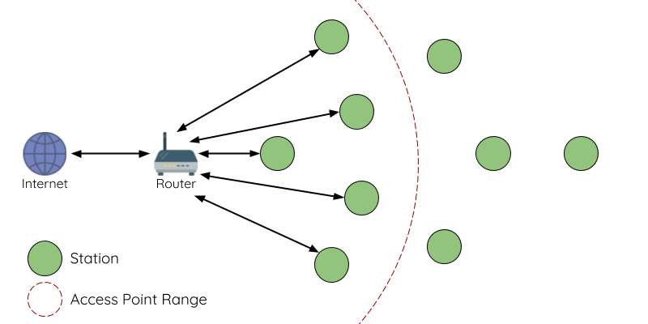
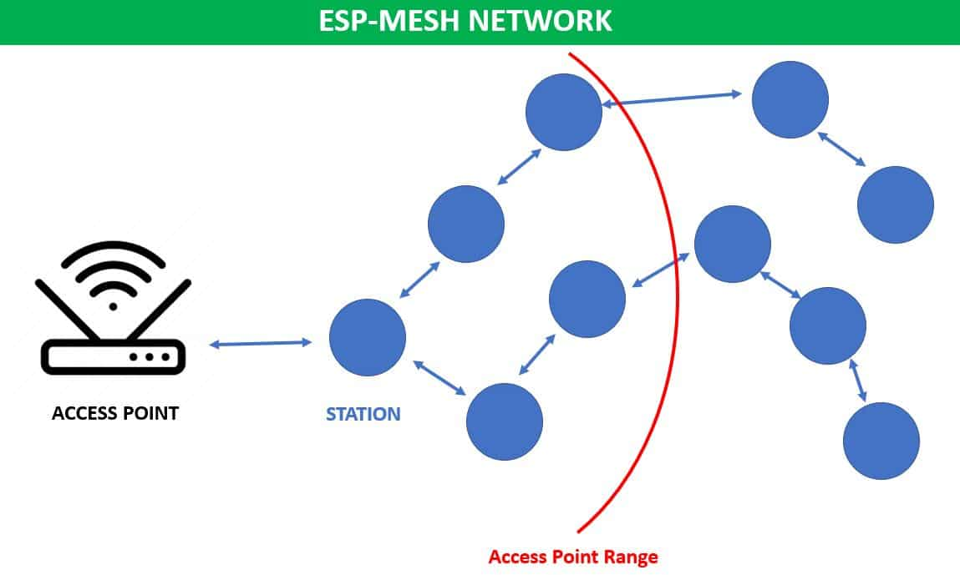

Slide 4
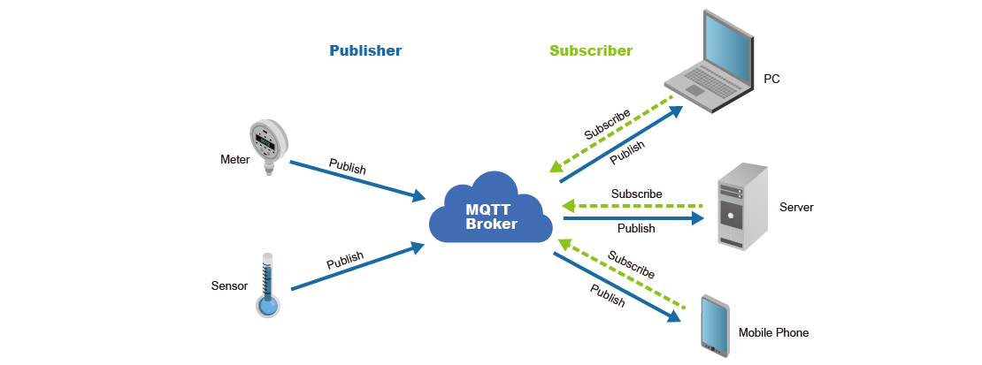
Internet Request Protocols
HTTP
CoAP
MQTT

Slide 5
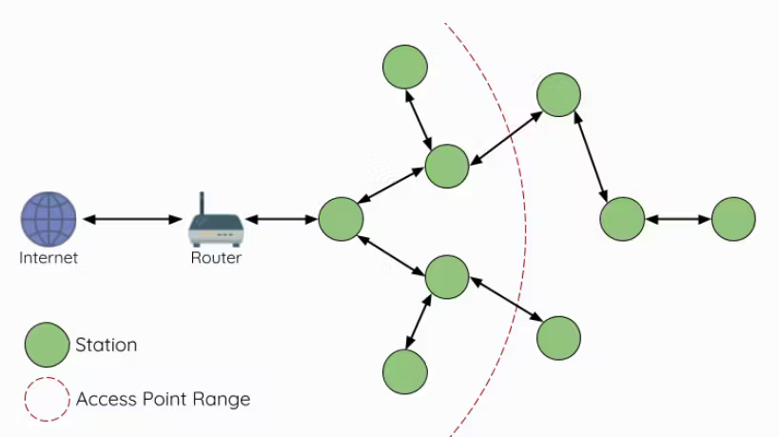

My Project
Control
Server
Sensor
Client
MQTT
Broker
Panel
Server

