Slide 1
Computer Networks
(Graduate level)
Lecture 5: Inter-domain Routing
University of Tehran
Dept. of EE and Computer Engineering
By:
Dr. Nasser Yazdani
Univ. of Tehran
Computer Network

Slide 2
Inter-Domain Routing
Border Gateway Protocol (BGP)
Sources
  “Resolving Inter-Domain Policy Disputes”, Cheng Tien Ee, atl.
  Hari Balakrishnan notes about Interdomain from MIT
  Craig Labovitz and .. “Delayed internet Routing Convergence”
  HLP: A Next Generation Interdomain Routing Protocol
  “Some Foundational Problems in Interdomain Routing”
  Consensus Routing: The Internet as a Distributed System.
  BGP Security in Partial Deployment
Univ. of Tehran
Computer Network

Slide 3
Outline
External BGP (E-BGP)
Internal BGP (I-BGP)
Multi-Homing
Stability Issues
Scalability Issues
Security
Univ. of Tehran
Computer Network

Slide 4
Internet Routing
Routing protocols like Distance vector or Link state suffer from different problems like convergence and Scaling due to the broadcasting routing packets.
Internet organized as a two levels hierarchy
  First level – autonomous systems (AS’s)
    AS – region of network under a single administrative domain
  Each AS assigned unique ID
  AS’s peer at network exchange routing information.
  AS’s run an intra-domain routing protocols
    Distance Vector, e.g., RIP
    Link State, e.g., OSPF
  Between AS’s runs inter-domain routing protocols, e.g., Border Gateway Routing (BGP)
    De facto standard today, BGP-4
Univ. of Tehran
Computer Network

Slide 5
Example
Interior router
BGP router
AS-1
AS-3
AS-2
Univ. of Tehran
Computer Network

Slide 6
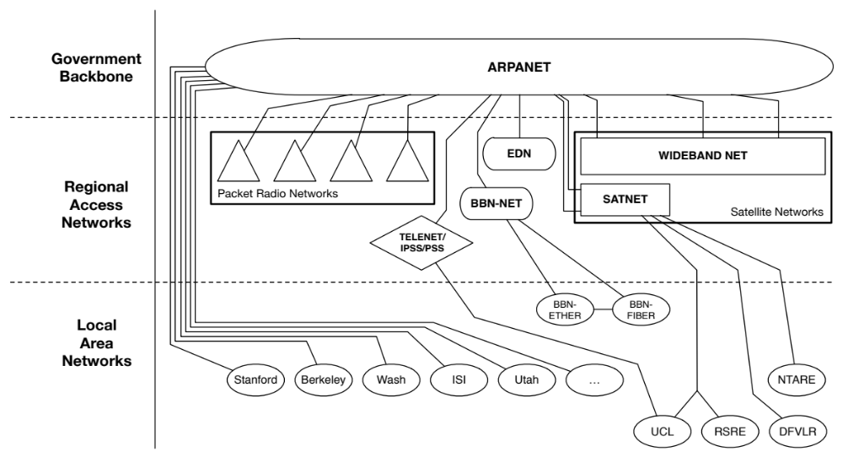
Interconnection Pre-1995
Network interconnection in the U.S. has evolved significantly since the early days of the Internet.
Notes:
The initial form of the Internet was a single, wide area or backbone network (the Internet equivalent of a long-distance provider) that was operated by the U.S. government.
Smaller, regional networks connected to this network forming a simple hierarchical structure.
Traffic from one part of the Internet to another was handed off to this backbone network, which carried it to the destination network.
For many years, the technical requirements on the routing protocol providing this function were simple, and there was no need to deal with business issues.

Slide 7
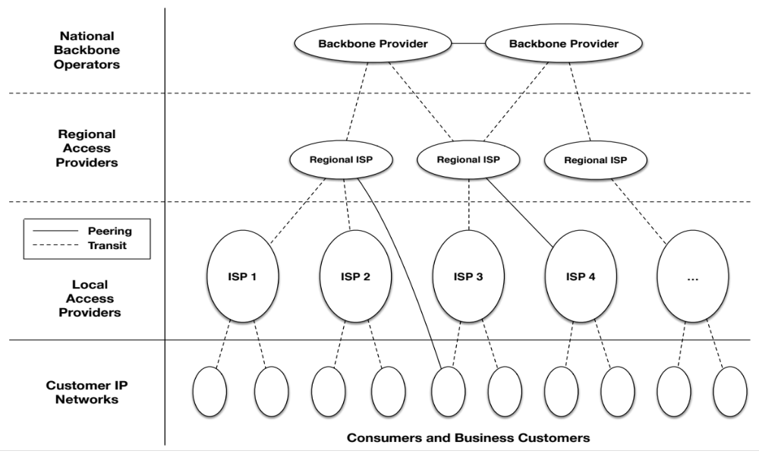
Interconnection Circa 1995-2005
The backbone eventually transitioned from a single government-operated backbone to a federated backbone model comprised of multiple commercial network operators.
Notes:
As a result of the commercial transition, the routing protocol responsible for maintaining the map of destination networks required improvement.
A new routing protocol, called Border Gateway Protocol (BGP), was created, allowing for commercial provision of backbone connectivity by multiple parties.
BGP allowed network operators to manage this more complex and competitive space, and to express at least a limited set of business constraints on routing.
For example, using BGP a network operator could specify how it preferred traffic flow into and out of its network. At the time of this report, BGP remains the standard routing protocol used to exchange information about IP routing between networks.

Slide 8
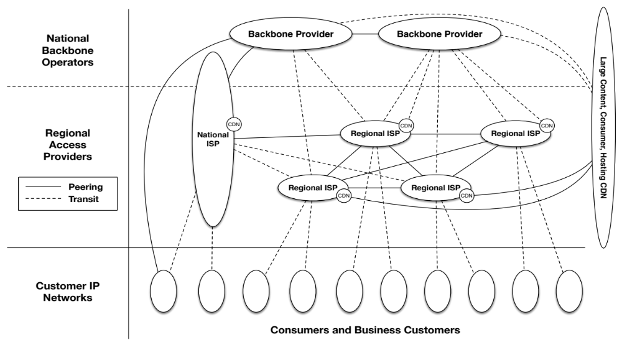
Today: Flattening due to CDNs and IXPs
Evolved into a “complex amalgam of models incorporating new connectivity options, delivery options, traffic management requirements and business practices”
https://www.bitag.org/documents/Interconnection-and-Traffic-Exchange-on-the-Internet.pdf
Notes:
The diagram shows the “flatter,” highly interconnected Internet of today.

Slide 9
History
Mid-80s: EGP
  Reachability protocol (no shortest path)
  Did not accommodate cycles (tree topology)
  Evolved when all networks connected to NSF backbone
Result: BGP introduced as routing protocol
  Latest version = BGP 4
  BGP-4 supports CIDR
  Primary objective: connectivity not performance
Univ. of Tehran
Computer Network

Slide 10
Inter-domain Routing basics
Internet is composed of over more than 16000 autonomous systems
BGP = Border Gateway Protocol
  Is a Policy-Based routing protocol
    Each domain is free to specify inside its routing policy
  Is the de facto inter-domain routing protocol of today’s global Internet
Relatively simple but configuration is complex and the entire world can see, and be impacted by, your mistakes.
Univ. of Tehran
Computer Network

Slide 11
Routing Choices
Link state or distance vector?
  No universal metric – policy decisions
Problems with distance-vector:
  Bellman-Ford algorithm may not converge
Problems with link state:
  Metric used by routers not the same – loops
  LS database too large – entire Internet
  May expose policies to other AS’s
Univ. of Tehran
Computer Network

Slide 12
Solution: Distance Vector with Path
Each routing update carries the entire path
Loops are detected as follows:
  When AS gets route check if AS already is in path
    If yes, reject route
    If no, add self and (possibly) advertise route further
Advantage:
  Metrics are local - AS chooses path, protocol ensures no loops
Univ. of Tehran
Computer Network

Slide 13

Internet Routing Protocol: BGP
Autonomous Systems (ASes)
Route Advertisement
Destination Next-hop AS Path
130.207.0.0/16
Traffic
192.5.89.89
10578,..,2637
130.207.0.0/16
66.250.252.44
174,… ,2637
Session
Notes:
Diagram of routing table is very confusing because it’s not pointing to anything
Green arrow shorter, and too thick… green is a msg
More intuition about how the system actually works.
Don’t say “interdomain”
DESTINATION-BASED Routing
Tables look like a set of possible routes and a rankings over these routes
(pop up a simplified table fragment)

Slide 14
Interconnecting BGP Peers
BGP uses TCP to connect peers
AS’s exchange reachability information through their BGP routers, only when routes change
Advantages:
  Simplifies BGP
  No need for periodic refresh - routes are valid until withdrawn, or the connection is lost
  Incremental updates
Disadvantages
  Congestion control on a routing protocol?
  Poor interaction during high load
Univ. of Tehran
Computer Network

Slide 15


BGP Operations (Simplified)
Establish session on
TCP port 179
AS1
BGP session
Exchange all
active routes
AS2
While connection
is ALIVE exchange
route UPDATE messages
Exchange incremental
updates
Univ. of Tehran
Computer Network

Slide 16
BGP Routing policies
In theory BGP allows each domain to define its own routing policy...
In practice there are two common policies
  customer-provider routing
    Customer c buys/pays Internet connectivity from provider P
  shared-cost peering
    Domains x and y agree to exchange packets by using a direct link or through an interconnection point.
Univ. of Tehran
Computer Network

Slide 17
Implementing Transit
Filtering
  Routes from customer: to everyone
  Routes from provider: only to customers
From other destinations
To the customer
From the customer
To other destinations
providers
providers
advertisements
traffic
customer
customer

Slide 18
Implementing Peering
Filtering
  Routes from peer: only to customers
  No routes from other peers or providers
advertisements
peer
peer
traffic
customer
customer

Slide 19
Peering Provides Shortcuts
Peering also allows connectivity between
the customers of “Tier 1” providers.
peer
peer
Univ. of Tehran
provider
customer
Computer Network

Slide 20
Physical Facilities for Interconnection
For networks to interconnect, they have to physically connect their networking equipment with each other.
  This requires the networks to meet in a common location, in facilities capable of supporting the equipment required for interconnection.
  These colocation facilities lease their customers secure space to locate and operate equipment
Point of Presence (PoP)
  An access point to a communication provider’s network.
Notes:
The secure space often in the form of lockable rack cabinets or cages.
In addition to floor space, a colocation facility provides power, cooling, structured cabling to support network connection, real-time physical security monitoring, and fire protection.
Colocation facilities are provided by commercial enterprises to house multiple network providers in the same or adjacent buildings.
POPs:
In order for two (or more) networks to interconnect, their networks need PoPs in close proximity to one another for local interconnection.
Another option is the acquisition of a circuit providing the extra network reach needed to connect with other PoPs.
Network operators often maintain PoPs located in multiple colocation facilities across the country and/or globe.

Slide 21
Interconnection: Public & Private
    Interconnecting two networks requires both:
      (1) physical connectivity, and
      (2) network connectivity.
Common options for interconnection are either:
  Direct interconnection:
    Private bilateral arrangement between two networks using a dedicated physical connection
  Public connection:
    A multilateral arrangement where all networks connect into a public Internet Exchange switch.
Notes:
A private interconnect is accomplished using one or more dedicated physical cables to interconnect two networks in close proximity, and it is used exclusively for the exchange of traffic between those two networks.
The physical media that connects the two networks at that site is often referred to as a “cross-connect” and can be copper or fiber.
Data speed of a cross-connect can range from Mbps up to many Gbps.
It is common in larger networks for the traffic volume between networks at a single location to exceed the capabilities of any single router interface.
This limit is typically overcome through the combination of multiple physical connections into a single logical one.
The downside of this arrangement is the additional operational overhead of having to manage multiple (sometimes dozens) physical connections as well as added complexity in troubleshooting faults in the connections.
Alternatively, multiple networks can interconnect through a public Internet Exchange.
An Internet Exchange is a service that uses a switch infrastructure (sometimes referred to as a switch fabric or peering exchange) to provide connectivity between multiple networks.
The multi-party switching fabric often comprises one or more Layer 2 Ethernet switches and provides an alternative to the dedicated cross-connect required for private interconnection.
For some networks the ability to reach multiple networks using only a single connection into the IX is advantageous, resulting in lower operating expenses.
Conversely, for very large networks with large data flows with a few networks, it may be more advantageous to use private interconnects.

Slide 22
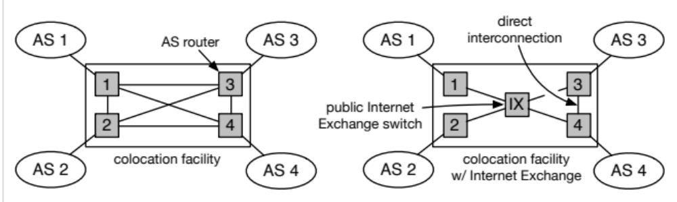
Public and Private Interconnection
    At left: Simple colocation facility with direct interconnects
    At right: colocation facility that also offers IX through a public switch (or “switching fabric”)
Notes:
This diagram illustrates the differences between the types of connections at a colocation facility where ASes can privately interconnect and a colocation facility that provides a public Internet Exchange switch.

Slide 23
Costs of Peering
Connecting two networks in a peering relationship has costs:
  Networking equipment for interconnecting the networks
  The leasing costs for space and power at the colocation site for the network equipment
  Interconnection fees charged by the colocation site or IX
  Network connectivity (transit, leased circuits, and/or fiber) capacity from the PoP to the rest of the network for the additional peered traffic
  Operational fees
  Engineering labor to design and deploy the network for the new interconnect
Notes:
Both networks must have PoPs at a common colocation facility or purchase connectivity to the colocation facility in order to be able to interconnect.
This may mean that one or both networks must create a PoP that may require laying or leasing fiber-optic cable, purchasing network infrastructure and installing that equipment in a colocation facility.

Slide 24
Motivation for Peering
Network effects
Increased redundancy
Increased routing control
Reduced latency
Reduced congestion
Improved traffic management and predictability of traffic
Reduced costs
Notes:
Network operators may be motivated to peer for a variety reasons, both business and technical. For some complex transit relationships, similar motivations may apply.
Network effects – Put simply, a network (or a network of networks) is not particularly useful if no one is connected to it or those who are connected to it cannot reach each other. A related concept is that a network becomes more valuable to the connected participants as more and more connect to the network.
Increased redundancy – Network operators strive for as redundant and as resilient a network connectivity map (called a “topology”) as economically possible. If one network interconnects to another in a single location this poses some risk, as a single point of interconnection has a higher likelihood of failure compared to two or more points. Increasing the number of interconnection points between networks results in a more resilient and reliable network for both parties.
Increased routing control – The ability of a network operator to influence path selection between endpoints in the network can lead to lower latency, decreased packet loss and increased quality of experience for network users. Each new peering connection increases network operator’s control over the traffic routed between them, given that their traffic no longer has to traverse intermediary networks.
Reduced latency – Users’ quality of experience generally improves with decreased latency, especially for applications that communicate time-sensitive data, such as interactive voice or video. Relying upon intermediaries for traffic exchange between two networks means that latency characteristics of the connection cannot be as tightly controlled, which can lead to degraded quality of experience for network users. Introducing direct interconnection between the networks provides for well-known and clearly measurable paths between each network’s users. With these clear pathways under the control of the network operators who have an interest in optimizing the quality of experience, latency can be reduced.
Reduced congestion – Congestion along the path between the source and destination through intermediaries can degrade the quality of experience for network users. Direct interconnections between the networks allows for both networks to ensure sufficient bandwidth is available between network users for consistent performance.
Improved traffic management and predictability of traffic – When networks interconnect, they have direct control in managing the flow of traffic between them. Because of this, both networks may reduce the need to maintain spare capacity on their transit and other connections to the Internet, as the traffic that is directly peered is now less likely to appear on other routes.
Reduced costs – Peering can reduce the costs of routing traffic between certain endpoints. For example, if an AS exchanges a significant amount of customer traffic with another AS, rather than sending that traffic up through its transit provider and into the other network through their transit connection, the two networks could peer at a common facility and each will eliminate the transit cost for that traffic exchange. In the case of paid peering, the new cost may be cheaper for the AS that is paying than its previous transit cost.

Slide 25
Policy with BGP
BGP provides capability for enforcing policies.
Policies are not part of BGP: they are configuration information
BGP enforces choosing paths from alternatives and controlling advertisement to other AS’s
Example:
  An AS refuses to act as transit, Limit path advertise
  An AS can become transit for some AS’s
    Only advertise paths to some AS’s
  An AS can favor or disfavor certain AS’s for traffic transit from itself
Univ. of Tehran
Computer Network

Slide 26
Implementation (RIB) Routing Information Bases
Routes are stored in RIBs
  Adj-RIBs-In: routing info that has been learned from other routers (unprocessed routing info)
  Loc-RIB: local routing information selected from Adj-RIBs-In (routes selected locally)
  Adj-RIBs-Out: info to be advertised to peers (routes to be advertised)
routing policies enforced by defining two sets of filters for each peer
  Import filter
  Export filter
Univ. of Tehran
Computer Network

Slide 27
Implementing (2)
Enforce transit relationships
  Outbound route filtering
Enforce order of route preference
  provider < peer < customer
Filters are defined in RPSL, Routing Policy Specification Language
  Export: to Customer announce ANY
  Export: to Peer announce Customer1 Customer2
Univ. of Tehran
Computer Network

Slide 28
Import and Export policies
Import policy
  What to do with routes learned from neighbors?
  Selecting best path
Export policy
  What routes to announce to neighbors?
  Depends on relationship with neighbor

Slide 29
Export Policy
An AS exports only best paths to its neighbors
  Guarantees that once the route is announced the AS is willing to transit traffic on that route
To Customers
  Announce all routes learned from peers, providers and customers, and self-origin routes
To Providers
  Announce routes learned from customers and self-origin routes
To Peers
  Announce routes learned from customers and self-origin routes

Slide 30
Two Types of BGP Neighbor Relationships
External Neighbor (eBGP) in a different Autonomous Systems
Internal Neighbor (iBGP) in the same Autonomous System
AS1
iBGP is routed
using Interior Gateway Protocol
(IGP)!
eBGP
iBGP
AS2
Univ. of Tehran
Computer Network

Slide 31
iBGP Peers Must be Fully Meshed
iBGP is needed to avoid routing loops within an AS
Injecting external routes into IGP does not scale and causes BGP policy information to be lost
BGP does not provide “shortest path” routing
eBGP update
iBGP updates
iBGP neighbors do not announce
routes received via iBGP to other iBGP
neighbors.
Univ. of Tehran
Computer Network

Slide 32
BGP Messages
Open : Establish a peering session.
Keep Alive : Handshake at regular intervals.
Notification : Shuts down a peering session.
Update : Announcing new routes or withdrawing previously announced routes.
announcement
=
prefix + attributes values
Univ. of Tehran
Computer Network

Slide 33
BGP Common Header
0
1
2
3
Marker (security and message delineation)
16 bytes
Length (2 bytes)
Type (1 byte)
Types: OPEN, UPDATE, NOTIFICATION, KEEPALIVE
Univ. of Tehran
Computer Network

Slide 34
BGP OPEN message
0
1
2
3
Marker (security and message delineation)
Length
Type: open
version
My autonomous system
Hold time
BGP identifier
Optional parameters <type, length, value>
Parameter length
My AS: id assigned to that AS
Hold timer: max interval between KEEPALIVE or UPDATE messages interval implies no keep_alive.
BGP ID: IP address of one interface (same for all messages)
Univ. of Tehran
Computer Network

Slide 35
BGP UPDATE message
0
1
2
3
Marker (security and message delineation)
Length
Type: update
Withdrawn..
..routes len
Withdrawn routes (variable)
...
Path attribute len
Path attributes (variable)
Network layer reachability information (NLRI) (variable)
Many prefixes may be included in UPDATE, but must
  share same attributes.
UPDATE message may report multiple withdrawn routes.
Univ. of Tehran
Computer Network

Slide 36
BGP UPDATE Message
List of withdrawn routes
Network layer reachability information
  List of reachable prefixes
Path attributes
  Origin
  Path
  Metrics
All prefixes advertised in a message have same path attributes
Univ. of Tehran
Computer Network

Slide 37
NLRI
Network Level Reachability Information
  list of IP address prefixes encoded as follows:
Length (1 byte)
Prefix (variable)
Univ. of Tehran
Computer Network

Slide 38
BGP NOTIFICATION message
0
1
2
3
Marker (security and message delineation)
Length
Type: NOTIFICATION
Error code
Data
Error sub-code
Used for error notification
  TCP connection is closed immediately after notification
Univ. of Tehran
Computer Network

Slide 39
BGP KEEPALIVE message
0
1
2
3
Marker (security and message delineation)
Length
Type: KEEPALIVE
Sent periodically to peers to ensure connectivity.
If hold_time is zero, messages are not sent..
Sent in place of an UPDATE message
Univ. of Tehran
Computer Network

Slide 40
Example BGP Routing Table
The full routing table
> show ip bgp
Network Next Hop Metric LocPrf Weight Path
*>i3.0.0.0 4.79.2.1 0 110 0 3356 701 703 80 i
*>i4.0.0.0 4.79.2.1 0 110 0 3356 i
*>i4.21.254.0/23 208.30.223.5 49 110 0 1239 1299 10355 10355 i
* i4.23.84.0/22 208.30.223.5 112 110 0 1239 6461 20171 i
Specific entry. Can do longest prefix lookup:
> show ip bgp 130.207.7.237
BGP routing table entry for 130.207.0.0/16
Paths: (1 available, best #1, table Default-IP-Routing-Table)
Not advertised to any peer
10578 11537 10490 2637
192.5.89.89 from 18.168.0.27 (66.250.252.45)
Origin IGP, metric 0, localpref 150, valid, internal, best
Community: 10578:700 11537:950
Last update: Sat Jan 14 04:45:09 2006
Prefix
AS path
Next-hop

Slide 41
AS Categories
AS1
AS3
AS1
AS2
AS1
AS3
AS2
Transit
Stub
Carry transit and local traffic
AS2
Multi-homed
Univ. of Tehran
Computer Network

Slide 42
Important BGP attributes
LocalPREF
  Local preference policy to choose “most” preferred route. Numerical value assigned by routing policy. Higher values are more preferred
Multi-exit Discriminator (MED)
  Which peering point to choose? One AS to specify that one exit point is more preferred than another. Lower values are more preferred.
Import Rules
  What route advertisements do I accept?
Export Rules
  Which routes do I forward to whom?
Univ. of Tehran
Computer Network

Slide 43
Route Selection Summary
It is policy based and complex but in general
Highest Local Preference
Enforce relationships
Shortest ASPATH
Lowest MED
i-BGP < e-BGP
Send out traffic ASAP
Lowest IGP cost
to BGP egress
Lowest router ID
Throw up hands and
break ties
Univ. of Tehran
Computer Network

Slide 44
Local pref,
Local preference only used in iBGP
How to choose from
Different entry points?
AS 4
local pref = 80
AS 3
local pref = 90
local pref = 100
AS 2
Higher Local
preference values
are more preferred
AS 1
13.13.0.0/16
Univ. of Tehran
Computer Network

Slide 45
Backup Links with Local Preference (Outbound Traffic)
AS 1
primary link
backup link
Set Local Pref = 100
for all routes from AS 1
Set Local Pref = 50
for all routes from AS 1
AS 65000
Forces outbound traffic to take primary link, unless link is down.
We’ll talk about inbound traffic soon …
Univ. of Tehran
Computer Network

Slide 46
ASPATH Attribute
AS 1129
135.207.0.0/16
AS Path = 1755 1239 7018 6341
Global Access
AS 1755
135.207.0.0/16
AS Path = 1239 7018 6341
135.207.0.0/16
AS Path = 1129 1755 1239 7018 6341
Ebone
AS 12654
AS 1239
135.207.0.0/16
AS Path = 7018 6341
RIPE NCC
RIS project
Sprint
AS7018
135.207.0.0/16
AS Path = 3549 7018 6341
135.207.0.0/16
AS Path = 6341
AT&T
AS 6341
AS 3549
135.207.0.0/16
AS Path = 7018 6341
AT&T Research
Global Crossing
135.207.0.0/16
Shortest ASPATh wins
Prefix Originated
Univ. of Tehran
Computer Network

Slide 47
Hot Potato Routing
192.44.78.0/24
egress 1
egress 2
IGP distances
56
15
This Router has two BGP routes to 192.44.78.0/24.
Hot potato: get traffic off of your network as
Soon as possible. Go for egress 1!
Univ. of Tehran
Computer Network

Slide 48
Getting Burned by the Hot Potato
2865
Heavy
Content
Web Farm
High bandwidth
Provider backbone
17
SFF
NYC
Low bandwidth
customer backbone
56
15
San Diego
Many customers want
their provider to
carry the bits!
tiny http request
huge http reply
Univ. of Tehran
Computer Network

Slide 49
Cold Potato Routing with MEDs
(Multi-Exit Discriminator Attribute)
Prefer lower
MED values
2865
Heavy
Content
Web Farm
17
192.44.78.0/24
MED = 15
192.44.78.0/24
MED = 56
56
15
192.44.78.0/24
This means that MEDs must be considered BEFORE
IGP distance!
Note1 : some providers will not listen to MEDs
Note2 : MEDs need not be tied to IGP distance
Univ. of Tehran
Computer Network

Slide 50
MED
MED is typically used in provider/subscriber scenarios
It can lead to unfairness if used between ISP because it may force one ISP to carry more traffic:
ISP1
SF
ISP2
NY
ISP1 ignores MED from ISP2
ISP2 obeys MED from ISP1
ISP2 ends up carrying traffic most of the way
Univ. of Tehran
Computer Network

Slide 51
Policies Can Interact Strangely
(“Route Pinning” Example)
customer
backup
1
2
Install backup link using community
3
Disaster strikes primary link
and the backup takes over
4
Primary link is restored but some
traffic remains pinned to backup
Univ. of Tehran
Computer Network

Slide 52
Outline
External BGP (E-BGP)
Internal BGP (I-BGP)
Stability Issues
Univ. of Tehran
Computer Network

Slide 53
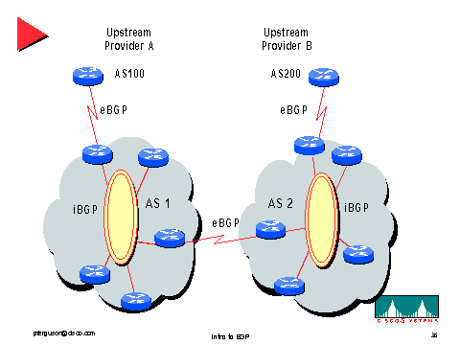
I-BGP
Univ. of Tehran
Computer Network

Slide 54
Internal BGP (I-BGP)
Same messages as E-BGP
Different rules about re-advertising prefixes:
  Prefix learned from E-BGP can be advertised to I-BGP neighbor and vice-versa, but
  Prefix learned from one I-BGP neighbor cannot be advertised to another I-BGP neighbor
  Reason: no AS PATH within the same AS and thus danger of looping.
Univ. of Tehran
Computer Network

Slide 55
Internal BGP (I-BGP)
R3 can tell R1 and R2 prefixes from R4
R3 can tell R4 prefixes from R1 and R2
R3 cannot tell R2 prefixes from R1
R2 can only find these prefixes through a direct connection to R1
Result: I-BGP routers must be fully connected (via TCP)!
  contrast with E-BGP sessions that map to physical links
R1
E-BGP
AS1
R3
R4
AS2
R2
I-BGP
Univ. of Tehran
Computer Network

Slide 56
Link Failures
Two types of link failures:
  Failure on an E-BGP link
  Failure on an I-BGP Link
These failures are treated completely different in BGP
Why?
Univ. of Tehran
Computer Network

Slide 57
Failure on an E-BGP Link
If the link R1-R2 goes down
  The TCP connection breaks
  BGP routes are removed
This is the desired behavior
AS1
AS2
E-BGP session
R1
R2
Physical link
138.39.1.1/30
138.39.1.2/30
Univ. of Tehran
Computer Network

Slide 58
Failure on an I-BGP Link
If link R1-R2 goes down, R1 and R2 should still be able to exchange traffic
The indirect path through R3 must be used
Thus, E-BGP and I-BGP must use different conventions with respect to TCP endpoints
138.39.1.2/30
R2
Physical link
138.39.1.1/30
R1
R3
I-BGP connection
Univ. of Tehran
Computer Network

Slide 59
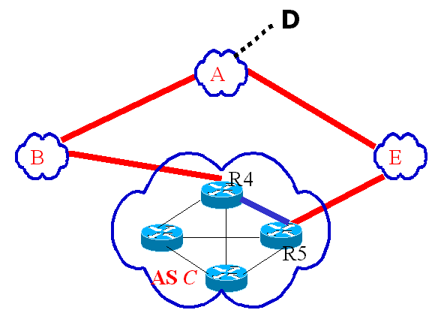
BGP Traffic Engineering
We assumed an AS could be modeled as a node
    with a single best path to the destination
But a single AS may advertise more than one path.
BGP Traffic Engineering:
  R4 chooses path <C B A>
  R5 chooses path <C E A>
Divide one AS into Logical ASes such that
  All routers within a logical AS have the same best path→each logical AS can be modeled as a node.
Univ. of Tehran
Computer Network

Slide 60
Issues on Routing
Challenges Facing Internet Routing
  Internet Has Grown Dramatically
    Large number of routing entries
    High volumes of updates
    Frequent topological changes
  Fault-Model Has Changed Dramatically
    More malfunctioning components
    Intentional attacks
Do we need a fundamentally new routing architecture?
Univ. of Tehran
Computer Network

Slide 61
Toward a New Architecture
One claim: BGP is nearing the end of its useful lifetime
  The Internet will soon collapse unless we act!!
Other claim: BGP is the best engineering solution we are likely to produce
  We need incremental patches to new problems
Who is right?
We look some problems facing BGP and ask some fundamental questions regarding BGP.
Univ. of Tehran
Computer Network

Slide 62
Path Vector Routing Changes
Worms triggered edge instability
  Routers crashed due to ARP cache overflow.
  Links were congested by worm traffic.
BGP Path Exploration Exacerbates Dynamics
D
B’s route to D
withdraw
withdraw
A
  Route via A=<A>
B
E
Route via C=<C E A>
C
withdraw
Obsolete backup path <C E A >is used and convergence is delayed
Univ. of Tehran
Computer Network

Slide 63
What About Security?
Convergence Discussion Neglects Security
  What if routers send intentionally bad information?
What is the Simplest Possible Attack?
  Announce someone else routes
Example: Suppose Univ. of Tehran announces it is the origin for 129.82.0.0/16
  Can this Happen and/or What Would Prevent It?
Univ. of Tehran
Computer Network

Slide 64
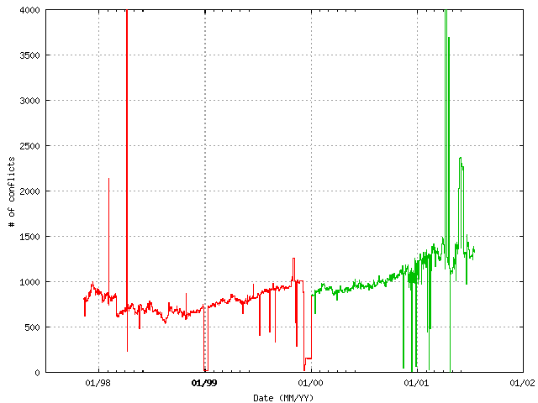
Multiple Origin AS (MOAS) Cases
Prefixes originate from Multiple Origin AS (MOAS)
  Lower curve likely due to valid operational needs
Spikes are errors that disrupt routing to prefix
  Includes loss of routes to top level DNS servers
Univ. of Tehran
Computer Network

Slide 65

Infrastructure Faults and Attacks
BGP and DNS Provide No Authentication
  Faults and attacks can mis-direct traffic.
  One (of many) examples observed from BGP logs.
  Server could have replied with false DNS data.
originates route to
192.26.92/24
ISPs announced new path
for 20 minutes to 3 hours
Internet
c.gtld-servers.net
192.26.92.30
BGP
monitor
Univ. of Tehran
Computer Network

Slide 66
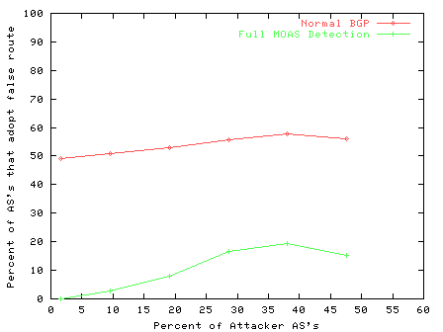
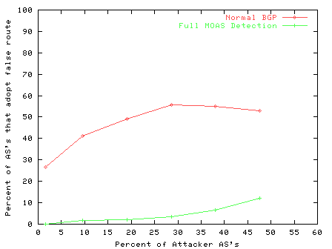
BGP false origin detection
Simulation Results
(a) One Origin AS
(b) Two Origin AS’s
Univ. of Tehran
Computer Network

Slide 67
A Simple Filter
Current BGP provides dynamic routes
  Explore the opposite extreme...
Select a single static route to each server.
  Apply AS path filters to block all other announcements.
    Also filter against more specifics.
Route changes on a frequency of months, if at all.
  Change in IP address, origin AS, or transit policy.
  Adjust route only after off-line verification
Univ. of Tehran
Computer Network

Slide 68
General view
Scale is limited to a small number of routes.
  No exponential growth in top level DNS servers.
Loss of a server is tolerable, invalid server is not.
  Resolvers detect and time-out unreachable servers.
    Provided surviving servers handle load, cost is some delay.
Expect predictable properties and stable routes.
  Servers don’t change without non-trivial effort.
  Servers located in highly available locations.
Univ. of Tehran
Computer Network

Slide 69
Convergence And Authentication
BGP Suffers From Both Convergence Problems and Authentication Problems
  Convergence fixes are good, if no attacks.
  Authentication fixes work for redundant sites
Can you improve both convergence and authentication in a realistic environment?
Wide Variety of Other Routing Challenges
  Check out and BBGP Project in Colorado state univ. if interested
Univ. of Tehran
Computer Network

Slide 70
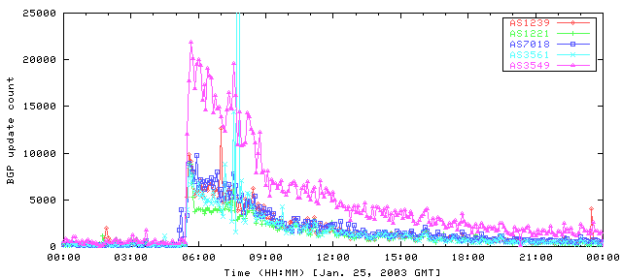
BGP Updates During Worm
Univ. of Tehran
Computer Network

Slide 71
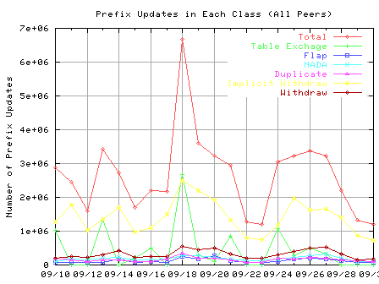
BGP Updates During Nimda Worm
Total Attack
Routing Changes
Measurement Artifacts
Univ. of Tehran
Computer Network
Notes:
Observations:
Both BGP table exchanges and implicit withdraws had significant increase during the code red attacks.
The bulk of the increase in the total BGP messages are due to the increase in these two classes.

Slide 72
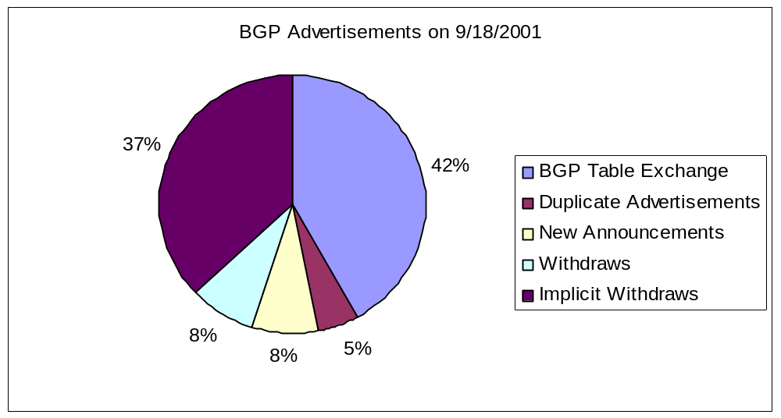
What Analysis Shows
37.6%
40.2%
8.3%
8.8%
A substantial percentage of the BGP messages during the worm attack were not about route changes
Univ. of Tehran
Computer Network

Slide 73
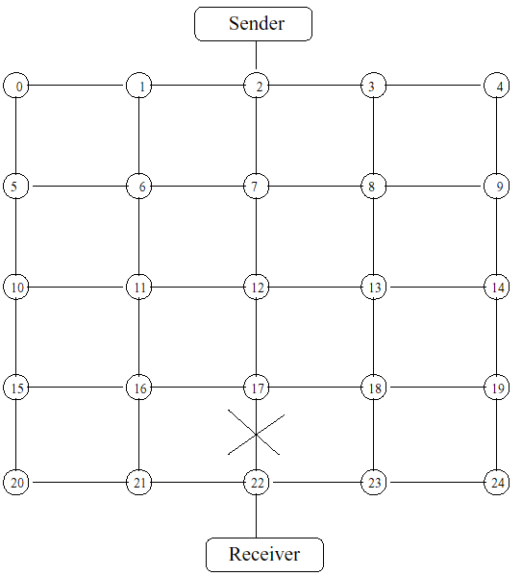
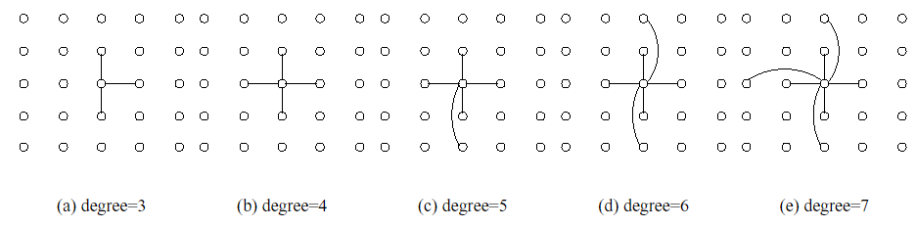
Simulation conducted
20 pkts/second
7 by 7 mesh topologies similar those in [Baran64]
Simulated node degree range [3 ~ 16]
Measure Packet loss, loops, path convergence time, throughput, and e2e delay.
Univ. of Tehran
Computer Network

Slide 74
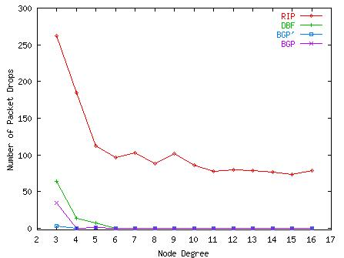
Packet Losses (I) : Observation
Packet losses of DBF, BGP’ and BGP decrease to zero at degree 6.
Richer connectivity helps RIP little.
DBF- Distributed Bellman-Ford
Packet Loss
RIP
DBF, BGP’ and BGP
Node Degree
Univ. of Tehran
Computer Network

Slide 75
Packet Loss(II): Lessons Learned
Keeping alternate paths
D
RIP:
A
B
E
F
DBF, BGP:
C
D
Connectivity Matters
  no immediate available alternative due to poor connectivity and poison reverse
A
B
E
F
  alternative is more likely with richer connectivity
C
Univ. of Tehran
Computer Network

Slide 76
Is an alternate path valid?
D
Valid Alternate Paths: not using the failed link
  Poison reverse and BGP’s path information are not enough! [Pei:Infocom2002]
D: < >
D: < >
A
B
D: < >
E
F
C
C2
X
U
W
Richer connectivity -->
  reduces one single link’s impact
  better availability of valid(but may be suboptimal) path
V
Univ. of Tehran
Computer Network

Slide 77
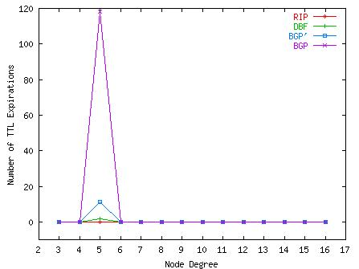
Transient Loops(I): Observation
BGP has the most loops!
RIP has no loops
Richer connectivity reduces the chance of looping.
BGP
Losses due to loops
DBF
BGP’
Node Degree
Univ. of Tehran
Computer Network

Slide 78
Transient Loops(II): Msg Propagation
Damping timer slows the msg propagation, causing looping
V
W
U
X
D
D: < >
Y
A
D: < >
D: < >
D: <B A E F>
D: < >
B
E
F
D: <B C A E F>
Richer connectivity can reduce the chance of looping
More details in:
  “A Study of Transient Loops in BGP”
D: < >
C
30 seconds!
D:<C A E F>
D:<C B A E F>
Univ. of Tehran
Computer Network

Slide 79
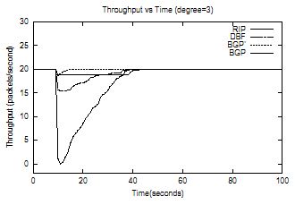
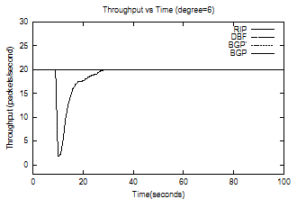
Instantaneous Throughput
BGP’
Throughput(pkts/second
BGP
DBF
RIP
RIP
Time
Univ. of Tehran
Computer Network
Notes:
_x0018_

Slide 80
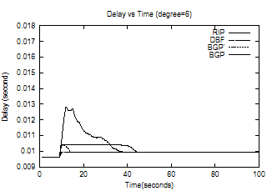
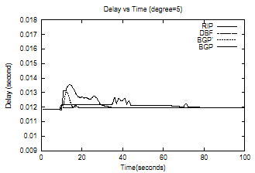
Packet Delay During Convergence
Univ. of Tehran
Computer Network
Notes:
When node degree increases, DBF, BGP and BGP’ might experience more extra delay than the eventual steady delay, and those packets escaping from forwarding loopshave even longer delays.

Slide 81
Outline
External BGP (e-BGP)
Internal BGP (i-BGP)
Stability Issues
Scalability Issues
Univ. of Tehran
Computer Network

Slide 82
Convergence in the real-world?
[Labovitz99] Experimental results from two year study which measured 150,000 BGP faults injected into peering sessions at several IXPs
Found
  Internet averages 3 minutes to converge after failover
  Some multihomed failovers (short to long ASPath) require 15 minutes
Univ. of Tehran
Computer Network

Slide 83
Signs of Routing Instability
Record of BGP messages at major exchanges, packet loss 30 times and delay 4.
Discovered orders of magnitude larger than expected updates
  Bulk were duplicate withdrawals
    Stateless implementation of BGP – did not keep track of information passed to peers
    Impact of few implementations
  Strong frequency (30/60 sec) components
    Interaction with other local routing/links etc.
Univ. of Tehran
Computer Network

Slide 84
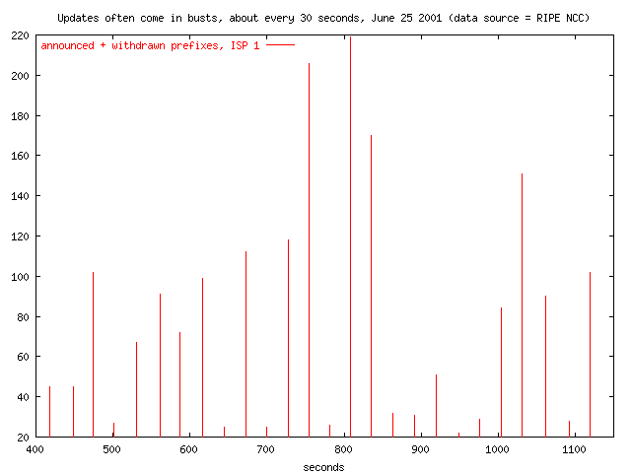
30 Second Bursts
Univ. of Tehran
Computer Network

Slide 85
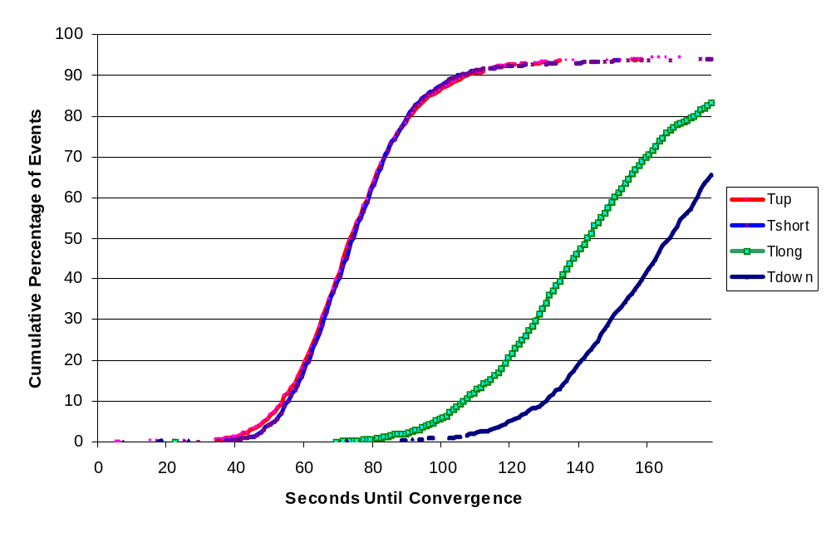
How Long Does BGP Take to Adapt to Changes?
Thanks to Abha Ahuja and Craig Labovitz for this plot.
Univ. of Tehran
Computer Network

Slide 86
Route Flap Storm
Overloaded routers fail to send Keep_Alive message and marked as down
I-BGP peers find alternate paths
Overloaded router re-establishes peering session
Must send large updates
Increased load causes more routers to fail!
Univ. of Tehran
Computer Network

Slide 87
Route Flap Dampening
Routers now give higher priority to BGP/Keep_Alive to avoid problem
Associate a penalty with each route
  Increase when route flaps
  Exponentially decay penalty with time
When penalty reaches threshold, suppress route
Univ. of Tehran
Computer Network

Slide 88
BGP Limitations: Oscillations
(*R,1R,2R)
AS 0
R
AS 2
AS 1
(0R,1R,*R)
(0R,*R,2R)
Univ. of Tehran
Computer Network

Slide 89
BGP Limitations: Oscillations
AS 0
(-,*1R,2R)
←
(*R,1R,2R)
W
R
W
W
AS 2
AS 1
(0R,1R,*R)
→
(*0R,1R,-)
(*0R,-,2R)
←
(0R,*R,2R)
Univ. of Tehran
Computer Network

Slide 90
BGP Limitations: Oscillations
AS 0
(-,*1R,2R)
←
(-,*1R,2R)
01R
01R
R
AS 2
AS 1
(*0R,1R,-)
→
(01R,*1R,-)
(-,-,*2R)
←
(*0R,-,2R)
Univ. of Tehran
Computer Network

Slide 91
BGP Limitations: Oscillations
AS 0
(-,-,*2R)
←
(-,*1R,2R)
10R
R
AS 2
AS 1
(01R,*1R,-)
→
(*01R,10R,-)
10R
(-,-,*2R)
←
(-,-,*2R)
Univ. of Tehran
Computer Network

Slide 92
BGP Limitations: Oscillations
AS 0
(-,-,-)
←
(-,-,*2R)
20R
R
AS 2
AS 1
(*01R,10R,-)
→
(*01R,10R,-)
20R
(-,-,*20R)
←
(-,-,*2R)
Univ. of Tehran
Computer Network

Slide 93
BGP Limitations: Oscillations
AS 0
(-,*12R,-)
←
(-,-,-)
12R
R
AS 2
AS 1
(*01R,10R,-)
→
(*01R,-,-)
12R
(-,-,*20R)
←
(-,-,*20R)
Univ. of Tehran
Computer Network

Slide 94
BGP Limitations: Oscillations
AS 0
(-,*12R,21R)
←
(-,*12R,-)
21R
R
AS 2
AS 1
(*01R,-,-)
→
(*01R,-,-)
21R
(-,-,-)
←
(-,-,*20R)
Univ. of Tehran
Computer Network

Slide 95
BGP Oscillations
Can possible explore every possible path through network → (n-1)! Combinations
Limit between update messages (MinRouteAdver) reduces exploration
  Forces router to process all outstanding messages
Typical Internet failover times
  New/shorter link → 60 seconds
    Results in simple replacement at nodes
  Down link → 180 seconds
    Results in search of possible options
  Longer link → 120 seconds
    Results in replacement or search based on length
Univ. of Tehran
Computer Network

Slide 96
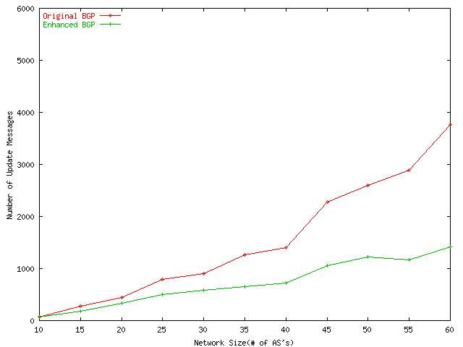
Number of Updates
Number of Updates
Original BGP
Enhanced BGP
Substantial reduction is achieved.
  E.g. 3766 to 1419 in the 60-AS topology
MinRouteAdver timer: within 30 seconds, only one advertisement is allowed.
It “packs” consecutive changes into one update.
Number of ASes in Network
Univ. of Tehran
Computer Network

Slide 97
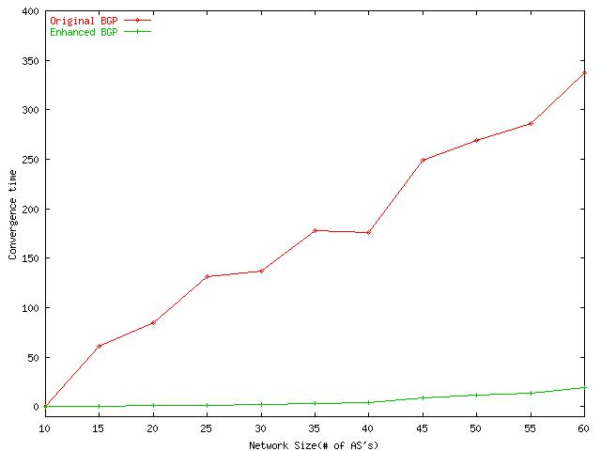
Convergence time
Convergence Time(seconds)
Enhanced BGP reduces the convergence time substantially.
  E.g. 337.0 seconds to 19.5 seconds in the 60-AS topology
  Elimination of one advertisement can cut convergence time by 30 seconds
Original BGP
Enhanced BGP
Number of ASes in Network
Univ. of Tehran
Computer Network

Slide 98
Problems
Routing table size
  Need an entry for all paths to all networks
Required memory= O((N + M*A) * K)
  N: number of networks
  M: mean AS distance (in terms of hops)
  A: number of AS’s
  K: number of BGP peers
Univ. of Tehran
Computer Network

Slide 99
Outline
External BGP (e-BGP)
Internal BGP (i-BGP)
Stability Issues
Scalability Issues
Univ. of Tehran
Computer Network

Slide 100
Big and Getting Bigger
Scaling the iBGP mesh
  Confederations
  Route Reflectors
BGP Table Growth
  Address aggregation (CIDR)
  Address allocation
AS number allocation and use
Dynamics of BGP
  Inherent vs. accidental oscillation
  Rate limiting and route flap dampening
  Lots and lots of noise
  Slow convergence time
Scale
Scale
Scale
Scale
Scale
Scale
Scale
Scale
Scale
Scale
Scale
Scale
Scale
Univ. of Tehran
Computer Network

Slide 101
iBGP Mesh Does Not Scale
eBGP update
N border routers means N(N-1)/2 peering sessions
Each router must have N-1 iBGP sessions configured
The addition a single iBGP speaker requires configuration changes to all other iBGP speakers
Size of iBGP routing table can be order N larger than number of best routes (remember alternate routes!)
Each router has to listen to update noise from each neighbor
iBGP updates
Currently four solutions:
(0) Buy bigger routers!
Break AS into smaller ASes
BGP Route reflectors
BGP confederations
Univ. of Tehran
Computer Network

Slide 102
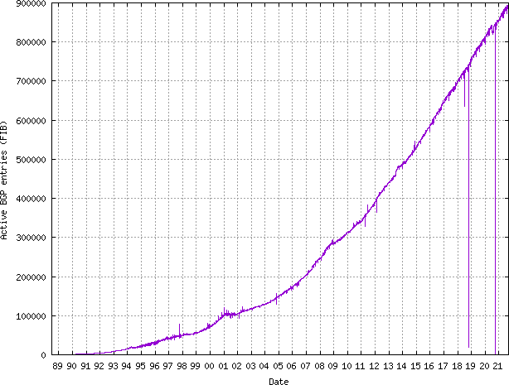
Routing Table Growth (IPv4)
https://www.cidr-report.org/

Slide 103
Large BGP Tables Considered Harmful
Routing tables must store best routes and alternate routes
Burden can be large for routers with many alternate routes (route reflectors for example)
Routers have been known to die
Increases CPU load, especially during session reset
Moore’s Law may save us in theory. But
in practice it means spending money to upgrade
equipment …
Univ. of Tehran
Computer Network

Slide 104
Deaggregation Due to Multihoming May be a Leading Cause
If AS 1 does
not announce the
more specific prefix,
then most traffic
to AS 2 will go
through AS 3
because it is a
longer match
12.2.0.0/16
12.0.0.0/8
12.2.0.0/16
AS 3
AS 1
provider
provider
AS 2
customer
12.2.0.0/16
AS 2 is
“punching a hole” in
The CIDR block of AS 1
Univ. of Tehran
Computer Network

Slide 105
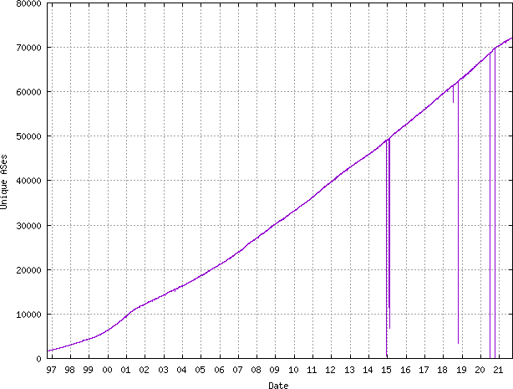
AS Growth with Time
https://www.cidr-report.org/

Slide 106
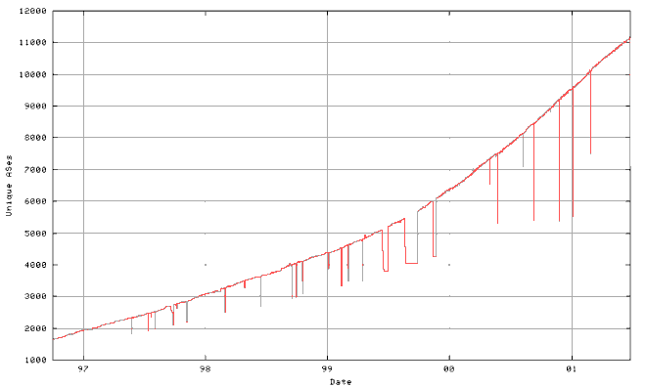
When will we run out of ASNs?
64,511
2005?
Univ. of Tehran
Computer Network
2007?

Slide 107
What is to be done?
Make ASNs larger than 16 bits
  How about 32 bits?
  See Internet Draft: “BGP support for four-octet AS number space” (draft-ietf-idr-as4bytes-03.txt)
  Requires protocol change and wide deployment
Change the way ASNs are used
  Allow multihomed, non-transit networks to use private ASNs
  Uses ASE (AS number Substitution on Egress )
  See Internet Draft: “Autonomous System Number Substitution on Egress” (draft-jhaas-ase-00.txt)
  Works at edge, requires protocol change (for loop prevention)
  Makes some kinds of debugging harder!
Univ. of Tehran
Computer Network

Slide 108
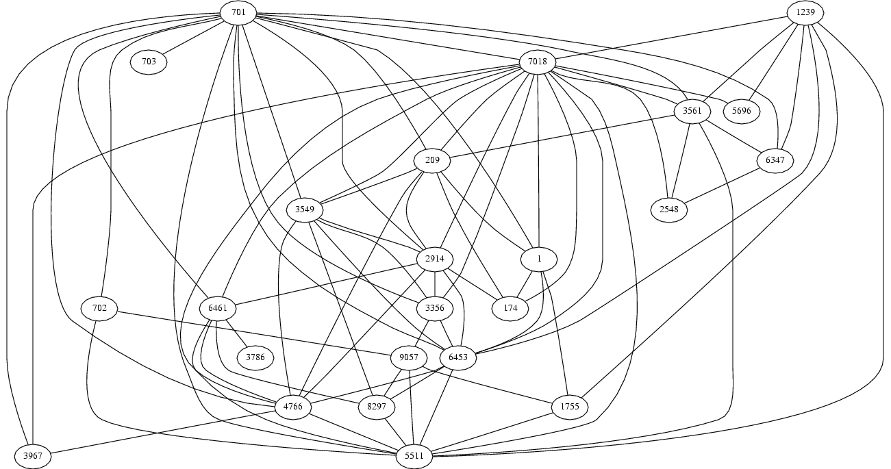
AS Graphs Can Be Fun
The subgraph showing all ASes that have more than 100 neighbors in full
graph of 11,158 nodes. July 6, 2001. Point of view: AT&T route-server
Univ. of Tehran
Computer Network

Slide 109
AS Graphs Do Not Show Topology!
BGP was designed to
throw away information!
The AS graph
may look like this.
Reality may be closer to this…
Univ. of Tehran
Computer Network

Slide 110
BGP Dynamics
How many updates are flying around the Internet?
How long Does it take Routes to Change?
The goals of
(1) fast convergence
(2) minimal updates
(3) path redundancy are at odds
Univ. of Tehran
Computer Network

Slide 111
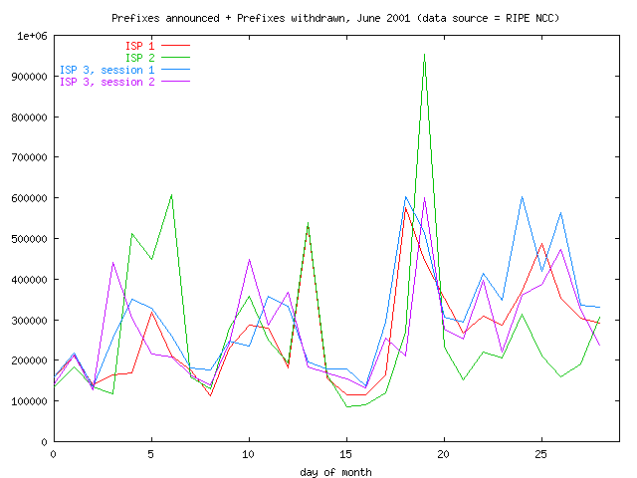
Daily Update Count
Univ. of Tehran
Computer Network

Slide 112
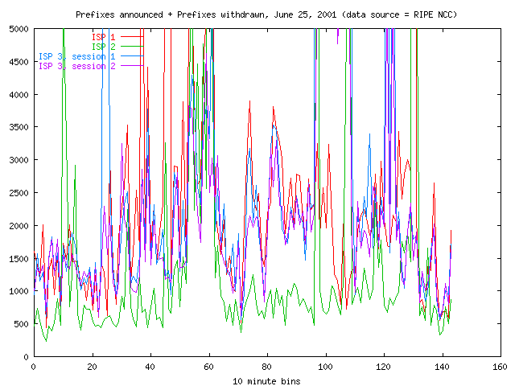
What is the Sound of One Route Flapping?
Univ. of Tehran
Computer Network

Slide 113
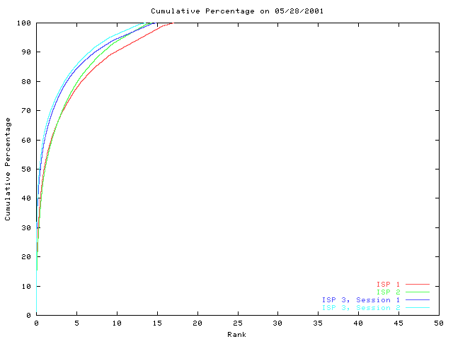
A Few Bad Apples …
Most prefixes are
stable most of the time.
On this day, about 83% of the prefixes were not updated.
Typically, 80% of
the updates are
for less than 5%
Of the prefixes.
Percent of BGP table prefixes
Univ. of Tehran
Computer Network
Thanks to Madanlal Musuvathi for this plot.
Data source: RIPE NCC

Slide 114
Two BGP Mechanisms for Squashing Updates
Rate limiting on sending updates
  Send batch of updates every MinRouteAdvertisementInterval seconds (+/- random fuzz)
  Default value is 30 seconds
  A router can change its mind about best routes many times within this interval without telling neighbors
Route Flap Dampening
  Punish routes for misbehaving
Effective in dampening
oscillations
inherent in the
vectoring
approach
Must be turned on
with configuration
Univ. of Tehran
Computer Network

Slide 115
Q: Why All the Updates?
Networks come, networks go
There’s always a router rebooting somewhere
Hardware failure, flaky interface cards, backhoes digging, floods in Houston, …
This is “normal” --- exactly what
dynamic routing is designed for…
Univ. of Tehran
Computer Network

Slide 116
Q: Why All the Updates?
Misconfiguration
Route flap dampening not widely used
BGP exploring many alternate paths
Software bugs in implementation of routing protocols
BGP session resets due to congestion or lack of interoperability: BGP sessions are brittle. One malformed update is enough to reset session and flap 100K routes. (Consequence of incremental approach)
IGP instability exported by use of MEDs or IGP tie breaker
Sub-optimal vendor implementation choices
Secret sauce routing algorithms attempting fancy-dancy tricks
Weird policy interactions (MED oscillation, BAD GADGETS??)
Gnomes, sprites, and fairies
….
A: NO ONE REALLY KNOWS …
Univ. of Tehran
Computer Network

Slide 117
IGP Tie Breaking Can Export Internal Instability to the Whole Wide World
192.44.78.0/24
AS 1
AS 2
AS 3
10
FLAP
AS 4
15
56
FLAP
192.44.78.0/24
ASPATH = 4 2 1
FLAP FLAP
192.44.78.0/24
ASPATH = 4 3 1
Univ. of Tehran
Computer Network

Slide 118
MEDs Can Export Internal Instability
2865
Heavy
Content
Web Farm
FLAP
17
FLAP
192.44.78.0/24
MED = 15
192.44.78.0/24
MED = 56 OR 10
10
FLAP
15
56
FLAP
FLAP
FLAP
192.44.78.0/24
Univ. of Tehran
Computer Network

Slide 119
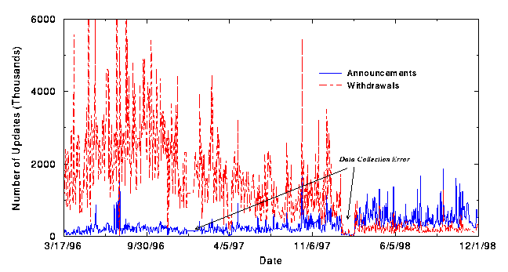
Implementation Does Matter!
stateless withdraws
widely deployed
stateful withdraws
widely deployed
Thanks to Abha Ahuja and Craig Labovitz for this plot.
Univ. of Tehran
Computer Network

Slide 120
How Long Will Interdomain Routing Continue to Scale?
A quote from some recent email:
... the existing interdomain routing
infrastructure is rapidly nearing the
end of its useful lifetime. It
appears unlikely that mere tweaks
of BGP will stave off fundamental
scaling issues, brought on by growth,
multihoming and other causes.
Is this true or false? How can we tell?
Research required…
Univ. of Tehran
Computer Network

Slide 121
HLP: Hybrid Link state path vector routing
Conflict between full path information and private policy.
BGP problems:
  Rapid grows (from 3000 AS to 17000, 1997-now) Scalability
  Route Oscillations, %25 of prefixes flap and have 10 hours convergence problem
  Poor fault isolation: most of routing event are globally visible
Univ. of Tehran
Computer Network

Slide 122
HLP: Solutions
Use two types of routing, Link state for hierarchy and path for peering or Fragmented Path Vector (FPV)
Explicit information hiding
Model complex relations as peering
Policy variation as exceptions
Result: Reduction of the size and domain of announcements.
Univ. of Tehran
Computer Network

Slide 123
Foundational Problems
Two complexity in BGP
  Policy: Cause persistent oscillation, loops, slow convergence and network partitioning
  Scalability:
Two basic questions:
  Which ones rooted in BGP design?
  Which ones are fundamental limitation & challenging of scalable policy-based routing?
Univ. of Tehran
Computer Network

Slide 124
Policy-induced Problems
Protocol oscillation: Stem from inability to satisfy group preference
  Inter-As oscillation: Caused by policy dispute
    Finding policy dispute is NP-complete
    Even with stable input BGP might never converge.
  Intera-As oscillation: Caused by non-monotonic ranking. MED from different Ases.
Is it possible to have a protocol that always converges? Yes
Univ. of Tehran
Computer Network

Slide 125
Convergence Problems
Basic questions
  Policy restriction: What restriction on policy such that with no topology and export policy it always converge?
  Protocol change: With additional features and flexible policy guaranteeing convergence?
  Total ordering : Are a set of preferences without pairwise ranking but always converge?
Univ. of Tehran
Computer Network

Slide 126
Security
BGP does not prevent an AS from advertising arbitrary perfixes
  Works to determine out of band prefix ownerships.
Is it possible to have
  Decentralized verification?
  In-band verification?
  Detecting routes that violate polices?
  Verifying the forwarding pathes?
Univ. of Tehran
Computer Network

Slide 127
Scaling in BGP
Different scaling techniques
  An AS as a single node.
  Route reflection
  Prefixes aggregation
But all hide routing information which makes problem diagnosis difficult and sometimes impossible.
There is a trade off between scalability and convergence.
Univ. of Tehran
Computer Network

Slide 128

Prefix Hijacking
Originating someone else’s prefix
  What fraction of the Internet believes it?
4
3
5
2
7
6
1
12.34.0.0/16
12.34.0.0/16

Slide 129
Sub-Prefix Hijacking
4
3
5
2
7
6
1
12.34.0.0/16
12.34.158.0/24
Originating a more-specific prefix
  Every AS picks the bogus route for that prefix
  Traffic follows the longest matching prefix

Slide 130
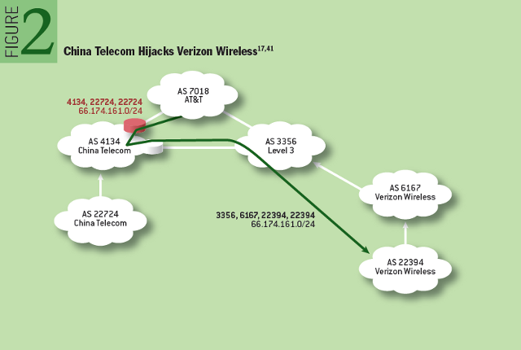
Interception Attack
http://queue.acm.org/detail.cfm?id=2668966

Slide 131
Bogus AS Paths to Hide Hijacking
Adds AS hop(s) at the end of the path
  E.g., turns “701 88” into “701 88 3”
Motivations
  Evade detection for a bogus route
  E.g., by adding the legitimate AS to the end
Hard to tell that the AS path is bogus…
  Even if other ASes filter based on prefix ownership
701
3
18.0.0.0/8
88
18.0.0.0/8

Slide 132
Path-Shortening Attacks
Remove ASes from the AS path
  E.g., turn “701 3715 88” into “701 88”
Motivations
  Make the AS path look shorter than it is
  Attract sources that normally try to avoid AS 3715
  Help AS 88 look like it is closer to the Internet’s core
Who can tell that this AS path is a lie?
  Maybe AS 88 *does* connect to AS 701 directly
701
3715
88
?

Slide 133
Attacks that Add a Bogus AS Hop
Add ASes to the path
  E.g., turn “701 88” into “701 3715 88”
Motivations
  Trigger loop detection in AS 3715
    Denial-of-service attack on AS 3715
    Or, blocking unwanted traffic coming from AS 3715!
  Make your AS look like is has richer connectivity
Who can tell the AS path is a lie?
  AS 3715 could, if it could see the route
  AS 88 could, but would it really care as long as it received data traffic meant for it?
701
88

Slide 134
Violating “Consistent Export” to Peers
Peers require consistent export
  Prefix advertised at all peering points
  Prefix advertised with same AS path length
Reasons for violating the policy
  Trick neighbor into “cold potato”
  Configuration mistake
Main defense
  Analyzing BGP updates
  … or data traffic
  … for signs of inconsistency
dest
Bad AS
BGP
data
src

Slide 135
Other Attacks
Attacks on BGP sessions
  Confidentiality of BGP messages
  Denial-of-service on BGP session
  Inserting, deleting, modifying, or replaying messages
Resource exhaustion attacks
  Too many IP prefixes (e.g., BGP “512K Day”)
  Too many BGP update messages
Data-plane attacks
  Announce one BGP route, but use another

Slide 136
Improving BGP Security

Slide 137
Solution Techniques
Protective filtering
  Know your neighbors
Anomaly detection
  Suspect the unexpected
Checking against registries
  Establish ground truth for prefix origination
Signing and verifying
  Prevent bogus AS PATHs
Data-plane verification
  Ensure the path is actually followed

Slide 138

















Route Attestations in Secure BGP
  If AS a announced path abP then b announced bP to a
Public Key Infrastructure
Comcast: (IBM)
Local: (Comcast, IBM)
Princeton: (Local, Comcast, IBM)
Princeton
AT&T
IBM
Local
ISP
Comcast
Comcast: (IBM)
Comcast: (IBM)
Local: (Comcast, IBM)
Public Key Signature: Anyone who knows IBM’s public key can verify the message was sent by IBM.

Slide 139
Next Lecture: Routers
How do you build a router
References
  Scaling Internet Routers Using Optics
  [P+98] A 50 Gb/s IP Router
Univ. of Tehran
Computer Network

