Slide 1
Computer Networks (Graduate level)
Lecture 5: Internetworking Design Principles
University of Tehran
Dept. of EE and Computer Engineering
By:
Dr. Nasser Yazdani

Slide 2
Network Design
Network Design principle
How to determine split of functionality
Across protocol layers
Across network nodes
Assigned Reading
End-to-end Arguments in System Design
Design Philosophy of the DARPA Internet Protocols
Architectural Consideration for a New Generation of Protocols
Tussle in Cyberspace
Rethinking the Design of the Internet: The End-to-End Arguments vs. the Brave New World
The End-to-End Argument and Application Design: The Role of Trust
A Protocol for Packet Network Intercommunication
IP Next Generation Overview
Chapt. 4 of the book

Slide 3
Goals
Connect existing networks
initially ARPANET and ARPA packet radio network
Survivability
ensure communication service even in the presence of network and router failures
Support multiple types of services
Must accommodate a variety of networks
Allow distributed management
Cost effective
Allow host attachment with a low level of effort
Allow resource accountability

Slide 4
Possible solutions
Reengineer and develop one global packet switching network standard
not economically feasible
not deployable
Decision: packet switching
Existing networks already were using this technology
Have every host implement the protocols of any network it wants to communicate with
Complexity/node = O(n)
O(n²) global complexity

Slide 5
Internetworking
Communication between networks.
Problems & Challenges
Different Networking technologies (Heterogeneity).
So many Networks (Scaling).
Some terminologies:
“internetworking” refer to an arbitrary collection of connected networks.
“Internet” the global internetwork.
“Network” either directly connected or switched network using any LAN technology such as Ethernet, Token ring, ATM, etc.

Slide 6
Connect Existing Networks …..
Existing networks: ARPANET and ARPA packet radio
Many differences between networks
Address formats
Performance – bandwidth/latency
Packet size
Loss rate/pattern/handling
Routing
…….

Slide 7
Gateway Alternatives
Translation
Difficulty in dealing with different features supported by networks
Scales poorly with number of network types (N² conversions)
Standardization
“IP over everything” (Design Principle 1)
Minimal assumptions about network
Hourglass design

Slide 8
Solution
Gateways

Slide 9
Solution
Add an extra layer: internetworking layer
hosts:
understand one network protocol
understand one physical/link protocol
Routers/Switchses/gateways:
understand one network protocol
understand the physical/link protocols of the networks they gateway
Complexity to add a node/network: O(1) with respect to number of existing nodes

Slide 10

IP Hourglass
Need to interconnect many existing networks
Hide underlying technology from applications
Decisions:
Network provides minimal functionality
“Narrow waist”
email WWW phone...
SMTP HTTP RTP...
TCP UDP…
IP
ethernet PPP…
CSMA async sonet...
copper fiber radio...
Applications
Technology
Tradeoff: No assumptions, no guarantees.

Slide 11
IP Layering (Principle 2)
Relatively simple modle
Application
Transport
Network
Link
Host
Router
Router
Host

Slide 12
Different Address Formats
Options:
Map one address format to another. Why not?
Provide one common format
map lower level addresses to common format
Common Address Format:
Initially: 8b network 16b host 24b total
Before Classless InterDomain Routing (CIDR):
7b/24b, 14b/16b, or 21b/8b 32b total
After CIDR: Arbitrary division 32b total
NAT: 32b + 16b simultaneously active
IPv6: 128b total

Slide 13
Different Packet Sizes
Need to define maximum packet size
Options:
Take the minimum of the maximum packets sizes over all networks
Implement fragmentation/reassembly
Flexibility to adjust packet sizes as new technologies arrive
IP: fragment at routers, reassemble at host
Why not reassemble at routers?
Still stuck with 1500B as de facto maximum

Slide 14
Other Challenges
Errors → require end-to-end reliability
Thought to be rarely invoked, but necessary
Different (routing) protocols → coordinate these protocols
Accounting
Did not envision script kiddies
Quality of Service
Not addressed

Slide 15
Key problem: Heterogeneity
Not described as such in paper
Heterogeneous addressing conventions => common addressing scheme
Heterogeneous MTU => fragmentation
Heterogeneous queuing/transit delays =>adaptive “timing procedures”
Heterogeneous reliability => end-to-end recovery mechanisms
Heterogeneous control/status info => common error/coordination mechanism

Slide 16
Principle 3
Best effort delivery
All packets are treated the same
Relatively simple core network elements
Building block from which other services (such as reliable data stream) can be built
Contributes to scalability of network

Slide 17
Principle 4
Fate sharing
Critical state only at endpoints
Only endpoint failure disrupts communication
Helps survivability
Connection State
No State
State

Slide 18
Principle 5
Soft-state
Announce state
Refresh state
Timeout state
Penalty for timeout – poor performance
Robust way to identify communication flows
Possible mechanism to provide non-best effort service
Helps survivability

Slide 19
Principle 6
Decentralization
Each network owned and managed separately
Will see this in BGP routing especially

Slide 20
Principle 7
Be conservative in what you send and liberal in what you accept
Unwritten rule
Especially useful since many protocol specifications are ambiguous
E.g. TCP will accept and ignore bogus acknowledgements

Slide 21
Survivability
Continue to operate even in the presence of network failures (e.g., link and router failures)
As long as the network is not partitioned, two endpoint should be able to communicate, moreover, any other failure (excepting network partition) should be transparent to endpoints
Decision: maintain state only at end-points (fate-sharing)
Eliminate the problem of handling state inconsistency and performing state restoration when router fails
Internet: stateless network architecture

Slide 22
2. Types of Services
Add UDP to TCP to better support other types of applications
e.g., “real-time” applications
Probably main reason for separating TCP and IP
Provide datagram abstraction: lower common denominator on which other services can be built
service differentiation considered (ToS header bits)
was not widely deployed (why?)

Slide 23
3. Variety of Networks
Very successful
because the minimalist service; it requires from underlying network only to deliver a packet with a “reasonable” probability of success
…does not require:
reliability, in-order delivery, single delivery, QoS guarantees
IP over everything
Then: ARPANET, X.25, DARPA satellite network..
Now: ATM, SONET, WDM, PPP, USB, 802.11b, GSM, GPRS, DSL, cable modems, power lines

Slide 24
Key Advantages
The service can be implemented by a large variety of network technologies
Does not require routers to maintain any fined grained state about traffic. Thus, network architecture is
Robust
Scalable

Slide 25
Other Goals
Allow distributed management
each network can be managed by a different organization
different organizations need to interact only at the boundaries
doesn’t work so well for routing, accounting
Cost effective
sources of inefficiency
header overhead
retransmissions
Routing
Congestion control
…..

Slide 26
Other Goals (Cont)
Low cost of attaching a new host
not a strong point → higher than other architecture because the intelligence is in hosts (e.g., telephone vs. computer)
Moore’s law made this moot point, both <$100
bad implementations or malicious users can produce considerably harm (remember fate-sharing?)
DDoS possibly biggest threat to Internet
Accountability
very little so far

Slide 27
Services
At network layer provides one simple service: best effort datagram (packet) delivery
Only one higher level service implemented at transport layer: reliable data delivery (TCP)
performance enhancement; used by a large variety of applications (Telnet, FTP, HTTP)
does not impact other applications (can use UDP)
Everything else implemented at application level

Slide 28
What About Other Services?
Multicast?
Quality of Service (QoS)?
Security, virus?
Trust?
….

Slide 29
IP Design Weaknesses
Greedy sources aren’t handled well
Weak accounting and pricing tools
Weak administration and management tools
Trust is problem now
Incremental deployment difficult at times
Result of no centralized control
No more “flag” days
Are active networks the solution?

Slide 30
Summary: Minimalist Approach
Dumb network
IP provide minimal functionalities to support connectivity
Addressing, forwarding, routing
Smart end system
Transport layer or application performs more sophisticated functionalities
Flow control, error control, congestion control
Advantages
Accommodate heterogeneous technologies (Ethernet, modem, satellite, wireless)
Support diverse applications (telnet, ftp, Web, X windows)
Decentralized network administration

Slide 31

Common View of the IP Network

Slide 32
Needs some intelligence!
routing

Slide 33
How IP was implemented?
IP addressed facing problems in different ways?
For details read Paper: “A Protocol for Packet Network Intercommunication”.
Also see “IP Next Generation Overview “

Slide 34
Transmission Control Program
Original TCP/IP (Cerf & Kahn)
no separation between transport (TCP) and network (IP) layers
one common header flow control, but not congestion control (why not?)
fragmentation handled by TCP
Today’s TCP/IP
separate transport (TCP) and network (IP) layer (why?)
split the common header in: TCP and UDP headers
fragmentation reassembly done by IP
congestion control

Slide 35
How is IP Design Standardized?
IETF
Voluntary organization
Meeting every 4 months
Working groups and email discussions
“We reject kings, presidents, and voting; we believe in rough consensus and running code” (Dave Clark 1992)
Need 2 independent, interoperable implementations for standard

Slide 36
Problems in reality
IP address problem
New requirements for services
QoS
Security, trust
So many protocols, fast changing environments, …
SDN is a solution?

Slide 37
IP Address Classes (Some are Obsolete)
Network ID
Host ID
8
16
24
32
Class A
Network ID
0
Host ID
Class B
10
Class C
110
Class D
Multicast Addresses
1110
Class E
Reserved for experiments
1111

Slide 38
IP Address Problem (1991)
Address space depletion
In danger of running out of classes A and B
Why?
Class C too small for most domains
Very few class A – IANA (Internet Assigned Numbers Authority) very careful about giving
Class B – greatest problem

Slide 39
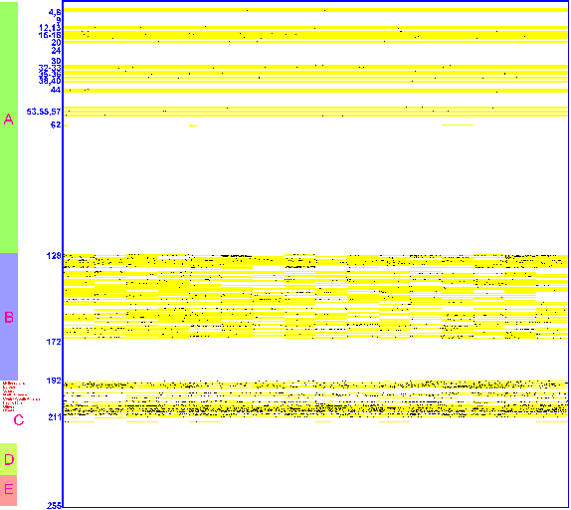
IP Address Utilization (‘98)
http://www.caida.org/outreach/resources/learn/ipv4space/

Slide 40
Subnet Addressing – RFC917 (1984)
For class B & C networks
Very few LANs have close to 64K hosts
For electrical/LAN limitations, performance or administrative reasons
Need simple way to get multiple “networks”
Use bridging, multiple IP networks or split up single network address ranges (subnet)
Must reduce the total number of network addresses that are assigned

Slide 41
Subnetting
Variable length subnet masks
Could subnet a class B into several chunks
Network
Host
Network
Subnet
Host
1111..
..1111
00000000
Mask

Slide 42
Network Address Translation (NAT)
Sits between your network and the Internet
Translates local network layer addresses to global IP addresses
Has a pool of global IP addresses (less than number of hosts on your network)

Slide 43
NAT Illustration
Pool of global IP addresses
Destination
Source
Global Internet
G
P
Private
Network
D_{g}
S_{g}
NAT
Data
D_{g}
S_{p}
Data
Operation: Source (S) wants to talk to Destination (D):
Create S_{g}-S_{p} mapping
Replace S_{p} with S_{g} for outgoing packets
Replace S_{g} with S_{p} for incoming packets

Slide 44
Classless Inter-Domain Routing
Do not use classes to determine network ID
Assign any range of addresses to network
Use common part of address as network number
e.g., addresses 192.4.16 - 196.4.31 have the first 28 bits in common. Thus, we use this as the network number
netmask is /28, /xx is valid for almost any xx
Enables more efficient usage of address space (and router tables)

Slide 45
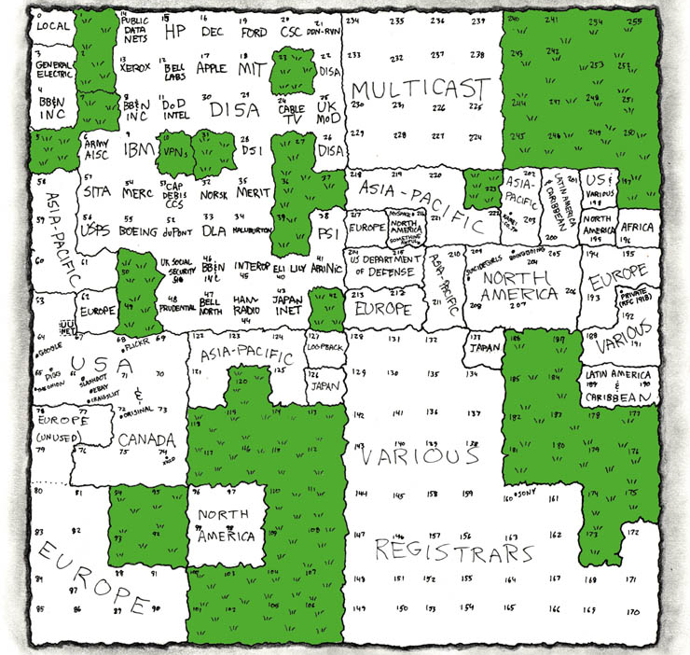
IP Address Utilization (‘06)
http://xkcd.com/195/

Slide 46
IPv6 Changes
Scale – addresses are 128bit
Header size?
Simplification
Removes infrequently used parts of header
40byte fixed size vs. 20+ byte variable
IPv6 removes checksum
Relies on upper layer protocols to provide integrity
IPv6 eliminates fragmentation
Requires path MTU discovery
Requires 1280 byte MTU

Slide 47
IPv6 Header
0
4
12
16
19
24
32
Version
Class
Flow Label
Payload Length
Next Header
Hop Limit
Source Address
Destination Address

Slide 48
IPv6 Changes
TOS replaced with traffic class octet
Flow
Help soft state systems
Maps well onto TCP connection or stream of UDP packets on host-port pair
Easy configuration
Provides auto-configuration using hardware MAC address to provide unique base
Additional requirements
Support for security
Support for mobility

Slide 49
IPv6 Changes
Protocol field replaced by next header field
Support for protocol demultiplexing as well as option processing
Option processing
Options are added using next header field
Options header does not need to be processed by every router
Large performance improvement
Makes options practical/useful

Slide 50
What About the Future?
Datagram not the best abstraction for:
resource management,accountability, QoS
A new abstraction: flow?
Routers require to maintain per-flow state (what is the main problem with this raised by Clark?)
state management

Slide 51
Devil’s Advocate
Who cares about resource sharing?
1974: cycles, storage, bandwidth expensive, people cheap
Today: resources cheap, people expensive
1974: Share computer resources
Today: Communicate with people, access documents, buy, sell
Does it still make sense to make processes the endpoint?
Where do people and organizations fit into the ISO layering model?

Slide 52
End-to-End Argument (Principle 2)
Deals with where to place functionality
Inside the network (in switching elements)
At the edges
Argument
There are functions that can only be correctly implemented by the endpoints do not try to completely implement these at them elsewhere
Can provide a partial form as performance enhancement
Guideline not a law

Slide 53
End-to-End Argument
Think twice before implementing a functionality that you believe that is useful to an application at a lower layer
If the application can implement a functionality correctly, implement it a lower layer only as a performance enhancement

Slide 54
Example: Reliable File Transfer
Host A
Host B
Appl.
Appl.
OS
OS
OK
Solution 1: make each step reliable, and then concatenate them
Solution 2: end-to-end check and retry

Slide 55
Discussion
Solution 1 not complete
What happens if the sender or/and receiver misbehave?
The receiver has to do the check anyway!
Thus, full functionality can be entirely implemented at application layer; no need for reliability from lower layers

Slide 56
Discussion
Is there any need to implement reliability at lower layers?
Yes, but only to improve performance
Example:
Assume a high error rate on communication network
Then, a reliable communication service at data link layer might help

Slide 57
Trade-offs
Application has more information about the data and the semantic of the service it requires (e.g., can check only at the end of each data unit)
A lower layer has more information about constraints in data transmission (e.g., packet size, error rate)
Note: these trade-offs are a direct result of layering!

Slide 58
Rule of Thumb
Implementing a functionality at a lower level should have minimum performance impact on the application that do not use the functionality

Slide 59
Example: File Transfer
Even if network guaranteed reliable delivery
Need to provide end-to-end checks
E.g., network card may malfunction
If network is highly unreliable
Adding some level of reliability helps performance, not correctness
Don’t try to achieve perfect reliability!
Is FTP like this?
TCP provides reliability between kernels not disks

Slide 60
Internet & End-to-End Argument
Provides one simple service: best effort datagram (packet) delivery
Only one higher level service implemented at transport layer: reliable data delivery (TCP)
Performance enhancement; used by a large variety of applications (Telnet, FTP, HTTP)
Does not impact other applications (can use UDP)
Everything else implemented at application level
Move functions “up and out”.
The network should be “as transparent as technology permits”.

Slide 61
A simple view of the Internet
User
User
Router
Router
User
User
Router
User
Router
User
Router
User
Router
Router
User
Router
User
“The Internet”

Slide 62
Benefits of the end to end arguments
User empowerment.
Run what you please.
Flexibility in the face of unknown applications.
A network to hook computers together.
Lower cost in core of network.
Eliminate special “features”.
Rely on edge-node equipment.
More robust applications.
No unexpected failures of third-party nodes.

Slide 63
But in today’s Internet...
There are “new” factors to consider:
Assured operation in an untrustworthy world.
More demanding applications.
Growing need for enhanced services.
Less sophisticated users.
User empowerment is a burden.
Does today’s software really empower the user?
Third parties who want to intervene.
New sorts of end-node devices.
Appliances, not PCs.
The evolving role of the Internet Service Provider.

Slide 64
In the brave new world
The end to end model does not empower the ISP.
ISPs want to sell services, add value, and make money.
New network services (or not), protection, control of applications/content, accounting.
The end to end model does not empower rights holders.
The end to end model does not empower governments.
Control of content, taxation, consumer protection, law enforcement.
The end to end model does not empower employers.
The end to end model only empowers certain application makers.

Slide 65
The E2E argument at the network level
At the network level:
More complex role for commercial ISPs
vertical integration of transport/QoS with apps.
control of what apps users can use.
filtering of unacceptable behavior.
Others (e.g., employers, universities) restrict activities.
Firewalls, filters
Governments propose controls in the net.
The Internet is hard to find and control.
What is the Internet?

Slide 66
The end to end argument functions at two levels
At the “network” level:
Avoid putting constraining per-application functions into the core of the network.
Build general purpose services.
At the “application” level:
Build applications in a way that makes them robust, easy to use, reliable, etc.
Simple approach: push software to the edge.
Perhaps more realistic: reason carefully about role of servers, trusted third parties, etc.
Increasing concern about the goal of making money?

Slide 67
The end to end argument at the application level
At the application level:
Ease of use, mutual distrust, multi-party interactions may motivate servers and services other than at the end-points of the users.
Relays for content, trusted third parties.
How do we make these applications robust?
How do the parties know who they are talking to?
Appliance and devices motivate new designs.
Both ISPs and ASPs (A = Application) want to “get into the action”.
ISP involvement will imply constraints on location/structure.

Slide 68
A more complex view of the Internet
Little
ISP
User
User
Campus
Backbone
(big ISP)
User
User
Little
ISP
Backbone
(big ISP)
User
User
Backbone
(big ISP)
User
User
Corp
Little
ISP
User
The ISP lives here.
And below.
The ISP does not live
at the end-points.
(They can try…)
User
User
By the end to end
argument,
applications live at
the edge.
Notes:
Note the current Internet study.
Peering. Open interfaces.

Slide 69
Some ideas for moving forward
Labels.
A compromise between autonomy and visibility of action.
Distinction between private and public communication.
Accept that private communication is not restricted.
Focus on communication “to the public”.
New principles for application design.
Do not force an end-node implementation.
Allow the user to select an alternative.
A more sophisticated form of empowerment.
Tolerance for experimentation.
That which is not forbidden is permitted?

Slide 70
Some “contradictions” in the end to end approach
How can we build a trustworthy network out of edge-devices that cannot be trusted?
How can we have anonymity and accountability?
How can the network control unacceptable behavior and still permit unknown applications?
Flexibility is critical if the Internet is to be a part of the computer world.
Must find a balance among the goals.

Slide 71
What has really changed?
A loss of trust among users.
Global communication with local trust.
The need to factor in economic forces.
Role of commercial (and other) ISPs.
The change in the nature of the user base.
Less sophisticated: ease of use, protection concerns
Co-evolution of technology and law.
Complex cycle of evolution.
Geographic differences.
Change in nature of innovation.
Big players.

Slide 72
Summary: End-to-End Argument
If the application can do it, don’t do it at a lower layer -- anyway the application knows the best what it needs
Add functionality in lower layers iff it is (1) used and improves performances of a large number of applications, and (2) does not hurt other applications
Success story: Internet

Slide 73
Summary
Challenge of building a good (network) system: find the right balance between:
Reuse, implementation effort
(apply layering concepts)
Performance
End-to-end argument
No universal answer: the answer depends on the goals and assumptions!

Slide 74
Problems over time
Architecture developed in simpler times
Common goals, consistent vision
• With success, the goals of different players have diverged– examples:
ISPs must talk to provide connectivity but are fierce competitors
Privacy of users vs. government’s need to monitor
User’s desire to exchange files vs. copyright owners
• Must deal with the tussle between concerns in design

Slide 75
New Principles?
Design for variation in outcome
Allow design to be flexible to different uses/results
Isolate tussles
QoS designs uses separate ToS bits instead of overloading other parts of packet like port number
Separate QoS decisions from application/protocol design
Provide choice: allow all parties to make choices on interactions
Creates competition
Fear between providers helps shape the tussle

Slide 76
Trust-to-Trust Principle
Security and Trust are big issues today. To see a website, you have to trust 10 parties.
Did they ignored them in the early design?
They thought about it. They were familiar with malware in 1970’s
They make few mistakes
They did not know what the security means.
They assumed users can trust each others
And the end nodes are reliable.
They did not know how to model/modularize the security/trust.

Slide 77
Trust-to-Trust Principle
Some basic question on the end point
Not everything in the end point
Cash server, mail server, Clouds, CDN
What about human in VoIP.
Trust to Trust is a generalization of End to End principle.
The end user should have control over the trust decisions.
Move trust from the core of the network to the edges.

Slide 78
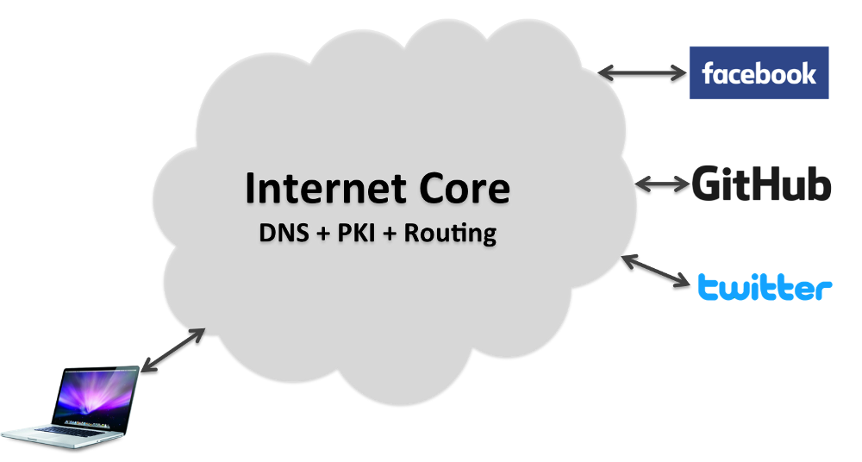
Trust to trust Internet
DNS and public Key (PKI) server in the network that must
be trusted .

Slide 79
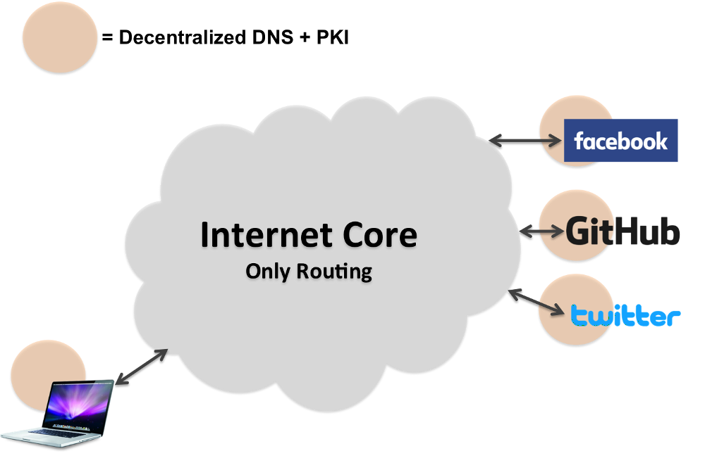
End to End Internet
DNS and public Key (PKI) server in the points that must
be trusted .

Slide 80
What do we face Today
Internet is a huge system
Very Complicated
Around 7000 RFCs
Difficult to modify/change
Not easy to fix bugs
Not easy to innovate
Overwhelming demands for scale and new services
Solution?
Complexity: new design?
Flexibility: move to software?
Is SDN a solution?

Slide 81
NSF Programs
Stagnation
100x100 → Clean Slate Design
PlanetLab
Overcoming the Internet Impasse through Virtualization → GENI
Internet architecture projects
Named Data Networking
MobilityFirst
eXpressive Internet Architecture

Slide 82
NSF FIND Project [Clark]
1988
Internet communication must continue despite loss of networks or gateways.
The Internet must support multiple types of communications service.
The Internet architecture must accommodate a variety of networks.
The Internet architecture must permit distributed management of its resources.
The Internet architecture must be cost effective.
The Internet architecture must permit host attachment with a low level of effort.
The resources used in the Internet architecture must be accountable.
2008
Security
Availability and resilience
Economic viability
Better management
Meet society’s needs
Longevity
Support for tomorrow’s computing
Exploit tomorrow’s networking
Support tomorrow’s applications
Fit for purpose (it works...)
Notes:
The list from 1988 does not mention the word “security”. The first 1988 requirement, that the network continue operation despite loss of networks or gateways, could be seen as a specific sub-case of security, but the text in the next section of the original paper (see below) does not even hint that the failures might be due to malicious actions. In retrospect, it is difficult to reconstruct what our mind-set was when this paper was written (which is in the years immediately prior to 1988). By the early 1990s, security was an important if unresolved objective. It seems somewhat odd that the word did not even come up in this paper.
The modern list calls out availability and resilience as distinct from the general category of “security”, a distinction that was motivated by my sense that this set of goals in particular were important enough that they should not be buried inside the broader category. So there is some correspondence between goal 1 in the 1988 list and 2 in the 2008 list.
The 2008 list has economic viability as its third objective. As I noted above, the 1988 paper discussed “the problem of integrating a number of separately administrated entities into a common utility”, which seems like a specific manifestation of the recognition that the net is built out of parts. But the focus on economic viability seems to have been poorly understood, if at all.
integrity/confidentiality
Avail/resilience
Can everyone make money
Management – fault detection/isolation
E.g. privacy, lawful intercept, control of illegal behavior
Is evolution easy?
E.g. 9bit bytes, sensors, etc.
E.g. mobile links, optical links, etc.
Tomorrow’s apps
Perhaps it doesn’t need to do everything…

Slide 83
NSF FIND Project [Clark]
2008
Security
Availability and resilience
Economic viability
Better management
Meet society’s needs
Longevity
Support for tomorrow’s computing
Exploit tomorrow’s networking
Support tomorrow’s applications
Fit for purpose (it works...)
Internet Support
End2end integrity/confidentiality with encryption
Routing and TTL – but little else
None
None
None
Has been effective – but parts such as addressing
Was developed in very heterogeneous settings. Hard to predict
Mobile and optical have raised issues. Link failure and network management interactions could be better.
Done well but are important applications just ignored?
It does work ☺

Slide 84
Named Data Networking
In the beginning...
First applications strictly focused on host-to-host interprocess communication:
Remote login, file transfer, ...
Internet was built around this host-to-host model.
Architecture is well-suited for communication between pairs of stationary hosts.
... while today
Vast majority of Internet usage is data retrieval and service access.
Users care about the content and are oblivious to location. They are often oblivious as to delivery time:
Fetching headlines from CNN, videos from YouTube, TV from Tivo
Accessing a bank account at www.bank.com.

Slide 85





What does the network look like…
ISP
ISP

Slide 86

What should the network look like…
ISP
ISP

Slide 87
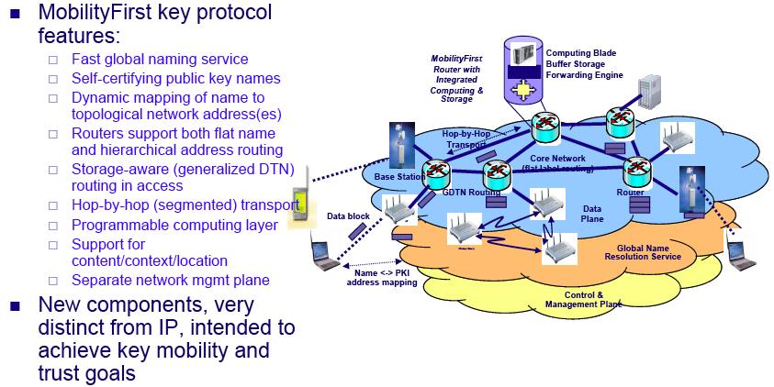
MobilityFirst Architecture

Slide 88

A History of Internet Evolution
Applications
Innovation both above and below IP
IP
Technology
Hard to change IP
…especially after 1990

Slide 89
XIA: An Evolvable Internet Architecture
Network design
End-point design
How do we design a network in which we can gracefully introduce new functionality?
How should the end-points change when the networks provide new functionality?

Slide 90

XIA: Evolvable Set of Principals
Identifying the intended communicating entities reduces complexity and overhead
No need to force all communication at a lower level (hosts), as in today’s Internet
Allows the network to evolve
Content
a581fe9 ...
Services
d9389fa …
Host
Future
Entities
024e881 …
39c0348 …

Slide 91
Next: Packet forwarding
IP lookup
How router find packets’ output ports.
References
DMP-tree: A dynamic M-way prefix tree data structure for strings matching, Nasser Yazdani, Hossein Mohammadi http://www.sciencedirect.com

