Slide 1
Computer Networks
(Graduate level)
Lecture 4: Packet forwarding
University of Tehran
Dept. of EE and Computer Engineering
By:
Dr. Nasser Yazdani
Univ. of Tehran
Computer Network

Slide 2
Packet forwarding
How do routers process IP packets
How do they forward packets
Assigned reading
  Fast and Scalable schemes for the IP address Lookup Problem
Univ. of Tehran
Computer Network

Slide 3
Forwarding vs. Routing
Forwarding: the process of moving packets from input to output
  The forwarding table Lookup.
  How to populate the lookup table?
Routing: process by which the forwarding table is built and maintained
  One or more routing protocols
  Procedures (algorithms) to convert routing info to forwarding table.
Univ. of Tehran
Computer Network

Slide 4
Outline
Alternative methods for packet forwarding
IP packet routing
Variable prefix match
Univ. of Tehran
Computer Network

Slide 5
Techniques for Forwarding Packets
Source routing
  Packet carries path
Virtual circuit switching: Table of virtual circuits
  Connection routed through network to setup state
  Packets forwarded using connection state
Datagram Network: Table of global addresses (IP)
  Routers keep next hop for destination
  Packets carry destination address
Univ. of Tehran
Computer Network

Slide 6
Switching a packet
R3
R1
A
R4
D
B
E
D
R2
C
Destination
Next Hop
R5
F
D
R3
E
R3
F
R5
Univ. of Tehran
Computer Network

Slide 7
What is Routing?
R3
R1
A
R4
D
1
4
16
32
Ver
HLen
T.Service
Total Packet Length
B
Fragment ID
Flags
Fragment Offset
E
TTL
D
20 bytes
Protocol
Header Checksum
R2
C
Source Address
Destination
Next Hop
R5
Destination Address
F
D
R3
Options (if any)
E
R3
Data
F
R5
Univ. of Tehran
Computer Network

Slide 8
Problems?
How does a router populates the table?
  By routing protocol
How big is the table?
  3 billions entries?
How much does it take to find a match?
  In Ave. search half entries? 1.5 billions?
  With 3 GHz clock & 4 cycles for each mach, it takes 2 sect
  Throughput is 0.5 packet/sec, very bad!!
Univ. of Tehran
Computer Network

Slide 9
A better Solution
What is the destination address?
  An IP address
How is the IP address?
A point: It is enough to forward packet to the network.
  Cuts the size of the table to at least 1/100?
  With 3 GHz clock & 4 cycles for each mach, it takes 20 msect
  Throughput is 50 packet/sec, a little better
Network Address | Host Address
Univ. of Tehran
Computer Network

Slide 10
Even better Solution
How many bits for each part in IP address?
  Different IP classes
Address Classes
  Class D for Multicasting
  Class E for experiments
Solution
  One table for each class
  Takes network address as index to the table
  One memory access for each maching
Then, assume 4 cycles for each memory access
7
24
A:
0
Network
Host
14
16
B:
1
0
Network
Host
21
8
C:
1
1
0
Network
Host
  Throughput is 750 millions packet/sec, Excellent!!
Univ. of Tehran
Introduction to Computer Network

Slide 11
Outline
Alternative methods for packet forwarding
Variable prefix match
Routing protocols – distance vector
Univ. of Tehran
Computer Network

Slide 12
IP Address Problem (1991)
Inefficient use of Hierarchical Address Space
  class C with 2 hosts (2/255 = 0.78% efficient)
  class B with 256 hosts (256/65535 = 0.39% efficient)
Address space depletion
  In danger of running out of classes A and B
  Class C too small for most domains
  Very few class A – IANA (Internet Assigned Numbers Authority) very careful about giving
  Class B – greatest problem
Univ. of Tehran
Introduction to Computer Network

Slide 13
Solutions for IP Address
Better utilize address space
  Subnetting
  Supperneting
Locally use unofficial IP addresses (NATing)
Use wider IP addresses
  New version of IP, IPv6.
Univ. of Tehran
Introduction to Computer Network

Slide 14
Supernetting
Assign block of contiguous network numbers to nearby networks
Called CIDR: Classless Inter-Domain Routing
Represent blocks with a single pair
(first_network_address, count)
Restrict block sizes to powers of 2
Use a bit mask (CIDR mask) to identify block size
All routers must understand CIDR addressing
Univ. of Tehran
Introduction to Computer Network

Slide 15
CIDR Revisited
Supernets
  Assign adjacent net addresses to same org
  Classless routing (CIDR)
How does this help routing table?
  Combine routing table entries whenever all nodes with same prefix share same hop
Univ. of Tehran
Computer Network

Slide 16
CIDR Illustration
Provider is given 201.10.0.0/21
Provider
201.10.0.0/22
201.10.4.0/24
201.10.5.0/24
201.10.6.0/23
Univ. of Tehran
Computer Network

Slide 17
Classless Addressing
CIDR
Class-based:
A
B
C
D
0
2³²-1
Class A cover a large range of addresses
Classless:
128.9.0.0
142.12/19
65/8
128.9/16
0
2³²-1
2¹⁶
128.9.16.14
Take necessary part of address space for network addresses.
Univ. of Tehran
Computer Network

Slide 18
Classless Addressing
CIDR
Matching different networks in the forwarding table?
128.9.19/24
128.9.25/24
128.9.16/20
128.9.176/20
128.9/16
0
2³²-1
128.9.16.14
Most specific route = “longest matching prefix”
Univ. of Tehran
Computer Network

Slide 19
Forwarding Table
128.17.20.1
e.g. 128.9.16.14 => Port 2
R2
Prefix
Next-hop
Port
65/8
128.17.16.1
3
R1
R3
1
128.9/16
128.17.14.1
4
2
3
128.9.16/20
128.17.14.1
2
128.9.19/24
128.17.10.1
7
128.9.25/24
128.17.14.1
2
R4
128.9.176/20
128.17.20.1
1
142.12/19
128.17.16.1
3
128.17.16.1
It is prefix matching in the table.
Univ. of Tehran
Computer Network

Slide 20
Problems?
With CIDR we have to match all of the table not even half.
How much does it take to find a match?
  In Ave. 1 million entries in table
  With 2 GHz clock & 4 cycles for each match, it takes 2 msec for each match
  Throughput is 500 packet/sec, bad!!
Univ. of Tehran
Computer Network

Slide 21
Forwarding Algorithm
If the datagram destination address is in the local network
deliver packet over the interface
else if the network address is in the forwarding table
deliver packet to the corresponding next hop
else
deliver packet to the default router.
For Class address there is exact matching
For Classless address it is prefix matching.
Univ. of Tehran
Computer Network

Slide 22
Inside a Router
1.
3.
Output
Scheduling
Forwarding
Table
2.
Interconnect
Forwarding
Decision
Forwarding
Table
Forwarding
Decision
Forwarding
Table
Forwarding
Decision
Univ. of Tehran
Computer Network

Slide 23
Forwarding in an IP Router
A higher level view from router perspective.
Lookup packet DA in forwarding table.
  If known, forward to correct port.
  If unknown, drop packet.
Decrement TTL, update header Checksum.
Forward packet to outgoing interface.
Transmit packet onto link.
Univ. of Tehran
Computer Network

Slide 24
Outline
Alternative methods for packet forwarding
IP packet routing
Variable prefix match
Univ. of Tehran
Computer Network

Slide 25
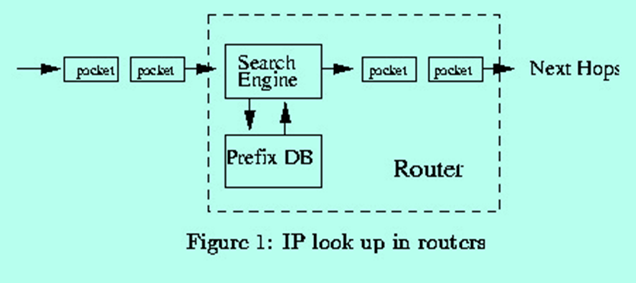
IP Lookup
Packets are forwarded to their destination based on their destination addresses.
Router must find the address of the next hop for each packet by finding the longest prefix matching with the packet destination address.
Univ. of Tehran
Computer Network

Slide 26
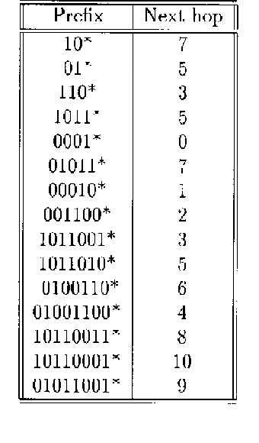
IP lookup
Example:
If the a packet destination
address is 101100111,
the next hop will be 8
since 10110011 is the
longest matching prefix.
Univ. of Tehran
Computer Network

Slide 27
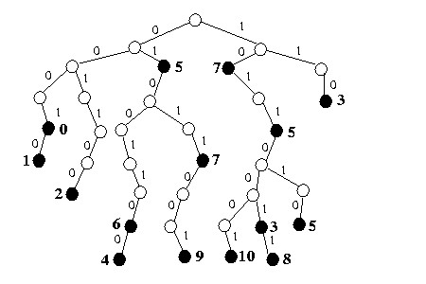
Trie Based Methods
Trie or radix tree is a data structure in which each data element is represented by the path to the leaf and no. of internal nodes are the no. of alphabet.
Two branching.
Black node in the leaves represent next hops
Univ. of Tehran
Computer Network

Slide 28
Trie Based Methods (cont)
Trie has been the base of many methods.
There are two main problems with trie:
The blank nodes do not correspond to any data element in the lookup table.
The number of branching is small, 2.
Both of these add to the height of trie, waste memory and prolong the search time.
The Max search time is proportional to string length or O(32) for IPv4 and O(128) for IPv6.
Univ. of Tehran
Computer Network

Slide 29
Trie Based Methods (cont)
Solutions:
Remove or reduce blank nodes, Patricia tree, Path compression method, etc.
Compare 2 or more bits at each steps, Level compression and other methods.
Use tree or other well known data structures.
Other consideration: memory speed is a bottleneck!, minimize memory access.
Univ. of Tehran
Computer Network

Slide 30
Tree Based Lookup
Comparing prefixes.
Sorting prefixes
Binary prefix Tree.
M_way prefix tree.
Univ. of Tehran
Computer Network

Slide 31
Sorting prefixes
Question? Why well-known tree structures cannot be applied to the longest prefix matching problem?
Answer- No a well-known method for comparing prefixes.
Definition: Assume A=a₁a₂…a_{n} and B=b₁b₂…b_{m} to be prefixes of (0,1) and
  1. If n=m, the numerical values of A and B are compared.
  2. If n ≠ m (assume n<m), the two substrings a₁a₂…a_{n} and b₁b₂…b_{n} are compared. If a₁a₂…a_{n} and b₁b₂…b_{n} are equal, then, the (n+1)^{th} character of string B is checked. It is considered B>A if b_{n+1} is 1 and B ≤ A otherwise.
Univ. of Tehran
Computer Network

Slide 32
Sorting prefixes (cont)
Example-
Sorting is a function to determine the position of each prefix.
Prefixes of table is sorted as:
00010*,0001*,001100*,01001100*,0100110*,01011,001*,01011*,01*,10*,10110001*,1011001*,10110011*,1011010*,1011*,110*
Univ. of Tehran
Computer Network

Slide 33
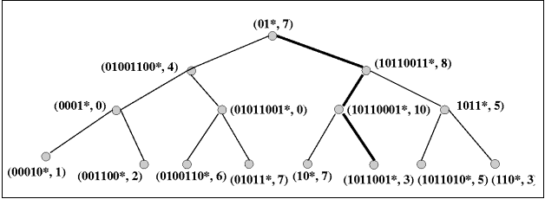
Binary prefix tree
Unfortunately, it fails for 101100001000 Why?
Prefixes are ranges and not just a data point in the search space.
Univ. of Tehran
Computer Network

Slide 34
Binary prefix tree (cont)
Definition: prefixes A and B are disjoint if none of them is a prefix of other.
Definition : prefix A is called enclosure if there exists at least one element in the set such that A is a prefix of that element.
We modify the sort structure;
  Each enclosure has a bag to put its data element on it.
  Sort remaining elements.
  Distribute the bag elements to the right and left according the sort definition.
  Apply algorithm recursively.
Univ. of Tehran
Computer Network

Slide 35
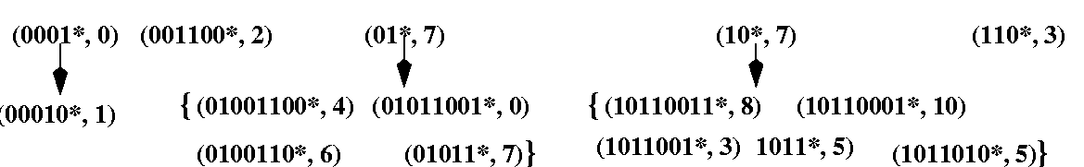
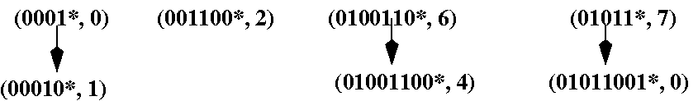
Binary prefix tree (cont)
Example- Prefixes in table 1. First step.
The second step,
Note- enclosures are in the higher level than the contained elements. (important!)
Univ. of Tehran
Computer Network

Slide 36
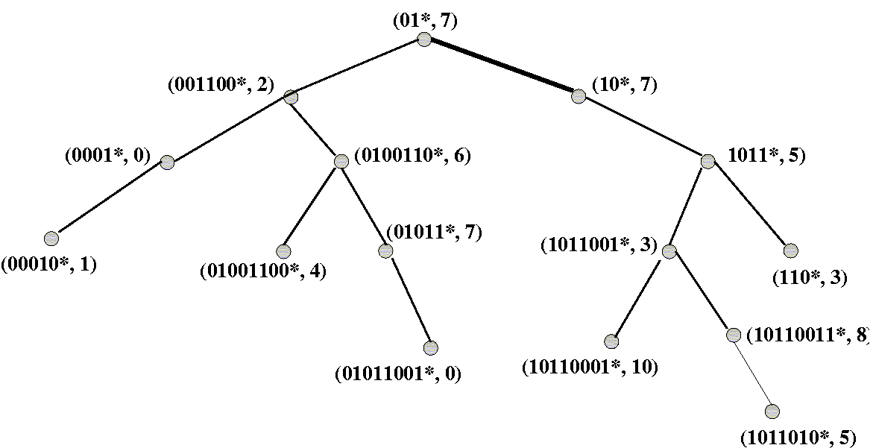
Binary prefix tree (cont)
The final tree structure
Univ. of Tehran
Computer Network

Slide 37
M_way prefix tree
Problems with the binary prefix tree.
  Two way branching.
  The structure is not dynamic and insertion may cause problems!.
Divide by m after sorting the strings
  Static m_way tree.
Build a dynamic data structure like B-tree.
  How to guarantee enclosure to be in the higher level than its contained elements.
  Define node splitting and insertion.
Univ. of Tehran
Computer Network

Slide 38
M_way prefix tree (Cont)
Node splitting: Finding the split point.
  Take the median if the data elements are disjoint.
  If there is an enclosure containing other elements, take it as split point.
  Otherwise, take an element which gives the best splitting result.
Note, this does not guarantee the final tree will be balanced.
Univ. of Tehran
Computer Network

Slide 39
M_way prefix tree (Cont)
Insertion:
  If the new element is not an enclosure of any prefix in the tree, find its place and insert it in the corresponding leaf, like B-tree.
  Otherwise, replace it with its shortest enclosed element.
  Reinsert the replace element and all elements in the substrees . It may cause space division.
Building tree is similar to building B-tree.
Univ. of Tehran
Computer Network

Slide 40
An Example
Routing
Table
Prefix
Abbrv.
Prefix
Abbrv.
10
-
1101110010
K
01
-
10001101
L
110
-
11101101
M
1011
-
01010110
N
0001
-
00100101
O
01011
-
100110100
P
00010
-
101011011
Q
001100
A
11101110
R
1011001
B
10110111
S
1011010
C
011010
T
0100110
D
011011
U
01001100
E
011101
V
10110011
F
0110010
W
10110001
G
101101000
X
01011001
H
101101110
Y
001011
I
00011101
Z
Univ. of Tehran
00111010
J
011110110
II
Computer Network

Slide 41
M-way prefix tree (cont)
We insert prefixes randomly.
The tree uses 5 branching factor (at most 4 prefixes in each node)
Insert 01011, 1011010, 10110001 and 0100110. Then, adding 110 cause overflow. Split node
 10110001 
(0100110,01011) (1011010, 110)
(all element are disjoint)
Univ. of Tehran
Computer Network

Slide 42
M-way prefix tree (cont)
Insert 10110011, 1101110010, 00010. Adding 1011001 causes overflow.
 10110001 ↓ 1011010 
(00010,0100110,01011) (1011001,10110011) (110,1101110010)
(case 3 of splitting)
Latter adding 1011 cause problem. It is the case of adding an enclosure. We will have space division.
Univ. of Tehran
Computer Network

Slide 43
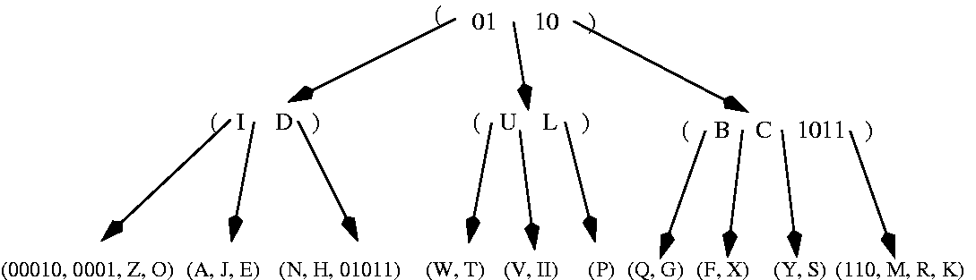
M-way prefix tree (cont)
The final tree
The tree supersede B-tree or B-tree is a special case of this tree. Then, when data element are relatively disjoint, the height of tree is log_{M}N.
Univ. of Tehran
Computer Network

Slide 44
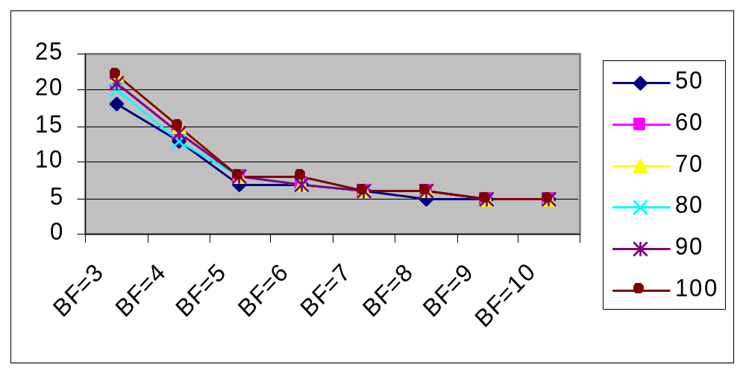
DMP-Tree
Max. height
No. of Data
BF is Branching factor in the internal nodes.
No. of Data is in1000s.
Univ. of Tehran
Computer Network

Slide 45
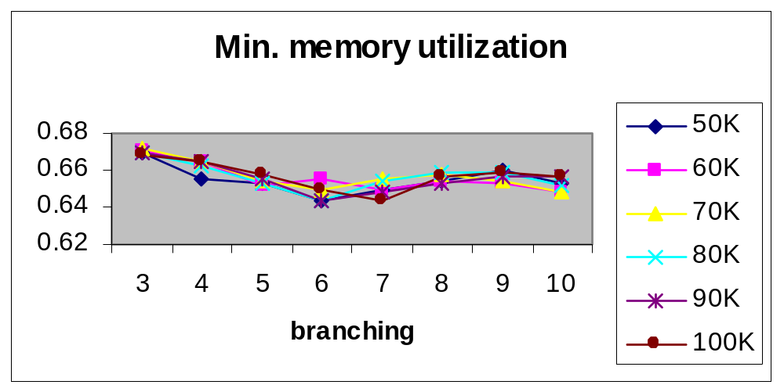
DMP-Tree
No. of Data
Number of prefixes are in the right.
Univ. of Tehran
Computer Network

Slide 46
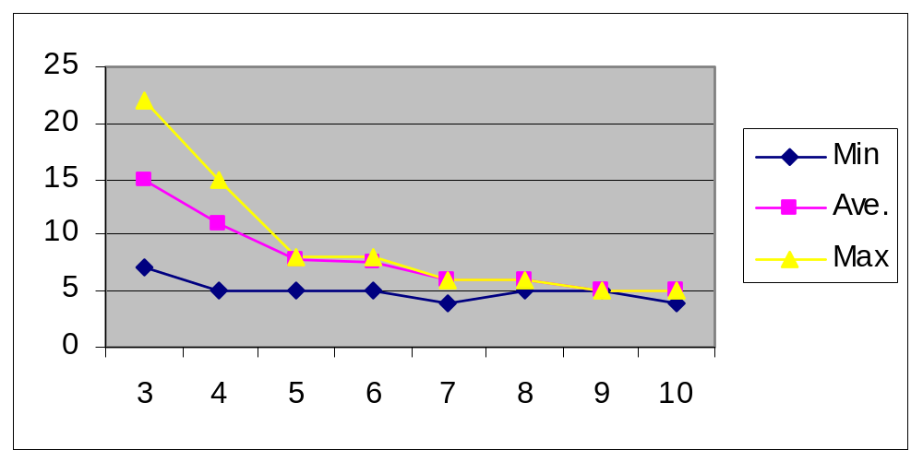
DMP-Tree
Height of tree for 100K data prefixes.
Height
Branching
Univ. of Tehran
Computer Network

Slide 47
Implementation: Tree Nodes
Internal nodes
Branching factor
Internal nodes.
  Each prefix has a left and right pointer which are pointing to left and right subtrees respectively.
  We can have N prefixes in each internal node. Then, N+1 is the branching factor.
  The bigger N, the faster search time, but the more logic is needed.
  Port is the address of the port in the switch to which the packet will be sent.
Leaf nodes
Addr 1 [?] | Prefix 1 [33] | Port [?] | Addr 2 [?] | Prefix 2 [33] | port [?] | … | Addr N+1
Univ. of Tehran
Computer Network

Slide 48
Tree Nodes
Leaf nodes.
  There is no left and right subtree pointers.
  The number of prefixes in the leaf node is M.
  The leaf nodes are stored in a off chip memory to make the scheme scalable to the large number of prefixes.
Prefix 1 [33] | port [?] | Prefix 2 [33] | port [?] | …
Univ. of Tehran
Computer Network

Slide 49
Branching Factor
What is the best number for N? (Branching factor)
  The bigger N, the faster search process. (Fact 1)
  The bigger N, the more memory pins are and usually the more memory Bandwidth is needed (Fact 2).
  The bigger N, the more logic we need to process the node (Fact 3).
Simulation result shows
  The bigger N, the better memory utilization in the memory.
  For N ≥ 8, the max. height of the tree does not decrease considerably.
Univ. of Tehran
Computer Network

Slide 50
Simulation result
Total memory: assuming one memory block and OC-192.
# of Prefixes | required Mem. | Branching Factor | Mem. Pins | Mem BW (G/s) max | Max mem Access | Mem. Size (on chip)mm² | Max heights
64K | 5.4 Mbits | 15 | 897 | 89.7 | 4 | 81 | 5
64K | 5.5 Mbits | 11 | 655 | 65.5 | 4 | 82 | 5
64K | 5.4Mbit | 9 | 527 | 52.7 | 4 | 81 | 5
64K | 6 Mbit | 6 | 335 | 46.9 | 6 | 96 | 7
64K | 6.6 Mbit | 5 | 275 | 44 | 7 | 110 | 8
64K | 6.5 Mbit | 4 | 207 | 62.1 | 14 | 112 | 15
100K | 8.3 Mbit | 15 | 897 | 89.7 | 4 | 122 | 5
100K | 8.5 Mbit | 11 | 655 | 65.5 | 4 | 125 | 5
100K | 8.3 | 9 | 527 | 63.24 | 5 | 122 | 6
100K | 9 Mbit | 6 | 335 | 53.6 | 7 | 135 | 8
100K | 9.1Mbit | 5 | 275 | 49.5 | 8 | 140 | 9
100K | 9.5 | 4 | 207 | 62.1 | 14 | 150 | 15
30K | 2.6 | 9 | 527 | 52.7 | 4 expected | 40 | 5 expected
Univ. of Tehran
Computer Network

Slide 51
Branching Factor
It seems any number between 8-16 is reasonable. But, N=9 gives a better search time and memory size.
Assuming 9 branching factors in the internal node, %50 node utilization and 128K prefixes, we need max. 128K/4.5= 28.5K address. Then, 15 bit address for left and right pointers are more than enough. But, we need more for off chip addressing
Univ. of Tehran
Computer Network

Slide 52
Branching Factor
In order to make the internal node branching and leaf node branching even, M=10.
If we want to read a node at once, we will need 41x10=410 pins which is difficult to support in one chip.
We can divide a node in two and read/write in two clock cycles. This reduce the memory pins to 205 which is affordable.
Univ. of Tehran
Computer Network

Slide 53
Memory requirement
Prefix tree: 128K prefixes, N = 9 (BF) and M=10 (BF in leaves), %80 of prefixes will be in leaves, assume %65 node utilization,
  # of ave prefixes in a leaf node node = 10*0.6 5= 6.5
  # of leaf nodes ≅ 128Kx%80x2/6.5 = 31.5K and %10 overhead ≅ 35 K
  Total off chip memory = 35K x 205(Mem BW) = 7.2 Mbits
  We need 16 bits for addressing. 1 bit for internal/external.
  # of internal nodes= 128Kx%20/5.8=4.41K and %10 overhead ≅4.9 K
  Total on chip memory=4.9Kx529 ≅ 2.6Mbits
Port to link address mapping table.
  For each port corresponding link address
  Max. 256 ports, on chip, some mem for indexing
Link Addr
48 bit addr.
Univ. of Tehran
Computer Network

Slide 54
Memory requirement
In summary:
# of Prefixes | on chip memory Mbits | Branching Factor | On chip Mem. Pins | Off chip memory Mbits | mem Access(search) | Mem. Size (on chip) mm² | ^{Off} chip mem pins
128K | 2.6 | 10 | 529 | 7.2 | 5 | 40 | 250
Note:
  Branching factor is the # of branching in internal nodes.
  The size of the memory scales with the size of data or
    # of prefixes.
  Power dissip. depends on the r/w freq, current & core voltage
  Considering Faraday Mem. Modules
    A 10Kx32 bits single port mem size is 36x1.45 mm².
Univ. of Tehran
Computer Network

Slide 55
Overall Design
Memory
Mem.
Ctrl
Search
root addr
Update Search
To/From
NP
root content
Insertion
update
delete
CPU
Inter
face
To/From
CPU
Port2Addr
Ctrl
MEM
Output mem Ctrl
Univ. of Tehran
To/From out Mem
Computer Network

Slide 56
Search Path
Mem Ctrl
To/From
Off mem
RdAdd[19]
Node
Root
Data[32]
Input
Addr[32]
Node
Node
SOA[1]
Piping
Addr[32]
GetLen
Compare
CResult[1]
Next
InClk[1]
Len[Nx6]
Match[1]
SOA[1]
First[1]
Addr[32]
Prty[1]
MemAddr[14]
Addr[32]
PackAdd[29]
Found[1]
IpAddr[32]
OutMemAddr
Cashing
LinkAddr[48]
Dispatch
Port[8]
Addr[32]
Addr[32]
DataOut[32]
To Scheduler
There are data assertion signals between blocks which has not been
shown every where because of space limitation.
Univ. of Tehran
Computer Network

Slide 57
Search Process
operations: This is for large prefixes (50K &up)
cashing
Piping
Piping
Piping
Piping
Piping
Off Mem
Dispatch
root
On chip memory nodes
Leaf node
0
2
5
8
11
14
16
19
Time
This operation is for an IP address lookup
Piping is the bottleneck in the system and in ave. take 5 cycles.
Assuming 100 MHZ operation
  # of packets = 10⁹/50 = 20 Million
  Line speed = 512x20 = 10.24 G for 64 byte packets.
  = 256x8x20= 41 G for 256 byte packets.
It is possible to support higher speeds with duplicating pipe.
Univ. of Tehran
Computer Network

Slide 58
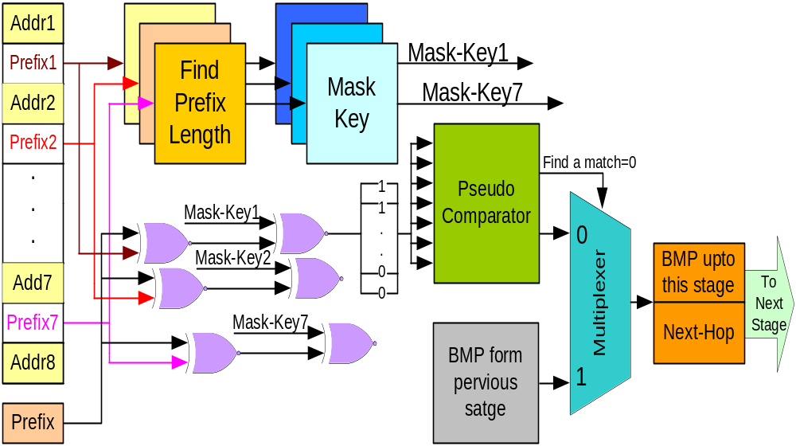
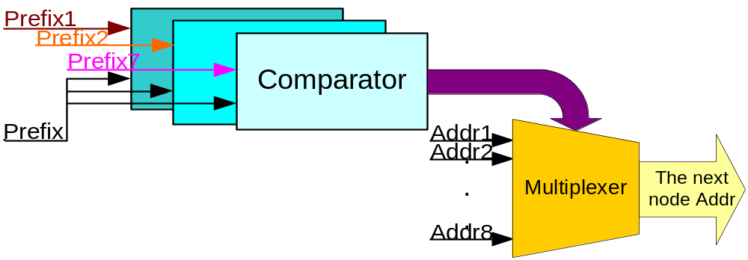
Full Pipelining of node
Full pipelining of
One level or one
Node of the tree
Univ. of Tehran
Computer Network

Slide 59
Full Pipelining of whole tree
Whole tree can be pipelined by repeating the logic with the number of tree level.
Each level of tree needs to be stored in a different memory module.
In average, a lookup can be done in one clock cycle.
Univ. of Tehran
Computer Network

Slide 60
Software Implementation
How to represent prefixes
  With adding 1 in the end and filling with 0’s
    Needs around 3 clk cycles to extract length, for two 6 cycles.
How to compare
  According to definition
    Check which one’s length is bigger (1 clock)
    Makes lengths equal (3-4 clock)
    Compare prefixes (1 clock)
    Check next bit if they are equal (3 clock)
  at least 15 clock to compare.
With 9 branching 6x9x15=810 cycles plus overhead and memory access. Over 1000 cycles.
Univ. of Tehran
Computer Network

Slide 61
Software Impl: improvement
We know which one’s length is bigger.
We know the length of one prefix, IP addr.
No need to compare all fields, in ave, 6 compare (5-6 clock)
How to compare
  According to definition
    Extract prefix length (3-4 clock)
    Makes lengths equal (3-4 clock)
    Compare prefixes (1 clock)
    Check next bit if they are equal (3 clock)
  at least 10 clock to compare.
With 9 branching 6x6x10=360 cycles plus overhead and memory access.
Univ. of Tehran
Computer Network

Slide 62
Software Impl: HOSM format
Prefix can be represented by adding a zero to its tail, and then filling it with ones to make its length equal to the biggest possible prefix length plus one, here 32. (e.g.: 101* represents as 101011….1.)
Numerical comparison between prefixes in Hosm-Format is equivalent to prefix-comparison of the original Definition.
We can compare prefixes in one cycle.
With 9 branching 6x6=36! cycles plus overhead and memory access.
Univ. of Tehran
Computer Network

Slide 63
New Service requirements
Blocking traffic sent by insecure sites (firewalls)
Preferential treatment for premium traffic (resource reservation)
Routing based on traffic type and source (QoS routing)
Accounting for each user (Billing)
Limiting rate from some sources (Shaping)
We need to distinguish traffic based on destination, source, application type, etc or to Classify packets.
Univ. of Tehran
Computer Network

Slide 64
Packet Classification?
Informally
  Identifies the flow a packet belongs to, based on one or more fields in the packet header
  The ability to match each packet against a database of rules
  The process of categorizing packets into “flows” in an Internet router
<number>/119

Slide 65
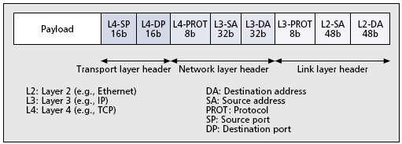
Packet Header
<number>/119
Some of the header fields be used for classifying the packet. Although not shown, higher-layer (application level) headers may also used.

Slide 66
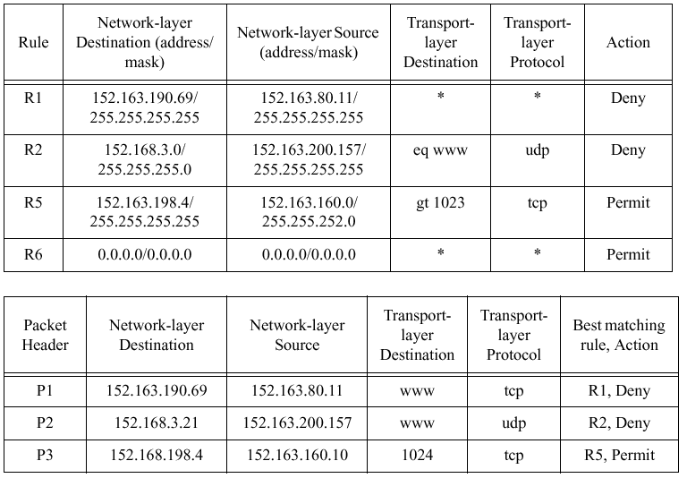
Example Classifier
<number>/119

Slide 67
Performance Metrics
Search speed
Storage requirement
Scalability in classifier size
Scalability in the number of header fields
Update time
Flexibility in specification
<number>/119

Slide 68
Next Lecture: Routing
Interdomain routing.
References
  Hari Balakrishnan notes about Interdomain from Mit
  RFC1771-2-3-4., rfc1267, rfc4632 : Main BGP RFCs.
  RFC1965: AS confederations for BGP
  Craig Labovitz and .. “Delayed internet Routing Convergence”
  John Stewart III: “BGP4 - Inter-domain routing in the Internet”
  HLP: A Next Generation Interdomain Routing Protocol
  “Some Foundational Problems in Interdomain Routing”
Univ. of Tehran
Computer Network

