Slide 1
Computer Networks
(Graduate level)
Lecture 6: Router & Switch Design
University of Tehran
Dept. of EE and Computer Engineering
By:
Dr. Nasser Yazdani

Slide 2
Routers
How do you build a router
How to process and forward packets
Switch fabric design.
Assigned reading
  [P+98] A 50 Gb/s IP Router
  Chapter 3 of the book

Slide 3
Outline
What is a router?
Router Architecture
  Different router Architectures
  The evolution of router architecture.
A case Study

Slide 4
What is Routing?
R3
R1
A
R4
D
B
E
R2
C
R5
F

Slide 5
Points of Presence (POPs)
POP3
POP2
POP1
A
POP4
D
B
POP5
E
C
POP6
POP7
POP8
F

Slide 6
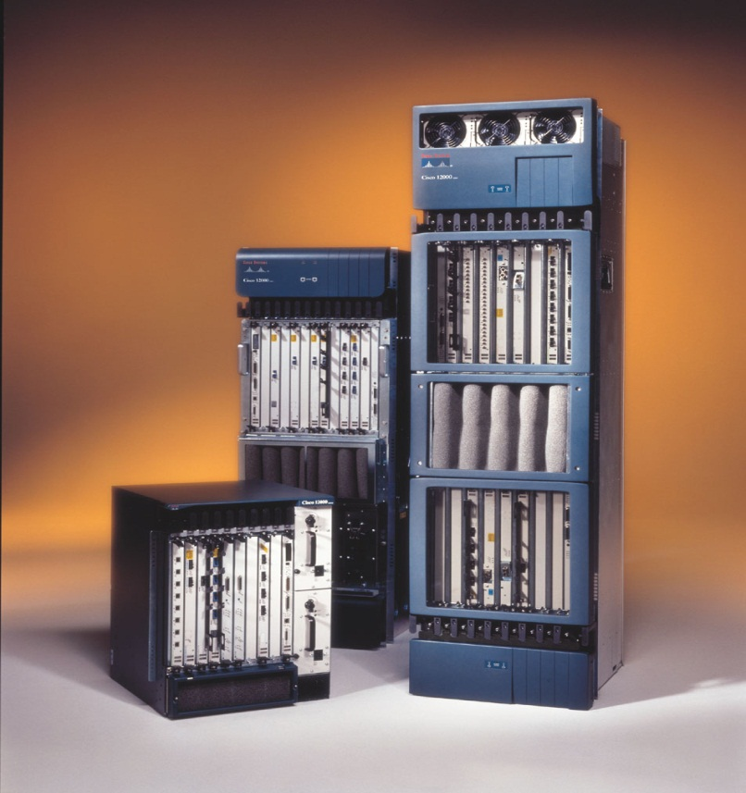
High Performance Routers Usage
R2
(2.5 Gb/s)
(2.5 Gb/s)
R1
R6
R5
R4
R3
R7
R9
R8
R10
R11
R12
R14
R13
R16
R15
(2.5 Gb/s)
(2.5 Gb/s)

Slide 7
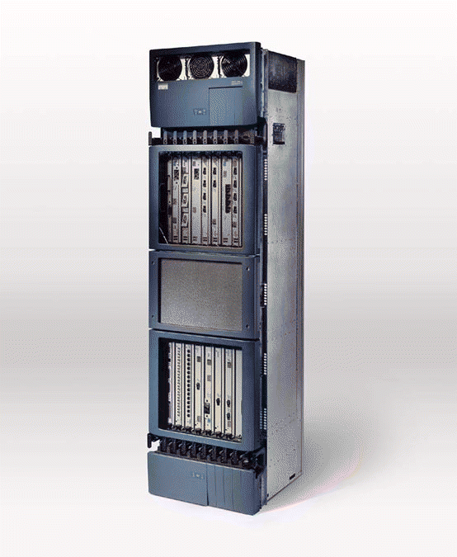
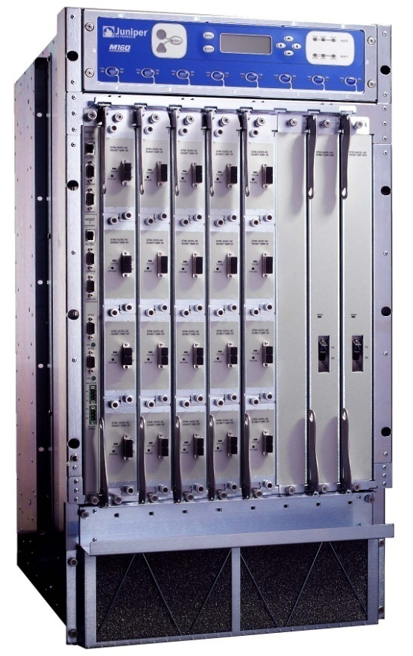
What a Router Looks Like
Cisco GSR 12416
Juniper M160
19”
19”
Capacity: 160Gb/s
Power: 4.2kW
Capacity: 80Gb/s
Power: 2.6kW
6ft
3ft
2ft
2.5ft

Slide 8
IP Router
.
.
.
.
.
.
Router implements the following functionalities
  Forward packet to corresponding output interface, Forwarding engine.
  Manage routing/congestion

Slide 9
Components of an IP Router
Routing
Protocols
Control Plane
Routing
Table
Datapath
per-packet
processing
Forwarding
Table
Switching
Two distinguish functional planes
Slow path or Control Plane
Fast Path or Data Plane

Slide 10
Per-packet processing
Accept packet arriving on an incoming link.
Lookup packet destination address in the forwarding table, to identify outgoing port(s).
Manipulate packet header: e.g., decrement TTL, update header checksum.
Send packet to the outgoing port(s).
Buffer packet in the queue.
Transmit packet onto outgoing link.

Slide 11
Generic Network Processor
Processing View
Header Processing
Data
Hdr
Lookup
IP Address
Update
Header
Queue
Packet
Data
Hdr
IP Address
Next Hop
Address
Table
Buffer
Memory
~1M prefixes
Off-chip DRAM
~1M packets
Off-chip DRAM

Slide 12
Generic Router Architecture
Data
Hdr
Data
Header Processing
Backplane
Hdr
Buffer
Manager
Lookup
IP Address
Update
Header
Address
Table
Buffer
Memory
Switching
Data
Hdr
Data
Header Processing
Hdr
Buffer
Manager
Lookup
IP Address
Update
Header
Address
Table
Buffer
Memory
Data
Hdr
Data
Hdr
Header Processing
Buffer
Manager
Lookup
IP Address
Update
Header
Central
Processor
Address
Table
Buffer
Memory

Slide 13
Function division
Line cards
  Network interface cards
Input interfaces:
  May enqueue packets and perform scheduling
Output interfaces:
  May enqueue packets and perform scheduling
Forwarding engine
  Fast path routing (hardware vs. software)
Backplane
  Switch or bus interconnect
Network controller or central unit
  Handles routing protocols, error conditions

Slide 14
Router Architectures
Where to queue incoming packets?
Output queued
Input queued
Combined Input-Output queued
It is the same as switch architecture

Slide 15
Output Router
Data
1
1
Hdr
Header Processing
Queue
Packet
Lookup
IP Address
Update
Header
Address
Table
Buffer
Memory
Data
2
2
N times line rate
Hdr
Header Processing
Queue
Packet
Lookup
IP Address
Update
Header
Address
Table
Buffer
Memory
N times line rate
Data
Hdr
Header Processing
N
N
Queue
Packet
Lookup
IP Address
Update
Header
Address
Table
Buffer
Memory

Slide 16
Output Queuing (OQ)
Only output interfaces store packets
Advantages
  Easy to design algorithms: only one congestion point
Disadvantages
  Requires an output speedup of N, where N is the number of interfaces → not feasible
input interface
output interface
Backplane
R_{O}
C

Slide 17
Input Router
Data
Hdr
Header Processing
Lookup
IP Address
Update
Header
Queue
Packet
1
1
Address
Table
Buffer
Memory
Data
Hdr
Data
Hdr
Header Processing
Data
Queue
Packet
2
2
Hdr
Lookup
IP Address
Update
Header
Address
Table
Buffer
Memory
Scheduler
Data
Hdr
Header Processing
Lookup
IP Address
Update
Header
Queue
Packet
N
N
Address
Table
Buffer
Memory
Data
Hdr

Slide 18
Input Queuing
The best that any queueing system can achieve.

Slide 19
Input Queuing
Head of Line Blocking
The best that any queueing system can achieve.

Slide 20
Head of Line Blocking

Slide 21
An input-queued (IQ) switch
1
R
R
Properties of an IQ switch
All buffering takes place at the input.
Input queues only need to be able to write packets at rate R (instead of N x R).
2
R
R
R
R
Consequences
Can build a switch N times faster.
But, a packet can be held up by packet ahead destined to a different output.
Hence an IQ switch is not “work conserving”. It can unnecessarily idle.
May not achieve “100% throughput”.
Average delay is not minimized.
3
…
N
R
R

Slide 22
Input Queueing (IQ)
Advantages
  Easy to built
    Store packets at inputs if contention at outputs
  Relatively easy algorithm
    Only one congestion point, but not output…
    need to implement backpressure
input interface
output interface
Backplane
R_{O}
C
Disadvantages
  Hard to achieve %100 utilization (due to output contention, head-of-line blocking)
    However, theoretical and simulation results show that for realistic traffic an input/output speedup of 2 is enough to achieve utilizations close to 1

Slide 23
Virtual Output Queues

Slide 24
with Virtual Output Queues
The best that any queueing system can achieve.

Slide 25
Maximum Weight Matching
S*(n)
L₁₁(n)
A₁(n)
A₁₁(n)
D₁(n)
1
1
A_{1N}(n)
A_{N}(n)
A_{N1}(n)
D_{N}(n)
A_{NN}(n)
N
N
L_{NN}(n)
L₁₁(n)
Maximum
Weight Match
L_{N1}(n)
“Request” Graph
Bipartite Match

Slide 26
Combined Input-Output Queueing (CIOQ) Routers
Both input and output store packets
Advantages
  Easy to achieve higher performance
    Utilization 1 can be achieved with limited input/output speedup (<= 2)
Disadvantages
  Harder design algorithms
    Two congestion points
    Need to design flow control
  Note: recent results show that with a input/output speedup of 2, a CIOQ can emulate any work-conserving OQ [G+98,SZ98]
input interface
output interface
Backplane
R_{O}
C

Slide 27
Generic Architecture of a High Speed Router Today
Combined Input-Output Queued Architecture
  Input/output speedup <= 2
Input interface
  Perform packet forwarding (and classification)
Output interface
  Perform packet (classification and) scheduling
Backplane
  Point-to-point (switched) bus; speedup N
  Schedule packet transfer from input to output

Slide 28
Backplane
Point-to-point switch allows to simultaneously transfer a packet between any two disjoint pairs of input-output interfaces
Goal: come-up with a schedule that
  Meet flow QoS requirements
  Maximize router throughput
Challenges:
  Address head-of-line blocking at inputs
  Resolve input/output speedups contention
  Avoid packet dropping at output if possible
Note: packets are fragmented in fix sized cells (why?) at inputs and reassembled at outputs
  In Partridge et al, a cell is 64 B (what are the trade-offs?)

Slide 29
Cell transfer
Schedule:
  Ideally: find the maximum number of input-output pairs:
    Resolve input/output contentions
    Avoid packet drops at outputs
    Packets meet their time constraints (e.g., deadlines), if any
Example
  Assign cell preferences at inputs, e.g., their position in the input queue
  Assign cell preferences at outputs, e.g., based on packet deadlines, or the order in which cells would depart in a OQ
  Match inputs and outputs based on their preferences
Problem:
  Achieving a high quality matching complex, i.e., hard to do in constant time

Slide 30
Bus-Based Switches
CP
Input Port Processors (IPP) do:
  lookup, sync and format conversion and put cells on bus
Output Port Processors (OPP)
  Buffer cells awaiting transmission
Control Processor (CP)
  exchanges control messages with terminals and other CPs
  configures connections by writing in IPP routing tables
IPP
OPP
. . .
. . .
Common bus interconnects various components.
  Requires bandwidth equal to sum of external link bandwidths;
  bus width must increase with number of links (scale?)
    capacitive loading generally reduces clock rate as number of links grows
Problems?
  Scale? Usually O(n²)
  OPP should operate with the rate of bus.
  Fairness?

Slide 31
Bus Arbitration: Rotating Daisy Chain (Fairness)
0
In systems where link bandwidth is larger than bus bandwidth, need mechanism to regulate bus access
Rotating token eliminates positional favoritism of static daisy chain
Not always fair
  if two consecutive inputs are competing “second” one gets fewer bus cycles
For “fair-sharing”
  advance token to winning IPP
Limited functionality!
request
data
1
request
data
0
request
data
0
request
data

Slide 32
Bus Arbitration: Central Arbiter
IPPs send requests to central arbiter which picks winner.
Requests may include priority.
  static “importance” of data to be sent
  waiting time of data
  length of IPP queue
  combination
Arbiter can become a performance bottleneck.
Distributed version eliminates bottleneck
  uses bit-serial maximum computation to select highest priority value
request
data
request
data
ARB
request
data
request
data

Slide 33
Two Level Bus Design(scale)
In simple bus, every driver and receiver contributes to capacitive loading.
  increases rise and fall times of signals, limiting frequency.
In two level bus, lower capacitive loads per segment.
Adds control complication and delay.
Can be extended to more than two levels, but diminishing returns.
Group Bus
Inputs from IPPs
Global Bus
. . .
Outputs to OPPs
. . .
Group Bus

Slide 34
Subdivided Bus with Knockout Concentrators
w/n
IPP
Split bus into n “minibuses”
with w/n wires each
Each minibus driven by just
one IPP.
  cuts capacitive loading in half
  adding fanout components
  allows higher clock frequencies
OPPs concentrate n minibuses
onto L<n outputs (optional)
OPPs must each be able to
buffer up to L cells in parallel
Parallel reception complicates control somewhat
Concentration reduces required OPP memory bandwidth
IPP
IPP
IPP
w
OPPs

Slide 35
Knockout Switch
Inputs
D
D
D
D
D
D
Concentrator
  select l of
  n packets
Complexity: o(n²)
D
D
D
D
D
D
D
D
1
2
3
4
Outputs

Slide 36
Ring Switches
Ring Interfaces (RI) connect IPP and OPP to ring.
Ring avoids capacitive loading of bus, allowing higher clock frequencies.
Latency of 1-4 clock ticks
per RI.
Same overall bandwidth requirements and complexity characteristics as bus.
Common control mechanisms
  token passing
  slotted ring with busy bit
  delay-insertion
ITI
RI
RI
ITI
OTI
OTI
ITI
RI
RI
ITI
OTI
OTI

Slide 37
Shared Buffer Switches
CP
IPP
OPP
Queues are rarely full, then, memory for queues is rarely fully used.
Share memory among all queues.
Requires a central memory with bandwidth equal to twice the external link bandwidth. Bus bandwidth must also be doubled.
Per output or per flow queues typically implemented as linked lists.
. . .
. . .
. . .
Size of Memory can be estimated by taking the convolution of the queue length distributions of individual output queues.
For switches with 10 or more links, can reduce required memory by up to an order of magnitude.
Depends on independence of queuing processes at different outputs.

Slide 38
Crossbar Switches
Crossbar allows multiple cells to
pass in parallel to distinct outputs
  use of point-to-point transmission cuts
  capacitive loading at circuit board level
  parallelism allows smaller data path
  widths at IPPs, OPPs
Control circuit arbitrates access to
outputs
  for each output can use any standard bus
  arbitration mechanism
    daisy-chain with optional rotating starting point
    dynamic priority arbitration mechanism
  alternative approach is time-slotted arbitration ring
Retains quadratic complexity, but concentrates it within chip or chip set, reducing impact on system cost
OPP
OPP
. . .
OPP
IPP
IPP
. . .
IPP
Controller

Slide 39
Crossbar Implementation
OPPs
Detail of one column
IPPs
control
registers
staging
registers
Control
_ _ _
a₂a₂ a₁a₁ a₀a₀
Control registers specify connected input.
Crosspoints decode specified “row number”.
New values are pre-loaded into staging registers.
One input can connect to multiple outputs.

Slide 40
Time Slotted Arbitration Ring
step 1
step 2
step 3
step 4
step 5
step 6
positive
acks
x
y
z
y
z
y
z
y
z
y
z
y
z
3
0
0
1
1
2
0
3
ü
0
4
0
5
1
1
1
ü
0
2
0
3
0
4
0
5
1
0
0
5
2
0
3
0
4
0
5
û
1
0
0
1
1
1
3
0
4
0
5
1
0
0
1
û
1
2
0
3
4
0
5
1
0
0
1
1
2
0
3
û
1
5
5
ü
0
0
0
1
1
2
0
3
1
4
0
For each input, there is a register x_{i} containing desired output, a register y_{i} and a flip flop z_{i}, linked in circular shift register; initially y_{i} =i, z_{i}=0.
Shift register shifts between each arbitration step, so y_{i} , z_{i} are assigned previous values of y_{i+1}, z_{i+1}.
During arbitration step, x_{i} and y_{i} are compared; if equal and if z_{i} =0, then waiting cell has “won” and z_{i} is set.
Make accessibility even by initializing y_{i} to i+offset at start of each cycle, where offset is incremented by 1 modulo n before first step.
Arbitration time is proportional to n.

Slide 41
Scalable Crossbar Controller
in_{i}
Inputs send requests bit-serially along rows.
Arbitration Elements compare request bits to column number bits.
One AE per column holds token for rotating daisy-chain arbitration.
Token passed to AE following winner at end of cycle.
Approximately 25 gate-equivalents per AE.
  64 port crossbar controller requires 100K gates
req_{i}
ack_{i}
row_{i}
out₀
out₁
out₂
out₃
out₄
out₅
out₆
out₇
in₀
0,0
0,1
0,2
0,3
0,4
0,5
0,6
0,7
in₁
1,0
1,1
1,2
1,3
1,4
1,5
1,6
1,7
in₂
2,0
2,1
2,2
2,3
2,4
2,5
2,6
2,7
in₃
3,0
3,1
3,2
3,3
3,4
3,5
3,6
3,7
in₄
4,0
4,1
4,2
4,3
4,4
4,5
4,6
4,7
in₅
5,0
5,1
5,2
5,3
5,4
5,5
5,6
5,7
in₆
6,0
6,1
6,2
6,3
6,4
6,5
6,6
6,7
in₇
7,0
7,1
7,2
7,3
7,4
7,5
7,6
7,7
req_{i}
column₀
column₁
column₂
column₃
column₄
column₅
column₆
column₇
i,j
ack_{i,j}
row_{i}
avail_{i,j}
winner_{i,j}
column_{j}
requestor_{j}

Slide 42
Arbitration Element Details
Upper flip flop holds token for arbitration process.
  passed at end of cycle to AE following winner
  if no winner in previous cycle, stays in same location
Lower flip flop & associated gates implement serial comparator.
  flip flop initialized to 1 and cleared on first mismatched bit
Acknowledgement returned to input, after arbitration.
Input passes row number through enabled tri-state driver to output.
winner_{i-1,j}
avail_{i-1,j}
req_{i}
i,j
D
Q
>C
D
Q
>C
ack_{i,j}
row_{i}
init
pass
avail_{i,j}
column_{j}
compare
winner_{i,j}
requestor_{j}

Slide 43
Output Contention in Crossbars
Different inputs can compete for one output.
Can alleviate by increasing crossbar bandwidth
Simple analysis
  assume each crossbar input has cell with probability p, each input cell is independent and output addresses are equiprobable.
  for any given output, probability that i cells are addressed to it is
  on average, there are n(1−p/n)^{n} ≈ ne^{-p} outputs for which there are no cells.
  so, out of expected pn input cells, ≈ (1−e^{−p})n leave.
  for p=1, about .63n can leave, implying limit on usable crossbar capacity.
More precise analysis shows that for large n, maximum crossbar throughput closer to .58n cells per cycle.

Slide 44
Crossbar, Virtual Output Queues
Separate virtual output queues at each input.
  queues implemented using linked lists in common memory
Controller seeks to match inputs to outputs.
  keep outputs busy
  emulate queuing behavior of “ideal switch”
  best algorithms work well for arbitrary input traffic
  some speedup still needed
Does not extend readily to multicast.
  cannot associate cell with single VOQ
OPP
OPP
. . .
OPP
IPP
. . .
IPP
. . .
IPP
Controller

Slide 45
Iterative Matching with Random Selection
first round
second round
traffic
pairs
outputs
select inputs
inputs select
outputs
outputs
select inputs
inputs select
outputs
While there is an “unscheduled output” with waiting cells,
  for each unscheduled output with waiting cells, randomly select an input with cells to send
  for each selected input, randomly pick one of the selecting outputs
    call these (input,output) pairs, matched pairs
May produce as few as half the ideal number of matched pairs.

Slide 46
Performance on Random Traffic
Ratio of number of “lost” transmit opportunities to input load
Negligible lost link capacity for speedups >1.5
Loss drops at heavy loads, since output queues rarely empty.

Slide 47
Iterative Round Robin with iSLIP
first round
second round
initial
configuration
outputs
select inputs
inputs select
outputs
outputs
select inputs
inputs select
outputs
i-SLIP algorithm seeks to desynchronize priorities.
  update priorities only for those outputs whose selections are “confirmed” in second half of round
  update priorities only in first round
  provides good performance for random traffic with minimal speedup
  works well even with limit on iterations

Slide 48
High Performance Crossbars
Need parallelism for high performance systems.
  32×10G system needs total bandwidth over 1 Tb/s
  single ICs now limited to under under 100 Gb/s
    32 gigabit serial links at 2.5 Gb/s each
“Bit-sliced” design makes best use of IC bandwidth.
IPP
OPP
crossbar
chip
IPP
OPP
controller
  mux/demux convert single fast datapath to/from many small ones
    divides each cell into smaller pieces, or
    send each cell through just one crossbar - allows control to be parallelized too, but may get cells out of order
Can also build large crossbars by tiling smaller components.
  leads to complex and high cost systems (relative to alternatives)
  often done, but almost never a good idea

Slide 49
First Generation Routers
Shared Backplane
CPU
Buffer
Memory
Route
Table
CPU
Line Interface
Memory
Line
Interface
Line
Interface
Line
Interface
MAC
MAC
MAC
Typically <20 Gb/s aggregate capacity

Slide 50
Second Generation Routers
CPU
Route
Table
Buffer
Memory
Line
Card
Line
Card
Line
Card
Buffer
Memory
Buffer
Memory
Buffer
Memory
Fwding
Cache
Fwding
Cache
Fwding
Cache
MAC
MAC
MAC
Typically < 120 Gb/s aggregate capacity

Slide 51
Third Generation Routers
Switched Backplane
Line
Card
CPU
Card
Line
Card
Local
Buffer
Memory
Local
Buffer
Memory
Line Interface
CPU
Routing
Table
Memory
Fwding
Table
Fwding
Table
MAC
MAC
Typically < 640 Gb/s aggregate capacity

Slide 52
Fourth Generation Routers/Switches
Optics inside a router for the first time
Optical links
100s
of metres
Switch Core
Linecards
0.3 - 10Tb/s routers in development

Slide 53
A Case Study [Part., ’98]
Goal: show that routers can keep pace with improvements of transmission link bandwidths
Architecture
  A CIOQ router
  15 (input/output) line cards: C = 2.4 Gbps
    Each input card can handle up to 16 (input/output) interfaces
    Separate forward engines (FEs) to perform routing
  Backplane: Point-to-point (switched) bus, capacity B = 50 Gbps (32 MPPS)
    B/C = 20, but 25% of B lost to overhead (control) traffic

Slide 54
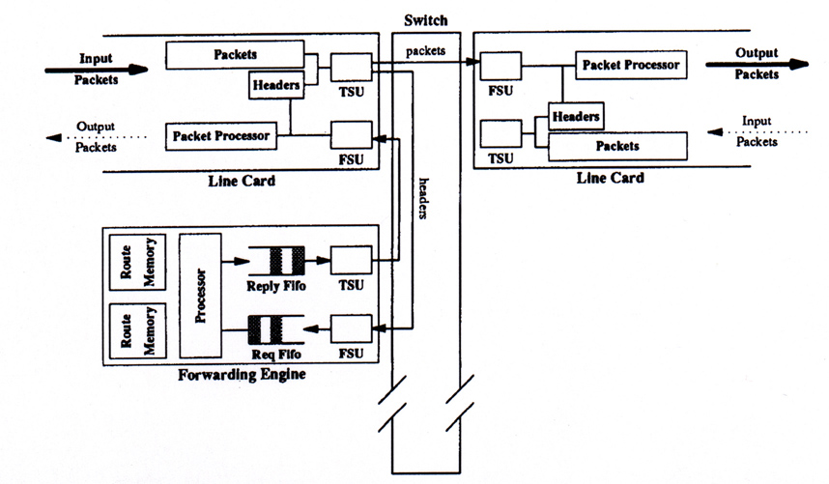
Router Architecture
packet
header

Slide 55
Architecture
input interface
output interfaces
1
Backplane
Data out
15
Data in
Update
routing
tables
Set scheduling
(QoS) state
forward engines
Network
processor
Control data
(e.g., routing)

Slide 56
Data Plane
Line cards
  Input processing: can handle input links up to 2.4 Gbps (3.3 Gbps including overhead)
  Output processing: use a 52 MHz FPGA; implements QoS
Forward engine:
  415-MHz DEC Alpha 21164 processor, three level cache to store recent routes
    Up to 12,000 routes in second level cache (96 kB); ~ 95% hit rate
    Entire routing table in tertiary cache (16 MB divided in two banks)

Slide 57
Control Plane
Network processor: 233-MHz 21064 Alpha running NetBSD 1.1
  Update routing
  Manage link status
  Implement reservation
Backplane Allocator: implemented by an FPGA
  Schedule transfers between input/output interfaces

Slide 58
Checksum
Takes too much time to verify checksum
  Requires 17 instructions with min of 14 cycles, Increases forwarding time by 21%
Take an optimistic approach: just incrementally update it
  Safe operation: if checksum was correct it remain correct
  If checksum bad, it will be anyway caught by end-host
Note: IPv6 does not include a header checksum anyway!

Slide 59
Slow Path Processing
Headers whose destination misses in the cache
Headers with errors
Headers with IP options
Datagrams that require fragmentation
Multicast datagrams
  Requires multicast routing which is based on source address and inbound link as well
  Requires multiple copies of header to be sent to different line cards

Slide 60
Backplane Allocator
Time divided in epochs
  An epoch consists of 16 ticks of data clock (8 allocation clocks)
Transfer unit: 64 B (8 data click ticks)
During one epoch, up to 15 simultaneous transfers in an epoch
  One transfer: two transfer units (128 B of data + 176 auxiliary bits)
Minimum of 4 epochs to schedule and complete a transfer but scheduling is pipelined.
  Source card signals that it has data to send to the destination card
  Switch allocator schedules transfer
  Source and destination cards are notified and told to configure themselves
  Transfer takes place
Flow control through inhibit pins

Slide 61
The Switch Allocator Card
Takes connection requests from function cards
Takes inhibit requests from destination cards
Computes a transfer configuration for each epoch
15X15 = 225 possible pairings with 15! Patterns

Slide 62
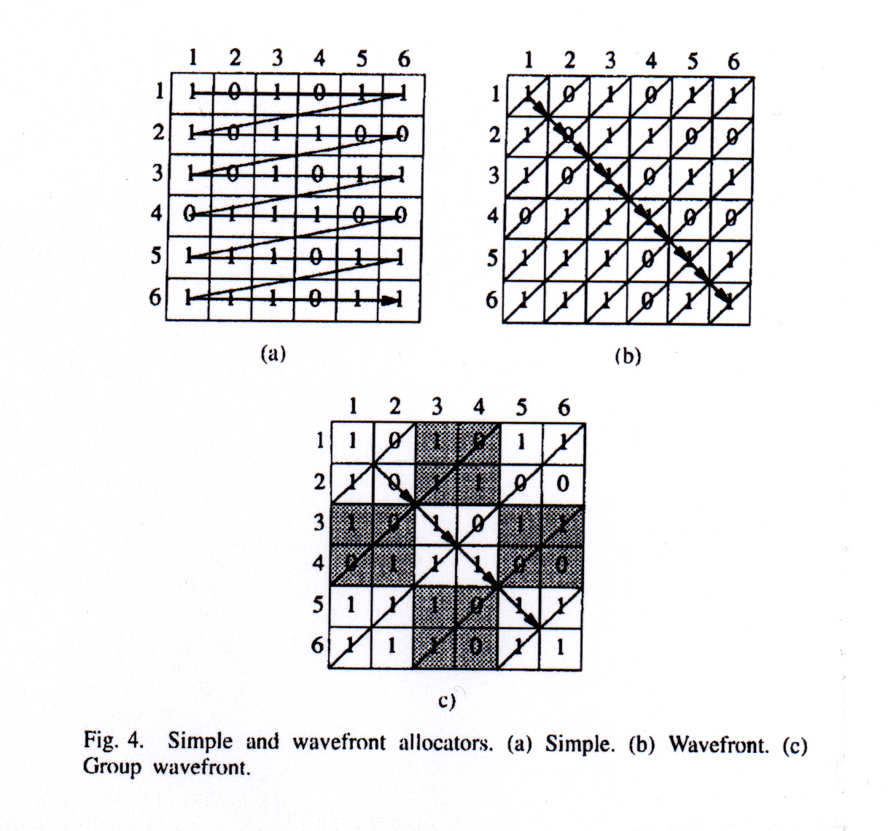
Allocator Algorithm

Slide 63
The Switch Allocator
Disadvantages of the simple allocator
  Unfair: there is a preference for low-numbered sources
  Requires evaluating 225 positions per epoch, which is too fast for an FPGA
Solution to unfairness problem: Random shuffling of sources and destinations
Solution to timing problem: Parallel evaluation of multiple locations
Priority to requests from forwarding engines over line cards to avoid header contention on line cards

Slide 64
But…
Remember that if you want per flow processing the performance need to increase at a faster rate than the link capacity!
If link capacity increases by n, two effects:
  The time to process a packet decreases by n
  The number of flows increase (by n?), thus the per packet processing also increases

Slide 65
Challenges
Build an optimal allocator that makes decisions in constant time
Packet classification.
Packet scheduling.

Slide 66
Fast path of the code
Stage 1:
  Basic error checking to see if header is from a IP datagram
  Confirm packet/header lengths are reasonable
  Confirm that IP header has no options
  Compute hash offset into route cache and load the route
  Start loading of next header

Slide 67
Fast path of the code
Stage 2
  Check if cached route matches destination of the datagram
  If not then do an extended lookup in the route table in Bcache
  Update TTL and CHECKSUM fields
Stage 3
  Put updated TTL, checksum and the route information into IP hdr along with link layer info from the forwarding table

Slide 68
Some datagrams not handled in fast path
Headers whose destination misses in the cache
Headers with errors
Headers with IP options
Datagrams that require fragmentation
Multicast datagrams
  Requires multicast routing which is based on source address and inbound link as well
  Requires multiple copies of header to be sent to different line cards

Slide 69
Instruction set
27% of them do bit, byte or word manipulation due to extraction of various fields from headers
The above instructions can only be done in E0, resulting in contention (checksum verifying)
Floating point instructions account for 12% but do not have any impact on performance as they only set SNMP values and can be interleaved
There is a minimum of loads(6) and stores(4)

Slide 70
Issues in forwarding design
Why not use an ASIC in place of the engine ?
  Since IP protocol is stable, why not do it ?
  Answer depends on where the router will be deployed: corporate LAN or ISP’s backbone?
How effective is a route cache ?
  A full route lookup is 5 times more expensive than a cache hit. So we need modest hit rates.
  And modest hit rates seem to be assured because of packet trains

Slide 71
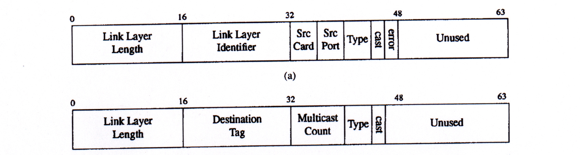
Abstract link layer header
Designed to keep the forwarding engine and its code simple

Slide 72
Forwarding Engine (P+88)
General purpose processor + software
8KB L1 Icache
  Holds full forwarding code
96KB L2 cache
  Forwarding table cache
16MB L3 cache
  Full forwarding table x 2 - double buffered for updates

Slide 73
Network Processor
Runs routing protocol and downloads forwarding table to forwarding engines
  Two forwarding tables per engine to allow easy switchover
Performs “slow” path processing
  Handles ICMP error messages
  Handles IP option processing

Slide 74
Line Card Interconnect (P+88)
Virtual output buffering
  Maintain per output buffer at input
  Solves head of line blocking problem
  Each of MxN input buffer places bid for output
Crossbar connect
Challenge: map of bids to schedule for crossbar

Slide 75
Switch Scheduling (P+88)
Schedule for 128 byte slots
  Greedy mapping of inputs to outputs
Fairness
  Order of greedy matching permuted randomly
  Priority given to forwarding engine in schedule (why?)
Parallelized
  Check independent paths simultaneously

Slide 76
Summary: Design Decisions (Innovations)
Each FE has a complete set of the routing tables
A switched fabric is used instead of the traditional shared bus
FEs are on boards distinct from the line cards
Use of an abstract link layer header
Include QoS processing in the router

Slide 77
Why Faster Routers?
To prevent routers becoming the bottleneck in the Internet.
To increase POP capacity, and to reduce their cost, size and power.

Slide 78
Why Faster Routers?
1: To prevent routers from being the bottleneck
Packet processing Power
Link Speed
10000
2x / 18 months
2x / 7 months
1000
100
Fiber Capacity (Gbit/s)
10
1
1985
1990
1995
2000
0,1
TDM
DWDM
Source: SPEC95Int & David Miller, Stanford.

Slide 79
Why Faster Routers?
2: To reduce cost, power & complexity of POPs
POP with large routers
POP with smaller routers
  Ports: Price >$100k, Power > 400W.
  It is common for 50-60% of ports to be for interconnection.

Slide 80
Fast Routers Difficulties?
It’s hard to keep up with Moore’s Law:
  The bottleneck is memory speed.
  Memory speed is not keeping up with Moore’s Law.
1.1x / 18 months

Slide 81
Fast Routers Difficulties?
Speed of Commercial DRAM
Moore’s Law
2x / 18 months

Slide 82
Fast Routers Difficulties?
It’s hard to keep up with Moore’s Law:
  The bottleneck is memory speed.
  Memory speed is not keeping up with Moore’s Law.
Moore’s Law is too slow:
  Routers need to improve faster than Moore’s Law.

Slide 83
Router Performance Exceeds Moore’s Law
Growth in capacity of commercial routers:
  Capacity 1992 ~ 2Gb/s
  Capacity 1995 ~ 10Gb/s
  Capacity 1998 ~ 40Gb/s
  Capacity 2001 ~ 160Gb/s
  Capacity 2003 ~ 640Gb/s
Average growth rate: 2x / 18 months.

Slide 84
Conclusions
It is feasible to implement IP routers at very high speeds
Today:
  Input link: 100 Gbps
  Backplane: 4 Tbps

Slide 85
Next-lecture: software define Networking
What is SDN?
Why wee need SDN?
SDN Architecture.
Problems with SDN.

