Slide 1
Computer Networks
(Graduate level)
Lecture 8: SDN, Enabling technologies
University of Tehran
Dept. of EE and Computer Engineering
By:
Dr. Nasser Yazdani
Univ. of Tehran
Computer Network

Slide 2
Outline
Active Network
History of separating control and data
RCP
Network virtualization
  Active Network
  RCP: Routing Control Platform
Univ. of Tehran
Computer Network

Slide 3
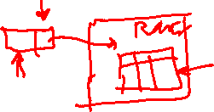

What is Active Network?
Normally nodes (routers) passively forward data. What does it mean to make the nodes active?
  Packets carry code
  Next hop determined by executing code in a router (i.e. actively as opposed to passive table lookup)
Sounds clever
  Can provide customized service to packets
  Similarities to “customizing” OS services like SPIN and Exokernel
Gotchas
  How to write such code?
  Who can write such code?
  How to make sure injected code does not break the network?
Univ. of Tehran
Computer Network

Slide 4
Why Active Networking?
Motivating problems
  Passive handling of packets, nothing cab be done!
  It’s too slow/hard to develop and deploy new services on the network (network ossification)
  Third-party interest in value-added, fine-grain control to dynamically meet the needs of particular applications/network conditions
  Researcher’s desire to experiment at scale
  Unified control over middleboxes (firewalls, proxies, transcoders)
Remarkably similar to those of SDN!
9/8/14
Software Defined Networking (COMS 6998-10)

Slide 5
Some Acronyms
ANTS
  Active Node Transfer System
IETF
  Internet Engineering Task Force
MD5
  Message Digest version 5 (RFC 1321)
    A one way hash function that generates a 128-bit cipher from arbitrary data
PIM
  Protocol Independent Multicast
PIP
  Private IP – precursor to IPv6
MTU
  Maximum Transmission Unit
Univ. of Tehran
Computer Network

Slide 6
Active Networks
Introduced by Tennenhouse and Wetherall (1996)
Vision
  Architecture for incremental innovation of network services
  Changing core services (e.g. from IPv4 to IPv6) not easy
  Allows innovation (by adding services) without full replacement of core services
Expanded in Wetherall’s PhD thesis with example services (1999)
Worked on by several groups
  MIT, UPenn, CMU, GT (Calvert and Zegura)
Impact
  Difficult to say…CISCO is router king…”don’t want you messing around with my routers” attitude
Univ. of Tehran
Computer Network

Slide 7
Takeaways of this paper
Benchmarking original vision against reality
Specific contributions
  A programming model and implementation
  ANTS toolkit
  Feasibility of router programming with ANTS
Univ. of Tehran
Computer Network

Slide 8
Leading up to Active Networks
Extensible individual routers for network admins to program (e.g. firewall code)
Programmability across multiple nodes for control tasks (e.g. traffic measurement, route discovery)
Limitations
  Who can program
  Where can such programs run
Active networks
  Remove both these restrictions
Univ. of Tehran
Computer Network

Slide 9

Two Different Approaches
Capsules (“integrated”)
  Every message is a program. Active nodes evaluate content carried in packets.
  Code dispatched to execution environment
Programmable Switches (“discrete”)
  Custom processing functions run on the routers
  Packets are routed through programmable nodes
  Program depends on the packet header
Univ. of Tehran
Computer Network

Slide 10
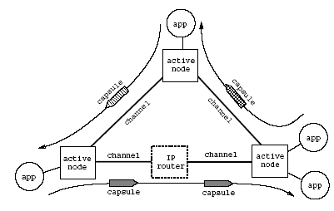
ANTS Active Network
Univ. of Tehran
Computer Network

Slide 11
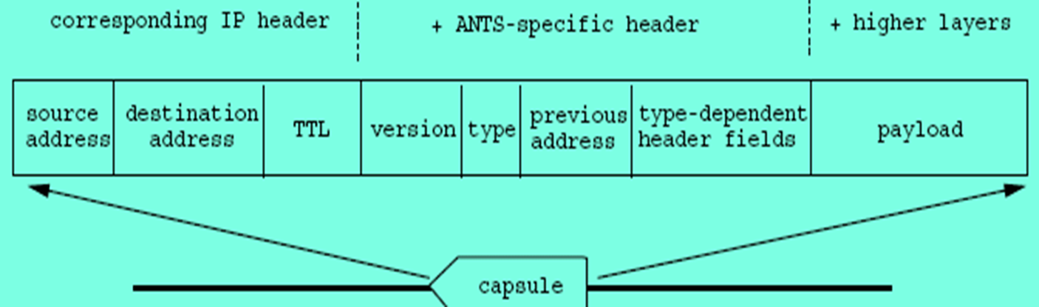
Capsule
Originally extension of IP packet format
    ANTS toolkit uses UDP datagrams in overlay with capsule as payload
Capsules are typed
  Type is an MD5 fingerprint
    Identifies the code that should handle the capsule
Univ. of Tehran
Computer Network

Slide 12
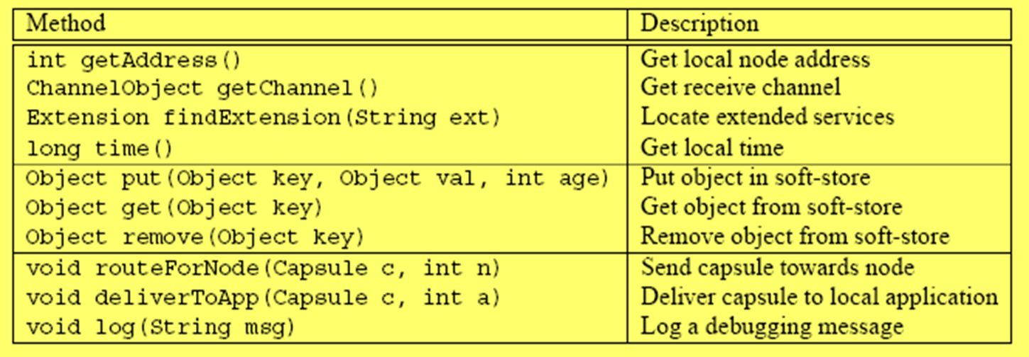
API for coding active nodes
Three categories
  Query node
  Manipulate soft-store
  Route capsule
Univ. of Tehran
Computer Network

Slide 13
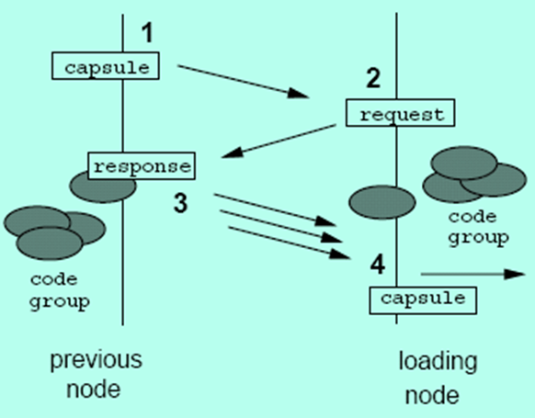
Implementation
Capsule code passed by reference, why?
  Type field serves as the fingerprint of the capsule
  Active node “demand loads” capsule code
    Either in soft store
    Or from previous address (and cached for subsequent use)
    Or drop packet (higher levels will take care of retransmission)
ANTS implemented in Java (nothing fundamental here…just convenience)
Univ. of Tehran
Computer Network

Slide 14
Capsule feasibility
Capsules represent in-network processing
Why is this a problem?
  Routing now happens in software
  Plus there is overhead for processing
Software based routing not feasible always
  Commercial hardware routers
    Forward 4 M packets/sec (70 byte packets) => nGbps throughput
  PC-based routers
    70K packets/sec => cannot keep up the forwarding rate
ANTS architecture
  Partially active nodes (for example at the edges); core routers simply forward (i.e. not active)
Code spoofing
  MD5 fingerprint ensures no spoofing (locally verified)
Univ. of Tehran
Computer Network

Slide 15

ANTS Forwarding performance
Three reasons to feel good
  Adequate for access links up to T1 (1.5 Mbps)
  Comparable to a Java based relay
  No data dependent loss of performance (Java, C, and ANTS perf lines same slope in Figures 4 and 5)
ANTS performance can be much better
  With C implementation
  In kernel implementation
Univ. of Tehran
Computer Network

Slide 16
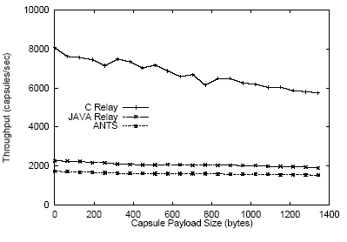
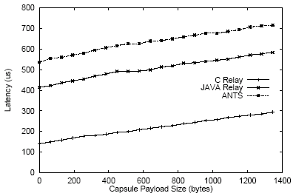

Performance
Thruput
Latency
Univ. of Tehran
Computer Network

Slide 17

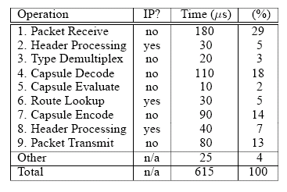
Profile of Capsule Processing
Xmit/recv (1 and 9) can be eliminated by in-kernel implementation
Enc/Dec (4 and 7) due to Java
Leaves 30% overhead compared to IP
Univ. of Tehran
Computer Network

Slide 18
Security and Safety
Who can introduce new services? – two basic concerns
  Protection – can my service damage yours (intentionally or not)
  Resource management – can my service consume arbitrary resources
Univ. of Tehran
Computer Network

Slide 19
Protection threats
Corrupt the ANTS runtime at a node?
  Java sandboxing (other implementations possible (PCC, SFI)
Code spoofing (incorrect or corrupted code)?
  Capsule type is a MD5 fingerprint of the code – no way to spoof unless you can break MD5
Corrupt soft-state at node?
  Restricted node API
  Soft-state also controlled by fingerprint
    A class can only access its own soft-state
  State sharing through hierarchy of fingerprint types
Summary: ANTS as good (or bad!) as Internet
Univ. of Tehran
Computer Network
Notes:
Other runtime implementations need to have these capabilities

Slide 20

Resource management threats
Unconstrained resource consumption at a single node?
  Programming model is restricted
    ANTS node runtime enforces resource bounds
Unconstrained resource consumption at multiple nodes
  Watchdog timers
  Capsule TTL fields
An application floods the network with capsules, starving other apps?
  Punt (the Internet doesn’t address this either)
Univ. of Tehran
Computer Network

Slide 21
Resource Management Threats
A capsule consumes large amounts of resources across a subset of the network?
  By creating other capsules and routing them
  Internet is static; ANTS is not
  Per capsule hop limit?
    Can still inflict damage
    Some behaviour is OK (multicast) – hop limit not related to topology
  Punt (rely on certified code => limits ‘any user can introduce new code’ idea)
Univ. of Tehran
Computer Network

Slide 22
Applications can be built?
Ones that are difficult to deploy in the Internet
  not tied to administrative setup, which tends to mirror physical setup
  services whose implementation is spread along the datapath
  make use of network level info: topology, loss, load…
  variants of routing, forwarding, flow setup, congestion handling
Characteristics
  Expressible – restricted API
  Compact – limit of 16KB
  Fast – node runtime is limited, no blocking
  Incremental – not all nodes are active nodes
Network layer services tend to be best for this, rather than application code
In general There is no “killer app” for an “Extensible foo”!!
Univ. of Tehran
Computer Network

Slide 23
Example Services
Multicast (PIM-style)
Reliable multicast
Explicit congestion notification
PIP
Anycasting
Univ. of Tehran
Computer Network

Slide 24
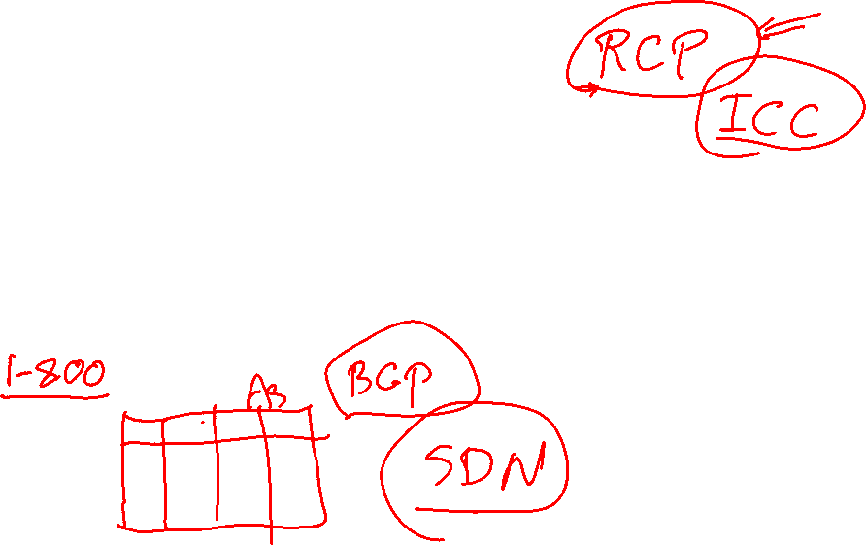
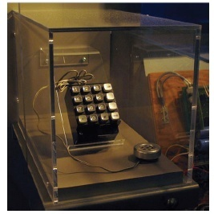
Early Days at Telephone
Control and Data Together
  In-band signaling
    Data and control sent over the same channel
    Certain frequencies (e.g., 2600 Hz) could reset phone trunk lines, route calls
Resulting network was brittle, insecure, etc.
Univ. of Tehran
Computer Network

Slide 25
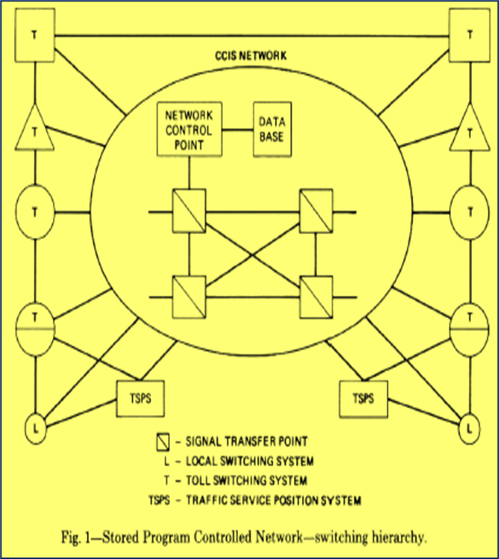
Network Control Point
Introduced in 1981
Signaling at NCP
Benefits
  Services on demand
  Rapid introduction of new services
Univ. of Tehran
Computer Network

Slide 26
Benefits of NCP
Elimination of in-band signaling reduces expenditures
  Shorter circuit holding time
  Ability to determine busy/idle status before requesting a circuit
Rapid introduction of new services
  “In the area of new services that can be supported…possibilities are limited only by imagination.
Univ. of Tehran
Computer Network

Slide 27
Apps Basic Primitives
Collect N digits
Send a message to the NCP
Make a billing record
Univ. of Tehran
Computer Network

Slide 28
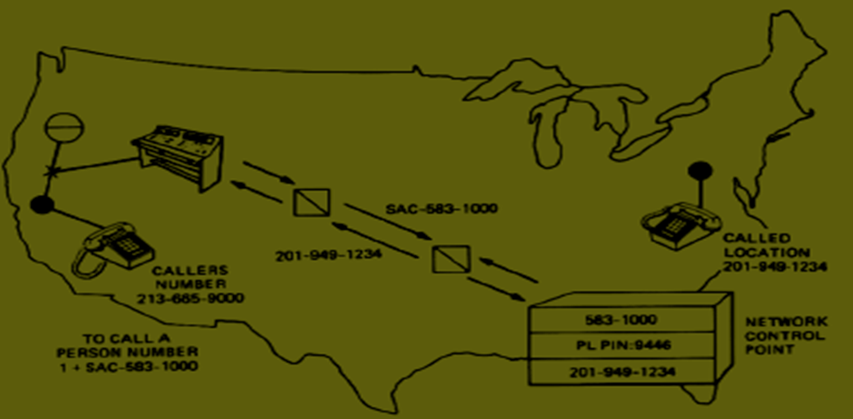
Person Locator
NCP
User registers location with NCP database
NCP routes call to the current location/ number
NCPs currently used to route 800 calls
Univ. of Tehran
Computer Network

Slide 29
Benefits of Central Control
Network-wide vantage point
  Can directly observe (rather than infer) network wide behavior
Independent evolution of infrastructure, data, and services
  Services and resource allocation decisions can be made based on customer data, network load, etc.
Univ. of Tehran
Computer Network

Slide 30
Routing Control platform (RCP)
What’s wrong with Internet routing?
  Full‐mesh iBGP doesn’t scale
  Route‐reflectors help by introducing hierarchy
    but introduce configuration complexity, protocol oscillations/loops
  Hard to manage
    Many highly configurable mechanisms
    Difficult to model effects of configuration changes
    Hard to debug
  Hard to evolve and provide new services, improve upon protocols
Univ. of Tehran
Computer Network

Slide 31
Problems with BGP
BGP is broken
  It converges slowly, sometimes not at all
  It causes routing loops
  It’s misconfigured frequently
  Traffic engineering is hard
Fixing BGP is hard
  Incremental fixes: Makes BGP even more complicated
  New architectures and inter-domain protocols: Deployment is almost impossible
Univ. of Tehran
Computer Network

Slide 32
BGP Problems
AS is the logical entity for inter-domain
  BGP state, logic are decomposed across routers
  No router has complete BGP state
  Each router makes routing decision based on partial and incomplete view
BGP interacts in odd ways with other protocols
  Most notably with the IGP (Interior Gateway Protocol) running inside an AS
Univ. of Tehran
Computer Network

Slide 33
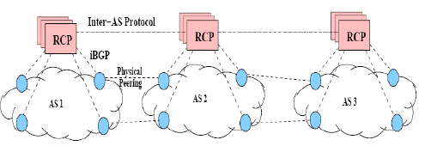
Possible solution
Route Computation logic should have “full view” of the network state
• Control Routing Protocol Interactions
Univ. of Tehran
Computer Network

Slide 34
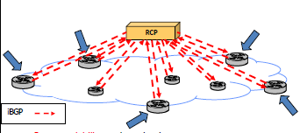
In an ISP
Better scalability: reduces load on routers
Easier management: configuration from a single point
Easier evolvability: freedom from router software
Univ. of Tehran
Computer Network

Slide 35
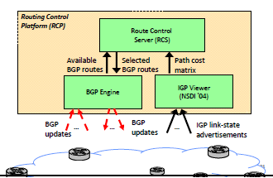
RCP architecture
Univ. of Tehran
Computer Network

Slide 36
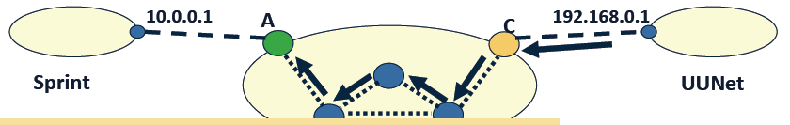
Decomposed Configuration State
Simple policy: “Don’t advertise routes learned from UUNet to Sprint”
Configuration is decomposed, so routes must carry state
  Assign routes “From UUNet” tag at router C
With RPC is easier, We have all information
Univ. of Tehran
Computer Network

Slide 37
More Flexible Routing
Better network management
  Diagnostics and trouble-shooting
  Routing co-located with other information (e.g. traffic)
  Ability to reason about an AS as a single entity
Protocol Improvements
  Attaching prices to routes
  Inter-AS negotiation of exit points
  Overlay routing informed by IP-layer information
Univ. of Tehran
Computer Network

Slide 38
In summary
RCP embodies two principles for inter-domain routing
  Treat an AS as a single logical entity
    Compute consistent routes using complete AS-wide view
  Control routing protocol interactions
Benefits
  Simpler, more expressive configuration
  Intrinsic robustness: no loops, faster convergence
   Enable new applications and innovations
    Opportunity for new traffic engineering applications
niv. of Tehran
Computer Network

Slide 39
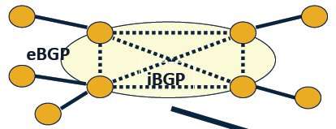
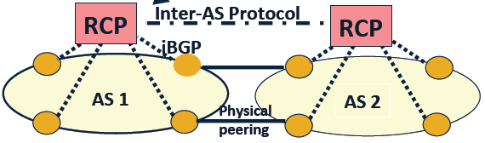
Deployment
Current state
Three phases:
iBGP
eBGP
final
Two issues
  Backward compatibility
  Deployment incentives
Univ. of Tehran
Computer Network

Slide 40
Challenges and contributions
Reliability
  Problem: single point of failure
  Solution : replication of RCP components
Consistency
  Problem: inconsistent decisions by replicas
  Solution : guaranteed consistency without inter‐replica protocol
Scalability
  Problem: large cpu/memory usage
  Solution : Support large ISP in one computer
Univ. of Tehran
Computer Network

Slide 41
Scalability solution
Eliminate redundancy
  Store only a single copy of each BGP route
Accelerate lookup
  Quickly find routers whose routes changed
Avoid recomputation
  Compute routes once for groups of routers
  Don’t recompute if relative ranking of egress routers unchanged
Univ. of Tehran
Computer Network

Slide 42
Next-lecture: SDN, Data Plane
Assigned reading
  Click: a modular software router
  RouteBricks: Exploiting Parallelism To Scale Software Routers
  Forwarding Metamorphosis: Fast Programmable Match-Action Processing in Hardware for SDN
  SwitchBlade: A Platform for Rapid Deployment of Network Protocols on Programmable Hardware
Univ. of Tehran
Computer Network

