Slide 1
الکترونیک دیجیتال فیزیک الکترونیک
Nasser Mozayani
School of Computer Engineering
Iran University of Science and Technology

Slide 2
Prerequisites
To understand this presentation, you should have the following prior knowledge:
Draw the structure of an atom, including electrons, protons, and neutrons.
Define resistance and conductance.
Label an electronic schematic, indicating current flow.
Define Ohm’s and Kirchhoff’s laws.
Describe the characteristics of DC and AC (sine wave) voltages.

Slide 3
مثال
مدار زیر را تحلیل کنید

Slide 4
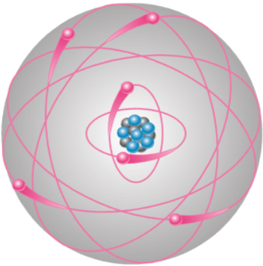
Bohr model of an atom
As seen in this model, electrons circle the nucleus. Atomic structure of a material determines it’s ability to conduct or insulate.
Notes:
Figure 1-1 Bohr Model

Slide 5
Conductors, Insulators, and Semiconductors
The ability of a material to conduct current is based on its atomic structure
The orbit paths of the electrons surrounding the nucleus are called shells
Each shell has a defined number of electrons it will hold. This is a fact of nature and can be determined by the formula, N_{e} = 2n².
The outer shell is called the valence shell.
The less complete a shell is filled to capacity the more conductive the material is.

Slide 6
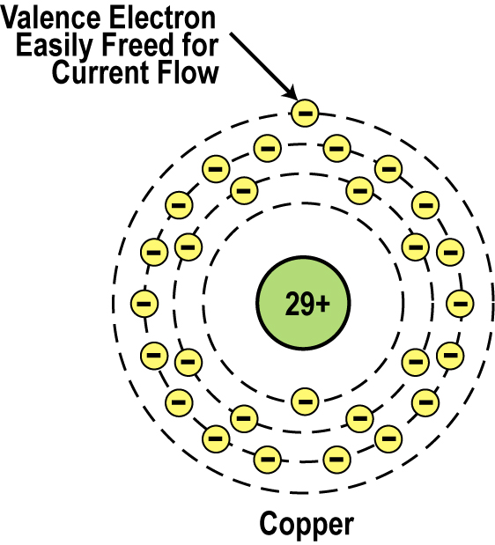
Conductor Atomic Structure
The atomic structure of good conductors usually includes 1, 2 or 3 electron in their outer shell.
It is called a valence electron.
It is easily striped from the atom, producing current flow.
_{Copper Atom}

Slide 7
Insulators
Insulators have a high resistance so current does not flow in them.
Good insulators include:
Glass, ceramic, plastics, & wood
Most insulators are compounds of several elements.
The atoms are tightly bound to one another so electrons are difficult to strip away for current flow. They usually includes 8 electron in their outer shell.

Slide 8
Semiconductors
Semiconductors are materials that essentially can be conditioned to act as good conductors, or good insulators, or any thing in between.
Common elements such as carbon, silicon, and germanium are semiconductors. They usually includes 4 electron in their outer shell.
Silicon is the best and most widely used semiconductor. (Compound is recently preferred)

Slide 9
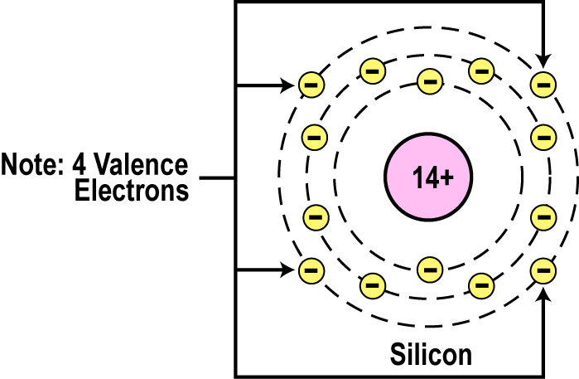
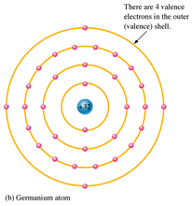
Semiconductor Valence Orbit
The main characteristic of a semiconductor element is that it has four electrons in its outer or valence orbit.

Slide 10
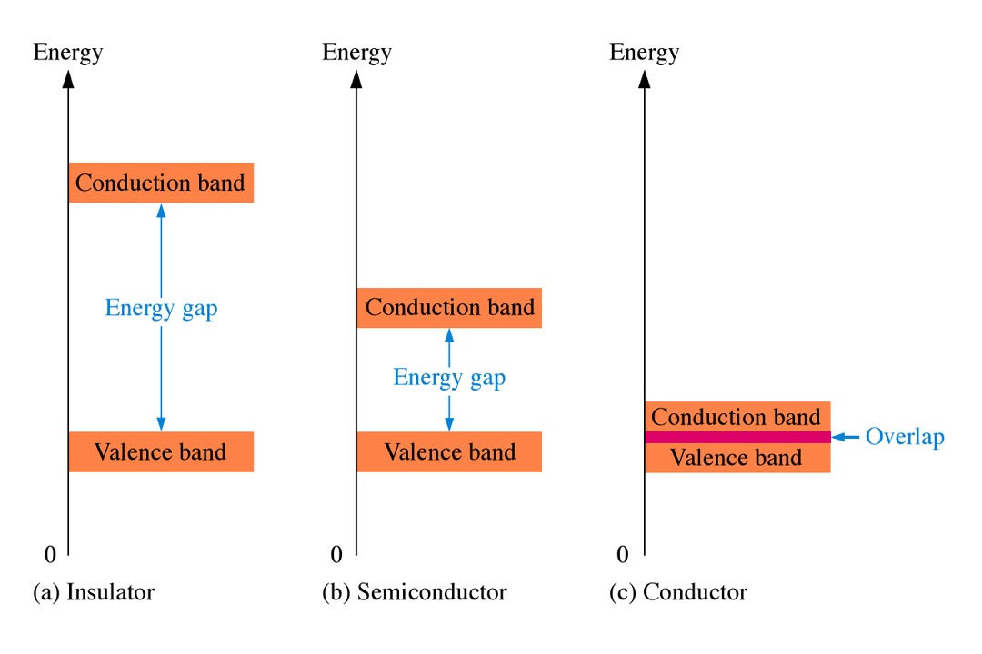
Energy Bands

Slide 11
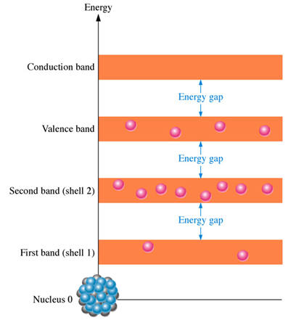
Conduction in Semiconductors

Slide 12
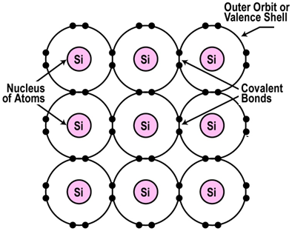
Crystal Lattice Structure
The unique capability of semiconductor atoms is their ability to link together to form a physical structure called a crystal lattice.
The atoms link together with one another sharing their outer electrons.
These links are called covalent bonds.
_{2D Crystal Lattice Structure}

Slide 13
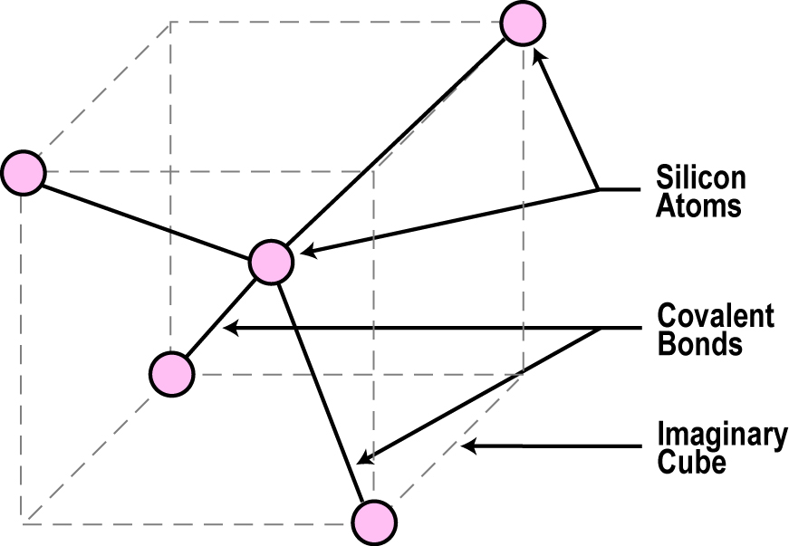
3D Crystal Lattice Structure

Slide 14
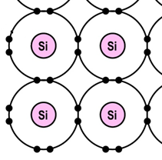
Semiconductors can be Insulators
In pure semiconductor material like silicon, the crystal lattice structure forms an excellent insulator since all the atoms are bound to one another and are not free for current flow.
Since the outer valence electrons of each atom are tightly bound together with one another, the electrons are difficult to dislodge for current flow
Silicon in this form is a great insulator

Slide 15
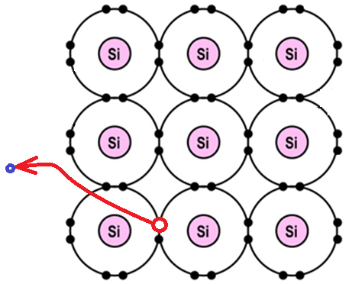
Semiconductor conductivity
In semiconductor there can be a very small current like in any other material
Because of outside temperature

Slide 16
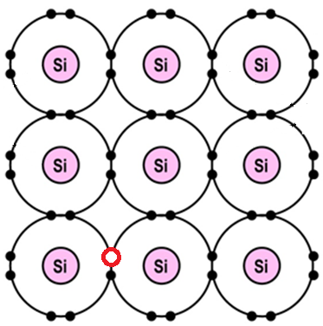
Semiconductor’s current
Current is made by 2 factores: electrons,
holes, how?
1st snapshot:

Slide 17
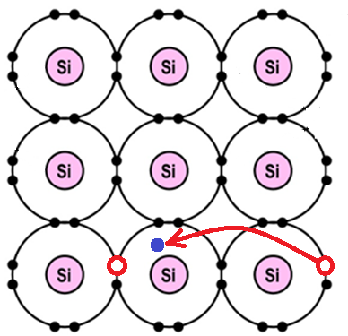
Semiconductor’s current
Current is made by 2 factores: electrons,
holes, how?
2nd snapshot:

Slide 18
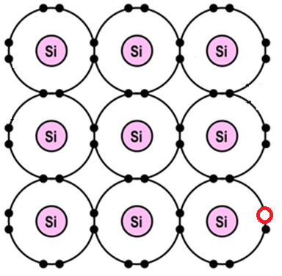
Semiconductor’s current
Current is made by 2 factores: electrons,
holes, how?
3rd snapshot:

Slide 19
Doping
To make the semiconductor conduct better, other atoms called impurities must be added.
“Impurities” are different elements.
This process is called doping.

Slide 20
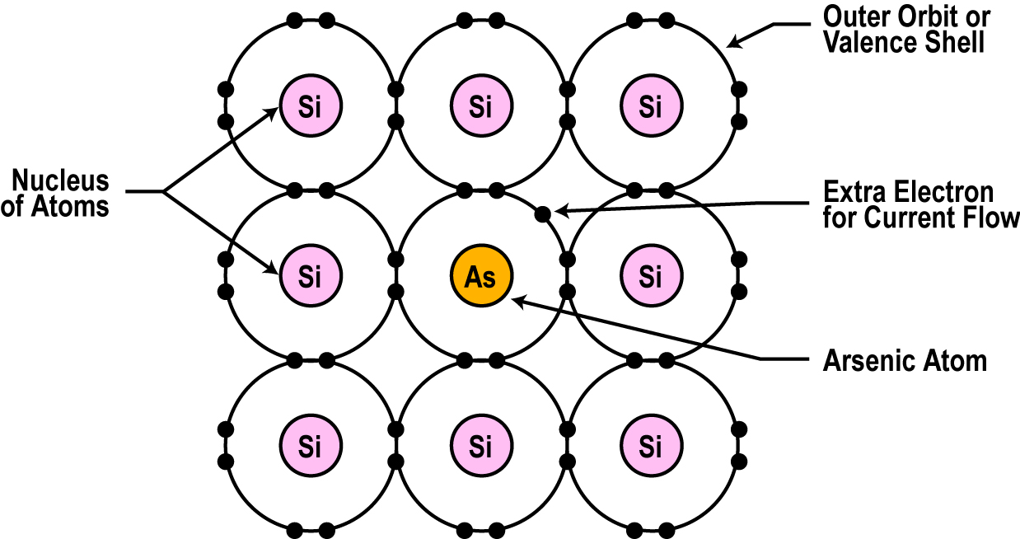
Semiconductors can be Conductors
An impurity like arsenic, has 5 valence electrons (Donnor)
Adding arsenic (doping) will allow four of the arsenic valence electrons to bond with the neighboring silicon atoms.
The one electron left over for each arsenic atom becomes available to conduct current flow

Slide 21
Resistance Effects of Doping
If you use lots of arsenic atoms for doping, there will be lots of extra electrons so the conductance of the material will be very better and current will flow freely.
By controlling the doping amount, virtually any conductance can be achieved.

Slide 22
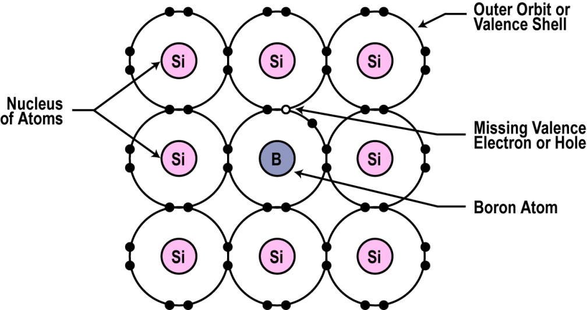
Another Way to Dope
You can also dope a semiconductor material with an atom such as boron that has only 3 valence electrons (Acceptor).
The 3 electrons in the outer orbit do form covalent bonds with its neighboring semiconductor atoms as before. But one atom is missing from the bond.
This place where a fourth electron should be is referred to as a hole.
The hole assumes a positive charge so it can attract electrons from some other source.
Holes become a type of current carrier like the electron to support current flow.

Slide 23
Types of Semiconductor Materials
The silicon doped with extra electrons is called an “N type” semiconductor.
“N” is for negative, which is the charge of an electron.
Silicon doped with material missing electrons that produce locations called holes is called “P type” semiconductor.
“P” is for positive, which is the charge of a hole.

Slide 24
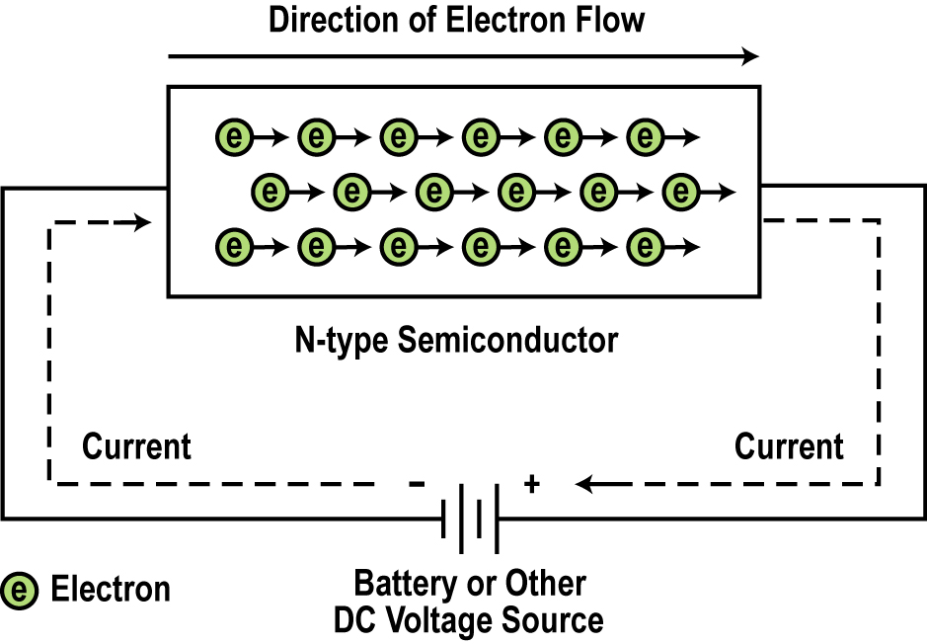
Current Flow in N-type Semiconductors
The DC voltage source has a positive terminal that attracts the free electrons in the semiconductor and pulls them away from their atoms leaving the atoms charged positively.
Electrons from the negative terminal of the supply enter the semiconductor material and are attracted by the positive charge of the atoms missing one of their electrons.
Current (electrons) flows from the positive terminal to the negative terminal.

Slide 25
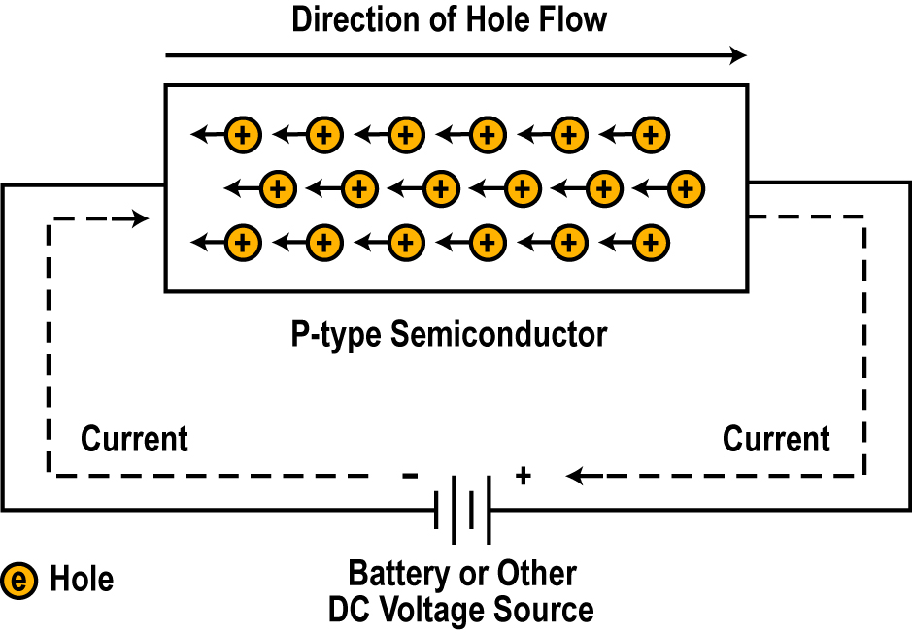
Current Flow in P-type Semiconductors
Electrons from the negative supply terminal are attracted to the positive holes and fill them.
The positive terminal of the supply pulls the electrons from the holes leaving the holes to attract more electrons.
Current (electrons) flows from the negative terminal to the positive terminal.
Inside the semiconductor current flow is actually by the movement of the holes from positive to negative.

Slide 26
In Summary
In its pure state, semiconductor material is an excellent insulator.
The commonly used semiconductor material is silicon.
Semiconductor materials can be doped with other atoms to add or subtract electrons.
An N-type semiconductor material has extra electrons.
A P-type semiconductor material has a shortage of electrons with vacancies called holes.
The heavier the doping, the greater the conductivity or the lower the resistance.
By controlling the doping of silicon the semiconductor material can be made as conductive as desired.

