Slide 1
Digital Electronics PN-junction and Diode
Nasser Mozayani
School of Computer Engineering
Iran University of Science and Technology

Slide 2
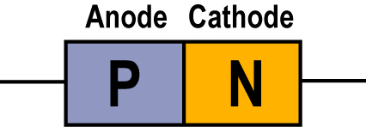
The PN junction
Notes:
Fig 1-18 a & b depletion region

Slide 3
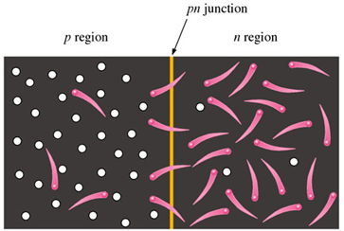
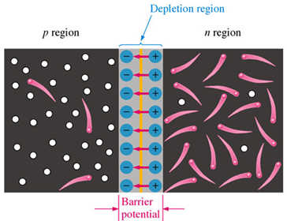
The Depletion Region
With the formation of the p and n materials combination of electrons and holes at the junction takes place.
This creates the depletion region and has a barrier potential. This potential cannot be measured with a voltmeter but it will cause a small voltage drop.
Notes:
Fig 1-18 a & b depletion region

Slide 4
The Depletion Region
In this figure P is more heavily doped than n (N_{A}>N_{D})

Slide 5
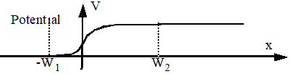
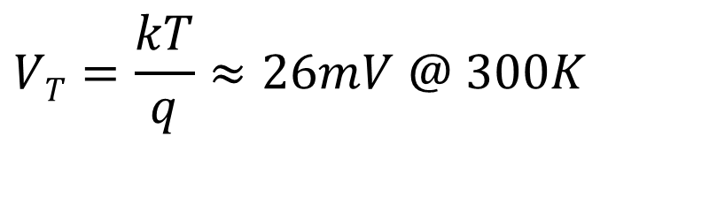

The Depletion Region
Built-in Potential
$$Vo=VT.ln\frac{NA.ND}{ni2}$$
$$VT=\frac{kT}{q}≈26mV @ 300K$$
n_{i}²=BT³exp(-E_{G}/kT) cm⁻⁶
ni_{(Si)} =

Slide 6
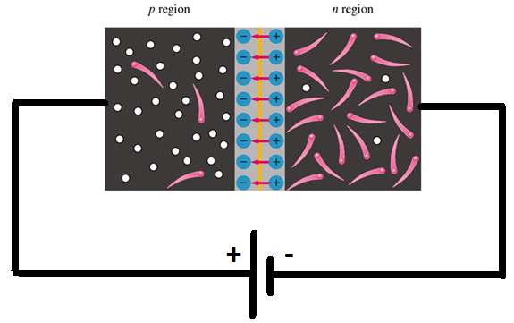
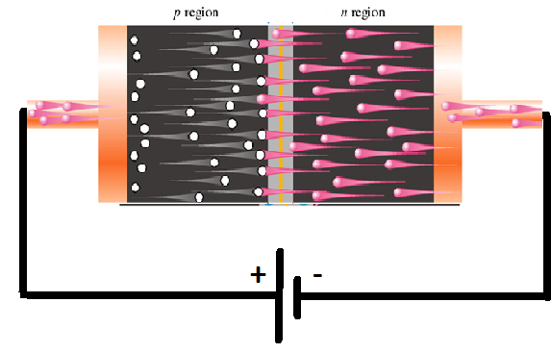
Forward Bias
Bias must be greater than .3 V for Germanium or .7 V for Silicon diodes
The depletion region narrows and huge current start

Slide 7
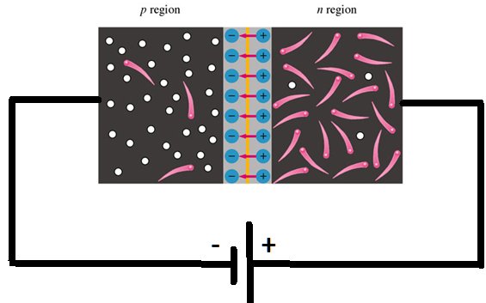
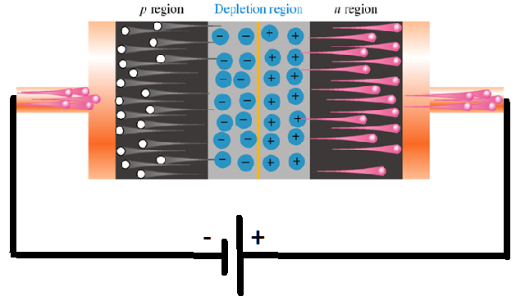
Reverse Bias
Bias must be less than the break down voltage
Current flow is negligible in most cases
The depletion region widens

Slide 8
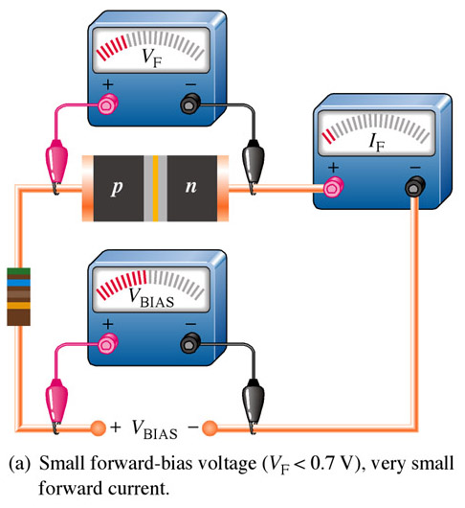
Forward Bias Measurements With Small Voltage Applied
In this case with the voltage applied is less than the barrier potential so the diode for all practical purposes is still in a non-conducting state. Current is very small.
Notes:
Fig 1-26a measurements with meters

Slide 9
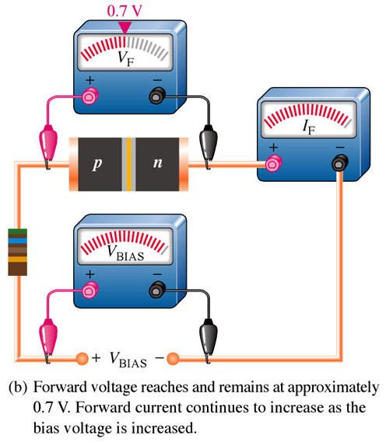
Forward Bias Measurements With Applied Voltage Greater Than the Barrier Voltage.
With the applied voltage exceeding the barrier potential the now fully forward biased diode conducts. Note that the only practical loss is the .7 Volts dropped across the diode.
Notes:
Fig. 1-26b measurements with meters

Slide 10
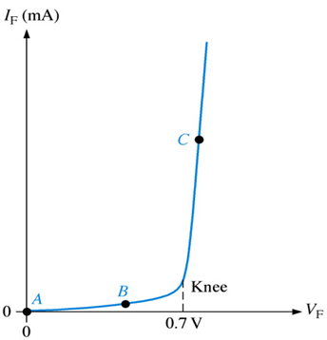
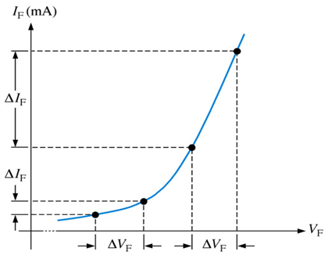
V-I Characteristic for Forward Bias
illustrates how the dynamic resistance r’_{d} decreases as you move up the curve (r’_{d} = ΔV_{F}/ΔI_{F}).

Slide 11
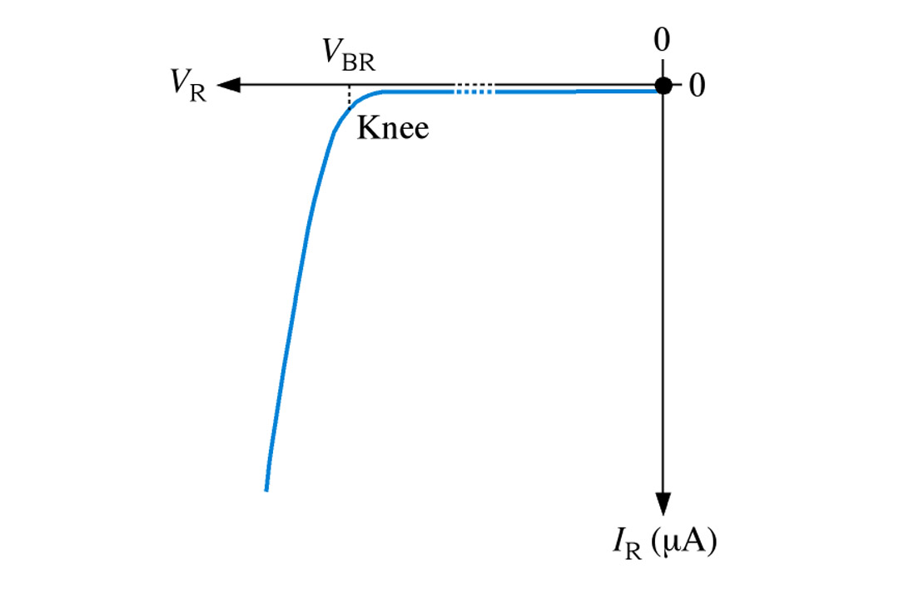
V-I Characteristic for Reverse Bias
V-I characteristic curve for reverse-biased diode.

Slide 12
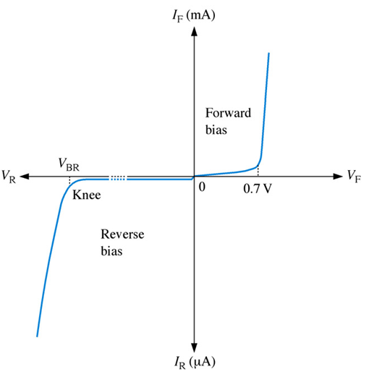
The complete V-I characteristic curve for a diode

Slide 13
Comparing to ideal diode

Slide 14
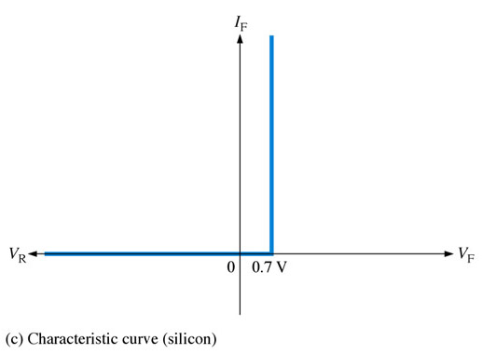
Practical Diode Characteristic Curve
In most cases we consider only the forward bias voltage drop of a diode. Once this voltage is overcome the current increases proportionally with voltage.This drop is particularly important to consider in low voltage applications.
Notes:
Fig. 1-34c practical curve

Slide 15
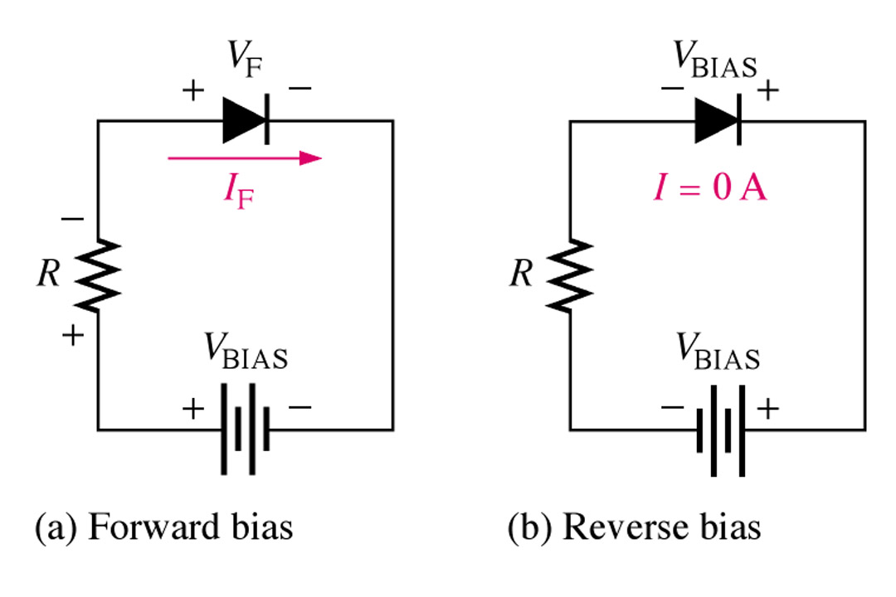
Forward-bias and reverse-bias connections showing the diode symbol.
Practical Diode biasing

Slide 16
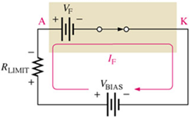
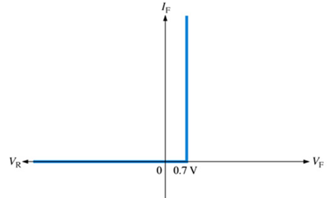
The Practical Diode Model- forward bias
V_{F} = 0.7 V (silicon)
V_{F} = 0.3 V (germanium)

Slide 17
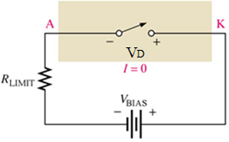
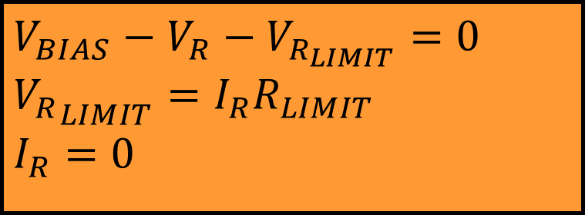
The Practical Diode Model- reverse bias
$$V_{BIAS}−V_{R}−V_{R_{LIMIT}}=0 \\ {V_{R}}_{LIMIT}=I_{R}R_{LIMIT}$$
$$I_{R}=0$$

Slide 18
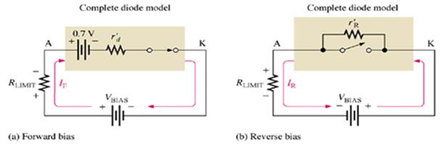
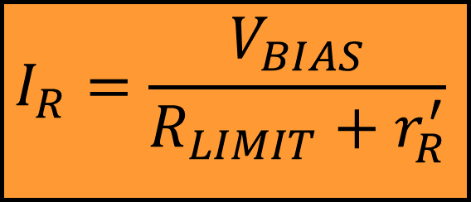
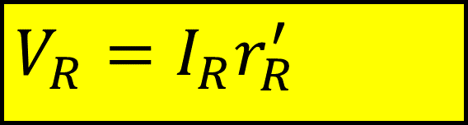
The Complete Diode Model
$$V_{R}=I_{R}r_{R}^{′}$$
$$I_{R}=\frac{V_{BIAS}}{R_{LIMIT}+r_{R}^{′}}$$
Notes:
Fig. 1-35 complex

Slide 19
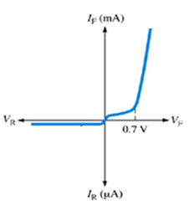
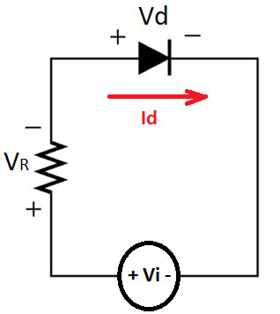
Shockley Equation
I_{s} is the saturation current ~10 ⁻¹⁴
V_{D} is the diode voltage
η= emission coefficient (varies from 1 - 2 )
k = 1.38 × 10^{–23} J/K is Boltzmann’s constant
q = 1.60 × 10^{–19} C is the electrical charge of an electron
at a temperature of 300 K

Slide 20
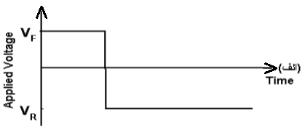
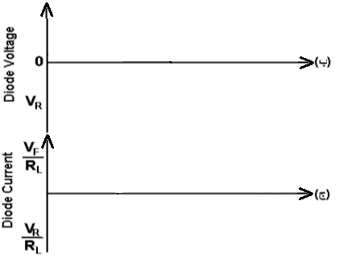
Timing characteristics
t₁
t₂
t₃
t_{rr} = t_{s} + t_{r}
t_{s}
t_{r}

Slide 21
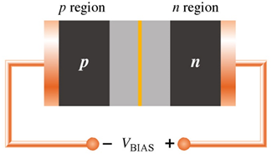
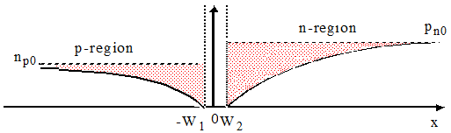
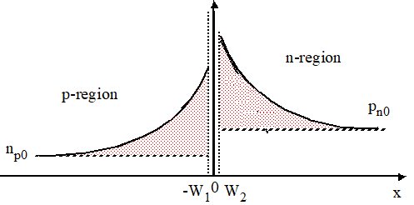
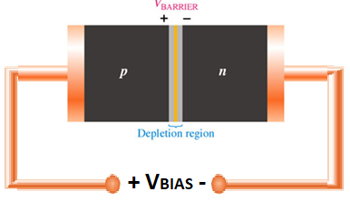
Minority distribution

Slide 22
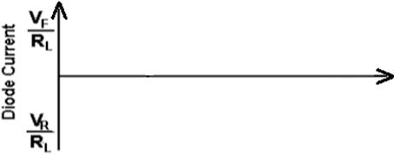
Timing characteristics
t₁
t₂
t₃
t_{s}
t_{r}

Slide 23
Diode Capacitance

Slide 24
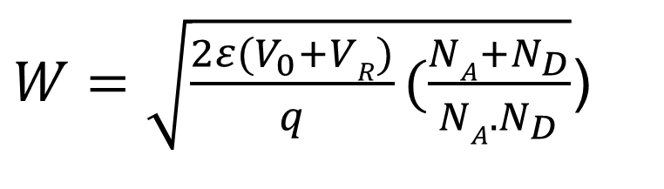
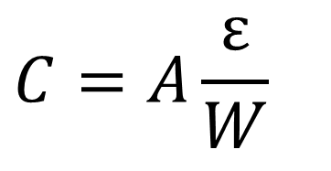
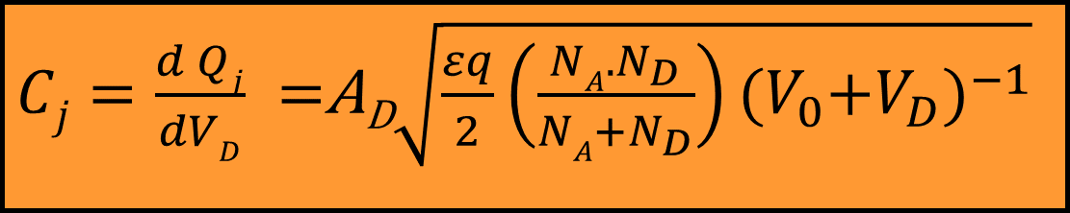
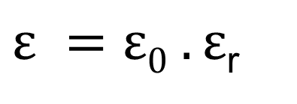
Diode Capacitance
$$C=A\frac{ε}{W}$$
$W=\sqrt{\frac{2ε{(V}_{0}+VR)}{q}(\frac{NA{+N}_{D}}{NA. N_{D}}}$)
$ε =ε0 .ε$_{r}
$Cj=\frac{d Qj}{dVD} =$A_{D}$\sqrt{\frac{εq}{2}\left(\frac{NA{.N}_{D}}{NA{+N}_{D}}\right){{(V}_{0}+V_{D})}^{−1}}$

Slide 25
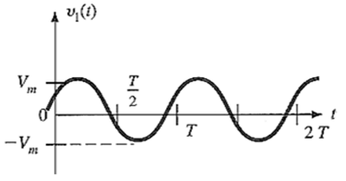
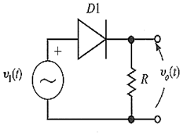
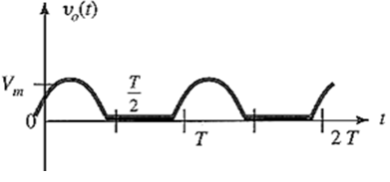
Half-wave Rectification
Simplest process used to convert ac to dc
And what if we use a practical diode?

Slide 26
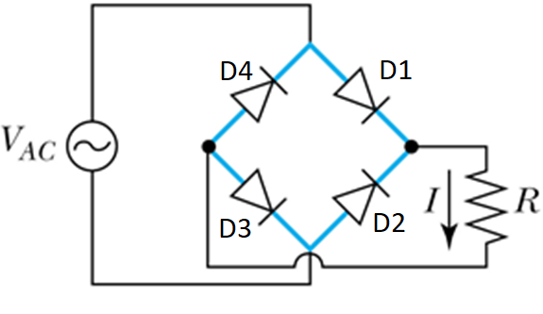
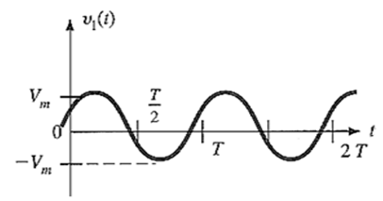
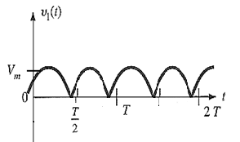
Bridge Rectifiers
And what if we use a practical diode?

Slide 27
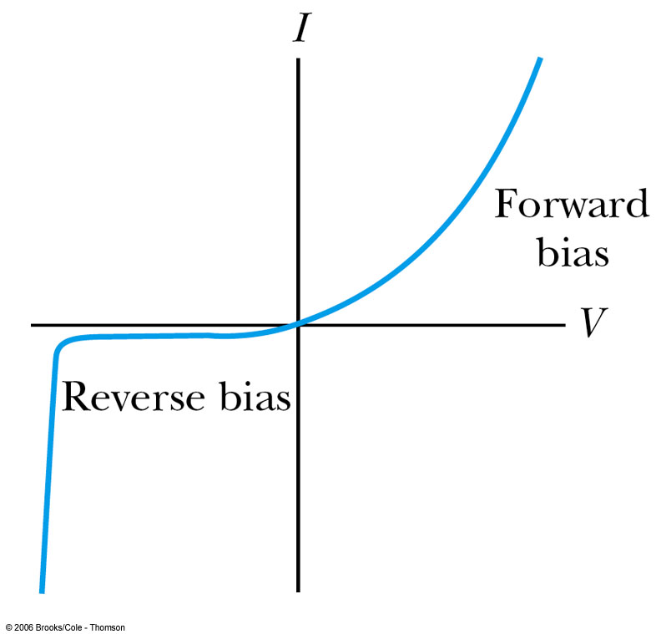
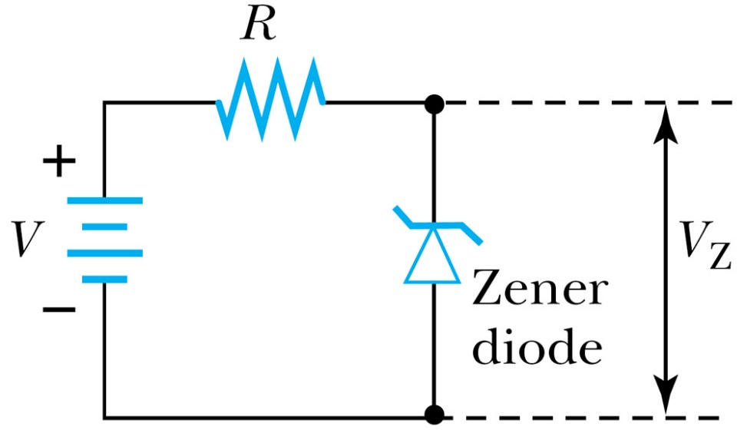
Zener Diode
The Zener diode is made to operate under reverse bias once a sufficiently high voltage has been reached

Slide 28
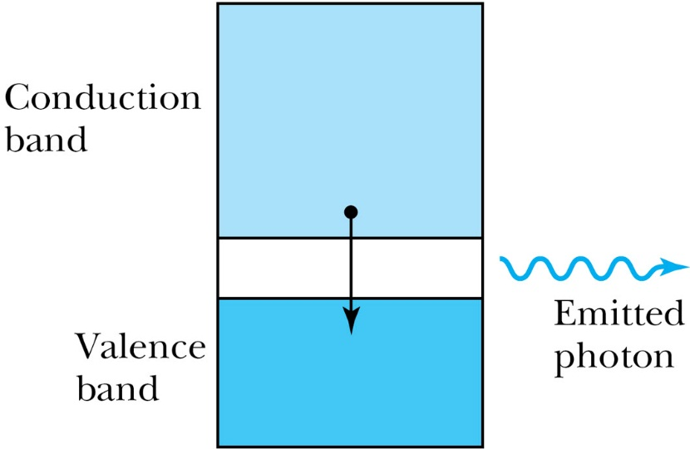
Light Emitting Diode
Whenever an electron makes a transition from the conduction band to the valence band (effectively recombining the electron and hole) there is a release of energy in the form of a photon
In some materials the energy levels are spaced so that the photon is in the visible part of the spectrum. In that case, the continuous flow of current through the LED results in a continuous stream of nearly monochromatic light.

Slide 29
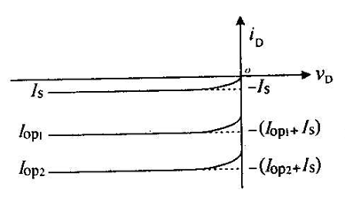
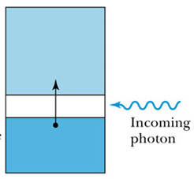
Photo Diode
Used in reverse bias
Conducting
band
Conducting
band
Valence
band
Valence
band

Slide 30
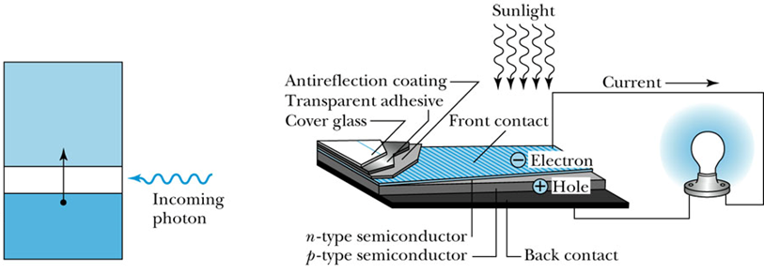
Photovoltaic Cells
solar cell, also known as the photovoltaic cell l takes incoming light energy and turns it into electrical energy.
Remember that the “solar constant” (the energy per unit area of solar radiation reaching the Earth) is over 1400 W/m², and more than half of this makes it through the atmosphere to the Earth’s surface.
Conducting
band
Valence
band

Slide 31



Schottky diode
Metals like Pt5Si2 connected to n-type

