Slide 1
Digital Electronics Bipolar Junction Transistor
Nasser Mozayani
School of Computer Engineering
Iran University of Science and Technology

Slide 2
Introduction
IN THIS CHAPTER YOU WILL LEARN:
The physical structure of the bipolar transistor and how it works.
How the voltage between two terminals of the transistor controls the current that flows through the third terminal, and the equations that describe these current-voltage relationships.
How to analyze and design circuits that contain bipolar transistors, resistors, and dc sources.
How the transistor can be used to make an amplifier or digital logic.

Slide 3
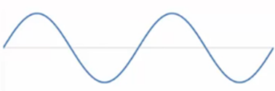

Introduction
What are functions of transistor?
1.Amplyfing
2.switching
transistor
transistor

Slide 4
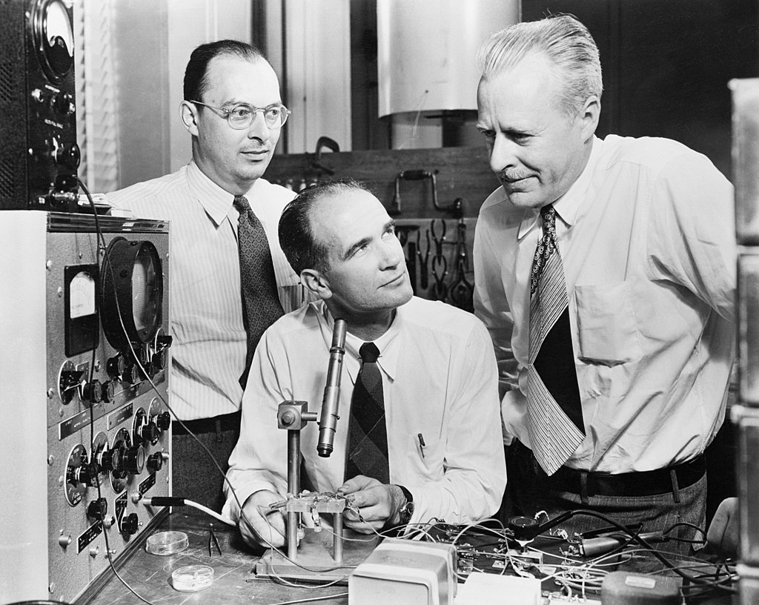
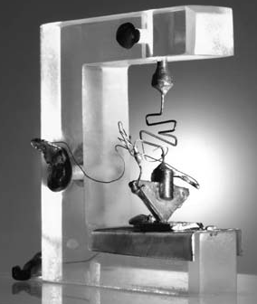
Inventors
Bardeen
Shockley
Brattain
1948

Slide 5
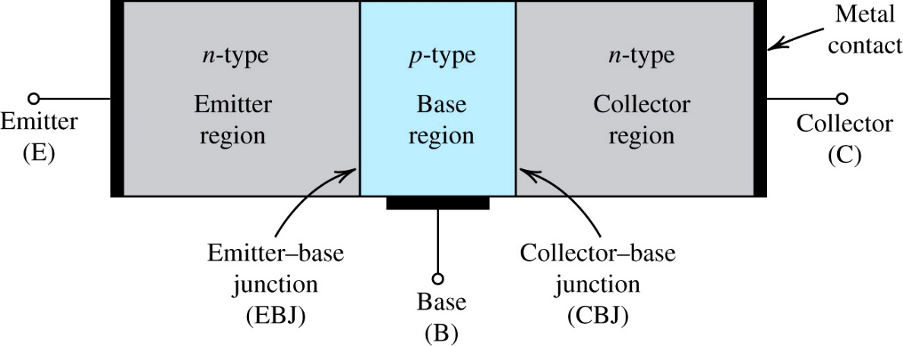
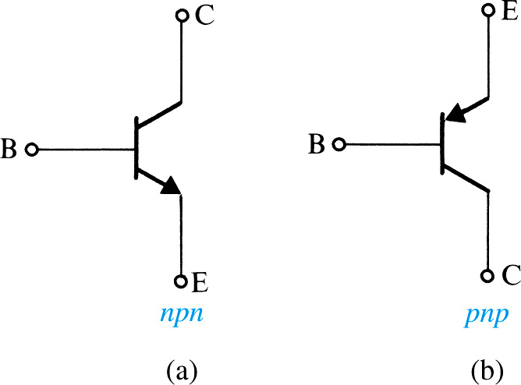
Device Structure and Physical Operation
A simplified structure of the npn transistor.

Slide 6
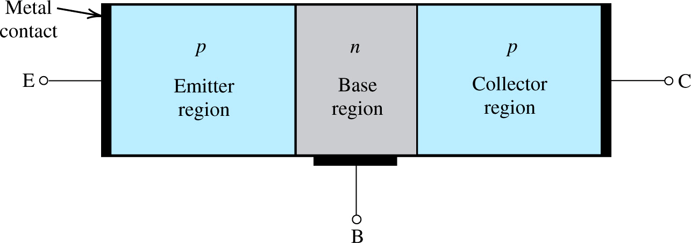
Device Structure and Physical Operation
A simplified structure of the pnp transistor.
Notes:
Note that this is normally implemented by doping regions on the surface of a silicon chip

Slide 7
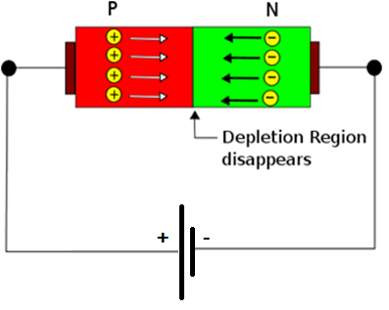
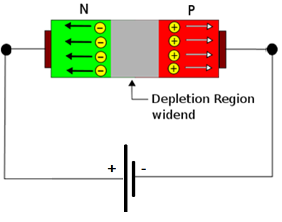
Electrical Switching on P-N Junction
In Forward Biasing polarity facilitates motion of free electrons
In Reverse Biasing polarity impedes motion of free electrons
Forward Biasing
Reverse Biasing
Circuit is “On”
Current is Flowing
Circuit is “Off”
Current not Flowing

Slide 8
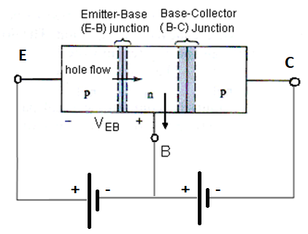
BJT operation - pnp
The emitter – base (E- B) junction is forward biased
and the base-collector (B- C) junction is reverse-biased
Big
current
Very small
current
Based on KCL: I_{E} = I_{C} + I_{B}
But there is a high Ic current !

Slide 9
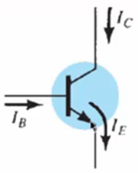
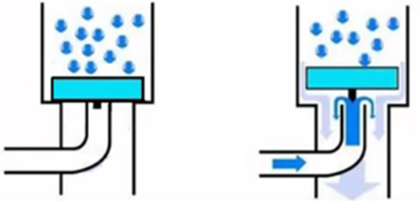
Understanding BJT Operation
Operation can be looked like:
Collector
Collector
I_{E}=I_{C}+I_{B}
Base
Base
Emitter
Emitter

Slide 10
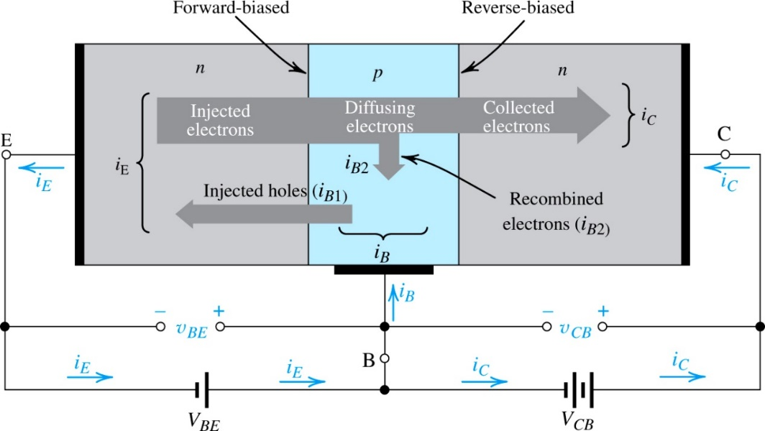
Operation of npn-Transistor in Active Mode
Two external voltage sources are required for biasing to achieve it
Current flow in an npn transistor biased to operate in the active mode.
(Reverse current components due to drift of thermally generated minority carriers are not shown)

Slide 11
BJT current relations
Based on KCL: I_{E} = I_{C} + I_{B}
I_{C} = β I_{B}
I_{C} = α I_{E}
I_{E} = β I_{B} + I_{B} = I_{B}( β + 1)
I_{E} = I_{B}( β + 1)
With I_{C} = β I_{B} → I_{B} = I_{C} / β
Hence,
I_{E} = [ I_{C} /β ] ( β + 1)
I_{C} = I_{E} [ β / β + 1 ]
Comparing with I_{C} = α I_{E}
α = [ β / β + 1 ]

Slide 12
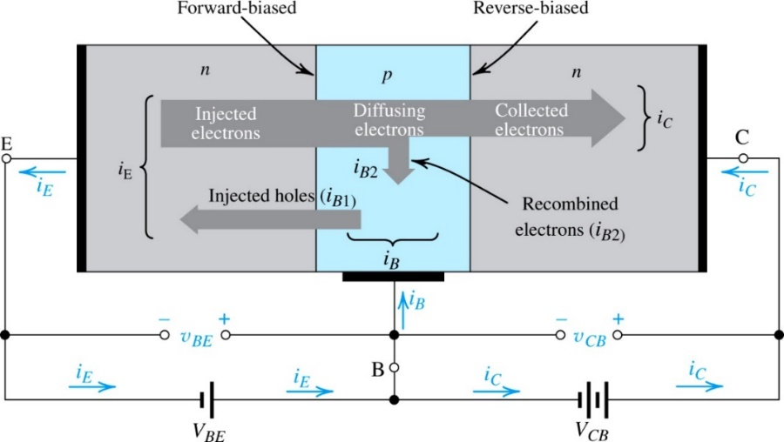
Operation of npn-Transistor in Active Mode
Three tricks for higher Value of β:
1- device shape
2- thin base (small W in nano-meters)
3- lightly doped base / heavily doped emitter (small NA/ND)
β is in the range 50 to 200
emitter
base
collector

Slide 13
VI characteristics
How to show V-I characteristics for 3 terminal device?
I_{B}
I_{C}
C
B
V_{BE}
V_{CE}
E

Slide 14
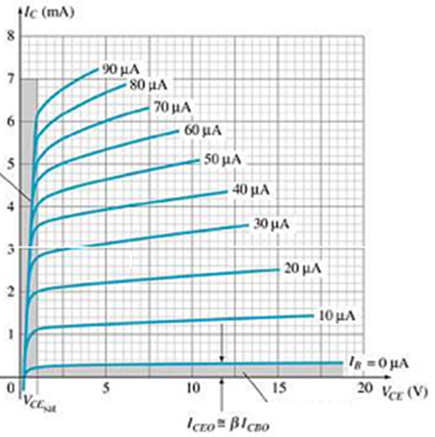
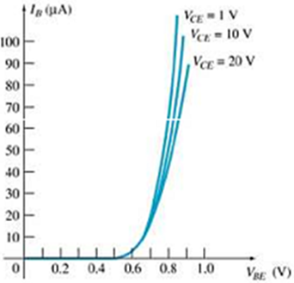
Common–Emitter Characteristics
breakdown region
Saturation region
active region
cutoff region
Base characteristics
Collector characteristics

Slide 15
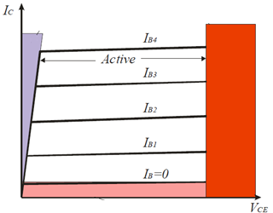
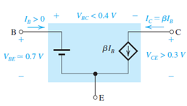
Recapitulation and Equivalent-Circuit Models
Basic relationship in collector current (i_{C}) is related exponentially to forward-bias voltage (v_{BE}).
It remains independent of v_{CB} as long as this junction remains reverse biased v_{CB} > 0
Thus in the active mode the collector terminal behaves as an ideal constant-current source where the value of the current is
determined by v_{BE}

Slide 16
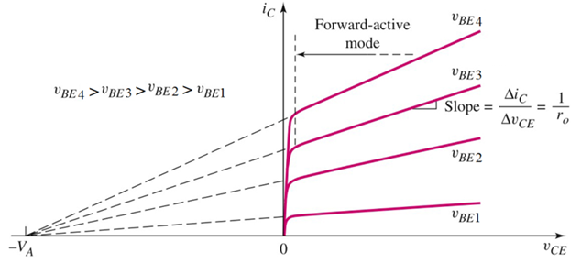

Real operation of collector circuit- npn
NOTE: V_{EC} for PNP
I-V characteristic showing Early voltage and the finite output resistance

Slide 17
Simplified Structure and Modes of Operation
Operating mode depends on biasing:
active mode – used for amplification
cutoff and saturation modes – used for switching
mode | EBJ | CBJ
Cutoff | Reverse | Reverse
Active | Forward | Reverse
saturation | Forward | Forward
Inverse Active | Reverse | Forward

Slide 18
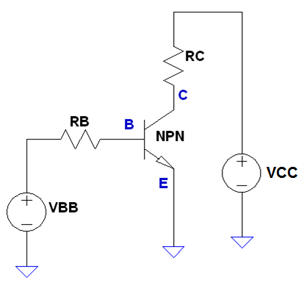
Common-Emitter biasing - npn
The Emitter is common to both input (base-emitter) and output (collector-emitter)
Since Emitter is grounded, V_{C} = V_{CE}
Node B
0V
With decreasing V_{C} (V_{CE}),
the junction B-C will become forward biased too
The current I_{C} quickly drops to zero because electrons are no longer collected by the collector

Slide 19
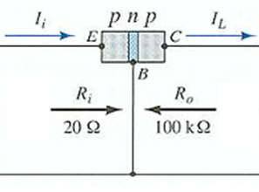
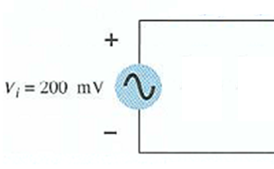
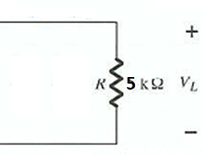
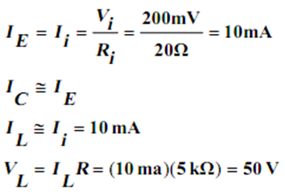

Amplification in Transistor
DC bias is not shown here
Current and Voltage:
Voltage gain:

Slide 20
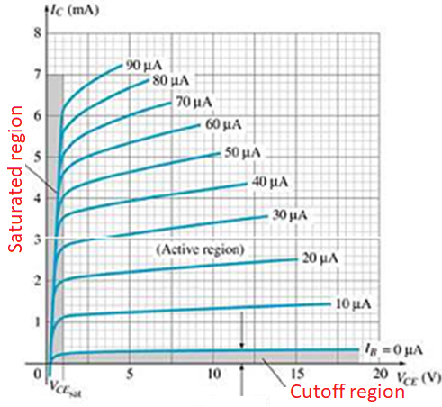
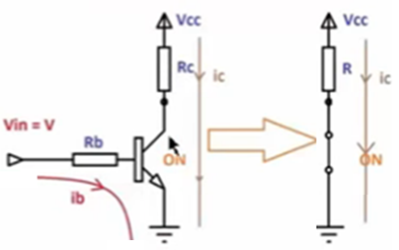
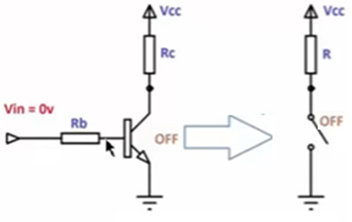
BJT digital applications
NPN BJT switch circuit

Slide 21
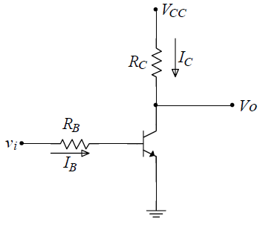
BJT inverter
Vcc
Vcc
0 V
0 V
If the voltage vi is zero (low) the transistor is in cutoff region, Ic=0 and Vo=Vcc (high)
If the voltage vi is Vcc (high) the transistor is in saturation, the output is equal to V_{CE}(sat) which is low

Slide 22
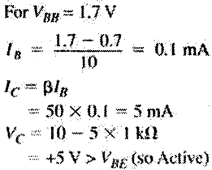
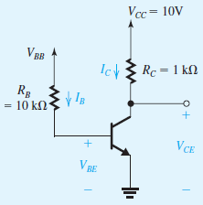
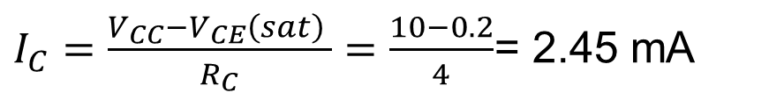
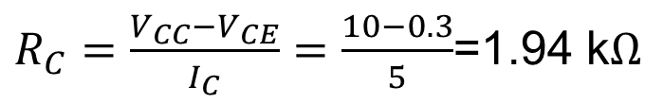
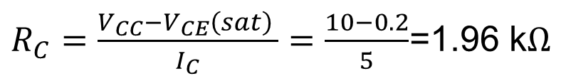
Example 1
(a) Edge of saturation v_{CE}=0.3^{v}
$R_{C}=\frac{V_{CC}−V_{CE}}{I_{C}}=\frac{10−0.3}{5}$=1.94 k$Ω$
(b) Deep saturation v_{CE}=0.2^{v}
$R_{C}=\frac{V_{CC}−V_{CE}\left(sat\right) }{I_{C}}=\frac{10−0.2}{5}$=1.96 k$Ω$
(c) If R_{C}= 4 kΩ
$I_{C}=\frac{V_{CC}−V_{CE}\left(sat\right) }{R_{C}}=\frac{10−0.2}{4}$= 2.45 mA

Slide 23
BJT Circuits at DC
in analyzing a circuit the first question that one must answer is: In which mode is the transistor operating?
quick check of the terminal voltages
Assume that the transistor is operating in the active mode, and determine the various voltages and currents that correspond
Then check for consistency of the results with the assumption of active-mode operation (v_{CE}>0.2^{v})
If the answer is no, assume saturation then test
compute the ratio I_{C} ⁄ I_{B} and to verify that it is lower than the transistor β

Slide 24
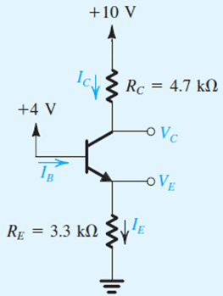
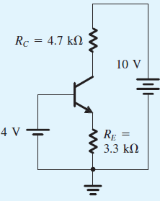
Example 2
Lets analyze this circuit to determine all node voltages and branch currents. Assume β=100
Simpler
representation

Slide 25
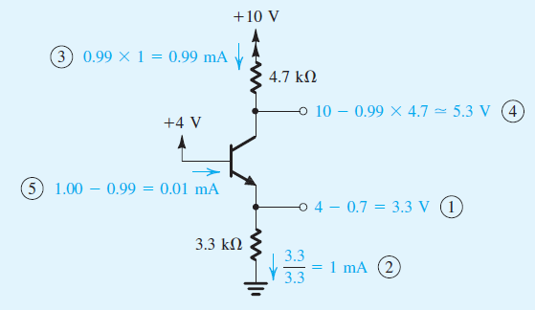
Example 2 solution

Slide 26
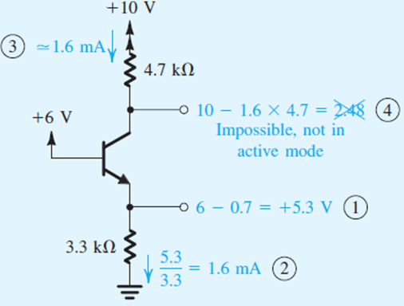
Example 3
Determine the voltages at all nodes and the currents through all branches. Β=50.

Slide 27
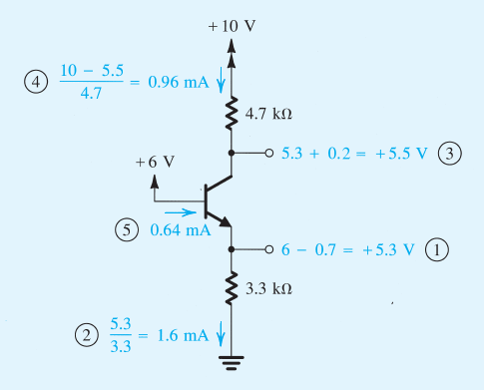
Example 3 cont’d.
In saturation mode because V_{C} < V_{B} so V_{CE}=0.2^{v}

Slide 28
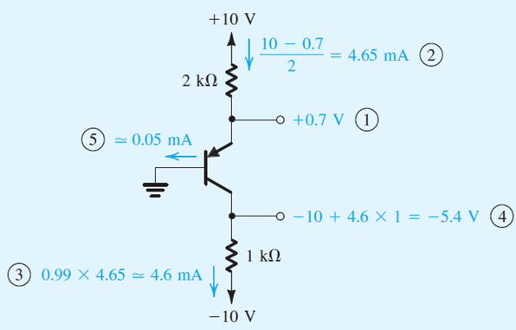
Example 4
Find all voltage nodes and currents

Slide 29
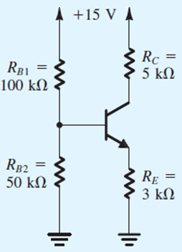
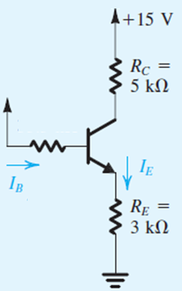
Example 5
Determine the voltages at all nodes and the currents through all branches. Assume β = 100.
V_{TH}=+5^{v}
R_{TH}=
33.3 kΩ

Slide 30
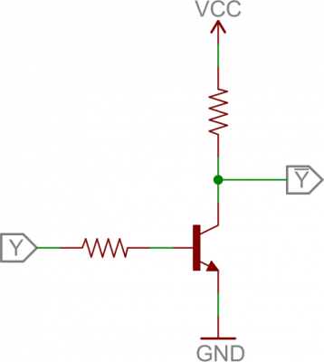
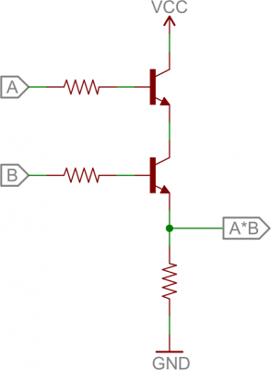
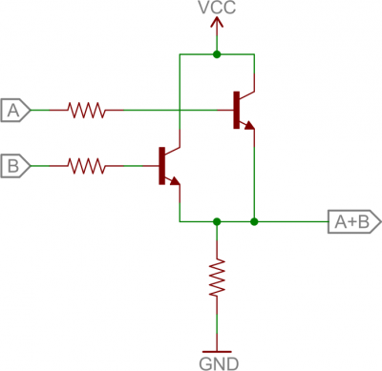
Applications
Digital Logic
Not Gate
AND Gate
OR Gate

Slide 31
BJT switching characteristics
Vcc
Vcc
0 V
0 V

Slide 32
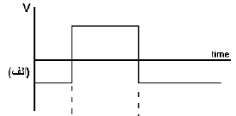
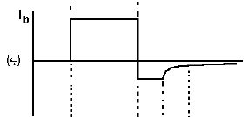
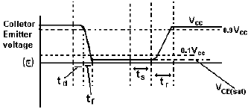
BJT switching characteristics

