Slide 1
Digital Electronics
Field Effect Transistor
Nasser Mozayani
School of Computer Engineering
Iran University of Science and Technology

Slide 2
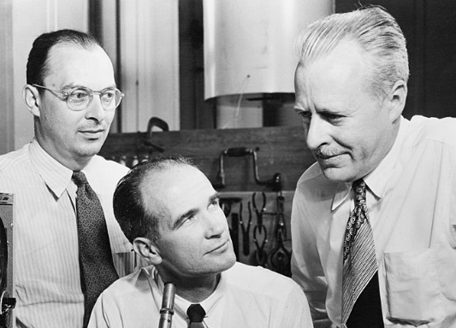
Field Effect Transistor (FET)
In 1945, Shockley had an idea for making
a solid state device out of semiconductors
He reasoned that a strong electrical field could cause the flow of electricity within a nearby semiconductor.
He tried to build one, but it didn't work.
Three years later, Brattain & Bardeen built the first working transistor, the germanium point-contact transistor, which was designed as the junction (sandwich) transistor.
In 1960 Bell scientist John Atalla developed a new design based on Shockley's original field-effect theories.
By the late 1960s, manufacturers converted from junction type integrated circuits to field effect devices.

Slide 3
FET
Field effect devices are those in which current is controlled by the action of an electron field, rather than carrier injection.
FET was known as a “unipolar” transistor
The term refers to the fact that current is transported by carriers of one polarity (majority), whereas in the conventional bipolar transistor carriers of both polarities (majority and minority) are involved.

Slide 4
FET
The family of FET devices may be divided into :
Junction FET
Depletion Mode MOSFET
Enhancement Mode MOSFET

Slide 5
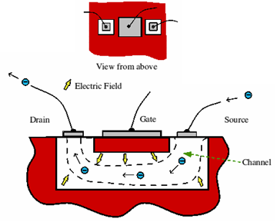
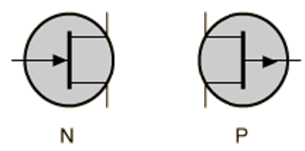
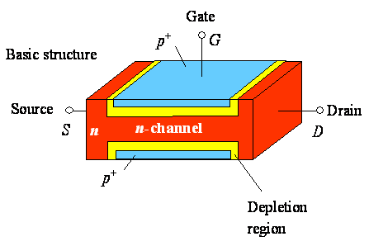
Junction FETs (JFETs)
JFETs consists of a piece of high-resistivity semiconductor material (usually Si) which constitutes a channel for the majority carrier flow
Conducting semiconductor channel between two ohmic contacts – source & drain

Slide 6
Junction FETs (JFETs)
The magnitude of DS current is controlled by a voltage applied to a gate, which is a reverse-biased.
difference between JFET and BJT: the gate current is practically zero, whereas the base current of the BJT is greater than zero.

Slide 7
nJFET and pJFET
JFET is a high-input resistance device, while the BJT is comparatively low.
In n-type channel the current will consist of electrons.
In, p-type channel the current will consist of holes.
N-channel devices have greater conductivity than p-channel types, since electrons have higher mobility than do holes; thus n-channel JFETs are approximately twice as efficient conductors compared to their p-channel counterparts

Slide 8
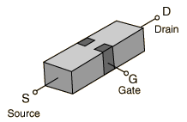
Basic structure of JFETs
In addition to the channel, a JFET contains two ohmic contacts: the source and the drain.
The JFET will conduct current equally well in either direction and the source and drain leads are usually interchangeable.

Slide 9
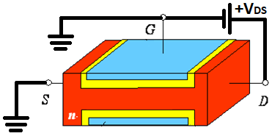
How JFET Function
Since the pn junction is reverse-biased, little current will flow in the gate connection.
The potential gradient established will form a depletion layer, where almost all the electrons present in the n-type channel will be swept away
The most depleted portion is in the high field between the G and the D, and the least-depleted area is between the G and the S

Slide 10
How JFET Function
+V_{DS}
+V_{DS}
the magnitude of DS current will fall as more Si becomes depleted of free electrons.
There is a limit to the drain current (I_{D}) which increased V_{DS} can drive through the channel.
This limiting current is known as I_{DSS} (Drain-to-Source current with the gate shorted to the source).

Slide 11
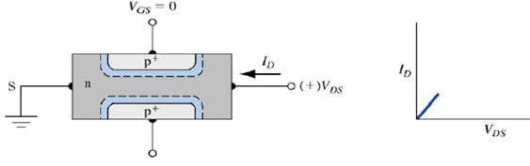
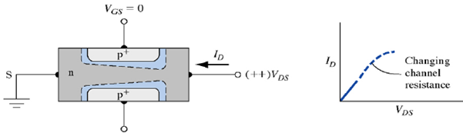
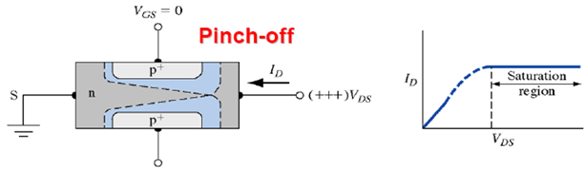
I-V characteristics
After pinch-off: I_{D}≠f(V_{D}), I_{D}=f(V_{G}), current source

Slide 12
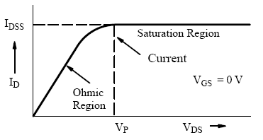
Output characteristics
The initial rise in I_{D} is related to the increase of V_{DS}
The curve approaches the level of the limiting current I_{DSS} when I_{D} begins to be pinched off

Slide 13
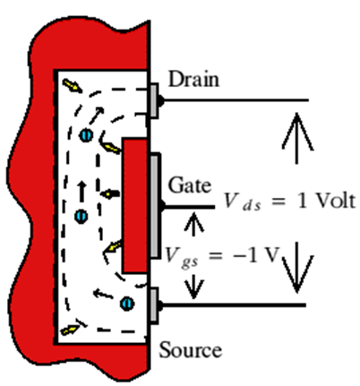
When V_{GS}=-1Volt
With a steady gate-source voltage of -1 V there is always 1 V across the wall of the channel at the source end.
V_{DS} of 1 V means that there will be 2 V across the wall at the drain end. (The drain is ‘up’ 1V from the source potential and the gate is 1V ‘down’, hence the total difference is 2V.)

Slide 14
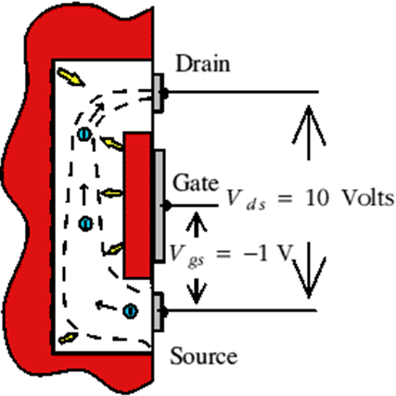
When V_{GS}=-1Volt
When V_{DS}=10V the voltage across the channel walls at the drain end increases to 11V, but remains just 1V at the source end
The field across the walls near the drain end is now a lot larger than at the source end.
As a result the channel near the drain is squeezed down quite a lot.

Slide 15
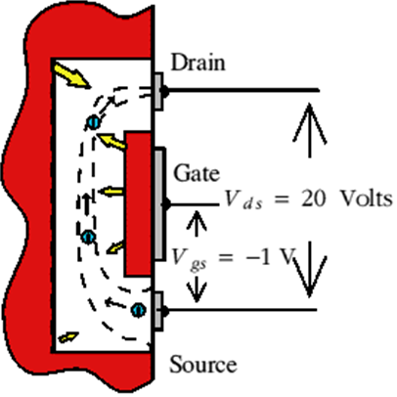
When V_{GS}=-1Volt
V_{DS}=20V squeezes down this end of the channel still more
As we increase this voltage we increase the electric field which drives electrons along the open part of the channel.
However, also squeezes down the channel near the drain end.
This reduction in the open channel width makes it harder for electrons to pass.
As a result the drain-source current tends to remain constant when we increase the drain-source voltage.

Slide 16
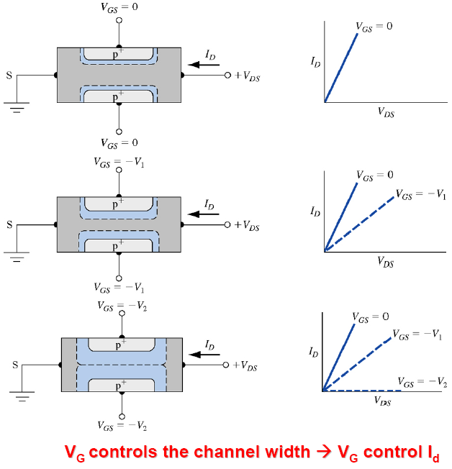
I-V characteristics

Slide 17
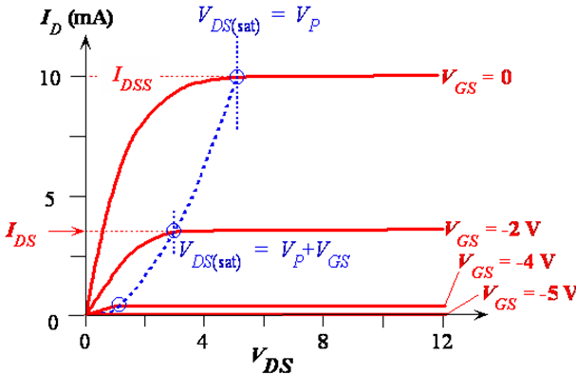
JFET: I-V characteristics
Beyond V_{DS} = V_{P}, as V_{DS} increases, most of additional voltage simply drops across ℓ_{po} as this region is depleted of carriers and hence highly resistive. Voltage drop across channel length, L_{ch} remain as V_{P}.
Beyond pinch-off then I_{D} = V_{P}/R_{AP} (V_{DS}>V_{P}).

Slide 18
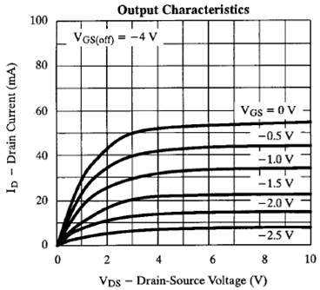
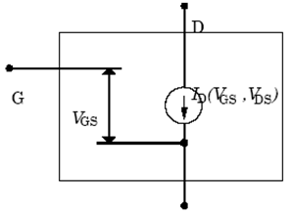
JFET model

Slide 19
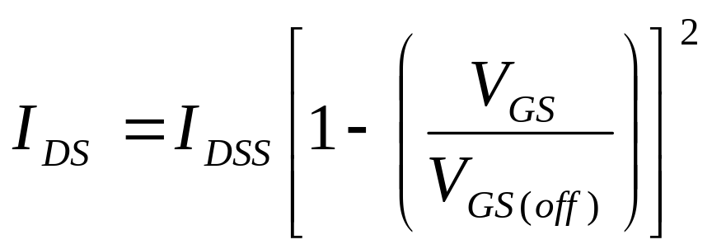
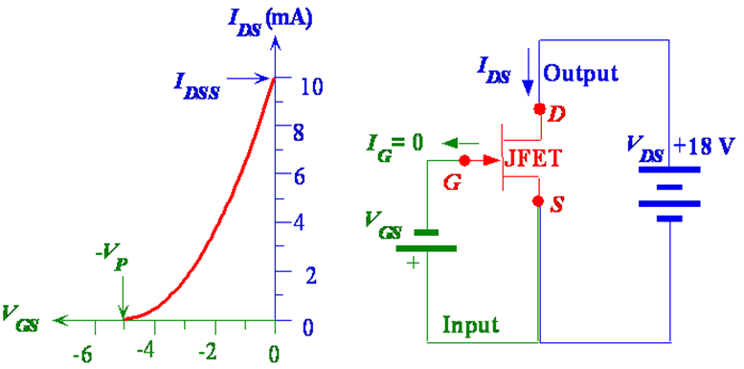
JFET model
Beyond pinch-off
Where I_{DSS} is drain current when V_{GS}= 0 and V_{GS(off)} is –V_{P}

Slide 20
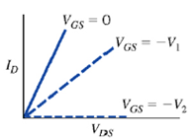
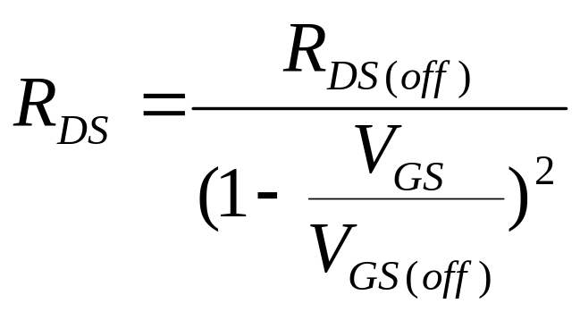
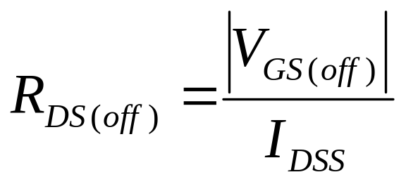
JFET model
Before pinch-off

Slide 21
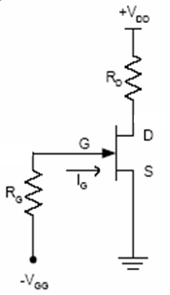
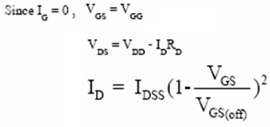
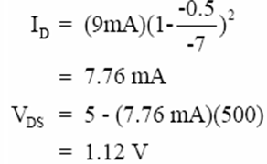
JFET Biasing example
Determine the Q point of the circuit below with:
V_{GG}=-0.5^{v}, V_{PO}=-7^{v}, I_{DSS}=9^{mA}, V_{DD}=5^{v}, R_{D}=500Ω

Slide 22
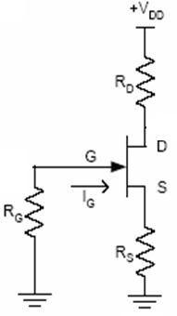
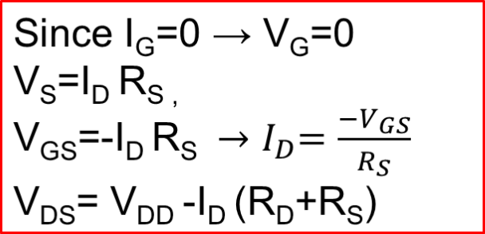
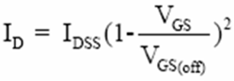
JFET example 2
Determine the Q point of the circuit below with:
V_{PO}=-8^{v}, I_{DSS}=16^{mA}, V_{DD}=10^{v}, R_{D}=500^{Ω}, R_{G}=1M^{Ω}, R_{S}=500^{Ω}
I_{D} =6mA ,
V_{DS}= 10-6(500+500) = 4^{V}

Slide 23
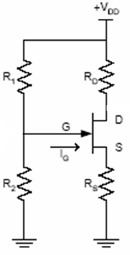
JFET example 3
Determine the Q point of the circuit below with:
V_{PO}=-8^{v}, I_{DSS}=16^{mA}, V_{DD}=10^{v}, R_{D}=500^{Ω}, R₁=90^{KΩ}, R₂=10^{KΩ}

