Slide 1
Digital Electronics
MOSFET
Nasser Mozayani
School of Computer Engineering
Iran University of Science and Technology

Slide 2
MOSFETs vs BJTs
Introduction
BJTs
Three terminal
Three different currents in the device: I_{C}, I_{B} and I_{E}
Consume a lot of power
Output current is controlled by an input current
Large size device
MOSFETs
Three terminal
Only 1 current, I_{D}
Low power
Output current is controlled by voltage (electric field)
Very small device (nm)
metal
oxide
semiconductor

Slide 3
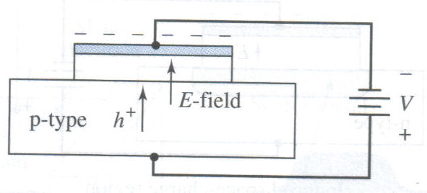
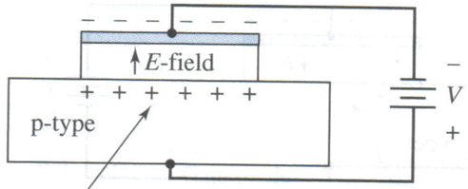
Two-Terminal MOS Structure
A negative charge will exist on the top metal plate, gate, and an electric field will be induced
an accumulation layer of holes will exist

Slide 4
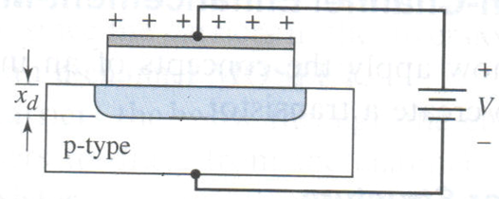
Two-Terminal MOS Structure
For reverse voltage, the holes are pushed away from the interface, a negative space-charge region is created.
- - - - - -
- - - - - -
This region of minority carrier electrons is called an electron inversion layer.
The larger the voltage the wider the layer

Slide 5
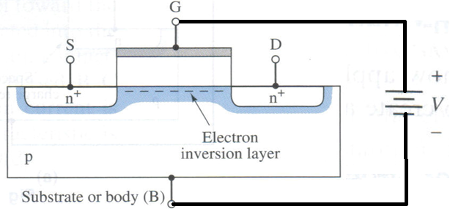
Three-Terminal MOS Structure
If a large enough positive voltage gate voltage is applied, an electron inversion layer connects the n-source to the n-drain
Since a voltage must be applied to the gate to create the inversion charge, this transistor is called an enhancemode MOSFET.
Since the carriers in the inversion layer are electrons, this device is called an n-channel MOSFET (NMOS).

Slide 6
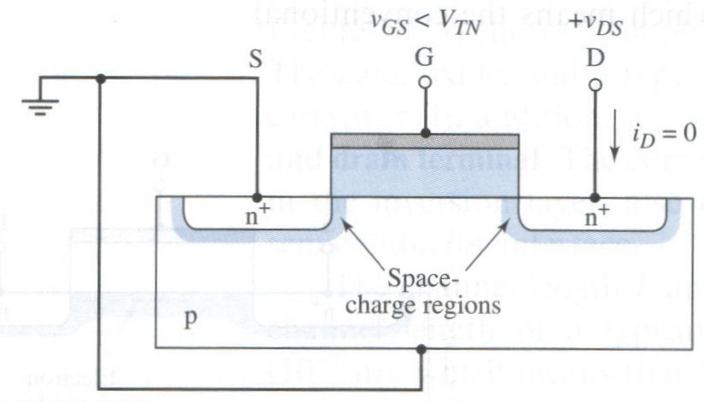
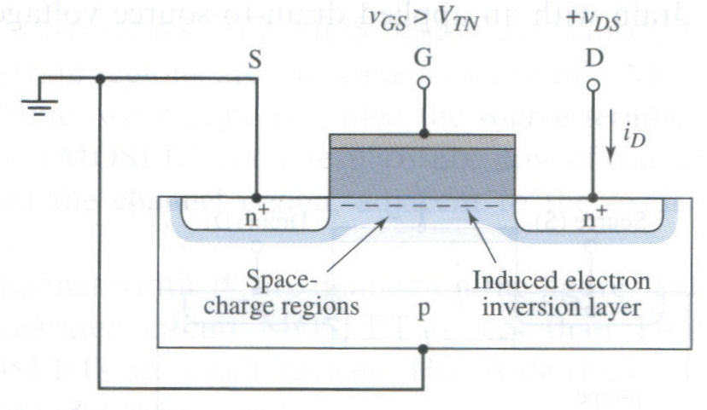
I-V characteristics
The threshold voltage V_{TN}, is defined as the applied gate voltage needed to create an inversion charge
If the V_{GS} < V_{TN}, the current in the device is essentially zero
If the V_{GS} > V_{TN}, a drain-to-source current, I_{D} is generated as an induced electron inversion layer / channel is created

Slide 7
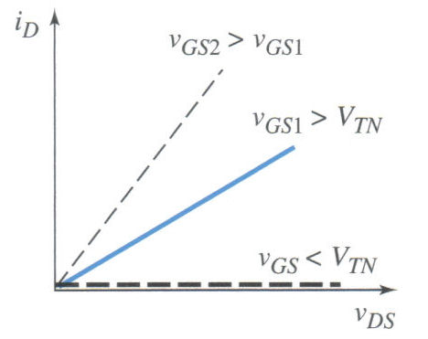
I-V characteristics
When v_{GS} > V_{TN}, the channel inversion charge is formed and the drain current increases with v_{DS}

Slide 8
I-V characteristics
V_{GS} = V_{G} – V_{S}
V_{GD} = V_{G} – V_{D}
But V_{GD} = V_{GS} – V_{DS}
= V_{G} – V_{S} – V_{D} +V_{S}
So, if V_{DS} is small, V_{GD} ≅V_{GS}, we have approximately equal distribution of channel inversion layer
-
V_{DS}
+
S
G
D
-
V_{GS}
+
- - - - - - - - - - - - - - - - - - - - - - - - -

Slide 9
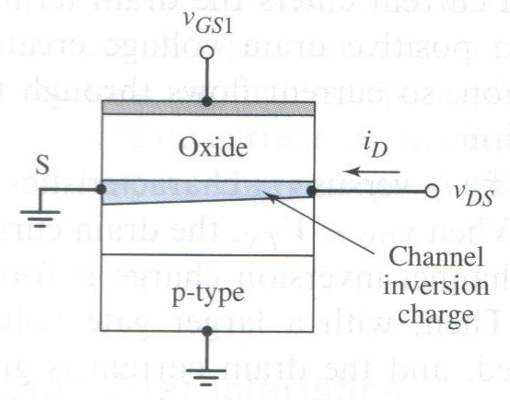
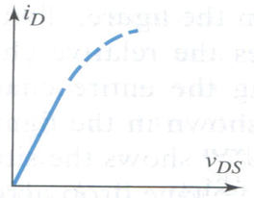
I-V characteristics
V_{GD} = V_{GS} – V_{DS}
When the drain voltage v_{DS} increases, the voltage drop across the oxide near the drain terminal decreases – no longer uniform distribution.
It means that the induced inversion charge density near the drain also decreases.
It causes the slope of the i_{D} versus v_{DS} curve to decrease.

Slide 10
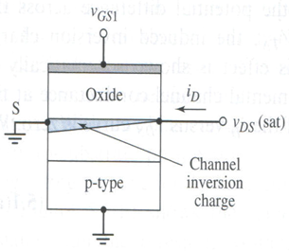
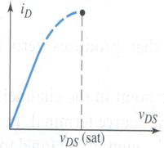
I-V characteristics
As V_{DS} increases, the channel at the drain end reaches the pinch-off point and the value of V_{DS} that causes the channel to reach this point is called saturation voltage V_{DSsat}
V_{GD} = V_{GS} – V_{DS sat}

Slide 11
I-V characteristics
At the pinch off point, V_{GD} = V_{TN}
V_{GD} = V_{GS} – V_{DS sat}
V_{TN} = V_{GS} – V_{DS sat}
Hence,
V_{DSsat} = V_{GS} - V_{TN}

Slide 12
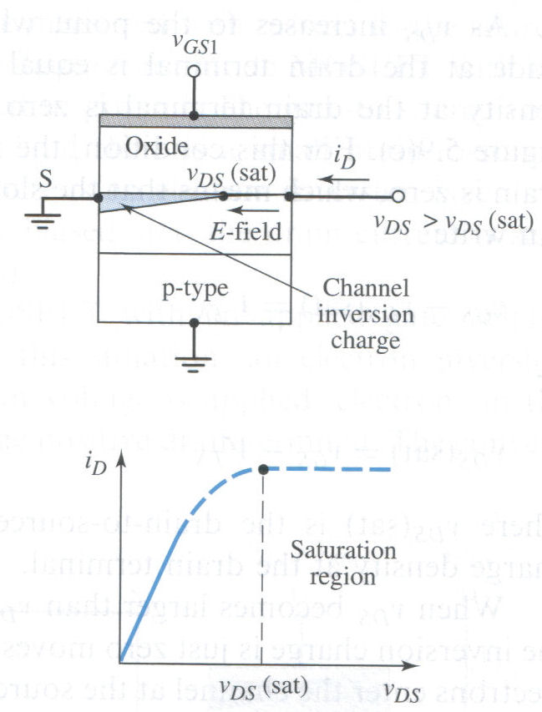
I-V characteristics
When v_{DS} > v_{DS}(sat), the drain current is constant
This region is referred to as the saturation region.

Slide 13
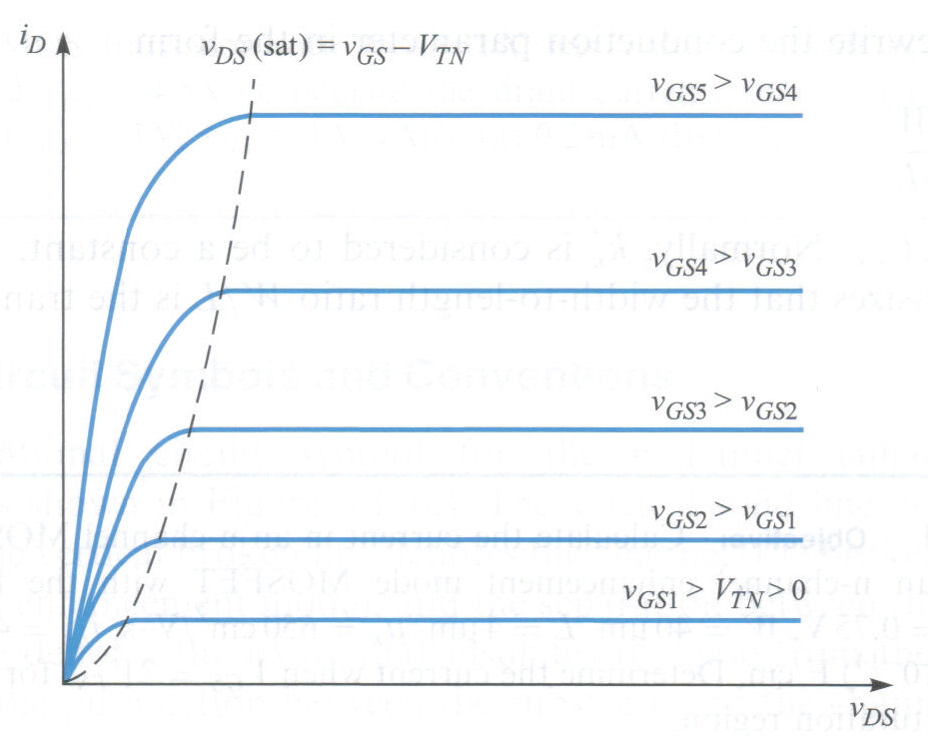
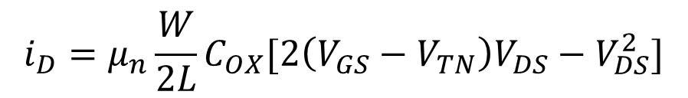
I-V characteristics
The region for which v_{DS} < v_{DS}(sat) is known as triode region
The ideal current-voltage characteristics in this region are described by the equation:
K_{n}

Slide 14

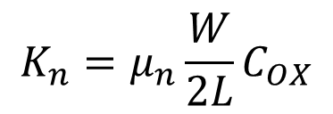
I-V characteristics
In saturation region, the ideal current-voltage characteristics for the v_{GS} > V_{TN} are described by the equation:

Slide 15


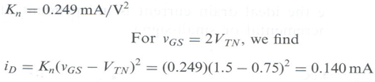
Example
Calculate the current of following nMOS parameters:
V_{TN}=0.75^{V}, W=40^{μm}, L=4 ^{μm} , μ_{n}=650 cm²/V-s, t_{ox}=450Ā, ε_{ox}=(3.9)(8.85 x 10⁻¹⁴)F/cm, and let v_{GS} > 2V_{TN}

Slide 16
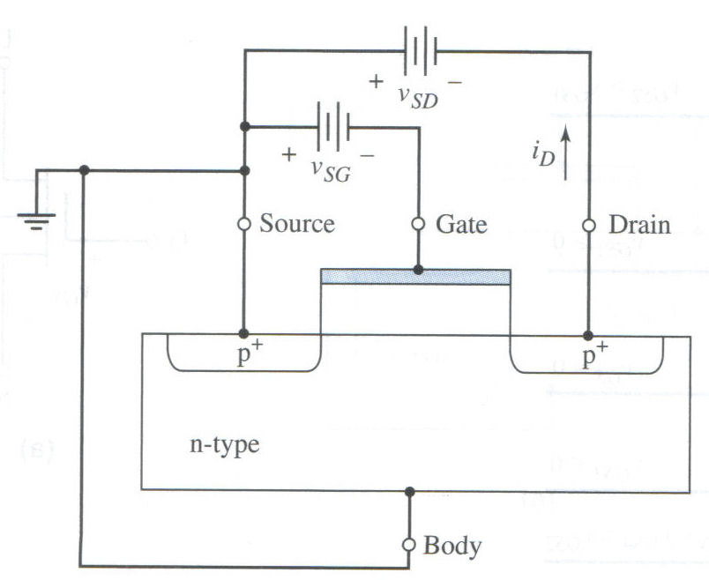
PMOS enhancement mode
The substrate is now n-type and source and drain areas are p-type.
The channel length, channel width, and oxide thickness parameter definitions are the same as those for NMOS device
The operation is the same as that of the n-channel device
All polarities must be swapped

Slide 17




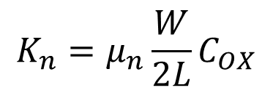
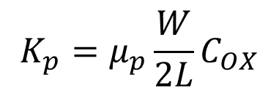
NMOS
  V_{TN} is POSITIVE
  V_{GS} > V_{TN} to turn on
  Triode region
  Saturation region
  V_{DSsat} = V_{GS} - V_{TN}
PMOS
  V_{TP} is NEGATIVE
  V_{SG} > |V_{TP}| to turn on
  Triode region
  Saturation region
  V_{SDsat} = V_{SG} + V_{TP}

Slide 18
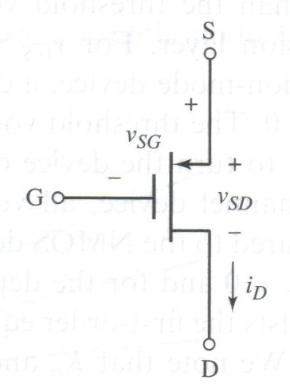
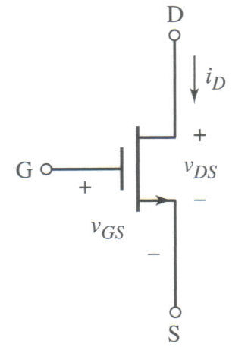
Circuit Symbols nMOS & pMOS enhancement mode

Slide 19
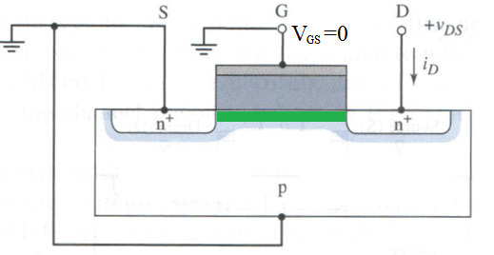
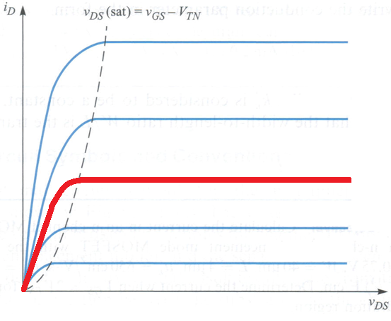
nMOS depletion mode
The operation is the same except for the pinch off
In -V_{TN} channel disappears
V_{GS}6>V_{GS}5
V_{GS}5>V_{GS}4
V_{GS}4=0
The n Channel already exist
V_{GS}3>V_{GS}2
V_{GS}2>V_{GS}1
V_{GS}1=-V_{TN}

Slide 20
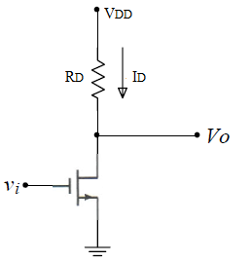
nMOS inverter
V_{DD}
V_{DD}
0 V
0 V

Slide 21
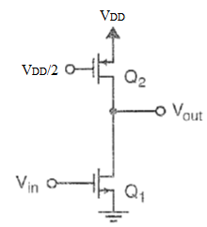
nMOS inverter with active load
V_{DD}
V_{DD}
0 V
0 V

Slide 22
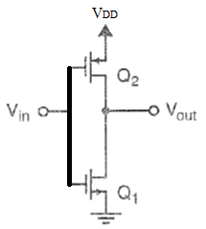
CMOS inverter
V_{DD}
V_{DD}
0 V
0 V

Slide 23
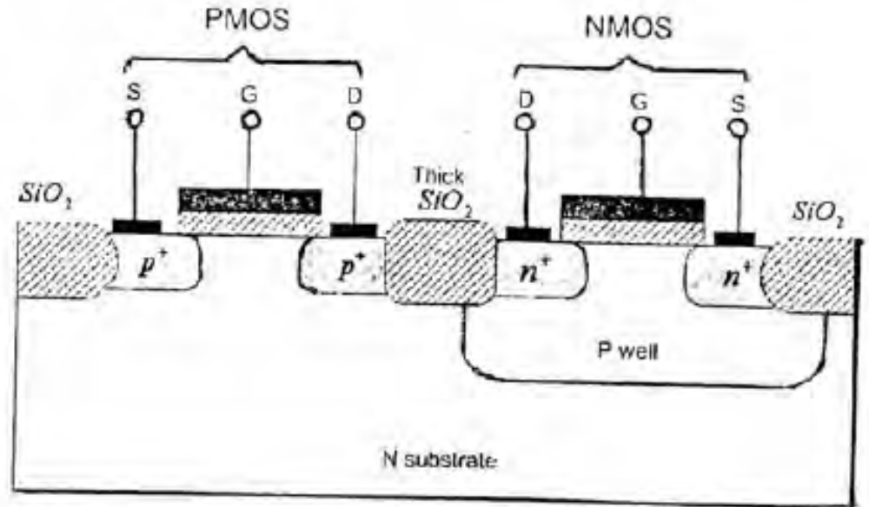
Complementary MOS cell

