Slide 1
Digital Electronics logic families
Nasser Mozayani
School of Computer Engineering
Iran University of Science and Technology

Slide 2
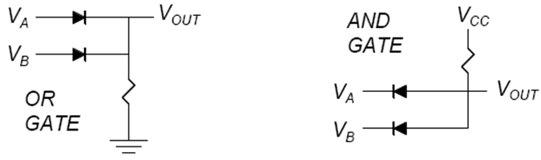
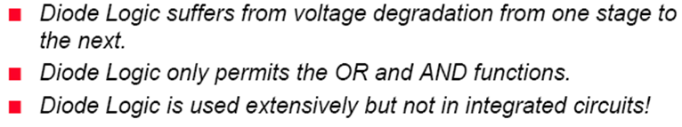
Diode Logic

Slide 3
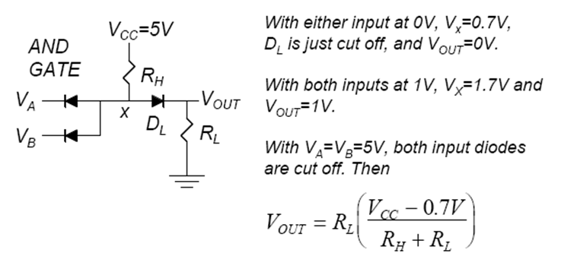
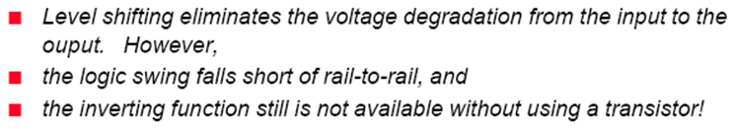
Diode Logic

Slide 4
Diode-Transistor Logic
We can also use diodes in conjunction with transistors to create Diode-Transistor Logic (or simply a DTL gate) circuits.
It is better to design a DTL gate than an RTL gate because it is lot easier to create diodes than resistors on a chip.
A diode on the chip may in fact be a transistor connected as a diode.

Slide 5
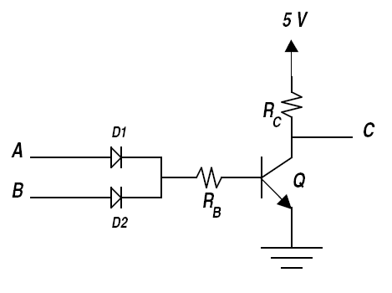
DTL NOR Gate:
We can use a diode OR circuit and couple its output to a transistor inverter (NOT) circuit in order to obtain a NOR gate. The resistance in the base circuit R_{B} is selected to limit the base current.

Slide 6

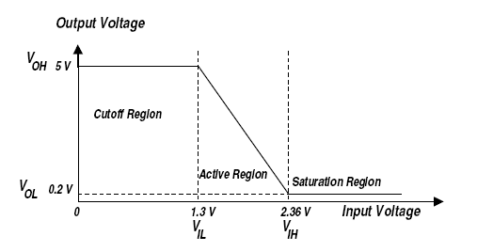
Input voltages

Slide 7
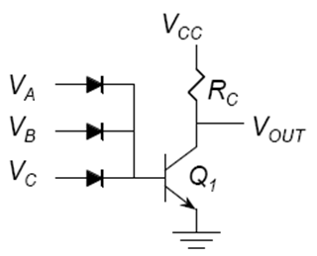
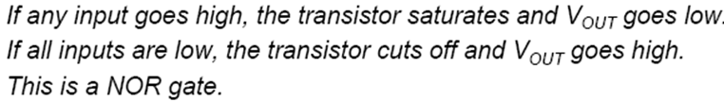
DTL NOR Gate:

Slide 8
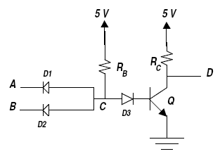
DTL NAND Gate
We can use a diode AND circuit followed by a transistor inverter (NOT) circuit to obtain a NAND gate.
The minimum voltage at C to turn on Q is 1.3 V [0.7 V for D3 and 0.6 V for Q].The maximum value of the input voltage, V_{IL}, is 0.6 V [1.3 – 0.7].
Thus, the lower-noise margin is only 0.4 V [0.6 – 0.2]. It would be better to use at least one more diode in series with D3 in order to increase the lower-noise margin.

Slide 9
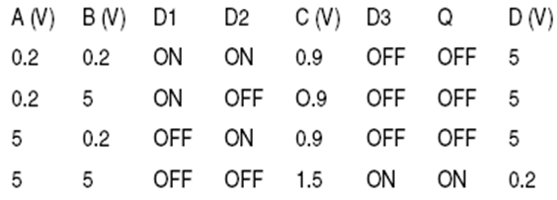
DTL NAND Gate
Function table:
Assumption: V_{BE}(sat)=0.8v, V_{D}(on)=0.7v, V_{CE}(sat)=0.2v

Slide 10
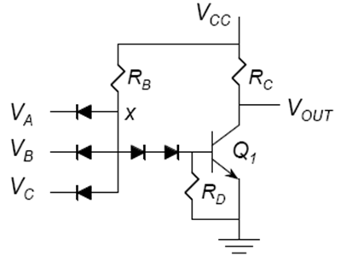
DTL NAND Gate
Improved NAND gate:

Slide 11
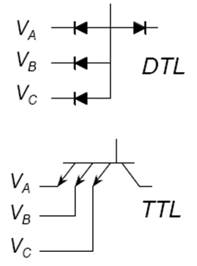
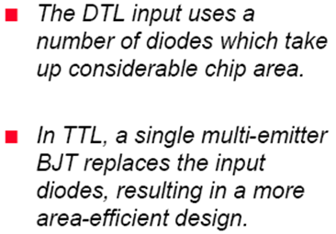
Why TTL?

Slide 12
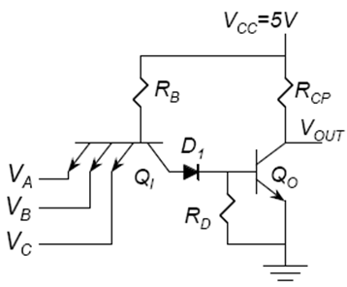
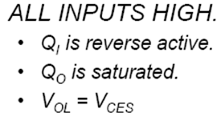
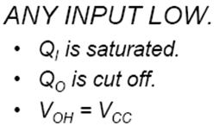
Basic TTL Gate

Slide 13
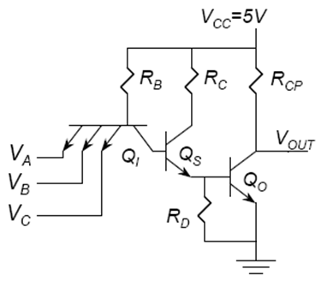

TTL switching speed t_{PLH}
The depletion capacitance of Q1 EB junction must discharge
Base charge must be removed from the saturated Qs and Qo
The capacitive load must be charged to V_{CC}

Slide 14
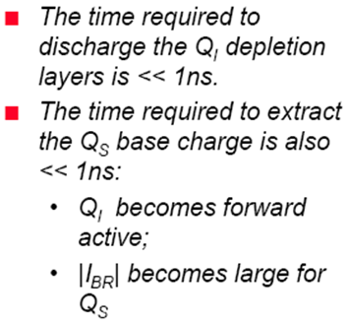

TTL switching speed t_{PLH}

Slide 15
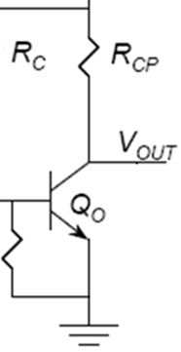
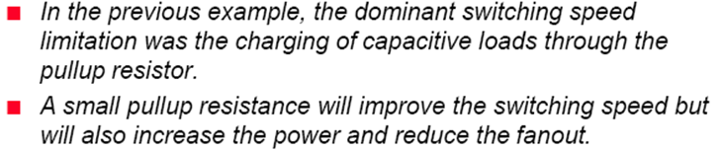
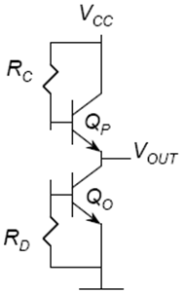
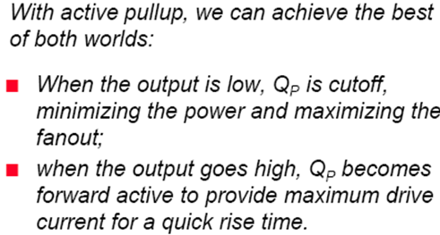
TTL with active Pullup

Slide 16
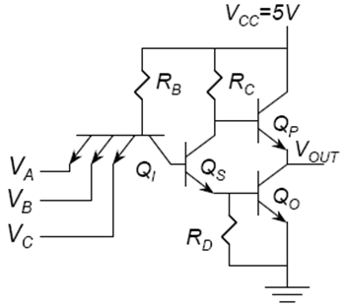
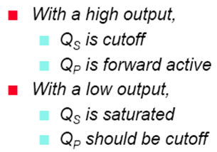
TTL with active Pullup
0.9
0.7
0.2
0.0
But there is problem with low output:
V_{BE}(Qp)

Slide 17
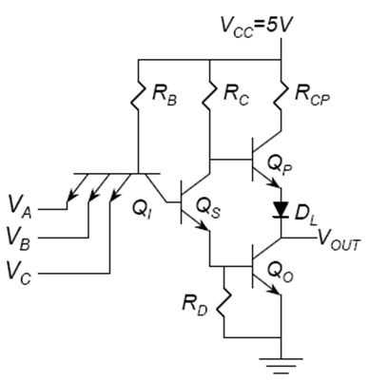
TTL with Totem Pole output
0.9
0.7
0.2
0.0

Slide 18
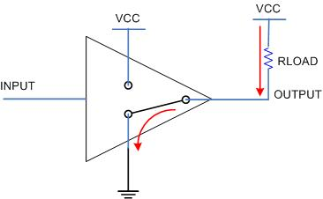
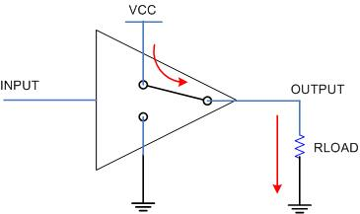
Sinking Sourcing
Figure : 1
Figure : 2
The combination of Q_{P} and Q_{O} working as a push-pull transistor pair has the ability to either source current from VCC via the output terminal and into a load, or to sink current to GND via the output terminal from a load.

Slide 19
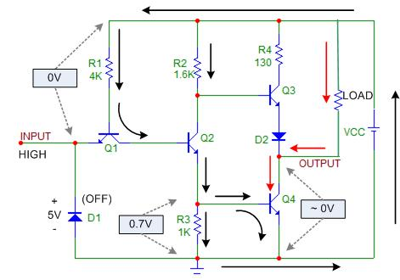
TTL Totem pole sinking

Slide 20
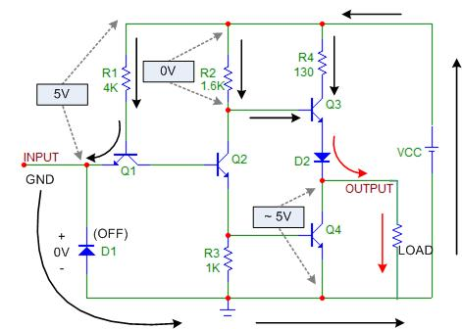
TTL Totem pole sourcing

Slide 21
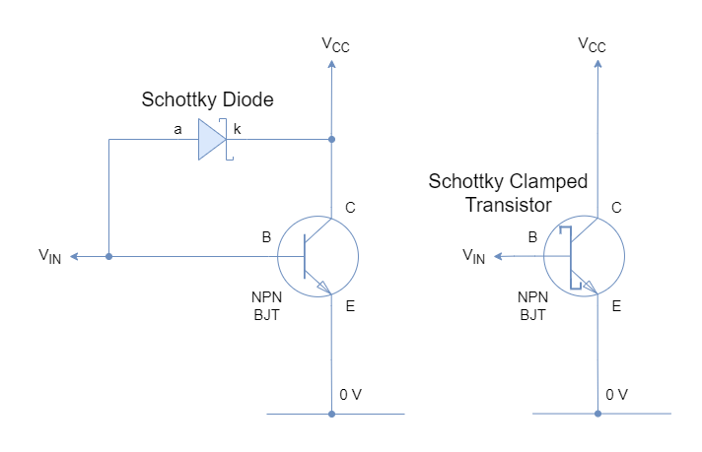
Schottky Transistor

Slide 22
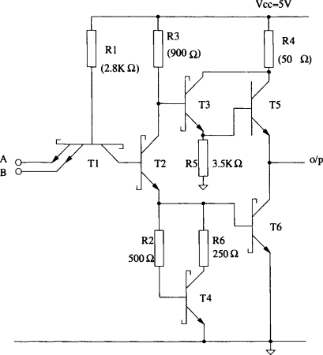
Schottky TTL

Slide 23
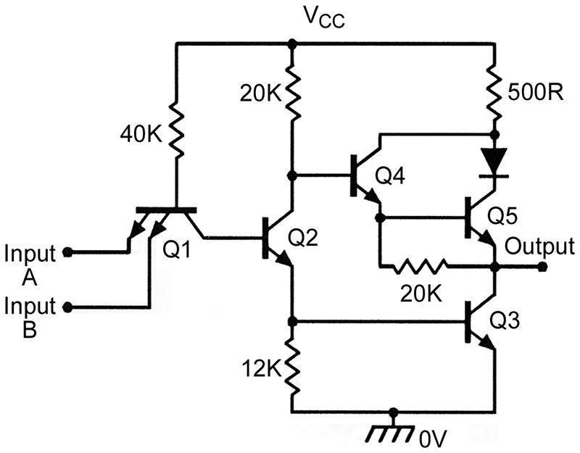
LOW POWER TTL
4k -> 40k
1.6k ->20k
1k -> 12k
130 -> 500

Slide 24
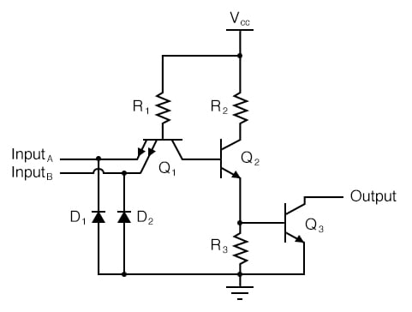
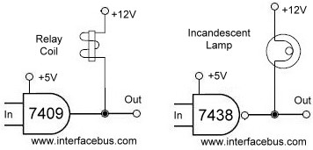
Open collector TTL
Protection diodes

Slide 25
Open collector TTL

Slide 26
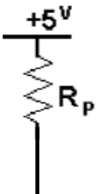
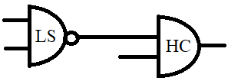
Pull UP for interfacing
 | 74LS | HC
V_{OH}(min) | 2.7 | 4.9
V_{OL}(max) | 0.5 | 0.1
V_{IH}(min) | 2.0 | 3.5
V_{IL}(max) | 0.8 | 1.0
V_{NH} = V_{OH} (min) - V_{IH} (min)
V_{NL} = V_{IL} (max) - V_{OL} (max)

Slide 27
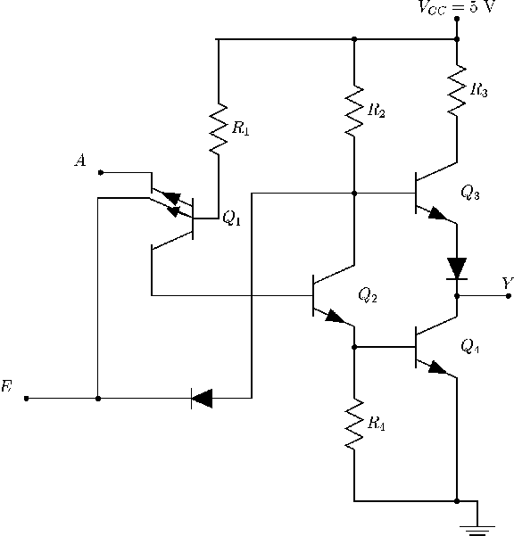
Tri-state TTL
0.7
0.2
Hi-Z
0.0
0.7

Slide 28

Squaring circuit

Slide 29
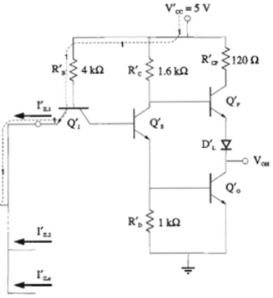
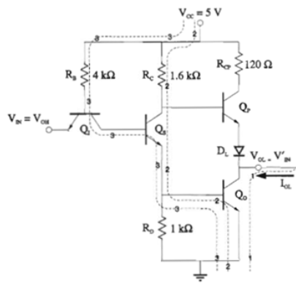



Cascading TTL (fan out)
When output is low:

Slide 30
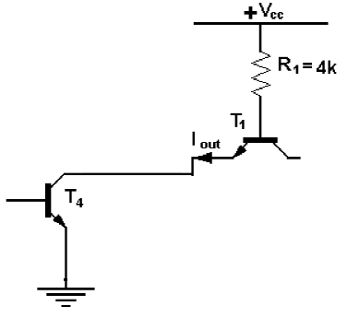
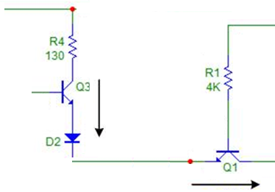
Cascading TTL (fan out)
When output is low:
I_{out}=(V_{CC}-V_{BE1}-V_{out})/R₁
= (5-0.7-0.2)/4000=1.025 mA
β₄.I_{B4}>1.025N
When output is high I_{IH}≈0
=> N ≈ ∞

Slide 31
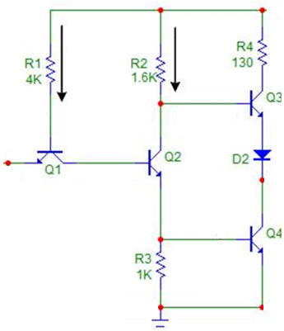
Noise Margin
When all inputs are high (≈3.8v):
V_{B1}=0.7+0.7+0.7=2.1
V_{NH}=V_{B1}-V_{E1}-V_{i}=2.1–0.7-3.8=-2.4 v
When one input is low (≈0.2):
V_{C1}=0.2+0.2=0.4
V_{NL}=V_{BE2}+V_{BE4}-V_{C1}=0.7+0.7-0.4=+1v

Slide 32
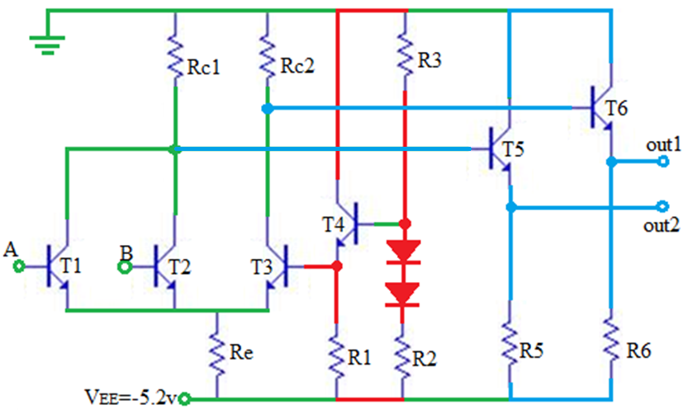
Emitter Coupled Logic
V_{high}=-0.75
V_{low}=-1.6
V_{ref}

Slide 33
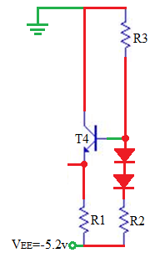
Emitter Coupled Logic
V_{REF}=-1.15

Slide 34
Emitter Coupled Logic
Output buffer

Slide 35
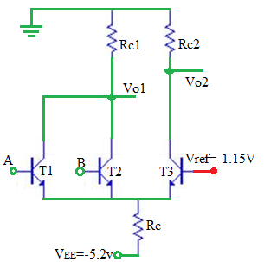
Emitter Coupled Logic
V_{A}=V_{B}=-0.75:
V_{E}=-1.45 or -1.85?
T₁= T₂= on, T₃=off
V_{o2}=0, V_{o1}=-R_{c1}.(I_{c1} +I_{c2}) ≈ -0.9

Slide 36
Emitter Coupled Logic
V_{A}=-0.75, V_{B}=-1.6:
V_{E}=-1.45 or -1.85 or -2.3?
T₁=on, T₂=T₃=off
V_{o2}=0, V_{o1}=-R_{c1}.I_{c2}≈-0.9

Slide 37
Emitter Coupled Logic
V_{A}=V_{B}=-1.6:
V_{E}=-1.85 or -2.3?
T₁= T₂=off, T₃=on
V_{o1}=0, V_{o2}=-R_{c2}.I_{c3}≈-0.9

Slide 38
Emitter Coupled Logic
V_{o1} V_{o2}
V_{o1}=0, V_{o2}= -0.9
V_{out2}=-0.75
V_{out1}=-1.6

Slide 39
ECL noise margin
a- V_{A}=-0.75, T1=on, T3=off,
V_{E}=-1.45 =>
V_{NH}= -1.85 -(-1.45)=-0.4
b- V_{A}=-1.6, T1=off, T3=on,
V_{E}=-1.85 =>
V_{NL}= -1.85 -(-2.3)=0.45

