Slide 1
Digital Electronics Memories
Nasser Mozayani
School of Computer Engineering
Iran University of Science and Technology

Slide 2
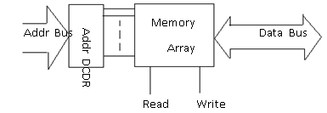
categories
Memories:
Non-Volatile:
Tape, Disk, CD, DVD
Semiconductor:
RAM, ROM
Arrangement:
Every bit in one cell,
All memory in array structures 64*1, 16*4, 8*8, …

Slide 3
semiconductor
Semiconductor Memory technologies:
Bipolar
MOS
pMOS, nMOS, CMOS
BiMOS

Slide 4
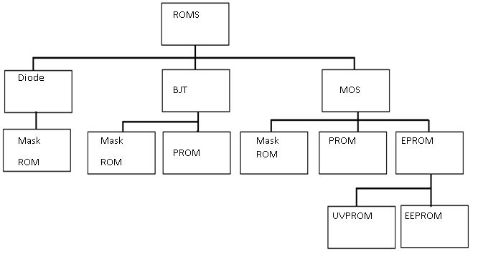
ROM

Slide 5
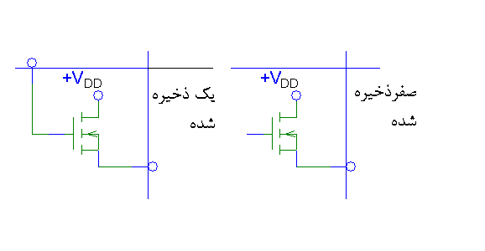
Mask ROM
Burned in factory

Slide 6
PROM
Programming or Burning the PROM

Slide 7
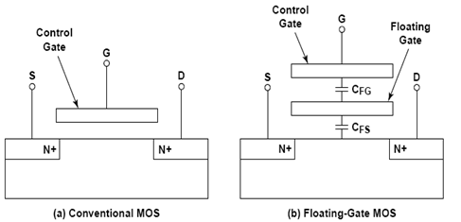
EPROM
E²PROM, UVPROM

Slide 8
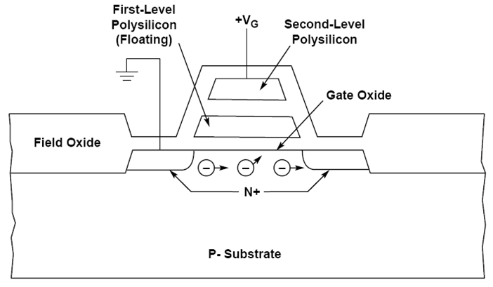
EPROM
Double poly structure (EPROM/flash memory cell)

Slide 9
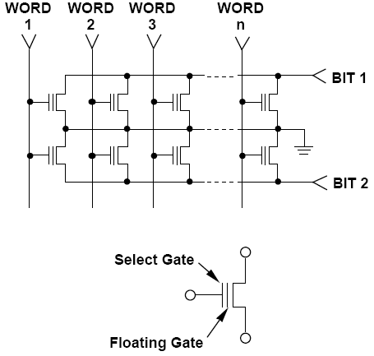
NOR EPROM configuration

Slide 10
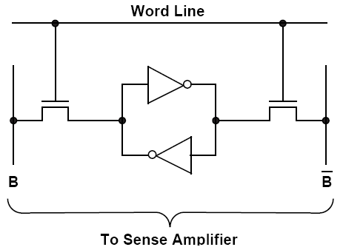
RAM
Static RAM
Dynamic RAM
SRAM cell:

Slide 11
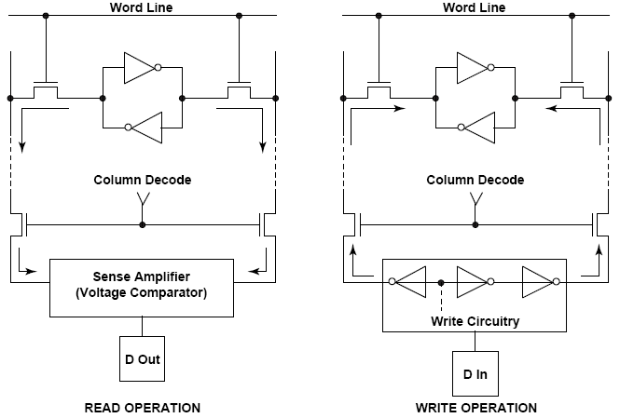
SRAM

Slide 12
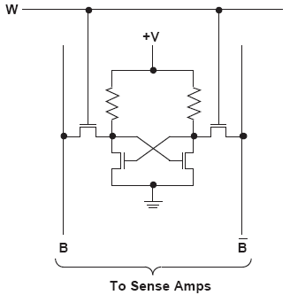
4T cell

Slide 13
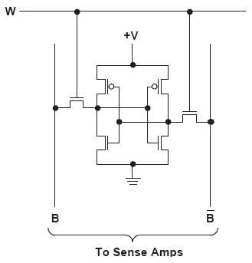
6T cell

Slide 14
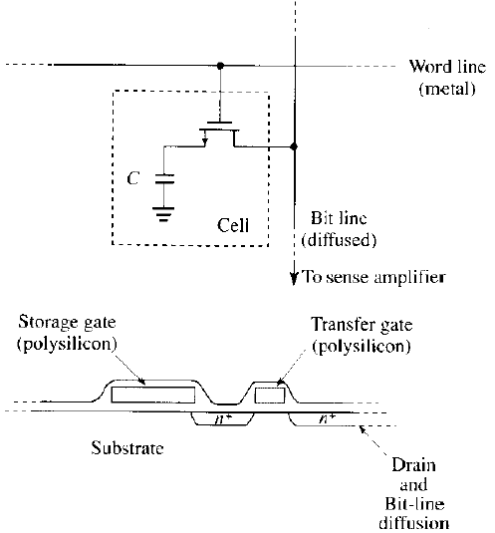
DRAM

Slide 15
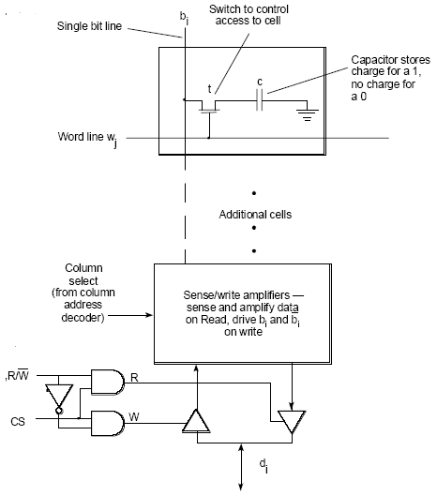
DRAM R/W

Slide 16
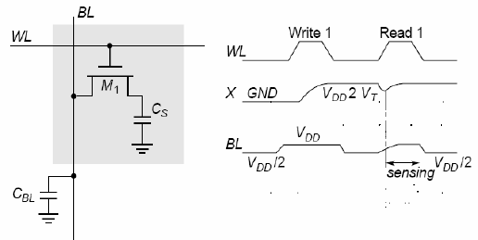
DRAM
Refreshing:
- burst
- distributed
ZRAM, VRAM, MVDRAM, DDR, …

