Slide 1
Bipolar Junction Transistors

Slide 2
Introduction
IN THIS CHAPTER YOU WILL LEARN
The physical structure of the bipolar transistor and how it works.
How the voltage between two terminals of the transistor controls the current that flows through the third terminal, and the equations that describe these current-voltage relationships.
How to analyze and design circuits that contain bipolar transistors, resistors, and dc sources.
How the transistor can be used to make an amplifier or digital logic.

Slide 3
Introduction
This chapter examines a three-terminal device.
bipolar junction transistor
BJT was invented in 1948 at Bell Telephone Laboratories.
Ushered in a new era of solid-state circuits.
It was replaced by MOSFET as predominant transistor used in modern electronics.
Notes:
The bipolar transistor enjoyed nearly three decades as the device of choice in the design of both discrete and integrated circuits.
Although the MOSFET had been known very early on, it was not until the 1970s and 1980s that it became a serious competitor to the BJT. By 2009, the MOSFET was undoubtedly the most widely used electronic device, and CMOS technology the technology of choice in the design of integrated circuits. Nevertheless, the BJT remains a significant device that excels in certain applications. For instance, the reliability of BJT circuits under severe environmental conditions makes them the dominant device in certain automotive applications.

Slide 4
Introduction
Three-terminal devices are more useful than two-terminal ones, such as the diodes, because they can be used in a multitude of applications:
signal amplification
design of digital logic and memory circuits.
The basic principle is the use of the voltage between two terminals to control the current flowing in the third terminal.
In this way, a three-terminal device can be used to realize a controlled source.
Notes:
The BJT is still the preferred device in very demanding analog circuit applications, both integrated and discrete. This is especially true in very-high-frequency applications, such as radio-frequency (RF) circuits for wireless systems. A very-high-speed digital logic-circuit family based on bipolar transistors, namely, emitter-coupled logic, is still in use.
Finally, bipolar transistors can be combined with MOSFETs to create innovative circuits that take advantage of the high-input-impedance and low-power operation of MOSFETs and the very-high-frequency operation and high-current-driving capability of bipolar transistors. The resulting technology is known as BiCMOS.

Slide 5
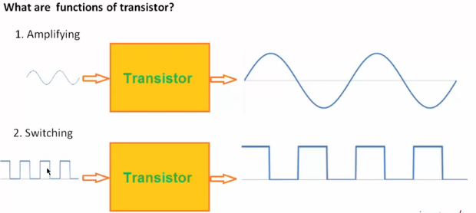
Introduction

Slide 6
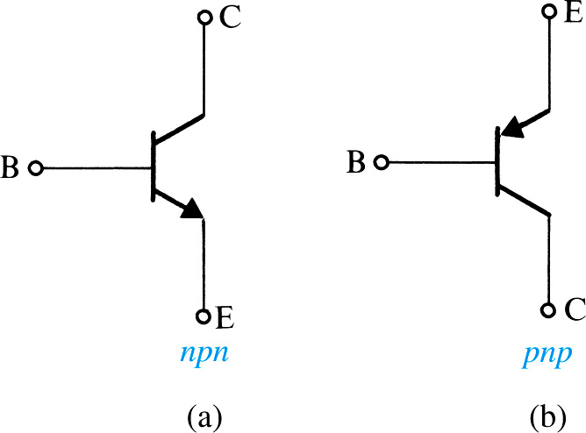
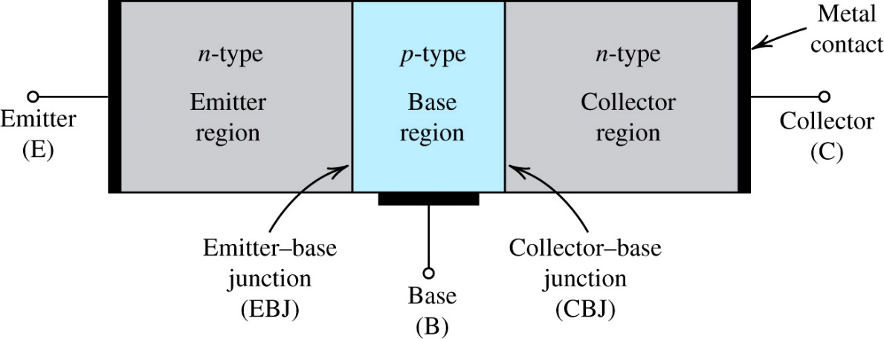
Device Structure and Physical Operation
A simplified structure of the npn transistor.
Notes:
The transistor consists of two pn junctions, the emitter–base junction (EBJ) and the collector–base junction (CBJ).
Depending on the bias condition (forward or reverse) of each of these junctions, different modes of operation of the BJT are obtained, as shown in Table 6.1

Slide 7
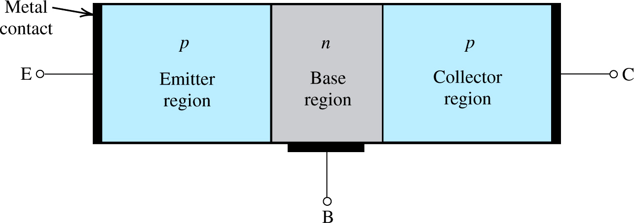
Device Structure and Physical Operation
A simplified structure of the pnp transistor.
Notes:
Note that this is normally implemented by doping regions on the surface of a silicon chip

Slide 8
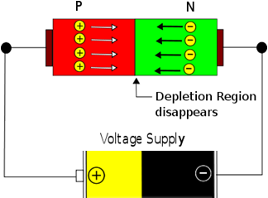
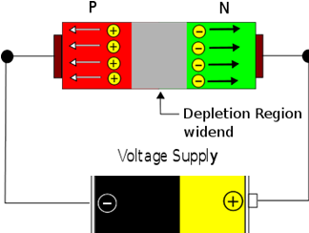
Electrical Switching on P-N Junction
Applying External Voltage…
…of Forward Biasing polarity facilitates motion of free electrons
…of Reverse Biasing polarity impedes motion of free electrons
Forward Biasing
Reverse Biasing
Circuit is “On”
Current is Flowing
Circuit is “Off”
Current not Flowing

Slide 9
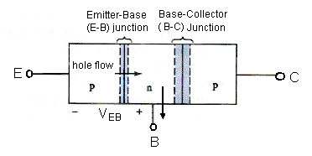
C
OPERATIONS - pnp
I_{B}
FORWARD ACTIVE MODE
I_{C}
B
-
The emitter – base (E- B) junction is forward biased and the base-collector (B- C) junction is reverse-biased,.
V_{EB}
I_{E}
+
E
I_{E} = I_{S} [ e ^{VEB / VT} -1 ] = I_{S} e ^{VEB / VT}
**Notice that it is V_{EB}
Based on KCL: I_{E} = I_{C} + I_{B}

Slide 10
Based on KCL: I_{E} = I_{C} + I_{B}
I_{C} = β I_{B}
I_{C} = α I_{E}
I_{E} = β I_{B} + I_{B} = I_{B}( β + 1)
I_{E} = I_{B}( β + 1)
Now
With I_{C} = β I_{B} → I_{B} = I_{C} / β
Hence,
I_{E} = [ I_{C} /β ] ( β + 1)
I_{C} = I_{E} [ β / β + 1 ]
Comparing with I_{C} = α I_{E}
α = [ β / β + 1 ]

Slide 11
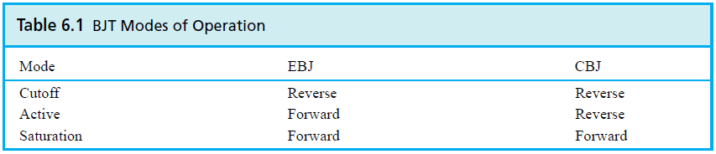
Simplified Structure and Modes of Operation
Transistor consists of two pn-junctions:
emitter-base junction (EBJ)
collector-base junction (CBJ)
Operating mode depends on biasing.
active mode – used for amplification
cutoff and saturation modes – used for switching.
Notes:
It is two diodes back to back with a narrow base region in common.
As we will see shortly, charge carriers of both polarities—that is, electrons and holes— participate in the current-conduction process in a bipolar transistor, which is the reason for the name bipolar.

Slide 12
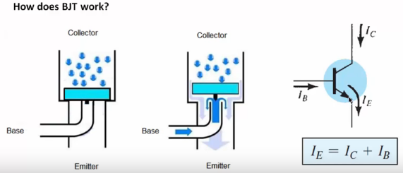
Device Structure and Physical Operation

Slide 13
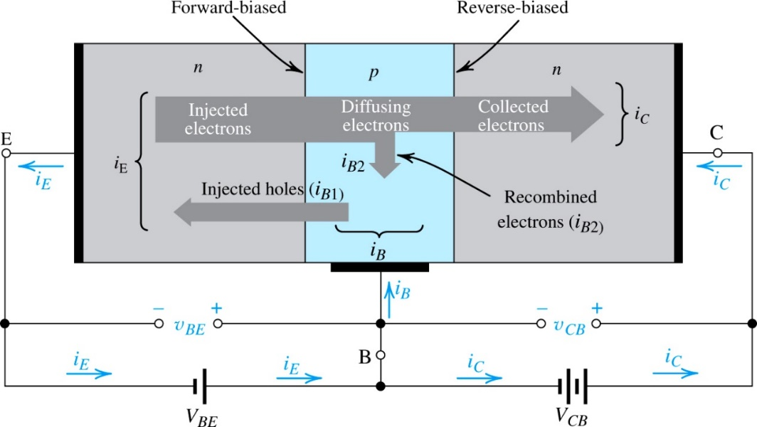
Operation of the npn-Transistor in the Active Mode
Active mode is the “most important.”
Two external voltage sources are required for biasing to achieve it
Current flow in an npn transistor biased to operate in the active mode. (Reverse current components due to drift of thermally generated minority carriers are not shown.)
Notes:
VBE causes the p-type base to be higher in potential than the n-type emitter, thus forward-biasing the emitter–base junction. The collector–base voltage VCB causes the n-type collector to be at a higher potential than the p-type base, thus reverse-biasing the collector–base junction.

Slide 14
The Collector Current
Magnitude of i_{C} is independent of v_{CB}.
As long as collector is positive, with respect to base.
saturation current (I_{S}) – is inversely proportional to W and directly proportional to area of EBJ.
Typically between 10⁻¹² and 10⁻¹⁸A
Also referred to as scale current.
Notes:
Because IS is proportional to ni^2, it is a strong function of temperature, approximately doubling for every 5°C rise in temperature. (For the dependence of ni^2 on temperature, refer to Eq. 3.37.)
Since IS is directly proportional to the junction area (i.e., the device size), it will also be referred to as the scale current. Two transistors that are identical except that one has an EBJ area, say, twice that of the other will have saturation currents with that same ratio (i.e., 2). Thus for the same value of vBE the larger device will have a collector current twice that in the smaller device. This concept is frequently employed in integrated-circuit design.

Slide 15
The Base Current
common-emitter current gain (β.) – is influenced by two factors:
width of base region (W)
relative doping of base emitter regions (N_{A}/N_{D})
High Value of β
thin base (small W in nano-meters)
lightly doped base / heavily doped emitter (small N_{A}/N_{D})
β is in the range 50 to 200

Slide 16
The Emitter Current
Notes:
Since the current that enters a transistor must leave it, it can be seen from Fig. 6.3 that the emitter current iE is equal to the sum of the collector current iC and the ..Qb~43FCase current iB; that is,

Slide 17
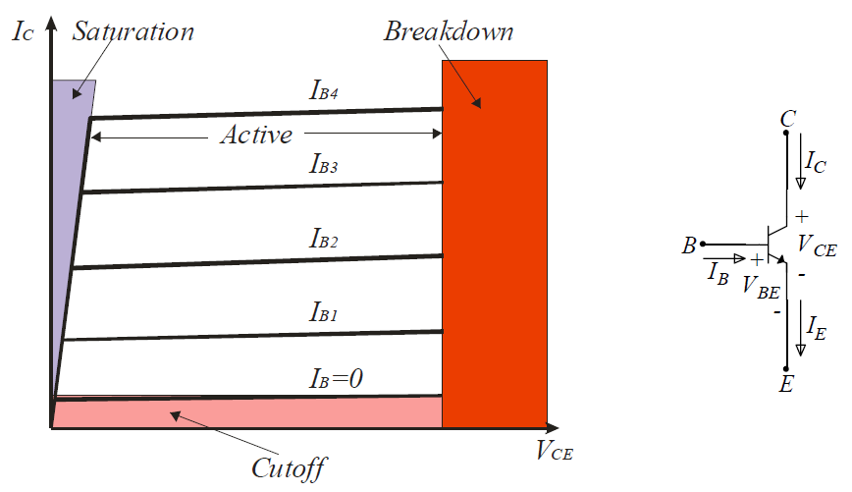
BJT regions of operation
Assumes npn transistor in active mode.

Slide 18
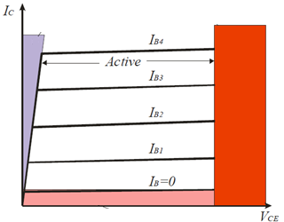
Recapitulation and Equivalent-Circuit Models
Basic relationship is collector current (i_{C}) is related exponentially to forward-bias voltage (v_{BE}).
It remains independent of v_{CB} as long as this junction remains reverse biased v_{CB} > 0
Thus in the active mode the collector terminal behaves as an ideal constant-current source where the value of the current is
determined by v_{BE}
Notes:
Basically, the forward-bias voltage vBE causes an exponentially related current iC to flow in the collector terminal. The collector current iC is independent of the value of the collector voltage as long as the collector–base junction remains
reverse biased; that is, vCB ≥ 0. Thus in the active mode the collector terminal behaves as an ideal constant-current source where the value of the current is determined by vBE.

Slide 19
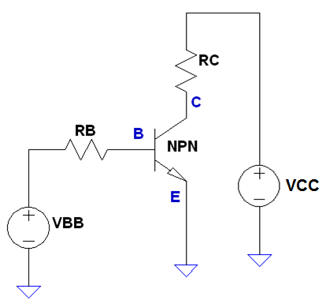
Common-Emitter Configuration - npn
The Emitter is common to both input (base-emitter) and output (collector-emitter).
Since Emitter is grounded, V_{C} = V_{CE}
With decreasing V_{C} (V_{CE}), the junction B-C will become forward biased too.
The current I_{C} quickly drops to zero because electrons are no longer collected by the collector
Node B
0V

Slide 20
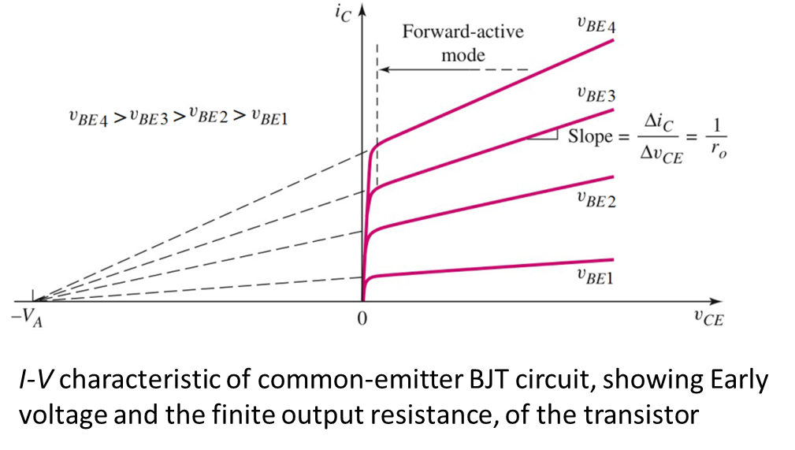

Characteristics of Common-Emitter - npn
NOTE: V_{EC} for PNP

Slide 21
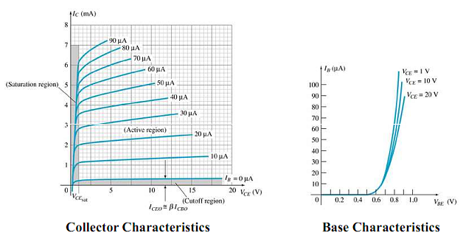
Common–Emitter Characteristics

Slide 22
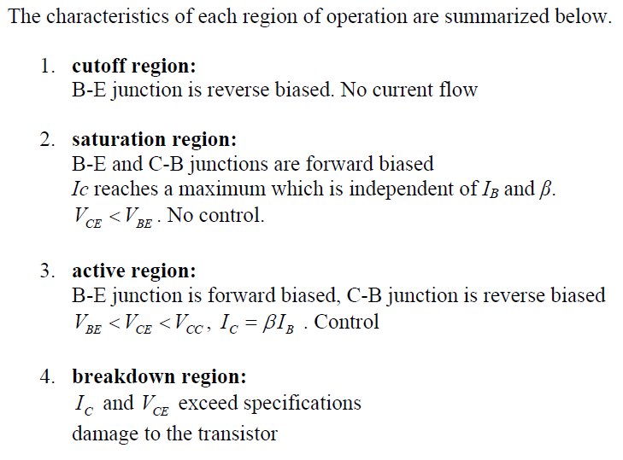

Slide 23
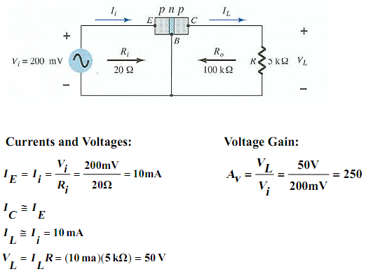
Amplification in Transistor

Slide 24
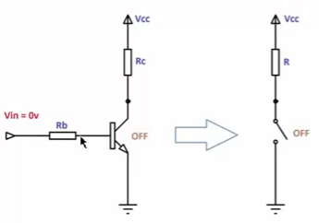
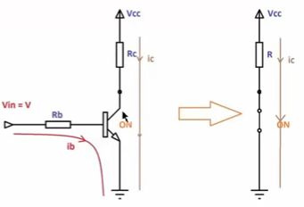
BJT applications
NPN BJT switch circuit

Slide 25
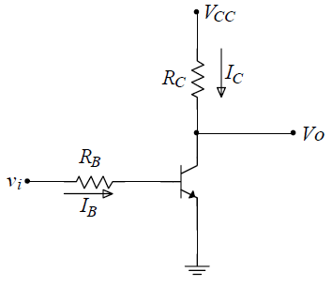
BJT applications
Vcc
Vcc
0 V
0 V
Basic BJT inverter circuit

Slide 26
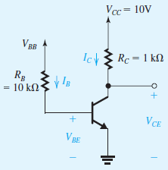
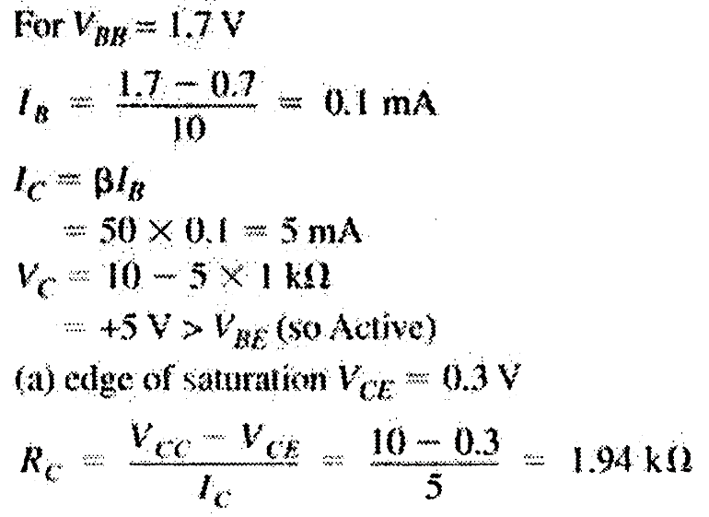
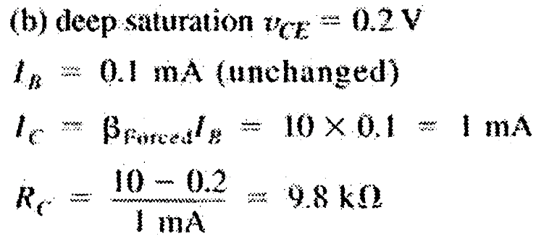
EXAMPLE

Slide 27
BJT Circuits at DC
in analyzing a circuit the first question that one must answer is: In which mode is the transistor operating?
quick check of the terminal voltages.
Assume that the transistor is operating in the active mode, and determine the various voltages and currents that correspond.
Then check for consistency of the results with the assumption of active-mode operation (v_{CB}> -0.4 volt);
If the answer is no, assume saturation-mode then test
compute the ratio I_{C} ⁄ I_{B} and to verify that it is lower than the transistor β (i.e., β_{forced} < β ).

Slide 28
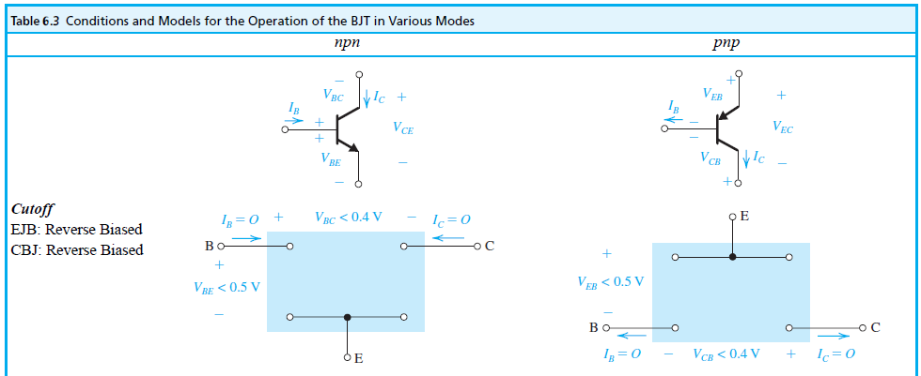
BJT Circuits at DC

Slide 29
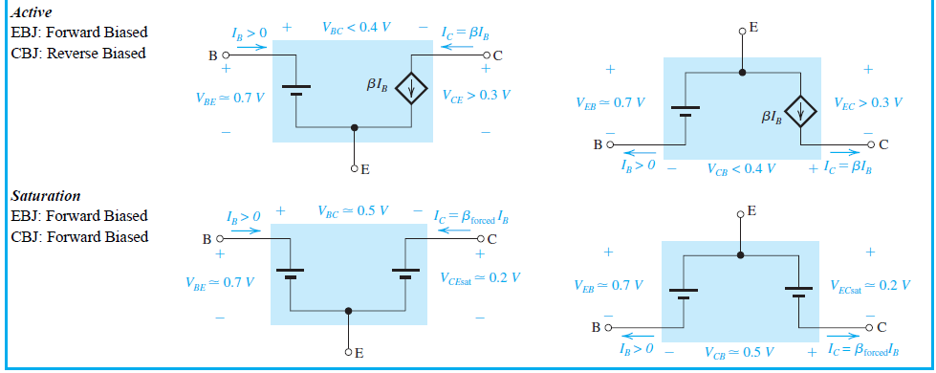
BJT Circuits at DC
Notes:
We are now ready to consider the analysis of BJT circuits to which only dc voltages are applied. In the following examples we will use the simple model in which V_{BE} of a conducting transistor is 0.7 V and of V_{CE} a saturated transistor is 0.2 V,

Slide 30
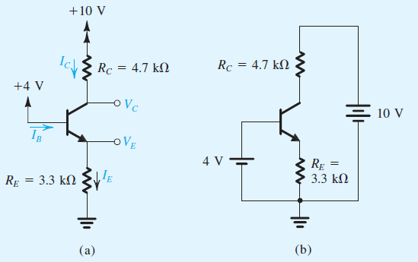
Example 6.5
Consider the circuit shown in Fig. 6.9(a), which is redrawn in Fig. 6.9(b) to remind the reader of the convention employed throughout this book for indicating connections to dc sources. We wish to analyze this circuit to determine all node voltages and branch currents. We will assume that β is specified to be 100.
Figure 6.9

Slide 31
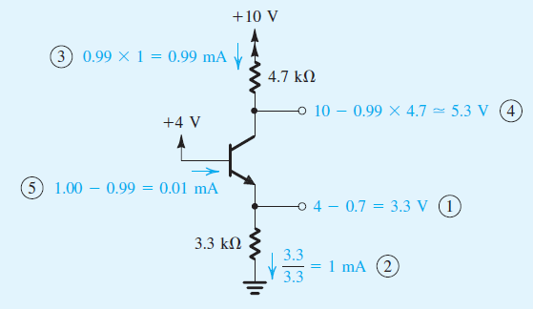
Example 6.5 – Sol.

Slide 32
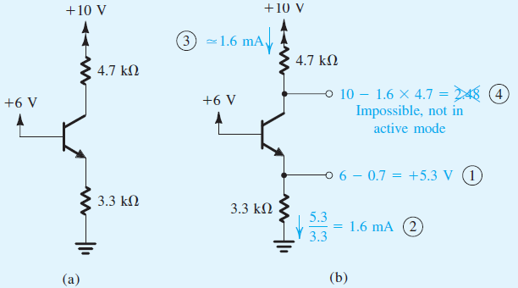
Example 6.6
We wish to analyze the circuit of Fig. 6.10 to determine the voltages at all nodes and the currents through all branches. Note that this circuit is identical to that of Fig. 1 except that the voltage at the base is now +6 V. Assume that the transistor β is specified to be at least 50.
Figure 6.10 Analysis of the circuit for Example 6.7.

Slide 33
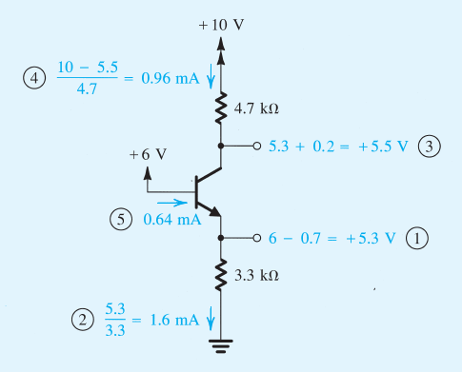
Example 6.6 – Sol.
Active mode assumption is not correct because V_{C} < V_{B}

Slide 34
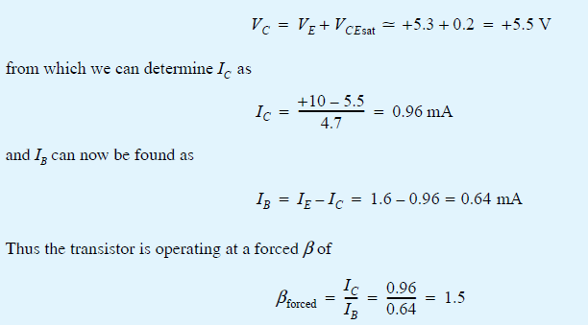
Example 6.6 – Sol.
Since β_{forced} is less than the minimum specified value of β, the transistor is indeed saturated. We should emphasize here that in testing for saturation the minimum value of β should be used. By the same token, if we are designing a circuit in which a transistor is to be saturated, the design should be based on the minimum specified β.

Slide 35
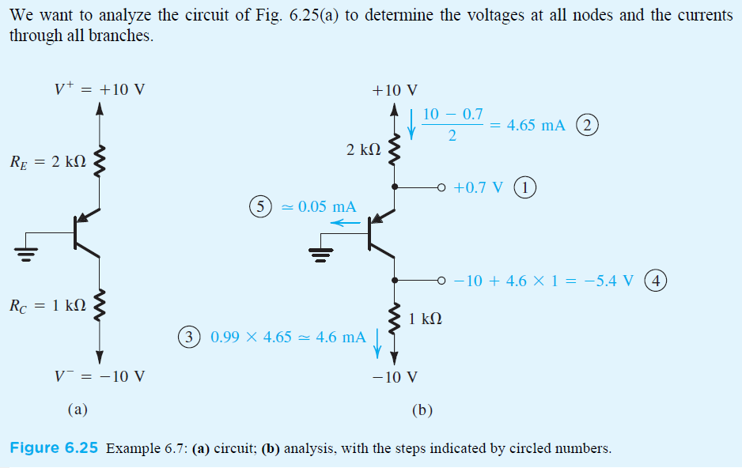
Example 6.7
Fig. 6.11 (a) to
Figure 6.11

Slide 36
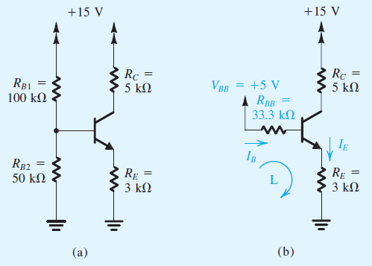
Example 6.8
We want to analyze the circuit, shown in the figure below, to determine the voltages at all nodes and the currents through all branches. Assume β = 100.
Figure 6.12

Slide 37
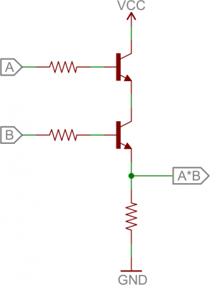
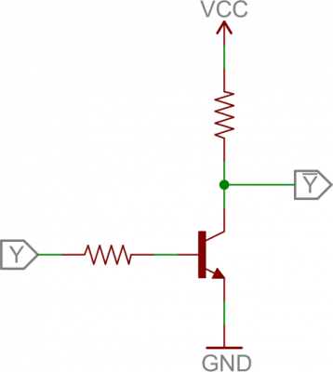
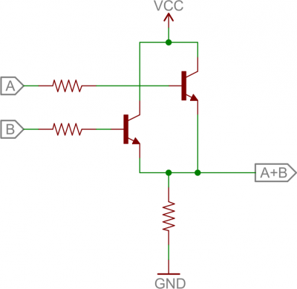
Applications
Digital Logic
Not Gate
OR Gate
AND Gate

