Slide 1
گيت های دینامیک CMOS
Nasser Mozayani
School of Computer Engineering
Iran University of Science and Technology

Slide 2
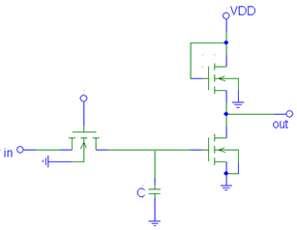
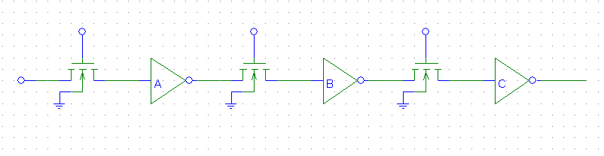
عملکرد گیتهای دینامیک
وقتی تاخیر گیتها با اهمیت شده و مساحت سیلیسوم بار اضافه تلقی می شود به سراغ گیتهای دینامیک می رویم
معمولا حدود 2 برابر سریعتر و مساحت کمتر دارند
ولی مصرف آنها می تواند کمتر یا بیشتر باشد
البته چون فشرده سازی بیشتر است مصرف بیشتر است
عملکرد بر اساس پیش شارژ و ارزیابی است
به گره ای که بتواند یک سطح منطقی را
به وسیله ی ذخیره ی بار در خود نگه دارد
Soft Node گویند
طراحی گیتهای بزرگ بصورت سنکرون است پس مدار دینامیک سرعت بهتری دارد

Slide 3
Dynamic Logic Gates
Clk
M_{p}
Clk
M_{p}
Out
Out
In₁
C_{L}
A
In₂
PDN
C
In₃
B
Clk
M_{e}
Clk
M_{e}
Two phase operation
Precharge (CLK = 0)
Evaluate (CLK = 1)
Notes:
For class handout

Slide 4
Dynamic Logic Gates
off
Clk
M_{p}
Clk
M_{p}
on
1
Out
Out
In₁
C_{L}
((AB)+C)
A
In₂
PDN
C
In₃
B
Clk
M_{e}
off
Clk
M_{e}
on
Two phase operation
Precharge (Clk = 0)
Evaluate (Clk = 1)
Notes:
For lecture
Evaluate transistor, Me, eliminates static power consumption

Slide 5
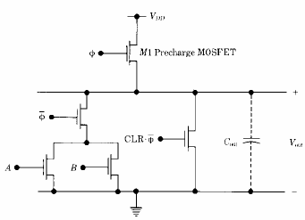
precharging
افزایش سرعت سوئیچینگ:
تا خیر انتشار نزولی از
رابطه زیر تعیین می شود
و تاخیر انتشار صعودی
(که کند بود) حل می شود
و کاهش مصرف توان (مسیر مستقیم بین زمین و Vdd اصلا وجود ندارد)

Slide 6
Dynamic CMOS
In static circuits at every point in time (except when switching) the output is connected to either GND or V_{DD} via a low resistance path.
fan-in of n requires 2n (n N-type + n P-type) devices
Dynamic circuits rely on the temporary storage of signal values on the capacitance of high impedance nodes.
requires n + 2 (n+1 N-type + 1 P-type) transistors

Slide 7
Conditions on Output
Once the output of a dynamic gate is discharged, it cannot be charged again until the next precharge operation.
Inputs to the gate can make at most one transition during evaluation.
Output can be in the high impedance state during and after evaluation (PDN off), state is stored on C_{L}
Notes:
This behavior is fundamentally different than the static counterpart that always has a low resistance path between the output and one of the power rails.

Slide 8
Properties of Dynamic Gates
Logic function is implemented by the PDN only
number of transistors is N + 2 (versus 2N for static complementary CMOS)
Full swing outputs (V_{OL} = GND and V_{OH} = V_{DD})
Non-ratiod - sizing of the devices does not affect the logic levels
Faster switching speeds
reduced load capacitance due to lower input capacitance (C_{in})
reduced load capacitance due to smaller output loading (C_{out})
no I_{sc}, so all the current provided by PDN goes into discharging C_{L}
Notes:
CL being lower also contributes to power savings

Slide 9
Properties of Dynamic Gates
Overall power dissipation usually higher than static CMOS
no static current path ever exists between V_{DD} and GND (including P_{sc})
no glitching
higher transition probabilities
extra load on Clk
PDN starts to work as soon as the input signals exceed V_{Tn}, so V_{M}, V_{IH} and V_{IL} equal to V_{Tn}
low noise margin (NM_{L})
Needs a precharge/evaluate clock

Slide 10
Dynamic CMOS
Advantages over static logic:
Avoids duplicating logic twice as both N-tree and P-tree, as in standard CMOS
The input capacitance is only that of the N device
Typically can be used in very high performance applications
Very simple sequential memory circuits; amenable to synchronous logic
High density achievable
Consumes less power (in some cases)
Disadvantages compared to static logic:
Problems with clock synchronization and timing
Design is more difficult

Slide 11
Issues in Dynamic Design 1: Charge Leakage
CLK
Clk
M_{p}
Out
A
C_{L}
V_{Out}
Evaluate
Clk
M_{e}
Precharge
Leakage sources
Dominant component is subthreshold current
Notes:
leakage sources are reverse-biased diode and the sub-threshold leakage of the NMOS pulldown device.
Charge stored on CL will leak away with time (input in low state during evaluation)
Requires a minimum clock rate - so not good for low performance products such as watches (or when have conditional clocks)
PMOS precharge device also contributes some leakage due to reverse bias diode and subthreshold conduction that, to some extent, offsets the leakage due to the pull down paths.

Slide 12
Solution to Charge Leakage
Keeper
Clk
M_{p}
M_{kp}
A
Out
C_{L}
B
Clk
M_{e}
Same approach as level restorer for pass-transistor logic
Notes:
During precharge, Out is VDD and inverter out is GND, so keeper is on
During evaluation if PDN is off, the keeper compensates for drained charge due to leakage.
If PDN is on, there is a fight between the PDN and the PUN - circuit is ratioed so PDN wins, eventually
Note Psc during switching period when PDN and keeper are both on simultaneously

Slide 13
Solution 2 to Charge Leakage

Slide 14
Issues in Dynamic Design 2: Charge Sharing
Clk
M_{p}
Out
Charge stored originally on C_{L} is redistributed (shared) over C_{L} and C_{A} leading to reduced robustness
A
C_{L}
B=0
C_{A}
Clk
M_{e}
C_{B}
Notes:
CA initially discharged and CL fully charged.

Slide 15
Charge Sharing Example
Clk
Out
A
A
C_{L}=50fF
C_{a}=15fF
B
B
B
!B
C_{b}=15fF
C_{c}=15fF
C
C
C_{d}=10fF
Clk
Notes:
Out = A xor B xor C . What is the worst case change in voltage on node Out - assume all inputs are low during precharge and all internal capacitances are initially 0V
Worst case is obtained by exposing the maximum amount of internal capacitance to the output node during evaluation. This happens when !A B C or A !B C. 30/(30+50) * 2.5 V = 0.94 V so the output drops to 2.5 - 0.94 = 1.56 V

Slide 16
Charge Sharing
V
DD
Clk
M
p
Out
C
L
A
M
a
X
C
B
=
0
M
a
b
C
Clk
M
b
e

Slide 17
Solution to Charge Redistribution
Clk
M_{p}
M_{kp}
Clk
Out
A
B
Clk
M_{e}
Precharge internal nodes using a clock-driven transistor (at the cost of increased area and power)

Slide 18
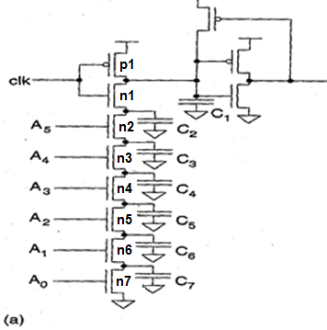
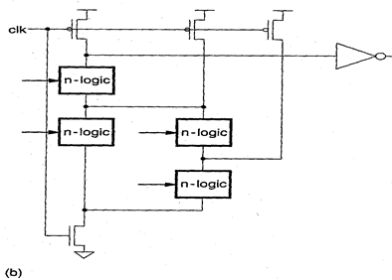
Solution to Charge Redistribution
During precharge C1 is charged high to Vdd, but C2-C7 do not get charged and may be sitting at ground potential.
When the clock goes high for the evaluate phase: VC1 may reduce to Vdd(C1/(C1 + C2 + C3 + C4 + C5 + C6 + C7)) in the worst case
The solution is to put the discharge transistor N1 at the bottom of the logic tree and reapeat P1 for every C2 to C7 thus allowing the possibility of getting C2-C7 charged during the precharge phase

Slide 19
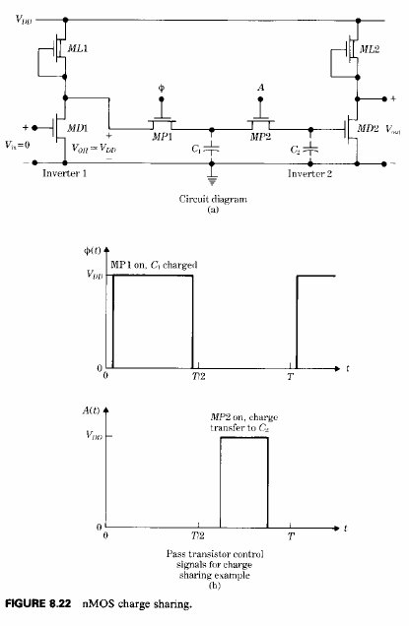
charge sharing in pass transistors

Slide 20
Issues in Dynamic Design Clock Feedthrough
Coupling between Out and Clk input of the precharge device due to the gate to drain capacitance. So voltage of Out can rise above V_{DD}. The fast rising (and falling edges) of the clock couple to Out
Danger is that signal levels can rise enough above VDD that the normally reverse-biased junction diodes become forward-biased causing electrons to be injected into the substrate.
Clk
M_{p}
Out
A
C_{L}
B
Clk
M_{e}

Slide 21
Clock Feedthrough
Clock feedthrough
Clk
Out
In₁
In₂
In₃
Voltage
In &
Clk
In₄
Out
Clk
Time, ns
Clock feedthrough

Slide 22
Radiation induced charge

Slide 23
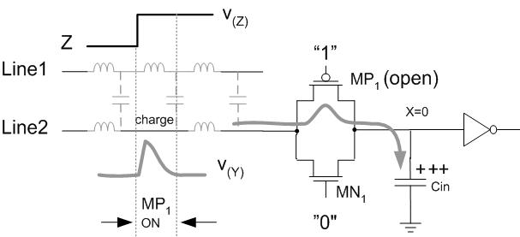
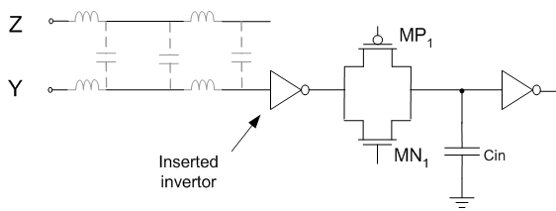
Accidental charge caused by capacitive or inductive coupling between the signal lines Y and Z. (a)
Crosstalk
Prevention by inserting and inverter between the affected line and the pass-transistor switch (b)

Slide 24
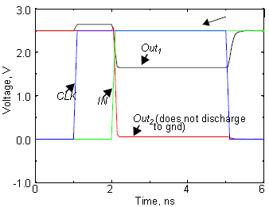
Backgate coupling (capacitive coupling)
Due to lick feedthrough
Dynamic gate
Static gate

Slide 25
Cascading Dynamic Gates
V
Clk
Clk
Clk
M_{p}
M_{p}
Out2
Out1
In
In
Clk
Clk
V_{Tn}
M_{e}
M_{e}
Out1
ΔV
Out2
t
Only 0 → 1 transitions allowed at inputs!
Notes:
Out2 should remain at VDD since Out1 transitions to 0 during evaluation. However, since there is a finite propagation delay for the input to discharge Out1 to GND, the second output also starts to discharge.
The second dynamic inverter turns off (PDN) when Out1 reaches VTn. Setting all inputs of the second gate to 0 during precharge will fix it.
Correct operation is guaranteed (ignoring charge redistribution and leakage) as long as the inputs can only make a single 0 -> 1 transition during the evaluation period

Slide 26
Domino Logic
Clk
M_{p}
Clk
M_{p}
M_{kp}
Out1
Out2
1 → 1
1 → 0
0 → 0
0 → 1
In₁
In₂
PDN
In₄
PDN
In₃
In₅
Clk
M_{e}
Clk
M_{e}
Notes:
Ensures all inputs to the Domino gate are set to 0 at the end of the precharge period. Hence, the only possible transition during evaluation is 0 -> 1

Slide 27
CMOS Domino Logic Operation
0
1
1
1
1
0
1
1
1
0
0
1
0
1
Dominos

Slide 28
Properties of Domino Logic
Only non-inverting logic can be implemented
Very high speed
tp_{HL} = 0
static inverter can be skewed, only L-H transition
Input capacitance reduced – smaller logical effort
static inverter can be optimized to match fan-out (separation of fan-in and fan-out capacitances)
First 32 bit micro (BellMAC 32) was designed in Domino logic
Notes:
First 32 bit micro (BellMAC 32) was designed in Domino logic
Now a rather rare design style due to non-inverting logic only

Slide 29
Properties of Domino Logic
Faster Gates:
Allows more logic per cycle with less delay
Allows for more complex gates (no dual P network)
Increased Power:
Precharging increases activity factors
Increased clock load
Increased Noise Sensitivity
High gain means low noise immunity
Charge sharing in complex gates
Increased Design Time
Added timing checks
CAD tools less automated
Domino typically only used in the most timing critical paths.

Slide 30
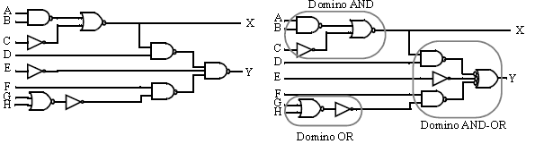
Restructuring logic to enable implementation using non-inverting Domino Logic

Slide 31
Designing with Domino Logic
V
DD
V
DD
V
DD
Clk
M
p
Clk
M
p
M
r
Out1
Out2
In
1
In
2
PDN
In
PDN
4
In
3
Can be eliminated!
Clk
M
e
Clk
M
e
Inputs = 0
during precharge

Slide 32
Footless Domino
The first gate in the chain needs a foot switch
Precharge is rippling – short-circuit current
A solution is to delay the clock for each stage

Slide 33
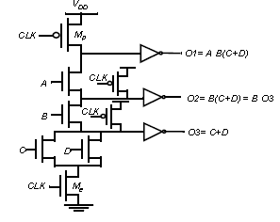
Multiple output Domino

Slide 34
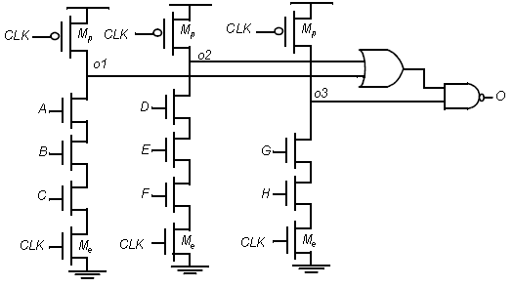
Compound Domino logic
Compound Domino logic where complex static gates can be placed at the output of dynamic gates.

Slide 35
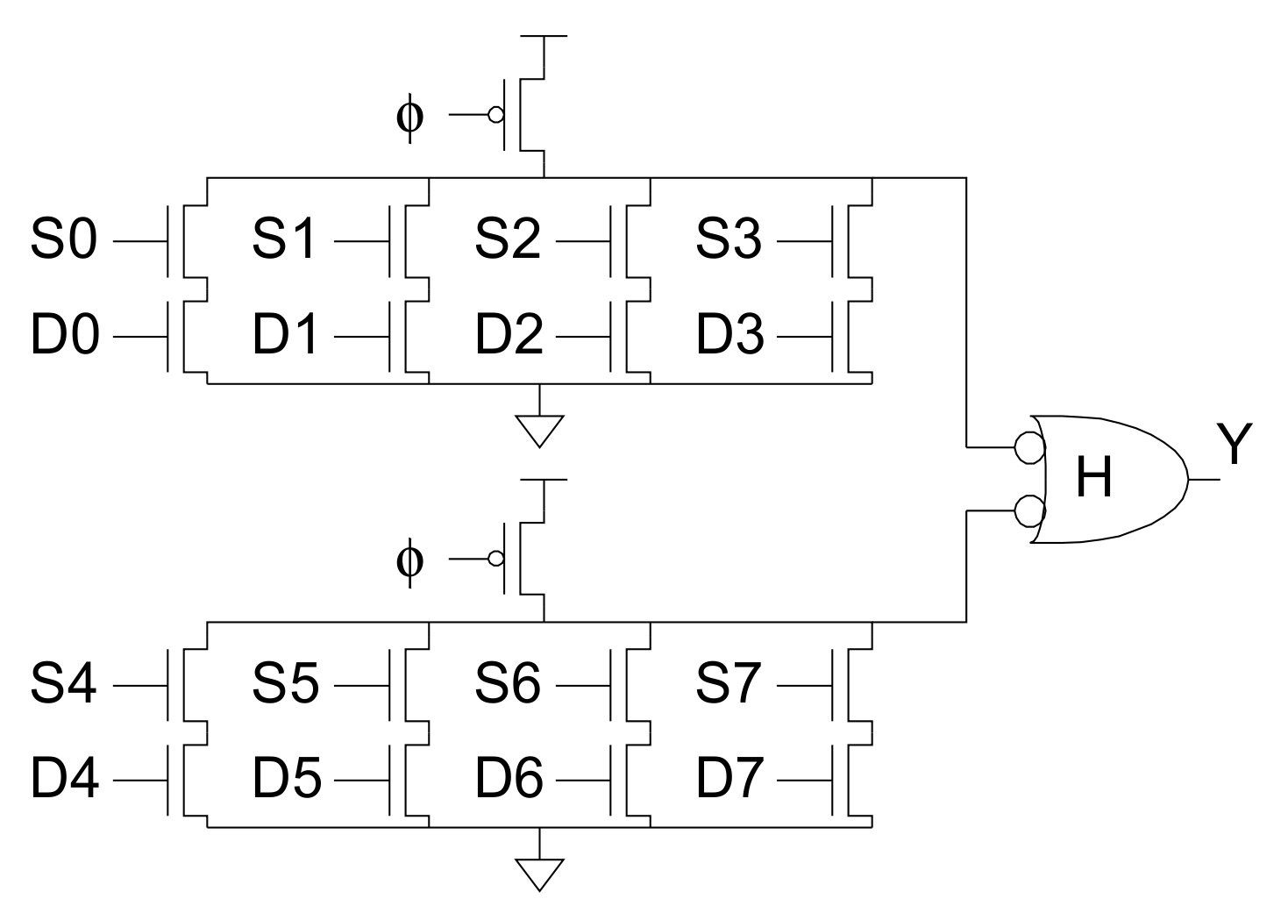
Domino optimizations
Each domino gate triggers next one, like a string of dominos toppling over
Gates evaluate sequentially, precharge in parallel
Evaluation is more critical than precharge
HI-skewed static stages can perform logic (Skewed gates favor one edge over another)
Using a higher or lower P/N ratio favors rising or falling outputs, respectively. For example, with a P/N ratio of 4/1, the input does not have to fall as far as VDD/2 before the output could switch. We call such a circuit a “high skewed” gate and use it on paths where the critical transition is a rising output

Slide 36
منطق تفاضلی Domino Differential (Dual Rail) Domino
ترکیب طراحی منطق تفاضلی و تکنیک های پویا منطق تفاضلی دامینو را ایجاد می کند
اتلاف توان dc آن بسیار کم است
در حالی که سرعت آن مناسب است
به دلیل وجود بافرهای خروجی، قابلیت تحریک
خروجی آن بسیار مناسب است
و مهمتر از همه، یکی از مهمترین محدودیت های
منطق Domino این است که به دلیل تفاضلی بودن
ذاتی این منطق، پیچیدگی های پیاده سازی توابع معکوسی،
حذف شده است
در منطق تفاضلی Domino این نوع توابع به سادگی با پیاده سازی تابع منطقی غیرمعکوسی و تعویض خطوط خروجی آن پیاده سازی می شود

Slide 37
منطق تفاضلی Domino Differential (Dual Rail) Domino
هنگامی که ظرفیت بار خروجی کوچک است، معکوس کننده ها در خروجی را می توان حذف نمود
این روش پیاده سازی دارای
تأخیر و حاصل ضرب
توان- تأخیر بسیار اندک است

Slide 38
Differential (Dual Rail) Domino
off
on
Clk
M_{p}
M_{kp}
M_{kp}
M_{p}
Clk
Out = AB
Out = AB
1 0
1 0
A
!A
!B
B
Clk
M_{e}
Notes:
AND/NAND differential logic gate. The inputs and their complements come from other differential DR gates and thus all inputs are low during precharge and make a conditional transition from 0 to 1.
Expensive - but can implement any arbitrary function.
Use significant power since they have a guaranteed transition every single clock cycle (regardless of signal statistics, since either Out or !Out will transition from 0 to 1).
Not ratioed (even though have a cross-coupled PMOS pair)

Slide 39
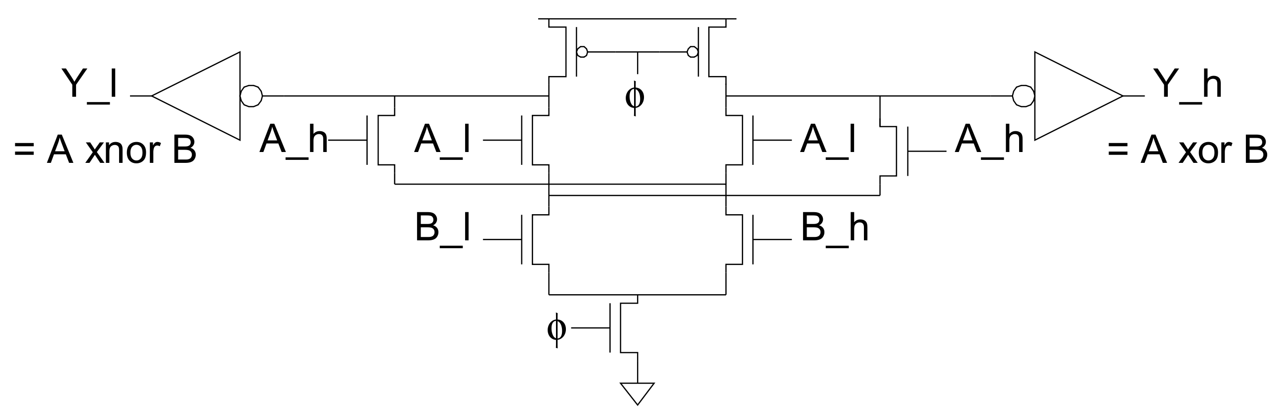
Differential (Dual Rail) Domino
Sometimes possible to share transistors
Sharing works well in implementations of symmetric functions

Slide 40
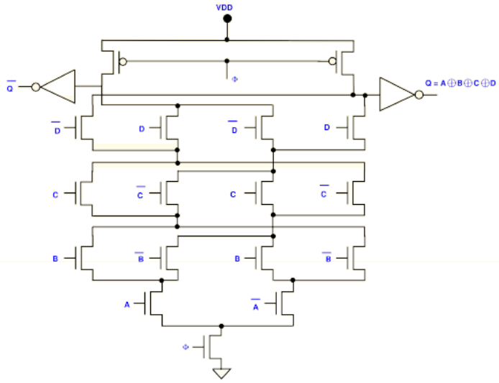
Dynamic CVSL (Cascade Voltage Switch Logic) XOR

Slide 41
Switching Asymmetry in DCVSL
This asymmetry causes current spikes and increased power consumption !
Drawback: area, power

Slide 42
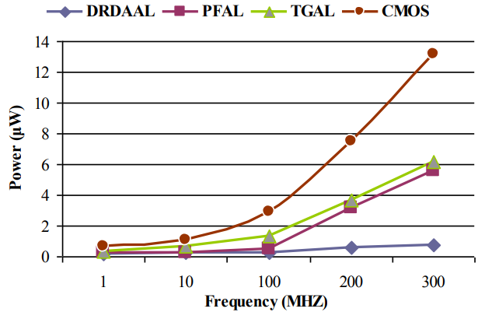
DRDAAL power consumption
Power comparison of DRDAAL full adder with different logic designs

Slide 43
np-CMOS
Clk
M_{p}
Clk
M_{e}
Out1
1 → 1
1 → 0
In₁
In₄
PUN
In₂
PDN
In₅
In₃
0 → 0
0 → 1
Out2
(to PDN)
Clk
M_{e}
Clk
M_{p}
Only 0 → 1 transitions allowed at inputs of PDN Only 1 → 0 transitions allowed at inputs of PUN
Really dense layouts and very high speed (20% faster than domino with the correct sizing)
DEC alpha uses np-CMOS logic (Dobberpuhl)
Notes:
Have to size the PUN’s to equalize the delay to that of the PDN’s
Reduced noise margin (as with any dynamic gate)
Have two clock signals to generate and route - CLK and !CLK

Slide 44
NORA Logic
Clk
M_{p}
Clk
M_{e}
Out1
1 → 1
1 → 0
In₁
In₄
PUN
In₂
PDN
In₅
In₃
0 → 0
0 → 1
Out2
(to PDN)
Clk
M_{e}
Clk
M_{p}
to other
PDN’s
to other
PUN’s
WARNING: Very sensitive to noise!
Notes:
NORA - no race CMOS

Slide 45
NORA Logic (Domino with Clocked Latch)
Combines NP Domino logic sections with C²MOS latch
n-logic block can drive p-logic block or another n-logic block with a static inverter
similarly for a p-logic block
Must end in a C²MOS latch
Rules to avoid race conditions:
During precharge, logic blocks are OFF
During eval, internal inputs make only one transition
Notes:
NORA - no race CMOS

Slide 46
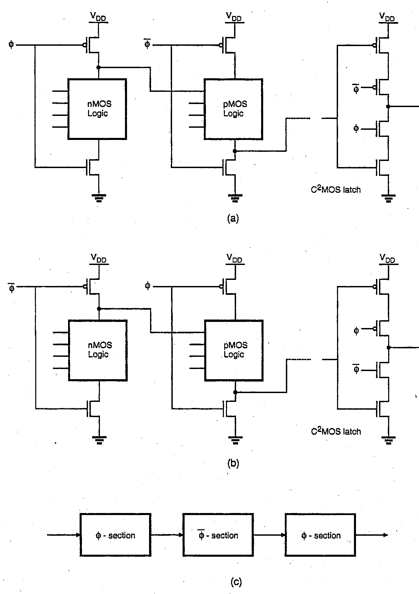
Pipelined NORA CMOS Circuit Operation
With pipelined NORA CMOS logic design
one can alternate N and P stages between C²MOS latches where φ high is used for evaluation as shown in (a)
Or, one can alternate N and P stages similarly between C²MOS latches with φ’ high used for evaluation as in (b)
φ sections may be alternately cascaded with φ’ sections as shown in (c)
During the evaluation phase, the logic ripples through each stage in succession up to the next C²MOS latch

Slide 47
No-Race
Notes:
NORA - no race CMOS

Slide 48
Full Adder with No-Race
Notes:
NORA - no race CMOS

Slide 49
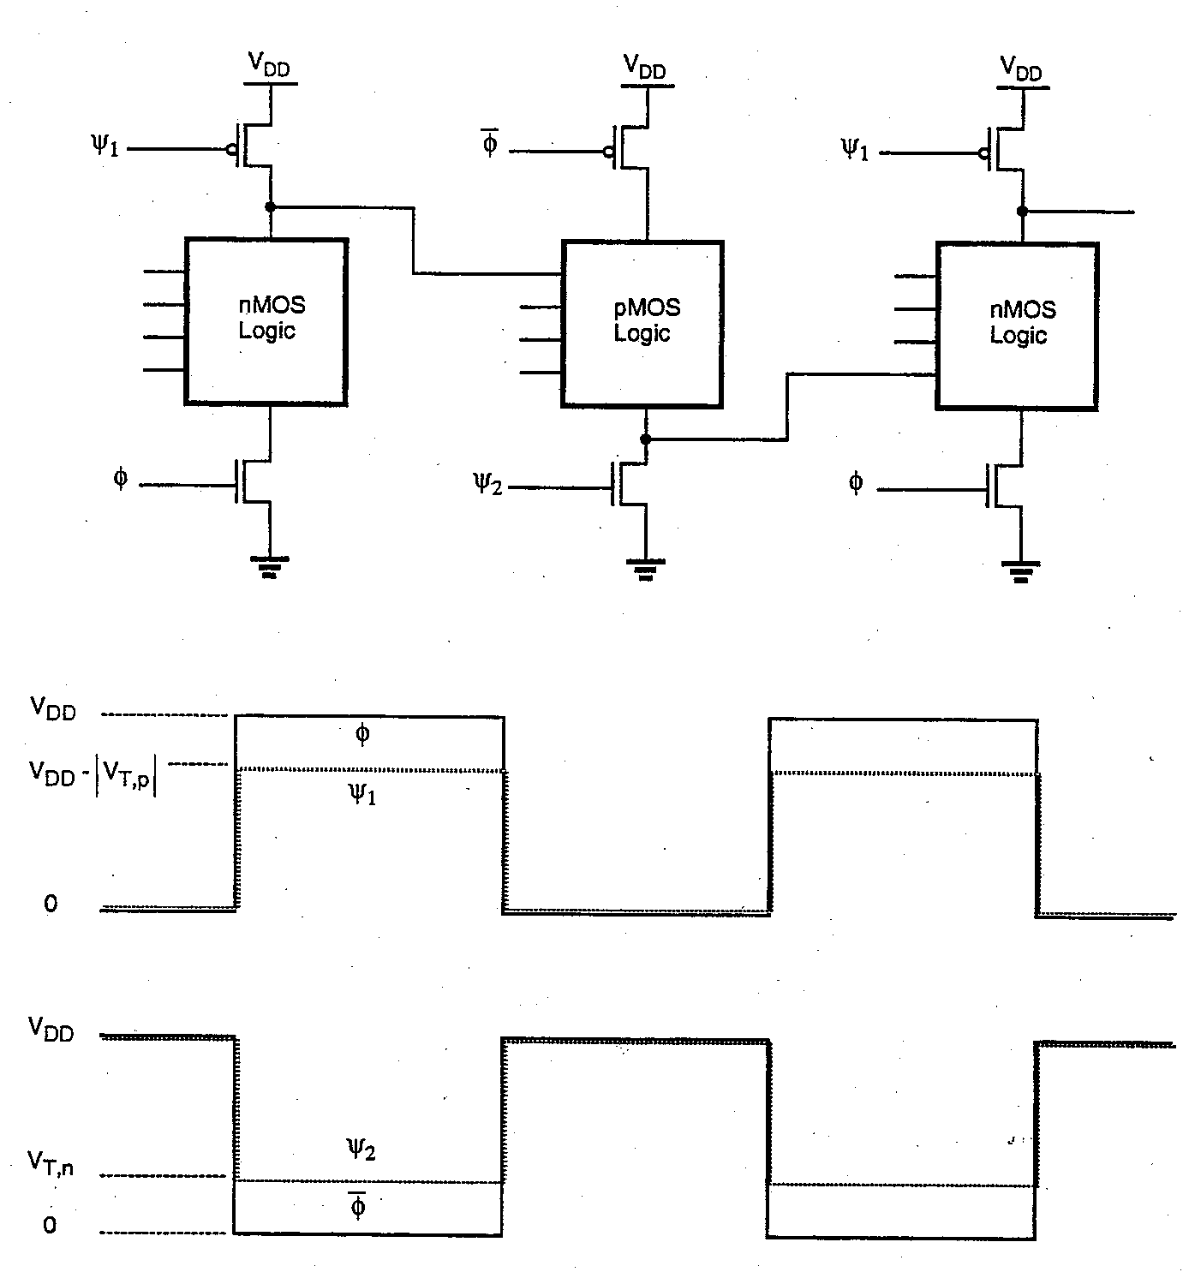
Zipper CMOS Dynamic Logic
Zipper CMOS logic is a scheme for improving charge leakage and charge sharing problems
Pre-charge transistors receive a slightly modified clock where the clock pulse (during pre-charge off time) holds the pre-charge transistor at weak conduction in order to provide a trickle pre-charge current during the evaluation phase
PMOS pre-charge transistor gates are held at Vdd - |Vtp|
NMOS pre-charge transistor gates are held at Vtn above GND

Slide 50
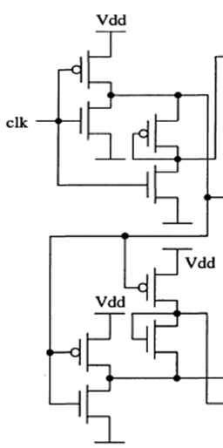
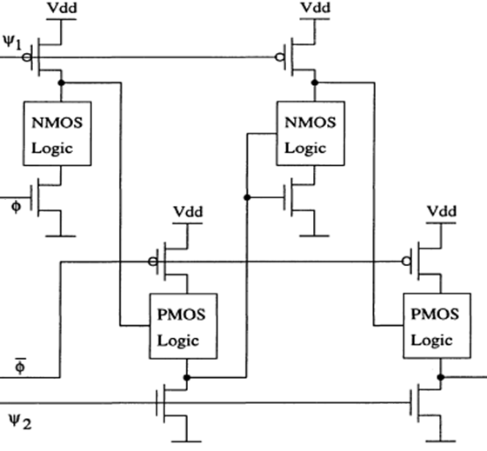
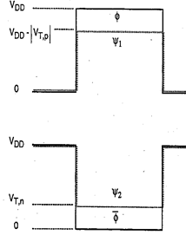
Zipper

Slide 51
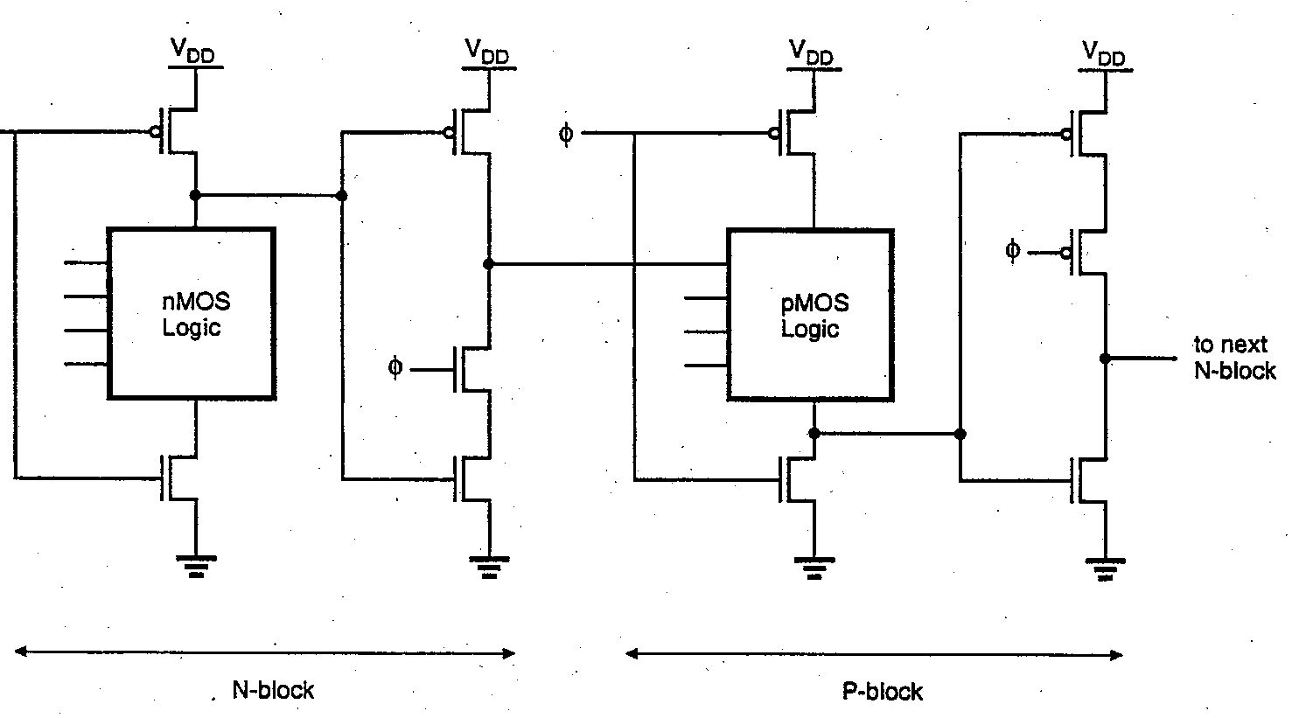
Pipelined True Single Phase Clock (TSPC) CMOS
A TSPC system (without any inverted clocks required) can be built as shown below
Each NMOS and PMOS stage is followed by a dynamic latch (inverter) built with only the single phase clock φ
The single phase clock φ is used for both NMOS and PMOS stages
NMOS logic stages pre-charge when φ is low and evaluate when φ is high
PMOS logic stages pre-charge when φ is high and evaluate when φ is low
With inverter latches between each stage, an erroneous evaluate condition can not exist
Attractive circuit for use in pipelined, high performance processor logic

Slide 52
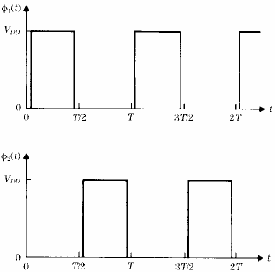
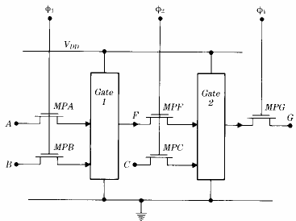
پالس های ساعت دو فازی

Slide 53
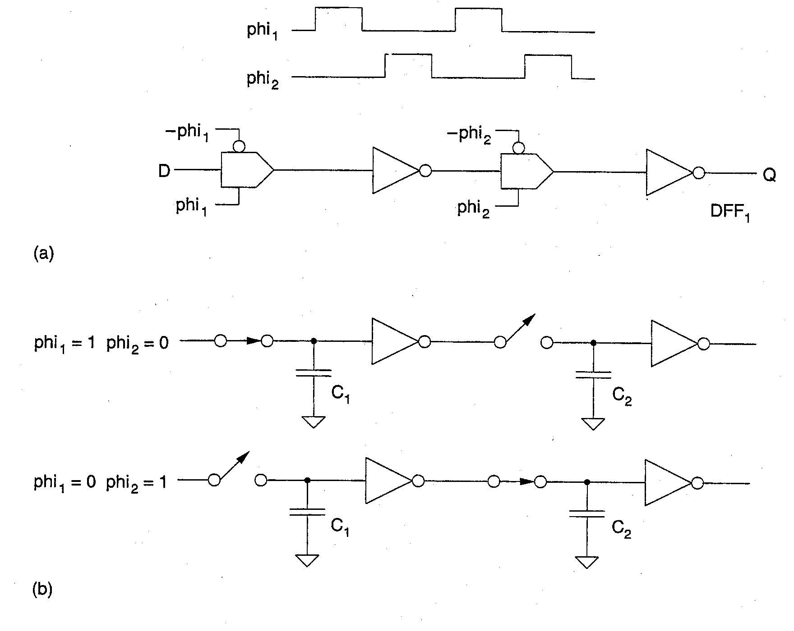
Dynamic Registers with Two Phase Clocks
Dynamic register with pass gates and two phase clocking is shown
Clocks phi1 and phi2 are non-overlapping
When phi1 is high & phi2 is zero,
1st pass gate is closed and D data charges gate capacitance C1 of 1st inverter
2nd pass gate is open trapping prior charge on C2
When phi1 is low and phi2 is high,
1st pass gate opens trapping D data on C1
2nd pass gate closes allowing C2 to charge with inverted D data
If clock skew or sloppy rise/fall time clock buffers cause overlap of phi1 and phi2 clocks,
Both pass gates can be closed at the same time causing mixing of old and new data and therefore loss of data integrity!

Slide 54
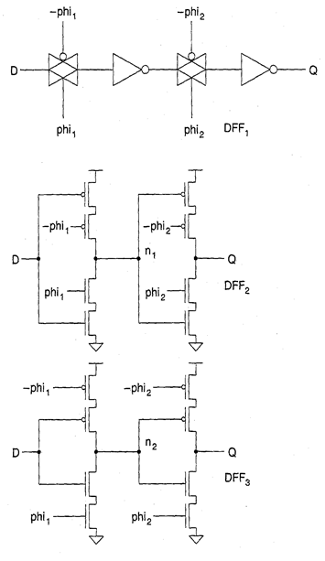
Two Phase Dynamic Registers (Compact Form)
Compact implementation of two phase dynamic registers shown at left using a tri-state buffer form.
Transmission gate and inverter integrated into one circuit
Two versions:
Pass devices closest to output
Inverter devices closest to output
Two phase dynamic registers and logic is often preferred over single phase because
Due to finite rise and fall times, the CLK and CLK’ are not truly non-overlapping
Clock skew often is a problem due to the fact that CLK’ is usually generated from CLK using an inverter circuit and also due to the practical problem of distributing clock lines without any skew

Slide 55
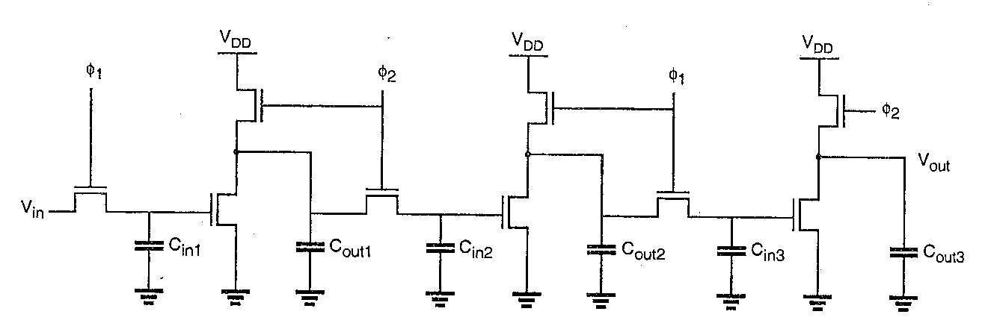
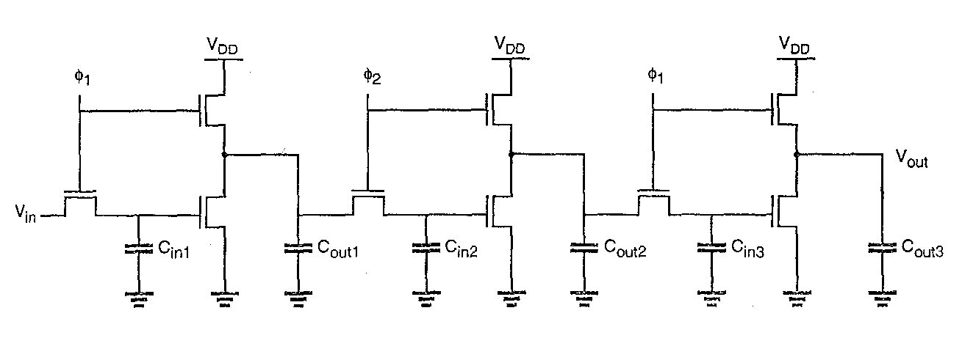
Dynamic Shift Registers with Enhancement Load
a dynamic shift register implemented with a technique named “ratiod dynamic logic”.
φ1 and φ2 are non-overlapping clocks
When φ1 is high, Cin1 charges to Vdd – Vt if Vin is high or to GND if Vin is low
When φ1 drops and φ2 comes up, the input data is trapped on Cin1 and yields a logic output on Cout1 which is transferred to Cin2
When φ2 drops and φ1 comes up again, the logic output on Cout1 is trapped on Cin2, which yields a logic output on Cout2, which is transferred to Cin3, etc.
To avoid losing too much voltage on the logic high level, Cout_{n} >> Cin_{n+1} is desired
Each inverter must be ratioed to achieve a desired V_{OL} (e.g. when φ2 is high on 1st inv)
The bottom left dynamic shift register is a “ratioless dynamic logic” circuit
When φ2 is high transferring data to stage 2, φ1 has already turned off the stage 1 load transistor, allowing a V_{OL} = 0 to be obtained without a ratio condition between load and driver transistors.

Slide 56
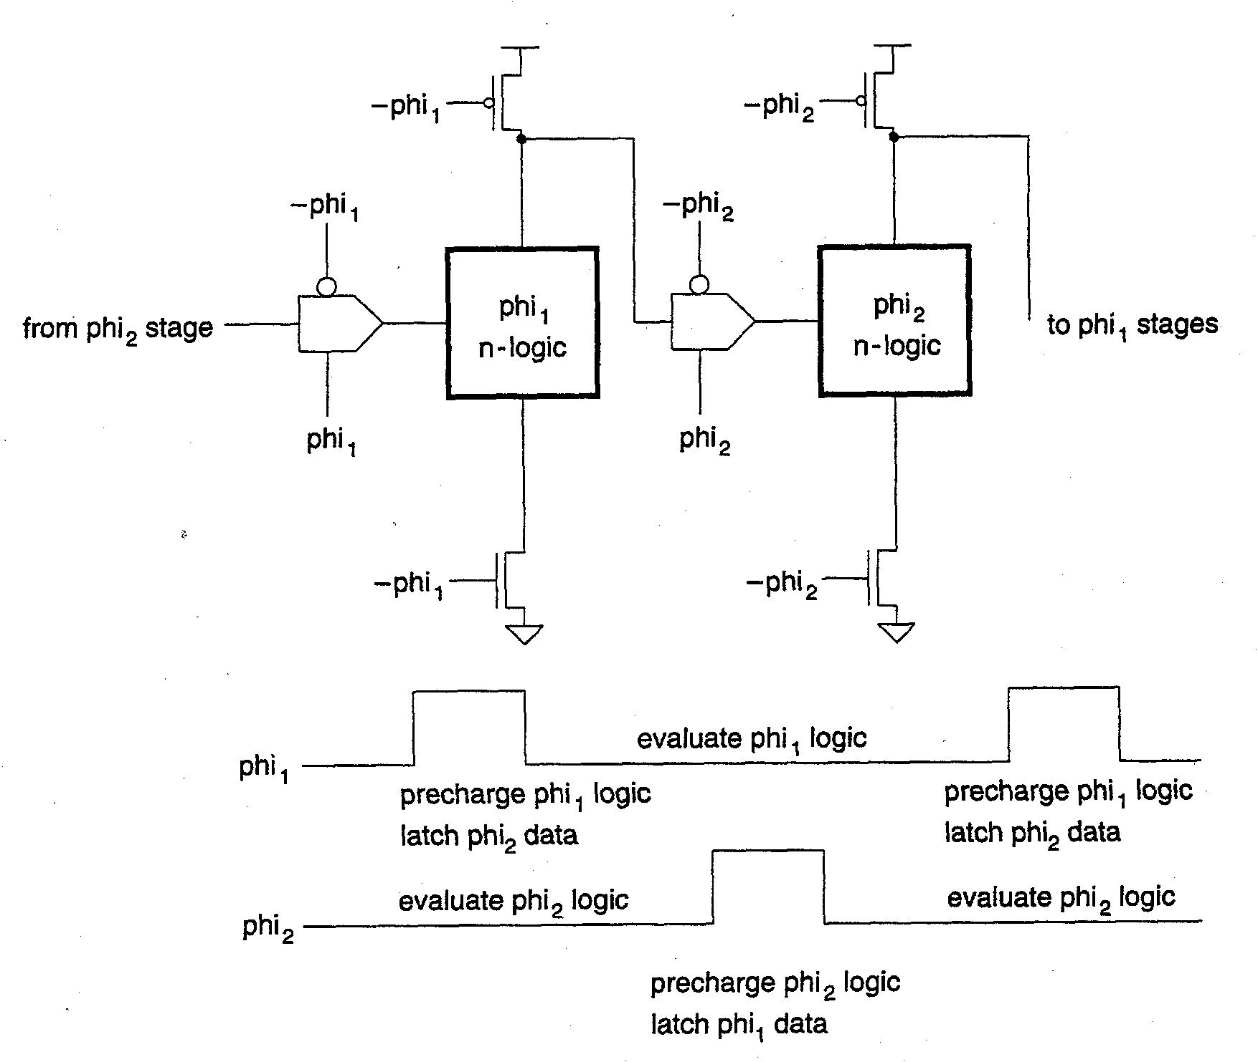
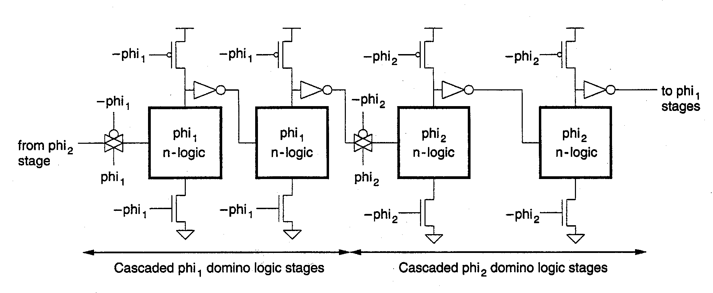
Two-Phase Dynamic Logic
Two phase dynamic logic similar to two phase dynamic register circuits
Top figure shows n type logic stages with two phase non-overlapping clocks
phi1 high: precharge phi1 logic, evaluate phi2 logic
phi2 high: precharge phi2 logic, evaluate phi1 logic
Bottom figure shows use of Domino logic having both phi1 and phi2 logic stages
Each block is separated from other by a clocked pass gate register/latch to store the logic result
Note that inverters must be used between successive stages of the same clock logic

Slide 57
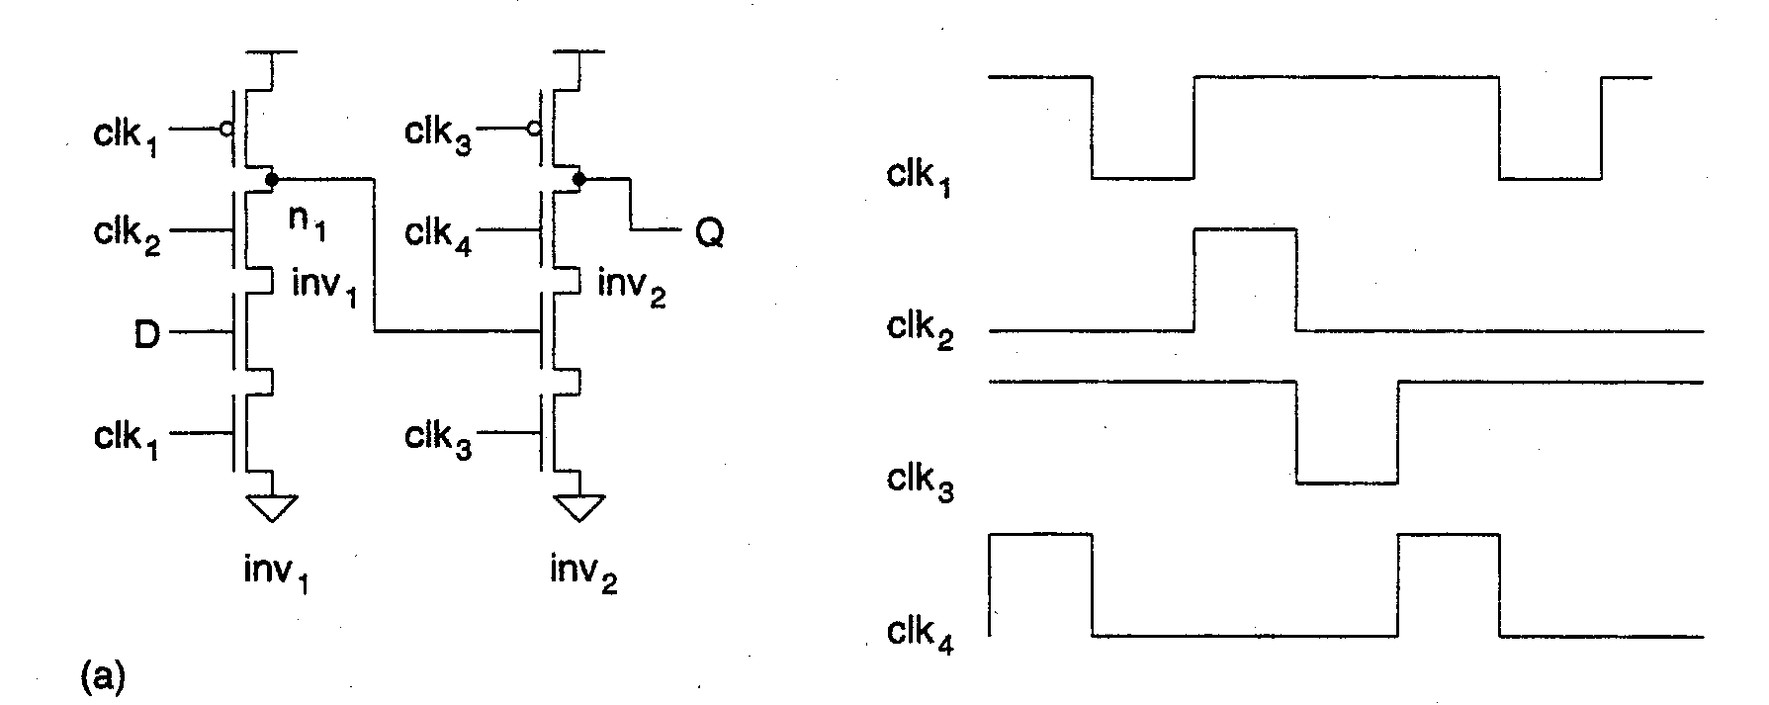
Four Phase Clocking and Registers
Four phase logic adds an evaluation phase to the existing precharge and evaluation phases of two-phase structures.
Simple four-phase structure below illustrates operation:
during t1 inverter1 is in precharge phase; node n1 charges to Vdd
during t2 inverter1 evaluates since both NFET devices in n-tree leg are ON
during t3 inverter2 precharges and inverter1 is in hold phase (i.e. both N and P devices are OFF isolating node n1
during t4 inverter2 evaluates while inverter1 continues in hold phase
Note that the hold phase is really two clock phases long
Due to charge sharing during the t2 phase, clk2 is sometimes replaced by clk12 (and clk4 is replaced by clk34) by keeping clk12 high during both t1 and t2 phases.
t1
t2
t3
t4

Slide 58
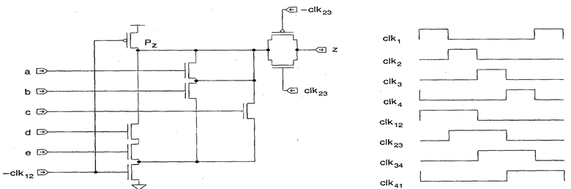
Four-Phase Logic Structures
Four phase logic structure shown using transmission gate to isolate data on z during hold time:
during clk1 time, -clk12 is down causing Pz to be precharged to Vdd
during clk2 time, -clk12 is still down keeping precharge active, but clk23 goes high thus precharging node z
during clk3 time, precharge of node Pz ends and evaluation begins with Xgate still closed
during clk4 time, the transmission gate opens and the correct data is isolated on node z
For the gate shown, z is valid during phases 4 and 1

Slide 59
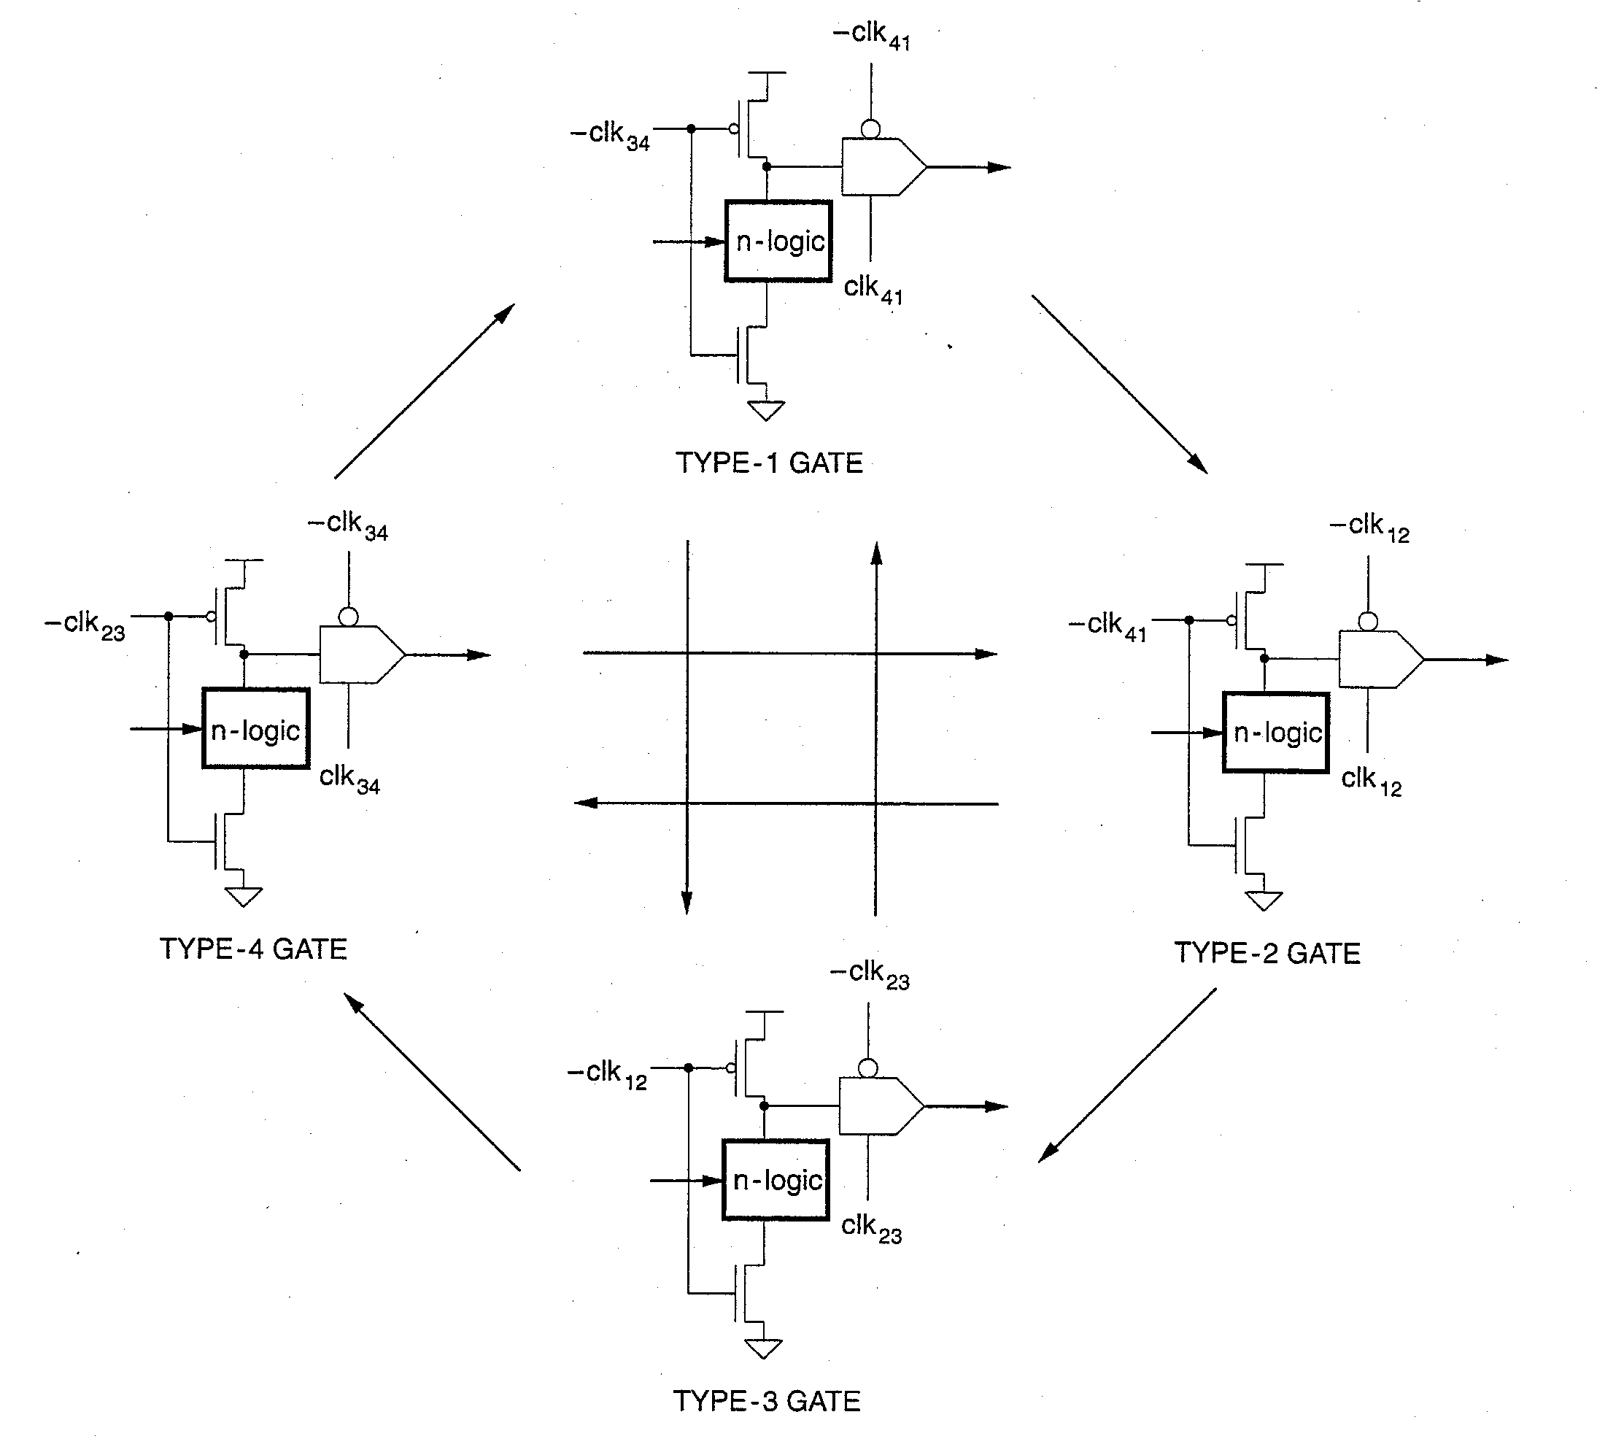
Four Phase Logic: Allowable Interconnections
Using four different type logic gates as shown in previous chart (where Type refers to the evaluation phase time), four phase logic can be used in pipelined logic structures where each type must be used per the allowable interconnection diagram at the left
a Type 1 gate can feed Type 2 or Type 3 gates
a Type 2 gate can feed Types 3 and 4
a Type 3 gate can feed Types 4 and 1
a type 4 gate can feed Types 1 and 2

Slide 60
Two-Phase Clock Generator
Phi1 and Phi2 clocks may be generated from a master clock using a two-phase clock generator circuit
RS type cross-coupled latch with delay built into each feedback loop
Use an even number of inverters in each feedback loop
The delay built into the feedback loop sets the non-overlap period in the two out-of-phase clocks
NOR (or NAND) gates used to synchronize the generator with a master clock input
Alternately, it may be desired to bring both phases on the chip as inputs and distribute both clocks globally

Slide 61
منطق تفاضلی NoRA
استفاده از لچ های clocked و منطق NORA
معکوس کننده های خروجی با لچ های clocked
جایگزین شده است
یک ترانزیستور کانال p در هر لچ clocked حذف شده است چون وقتی گیت های تفاضلی در حال پیش شارژ هستند گره های V₁⁺وV₁⁻ و در ولتاژهای بالا هستند و بنابر این لچ ها در وضعیت امپدانس بالای خود هستند، تضمین شده است بنابراین لچ های clocked دارای یک V_{DD} در امپدانس بالا می باشند بدون این که ترانزیستور کانال p اضافی وجود داشته باشد.

Slide 62
منطق تفاضلی احیا کننده regenerative
اگر مدارهای منطقی دارای شبکه های تحریک بزرگ با گره ها و ترانزیستورهای سری زیاد باشند، بسیار کند خواهند بود لذا از تقویت کننده های حساس برای تسریع آن استفاده می شود
وقتی φ=0 ترانزیستورهای Q₁ و Q₂ روشن
می شوند و چون ترانزیستورهای عریض هستند
هر دو گره V₁⁺وV₁⁻ را حدود V_{DD} می برند.
بسته به این که کدام طرف شبکه درختی کانال n
تفاضلی دارای امپدانس کم باشد، یکی از گره های فوق
در سطح ولتاژ پایینتری نسبت به دیگری قرار خواهد گرفت
وقتی φ=1، ترانزیستور بار کانال p پویا خاموش می شود
و تقویت کننده حساس متشکل از Q₃، Q₄ و Q₅ به کار
می افتد. این مدار تزویجی به سرعت یکی از گره های
مذکور را که در ابتدا در ولتاژ کمتری قرار داشتند دشارژ
می کند. گره دیگر که در ابتدا در V_{DD} قرار داشت تنها اندکی دشارژ خواهد

Slide 63
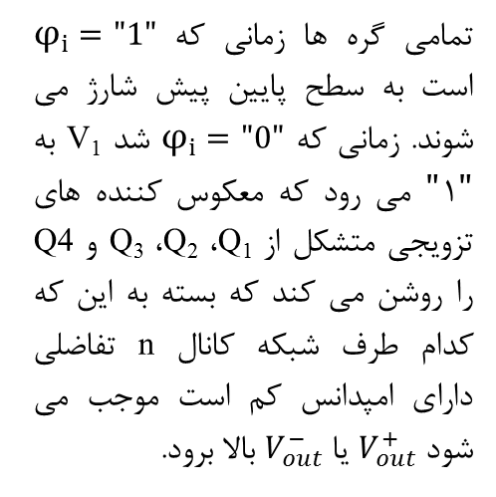

منطق تفاضلی احیا کننده
روش دیگری برای پیاده سازی مدارهای منطقی تفاضلی احیاکننده

Slide 64
کدام خانواده منطقی را انتخاب کنیم؟
Each of the circuit styles has its advantages and disadvantages
Which one to select depends upon the primary requirement: ease of design, robustness, area, speed, or power dissipation, system clocking requirements, fan-out, functionality, ease of testing
No single style optimizes all these measures at the same time
Even more, the approach of choice can vary from logic function to logic function

Slide 65
منطق استاتیک؟
The static approach has the advantage of being robust in the presence of noise
This makes the design process rather trouble-free and amenable to a high degree of automation
This ease-of-design does not come for free: for complex gates with a large fan-in, complementary CMOS becomes expensive in terms of area and performance
Alternative static logic styles have therefore been devised Pseudo-NMOS is simple and fast at the expense of a reduced noise margin and static power dissipation

Slide 66
منطق دینامیک یا ترانزیستور عبور؟
Pass-transistor logic is attractive for the implementation of a number of specific circuits, such as multiplexers and XOR- dominated logic such as adders
Dynamic logic, on the other hand, makes it possible to implement fast and small complex gates
This comes at a price. Parasitic effects such as charge sharing make the design process a precarious job
Charge leakage forces a periodic refresh, which puts a lower bound on the operating frequency of the circuit

Slide 67
ترجیح غالب کدام است؟
Current trend is towards an increased use of complementary static CMOS
This tendency is inspired by the increased use of design-automation tools at the logic design level
These tools emphasize optimization at the logic rather than the circuit level and put a premium on robustness
Another argument is that static CMOS is more amenable to voltage scaling than some of other approaches

Slide 68
یک مقایسه
4-input NAND
Style | # Trans | Ease | Ratioed? | Delay | Power
Comp Static | 8 | 1 | no | 3 | 1
CPL* | 12 + 2 | 2 | no | 4 | 3
domino | 6 + 2 | 4 | no | 2 | 2 + clk
DCVSL* | 10 | 3 | yes | 1 | 4
* Dual Rail

Slide 69
Static CMOS Path vs Dynamic Path
Dynamic performs the same logic as static CMOS with significantly less delay

Slide 70
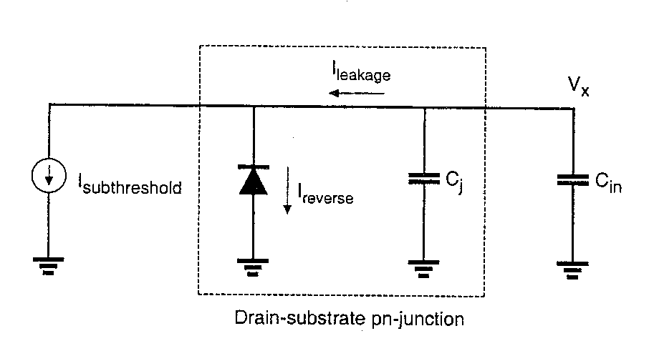
Leakage and Subthreshold Current in Dynamic Pass Gate
Charge can leak off the storage capacitor Cx mainly from two sources:
PN junction leakage of the NMOS drain (source) junction
Subthreshold current (I_{OFF}) through MP when its gate is down at zero volts
One can solve for the maximum amount of time Δt that charge can be retained on Cx using the differential equation C dv/dt = I, where
I is the total of the reverse PN junction leakage and the I_{OFF} current
C is the total load capacitance due to gate, junction, wire, and poly capacitance
the maximum allowable ΔV in order to preserve the logic “1” level is known
Typically ΔV ~ Vdd – Vtn – ½ Vdd = ½ Vdd – Vtn
The minimum frequency of operation can be found from f ~ 1/(2 Δt)

Slide 71
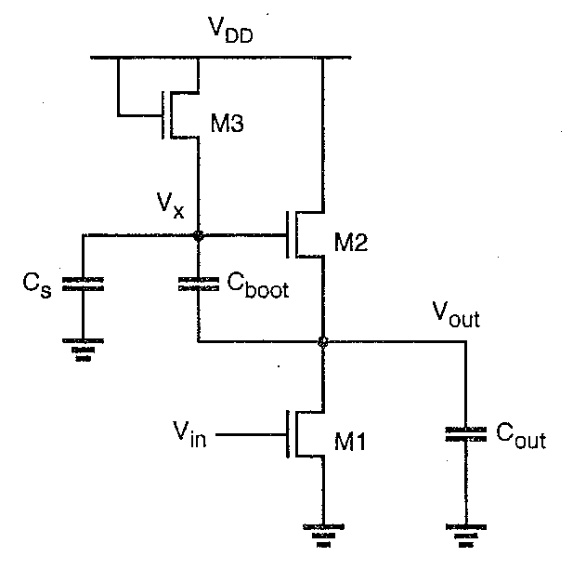
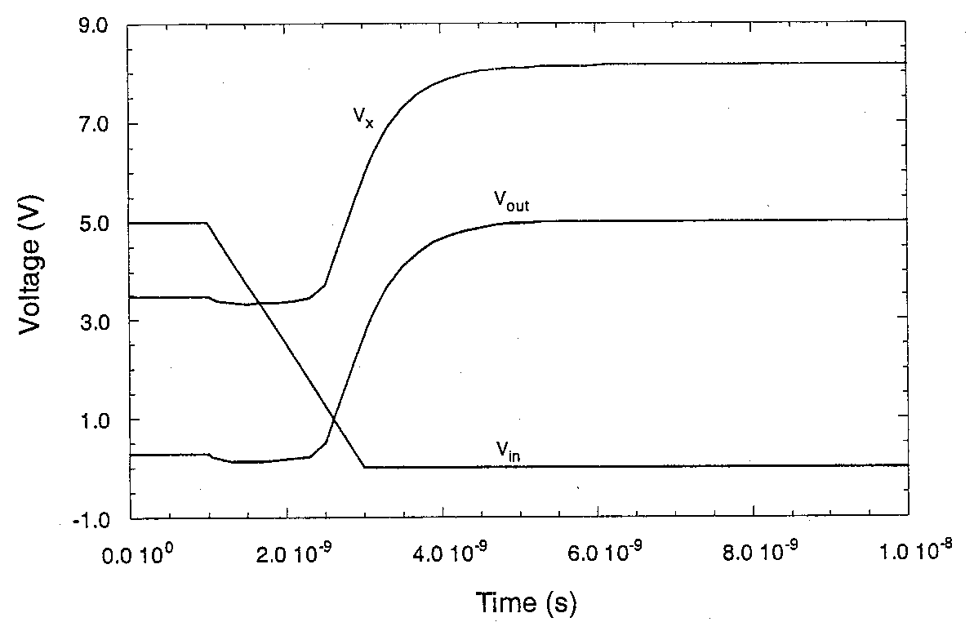
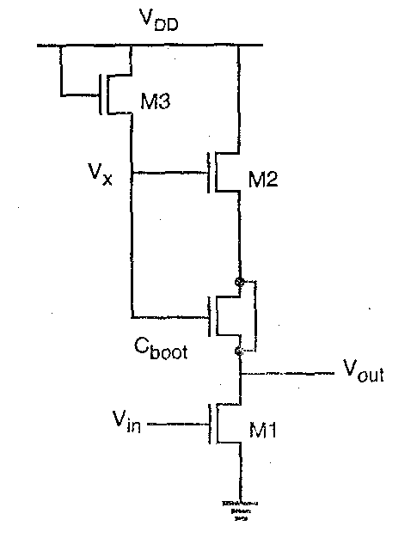
Dynamic Bootstrapping Technique
Bootstrapping is a technique that is sometimes used to charge up a transistor gate to a voltage higher than Vdd when that transistor has to drive a line to the full Vdd
At left is a NMOS bootstrap driver often used in memory circuits to drive a highly capacitive word line
Operation:
When Vin = high, M1 is on, holding Vout low while M3 charges Vx to Vdd – Vt. Thus, C_{boot} is charged to Vdd – Vt – V_{OL}
When Vin goes low, turning M1 off, M2 starts charging Vout high. If C_{boot} > C_{s}, most of the increase in Vout is “booted” to Vx, raising the voltage at Vx to well above Vdd.
It is desired to obtain Vx > Vdd + Vt in order to keep M2 linear, to allow Vout to be charged fully to Vdd.
Parasitic capacitor C_{s} bleeds some of the charge off C_{boot}, limiting the max voltage on Vx (charging coupling eq.)
Here C_{boot} is implemented with a transistor having source tied to drain.

Slide 72
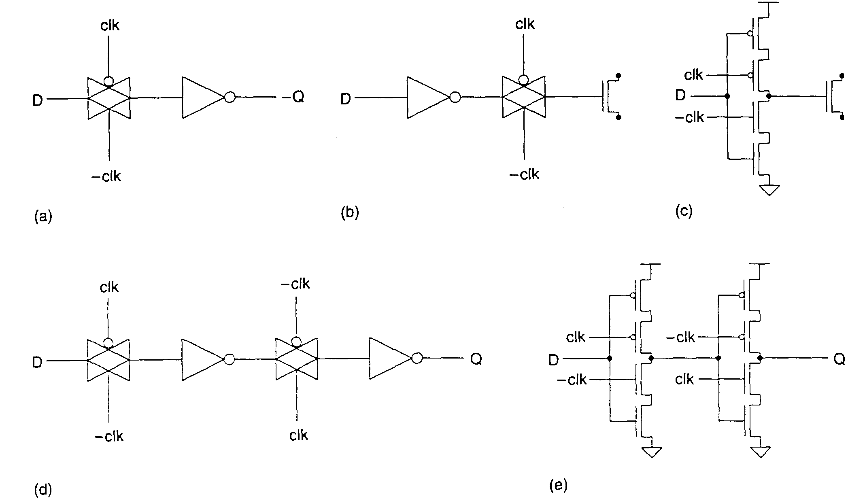
Dynamic Latches with a Single Clock
Dynamic latches eliminate dc feedback leg by storing data on gate capacitance of inverter (or logic gate) and switching charge in or out with a transmission gate
Minimum frequency of operation is typically of the order of 50-100 KHz so as not to lose data due to junction or gate leakage from the node
Can be clocked at high frequency since very little delay in latch elements
Examples:
(a) or (b) show simple transmission gate latch concept
(c ) tri-state inverter dynamic latch holds data on gate when clk is high
(d) and (e) dynamic D register

