Slide 1
Intelligent Information Retrieval Course Overview

Slide 2
Information overload problem
A state of having more information available that one can readily assimilate, that is, people have difficulty absorbing the information into their base of knowledge. This hinders decision-making and judgment by causing stress and cognitive impediments such as confusion, uncertainty and distraction.
A newer definition focuses on time and resources aspects. When a decision-maker is given many sets of information, the quality of its decision is decreased because of the individual’s limitation of scarce resources to process all the information and optimally make the best decision.

Slide 3
How much information? (2022)
Every minute:
GOOGLE users conduct 5.9M searches
TWITTER users share 347.2k tweets
INSTAGRAM users share 66k photos
FACEBOOK users share 1.7M pieces of content
AMAZON shoppers spend $443k
SNAPCHAT users send 2.43M snaps
EMAIL users send 231.4M messages
People send 16M texts

Slide 4
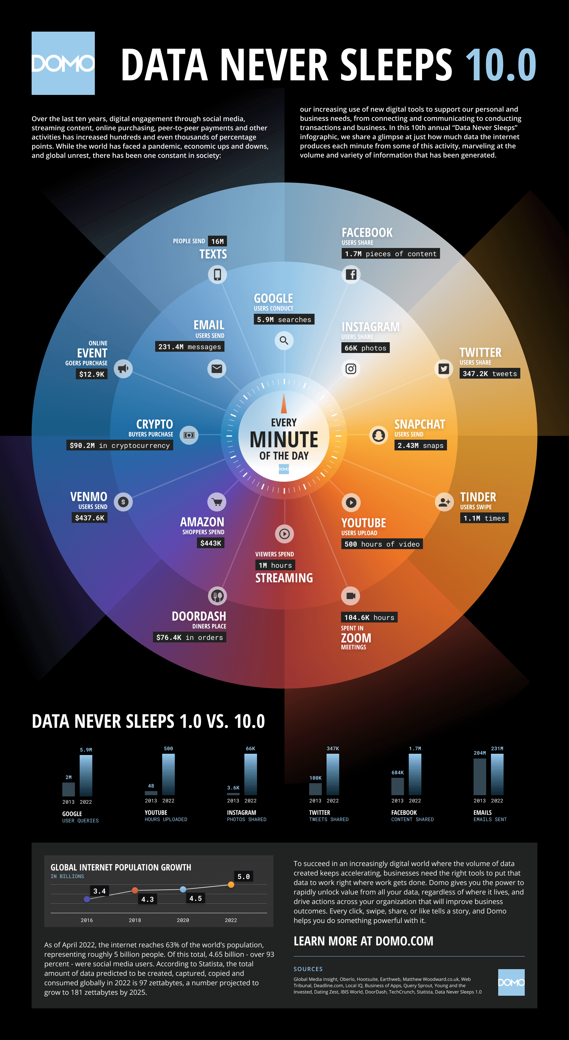

Slide 6
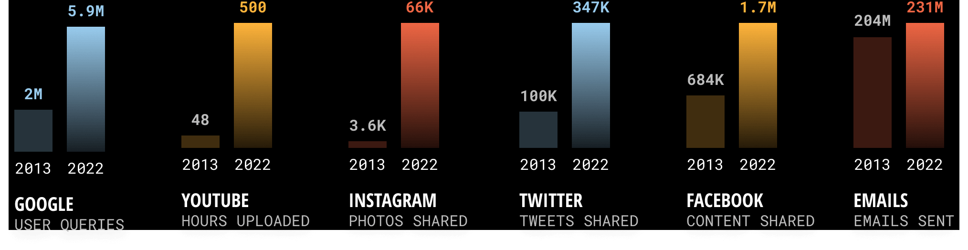
Data Never Sleeps 1.0 vs. Data Never Sleeps 10.0

Slide 7
The special role of textual information
The most natural way of encoding knowledge
Think about scientific literature
The most common type of information
Think about the amount of textual information we produce and consume every day
A universal representation language
It can be used to describe other media of information
We mostly focus on text information in this course

Slide 8
Motivation: Harnessing big text data
Text data is ubiquitous and growing rapidly
Internet
Blogs
News
Email
Literature
Twitter
…
Many
applications!
Knowledge

Slide 9
Many challenges
How can we
find useful information?
organize information automatically?
extract patterns?
…
How to manage text information
effectively and efficiently?

Slide 10
Main techniques for harnessing big text data: text retrieval + text mining
Text retrieval
Text mining
Big text data
Small relevant data
Knowledge
Many Applications

Slide 11
Examples of text management applications
Search
Web search engines (Google, Bing, …)
Library systems
Filtering/Recommendation
News filter
Spam email filter
Literature/movie recommender
Categorization
Automatically sorting emails
Mining/Extraction
Discovering major complaints from email in customer service
Bioinformatics
Many others…

Slide 12
Elements of text information management technologies
Retrieval
Applications
Summarization
Visualization
Mining
Applications
Filtering
Mining
Information
Organization
Information
Access
Knowledge
Acquisition
Search
Extraction
Categorization
Clustering
Natural Language Content Analysis
Raw Text

Slide 13
Major Research Milestones
Early days (late 1950s to 1960s): foundation and founding of the field
Luhn’s work on automatic encoding
Cleverdon’s Cranfield evaluation methodology and index experiments
Salton’s early work on SMART system and experiments
1970s-1980s: a large number of retrieval models
Vector space model
Probabilistic models
1990s: further development of retrieval models and new tasks
Language models
TREC evaluation
2000s-present: more applications, especially Web search and interactions with other fields
Web search
Learning to rank
Scalability (e.g., MapReduce)
Neural IR
Indexing: auto vs. manual
Evaluation
System
Indexing + Search
Theory
Large-scale evaluation, beyond ad hoc retrieval
Web search
Machine learning
Scalability

Slide 14
Related research areas
Applications:
Web, Bioinformatics…
Machine Learning
Data Mining
Library & Information
Sciences
Information
Retrieval
Natural Language
Processing
Databases
Software Engineering
Computer Systems

Slide 15
Publications/societies
Applications:
Web, Bioinformatics…
WWW
Machine Learning
Data Mining
ISMB
ICML
Library & Information
Sciences
WSDM
ICML, NIPS, UAI
RECOMB, PSB
Information
Retrieval
ACM SIGKDD
JASIS
JCDL
Natural Language
Processing
ACM SIGIR
AAAI
Databases
HLT
ECIR, CIKM, WSDM,TREC
TOIS, IRJ, IPM
ACL
Software Engineering
Computer Systems
ACM SIGMOD, VLDB
COLING, EMNLP, NAACL
EDBT, TODS, ICDE
OSDI

Slide 16
Questions?

