Slide 1
Word Association Mining and Analysis

Slide 2
Outline
What is a word association?
Why mine word associations?
How to mine word associations?
Paradigmatic Relations
Syntagmatic Relations

Slide 3
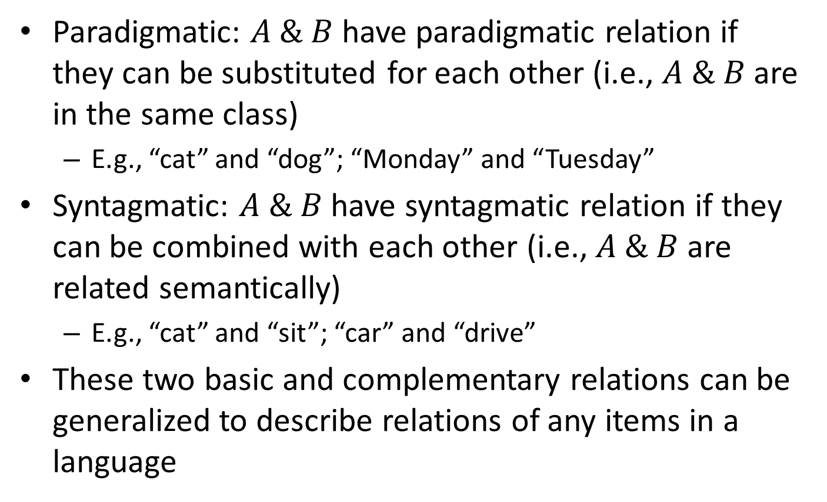
Basic Word Relations: Paradigmatic vs. Syntagmatic
Paradigmatic: $A \& B$have paradigmatic relation if they can be substituted for each other (i.e., $A \& B$are in the same class)
E.g., “cat” and “dog”; “Monday” and “Tuesday”
Syntagmatic: $A \& B$have syntagmatic relation if they can be combined with each other (i.e., $A \& B$are related semantically)
E.g., “cat” and “sit”; “car” and “drive”
These two basic and complementary relations can be generalized to describe relations of any items in a language

Slide 4
Why Mine Word Associations?
They are useful for improving accuracy of many NLP tasks
POS tagging, parsing, entity recognition, acronym expansion
Grammar learning
They are directly useful for many applications in text retrieval and mining
Text retrieval (e.g., use word associations to suggest a variation of a query)
Automatic construction of topic map for browsing: words as nodes and associations as edges
Compare and summarize opinions (e.g., what words are most strongly associated with “battery” in positive and negative reviews about iPhone 6 , respectively?)

Slide 5
Outline
What is a word association?
Why mine word associations?
How to mine word associations?
Paradigmatic Relations
Syntagmatic Relations

Slide 6
Mining Word Associations: Intuitions
Paradigmatic: similar context
My ___ eats fish on Saturday
His ___ eats turkey on Tuesday
…
cat:
My cat eats fish on Saturday
His cat eats turkey on Tuesday
My dog eats meat on Monday
His dog eats turkey on Tuesday
…
My ___ eats meat on Monday
His ___ eats turkey on Tuesday
…
dog:
Similar
left context
Similar
right context
Similar
general context
How similar are context (“cat”) and context (“dog”)?
How similar are context (“cat”) and context (“computer”)?

Slide 7
Mining Word Associations: Intuitions
Syntagmatic: correlated occurrences
My ___ eats ___ on Saturday
His ___ eats ___ on Tuesday
My ___ eats ___ on Monday
His ___ eats ___on Tuesday
…
My cat eats fish on Saturday
His cat eats turkey on Tuesday
My dog eats meat on Monday
His dog eats turkey on Tuesday
…
What words tend to occur
to the left of “eats”?
What words to
the right?
Whenever “eats” occurs, what other words also tend to occur?
How helpful is the occurrence of “eats” for predicting “meat”?
How helpful is the occurrence of “eats” for predicting “text”?

Slide 8
Mining Word Associations: General Ideas
Paradigmatic
Represent each word by its context
Compute context similarity
Words with high context similarity likely have paradigmatic relation
Syntagmatic
Count how many times two words occur together in a context (e.g., sentence or paragraph)
Compare their co-occurrences with their individual occurrences
Words with high co-occurrences, but relatively low individual occurrences likely have syntagmatic relation
Paradigmatic related words tend to have syntagmatic relation with the same word → joint discovery of the two relations
These ideas can be implemented in many different ways.

Slide 9
Outline
What is a word association?
Why mine word associations?
How to mine word associations?
Paradigmatic Relation Discovery
Syntagmatic Relation Discovery

Slide 10
Word Context as “Pseudo Document”
Left1(“cat”) = {“my”, “his”, “big”, “a”, “the”, …}
My ___ eats fish on Saturday
His ___ eats turkey on Tuesday
…
Window8 (“cat”) =
{“my”, “his” , “big”,
“eats”, “fish”, …}
cat:
Right1(“cat”) = {“eats”, “ate” , “is”, “has”, …}
Context = pseudo document = “bag of words”
Context may contain adjacent or non-adjacent words

Slide 11
Measuring Context Similarity
Sim (“cat”, “dog”) =
Sim (Left1(“cat”), Left1(“dog”))
+ Sim (Right1(“cat”), Right1(“dog”)) +
…
+ Sim (Window8(“cat”), Window8(“dog”)) = ?
High sim(word1, word2)
→ word1 and word2 are paradigmatically related

Slide 12
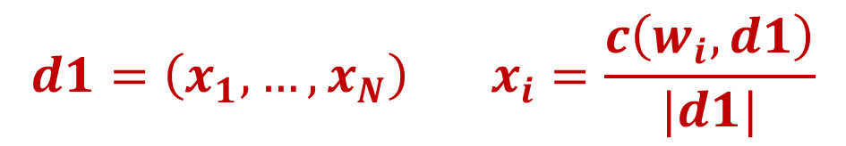
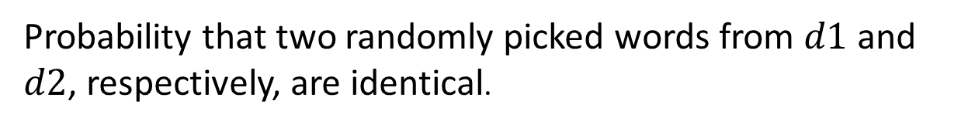
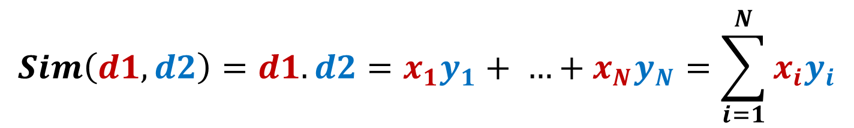
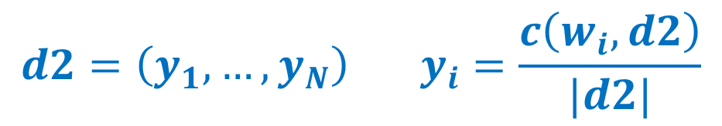
Expected Overlap of Words in Context (EOWC)
Probability that a randomly
picked word from d1 is w_{i}
Count of word w_{i} in d1
$$d1=\left(x_{1}, …,x_{N}\right) x_{i}=\frac{c\left(w_{i}, d1\right)}{|d1|}$$
Total counts
of words in d1
$$d2=\left(y_{1}, …,y_{N}\right) y_{i}=\frac{c\left(w_{i}, d2\right)}{|d2|}$$
$$Sim\left(d1, d2\right)=d1.d2=x_{1}y_{1}+ …+x_{N}y_{N}=\sum_{i=1}^{N}{x_{i}y_{i}}$$
Probability that two randomly picked words from $d1$ and $d2$, respectively, are identical.

Slide 13
Would EOWC Work Well?
Intuitively, it makes sense: the more overlap the two context documents have, the higher the similarity would be
However
It favors matching one frequent term very well over matching more distinct terms
It treats every word equally (overlap on “the” is not as so meaningful as overlap on “eats”)

Slide 14
Improving EOWC with Retrieval Heuristics
It favors matching one frequent term very well over matching more distinct terms
Sublinear transformation of Term Frequency (TF)
It treats every word equally (overlap on “the” is not as so meaningful as overlap on “eats”)
Reward matching a rare word: IDF term weighting

Slide 15
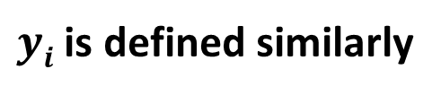

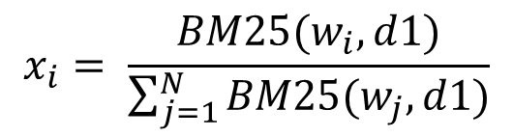
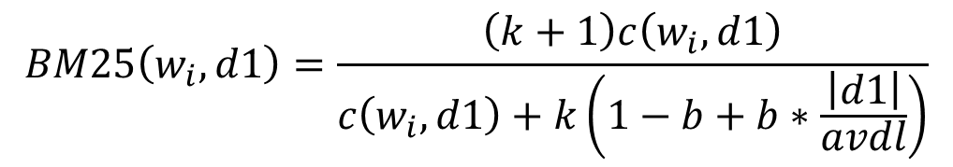
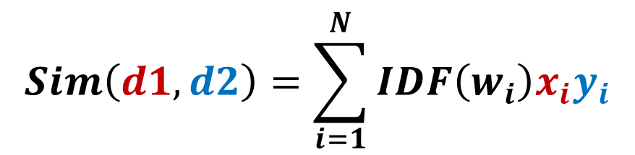



Adapting BM25 Retrieval Model for Paradigmatic Relation Mining
$$BM25\left(w_{i},d1\right)=\frac{\left(k+1\right)c\left(w_{i},d1\right)}{c\left(w_{i}, d1\right)+k\left(1−b+b∗\frac{\left|d1\right|}{avdl}\right)}$$
$$d1=\left(x_{1}, …,x_{N}\right)$$
$$x_{i}= \frac{BM25(w_{i},d1)}{\sum_{j=1}^{N}{BM25(w_{j},d1)}}$$
$$b∈\left[0, 1\right]$$
$$k ∈[0, +∞)$$
$$d2=\left(y_{1}, …,y_{N}\right)$$
$yi$ is defined similarly
$$Sim\left(d1, d2\right)=\sum_{i=1}^{N}{{IDF\left(w_{i}\right)x}_{i}y_{i}}$$

Slide 16

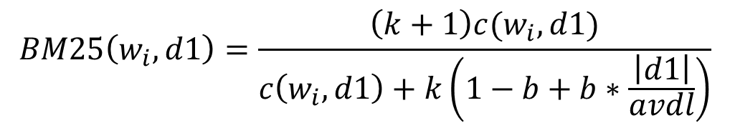
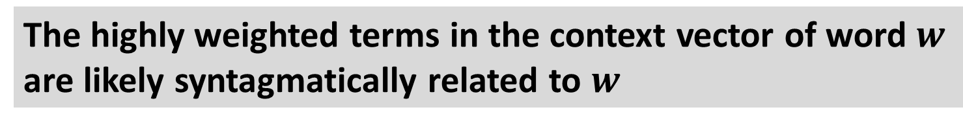
BM25 can also Discover Syntagmatic Relations
$$BM25\left(w_{i},d1\right)=\frac{\left(k+1\right)c(w_{i},d1)}{c\left(w_{i}, d1\right)+k\left(1−b+b∗\frac{\left|d1\right|}{avdl}\right)}$$
$$d1=\left(x_{1}, …,x_{N}\right)$$
$$x_{i}= \frac{BM25(w_{i},d1)}{\sum_{j=1}^{N}{BM25(w_{j},d1)}}$$
$$b∈\left[0, 1\right]$$
$$k∈[0, +∞)$$
IDF Weighted $d1=\left(x_{1} ∗IDF\left(w_{1}\right), …,x_{N}∗IDF(w_{N})\right)$
The highly weighted terms in the context vector of word $w$
are likely syntagmatically related to $w$

Slide 17
Summary of Paradigmatic Relation Discovery
Main idea for discovering paradigmatic relations:
Collecting the context of a candidate word to form a pseudo document (bag of words)
Computing the similarity of the corresponding context documents of two candidate words
Highly similar word pairs can be assumed to have paradigmatic relations
Many different ways to implement this general idea
Text retrieval models can be easily adapted for computing similarity of two context documents
BM25 + IDF weighting
Syntagmatic relations can also be discovered as a “by product”

Slide 18
Outline
What is a word association?
Why mine word associations?
How to mine word associations?
Paradigmatic Relation Discovery
Syntagmatic Relation Discovery

Slide 19
Syntagmatic Relation = Correlated Occurrences
Whenever “eats” occurs, what other words also tend to occur?
My cat eats fish on Saturday
His cat eats turkey on Tuesday
My dog eats meat on Monday
His dog eats turkey on Tuesday
…
My ___ eats ___ on Saturday
His ___ eats ___ on Tuesday
My ___ eats ___ on Monday
His ___ eats ___on Tuesday
…
What words tend to occur
to the left of “eats”?
What words to
the right?

Slide 20
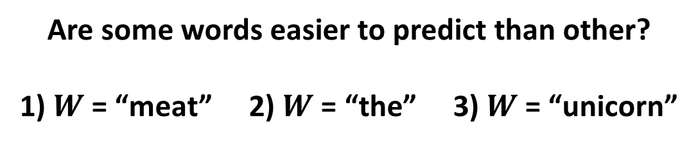
Word Prediction: Intuition
Prediction Question: Is word $W$ present (or absent) in this segment?
Text Segment (any unit, e.g., sentence, paragraph, document)
…
…
Are some words easier to predict than other?
1) $W$ = “meat” 2) $W$ = “the” 3) $W$ = “unicorn”

Slide 21
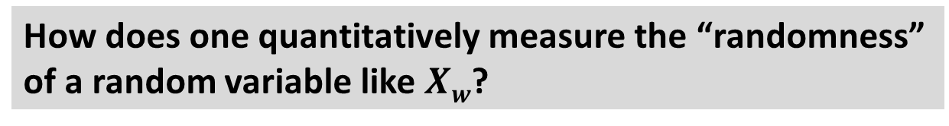
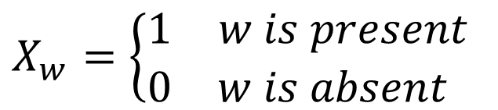

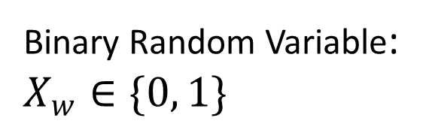
Word Prediction: Formal Definition
Binary Random Variable:
$$X_{w}∈\{0, 1\}$$
$$X_{w}=\left\{\begin{aligned}\begin{matrix}1 & w is present\end{matrix} \\ \begin{matrix}0 & w is absent \end{matrix}\end{aligned}\right.$$
$$p\left(X_{w}=1\right)+p\left(X_{w}=0\right)=1$$
The more random $Xw$ is, the more difficult the prediction would be.
How does one quantitatively measure the “randomness”
of a random variable like $Xw$?

Slide 22
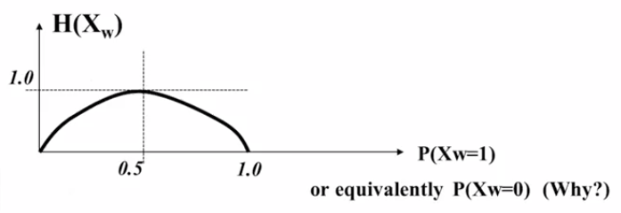
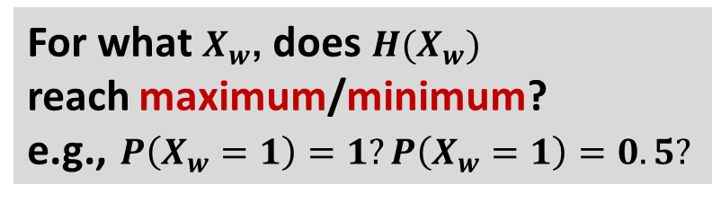
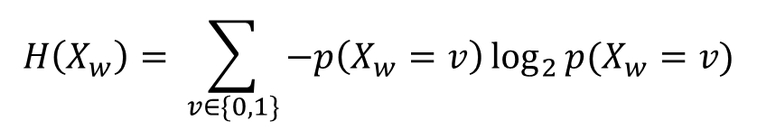

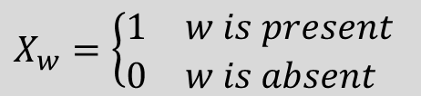
Entropy H(X) Measures Randomness of X
$$H\left(X_{w}\right)= \sum_{v∈\{0, 1\}}{−p\left(X_{w}=v\right)\log_{2}{p(X_{w}=v)}}$$
$$X_{w}=\left\{\begin{aligned}\begin{matrix}1 & w is present\end{matrix} \\ \begin{matrix}0 & w is absent \end{matrix}\end{aligned}\right.$$
$$Define 0\log_{2}{0=0}$$
$$=−p\left(X_{w}=0\right)\log_{2}{p\left(X_{w}=0\right)−p\left(X_{w}=1\right)\log_{2}{p(X_{w}=1)}}$$
For what $X_{w}$, does $H(X_{w})$
reach maximum/minimum?
e.g., $P\left(X_{w}=1\right)=1?P\left(X_{w}=1\right)=0.5?$

Slide 23
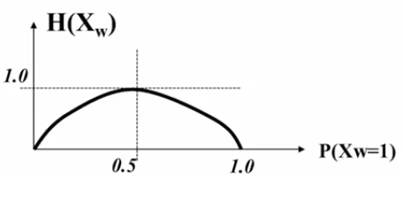
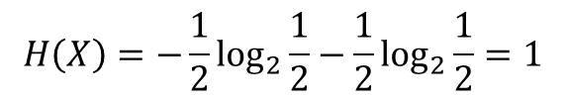
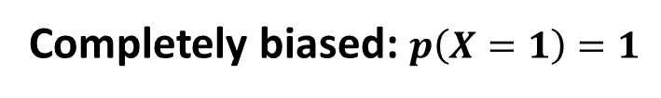
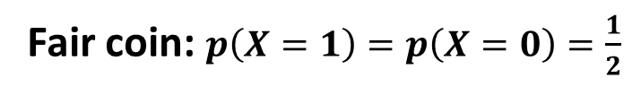
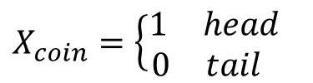

Entropy H(X): Coin Tossing
$$H(X_{coin})=−p\left(X_{coin}=0\right)\log_{2}{p\left(X_{coin}=0\right)−p\left(X_{coin}=1\right)\log_{2}{p(X_{coin}=1)}}$$
X_{coin} : tossing a coin
$$X_{coin}=\left\{\begin{aligned}\begin{matrix}1 & head\end{matrix} \\ \begin{matrix}0 & tail \end{matrix}\end{aligned}\right.$$
Fair coin: $p\left(X=1\right)=p\left(X=0\right)=\frac{1}{2}$
$$H\left(X\right)=−\frac{1}{2}\log_{2}{\frac{1}{2}−\frac{1}{2}\log_{2}{\frac{1}{2}=1}}$$
Completely biased: $p\left(X=1\right)=1$
$$H\left(X\right)=−0\log_{2}{0−1\log_{2}{1=0}}$$

Slide 24
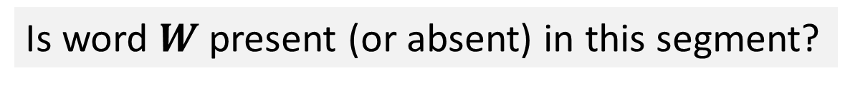
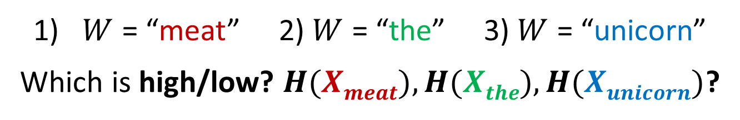
Entropy for Word Prediction
Is word $W$ present (or absent) in this segment?
…
…
$W$ = “meat” 2) $W$ = “the” 3) $W$ = “unicorn”
Which is high/low? $H(Xmeat), H(Xthe), H(Xunicorn)$?
$$H\left(X_{the}\right)≈0→no uncertainty since p(X_{the}=1)≈1$$
High entropy words are harder to predict!

Slide 25
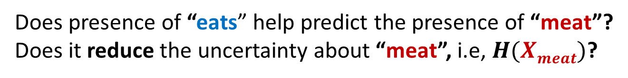
What If We Know More About a Text Segment?
Prediction Question: Is “meat” present (or absent) in this segment?
…
…
eats
Does presence of “eats” help predict the presence of “meat”?
Does it reduce the uncertainty about “meat”, i.e, $H(Xmeat)$?
What if we know the absence of “eats”? Does it also help?

Slide 26
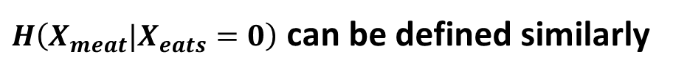
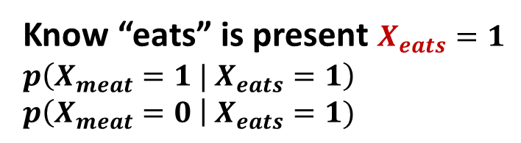
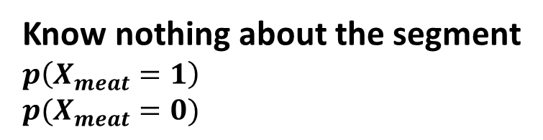
Conditional Entropy
Know nothing about the segment
$$p\left(X_{meat}=1\right)$$
$$p(X_{meat}=0)$$
Know “eats” is present $X_{eats}=1$
$$p\left(X_{meat}=1 | X_{eats}=1\right)$$
$$p\left(X_{meat}=0 \right| X_{eats}=1)$$
$$H(X_{meat})=−p\left(X_{meat}=0\right)\log_{2}{p\left(X_{meat}=0\right)−p\left(X_{meat}=1\right)\log_{2}{p(X_{meat}=1)}}$$
$$H(X_{meat}|X_{eats}=1)=−p\left(X_{meat}=0|X_{eats}=1\right)\log_{2}{p\left(X_{meat}=0|X_{eats}=1\right)}$$
$$−p\left(X_{meat}=1|X_{eats}=1\right)\log_{2}{p(X_{meat}=1|X_{eats}=1)}$$
$H\left(X_{meat}|X_{eats}=0\right)$ can be defined similarly

Slide 27
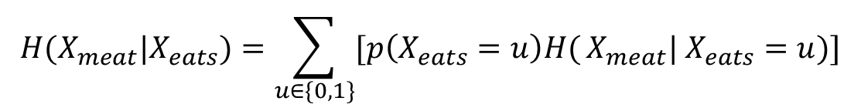
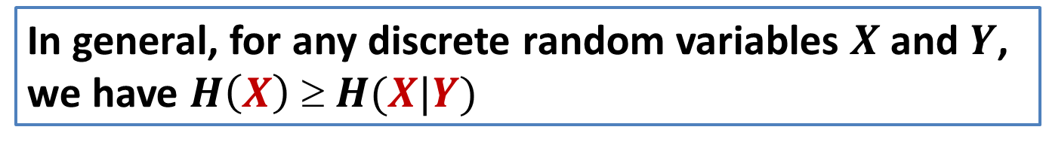
Conditional Entropy: Complete Definition
$$H(X_{meat}|X_{eats})=\sum_{u∈\{0,1\}}{[p\left(X_{eats}=u\right)H(}X_{meat}| X_{eats}=u)]$$
$$=\sum_{u∈\{0, 1\}}{[p\left(X_{eats}=u\right) \sum_{v∈\{0, 1\}}{[−p\left(X_{meat}=v|X_{eats}=u\right)\log_{2}{p\left(X_{meat}=v|X_{eats}=u\right)]]} }}$$
In general, for any discrete random variables $X$ and $Y$,
we have $H\left(X\right) ≥ H(X|Y)$
What is the minimum possible value of $H(X|Y)$?

Slide 28
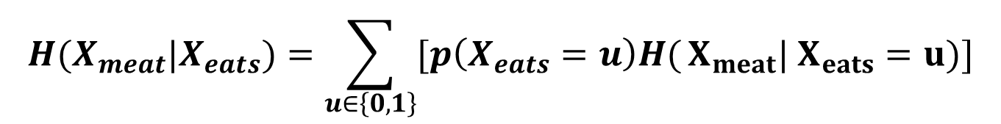
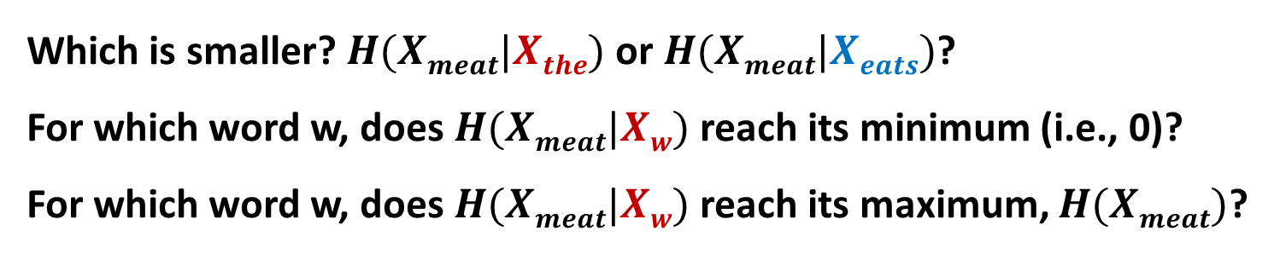
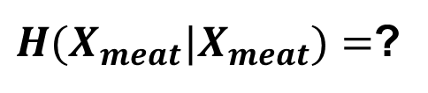
Conditional Entropy to Capture Syntagmatic Relation
$$H(X_{meat}|X_{eats})=\sum_{u∈\left\{0,1\right\}}{[p\left(X_{eats}=u\right)H(}X_{meat}| X_{eats}=u)]$$
$H(X_{meat}|X_{meat})=$?
Which is smaller? $H(Xmeat|Xthe)$ or $H(Xmeat|Xeats)$?
For which word w, does $H(Xmeat|Xw)$ reach its minimum (i.e., 0)?
For which word w, does $H(Xmeat|Xw)$ reach its maximum, $H(Xmeat)$?

Slide 29
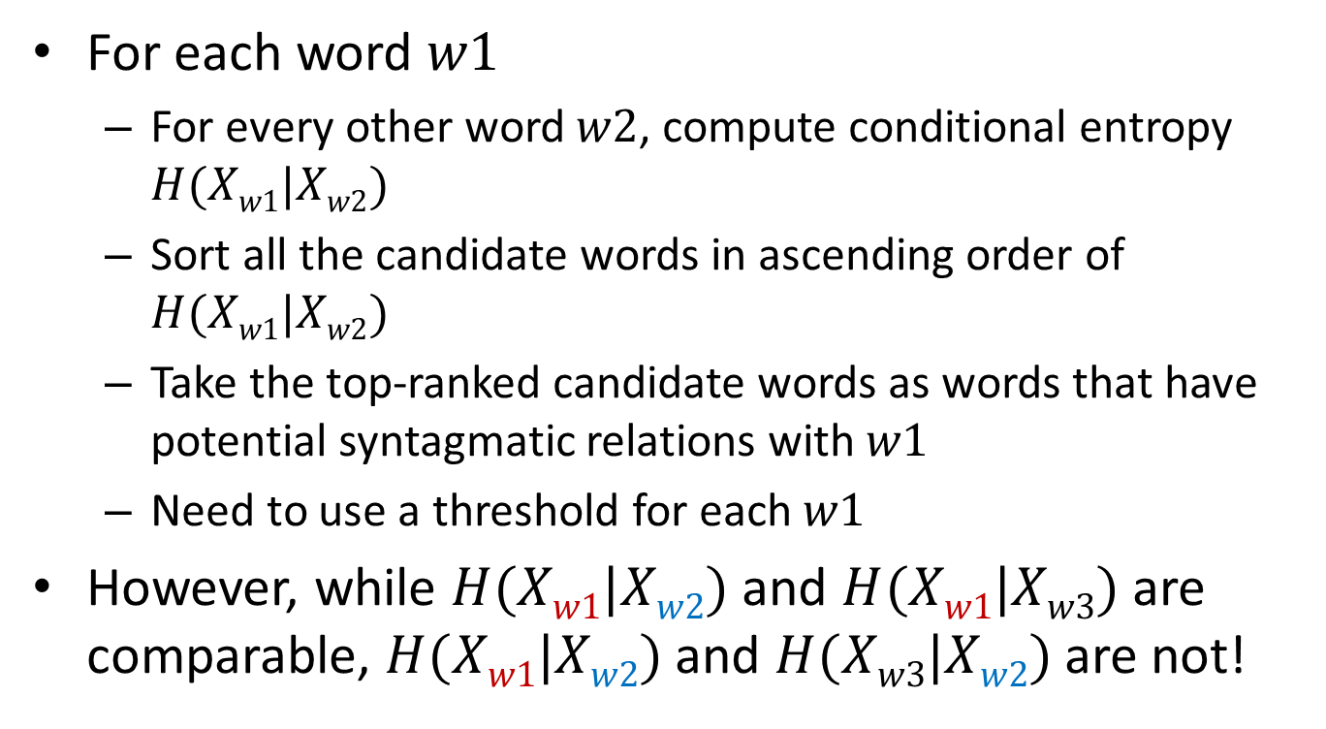
Conditional Entropy for Mining Syntagmatic Relations
For each word $w1$
For every other word $w2$, compute conditional entropy $H(Xw1|Xw2)$
Sort all the candidate words in ascending order of $H(Xw1|Xw2)$
Take the top-ranked candidate words as words that have potential syntagmatic relations with $w1$
Need to use a threshold for each $w1$
However, while $H(Xw1|Xw2)$ and $H(Xw1|Xw3)$ are comparable, $H(Xw1|Xw2)$and $H(Xw3|Xw2)$are not!
How can we mine the strongest $K$ syntagmatic relations from a collection?

Slide 30
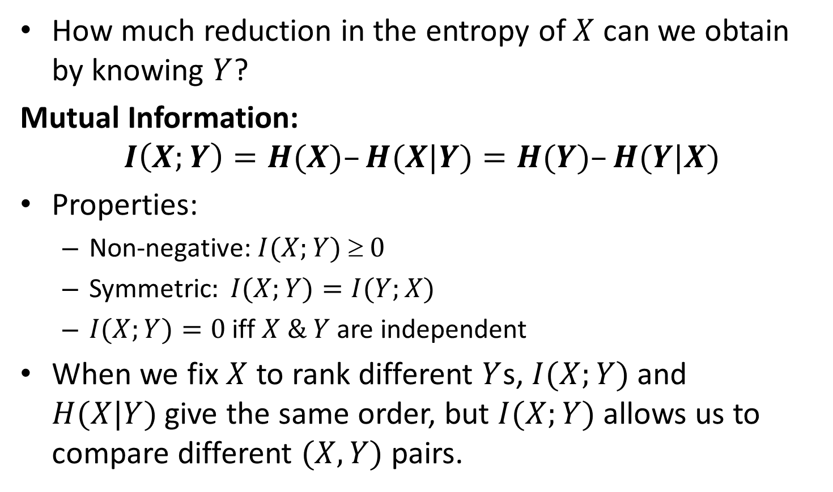
Mutual Information I(X; Y): Measuring Entropy Reduction
How much reduction in the entropy of $X$ can we obtain by knowing $Y$?
Mutual Information:
$$I\left(X;Y\right)=H(X)–H(X|Y)=H(Y)–H(Y|X)$$
Properties:
Non-negative: $I(X;Y)  0$
Symmetric$: I(X;Y)=I(Y;X)$
$I(X;Y)=0$ iff $X \& Y$ are independent
When we fix $X$ to rank different $Y$s, $I(X;Y)$and $H(X|Y)$give the same order, but $I(X;Y)$allows us to compare different $(X, Y)$ pairs.

Slide 31
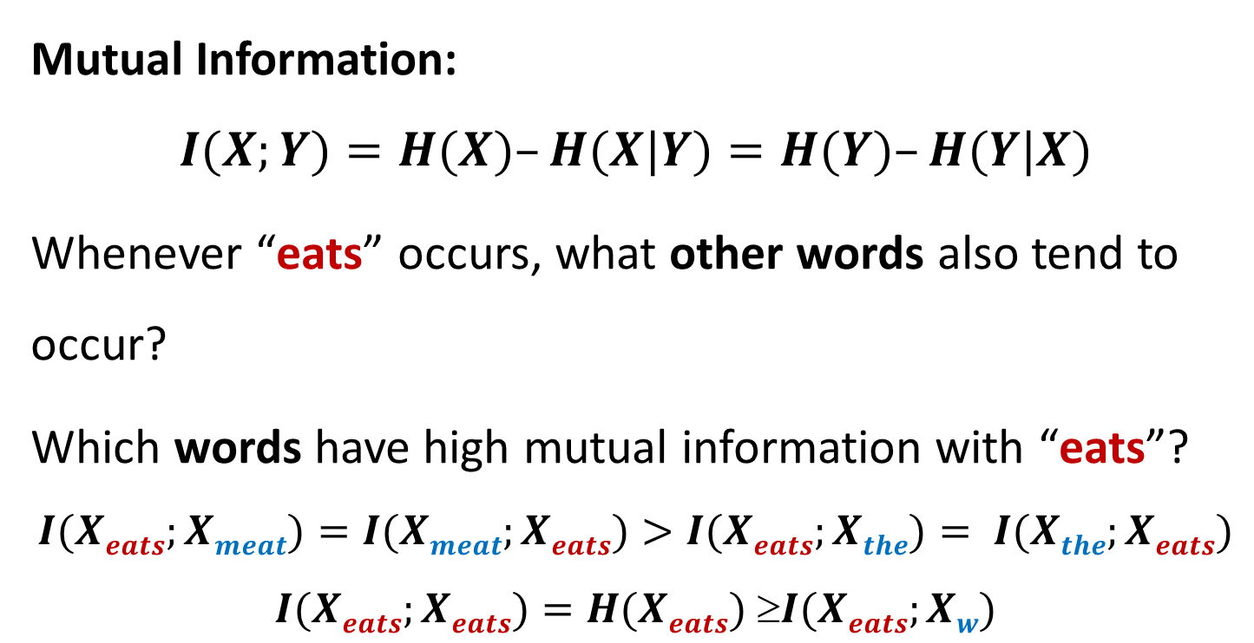
Mutual Information I(X;Y) for Syntagmatic Relation Mining
Mutual Information:
$$I(X;Y)=H(X)–H(X|Y)=H(Y)–H(Y|X)$$
Whenever “eats” occurs, what other words also tend to occur?
Which words have high mutual information with “eats”?
$$I(Xeats;Xmeat)=I(Xmeat;Xeats)>I(Xeats;Xthe)= I(Xthe;Xeats)$$
$$I(Xeats;Xeats)=H(Xeats) I(Xeats;Xw)$$

Slide 32
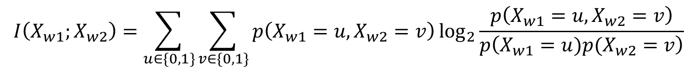
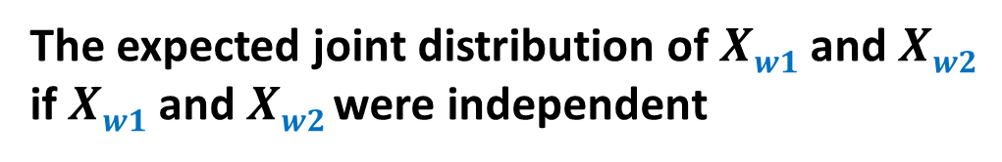
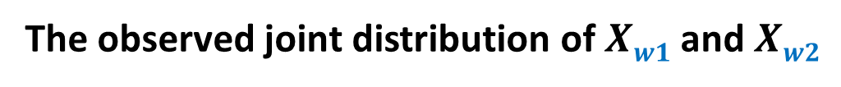
Rewriting Mutual Information (MI) using KL-divergence
The observed joint distribution of $Xw1$ and $Xw2$
$$I\left(X_{w1};X_{w2}\right)=\sum_{u∈\{0, 1\}}{\sum_{v∈\{0, 1\}}{p\left(X_{w1}=u, X_{w2}=v\right)\log_{2}{\frac{p\left(X_{w1}=u, X_{w2}=v\right)}{p\left(X_{w1}=u)p(X_{w2}=v\right)}}}}$$
The expected joint distribution of $Xw1$ and $Xw2$
if $Xw1$and $Xw2$ were independent
MI measures the divergence of the actual joint distribution from the
Expected distribution under the independence assumption. The larger the
divergence is, the higher the MI would be.

Slide 33
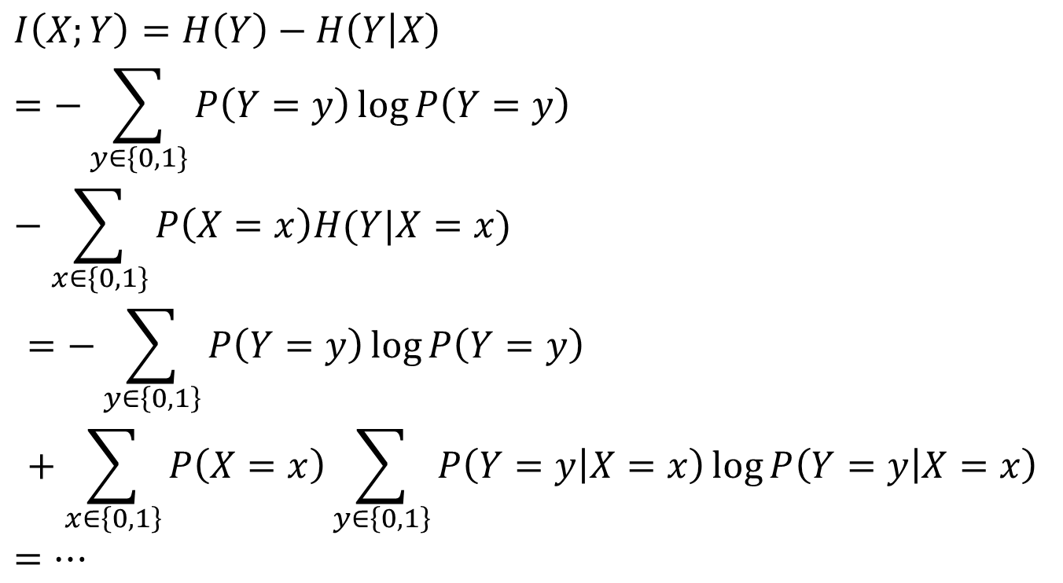
MI and KL-divergence
$$I\left(X;Y\right)=H\left(Y\right)−H\left(Y | X\right)$$
$$=−\sum_{y∈\{0,1\}}{P\left(Y=y\right)\log{P\left(Y=y\right)}}−\sum_{x∈\{0,1\}}{P\left(X=x\right)H(Y|X=x)}$$
$$=−\sum_{y∈\left\{0,1\right\}}{P\left(Y=y\right)\log{P\left(Y=y\right)}}+\sum_{x∈\left\{0,1\right\}}{P\left(X=x\right)\sum_{y∈\left\{0,1\right\}}{P\left(Y=y | X=x\right)\log{P\left(Y=y | X=x\right)}}}$$
$$=…$$

Slide 34
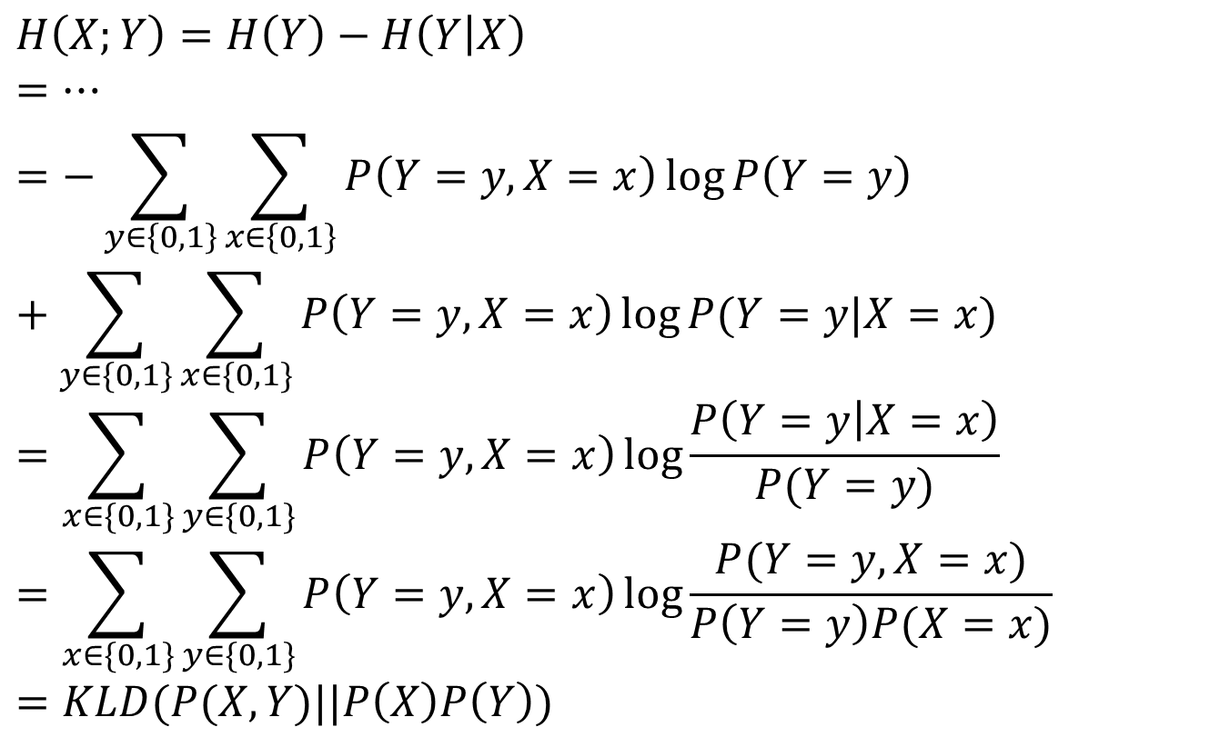
MI and KL-divergence (cont.)
$$H\left(X;Y\right)=H\left(Y\right)−H\left(Y | X\right)$$
$$=…$$
$$=\sum_{x∈\{0,1\}}{\sum_{y∈\{0,1\}}{P\left(Y=y,X=x\right)\log{\frac{P\left(Y=y | X=x\right)}{P(Y=y)}}}}=−\sum_{y∈\left\{0,1\right\}}{\sum_{x∈\left\{0,1\right\}}{P\left(Y=y,X=x\right)\log{P\left(Y=y\right)}}}+\sum_{y∈\{0,1\}}{\sum_{x∈\{0,1\}}{P\left(Y=y,X=x\right)\log{P(Y=y|X=x)}}}$$
$$=\sum_{x∈\{0,1\}}{\sum_{y∈\{0,1\}}{P\left(Y=y,X=x\right)\log{\frac{P(Y=y,X=x)}{P\left(Y=y\right)P(X=x)}}}}$$
$$=KLD(P(X,Y)||P\left(X\right)P\left(Y\right))$$

Slide 35

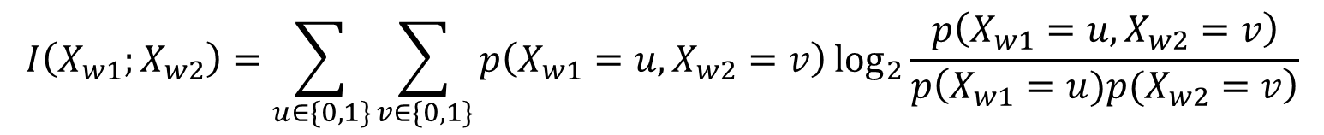


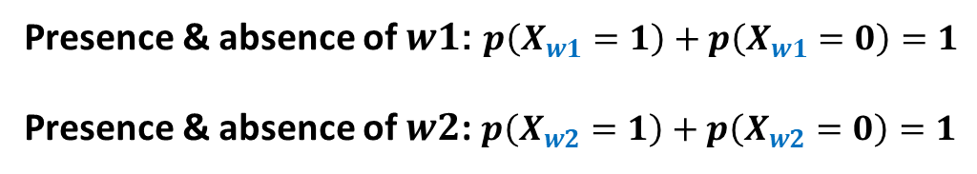
Probabilities Involved in Mutual Information
$$I\left(X_{w1};X_{w2}\right)=\sum_{u∈\{0, 1\}}{\sum_{v∈\{0, 1\}}{p\left(X_{w1}=u, X_{w2}=v\right)\log_{2}{\frac{p\left(X_{w1}=u, X_{w2}=v\right)}{p\left(X_{w1}=u)p(X_{w2}=v\right)}}}}$$
Presence & absence of $w1$: $p\left(X_{w1}=1\right)+p\left(X_{w1}=0\right)=1$
Presence & absence of $w2$: $p\left(X_{w2}=1\right)+p\left(X_{w2}=0\right)=1$
$p(X_{w1}=1, X_{w2}=1)$+$p(X_{w1}=1, X_{w2}=0)$+$p(X_{w1}=0, X_{w2}=1)$+$p(X_{w1}=0, X_{w2}=0)$ =1
Both $w1 \& w2$occur
only $w1$ occurs
only $w2$ occurs
None of them occurs

Slide 36
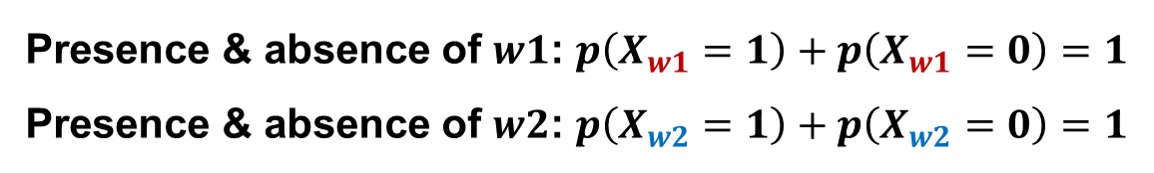

Relation Between Different Probabilities
Presence & absence of $w1$: $p\left(X_{w1}=1\right)+p\left(X_{w1}=0\right)=1$
Presence & absence of $w2$: $p\left(X_{w2}=1\right)+p\left(X_{w2}=0\right)=1$
Co-occurrences of $w1$ and $w2$:
$p(X_{w1}=1, X_{w2}=1)$+$p(X_{w1}=1, X_{w2}=0)$+$p(X_{w1}=0, X_{w2}=1)$+$p(X_{w1}=0, X_{w2}=0)$ =1
Constraints:
$p(X_{w1}=1, X_{w2}=1)$+$p\left(X_{w1}=1, X_{w2}=0\right)=p(X_{w1}=1)$
$p(X_{w1}=0, X_{w2}=1)$+$p\left(X_{w1}=0, X_{w2}=0\right)=p(X_{w1}=0)$
$p(X_{w1}=1, X_{w2}=1)$+$p\left(X_{w1}=0, X_{w2}=1\right)=p(X_{w2}=1)$
$p(X_{w1}=1, X_{w2}=0)$+$p\left(X_{w1}=0, X_{w2}=0\right)=p(X_{w2}=0)$
We only need to know p(X_{w1} = 1), p(X_{w2} = 1), and p(X_{w1} = 1, X_{w2} = 1).

Slide 37
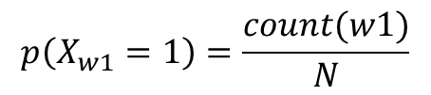
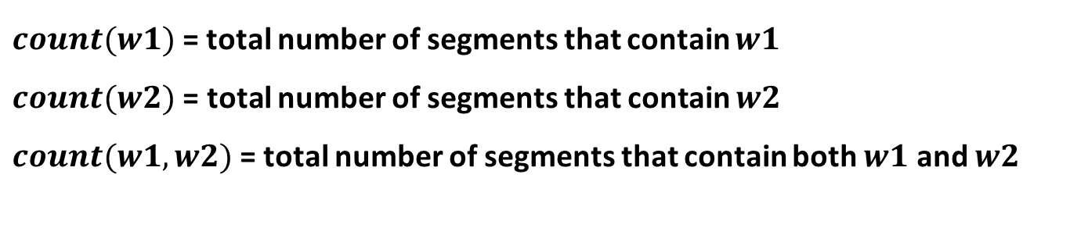
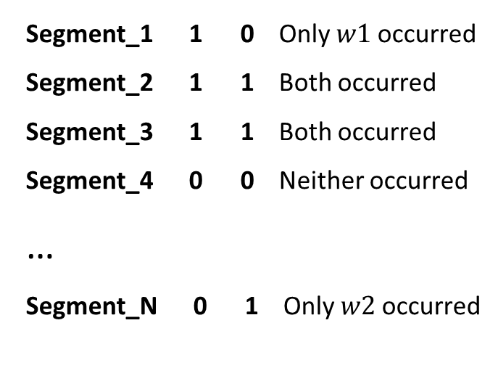
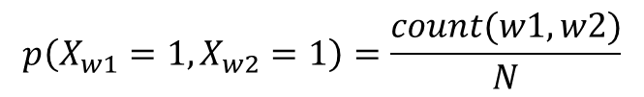

Estimation of Probabilities (Depending on the Data)
W1 W2
$$p\left(X_{w1}=1\right)=\frac{count(w1)}{N}$$
Segment_1 1 0 Only $w1$ occurred
Segment_2 1 1 Both occurred
Segment_3 1 1 Both occurred
Segment_4 0 0 Neither occurred
…
Segment_N 0 1 Only $w2$ occurred
$$p\left(X_{w2}=1\right)=\frac{count(w2)}{N}$$
$$p\left(X_{w1}=1, X_{w2}=1\right)=\frac{count(w1, w2)}{N}$$
$count(w1)$= total number of segments that contain $w1$
$count(w2)$ = total number of segments that contain $w2$
$count(w1, w2)$= total number of segments that contain both $w1$ and $w2$

Slide 38




Smoothing: Accommodating Zero Counts
$$W1 W2$$
$$p\left(X_{w1}=1\right)=\frac{count\left(w1\right)+0.5}{N+1}$$
¼ PseudoSeg1 0 0
¼ PseudoSeg1 1 0
¼ PseudoSeg1 0 1
¼ PseudoSeg1 1 1
Segment_1 1 0
…
Segment_N 0 1
$$p\left(X_{w2}=1\right)=\frac{count\left(w2\right)+0.5}{N+1}$$
$$p\left(X_{w1}=1, X_{w2}=1\right)=\frac{count\left(w1, w2\right)+0.25}{N+1}$$
Smoothing: Add pseudo data so that
no event has zero counts
(pretend we observed extra data)
Actually observed data

Slide 39

Summary of Syntagmatic Relation Discovery
Syntagmatic relations can be discovered by measuring correlations between occurrences of two words.
Three concepts from information theory:
Entropy $H(X)$: measures the uncertainty of a random variable $X$
Conditional Entropy $H(X|Y)$: entropy of $X$ given we know $Y$
Mutual Information $I(X;Y)$: entropy reduction of $X$ (or $Y$) due to knowing $Y$ (or $X$)
Mutual information provides a principled way for discovering syntagmatic relations

Slide 40
Questions?

