Slide 1
Learning to Rank for Information Retrieval

Slide 2
Challenges of Conventional Models
Manual parameter tuning is usually difficult, especially when there are many parameters and the evaluation measures are non-smooth.
Manual parameter tuning sometimes leads to over-fitting.
It is non-trivial to combine the large number of models proposed in the literature to obtain an even more effective model.

Slide 3
Machine Learning Can Help
Machine learning is an effective tool
  To automatically tune parameters.
  To combine multiple evidences.
  To avoid over-fitting (by means of regularization, etc.)

Slide 4
Learning to Rank Definition
“Learning to Rank”
  In general, those methods that use machine learning technologies to solve the problem of ranking can be named as “learning to rank” methods.
Learning to rank for Information Retrieval (IR) is a task to automatically construct a ranking model using training data, such that the model can sort new objects according to their degrees of relevance, preference, or importance.
Learning to rank methods are methods that learn how to combine pre-defined features for ranking by discriminative learning.

Slide 5
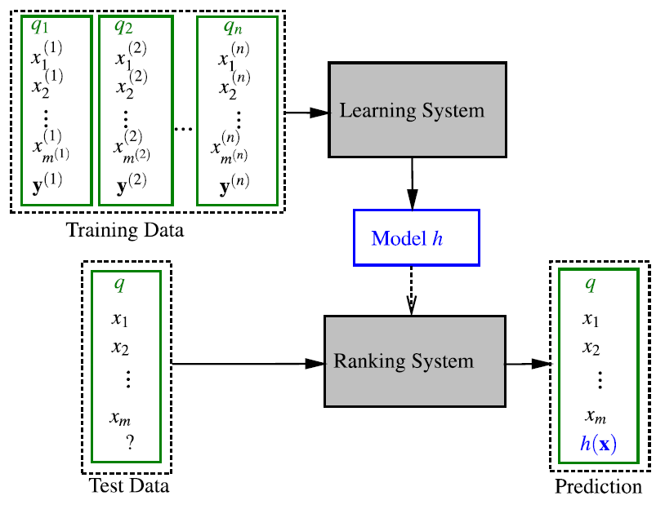
Learning-to-Rank Framework

Slide 6
Training Data Creation
LTR is a supervised learning task, and needs high quality training data
Two common ways to create training data:
  Human labeling
  Derivation from click through data

Slide 7
Feature Construction
Query-dependent document features (dynamic features):
  Depend both on the content of the document and the query.
  For example, TF-IDF score, BM25 score.
Query-independent document features (static features):
  Depend only on the document, but not on the query.
  For example, PageRank, document length.
Query level features (query features):
  Depend only on the query.
  The values of features for each query are the same for all documents
  For example, the number of words in a query.

Slide 8
Approaches to Learning-to-Rank
The pointwise approach
  Input space: feature vectors of single documents
  Output space: relevance degree of each document
The pairwise approach
  Input space: pairs of documents, each represented as feature vectors
  Output space: pairwise preference between each pair of documents
The listwise approach
  Input space: entire group of documents associated with each query
  Output space: relevance degrees of all the documents associated with a query

Slide 9
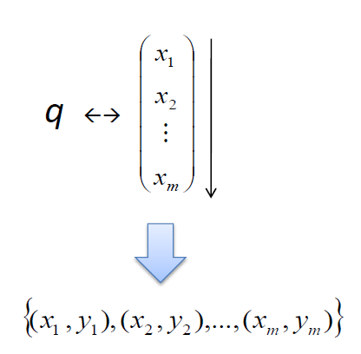
The Pointwise Approach
Use existing learning methods to solve the problem of ranking
Try to predict the exact relevance degree of each document
Three subcategories:
  Regression based algorithms
  Classification based algorithms
  Ordinal regression based algorithms

Slide 10
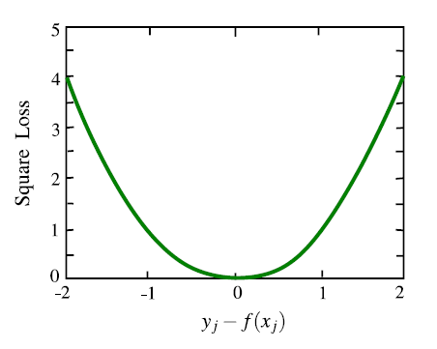

Subset Ranking with Regression
Regard relevance degree as real number, and use regression to learn the ranking function.
$$L\left(f;x_{j}, y_{j}\right)={\left(f\left(x_{j}\right)−y_{j}\right)}^{2}$$

Slide 11
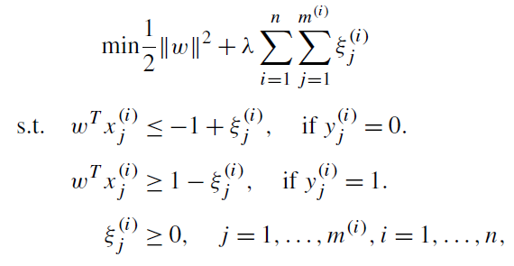


SVM-Based Method
Regards all the relevant documents (i.e., $y_{j}=+1$) as positive examples and all the irrelevant documents (i.e., $y_{j}=−1$) as negative examples
Uses SVM to perform binary classification:
Each training document is an instance of learning
Use SVM to perform binary classification on these instances, to learn model parameter w
Use w for testing

Slide 12
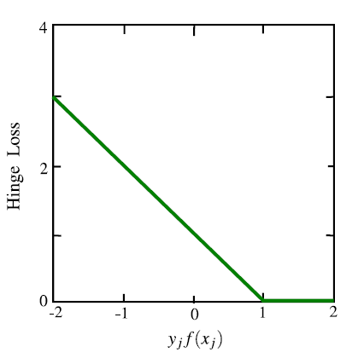

SVM-Based Method
$L\left(f;x_{j},y_{j}\right)={\left(1−y_{j}f\left(x_{j}\right)\right)}_{+}$

Slide 13
Problems with the Pointwise Approach
Properties of IR evaluation measures have not been well considered.
  The fact is ignored that some documents are associated with the same query and some are not.
    When the number of associated documents varies largely for different queries, the overall loss function will be dominated by those queries with a large number of documents.
The position of documents in the ranked list is invisible to the loss functions.
  The pointwise loss function may unconsciously emphasize too much those unimportant documents (which are ranked low in the final results).

Slide 14
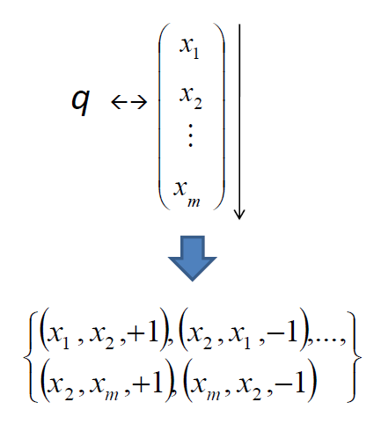
The Pairwise Approach
Cares about the relative order between two documents
The ranking problem is reduced to classification on document pairs
Goal: minimize the number of miss-classified document pairs

Slide 15
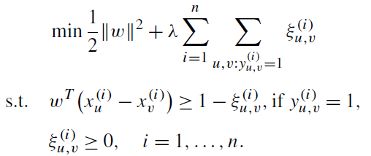

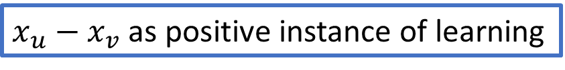

Ranking SVM
Applies the SVM technology to perform pairwise classification
Given $n$ training queries ${\left\{q_{i}\right\}}_{i=1}^{n}$, their associated document pairs ($x_{u}^{\left(i\right)},x_{v}^{(i)}$), and the corresponding ground truth label $y_{u,v}^{(i)}$, the mathematical formulation of Ranking SVM is:
$x_{u}−x_{v}$ as positive instance of learning
Use SVM to perform binary classification on these instances, to learn model parameter w
$$f\left(x\right)=w^{T}x$$
Use w for testing

Slide 16
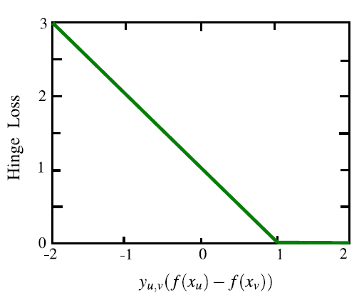

Ranking SVM
$L\left(f;x_{u},x_{v},y_{u,v}\right)={\left(1−y_{u,v}\left(f\left(x_{u}\right)−f\left(x_{v}\right)\right)\right)}_{+}$

Slide 17
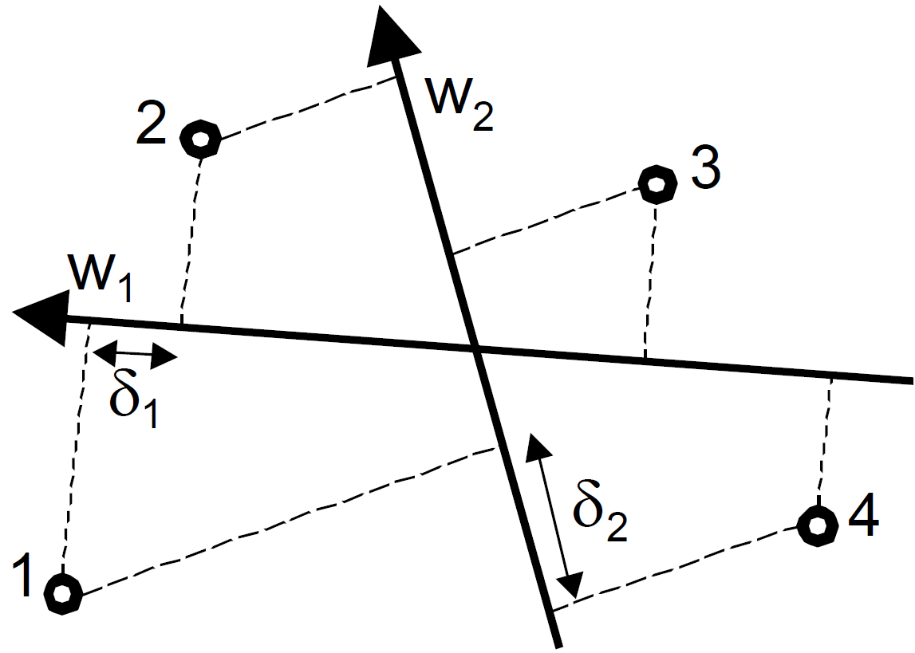



Ranking SVM
Minimizing the number of misordered pairs
$$y_{1}>y_{2}$$
$$y_{1}>y_{3}$$
$$y_{1}>y_{4}$$
$$y_{2}>y_{3}$$
$$y_{2}>y_{4}$$
$$y_{3}>y_{4}$$
$$y_{1}>y_{2}, y_{1}>y_{3}$$
2
0

Slide 18
Problems with the Pairwise Approach
When we are given the relevance judgment in terms of multiple ordered categories, converting it to pairwise preference will lead to the missing of the information about the finer granularity in the relevance judgment
The distribution of document pair number is more skewed than the distribution of document number, with respect to different queries.
The pairwise approach is more sensitive to noisy label than the pointwise approach.
Most of the pairwise ranking algorithms have not considered the position in the final ranking results.

Slide 19
The Listwise Approach
Measure-specific loss
  Optimize the IR evaluation measures directly
Non measure-specific loss
  Optimize a loss function defined on all documents associated with a query, according to the unique properties of ranking

Slide 20
Measure-specific Listwise Ranking
Also known as “Direct Optimization of IR Measures”.
It is natural to directly optimize what is used to evaluate the ranking results.
However, it is non-trivial.
  Evaluation measures such as NDCG are non-continuous and non-differentiable since they depend on the rank positions.
  It is challenging to optimize such objective functions, since most optimization techniques in the literature were developed to handle continuous and differentiable cases.

Slide 21
Tackle the Challenges
Approximate the objective
  Soften (approximate) the evaluation measure so as to make it smooth and differentiable (SoftRank)
Bound the objective
  Optimize a smooth and differentiable upper bound of the evaluation measure (SVM-MAP)
Optimize the non-smooth objective directly
  Use IR measure to update the distribution in Boosting (AdaRank)
  Use genetic programming (RankGP)

Slide 22
Non Measure-specific Listwise Ranking
Defining listwise loss functions based on the understanding on the unique properties of ranking for IR.
Representative Algorithms
  ListNet
  ListMLE
  BoltzRank

Slide 23
Discussions
Advantages
  Take all the documents associated with the same query as the learning instance
  Rank position is visible to the loss function
Problems
  Complexity issue.
  The use of the position information is insufficient.

Slide 24
Benchmark Datasets
 | Queries | Doc. | Rel. | Feat. | Year
Letor 3.0 – Gov | 575 | 568 k | 2 | 64 | 2008
Letor 3.0 – Ohsume | 106 | 16 k | 3 | 45 | 2008
Letor 4.0 | 2,476 | 85 k | 3 | 46 | 2009
Yandex | 20,267 | 213 k | 5 | 245 | 2009
Yahoo! | 36,251 | 883 k | 5 | 700 | 2010
Microsoft | 31,531 | 3,771 k | 5 | 136 | 2010

Slide 25
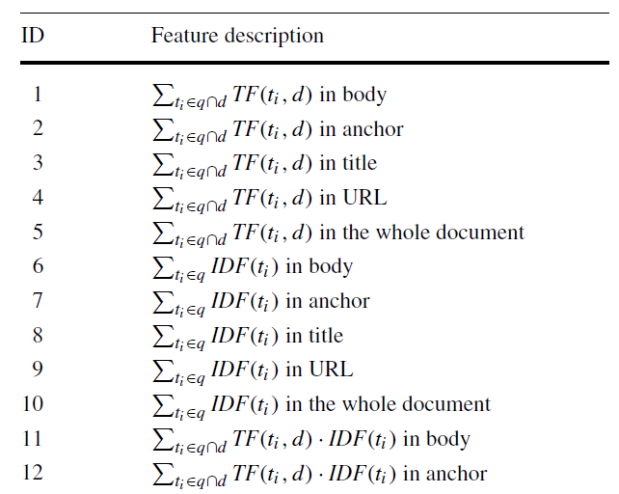
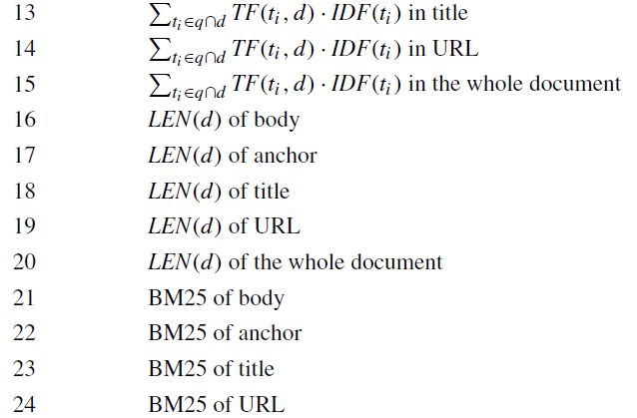
GOV Features

Slide 26
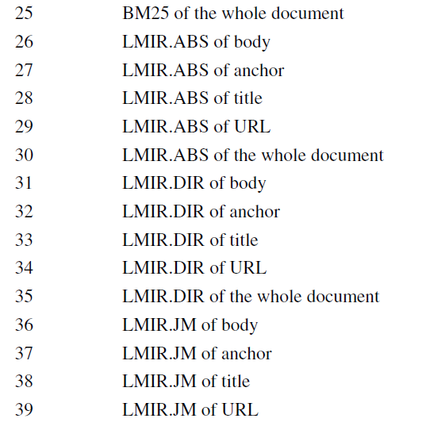
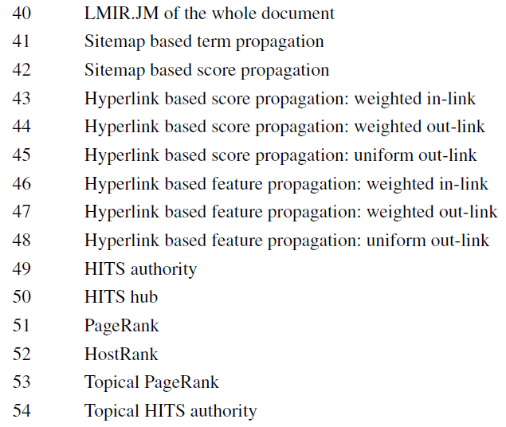
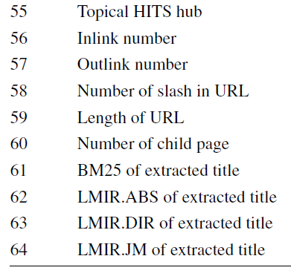
GOV Features

Slide 27
LTR Libraries
RankLib (Java) – from Lemur project (UMASS, CMU)
  Coordinate Ascent, Random Forest (pointwise), MART, RankNet, RankBoost (pairwise), LambdaMART (pair/listwise), AdaRank and ListNet (listwise)
SVMRank (C++) – from Cornell, provides SVMRank (pairwise)
XGBoost (Python/C++) – LambdaRank (pairwise)
PyLTR (Python) – LambdaMart (pairwise)
Michael Alcorn (Python) – RankNet and LambdaMART (pairwise)

Slide 28
Applications of Learning to Rank
Web search
Collaborative filtering
Definition search
Keyphrase extraction
Query dependent summarization

Slide 29



References

Slide 30
Questions?

