Slide 1
Web Search Engines

Slide 2
Web Search: Challenges & Opportunities
Challenges
Scalability
How to handle the size of the Web and ensure completeness of coverage?
How to serve many user queries quickly?
Low quality information and spams
Dynamics of the Web
New pages are constantly created and some pages may be updated very quickly
Opportunities
Many additional heuristics (e.g., links) can be leveraged to improve search accuracy
→ Parallel indexing & searching (MapReduce)
→ Spam detection & robust ranking
→ Link analysis & multi-feature ranking

Slide 3
Ranking Algorithms for Web Search
Standard IR models apply but aren’t sufficient
Different information needs
Documents have additional information
Information quality varies a lot
Major extensions
Exploiting links to improve scoring
Exploiting clickthroughs for massive implicit feedback
In general, rely on machine learning to combine all kinds of features

Slide 4
“Free Text” vs. “Structured Text”
So far, we’ve assumed “free text”
Document = word sequence
Query = word sequence
Collection = a set of documents
Minimal structure …
But, we may have structures on text (e.g., title, hyperlinks)
Can we exploit the structures in retrieval?
Sometimes, structures may be more important than the text

Slide 5
Examples of Document Structures
Intra-doc structures (=relations of components)
Natural components: title, author, abstract, sections, references, …
Annotations: named entities, subtopics, markups, …
Inter-doc structures (=relations between documents)
Topic hierarchy
Hyperlinks/citations (hypertext)

Slide 6
Structured Text Collection
General question: How do we search such a collection?
A general topic
Subtopic 1
Subtopic k
...

Slide 7
Exploiting Intra-Document Structures
D
Intuitively, we want to combine all the parts, but give more weights to some parts
Think about query-likelihood model…
Title
D₁
Abstract
D₂
Body-Part1
D₃
Select D_{j} and generate a query word using D_{j}
Body-Part2
…
D_{k}
Anchor text can be treated as a “part” of a document

Slide 8
Exploiting Inter-Document Structures
Document collection has links (e.g., Web, citations of literature)
Query: text query
Results: ranked list of documents
Challenge: how to exploit links to improve ranking?

Slide 9
Exploiting Inter-Document Links
“Extra text”/summary for a doc
Description
(“anchor text”)
Links indicate the utility of a doc
Hub
What does a link tell us?
Authority

Slide 10
Anchor Text

Slide 11
The Web as a Directed Graph
Assumption 1: A hyperlink is a quality signal.
A hyperlink between pages denotes that the author perceived relevance.
Assumption 2: The anchor text describes the target page.
We use anchor text somewhat loosely here: the text surrounding the hyperlink. E.g., “You can find cheap cars <a href=http://...>here</a>.”
Page d1
hyperlink
Page d2
Anchor Text

Slide 12
[Document Text Only] vs. [Document Text + Anchor Text]
Searching on [document text + anchor text] is often more effective than searching on [document text only].
Example: Query IBM
Matches IBM’s copyright page
Matches many spam pages
Matches IBM wikipedia article
May not match IBM home page! (if IBM homepage is mostly graphical)
Searching on anchor text is better for the query IBM.
Represent each page by all the anchor text pointing to it.
In this representation, the page with the most occurrences of IBM is www.ibm.com.
www.nytimes.com:
“IBM acquires Webify”
www.slashdot.org:
“New IBM optical chip”
www.stanford.edu:
“IBM faculty award recipients”
www.ibm.com

Slide 13
PageRank

Slide 14
PageRank: Capturing Page “Popularity” [Page & Brin 98]
Intuitions
Links are like citations in literature
A page that is cited often can be expected to be more useful in general
PageRank is essentially “citation counting”, but improves over simple counting
Consider “indirect citations” (being cited by a highly cited paper counts a lot…)
Smoothing of citations (every page is assumed to have a non-zero citation count)
PageRank can also be interpreted as random surfing (thus capturing popularity)

Slide 15
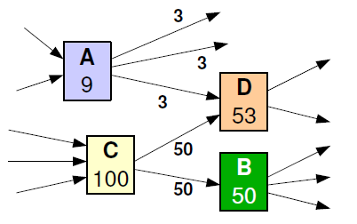
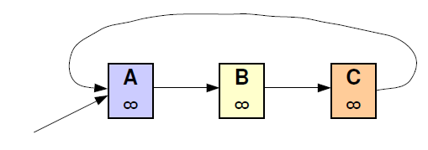
PageRank – An Intuitive Description
A page has a high rank if the sum of the ranks of its backlinks is high.
Rank of each page is divided among its forward links evenly to contribute to ranks of the pages it points to.
Problem: If some pages point to each other, but no other pages, during iterations, the loop will accumulate rank and will never distribute any rank.
The loop forms a trap which is called a rank sink. To overcome the problem, rank source is introduced.
If a real Web surfer gets into a small loop of pages, it is unlikely that it will continue in the loop forever and jumps to some other page.

Slide 16
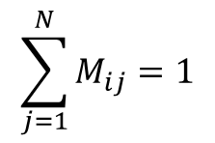
The PageRank Algorithm [Page et al. 98]
Random surfing model: At any page,
With prob. α, randomly jumping to a page
With prob. (1-α), randomly picking a link to follow.
p(di): PageRank score of di = average probability of visiting page di
d₁
“Transition matrix”
Mij = probability of going from di to dj
d₃
d₂
d₄
Probability of visiting page dj at time t+1
Probability of visiting page di at time t
Equilibrium Equation:
N= # pages
Reach dj via following a link
Reach dj via random jumping
Dropping the time index
I_{ij} = 1/N

Slide 17
PageRank: Example
d₁
d₃
d₂
d₄
Initial value p(d)=1/N,
iterate until converge

Slide 18
PageRank in Practice
Computation can be quite efficient since M is usually sparse
Interpretation of the damping factor α (≈0.15):
Probability of a random jump
Smoothing the transition matrix (avoid zero’s)
The zero-outlink problem: p(di)’s don’t sum to 1
One possible solution = page-specific damping factor (α=1.0 for a page with no outlink)
Many extensions (e.g. Topic Sensitive PageRank)
Many other applications (e.g., social network analysis)

Slide 19
PageRank Issues
Real surfers are not random surfers
Simple PageRank ranking produces bad results for many pages.
Consider the query video service
The Yahoo home page (i) has a very high PageRank and (ii) contains both words.
If we rank all Boolean hits according to PageRank, then the Yahoo home page would be top-ranked.
Clearly not desirable
In practice: rank according to weighted combination of many factors, including raw text match, anchor text match, PageRank and many other factors

Slide 20
What Google Says About PageRank
Through the years…
2020: “Yes, we do use PageRank internally, among many, many other signals. It’s not quite the same as the original paper, there are lots of quirks (e.g., disavowed links, ignored links, etc.), and, again, we use a lot of other signals that can be much stronger [John Mueller, Google]
2017: “DYK that after 18 years we’re still using PageRank (and 100s of other signals) in our ranking? [Gary Illyes, Google]
2011: “We use more than 200 signals, including our patented PageRank algorithm, to examine the entire link structure of the web and determine which pages are most important. We then conduct hypertext-matching analysis to determine which pages are relevant to the specific search being conducted” [http://www.google.com/technology]
2007: “The heart of our software is PageRank, a system for ranking web pages developed by our founders… And while we have dozens of engineers working to improve every aspect of Google on daily basis, PageRank continues to play a central role in many of our web search tools.”
2002: “… PageRank continues to provide the basis for all our web search tools.”

Slide 21
HITS

Slide 22
HITS: Capturing Authorities & Hubs [Kleinberg 98]
Intuitions
Pages that are widely cited are good authorities
Pages that cite many other pages are good hubs
The key idea of HITS (Hypertext-Induced Topic Search)
Good authorities are cited by good hubs
Good hubs point to good authorities
Iterative reinforcement…
Many applications in graph/network analysis

Slide 23
Root Set and Base Set
Good authority pages may not contain the query term.
If the text query manages to capture a good hub page in the root set, then the inclusion of pages linked to by this page will capture good authorities linked to by this page.
If the text query manages to capture a good authority page in the root set, then inclusion of pages linking to this page will capture good hubs.
Base Set
Root Set

Slide 24
Hub and Authority Scores
Compute for each page d in the base set a hub score h(d) and an authority score a(d)
Initialization: for all d: h(d) = 1, a(d) = 1
Iteratively update all h(d), a(d)
For all d: h(d) = ∑_{d → y} a(y)
For all d: a(d) = ∑_{y → d} h(y)
Iterate these two steps until convergence
y₁
y₁
d
y₂
y₂
d
y₃
y₃

Slide 25
The HITS Algorithm [Kleinberg 98]
d₁
“Adjacency matrix”
d₃
Initial values: a(d_{i})=h(d_{i})=1
d₂
d₄
Iterate
Normalize:

Slide 26
PageRank vs. HITS: Discussion
PageRank can be precomputed, HITS has to be computed at query time.
HITS is too expensive in most application scenarios.
The PageRank and HITS make two different design choices concerning (i) the eigen problem formalization (ii) the set of pages to apply the formalization to.
These two are orthogonal.
We could also apply HITS to the entire web and PageRank to a small base set.

Slide 27
PageRank Extension: Topic-Sensitive PageRank

Slide 28
Topic Sensitive PageRank
Computes a set of PageRank vectors biased upon a set of representative topics to yield more accurate search results.
Goals:
Allow query to influence link-based score
(Like HITS)
Requires Minimal query-time processing
(Like PageRank)

Slide 29
PageRank – A Review

Slide 30
Topic-Sensitive PageRank
Assigns multiple a-priori “importance” estimates to pages
One PageRank score per basis topic
Query specific rank score
Inexpensive at run-time

Slide 31
Topic-Sensitive PageRank

Slide 32
Topic-Sensitive PageRank
Step 1 – ODP-Biasing
Generate set of biased PageRank vectors using a set of basis topics
Create 16 different biased PageRank vectors
Performed offline, during preprocessing of crawled data
URLs in various categories in Open Directory Project (ODP)

Slide 33
Topic-Sensitive PageRank
For each category c_{j} , compute:
With T_{j} the set of URL for the ODP category c_{j}
will be PageRank vector for c_{j}
Also compute the 16 class term vectors
D_{jt} gives the number of occurrences of t in documents of class c_{j}

Slide 34
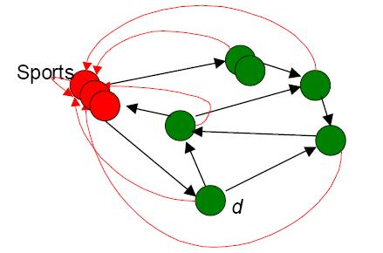
Graphical depiction of part I
Select set of pages on a topic, calculate PageRank for all pages.
For example r_{sports}[d] = 0.05

Slide 35
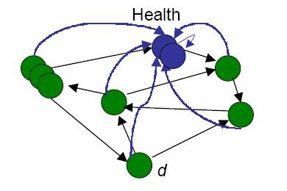
Graphical depiction of part I
Select set of pages on a topic, calculate PageRank for all pages.
For example r_{health}[d] = 0.01

Slide 36
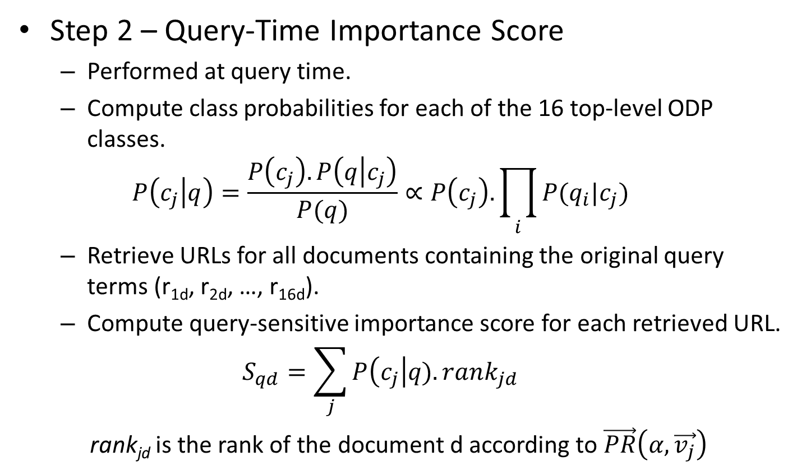
Topic-Sensitive PageRank
Step 2 – Query-Time Importance Score
Performed at query time.
Compute class probabilities for each of the 16 top-level ODP classes.
$$P\left(c_{j} | q\right)=\frac{P\left(c_{j}\right).P\left(q | c_{j}\right)}{P(q)}∝P\left(c_{j}\right).\prod_{i}{P(q_{i}|c_{j})}$$
Retrieve URLs for all documents containing the original query terms (r_{1d}, r_{2d}, …, r_{16d}).
Compute query-sensitive importance score for each retrieved URL.
$$S_{qd}=\sum_{j}{P\left(c_{j}\right|q).rank_{jd}}$$
rank_{jd} is the rank of the document d according to $\vec{PR}\left(α,\vec{v_{j}}\right)$

Slide 37
HITS Extension: Topic distillation

Slide 38
Topic Distillation
HITS problems:
Mutually Reinforcing Relationships Between Hosts
certain arrangements of documents “conspire” to dominate the computation
Automatically Generated Links
no human opinion is expressed by the link
Non-relevant Nodes
the graph contains documents not relevant to the query topic

Slide 39
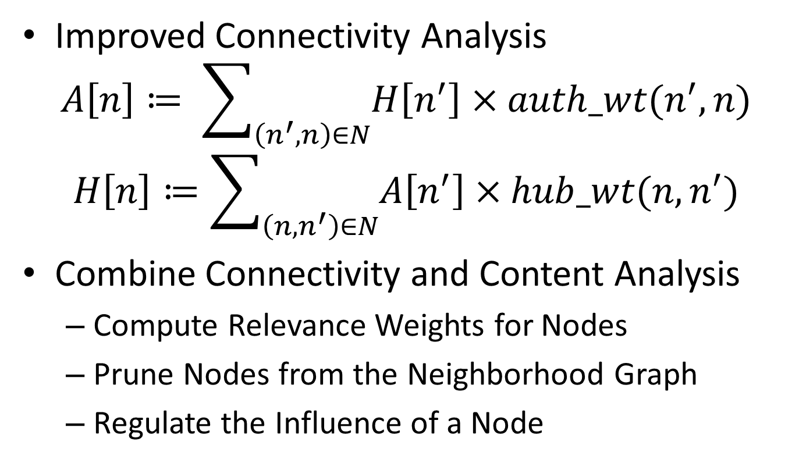
Topic Distillation – Proposed Solution
Improved Connectivity Analysis
$$A\left[n\right]≔ \sum_{\left(n^{′},n\right)∈N}{H\left[n^{′}\right]×auth_wt(n^{′},n)}$$
$$H\left[n\right]≔\sum_{\left(n, n^{′}\right)∈N}{A\left[n^{′}\right]×hub_wt(n, n^{′})}$$
Combine Connectivity and Content Analysis
Compute Relevance Weights for Nodes
Prune Nodes from the Neighborhood Graph
Regulate the Influence of a Node

Slide 40
Combining Ideas from PageRank and HITS: SALSA - Stochastic Approach for Link-Structure Analysis

Slide 41
SALSA – Walk on a Bipartite Graph
An alternative algorithm, that combines ideas from both PageRank and HITS, was proposed in 2001 by Lempel and Moran.
The SALSA algorithm splits the set of nodes into a bipartite graph, and then performs a random walk alternating between the hub and authority sides.

Slide 42
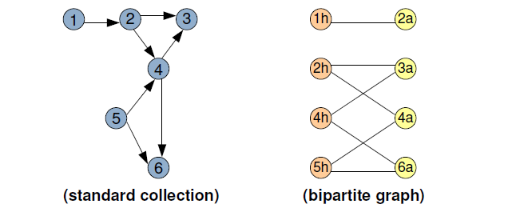
SALSA – Construction of the Graph
Each non-isolated page is represented in the bipartite graph with one or two nodes.
The authority walk starts from an authority node selected at random and then proceeds alternating backwards and forwards steps.

Slide 43
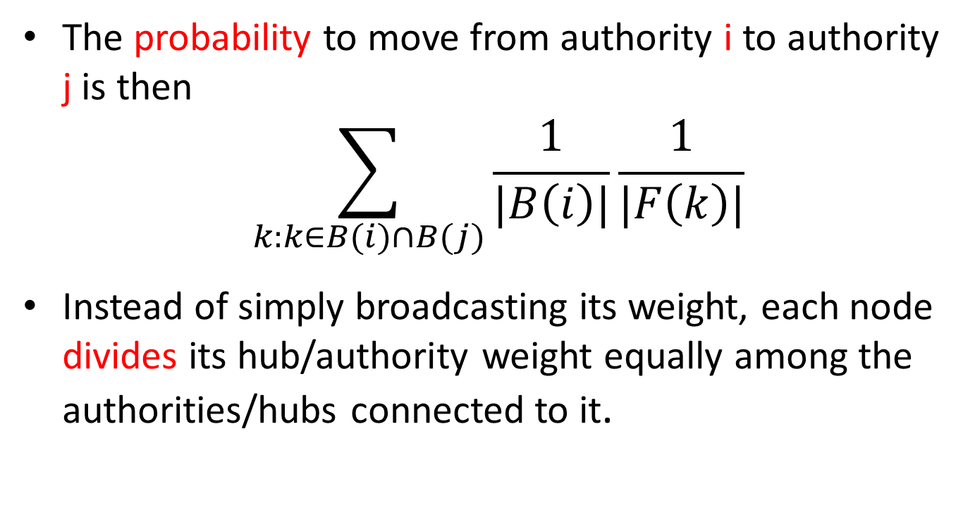
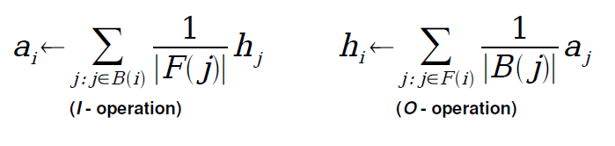
SALSA – A Variation of HITS

Slide 44
Web Spamming

Slide 45
Defining web spam
Working Definition
Spam web page: A page created for the sole purpose of attracting search engine referrals (to this page or some other “target” page)
Ultimately a judgment call
Some web pages are borderline useless
Sometimes a page might look fine by itself, but in context it clearly is “spam”

Slide 46
Why web spam is bad
Bad for users
Makes it harder to satisfy information need
Leads to frustrating search experience
Bad for search engines
Burns crawling bandwidth
Pollutes corpus (infinite number of spam pages!)
Distorts ranking of results

Slide 47
Taxonomy of web spam techniques
“Keyword stuffing”
“Cloaking”
“Link spam”

Slide 48
Link Spam
Since link analysis has played an important role in search engines, it has large commercial values
Improving one’s PageRank, can directly increase one’s clicks thus earn more money.
Link Spam is something trying to unfairly gain a high ranking on a search engine for a web page without improving the user experience, by mean of tricky modification / manipulation of the link graph.

Slide 49
Link Spamming Technologies
Adding outlinks
Replicate hub pages
Adding inlinks
Create a honey pot
Infiltrate a web directory
Post links on blog, wiki, etc
Participate in-link exchange
Buy expired domains
Create own spam farm (Clique Attack)

Slide 50
Anti-Spam: TrustRank
Basic assumption
Good pages seldom point to spam pages, but spam pages may very likely point to good pages.
Use TrustRank to denote the goodness of a webpage, and use Trust Propagation to label all the web pages starting from a small human-labeled seed set.
Good Pages
Spam Pages

Slide 51
TrustRank – Computing Trust
Initialization
Propagation
M-Step Trust Function

Slide 52
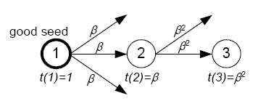
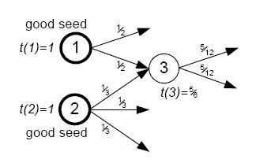
TrustRank – Trust Attenuation
Trust Dampening
Trust Splitting

Slide 53
TrustRank - Algorithm
s = SelectSeed(…) //evaluate seed desirability of pages
σ = Rank({1, …, N}, s) // select good seeds
d = 0_{N}
for i = 1 to L do
if (O(σ(i)) == 1) then
d(σ(i)) = 1
d = d / |d| // normalize static score distribution vector
t* = d // compute TrustRank scores
for i = 1 to M_{B} do
t* = α_{B}.T.t* + (1 - α_{B}).d
return t*

Slide 54
TrustRank – Selecting Seeds
Inverse PageRank
Hub pages, since they have more influence
High PageRank
Important pages are more important to search applications

Slide 55
TrustRank - Example
1
2
3
Select seed
4
S = [0.08,0.13,0.08,0.10,0.09,0.06,0.02]
7
5
6
Order = [2,4,5,1,3,6,7]
Assume L = 3
selected seed set = {2,4,5}
d = [0,1/2,0,1/2,0,0,0]
Assume α_{B}=0.85 and
M_{B} = 20
T*=[0,0.18,0.12,0.15,0.13,0.05,0.05]
Experiment results show that in spite
of errors like these, on a real web graph
the algorithm is able to correctly identify
a significant number of good pages
2
4
5
3
6
7
1
Ordered by trust score

Slide 56
Questions?

