Slide 1
Search Engine Technologies

Slide 2
Basic Search Engine Technologies
User
…
Browser
Web
Query
Host Info.
Results
Efficiency!!!
Retriever
Precision
Crawler
Coverage
Freshness
----
----
…
----
----
…
----
----
…
----
----
Indexer
Cached
pages
Error/spam handling
(Inverted) Index

Slide 3
Component I: Crawler/Spider/Robot
Building a “toy crawler” is easy
Start with a set of “seed pages” in a priority queue
Fetch pages from the web
Parse fetched pages for hyperlinks; add them to the queue
Follow the hyperlinks in the queue
A real crawler is much more complicated…
Robustness
Politeness
Distributed
Scalable
Performance and efficiency
Quality
Freshness
Extensible

Slide 4
Major Crawling Strategies
Breadth-First is common (balance server load)
Parallel crawling is natural
Variation: Focused crawling
Targeting at a subset of pages (e.g., all pages about “automobiles”)
Typically given a query
How to find new pages (they may not be linked to an old page!)
Incremental/repeated crawling
Need to minimize resource overhead
Can learn from the past experience (updated daily vs. monthly)
Target at: 1) frequently updated pages; 2) frequently accessed pages

Slide 5
Component II: Indexer
Standard IR techniques are the basis, but insufficient
Scalability
Efficiency
Google’s contributions:
Google file system (GFS): distributed file system
MapReduce: Software framework for parallel computation
Hadoop: Open source implementation of MapReduce

Slide 6
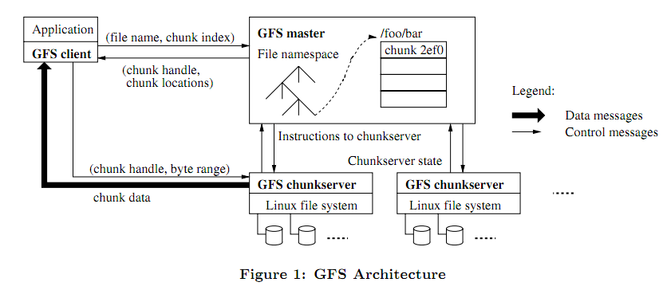
GFS Architecture
Simple centralized management
Fixed chunk size (64MB)
Chunk is replicated
to ensure reliability
Data transfer is directly between application and chunk servers
http://static.googleusercontent.com/media/research.google.com/en//archive/gfs-sosp2003.pdf

Slide 7
MapReduce: A Framework for Parallel Programming
Minimize effort of programmer for simple parallel processing tasks
Features
Hide many low-level details (network, storage)
Built-in fault tolerance
Automatic load balancing

Slide 8
MapReduce Flow
Split Input into Key-Value pairs.
Input
=
Key, Value
Key, Value
…
Map
Map
Map
For each K-V pair call Map.
Key, Value
Key, Value
Key, Value
Each Map produces new set of K-V pairs.
Key, Value
Key, Value
Key, Value
…
…
…
For each distinct key, call reduce. Produces one K-V pair for each distinct key.
Sort
Reduce(K, V[ ])
Output as a set of Key Value Pairs.
Output
=
Key, Value
Key, Value
…
Notes:
8

Slide 9
MapReduce WordCount Example
Input:
File containing words
Output:
Number of occurrences
of each word
Hello World Bye World
Hello Hadoop Bye Hadoop
Bye Hadoop Hello Hadoop
MapReduce
Bye 3
Hadoop 4
Hello 3
World 2
How can we do this within the MapReduce framework?
Basic idea: parallelize on lines in input file!
Notes:
9

Slide 10
MapReduce WordCount Example
Map Output
<Hello,1>
<World,1>
<Bye,1>
<World,1>
<Hello,1>
<Hadoop,1>
<Bye,1>
<Hadoop,1>
<Bye,1>
<Hadoop,1>
<Hello,1>
<Hadoop,1>
Input
1, “Hello World Bye World”
2, “Hello Hadoop Bye Hadoop”
3, “Bye Hadoop Hello Hadoop”
Map
Map(K, V) {
For each word w in V
Collect(w, 1);
}
Map
Map
Notes:
10

Slide 11
MapReduce WordCount Example
Reduce(K, V[ ]) {
Int count = 0;
For each v in V
count += v;
Collect(K, count);
}
Map Output
<Hello,1>
<World,1>
<Bye,1>
<World,1>
<Hello,1>
<Hadoop,1>
<Bye,1>
<Hadoop,1>
<Bye,1>
<Hadoop,1>
<Hello,1>
<Hadoop,1>
Internal Grouping
<Bye → 1, 1, 1>
<Hadoop → 1, 1, 1, 1>
<Hello → 1, 1, 1>
<World → 1, 1>
Reduce
Reduce
Reduce Output
<Bye, 3>
<Hadoop, 4>
<Hello, 3>
<World, 2>
Reduce
Reduce
Notes:
11

Slide 12
Inverted Indexing with MapReduce
D1: java resource java class
D2: java travel resource D3: …
Key Value
java (D1, 2)
resource (D1, 1)
class (D1,1)
Key Value
java (D2, 1)
travel (D2,1)
resource (D2,1)
Map
Built-In Shuffle and Sort: aggregate values by keys
Key Value
java {(D1, 2), (D2, 1)}
resource {(D1, 1), (D2,1)}
class {(D1, 1)}
travel {(D2, 1)}
…
Reduce
Slide adapted from Jimmy Lin’s presentation

Slide 13
Component III: Retriever
Standard IR models apply but aren’t sufficient
Different information need (home page finding vs. topic-driven)
Documents have additional information (hyperlinks, markups, URL)
Information is often redundant and the quality varies a lot
Server-side feedback is often not feasible
Major extensions
Exploiting links (anchor text, link-based scoring)
Exploiting layout/markups (font, title field, etc.)
Spelling correction
Spam filtering
Redundancy elimination
In general, rely on machine learning to combine all kinds of features

Slide 14
Effective Web Retrieval Heuristics
High accuracy in home page finding can be achieved by
Matching query with the title
Matching query with the anchor text
Plus URL-based or link-based scoring (e.g. PageRank)
Imposing a conjunctive (“and”) interpretation of the query is often appropriate
Queries are generally very short (all words are necessary)
The size of the Web makes it likely that at least a page would match all the query words
Combine multiple features using machine learning

Slide 15
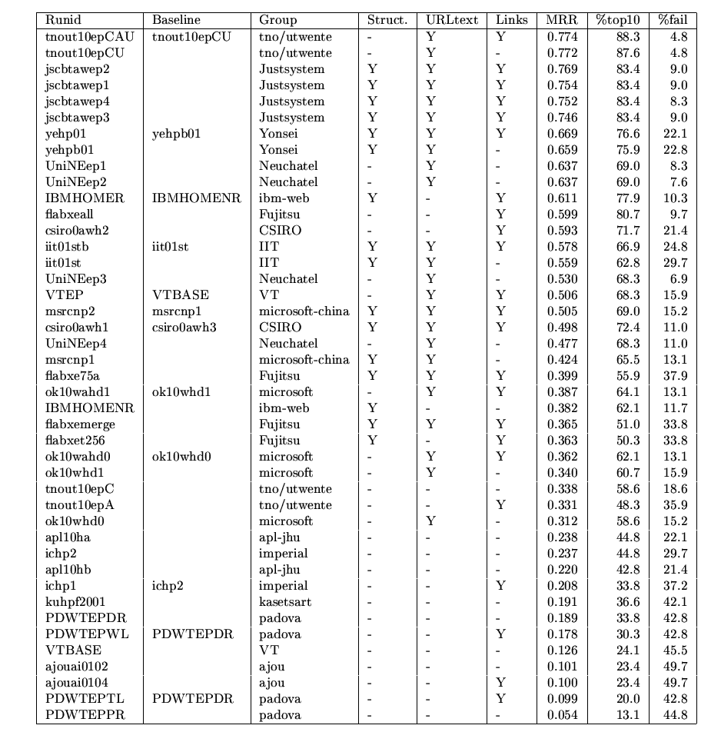
Home/Entry Page Finding Evaluation Results (TREC 2001)
MRR %top10 %fail
0.774 88.3 4.8
0.772 87.6 4.8
Unigram Query Likelihood
+ Link/URL prior
i.e., p(Q|D) p(D)
[Kraaij et al. SIGIR 2002]
Exploiting anchor text
or links or both
0.382 62.1 11.7
0.338 58.6 18.6
Query example:
Haas Business School

Slide 16
How can we Combine Many Features? (Learning to Rank)
General idea:
Given a query-doc pair (Q,D), define various kinds of features Xi(Q,D)
Examples of features: the number of overlapping terms, BM25 score of Q and D, p(Q|D), PageRank of D, p(Q|Di), where Di may be anchor text or big font text, “does the URL contain ‘~’?”…
Hypothesize p(R=1|Q,D)=s(X1(Q,D),…,Xn(Q,D), λ) where λ is a set of parameters
Learn λ by fitting function s with training data (i.e., 3-tuples like (D, Q, 1) (D is relevant to Q) or (D, Q, 0) (D is non-relevant to Q))

Slide 17
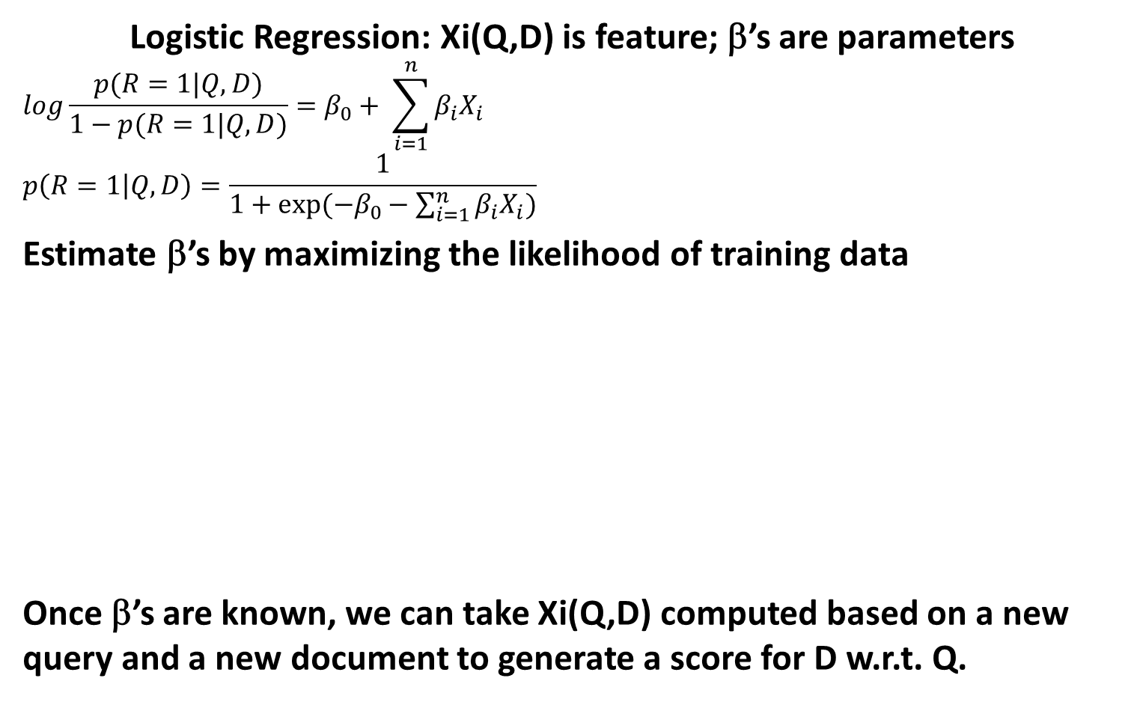
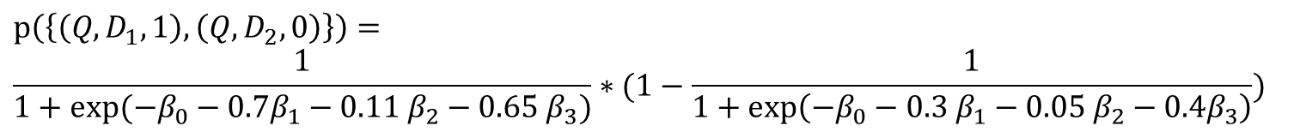
Regression-Based Approaches
Logistic Regression: Xi(Q,D) is feature; β’s are parameters
$$log\frac{p(R=1|Q,D)}{1−p(R=1|Q,D)}=β_{0}+ \sum_{i=1}^{n}{β_{i}X_{i}}$$
$$p\left(R=1 | Q,D\right)=\frac{1}{1+exp⁡(−β_{0}−\sum_{i=1}^{n}{β_{i}X_{i})}}$$
Estimate β’s by maximizing the likelihood of training data
Once β’s are known, we can take Xi(Q,D) computed based on a new query and a new document to generate a score for D w.r.t. Q.
 | X1(Q,D) | X2(Q,D) | X3(Q,D)
 | BM25 | PageRank | BM25Anchor
D1 (R = 1) | 0.7 | 0.11 | 0.65
D2 (R = 0) | 0.3 | 0.05 | 0.4
$$p\left(\left\{\left(Q, D_{1}, 1\right), \left(Q, D_{2},0\right)\right\}\right)=$$
$$\frac{1}{1+exp⁡(−β_{0}−0.7β_{1}−0.11 β_{2}−0.65 β_{3})}∗(1−\frac{1}{1+\exp\left(−β_{0}−0.3 β_{1}−0.05 β_{2}−0.4β_{3}\right)})$$
$$\vec{β^{∗}}=\arg{\max_{\vec{β}}{p(\left\{\left(Q_{1}, D_{11}, R_{11}\right), \left(Q_{1}, D_{12},R_{12}\right), …, \left(Q_{m}, D_{m1},R_{m1}\right), …\right\})}}$$

Slide 18
More Advanced Learning Algorithms
Attempt to directly optimize a retrieval measure (e.g. MAP, nDCG)
More difficult as an optimization problem
Many solutions were proposed [Liu 09]
Can be applied to many other ranking problems beyond search
Recommender systems
Computational advertising
Summarization

Slide 19
Machine Learning in Text Retrieval
Machine learning has been applied to text retrieval since many decades ago
Recent use of machine learning is driven by
Large-scale training data available
Need for combining many features
Need for robust ranking (again spams)
Modern Web search engines all use some kind of ML technique to combine many features to optimize ranking
Learning to rank is still an active research topic

Slide 20
Questions?

