Slide 1
Clustering

Slide 2
Overview
What is text clustering?
Why text clustering?
How to do text clustering?
How to evaluate clustering results?

Slide 3
The Clustering Problem
Discover “natural structure”
Group similar objects together
Objects can be documents, terms, passages, websites, …
Example
Not well defined! What does similar mean?

Slide 4
The “Clustering Bias”
Any two objects can be similar, depending on how you look at them!
Are “car” and “horse” similar?
A user must define the perspective (i.e., a bias) for assessing similarity!

Slide 5
Examples of Text Clustering
Clustering of documents in the whole collection
Term clustering to define “concept” or “theme”
Clustering of passages/sentences or any selected text segments from larger text objects
Clustering of websites (text objects has multiple documents)
Text clusters can be further clustered to generate a hierarchy

Slide 6
Why Text Clustering?
In general, very useful for text mining and exploratory text analysis
Get a sense about the overall content of a collection (e.g., what are some of the “typical”/representative documents in a collection?)
Link (similar) text objects (e.g., removing duplicated content)
Create a structure on the text data (e.g., for browsing)
As a way to induce additional features (i.e., clusters) for classification of text objects
Examples of applications:
Clustering of search results
Understanding major complaints in emails from customers

Slide 7
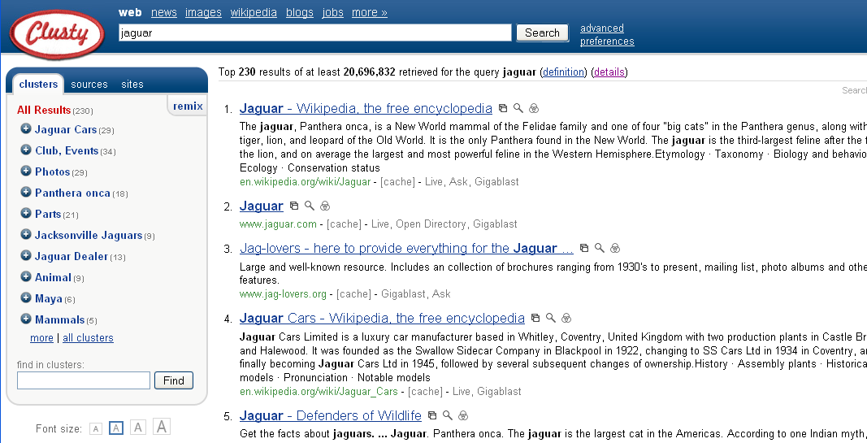
Clustering search results

Slide 8
Overview
What is text clustering?
Why text clustering?
How to do text clustering?
How to evaluate clustering results?

Slide 9
Similarity-based Clustering: General Idea
Explicitly define a similarity function to measure similarity between two text objects (i.e., providing “clustering bias”)
Find an optimal partitioning of data to
maximize intra-cluster similarity
minimize inter-cluster similarity
Two strategies of obtaining optimal clustering
Progressively construct a hierarchy of clusters (hierarchical clustering)
Bottom-up (agglomerative): gradually group similar objects into larger clusters
Top-down (divisive): gradually partition the data into smaller clusters
Starting with an initial tentative clustering and iteratively improve it (“flat” clustering, e.g., K-means)

Slide 10
Similarity-based Clustering Methods
Many general clustering methods are available
Two representative methods
Hierarchical Agglomerative Cluster (HAC)
k-means

Slide 11
Hierarchical Agglomerative Clustering
Given a similarity function to measure similarity between two objects
Gradually group similar objects together in a bottom-up fashion to form a hierarchy
Stop when some stopping criterion is met
Variations: different ways to compute group similarity based on individual object similarity

Slide 12
Similarity-induced Structure

Slide 13
How to Compute Group Similarity?
Three Popular Methods:
Given two groups g1 and g2,
Single-link algorithm: s(g1,g2)= similarity of the closest pair
Complete-link algorithm: s(g1,g2)= similarity of the farthest pair
Average-link algorithm: s(g1,g2)= average of similarity of all pairs

Slide 14
Three Methods Illustrated
complete-link algorithm
g1
g2
?
……
Single-link algorithm
average-link algorithm

Slide 15
Single Link Algorithm
Use maximum similarity of pairs:
Can result in “straggly” (long and thin) clusters due to chaining effect.

Slide 16
Complete Link Algorithm
Use minimum similarity of pairs:
Makes “tighter,” spherical clusters that are typically preferable.

Slide 17
Complete Link and Outliers
 | d1 | d2 | d3 | d4 | d5
d1 | 0 | 3-2ε | 4 | 5-2ε | 6-3ε
d2 | 3-2ε | 0 | 1+2ε | 2 | 3-ε
d3 | 4 | 1+2ε | 0 | 1-2ε | 2-3ε
d4 | 5-2ε | 2 | 1-2ε | 0 | 1-ε
d5 | 6-3ε | 3-ε | 2-3ε | 1-ε | 0
d1
(1+2ε)
d2
(4)
d3
(5+2ε)
d4
(6)
d5
(7-ε)

Slide 18
Average Link Algorithm
Similarity of two clusters = average similarity of all pairs within merged cluster.
Compromise between single and complete link.
Two options:
Averaged across all ordered pairs in the merged cluster
Averaged over all pairs between the two original clusters
No clear difference in efficacy

Slide 19
Comparison of the Three Methods
Single-link
“Loose” clusters
Individual decision, sensitive to outliers
Complete-link
“Tight” clusters
Individual decision, sensitive to outliers
Average-link
“In between”
Group decision, insensitive to outliers
Which one is the best?
Depends on what you need!

Slide 20
K-Means Clustering
Represent each text object as a term vector and assume a similarity function defined on two objects
Start with k randomly selected vectors and assume they are the centroids of k clusters (initial tentative clustering)
Assign every vector to a cluster whose centroid is the closest to the vector
Re-compute the centroid for each cluster based on the newly assigned vectors in the cluster
Repeat the process until the similarity-based objective function (i.e., within cluster sum of squares) converges (to a local minimum)

Slide 21
K Means Example (K=2)
Pick seeds
Assign clusters
Compute centroids
Reassign clusters
x
x
x
Compute centroids
x
x
x
Reassign clusters
Converged!

Slide 22
Termination conditions
Several possibilities, e.g.,
A fixed number of iterations
Doc partition unchanged
Centroid positions don’t change

Slide 23
Convergence of K-Means
Why should the K-means algorithm ever reach a fixed point?
Define goodness measure of cluster k as sum of squared distances from cluster centroid:
Reassignment monotonically decreases RSS since each vector is assigned to the closest centroid.
Recomputation monotonically decreases each RSS_{k}
K-means typically converges quickly

Slide 24
Seed Choice
Results can vary based on random seed selection.
Some seeds can result in poor convergence rate, or convergence to sub-optimal clusterings.
Exclude outliers from the seed set
Try out multiple starting points
Initialize with the results of another method.

Slide 25
Cluster Cardinality
Either: Number of clusters K is given.
Then partition into K clusters
K might be given because there is some external constraint.
Or: Finding the “right” number of clusters is part of the problem.
Given docs, find K for which an optimum is reached.
How to define “optimum”?
Can we use RSS or average squared distance from centroid?

Slide 26
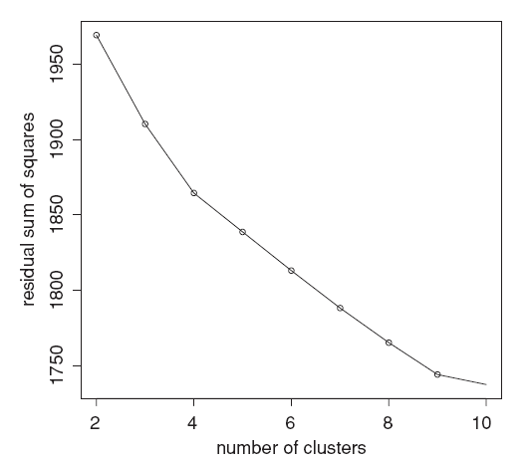
Cluster Cardinality
Pick the number of clusters where curve “flattens”. Here: 4 or 9.

Slide 27
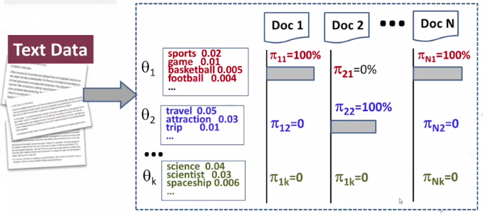


A Generative Model for Clustering
INPUT: C, k, V
OUTPUT: $\{θ_{1},…,θ_{k}\}$
$\left\{c_{1},…,c_{n}\right\} c_{i}∈[1,k]$

Slide 28
Mixture Model for Document Clustering
L
…
text 0.04
mining 0.035
association 0.03
clustering 0.005
…
the 0.000001
…
θ1
p(θ1)+p(θ2)=1
p(w|θ1)
d
p(θ1)=0.5
d=x1 x2 … xL
Topic
Choice
L
the 0.03
a 0.02
is 0.015
we 0.01
food 0.003
…
text 0.000006
θ2
p(w|θ2)
p(θ2)=0.5
d

Slide 29
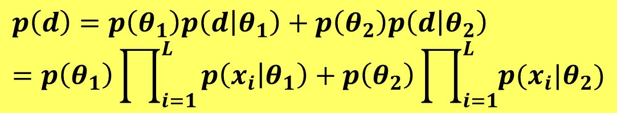
Likelihood Function: p(d)=?
$$p\left(d\right)=p\left(θ_{1}\right)p\left(d | θ_{1}\right)+p\left(θ_{2}\right)p\left(d | θ_{2}\right) =p\left(θ_{1}\right)\prod_{i=1}^{L}{p\left(x_{i} | θ_{1}\right)+p\left(θ_{2}\right)\prod_{i=1}^{L}{p(x_{i}|θ_{2})}}$$
L
…
text 0.04
mining 0.035
association 0.03
clustering 0.005
…
the 0.000001
…
θ1
p(θ1)+p(θ2)=1
p(w|θ1)
d
p(θ1)=0.5
d=x1 x2 … xL
Topic
Choice
L
the 0.03
a 0.02
is 0.015
we 0.01
food 0.003
…
text 0.000006
θ2
How can we generalize it to include k topics/clusters?
p(w|θ2)
p(θ2)=0.5
d

Slide 30
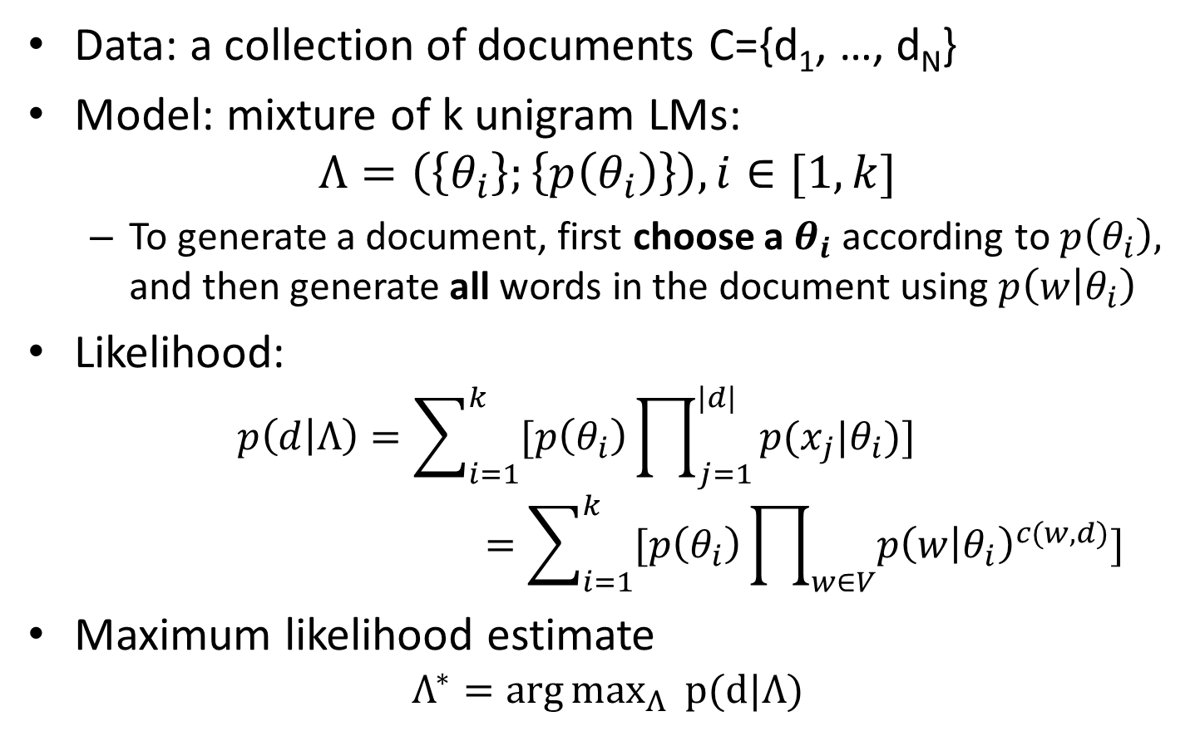
Mixture Model for Document Clustering
Data: a collection of documents C={d₁, …, d_{N}}
Model: mixture of k unigram LMs:
$$Λ=\left(\left\{θ_{i}\right\};\left\{p\left(θ_{i}\right)\right\}\right), i∈[1, k]$$
To generate a document, first choose a $θ_{i}$ according to $p\left(θ_{i}\right),$ and then generate all words in the document using $p\left(w | θ_{i}\right)$
Likelihood:
$$p\left(d | Λ\right)=\sum_{i=1}^{k}{[p\left(θ_{i}\right)\prod_{j=1}^{|d|}{p(x_{j}|θ_{i})]}}$$
$$=\sum_{i=1}^{k}{[p\left(θ_{i}\right)\prod_{w∈V}{p{\left(w | θ_{i}\right)}^{c(w,d)}}}]$$
Maximum likelihood estimate
$$Λ^{∗}={\arg{max}}_{Λ} p(d|Λ)$$

Slide 31
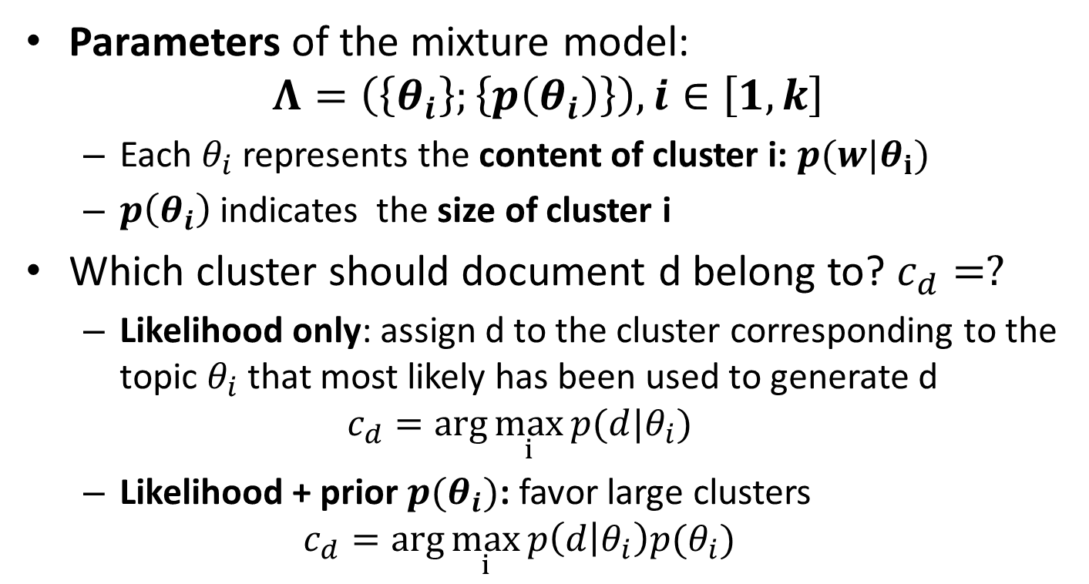
Cluster Allocation After Parameter Estimation
Parameters of the mixture model:
$$Λ=\left(\left\{θ_{i}\right\};\left\{p\left(θ_{i}\right)\right\}\right), i∈\left[1, k\right]$$
Each $θ_{i}$ represents the content of cluster i: $p(w|θ_{i})$
$p\left(θ_{i}\right)$indicates the size of cluster i
Which cluster should document d belong to? $c_{d}=?$
Likelihood only: assign d to the cluster corresponding to the topic $θ_{i}$ that most likely has been used to generate d
$$c_{d}=\arg{\max_{i}{p(d|θ_{i})}}$$
Likelihood + prior $p(θ_{i})$: favor large clusters
$$c_{d}=\arg{\max_{i}{p\left(d | θ_{i}\right)p(θ_{i})}}$$

Slide 32
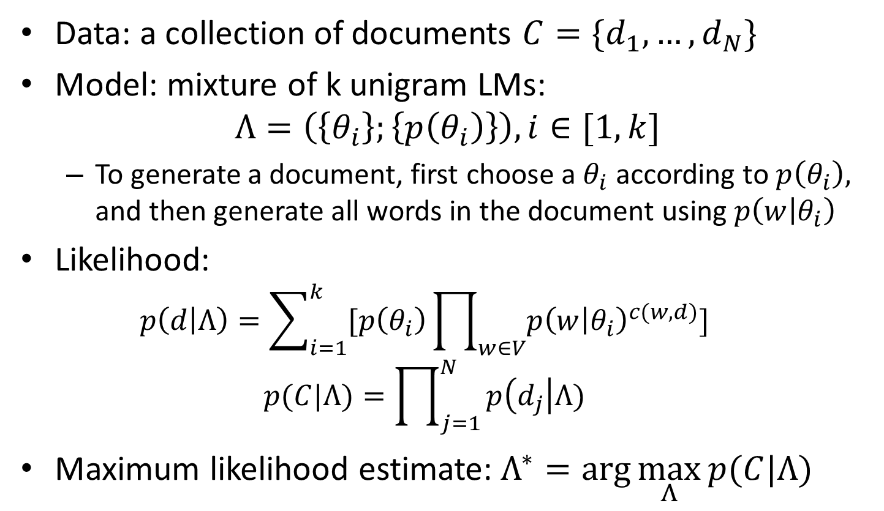
How Can We Compute the ML Estimate?
Data: a collection of documents $C=\{d_{1}, …, d_{N}\}$
Model: mixture of k unigram LMs:
$$Λ=\left(\left\{θ_{i}\right\};\left\{p\left(θ_{i}\right)\right\}\right), i∈[1, k]$$
To generate a document, first choose a $θ_{i}$ according to $p\left(θ_{i}\right),$ and then generate all words in the document using $p\left(w | θ_{i}\right)$
Likelihood:
$$p\left(d | Λ\right)=\sum_{i=1}^{k}{[p\left(θ_{i}\right)\prod_{w∈V}{p{\left(w | θ_{i}\right)}^{c(w,d)}}}]$$
$$p(C|Λ)=\prod_{j=1}^{N}{p\left(d_{j}\right|Λ)}$$
Maximum likelihood estimate:$Λ^{∗}=\arg{\max_{Λ}{p(C|Λ)}}$

Slide 33
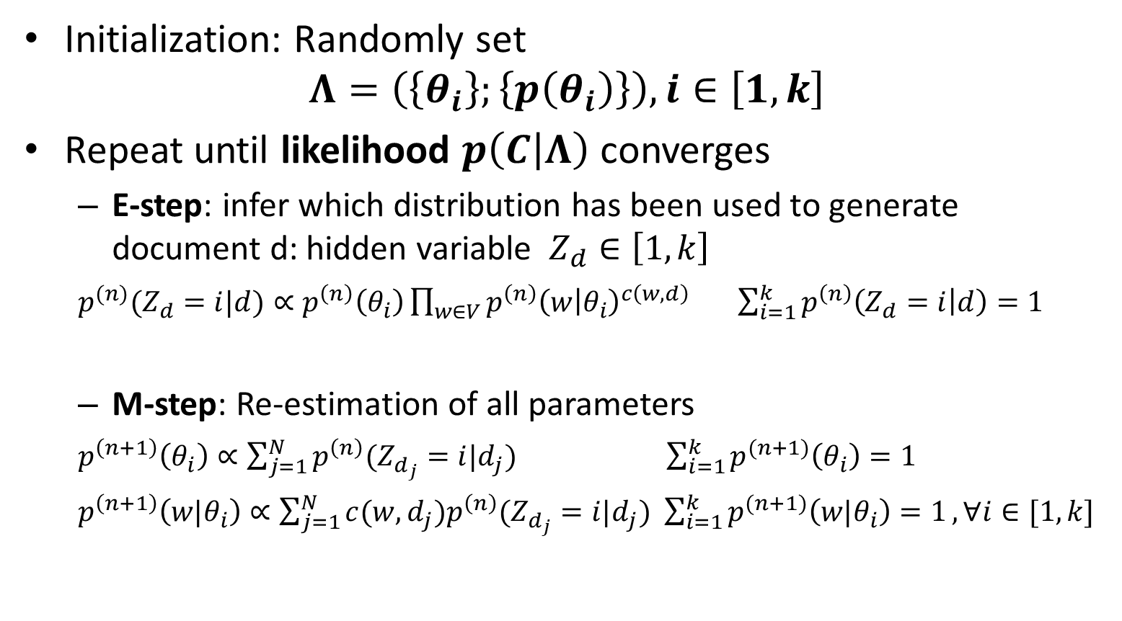
EM Algorithm for Document Clustering
Initialization: Randomly set
$$Λ=\left(\left\{θ_{i}\right\};\left\{p\left(θ_{i}\right)\right\}\right), i∈\left[1, k\right]$$
Repeat until likelihood $p\left(C | Λ\right)$ converges
E-step: infer which distribution has been used to generate document d: hidden variable $Z_{d}∈\left[1, k\right]$
$p^{(n)}(Z_{d}=i|d)∝p^{\left(n\right)}\left(θ_{i}\right)\prod_{w∈V}{p^{\left(n\right)}{\left(w | θ_{i}\right)}^{c\left(w,d\right)}}$ $\sum_{i=1}^{k}{p^{\left(n\right)}\left(Z_{d}=i | d\right)=1}$
M-step: Re-estimation of all parameters
$p^{\left(n+1\right)}\left(θ_{i}\right)∝\sum_{j=1}^{N}{p^{\left(n\right)}(Z_{d_{j}}=i|d_{j})}$ $\sum_{i=1}^{k}{p^{(n+1)}\left(θ_{i}\right)=1}$
$p^{\left(n+1\right)}\left({w|θ}_{i}\right)∝\sum_{j=1}^{N}{c(w,d_{j})p^{\left(n\right)}(Z_{d_{j}}=i|d_{j})}$ $\sum_{i=1}^{k}{p^{(n+1)}\left({w|θ}_{i}\right)=1}, ∀i∈[1,k]$

Slide 34

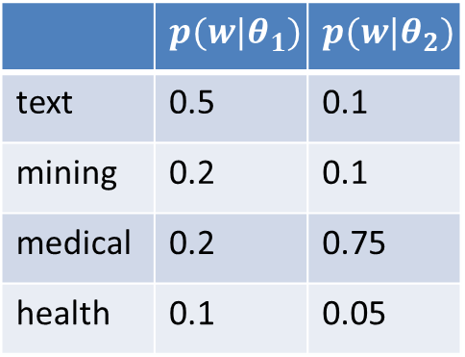
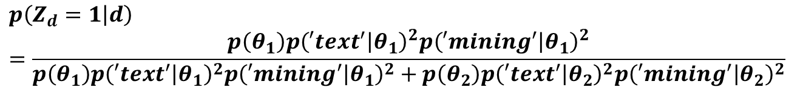



An Example of 2 Clusters
Random Initialization
E-step
Document d
 | c(w,d)
text | 2
mining | 2
medical | 0
Health | 0
$$p\left(θ_{1}\right)=\left(θ_{2}\right)=0.5$$
Hidden variables:
 | $$p(w|θ_{1})$$ | $$p(w|θ_{2})$$
text | 0.5 | 0.1
mining | 0.2 | 0.1
medical | 0.2 | 0.75
health | 0.1 | 0.05
$$Z_{d}∈\{1, 2\}$$
$$p\left(Z_{d}=1 | d\right)=\frac{p\left(θ_{1}\right)p{\left(′text^{′} | θ_{1}\right)}^{2}p{\left(′mining^{′} | θ_{1}\right)}^{2}}{p\left(θ_{1}\right)p{\left(′text^{′} | θ_{1}\right)}^{2}p{\left(′mining^{′} | θ_{1}\right)}^{2}+p\left(θ_{2}\right)p{\left(′text^{′} | θ_{2}\right)}^{2}p{\left(′mining^{′} | θ_{2}\right)}^{2}}$$
$$=\frac{0.5×0.5^{2}×0.2^{2}}{0.5×0.5^{2}×0.2^{2}+0.5×0.1^{2}×0.1^{2}}=\frac{100}{101}$$
$$p\left(Z_{d}=2 | d\right)=?$$

Slide 35
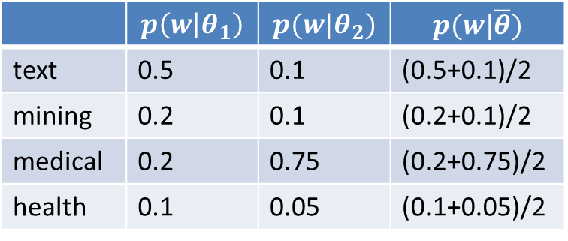
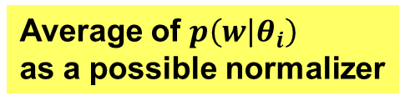
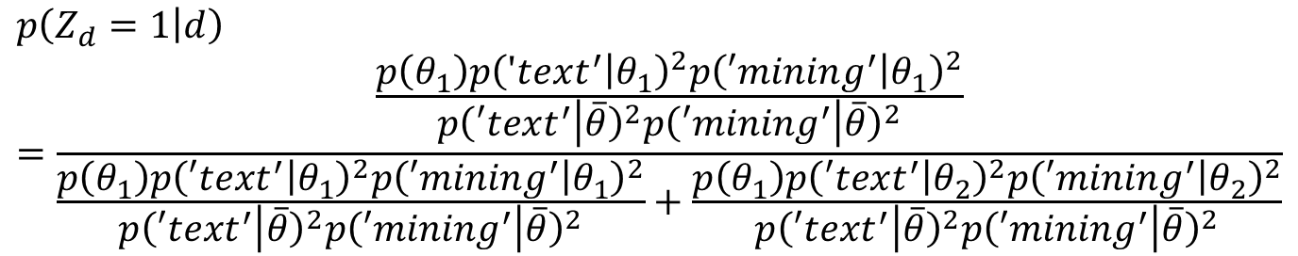
Normalization to Avoid Underflow
 | $$p\left(w | θ_{1}\right)$$ | $$p(w|θ_{2})$$ | $$p(w|\overline{θ})$$
text | 0.5 | 0.1 | (0.5+0.1)/2
mining | 0.2 | 0.1 | (0.2+0.1)/2
medical | 0.2 | 0.75 | (0.2+0.75)/2
health | 0.1 | 0.05 | (0.1+0.05)/2
Average of $p\left(w | θ_{i}\right)$
as a possible normalizer
$$p\left(Z_{d}=1 | d\right)=\frac{\frac{p\left(θ_{1}\right)p{\left(′text^{′} | θ_{1}\right)}^{2}p{\left(′mining^{′} | θ_{1}\right)}^{2}}{p{\left(′text^{′} | \overline{θ}\right)}^{2}p{\left(′{mining}^{′} | \overline{θ}\right)}^{2}}}{\frac{p\left(θ_{1}\right)p{\left(′text^{′} | θ_{1}\right)}^{2}p{\left(′mining^{′} | θ_{1}\right)}^{2}}{p{\left(′text^{′} | \overline{θ}\right)}^{2}p{\left(′{mining}^{′} | \overline{θ}\right)}^{2}}+\frac{p\left(θ_{1}\right)p{\left(′text^{′} | θ_{2}\right)}^{2}p{\left(′mining^{′} | θ_{2}\right)}^{2}}{p{\left(′text^{′} | \overline{θ}\right)}^{2}p{\left(′{mining}^{′} | \overline{θ}\right)}^{2}}}$$

Slide 36

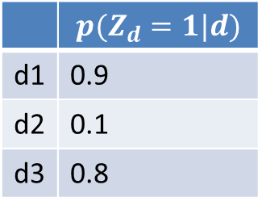
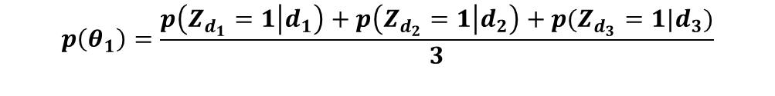
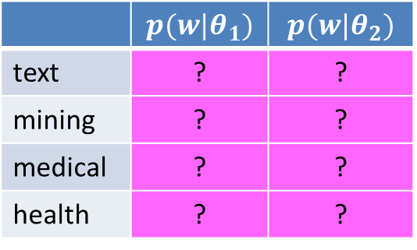

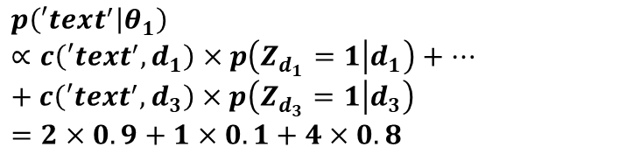
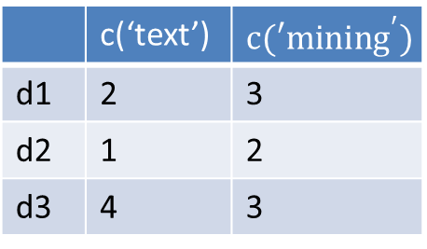
An Example of 2 Clusters (cont.)
From E-Step
M-Step
$$p\left(θ_{1}\right)=? p\left(θ_{2}\right)=?$$
 | $$p(Z_{d}=1|d)$$
d1 | 0.9
d2 | 0.1
d3 | 0.8
 | c(‘text’) | $$c(′mining^{′})$$
d1 | 2 | 3
d2 | 1 | 2
d3 | 4 | 3
 | $$p(w|θ_{1})$$ | $$p(w|θ_{2})$$
text | ? | ?
mining | ? | ?
medical | ? | ?
health | ? | ?
$$p\left(θ_{1}\right)=\frac{p\left(Z_{d_{1}}=1 | d_{1}\right)+p\left(Z_{d_{2}}=1 | d_{2}\right)+p(Z_{d_{3}}=1|d_{3})}{3}$$
$$=\frac{0.9+0.1+0.8}{3}=0.6$$
$$p\left(′text^{′} | θ_{1}\right)∝c\left(′text^{′},d_{1}\right)×p\left(Z_{d_{1}}=1 | d_{1}\right)+…+c\left(′text^{′},d_{3}\right)×p\left(Z_{d_{3}}=1 | d_{3}\right)=2×0.9+1×0.1+4×0.8$$
$$p\left(′mining′ | θ_{1}\right)∝3×0.9+2×0.1+3×0.8$$
$$p\left(′text^{′} | θ_{1}\right)+p\left(′mining^{′} | θ_{1}\right)+p\left(′medical^{′} | θ_{1}\right)+p\left(′health′ | θ_{1}\right)=1$$

Slide 37
Overview
What is text clustering?
Why text clustering?
How to do text clustering?
How to evaluate clustering results?

Slide 38
The “Clustering Bias”
Any two objects can be similar, depending on how you look at them!
Are “car” and “horse” similar?
A user must define the perspective (i.e., a bias) for assessing similarity!
Basis for evaluation

Slide 39
Direct Evaluation of Text Clusters
Question to answer: How close are the system-generated clusters to the ideal clusters (generated by humans)?
“Closeness” can be assessed from multiple perspectives
“Closeness” can be quantified
“Clustering bias” is imposed by the human assessors
Evaluation procedure:
Given a test set, have humans to create an ideal clustering results (i.e., an ideal partitioning of text objects or “gold standard”)
Use a system to produce clusters from the same test data
Quantify the similarity between the system-generated clusters and the gold standard clusters
Similarity can be measured from multiple perspectives

Slide 40
Purity
Purity: each cluster is assigned to the class which is more frequent in the cluster
Biased because having n clusters maximizes purity

Slide 41
Purity example
• •
• •
• •
• •
• •
• •
• •
• •
•
Cluster I
Cluster II
Cluster III
Cluster I: Purity = 1/6 (max(5, 1, 0)) = 5/6
Cluster II: Purity = 1/6 (max(1, 4, 1)) = 4/6
Cluster III: Purity = 1/5 (max(2, 0, 3)) = 3/5
Overall Purity = 1/17 (5 + 4 + 3) = 12/17

Slide 42
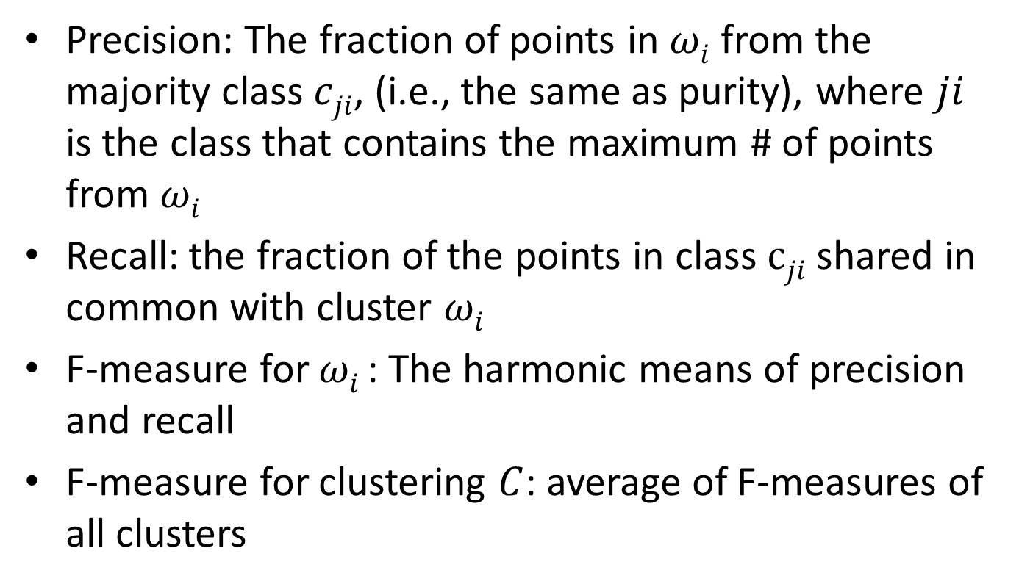
Matching-based F-Measure
Precision: The fraction of points in $ωi$ from the majority class $cji$, (i.e., the same as purity), where $ji$ is the class that contains the maximum # of points from $ωi$
Recall: the fraction of the points in class $cji$ shared in common with cluster $ωi$
F-measure for $ωi$ : The harmonic means of precision and recall
F-measure for clustering $C$: average of F-measures of all clusters

Slide 43
F-measure example
• •
• •
• •
• •
• •
• •
• •
• •
•
Cluster I
Cluster II
Cluster III
Cluster I: Precision = 5/6, Recall = 5/8, F1 = 0.714
Cluster II: Precision = 4/6, Recall = 4/5, F1 = 0.727
Cluster III: Precision = 3/5, Recall = 3/4, F1 = 0.667
Overall F1 = 0.703

Slide 44
Normalized Mutual Information (NMI)
Mutual Information: How much information does the clustering contain about the classification
Entropy: Information contained in a distribution
Normalized Mutual Information (NMI):

Slide 45
Rand Index measures between pair decisions. Here RI = 0.68
Number of points | Same Cluster in clustering | Different Clusters in clustering
Same class in ground truth | 20 | 24
Different classes in ground truth | 20 | 72

Slide 46
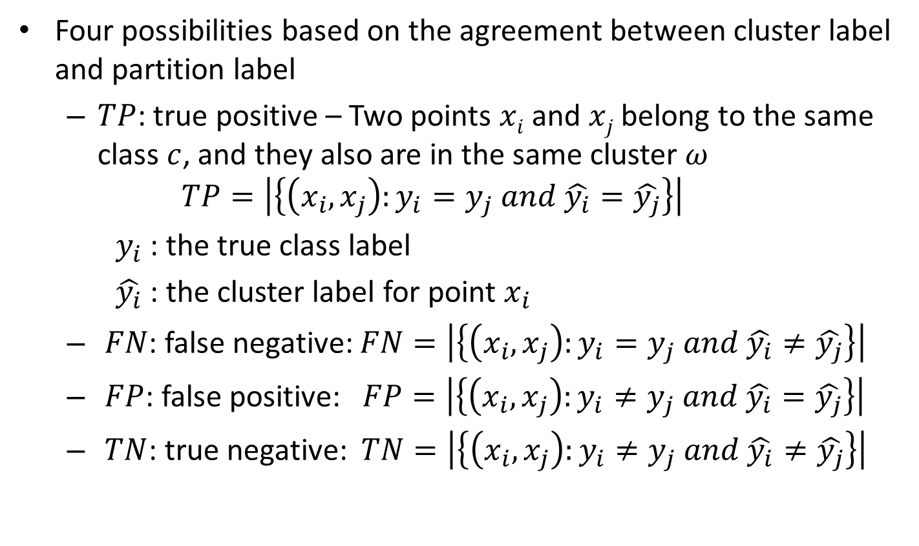
Four Possibilities for Truth Assignment
Four possibilities based on the agreement between cluster label and partition label
$TP$: true positive – Two points $xi$ and $xj$ belong to the same class $c$, and they also are in the same cluster $ω$
$$TP=\left|\left\{\left(x_{i}, x_{j}\right):y_{i}=y_{j} and \hat{y_{i}}=\hat{y_{j}}\right\}\right|$$
$y_{i}$ : the true class label
$\hat{y_{i}}$ : the cluster label for point $x_{i}$
$FN$: false negative: $FN=\left|\left\{\left(x_{i}, x_{j}\right):y_{i}=y_{j} and \hat{y_{i}}≠\hat{y_{j}}\right\}\right|$
$FP$: false positive: $FP=\left|\left\{\left(x_{i}, x_{j}\right):y_{i}≠y_{j} and \hat{y_{i}}=\hat{y_{j}}\right\}\right|$
$TN$: true negative: $TN=\left|\left\{\left(x_{i}, x_{j}\right):y_{i}≠y_{j} and \hat{y_{i}}≠\hat{y_{j}}\right\}\right|$

Slide 47
Rand index and Cluster Pairwise F-measure
Compare with standard Precision and Recall:
People also define and use a cluster F-measure, which is probably a better measure.

Slide 48
Indirect Evaluation of Text Clusters
Question to answer: How useful are the clustering results for the intended applications?
“usefulness” is inevitably application specific
“clustering bias” is imposed by the intended application
Evaluation procedure:
Create a test set for the intended application to quantify the performance of any system for this application
Choose a baseline system to compare with
Add a clustering algorithm to the baseline system → “clustering system”
Compare the performance of the clustering system and the baseline in terms of any performance measure for the application

Slide 49
Questions?

