Slide 1
Text Categorization

Slide 2
Overview
What is text categorization?
Why text categorization?
How to do text categorization?
How to do feature selection for text categorization?
How to evaluate categorization results?

Slide 3
Overview
What is text categorization?
Why text categorization?
How to do text categorization?
How to do feature selection for text categorization?
How to evaluate categorization results?

Slide 4
Text Categorization
Given the following:
A set of predefined categories, possibly forming a hierarchy
A training set of labeled text objects
Task: Classify a text object into one or more of the categories
Categorization Results
Text objects
Sports
Business
Education
Science
Categorization
System
…
…
Sports
Business
Education
Training data
(known categories)

Slide 5
Examples of Text Categorization
Text objects can vary (e.g., documents, passages, or collections of text)
Categories can also vary
“Internal” categories that characterize a text object (e.g., topical categories, sentiment categories)
“External” categories that characterize an entity associated with the text object (e.g., author attribution)
Some examples of applications
News categorization, literature article categorization (e.g., MeSH annotations)
Spam email detection/filtering
Sentiment categorization of product reviews or tweets
Automatic email sorting/routing
Author attribution

Slide 6
Variants of Problem Formulation
Binary categorization: only two categories
Retrieval: {relevant-doc, non-relevant-doc}
Spam filtering: {spam, non-spam}
Opinion: {positive, negative}
K-category categorization: more than two categories
Topic categorization: {sports, science, travel, business,…}
Email routing:{folder1, folder2,folder3, …}
Hierarchical categorization: Categories form a hierarchy
Binary categorization can potentially support all other categorizations

Slide 7
Overview
What is text categorization?
Why text categorization?
How to do text categorization?
How to do feature selection for text categorization?
How to evaluate categorization results?

Slide 8
Why Text Categorization?
To enrich text representation (more understanding of text)
Text can now be represented in multiple levels (keywords + categories)
Semantic categories assigned can be directly or indirectly useful for an application
Semantic categories facilitate aggregation of text content (e.g., aggregating all positive/negative opinions about a product)
To infer properties of entities associated with text data (discovery of knowledge about the world)
As long as an entity can be associated with text data, we can always use the text data to help categorize the associated entities
E.g., discovery of non-native speakers of a language

Slide 9
Overview
What is text categorization?
Why text categorization?
How to do text categorization?
How to do feature selection for text categorization?
How to evaluate categorization results?

Slide 10
Categorization Methods: Manual
Determine the categories based on rules that are carefully designed to reflect the domain knowledge about the categorization problem
Works well when
The categories are very well defined
Categories are easily distinguished based on surface features in text (e.g., special vocabulary is known to only occur in a particular category)
Sufficient domain knowledge is available to suggest many effective rules
Problems
Labor intensive → doesn’t scale up well
Can’t handle uncertainty in rules; rules may be inconsistent → not robust
Both problems can be solved/alleviated by using machine learning

Slide 11
Feature-based Categorization Methods: “Automatic”
Use human experts to
Annotate data sets with category labels → Training data
Provide a set of features to represent each text object that can potentially provide a “clue” about the category
Use machine learning to learn “soft rules” for categorization from the training data
Figure out which features are most useful for separating different categories
Optimally combine the features to minimize the errors of categorization on the training data
The trained classifier can then be applied to a new text object to predict the most likely category (that a human expert would assign to it)

Slide 12
Machine Learning for Text Categorization
General setup: learn a classifier f: X→Y
Input: X = all text objects; Output: Y = all categories
Learn a classifier function, f: X→Y, such that f(x)=y, y ∈ Y gives the correct category for x ∈ X (“correct” is based on the training data)
All feature-based methods
Rely on discriminative features of text objects to distinguish categories
Combine multiple features in a weighted manner
Adjust weights on features to minimize errors on the training data
Different methods tend to vary in
Their way of measuring the errors on the training data (may optimize different objective/loss/cost function)
Their way of combining features (e.g., linear vs. non-linear)

Slide 13
Generative vs. Discriminative Classifiers
Generative classifiers (learn what the data “looks” like in each category)
Attempt to model p(X, Y) = p(Y)p(X|Y) and compute p(Y|X) based on p(X|Y) and p(Y) using Bayes Rule
Objective function is likelihood, thus indirectly measuring training errors
E.g., Naïve Bayes
Discriminative classifiers (learn what features separate categories)
Attempt to model p(Y|X) directly
Objective function directly measures errors of categorization on training data
E.g., Logistic Regression, Support Vector Machine (SVM), k-Nearest Neighbor (kNN)

Slide 14










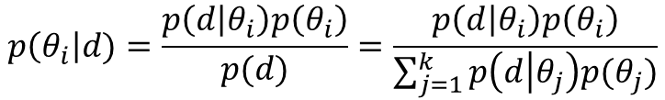

Document Clustering Revisited
Which cluster does d belong to? → Which $θ_{i}$ was used to generate d?
$d=x_{1}x_{2}…x_{L}$ where $x_{i}∈V$
sports 0.02
game 0.01
basketball 0.005
football 0.004
…
$$p(θ_{1})$$
$$p(w|θ_{1})$$
d
$$cluster\left(d\right)=\arg{\max_{i}{p(θ_{i}|d)}}$$
$$=\arg{\max_{i}{p\left(d | θ_{i}\right)p(θ_{i})}}$$
$$p(w|θ_{2})$$
travel 0.05
attraction 0.03
trip 0.01
…
$$p(θ_{2})$$
d
$$=\arg{\max_{i}{\prod_{j=1}^{L}{p\left(x_{j} | θ_{i}\right)p(θ_{i})}}}$$
…
$$=\arg{\max_{i}{\prod_{w∈V}{p{\left(w | θ_{i}\right)}^{c\left(w,d\right)}p(θ_{i})}}}$$
$$p(w|θ_{k})$$
science 0.04
scientist 0.03
spaceship 0.006
…
$$p(θ_{k})$$
d
$$p\left(θ_{i}\right|d)=\frac{p\left(d | θ_{i}\right)p\left(θ_{i}\right)}{p(d)}=\frac{p\left(d | θ_{i}\right)p\left(θ_{i}\right)}{\sum_{j=1}^{k}{p\left(d | θ_{j}\right)p(θ_{j})}}$$

Slide 15

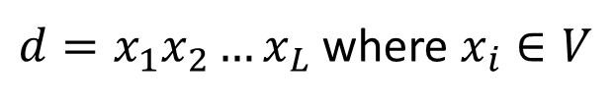
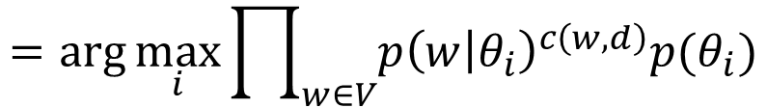








Text Categorization with Naïve Bayes Classifier
sports 0.02
game 0.01
basketball 0.005
football 0.004
…
$$p(θ_{1})$$
$d=x_{1}x_{2}…x_{L}$ where $x_{i}∈V$
$$p(w|θ_{1})$$
d
If $θ_{i}$ represents category $i$accurately, then …
$$p(w|θ_{2})$$
travel 0.05
attraction 0.03
trip 0.01
…
$$p(θ_{2})$$
How can we make this happen?
d
…
$$category\left(d\right)=\arg{\max_{i}{p(θ_{i}|d)}}$$
$$=\arg{\max_{i}{p\left(d | θ_{i}\right)p(θ_{i})}}$$
$$p(w|θ_{k})$$
science 0.04
scientist 0.03
spaceship 0.006
…
$$p(θ_{k})$$
d
$$=\arg{\max_{i}{\prod_{w∈V}{p{\left(w | θ_{i}\right)}^{c\left(w,d\right)}p(θ_{i})}}}$$
$$category\left(d\right)=\arg{\max_{i}{\log{p\left(θ_{i}\right)+\sum_{w∈V}{c\left(w,d\right)\log{p(w|θ_{i})}}}}}$$

Slide 16







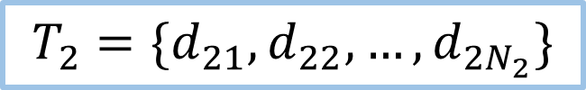

Learn from the Training Data
Category 1
Category 1
sports ?
game ?
basketball ?
football ?
…
$$p(w|θ_{1})$$
$$p(θ_{1})$$
$$T_{1}=\{d_{11},d_{12},…, d_{1N_{1}}\}$$
Category 2
Category 2
$$T_{2}=\{d_{21},d_{22},…, d_{2N_{2}}\}$$
$$p(w|θ_{2})$$
travel ?
attraction ?
trip ?
…
…
$$p(θ_{2})$$
…
Category k
Category k
$$T_{k}=\{d_{k1},d_{k2},…, d_{kN_{k}}\}$$
$$p(w|θ_{k})$$
$$p(θ_{k})$$
science ?
scientist ?
spaceship ?
…

Slide 17



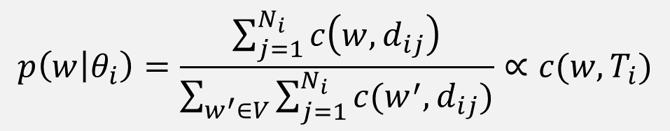

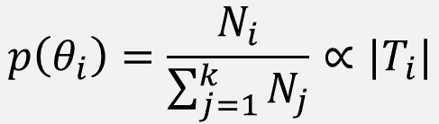

Naïve Bayes Classifier: $p\left(θ_{i}\right)=?and p\left(w | θ_{i}\right)=?$
Which category is most popular?
Category 1
$$T_{1}=\{d_{11},d_{12},…, d_{1N_{1}}\}$$
$$p\left(θ_{i}\right)=\frac{N_{i}}{\sum_{j=1}^{k}{N_{j}}}∝|T_{i}|$$
Category 2
$$T_{2}=\{d_{21},d_{22},…, d_{2N_{2}}\}$$
$$p\left(w | θ_{i}\right)=\frac{\sum_{j=1}^{N_{i}}{c\left(w,d_{ij}\right)}}{\sum_{w^{′}∈V}{\sum_{j=1}^{N_{i}}{c(w^{′}, d_{ij})}}}∝c(w,T_{i})$$
…
Category k
$$T_{k}=\{d_{k1},d_{k2},…, d_{kN_{k}}\}$$
Which word is most frequent in category $i$?
What are the constraints on $p(θ_{i})$ and $p(w|θ_{i})$?

Slide 18

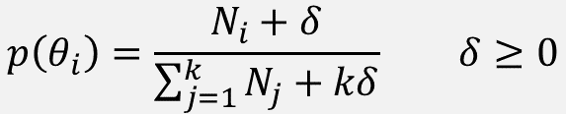


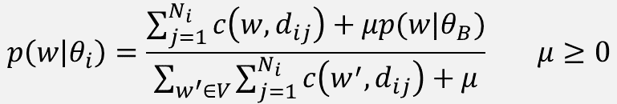

Smoothing in Naïve Bayes
Why smoothing?
Address data sparseness (training data is small → zero probability)
Incorporate prior knowledge
Achieve discriminative weighting (i.e., IDF weighting)
How?
$$p\left(θ_{i}\right)=\frac{N_{i}+δ}{\sum_{j=1}^{k}{N_{j}+kδ}} δ≥0$$
What if $δ→∞$?
$p(w|θ_{B})$: background LM
$$p\left(w | θ_{i}\right)=\frac{\sum_{j=1}^{N_{i}}{c\left(w,d_{ij}\right)+μp(w|θ_{B})}}{\sum_{w^{′}∈V}{\sum_{j=1}^{N_{i}}{c\left(w^{′},d_{ij}\right)+μ}}} μ≥0$$
$$p\left(w | θ_{B}\right)=1/\left|V\right|?$$
What if $μ→∞$

Slide 19

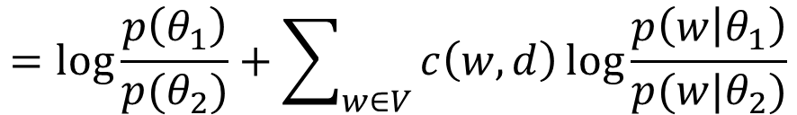
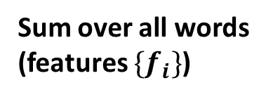
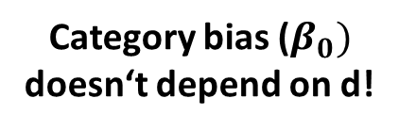
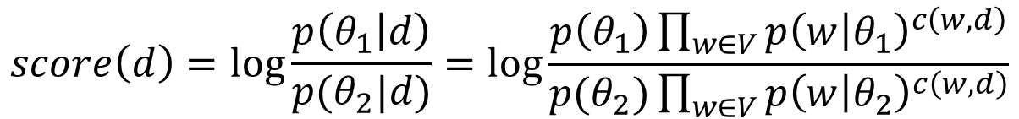
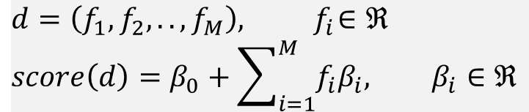
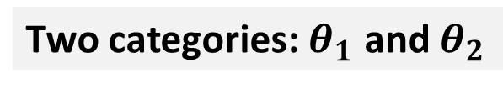
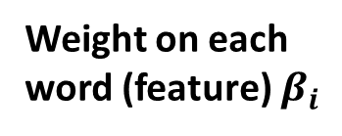
Anatomy of Naïve Bayes Classifier
Two categories: $θ_{1}$ and $θ_{2}$
$$score\left(d\right)=\log{\frac{p\left(θ_{1} | d\right)}{p(θ_{2}|d)}=\log{\frac{p\left(θ_{1}\right)\prod_{w∈V}{p{\left(w | θ_{1}\right)}^{c\left(w, d\right)}}}{p(θ_{2})\prod_{w∈V}{p{\left(w | θ_{2}\right)}^{c\left(w,d\right)}}}}}$$
$$=\log{\frac{p\left(θ_{1}\right)}{p(θ_{2})}+\sum_{w∈V}{c\left(w,d\right)\log{\frac{p\left(w | θ_{1}\right)}{p(w|θ_{2})}}}}$$
Weight on each word (feature) $β_{i}$
Category bias ($β_{0})$
doesn‘t depend on d!
Sum over all words (features $\{f_{i}\}$)
Feature value: $f_{i}=c(w,d)$
$$d=\left(f_{1},f_{2},.., f_{M}\right), { f}_{i}∈ℜ$$
$$score\left(d\right)=β_{0}+\sum_{i=1}^{M}{f_{i}β_{i}, β_{i}∈ℜ}$$
= Logistic Regression!
Generalize

Slide 20
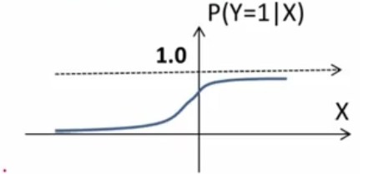
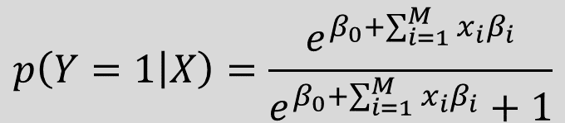

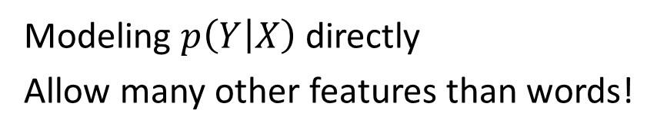
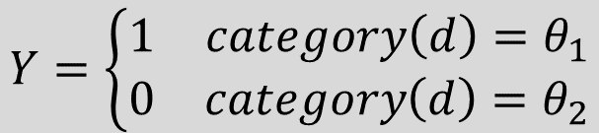
Discriminative Classifier 1: Logistic Regression
Binary Response Variable: $Y∈\left\{0, 1\right\}$ Predictors: $X=\left(x_{1},x_{2},…, x_{M}\right), x_{i}∈ℜ$
$$Y=\left\{\begin{matrix}1 & category\left(d\right)=θ_{1} \\ 0 & category\left(d\right)=θ_{2}\end{matrix}\right.$$
Modeling $p\left(Y | X\right)$ directly
Allow many other features than words!
$$\log{\frac{p\left(θ_{1} | d\right)}{p(θ_{2}|d)}=\log{\frac{p\left(Y=1 | X\right)}{p\left(Y=0 | X\right)}=\log{\frac{p\left(Y=1 | X\right)}{1−p(Y=1|X)}=β_{0}+\sum_{i=1}^{M}{x_{i}β_{i}}}}} β_{i}∈ℜ$$
$$p\left(Y=1 | X\right)=\frac{e^{β_{0}+\sum_{i=1}^{M}{x_{i}β_{i}}}}{e^{β_{0}+\sum_{i=1}^{M}{x_{i}β_{i}}}+1}$$

Slide 21
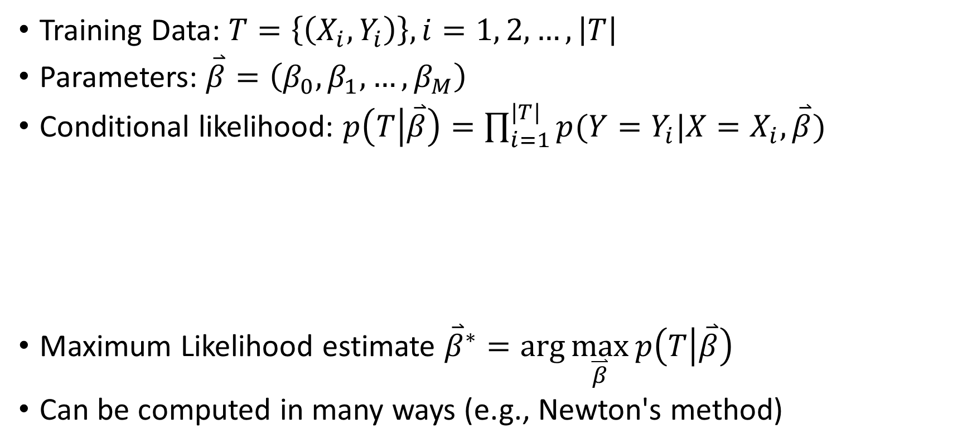


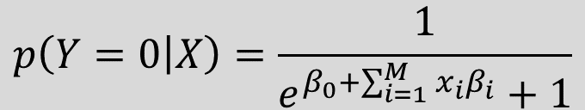
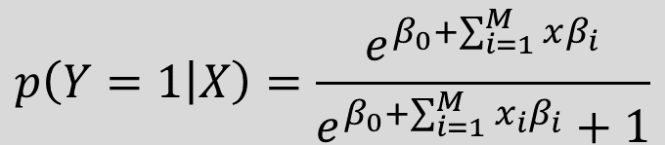
Estimation of Parameters
Training Data: $T=\left\{\left(X_{i}, Y_{i}\right)\right\}, i=1, 2, …, \left|T\right|$
Parameters: $\overset{⃑}{β}=\left(β_{0},β_{1},…, β_{M}\right)$
Conditional likelihood: $p\left(T | \overset{⃑}{β}\right)=\prod_{i=1}^{|T|}{p(Y=Y_{i}|X=X_{i}, \overset{⃑}{β})}$
Maximum Likelihood estimate ${\overset{⃑}{β}}^{∗}=\arg{\max_{\overset{⃑}{β}}{p\left(T | \overset{⃑}{β}\right)}}$
Can be computed in many ways (e.g., Newton's method)
$$Y_{i}=1$$
$$Y_{i}=0$$
$$p\left(Y=1 | X\right)=\frac{e^{β_{0}+\sum_{i=1}^{M}{xβ_{i}}}}{e^{β_{0}+\sum_{i=1}^{M}{x_{i}β_{i}}}+1}$$
$$p\left(Y=0 | X\right)=\frac{1}{e^{β_{0}+\sum_{i=1}^{M}{x_{i}β_{i}}}+1}$$

Slide 22
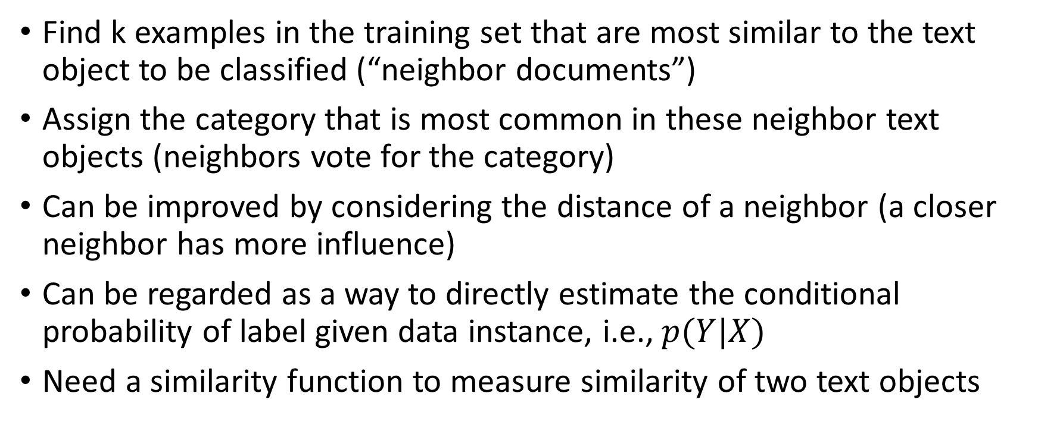
Discriminative Classifier 2: k-Nearest Neighbors (k-NN)
Find k examples in the training set that are most similar to the text object to be classified (“neighbor documents”)
Assign the category that is most common in these neighbor text objects (neighbors vote for the category)
Can be improved by considering the distance of a neighbor (a closer neighbor has more influence)
Can be regarded as a way to directly estimate the conditional probability of label given data instance, i.e., $p(Y|X)$
Need a similarity function to measure similarity of two text objects

Slide 23
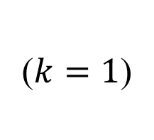
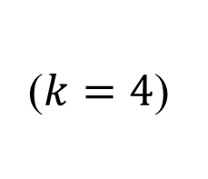
Illustration of K-NN Classifier
($k=4$)
($k=1$)

Slide 24
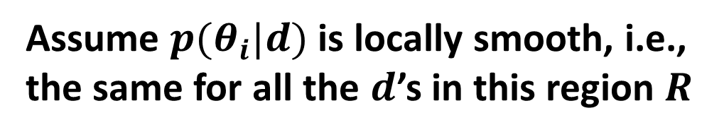
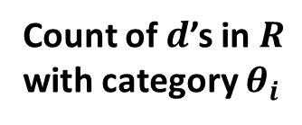
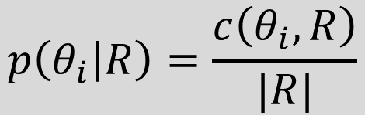


k-NN as an Estimate of p(Y|X)
Assume $p(θ_{i}|d)$ is locally smooth, i.e., the same for all the $d$’s in this region $R$
$$p\left(θ_{i} | d\right)=p\left(θ_{i}\right|R)$$
Count of $d$’s in $R$ with category $θ_{i}$
Estimate $p(θ_{i}|R)$ based on the known categories in the region
$$p\left(θ_{i} | R\right)=\frac{c\left(θ_{i},R\right)}{|R|}$$
Total # of docs in R

Slide 25
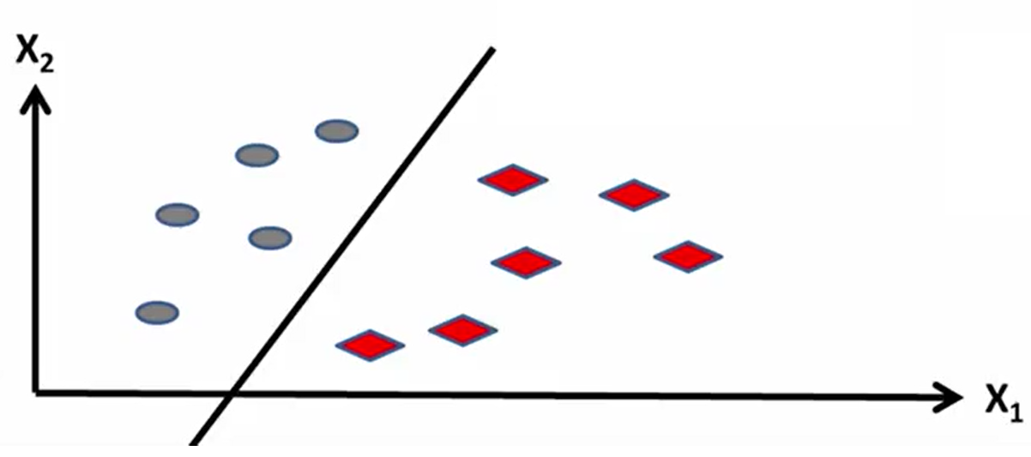


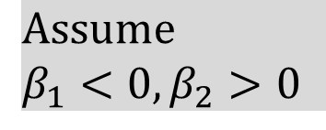

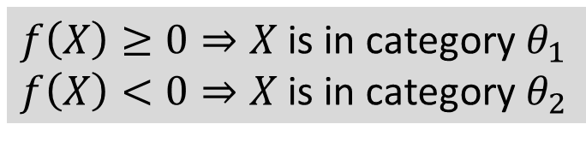

Discriminative Classifier 3: Support Vector Machine (SVM)
Consider two categories: $\left\{θ_{1},θ_{2}\right\}$
Use a linear separator $f\left(X\right)=β_{0}+\sum_{i=1}^{M}{x_{i}β_{i} β_{i}∈ℜ}$
$f\left(X\right)≥0⇒X$ is in category $θ_{1}$
$f\left(X\right)<0⇒X$ is in category $θ_{2}$
$$β_{0}+β_{1}x_{1}+β_{2}x_{2}>0$$
$$β_{0}+β_{1}x_{1}+β_{2}x_{2}=0$$
$$Assume$$
$$β_{1}<0, β_{2}>0$$
$$β_{0}+β_{1}x_{1}+β_{2}x_{2}<0$$

Slide 26


Which Linear Separator Is the Best?
$$γ_{0}+{\overset{⃑}{γ}}^{T}\overset{⃑}{x}=0$$
$$β_{0}+{\overset{⃑}{β}}^{T}\overset{⃑}{x}=0$$

Slide 27
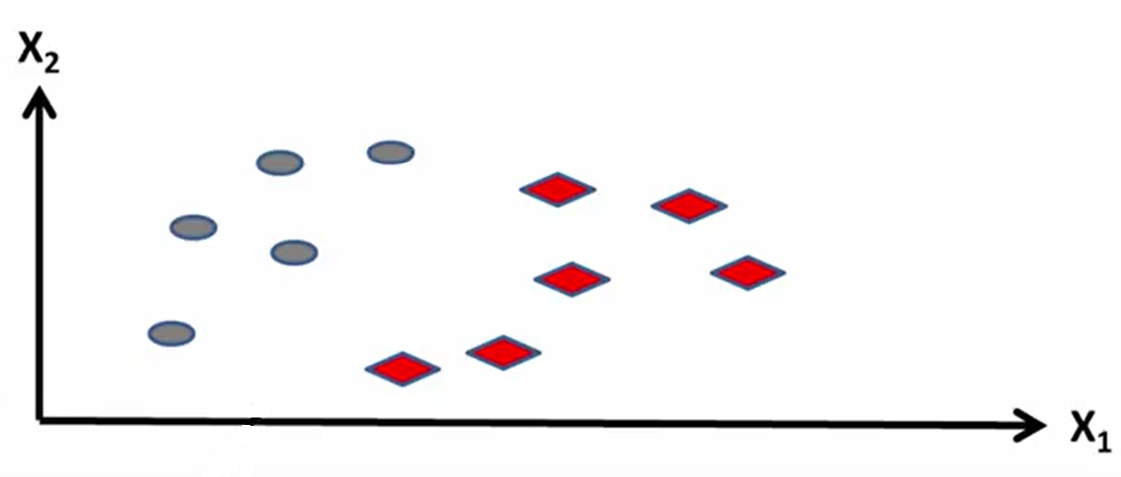
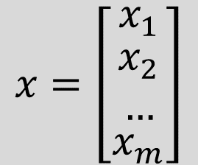
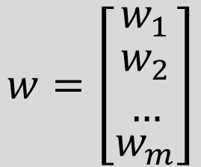
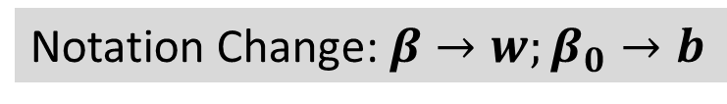

Best Separator = Maximize the Margin
Notation Change: $β→w;β_{0}→b$
Bias Constant
Feature Weights
Feature Vector
(e.g., word counts)
Margin
$$w^{T}x+b=0$$
Margin
$$w=\left[\begin{matrix}w_{1} \\ \begin{matrix}w_{2} \\ …\end{matrix} \\ w_{m}\end{matrix}\right]$$
$$x=\left[\begin{matrix}x_{1} \\ \begin{matrix}x_{2} \\ …\end{matrix} \\ x_{m}\end{matrix}\right]$$

Slide 28
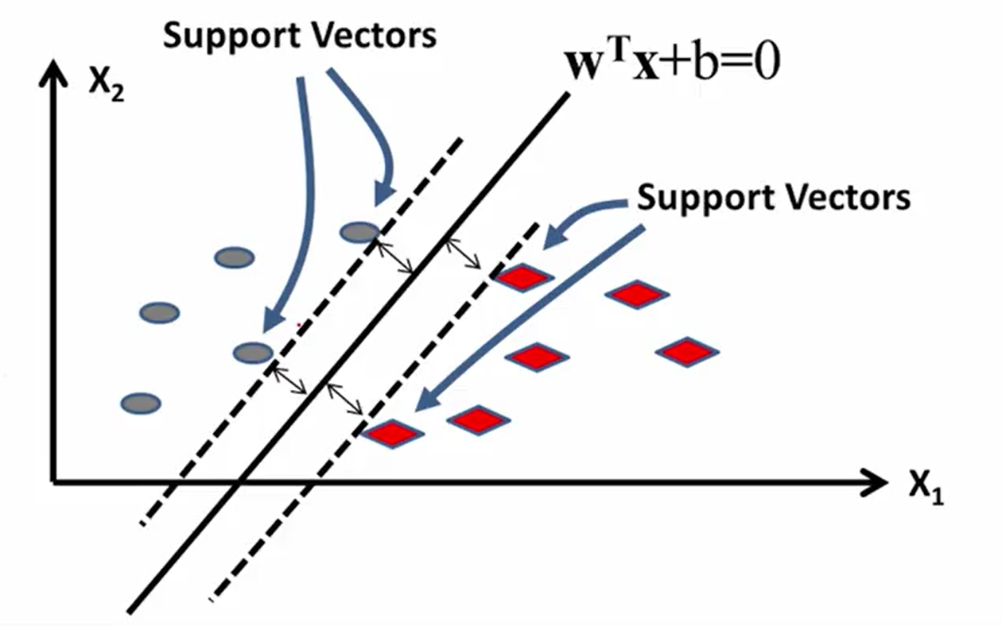
Only the Support Vectors Matter

Slide 29
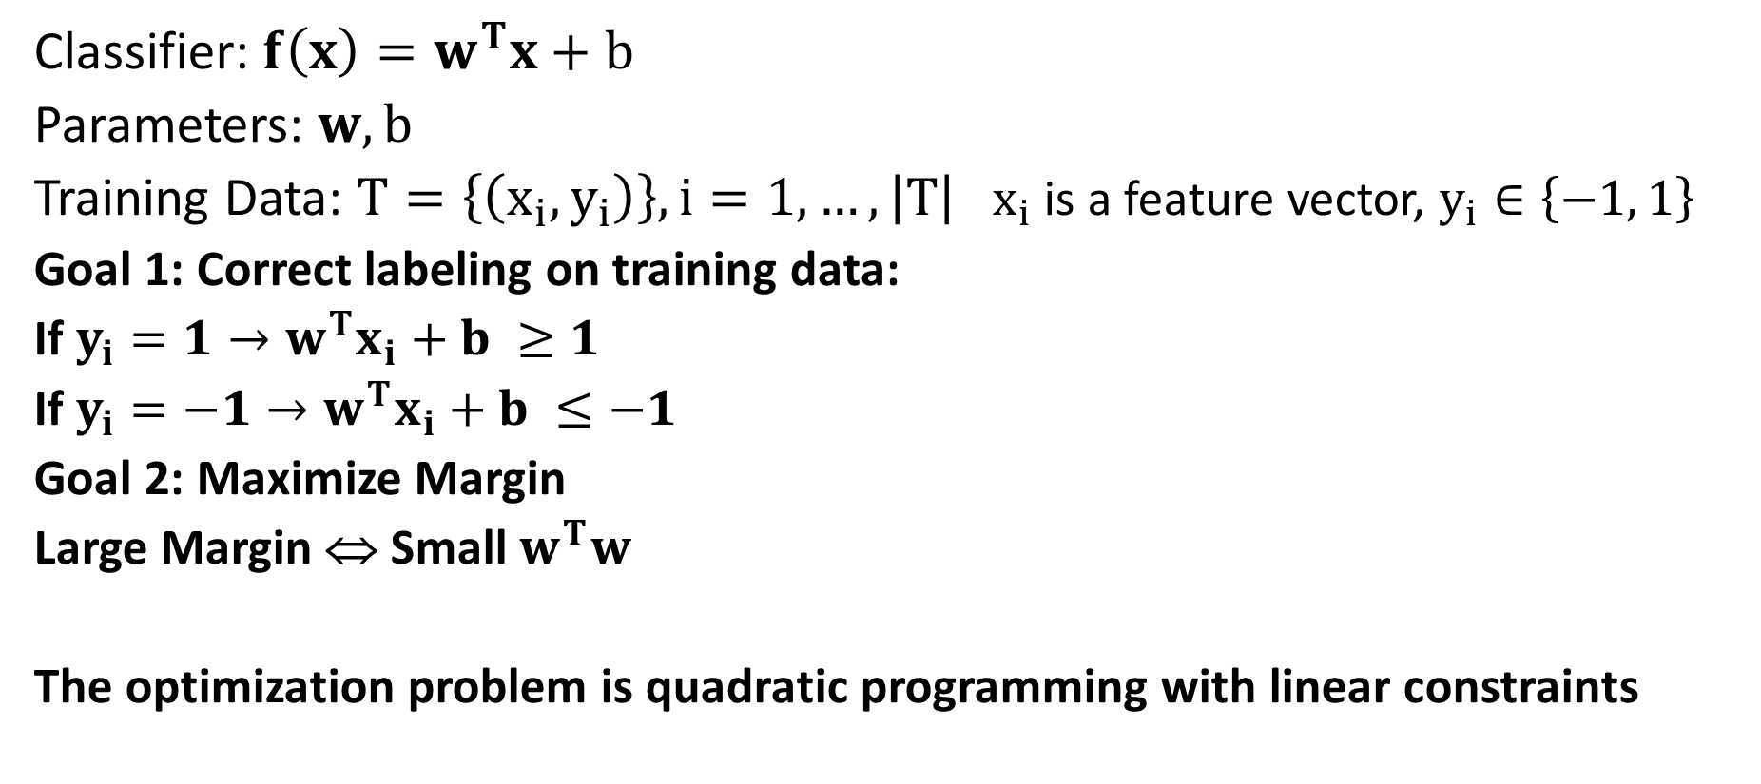


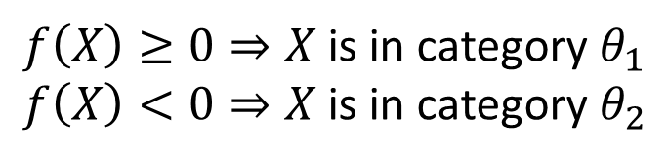
Linear SVM
Classifier: $f\left(x\right)=w^{T}x+b$
Parameters: $w, b$
Training Data: $T=\left\{\left(x_{i},y_{i}\right)\right\}, i=1, …, \left|T\right|$ $x_{i}$ is a feature vector, $y_{i}∈\left\{−1, 1\right\}$
Goal 1: Correct labeling on training data:
If $y_{i}=1→w^{T}x_{i}+b ≥1$
If $y_{i}=−1→w^{T}x_{i}+b ≤−1$
Goal 2: Maximize Margin
Large Margin ⇔ Small $w^{T}w$
The optimization problem is quadratic programming with linear constraints
$f\left(X\right)≥0⇒X$ is in category $θ_{1}$
$f\left(X\right)<0⇒X$ is in category $θ_{2}$
Constraint
$$∀i, y_{i}\left(w^{T}x_{i}+b\right)≥1$$
Objective
$$Minimize Φ\left(w\right)=w^{T}w$$

Slide 30
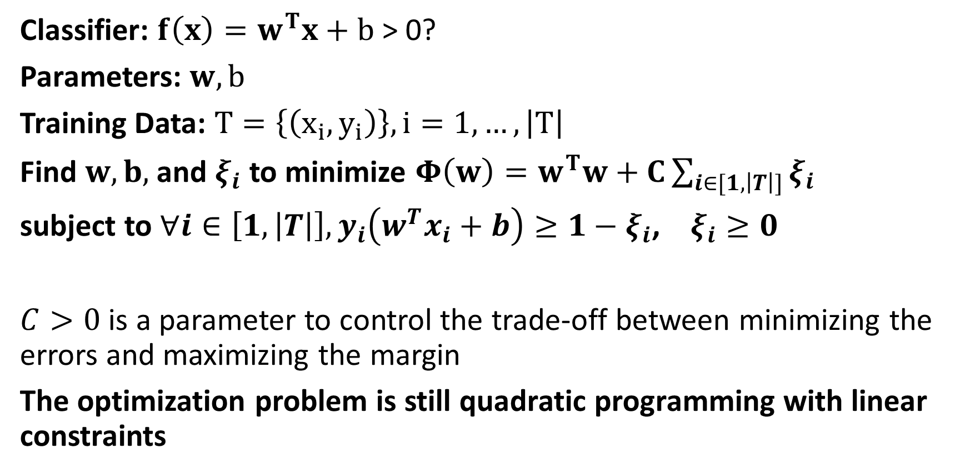
Linear SVM with Soft Margin
Classifier: $f\left(x\right)=w^{T}x+b$ > 0?
Parameters: $w, b$
Training Data: $T=\left\{\left(x_{i},y_{i}\right)\right\}, i=1, …, \left|T\right|$
Find $w, b,$ and $ξ_{i}$ to minimize $Φ\left(w\right)=w^{T}w+C\sum_{i∈[1,\left|T\right|]}{ξ_{i}}$
subject to $∀i∈\left[1,\left|T\right|\right], y_{i}\left(w^{T}x_{i}+b\right)≥1−ξ_{i}$, $ξ_{i}≥0$
$C>0$ is a parameter to control the trade-off between minimizing the errors and maximizing the margin
The optimization problem is still quadratic programming with linear constraints
Added to allow training errors

