Slide 1
Overview of Text Retrieval (TR)
Intelligent Information Retrieval

Slide 2
Lecture Plan
What is text retrieval (TR) ?
Document selection vs. document ranking
Major research milestones
Components in a TR system

Slide 3
What is Text Retrieval (TR)?
There exists a collection of text documents
User gives a query to express the information need
A retrieval system returns relevant documents to users
More often called “information retrieval” (IR) , but IR is actually much broader
May include non-textual information
May include text categorization or summarization…
Known as “search technology” in industry

Slide 4
TR vs. Database Retrieval
Information
Unstructured/free text vs. structured data
Ambiguous vs. well-defined semantics
Query
Ambiguous vs. well-defined semantics
Incomplete vs. complete specification
Answers
Relevant documents vs. matched records
TR is an empirically defined problem!

Slide 5
TR is Hard!
Under/over-specified query
Ambiguous: “buying CDs” (money or music?)
Incomplete: what kind of CDs?
What if “CD” is never mentioned in document?
Vague semantics of documents
Ambiguity: e.g., word-sense, structural
Incomplete: Inferences required
Even hard for people!
80% agreement in human judgments

Slide 6
TR is “Easy”!
TR CAN be easy in a particular case
Ambiguity in query/document is RELATIVE to the database
So, if the query is SPECIFIC enough, just one keyword may get all the relevant documents
PERCEIVED TR performance is usually better than the actual performance
Users can NOT judge the completeness of an answer

Slide 7
Short vs. Long Term Info Need
Short-term information need (Ad hoc retrieval)
“Temporary need”, e.g., info about used cars
Information source is relatively static
User “pulls” information
Application example: library search, Web search
Long-term information need (Filtering)
“Stable need”, e.g., new data mining algorithms
Information source is dynamic
System “pushes” information to user
Applications: news filter

Slide 8
Importance of Ad hoc Retrieval
Directly manages any existing large collection of information
There are many many “ad hoc” information needs
A long-term information need can be satisfied through frequent ad hoc retrieval
Basic techniques of ad hoc retrieval can be used for filtering and other “non-retrieval” tasks, such as categorization, clustering, and automatic summarization.

Slide 9
Lecture Plan
What is text retrieval (TR) ?
Document selection vs. document ranking
Major research mile stones
Components in a TR system

Slide 10
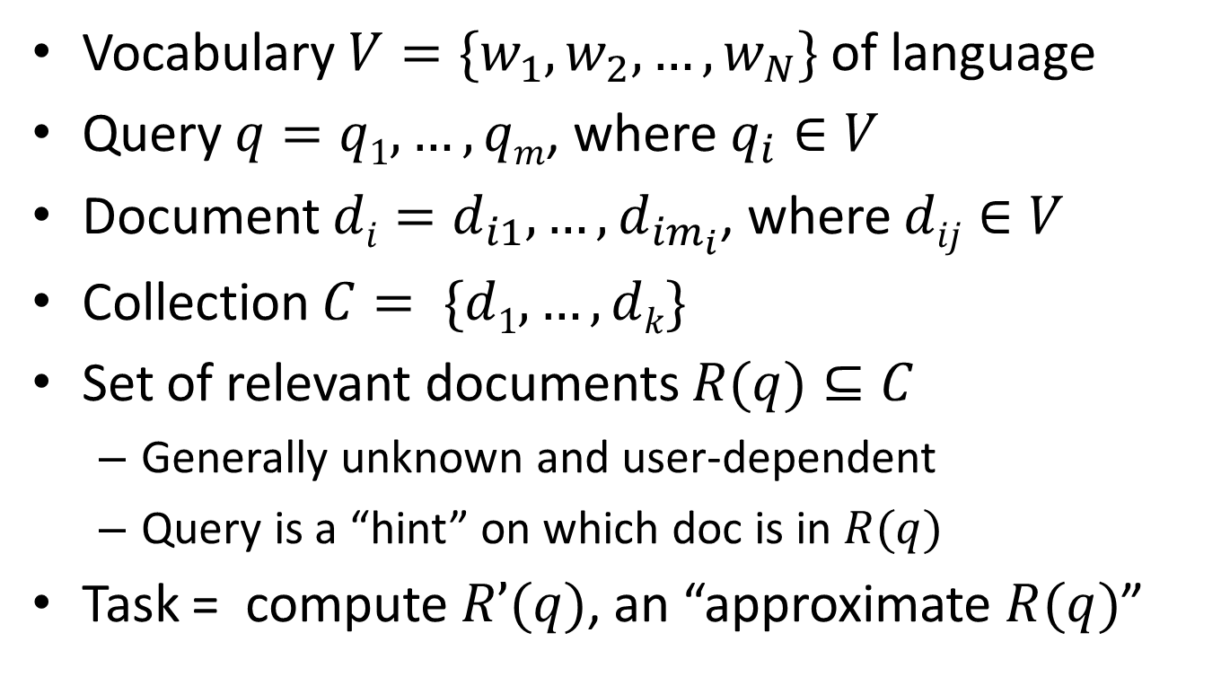
Formal Formulation of TR
Vocabulary $V=\{w_{1}, w_{2}, …, w_{N}\}$ of language
Query $q=q1,…,qm$, where $q_{i}∈V$
Document $di=d_{i1}, …, d_{im_{i}}$, where $dij∈V$
Collection $C= \{d1, …, dk\}$
Set of relevant documents $R(q)⊆C$
Generally unknown and user-dependent
Query is a “hint” on which doc is in $R(q)$
Task = compute $R’(q)$, an “approximate $R(q)$”

Slide 11
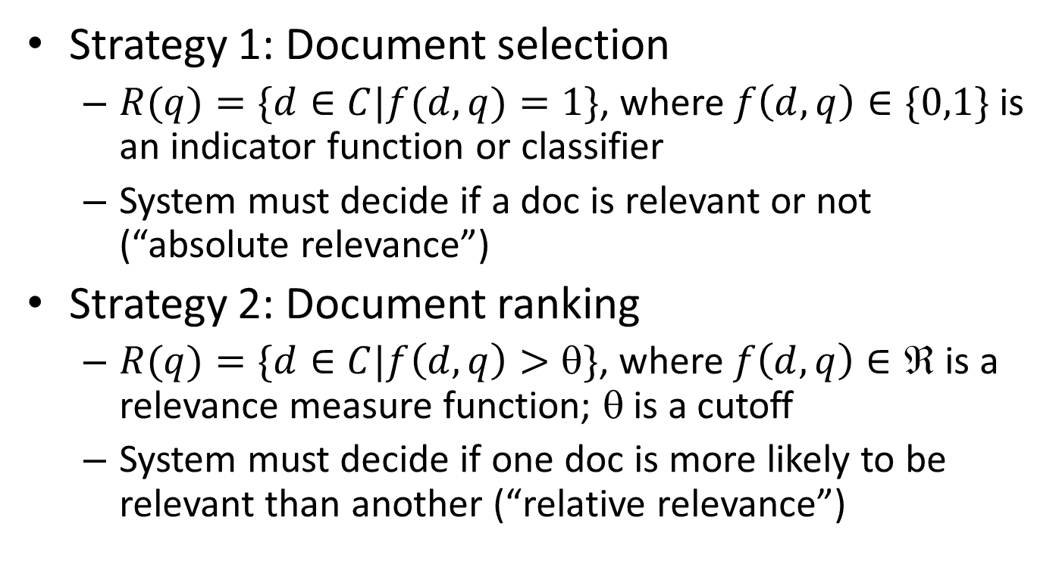
Computing R(q)
Strategy 1: Document selection
$R(q)=\{d∈C|f(d,q)=1\}$, where $f\left(d,q\right)∈\{0,1\}$is an indicator function or classifier
System must decide if a doc is relevant or not (“absolute relevance”)
Strategy 2: Document ranking
$R(q)=\{d∈C|f\left(d,q\right)>θ\}$, where $f\left(d,q\right)∈ℜ$ is a relevance measure function; θ is a cutoff
System must decide if one doc is more likely to be relevant than another (“relative relevance”)

Slide 12
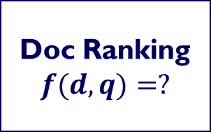
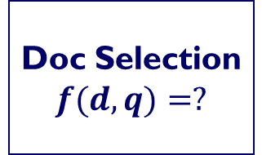
Document Selection vs. Ranking
+
-
+
-
R’(q)
1
+
True R(q)
Doc Selection
$$f(d,q)=?$$
+
+
-
-
-
+
-
-
0
-
-
-
+
-
+
-
-
+
-
+
-
-
+
-
-
-
-
-
-
-
-
-
-
Doc Ranking
$$f(d,q)=?$$
0.98 d₁ +
0.95 d₂ +
0.83 d₃ -
0.80 d₄ +
0.76 d₅ -
0.56 d₆ -
0.34 d₇ -
0.21 d₈ +
0.21 d₉ -
-
R’(q)

Slide 13
Problems of Doc Selection
The classifier is unlikely accurate
“Over-constrained” query (terms are too specific): no relevant documents found
“Under-constrained” query (terms are too general): over delivery
It is extremely hard to find the right position between these two extremes
Even if it is accurate, all relevant documents are not equally relevant
Relevance is a matter of degree!

Slide 14
Ranking is often preferred
Relevance is a matter of degree
A user can stop browsing anywhere, so the boundary is controlled by the user
High recall users would view more items
High precision users would view only a few

Slide 15
We will talk about many different ranking methods later…

Slide 16
Lecture Plan
What is text retrieval (TR) ?
Document selection vs. document ranking
Major research mile stones
Components in a TR system

Slide 17
Major Research Milestones
Early days (late 1950s to 1960s): foundation and founding of the field
Luhn’s work on automatic encoding
Cleverdon’s Cranfield evaluation methodology and index experiments
Salton’s early work on SMART system and experiments
1970s-1980s: a large number of retrieval models
Vector space model
Probabilistic models
1990s: further development of retrieval models and new tasks
Language models
TREC evaluation
2000s-present: more applications, especially Web search and interactions with other fields
Web search
Learning to rank
Scalability (e.g., MapReduce)
Indexing: auto vs. manual
Evaluation
System
Indexing + Search
Theory
Large-scale evaluation, beyond ad hoc retrieval
Web search
Machine learning
Scalability

Slide 18
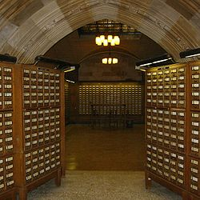
Background: library search in 1950s
Index cards are sorted in alphabetical orders:
- Title index
- Author index
- Subject index
Users can only sequentially
search for items
Indexing was done manually
Clear separation of indexing and search
Card catalogue of Yale Univ.’s Sterling Memorial Library
(picture from Wikipedia)

Slide 19
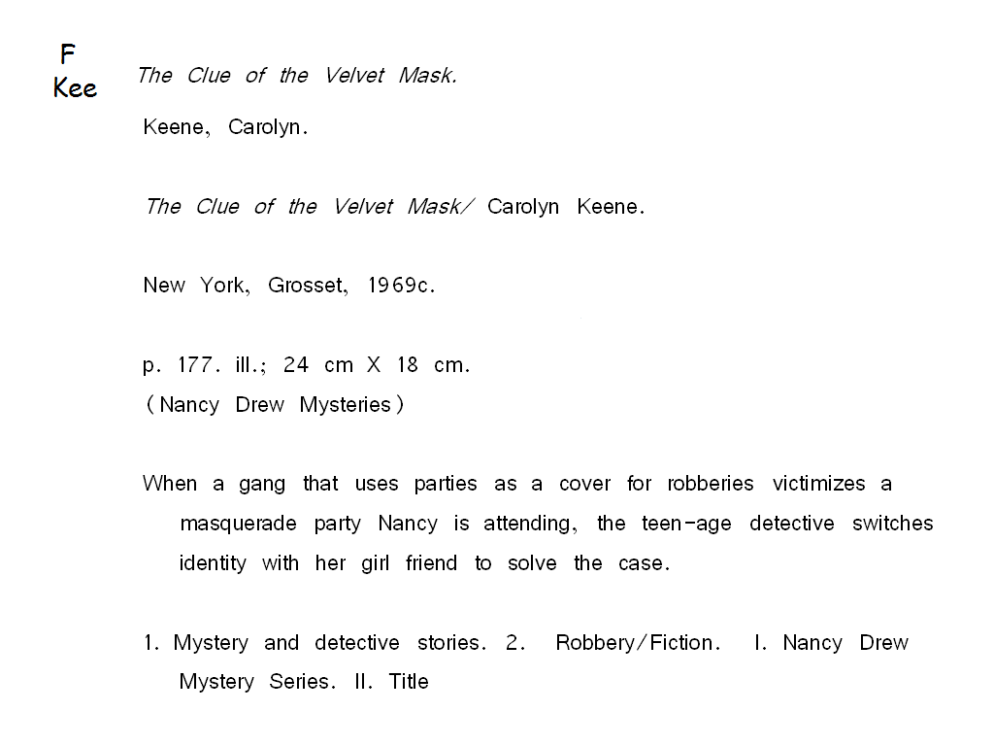
A typical title card (sorted by title)
(source: www.graves.k12.ky.us/powerpoints/elementary/symrrobertson.ppt )

Slide 20
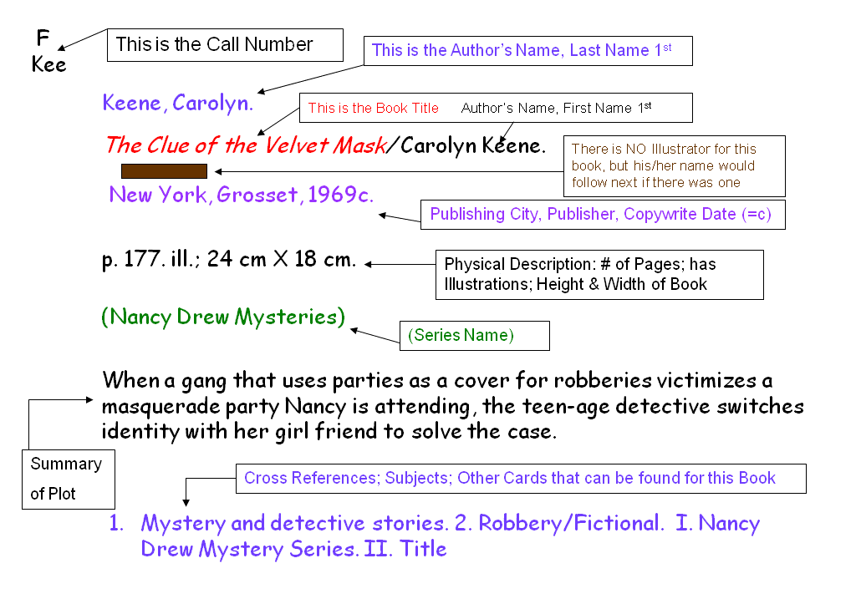
What’s on a card?
(source: www.graves.k12.ky.us/powerpoints/elementary/symrrobertson.ppt )

Slide 21
Milestone 1: Automatic Indexing

Slide 22

Luhn’s ideas: automatic indexing
Important contributions of Luhn
Automatic indexing (using term frequency to select terms, KWIC)
Automatic abstracting (summarization)
Measuring similarity of documents based on their indexing terms
Selective dissemination of information (SDI, i.e., filtering)
Coined the term “business intelligence”
Hans Peter Luhn
(IBM)

Slide 23
Luhn’s idea: automatic indexing based on statistical analysis of text
It is here proposed that the frequency of word occurrence in an article furnishes a useful measurement of word significance. It is further proposed that the relative position within a sentence of words having given values of significance furnish a useful measurement for determining the significance of sentences. The significance factor of a sentence will therefore be based on a combination of these two measurements. ” (Luhn 58)
LUHN, H.P., 'A statistical approach to mechanised encoding and searching of library information', IBM Journal of Research and Development, 1, 309-317 (1957).
LUHN, H.P., 'The automatic creation of literature abstracts', IBM Journal of Research and Development, 2, 159-165 (1958).

Slide 24
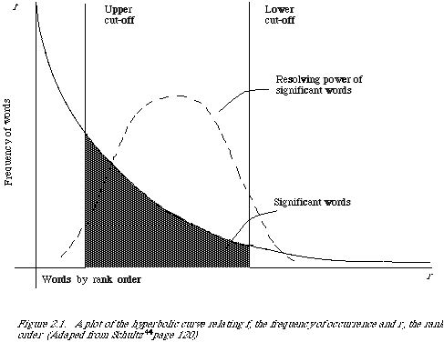
The notion of “resolving power of a word”

Slide 25
Probabilistic view of association and proximity
“the method to be developed here is a probabilistic one based on the physical properties of written texts. No consideration is to be given to the meaning of words or the arguments expressed by word combinations. Instead it is here argued that, whatever the topic, the closer certain words are associated, the more specifically an aspect of the subject is being treated. Therefore, wherever the greatest number of frequently occurring different words are found in greatest physical proximity to each other, the probability is very high that the information being conveyed is most representative of
the article.” (Luhn 58)

Slide 26
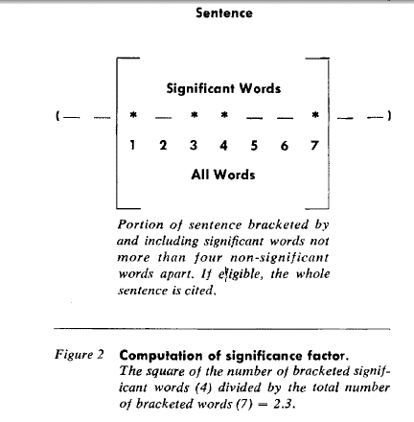
Automatic abstracting algorithm [Luhn 58]
The idea of query-specific summarization
“In many instances condensations of documents are made emphasizing the relationship of the information in the document to a special interest or field of investigation. In such cases sentences could be weighted by assigning a premium value to a predetermined class of words.”

Slide 27
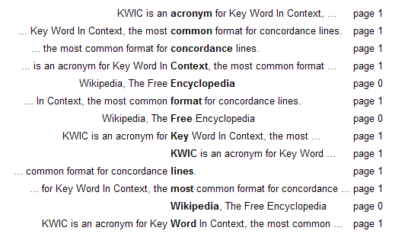
Key Word in Context (KWIC)
KWIC is an acronym for Key Word In Context, the most common format for concordance lines. The term KWIC was first coined by Hans Peter Luhn.
Sorted

Slide 28
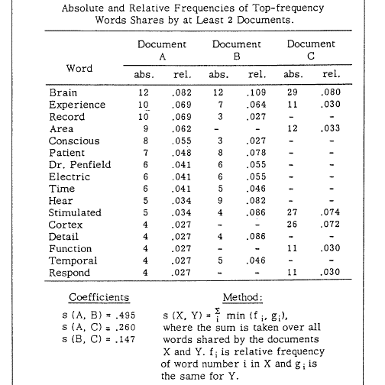
Probabilistic representation and similarity computation [Luhn 61]
An early idea about using
unigram language model to
represent text
What do you think about
the similarity function?

Slide 29
Other early ideas related to indexing
[Joyce & Needham 58]: Relevance-based ranking, vector-space model, query expansion, connection between machine translation and IR
[Doyle 62]: Automatic discovery of term relations/clusters, “semantic road map” for both search and browsing (and text mining!)
[Maron 61]: automatic text categorization
[Borko 62]: categories can be automatically generated from text using factor analysis
[Edmundson & Wyllys 61]: local-global relative frequency (kind of TF-IDF)
Many more (e.g., citation index…)

Slide 30
Milestone 2: Cranfield Evaluation Methodology

Slide 31
Background
IR is an empirically defined problem, thus experiments must be designed to test whether one system is better than another
However, early work on IR (e.g., Luhn’s) mostly proposed ideas without rigorous testing
Catalysts for experimental IR:
Hot debate over different languages for manual indexing
Automatic indexing vs. manual indexing
How can we experimentally test an indexing method?

Slide 32
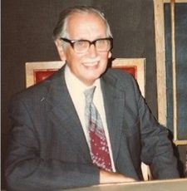
Cleverdon’s Cranfield Tests
1957-1960: Cranfield I
- Comparison of indexing methods
- Controversial results (lots of criticisms)
1960-1966: Cranfield II
- More rigorous evaluation methodology
- Introduced precision & recall
- Decomposed study of each component
in an indexing method
- Still lots of criticisms, but laid the
foundation for evaluation that has a
very long-term and broad impact
Cyril Cleverdon
(Cranfield Inst. of Tech, UK)
Cleverdon received the ACM SIGIR Salton Award in 1991.

Slide 33
Cranfield II Test: Experiment Design
Decomposed study of contributions of different components of an indexing language
Rigorous control of evaluation
Having complete judgments is more important than having a large set of documents
Document collection: 1400 documents (cited papers by 200 authors, no original papers by these authors)
Queries: 279 questions provided by authors of original papers
Relevance judgments:
Multiple levels: 1-5
Initially done by 6 students in 3 months; final judgments by the originators
Measures: precision, recall, fallout, prec-recall curve
Ranking method: coordination level (# matched terms)

Slide 34
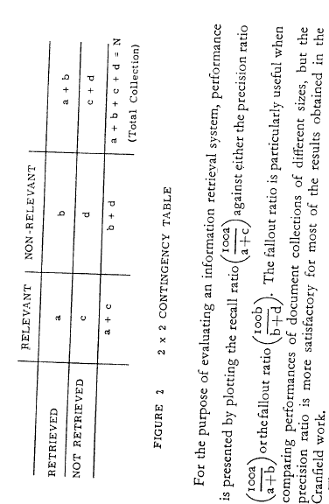
Measures: Precision, Recall, and Fallout [Cleverdon 67]

Slide 35
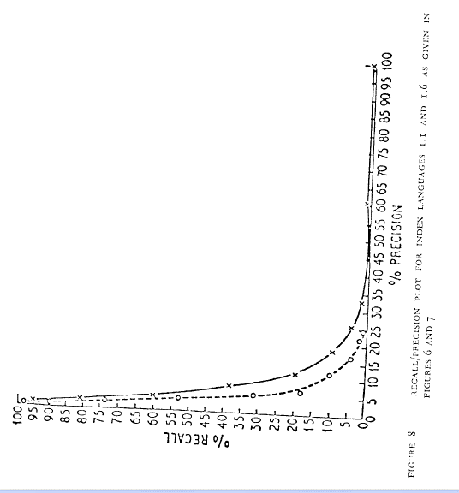
Precision-Recall Curve [Cleverdon 67]

Slide 36
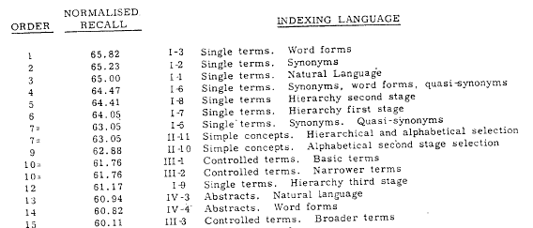
Cranfield II Test: Results [Cleverdon 67]
For more information about Cranfield II test, see
Cleverdon, C. W., 1967, The Cranfield tests on index language devices. Aslib Proceedings,
19, 173-192.

Slide 37
Cranfield test methodology
Specify a retrieval task
Create a collection of sample documents
Create a set of topics/queries appropriate for the retrieval task
Create a set of relevance judgments (i.e., judgments about which document is relevant to which query)
Define a set of measures
Apply a method to (or run a system on) the collection to obtain performance figures

Slide 38
Milestone 3: Smart IR System

Slide 39
Cranfield tests were done manually, how about doing all the tests with an automatic system?
SMART System

Slide 40

SMART: System for the Mechanical Analysis and Retrieval of Text
1961-1965: SMART system develop
(Gerard Salton + Michael Lesk)
First automatic retrieval system
Term weighting + vector similarity
Experimented with many ideas for indexing
Did statistical significance test
Major findings:
+ weighted terms help
+ automatic indexing is as good as manual indexing
+ Indexing based on abstracts outperforms titles
+ linguistic phrases and statistical phrases are
similar
Gerard Salton
(Harvard, Cornell)

Slide 41
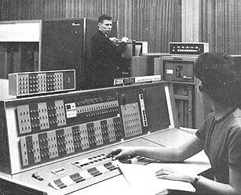
About the SMART system
Developed on IBM 7094
(time-sharing system, 0.35MIPS, 32KB memory)
Early development: (1961-1965):
Michael Lesk
First UNIX implementation(v8, 1980):
Edward Fox
The widely used SMART toolkit
(v10/11, 1980-1990s)
Chris Buckley
SMART was the most popular IR toolkit (in C) widely used in 1990s by
IR researchers and some machine learning researchers

Slide 42
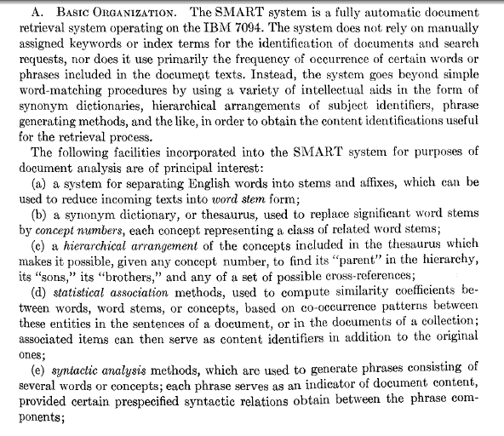
Features of SMART system

Slide 43
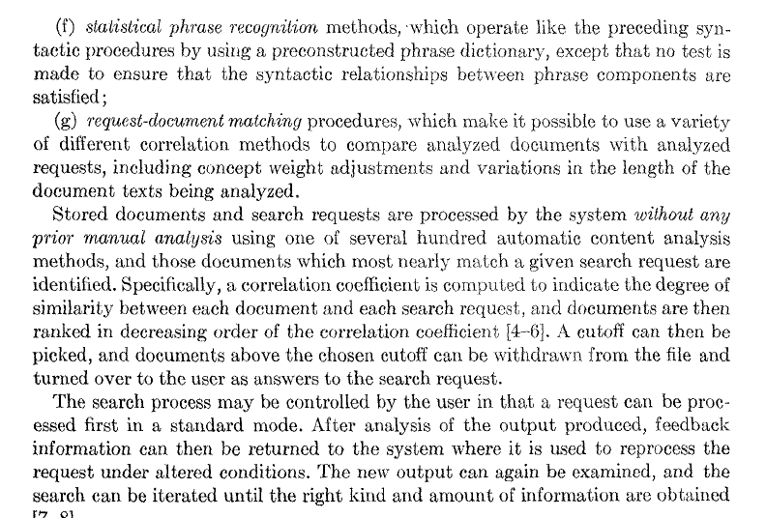
SMART Features (cont.)

Slide 44
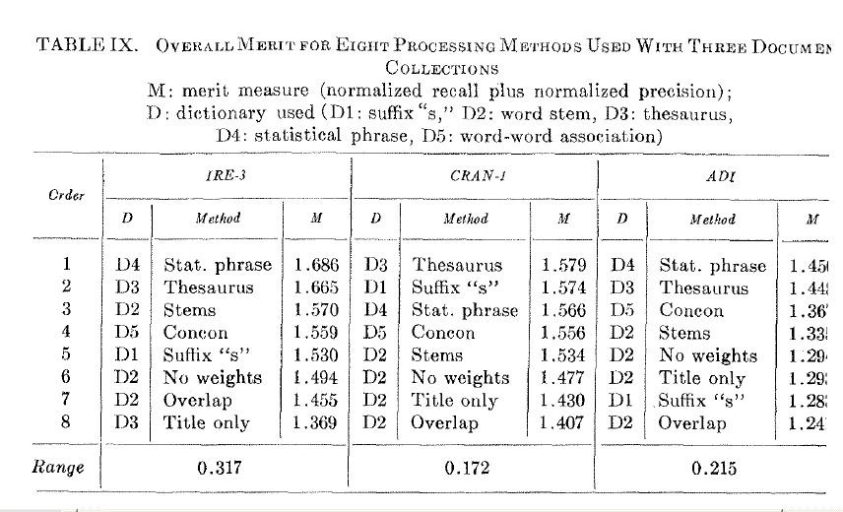
Overall Results
Title only, overlap similarity, and no weights are clearly the worst

Slide 45
Key Findings
Term weighting is very useful (better than binary values)
Cosine similarity is better than the overlap similarity measure
Using abstracts for indexing is better than using titles only
Synonyms are helpful
Automatic indexing may be as effective as manual indexing

Slide 46
Lecture Plan
What is text retrieval (TR) ?
Document selection vs. document ranking
Major research mile stones
Components in a TR system

Slide 47
Typical TR System Architecture
docs
query
Feedback
judgments
Tokenizer
Doc Rep (Index)
Query Rep
User
Scorer
Indexer
Index
results

Slide 48
Text Representation/Indexing
Making it easier to match a query with a document
Query and document should be represented using the same units/terms
Controlled vocabulary vs. full text indexing
Full-text indexing is more practically useful and has proven to be as effective as manual indexing with controlled vocabulary

Slide 49
Tokenization
Normalize lexical units: Words with similar meanings should be mapped to the same indexing term
Stemming: Mapping all inflectional forms of words to the same root form, e.g.
computer -> compute
computation -> compute
computing -> compute (but king->k?)
Porter’s Stemmer is popular for English

Slide 50
Relevance Feedback
Results:
d₁ 3.5
d₂ 2.4
…
d_{k} 0.5
...
Query
Retrieval
Engine
Updated
query
User
Document
collection
Judgments:
d₁ +
d₂ -
d₃ ₊
…
d_{k} -
...
Feedback

Slide 51
Pseudo/Blind/Automatic Feedback
Results:
d₁ 3.5
d₂ 2.4
…
d_{k} 0.5
...
Query
Retrieval
Engine
Updated
query
Document
collection
Judgments:
d₁ +
d₂ +
d₃ ₊
…
d_{k} -
...
top 10
Feedback

Slide 52
Questions?

