Slide 1
Retrieval Models: Vector Space
Intelligent Information Retrieval

Slide 2
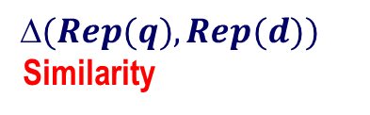
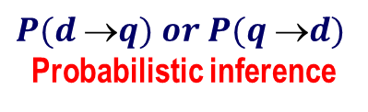
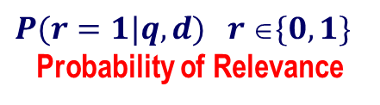
The Notion of Relevance
Relevance
Relevance constraints
(Fang et al. 04)
$$(Rep(q), Rep(d))$$
Similarity
$$P(r=1|q,d) r \{0,1\}$$
Probability of Relevance
$$P(d q) or P(q d)$$
Probabilistic inference
Regression
Model
(Fox 83)
Generative
Model
Different
inference system
Different
rep & similarity
Doc
generation
Query
generation
…
Prob. concept
space model
(Wong & Yao, 95)
Inference
network
model
(Turtle & Croft, 91)
Vector space
model
(Salton et al., 75)
Prob. distr.
model
(Wong & Yao, 89)
Classical
prob. Model
(Robertson &
Sparck Jones, 76)
LM
approach
(Ponte & Croft, 98)
(Lafferty & Zhai, 01a)

Slide 3
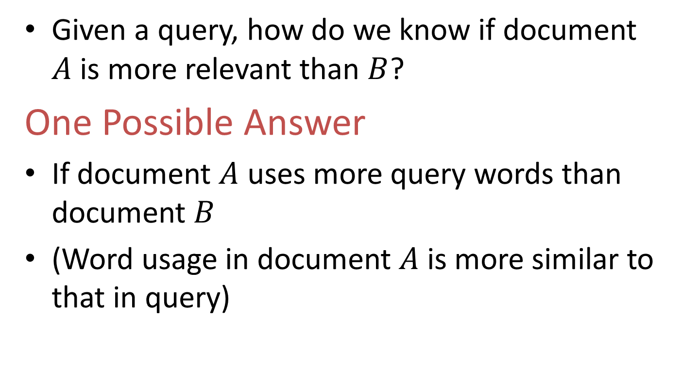
The Basic Question
Given a query, how do we know if document $A$ is more relevant than $B$?
One Possible Answer
If document $A$ uses more query words than document $B$
(Word usage in document $A$ is more similar to that in query)

Slide 4
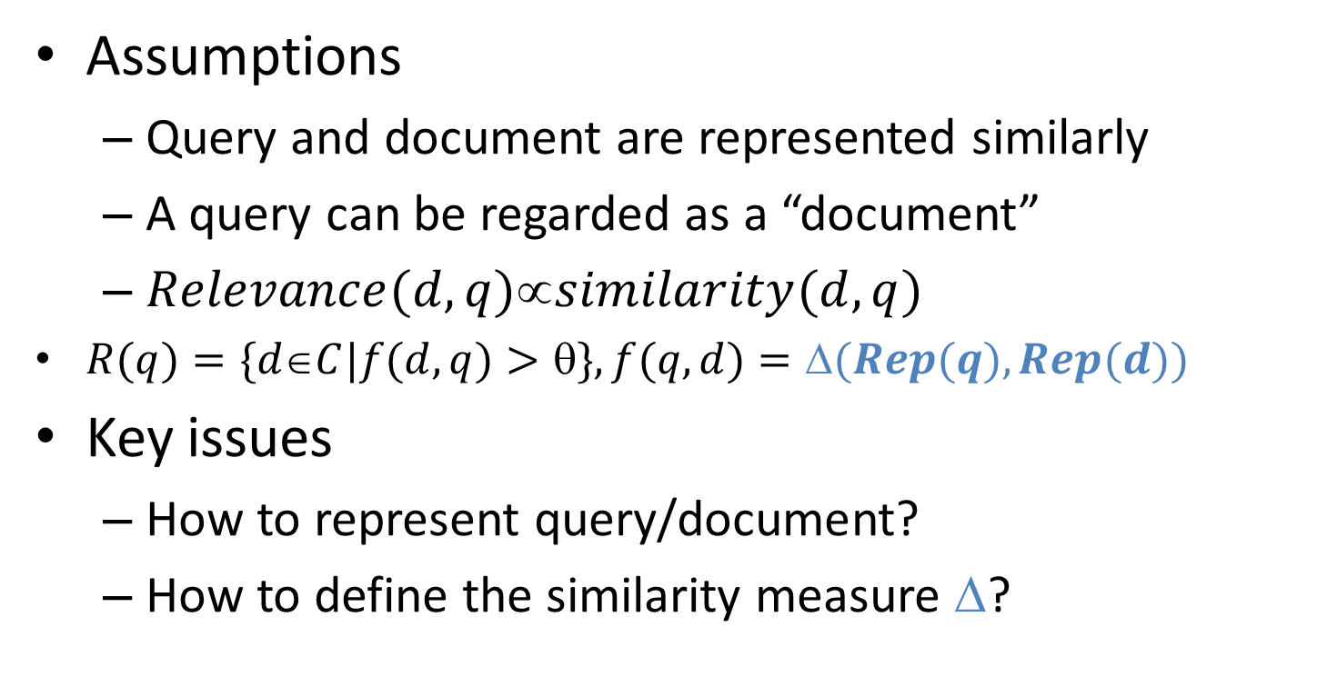
Relevance = Similarity
Assumptions
Query and document are represented similarly
A query can be regarded as a “document”
$Relevance(d,q)similarity(d,q)$
$R(q)=\{dC|f(d,q)>\}, f(q,d)=(Rep(q), Rep(d))$
Key issues
How to represent query/document?
How to define the similarity measure $$?

Slide 5
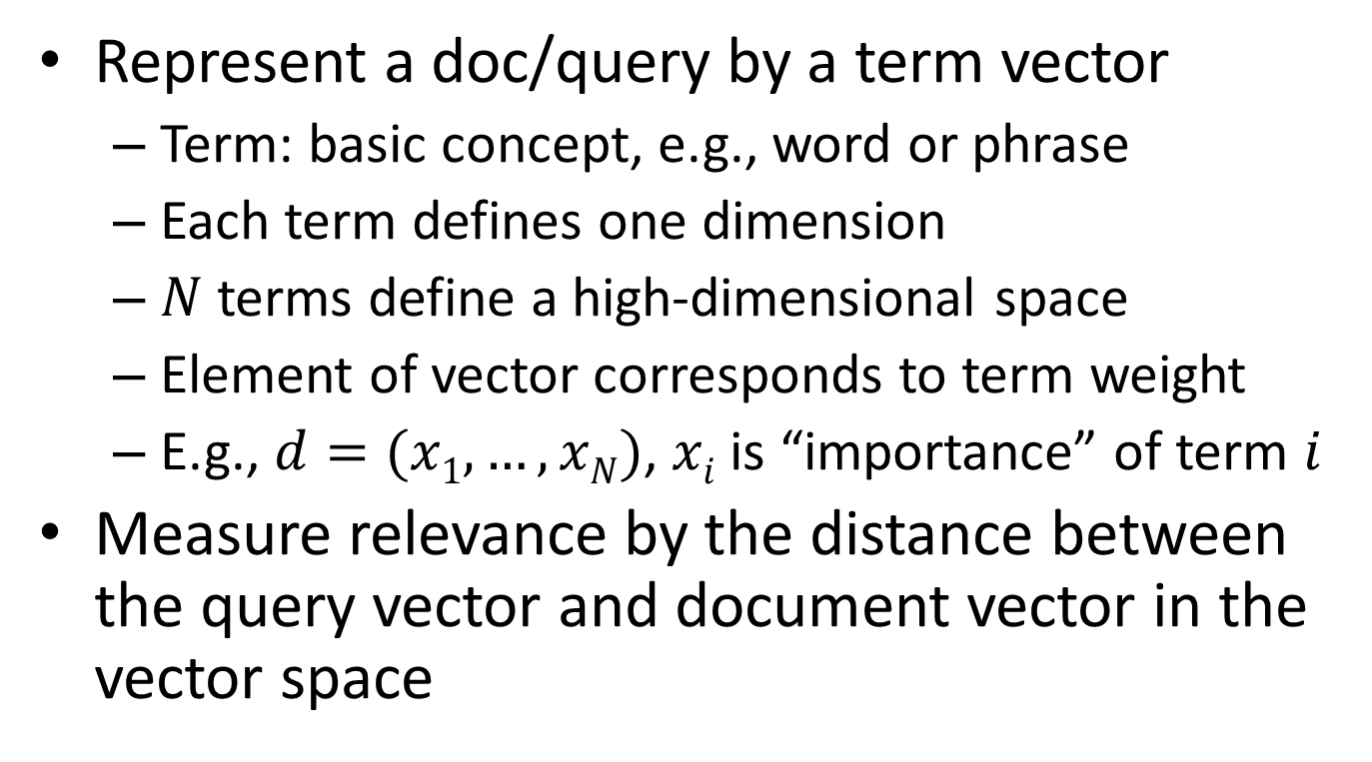
Vector Space Model
Represent a doc/query by a term vector
Term: basic concept, e.g., word or phrase
Each term defines one dimension
$N$ terms define a high-dimensional space
Element of vector corresponds to term weight
E.g., $d=(x1,…,xN)$, $xi$ is “importance” of term $i$
Measure relevance by the distance between the query vector and document vector in the vector space

Slide 6
What’s a good “basic concept”?
Orthogonal
Linearly independent basis vectors
“Non-overlapping” in meaning
No ambiguity
Many possibilities: Words, stemmed words, phrases, “latent concepts”, …
Single words + short statistical phrases are generally “good enough”

Slide 7











VS Model: illustration
Starbucks
? ?
$$D2$$
$$D9$$
? ?
$$D11$$
$$D3$$
$$D5$$
$$D10$$
$$D4$$
$$D6$$
Java
Query
$$D7$$
$$D8$$
$$D1$$
Microsoft
? ?

Slide 8


What the VS model doesn’t say
?
$$q=\left(x_{1}, …, x_{N}\right), x_{i}=?$$
$$d=\left(y_{1}, …, y_{N}\right), y_{i}=?$$
?
?

Slide 9
What the VS model doesn’t say
How to define the dimensions (define “basic concepts” or terms)
Concepts are assumed to be orthogonal
How to place queries and documents in the vector space (how to assign weights)
Weight in query indicates importance of term
Weight in doc indicates how well the term characterizes the doc
How to define the similarity/distance measure
Most research work in VS model tried to address these questions

Slide 10

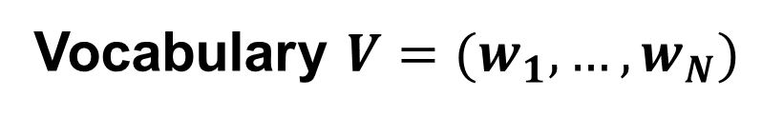


Dimension Instantiation: Bag of Words (BOW)
$$w_{1}$$
$$w_{3}$$
$$w_{2}$$
Vocabulary $V=(w_{1},…,w_{N})$

Slide 11
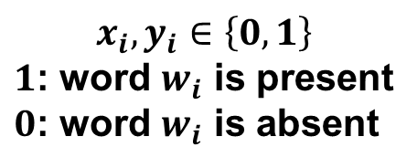


Vector Placement: Bit Vector
$$w_{1}$$
$$q=(x_{1}, …, x_{N})$$
$$d=(y_{1}, …, y_{N})$$
$$x_{i}, y_{i}∈\left\{0,1\right\}$$
$1$: word $w_{i}$ is present
$0$: word $w_{i}$ is absent
$$w_{3}$$
$$w_{2}$$

Slide 12
Similarity Instantiation: Dot Product
$$w_{1}$$
$$q=(x_{1}, …, x_{N})$$
$$d=(y_{1}, …, y_{N})$$
$$w_{3}$$
$$w_{2}$$

Slide 13


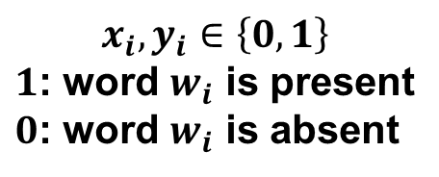
Simplest VSM = Bit-Vector + Dot-Product + BOW
$$x_{i}, y_{i}∈\left\{0,1\right\}$$
$1$: word $w_{i}$ is present
$0$: word $w_{i}$ is absent
What does this ranking function intuitively capture?
Is this a good ranking function?

Slide 14
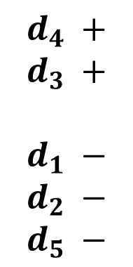





An Example: How Would You Rank These Documents?
Query = “news about presidential campaign”
Ideal Ranking?
$$d_{1}$$
… news about …
$$d_{2}$$
… news about organic food campaign …
$$d_{4} +$$
$$d_{3} +$$
$$d_{1} −$$
$$d_{2} −$$
$$d_{5} −$$
$$d_{3}$$
… news of presidential campaign …
$$d_{4}$$
… news of presidential campaign …
… presidential candidate…
$$d_{5}$$
… news of organic food campaign …
… campaign …. campaign … campaign …

Slide 15
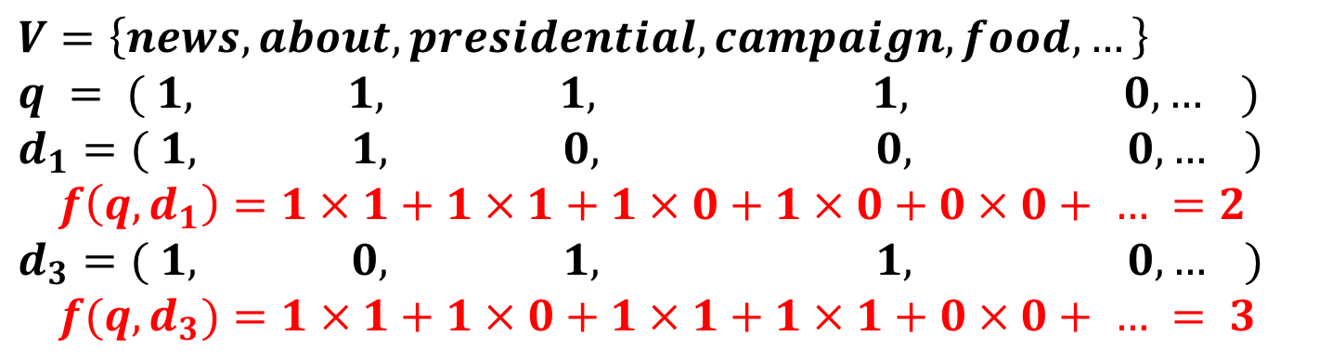

Ranking Using the Simplest VSM
Query = “news about presidential campaign”
$$d_{1}$$
… news about …
$$d_{3}$$
… news of presidential campaign …
$$V=\left\{news, about, presidential, campaign, food, …\right\}$$
$$q = ( 1, 1, 1, 1, 0, … )$$
$$d_{1}=( 1, 1, 0, 0, 0, … )$$
$$f\left(q, d_{1}\right)=1×1+1×1+1×0+1×0+0×0+ … =2$$
$$d_{3}=( 1, 0, 1, 1, 0, … )$$
$$f(q,d_{3})=1×1+1×0+1×1+1×1+0×0+ … = 3$$

Slide 16





Is the Simplest VSM Effective?
Query = “news about presidential campaign”
$$d_{1}$$
… news about …
$$f\left(q,d_{1}\right)=2$$
$$d_{2}$$
… news about organic food campaign …
$$f(q,d_{2})=3$$
$$d_{3}$$
… news of presidential campaign …
$$f(q,d_{3})=3$$
$$d_{4}$$
… news of presidential campaign …
… presidential candidate…
$$f(q,d_{4})=3$$
$$d_{5}$$
… news of organic food campaign …
… campaign …. campaign … campaign …
$$f(q,d_{5})=2$$

Slide 17
Two Problems of the Simplest VSM
Query = “news about presidential campaign”
$$d_{2}$$
… news about organic food campaign …
$$f(q,d_{2})=3$$
$$d_{3}$$
… news of presidential campaign …
$$f(q,d_{3})=3$$
$$d_{4}$$
… news of presidential campaign …
… presidential candidate…
$$f(q,d_{4})=3$$
Matching “presidential” more times deserves more credit.
Matching “presidential” is more important than matching “about”

Slide 18



Improved Vector Placement: Term Frequency Vector
$$w_{1}$$
$$q=(x_{1}, …, x_{N})$$
$x_{i}$ = count of word $wi$ in query
$y_{i}$ = count of word $wi$ in doc
$$d=(y_{1}, …, y_{N})$$
$$w_{3}$$
$$w_{2}$$

Slide 19

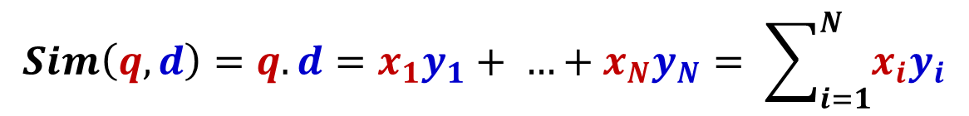



Improved VSM with Term Frequency Weighting
$$q=(x_{1}, …, x_{N})$$
$x_{i}$ = count of word $wi$ in query
$$d=(y_{1}, …, y_{N})$$
$y_{i}$ = count of word $wi$ in doc
$$Sim\left(q,d\right)=q.d=x_{1}y_{1}+ …+x_{N}y_{N}= \sum_{i=1}^{N}{x_{i}y_{i}}$$
What does this ranking function intuitively capture?
Does it fix the problems of the simplest VSM?

Slide 20






Ranking using Term Frequency (TF) Weighting
V= {news, about, presidential, campaign, food, …}
$$d_{2}$$
… news about organic food campaign …
$$q = (1, 1, 1, 1, 0, …)$$
$$f(q,d_{2})=3$$
$$d_{2}=(1, 1, 0, 1, 1, …)$$
$$d_{3}$$
… news of presidential campaign …
$$q = (1, 1, 1, 1, 0, …)$$
$$f(q,d_{3})=3$$
$$d_{3}=(1, 0, 1, 1, 0, …)$$
$$d_{4}$$
… news of presidential campaign …
… presidential candidate…
$$q=(1, 1, 1, 1, 0, …)$$
$$f(q,d_{4})=4!$$
$$d_{4}=(1, 0, 2, 1, 0, …)$$

Slide 21

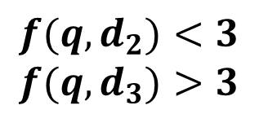
How to Fix Problem 2 (“presidential” vs. “about”)?
$$d_{2}$$
… news about organic food campaign …
$$d_{3}$$
… news of presidential campaign …
V={news, about, presidential, campaign, food, …}
$$q = (1, 1, 1, 1, 0, …)$$
$$d_{2}=(1, 1, 0, 1, 1, …)$$
$$f(q,d_{2})<3$$
$$f(q,d_{3})>3$$
$$q = (1, 1, 1, 1, 0, …)$$
$$d_{3}=(1, 0, 1, 1, 0, …)$$

Slide 22


Further Improvement of Vector Placement: Adding Inverse Document Frequency (IDF)
$$w_{1}$$
$$q=(x_{1}, …, x_{N})$$
$x_{i}$ = count of word $wi$ in query
$$y_{i}= c(wi, d)∗IDF(wi)$$
$$d=(y_{1}, …, y_{N})$$
$$w_{3}$$
$$w_{2}$$

Slide 23
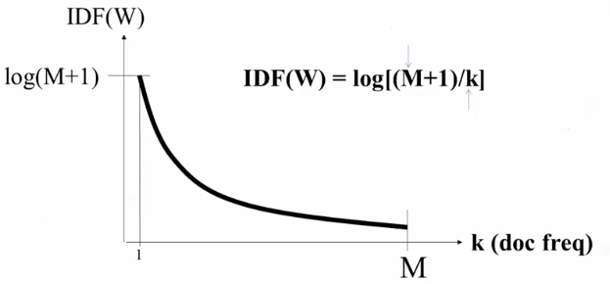
IDF Weighting: Penalizing Popular Terms
total number of docs in collection
total number of docs containing W
(Doc Frequency)

Slide 24
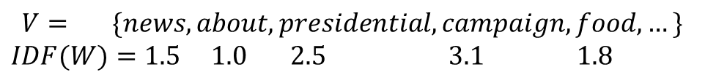

Solving Problem 2 (“presidential” vs. “about”)?
$$d_{2}$$
… news about organic food campaign …
$$d_{3}$$
… news of presidential campaign …
$$V= \{news, about, presidential, campaign, food, …\}$$
$$IDF(W)=1.5 1.0 2.5 3.1 1.8$$
$$q = (1, 1, 1, 1, 0, …)$$
$$d_{2}=(1∗1.5, 1∗1.0, 0, 1∗3.1, 1∗1.8,…)$$
$$q = (1, 1, 1, 1, 0, …)$$
$$d_{3}=(1∗1.5, 0, 1∗2.5, 1∗3.1 0, …)$$
$$f(q,d_{2})=5.6<f(q,d_{3})=7.1$$

Slide 25





How Effective is VSM with TF-IDF Weighting?
Query = “news about presidential campaign”
$$d_{1}$$
… news about …
$$f(q,d_{1})=2.5$$
$$d_{2}$$
… news about organic food campaign …
$$f(q,d_{2})=5.6$$
$$d_{3}$$
… news of presidential campaign …
$$f(q,d_{3})=7.1$$
$$d_{4}$$
… news of presidential campaign …
… presidential candidate…
$$f(q,d_{4})=9.6$$
$$d_{5}$$
… news of organic food campaign …
… campaign …. campaign … campaign …
$$f(q,d_{5})=13.9!$$

Slide 26
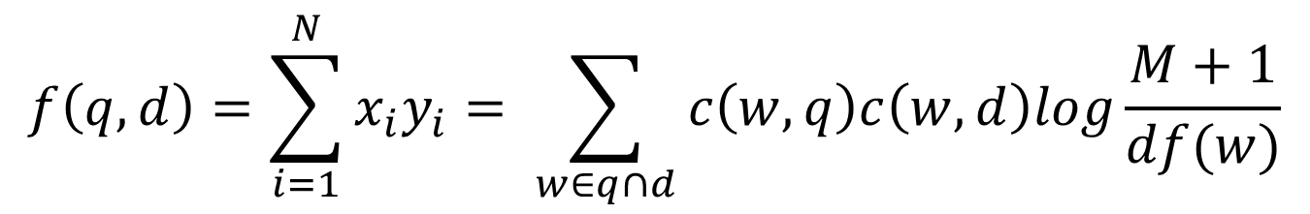
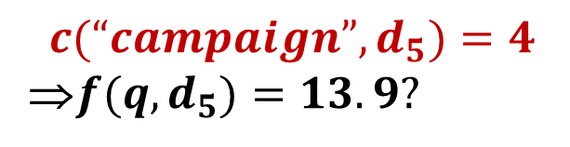

Ranking Function with TF-IDF Weighting
total # of docs in collection
$$f\left(q,d\right)=\sum_{i=1}^{N}{x_{i}y_{i}= \sum_{w∈q∩d}{c\left(w,q\right)c\left(w,d\right)log}\frac{M+1}{df(w)}}$$
Doc Frequency
All matched query words in $d$
$$d_{5}$$
… news of organic food campaign …
… campaign …. campaign … campaign …
$$c(“campaign”, d_{5})=4$$
⇒$f(q,d_{5})=13.9?$

Slide 27
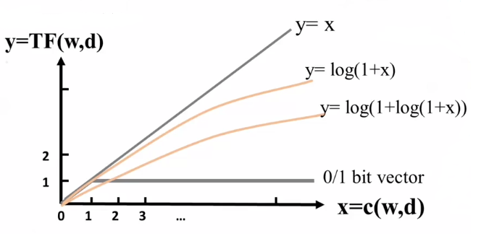
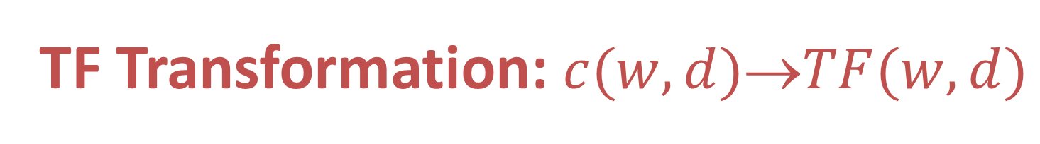
TF Transformation: $c(w,d)TF(w,d)$
Term Frequency Weight

Slide 28
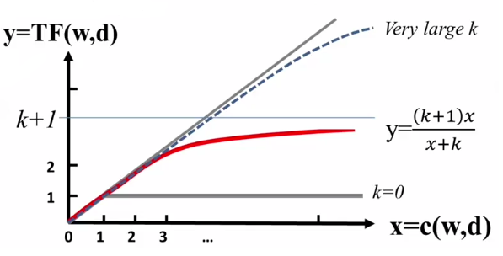
TF Transformation: BM25 Transformation
Term Frequency Weight

Slide 29


What about Document Length?
Query = “news about presidential campaign”
$$d_{4}$$
… news of presidential campaign …
… presidential candidate…
$$d_{6}>d_{4}?$$
100 words
$$d_{6}$$
… campaign ……………………………………………………………
…………………………………………………………………………...
……………news………………………………………………………
…………………………………………………………………………...
……………………………………………………news……………...
…………………………………………………………………………...
… presidential …. presidential …
5000 words

Slide 30
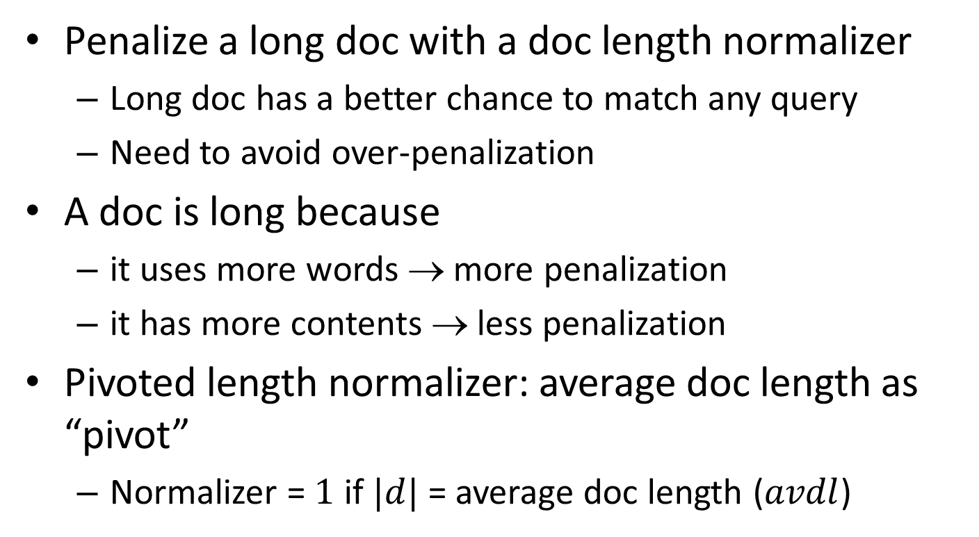
Document Length Normalization
Penalize a long doc with a doc length normalizer
Long doc has a better chance to match any query
Need to avoid over-penalization
A doc is long because
it uses more words → more penalization
it has more contents → less penalization
Pivoted length normalizer: average doc length as “pivot”
Normalizer = $1$ if $|d|$ = average doc length ($avdl$)

Slide 31
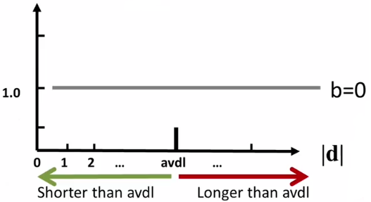

Pivoted Length Normalization
$$normalizer=1−b+b\frac{\left|d\right|}{avdl} b∈[0,1]$$
b>>0
b>0
reward
penalization

Slide 32
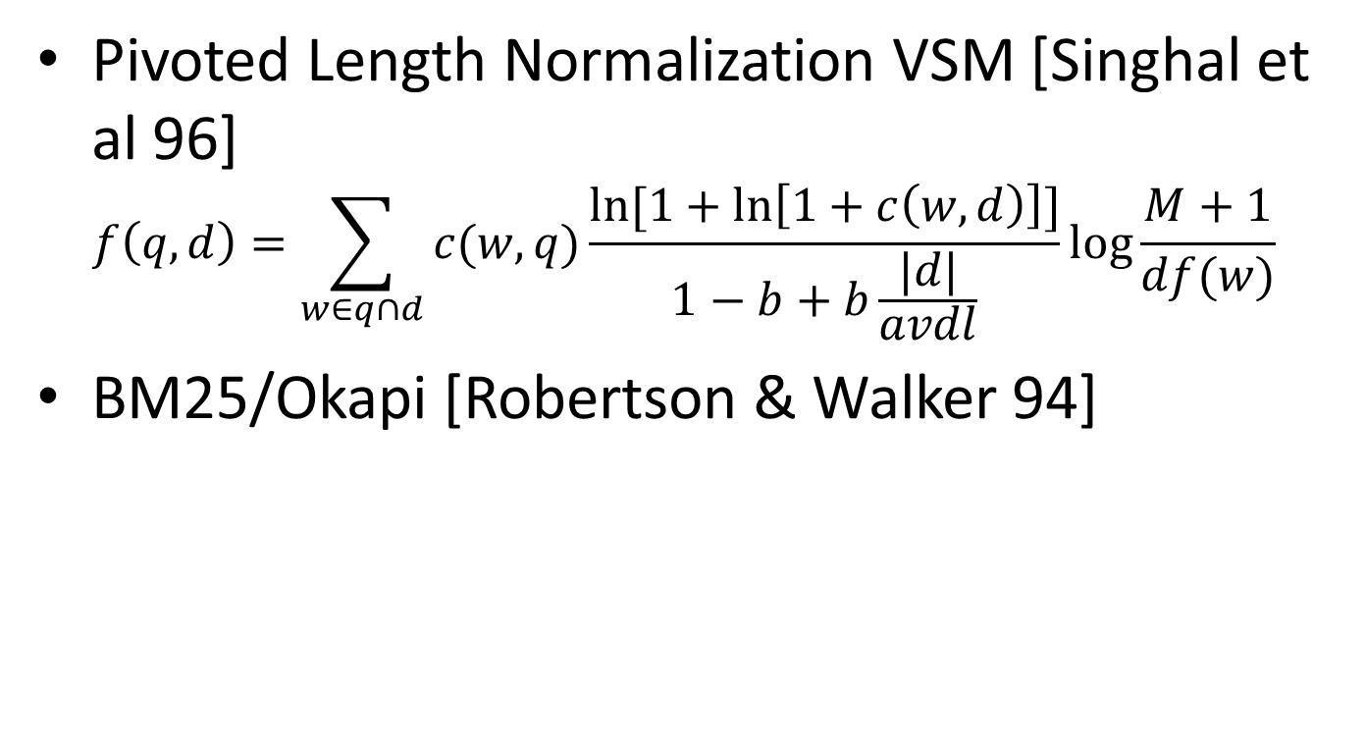


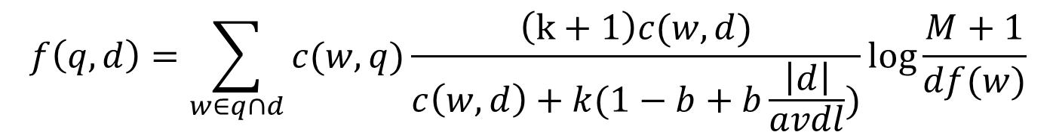
State of the Art VSM Ranking Functions
Pivoted Length Normalization VSM [Singhal et al 96]
$$f\left(q,d\right)=\sum_{w∈q∩d}{c(w,q)\frac{ln⁡[1+\ln\left[1+c\left(w,d\right)\right]]}{1−b+b\frac{|d|}{avdl}}}log\frac{M+1}{df(w)}$$
BM25/Okapi [Robertson & Walker 94]
$$b∈\left[0,1\right]$$
$$k_{1}, k_{3}∈[0,+∞)$$
$$f\left(q,d\right)=\sum_{w∈q∩d}{c(w,q)\frac{\left(k+1\right)c(w,d)}{c\left(w,d\right)+k(1−b+b\frac{\left|d\right|}{avdl})}}log\frac{M+1}{df(w)}$$

Slide 33
Further Improvement of VSM?
Improved instantiation of dimension?
Stemmed words, stop word removal, phrases, latent semantic indexing (word clusters), character n-grams, …
Bag-of-words with phrases is often sufficient in practice
Language-specific and domain-specific tokenization is important to ensure “normalization of terms”
Improved instantiation of similarity function?
Cosine of angle between two vectors?
Euclidean?
Dot product seems still the best (sufficiently general especially with appropriate term weighting)

Slide 34
Relevance Feedback in VS
Basic setting: Learn from examples
Positive examples: docs known to be relevant
Negative examples: docs known to be non-relevant
How do you learn from this to improve performance?
General method: Query modification
Adding new (weighted) terms
Adjusting weights of old terms
Doing both
The most well-known and effective approach is Rocchio [Rocchio 1971]

Slide 35
Rocchio Feedback: Illustration
-
-
-
-
-
+
-
+
+
-
-
+
+
-
-
-
-
+
q
q
-
-
+
+
+
-
-
+
+
-
-
+
+
+
+
+
-
+
+
+
-
-
-
-
-
-
-
-

Slide 36
Rocchio Feedback: Formula
Parameters
New query
Origial query
Rel docs
Non-rel docs

Slide 37
Rocchio in Practice
Negative (non-relevant) examples are not very important (why?)
Often project the vector onto a lower dimension (i.e., consider only a small number of words that have high weights in the centroid vector)
Avoid “training bias” (keep relatively high weight on the original query weights)
Can be used for relevance feedback and pseudo feedback
Usually robust and effective

Slide 38
Advantages of VS Model
Empirically effective! (Top TREC performance)
Intuitive
Easy to implement
Well-studied/Most evaluated
Warning: Many variants of TF-IDF!

Slide 39
Disadvantages of VS Model
Assume term independence
Assume query and document to be the same
Lots of parameter tuning!

Slide 40
Questions?

