Slide 1
Retrieval Models: Probabilistic
Intelligent Information Retrieval

Slide 2
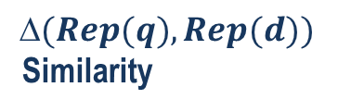
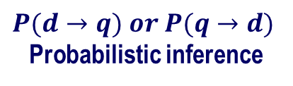
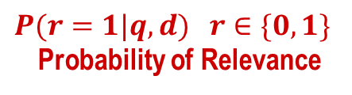
The Notion of Relevance
Relevance
Relevance constraints
(Fang et al. 04)
$$(Rep(q), Rep(d))$$
Similarity
$P(r=1|q,d)$ $r∈\{0,1\}$
Probability of Relevance
$$P(d→q) or P(q→d)$$
Probabilistic inference
Regression
Model
(Fox 83)
Generative
Model
Different
inference system
Different
rep & similarity
Doc
generation
Query
generation
…
Prob. concept
space model
(Wong & Yao, 95)
Inference
network
model
(Turtle & Croft, 91)
Vector space
model
(Salton et al., 75)
Prob. distr.
model
(Wong & Yao, 89)
Classical
prob. Model
(Robertson &
Sparck Jones, 76)
LM
approach
(Ponte & Croft, 98)
(Lafferty & Zhai, 01a)

Slide 3
Probability Ranking Principle [Robertson 77]
Returning a ranked list of documents in descending order of probability that a document is relevant to the query is the optimal strategy under the following two assumptions:
The utility of a document to a user is independent of the utility of any other document.
A user would browse the results sequentially

Slide 4
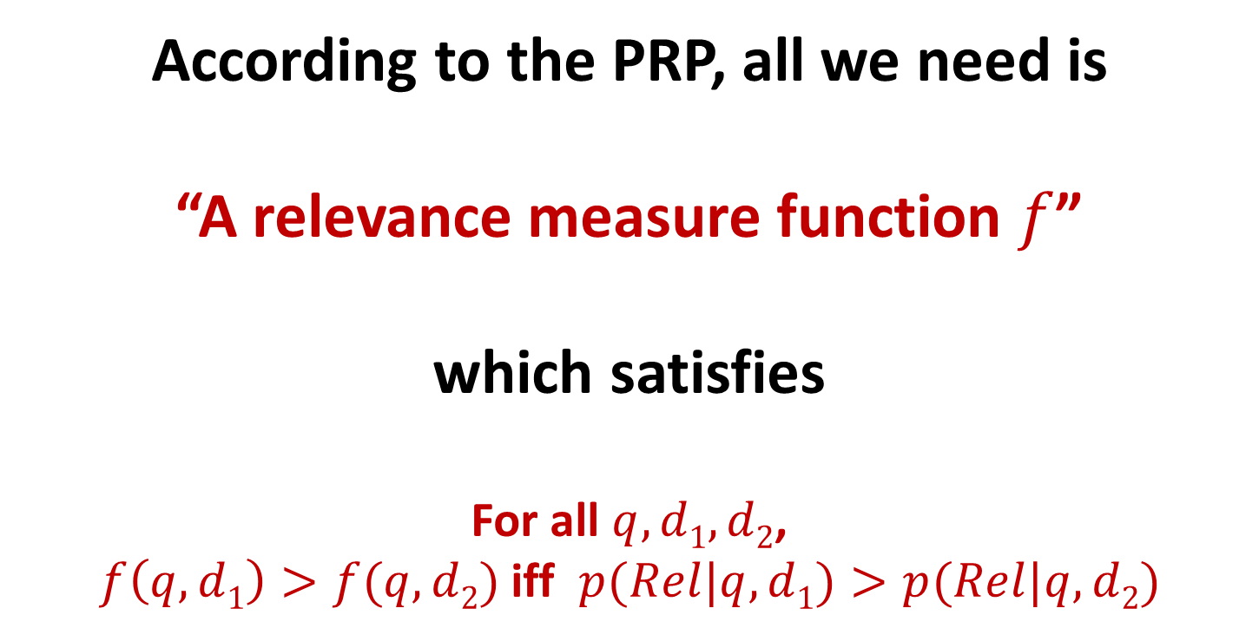
According to the PRP, all we need is “A relevance measure function $f$” which satisfies For all $q, d1, d2$, $f\left(q,d1\right)>f(q,d2)$iff $p(Rel|q,d1)>p(Rel|q,d2)$

Slide 5
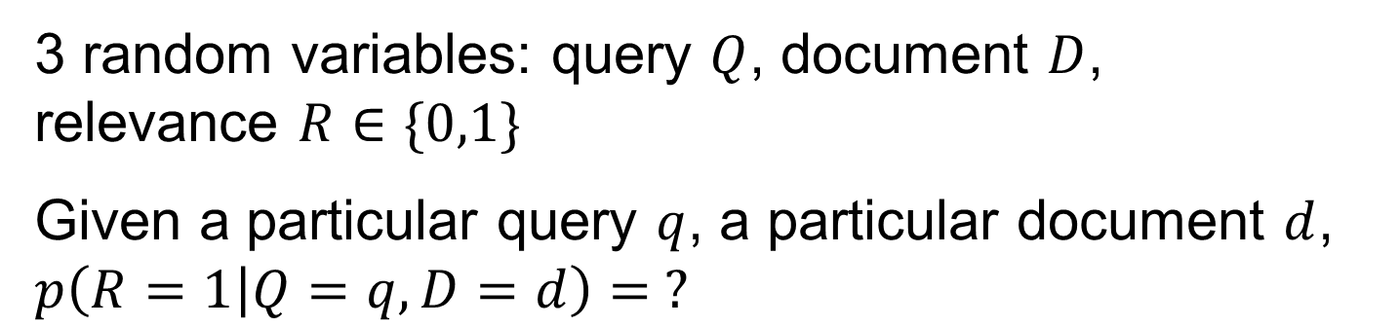
The Basic Question
What is the probability that THIS document is relevant to THIS query?
Formally…
3 random variables: query $Q$, document $D$, relevance $R∈\{0,1\}$
Given a particular query $q$, a particular document $d$, $p\left(R=1 | Q=q,D=d\right)= ?$

Slide 6
Detour ...
Brief Review of Probability

Slide 7
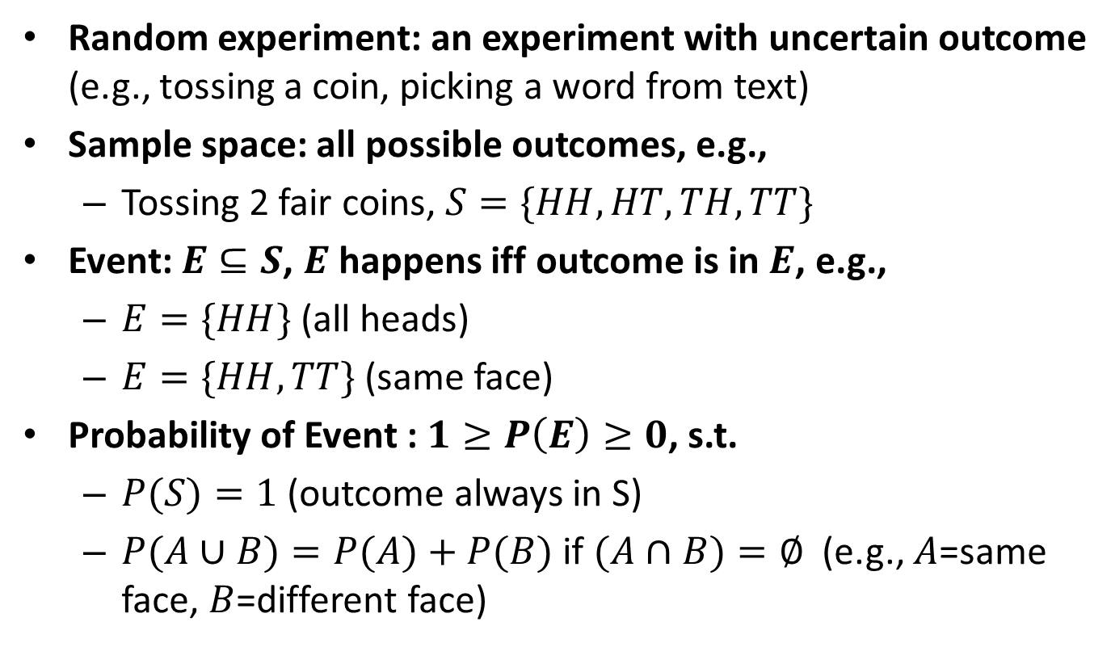
Basic Concepts in Probability
Random experiment: an experiment with uncertain outcome (e.g., tossing a coin, picking a word from text)
Sample space: all possible outcomes, e.g.,
Tossing 2 fair coins, $S=\{HH, HT, TH, TT\}$
Event: $E⊆S$, $E$ happens iff outcome is in $E$, e.g.,
$E=\{HH\}$(all heads)
$E=\{HH,TT\}$(same face)
Probability of Event : $1≥P\left(E\right)≥0$, s.t.
$P(S)=1$(outcome always in S)
$P(A∪B)=P(A)+P(B)$if $(A∩B)=∅$ (e.g., $A$=same face, $B$=different face)

Slide 8
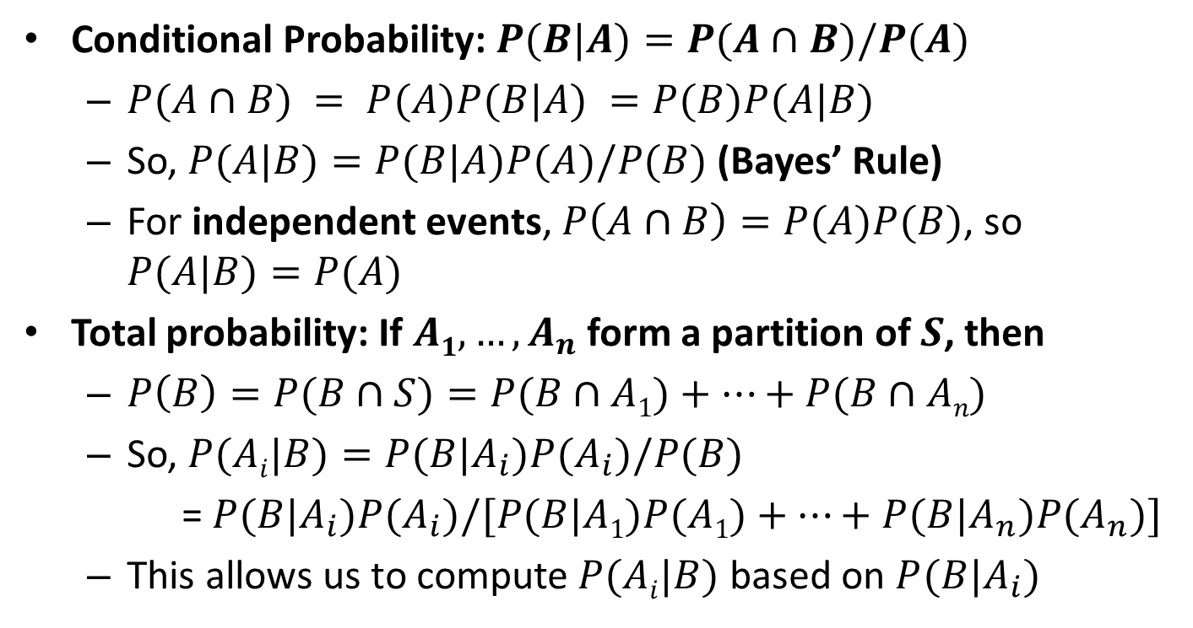
Basic Concepts of Prob. (cont.)
Conditional Probability: $P(B|A)=P(A∩B)/P(A)$
$P(A∩B) = P(A)P(B|A) =P(B)P(A|B)$
So, $P(A|B)=P(B|A)P(A)/P(B)$(Bayes’ Rule)
For independent events, $P\left(A∩B\right)=P(A)P(B)$, so $P(A|B)=P(A)$
Total probability: If $A1, …, A_{n}$ form a partition of $S$, then
$P\left(B\right)=P(B∩S)=P(B∩A1)+…+P(B∩An)$
So, $P(Ai|B)=P(B|A_{i})P(A_{i})/P(B)$
= $P(B|A_{i})P(A_{i})/[P(B|A1)P(A1)+…+P(B|A_{n})P(A_{n})]$
This allows us to compute $P(Ai|B)$ based on $P(B|A_{i})$

Slide 9
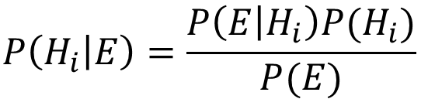
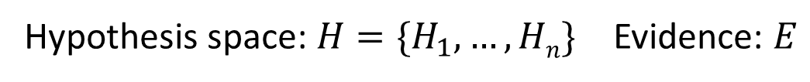
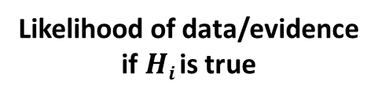



Interpretation of Bayes’ Rule
Hypothesis space: $H=\{H_{1},…,Hn\}$ Evidence: $E$
$$P\left(H_{i} | E\right)=\frac{P\left(E | H_{i}\right)P(H_{i})}{P(E)}$$
If we want to pick the most likely hypothesis $H^{∗}$, we can drop $P(E)$
Posterior probability of $Hi$
Prior probability of $Hi$
$$P(H_{i}|E)∝P\left(E | H_{i}\right)P(H_{i})$$
Likelihood of data/evidence
if $Hi$is true

Slide 10
End of Detour...
Now, let’s go back to retrieval!

Slide 11
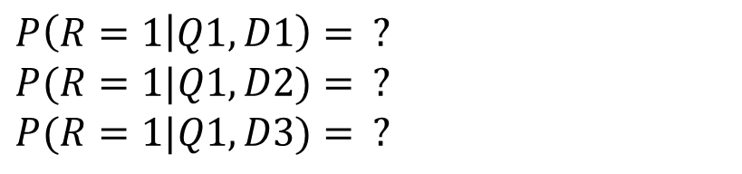
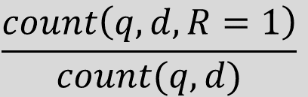
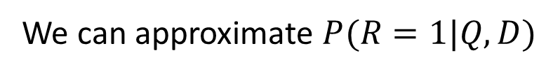
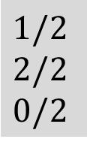
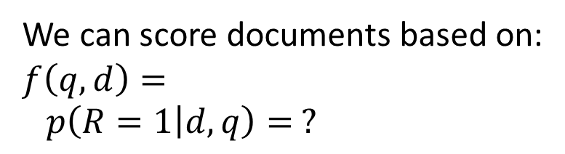
Probabilistic Retrieval Models: Intuitions
Suppose we have a large number of relevance judgments
(e.g. clickthroughs: “1”=clicked; “0”=skipped)
Query(Q) Doc(D) Rel(R) ?
Q1 D1 1
Q1 D2 1
Q1 D3 0
Q1 D4 0
Q1 D5 1
…
Q1 D1 0
Q1 D2 1
Q1 D3 0
Q2 D3 1
Q3 D1 1
Q4 D2 1
Q4 D3 0
…
We can score documents based on:
$$f\left(q,d\right)=$$
$$p\left(R=1 | d,q\right)= ?$$
$$\frac{count\left(q,d,R=1\right)}{count(q,d)}$$
$$1/2$$
$$2/2$$
$$0/2$$
$$P\left(R=1 | Q1,D1\right)= ?$$
$$P(R=1|Q1,D2)= ?$$
$$P(R=1|Q1,D3)= ?$$
What if we don’t have sufficient
search log?
Unseen documents/queries?
We can approximate $P(R=1|Q,D)$

Slide 12
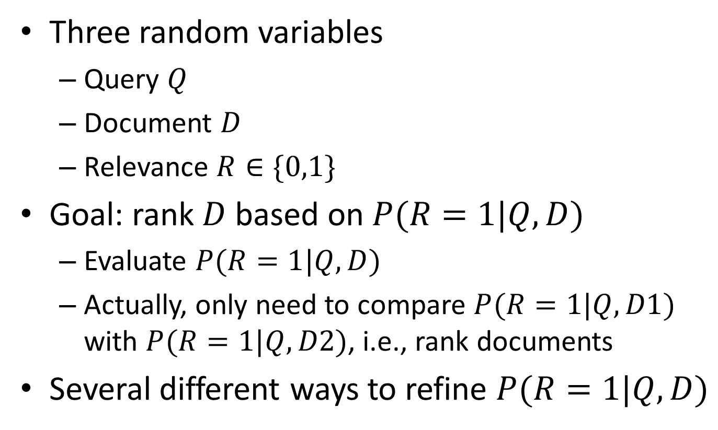
Probability of Relevance
Three random variables
Query $Q$
Document $D$
Relevance $R∈\{0,1\}$
Goal: rank $D$ based on $P(R=1|Q,D)$
Evaluate $P(R=1|Q,D)$
Actually, only need to compare $P(R=1|Q,D1)$ with $P(R=1|Q,D2)$, i.e., rank documents
Several different ways to refine $P(R=1|Q,D)$

Slide 13

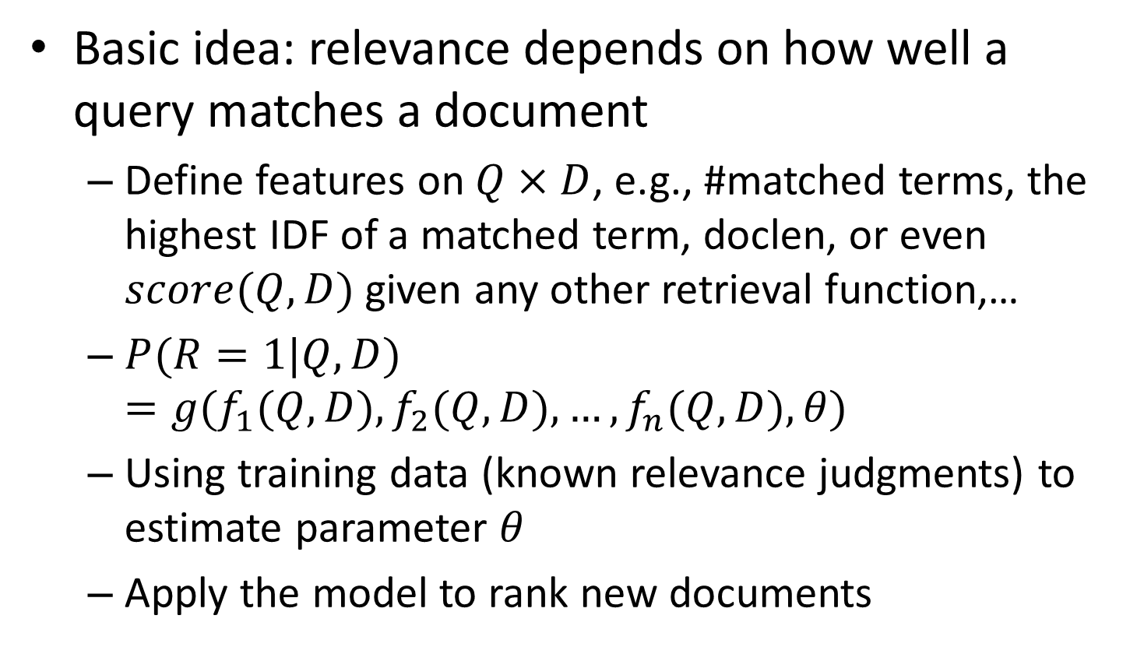
Refining $P(R=1|Q,D)$ Method 1: conditional models
Basic idea: relevance depends on how well a query matches a document
Define features on $Q×D$, e.g., #matched terms, the highest IDF of a matched term, doclen, or even $score(Q,D)$ given any other retrieval function,…
$P(R=1|Q,D)=g(f_{1}(Q,D), f_{2}(Q,D),…,f_{n}(Q,D),θ)$
Using training data (known relevance judgments) to estimate parameter $θ$
Apply the model to rank new documents

Slide 14

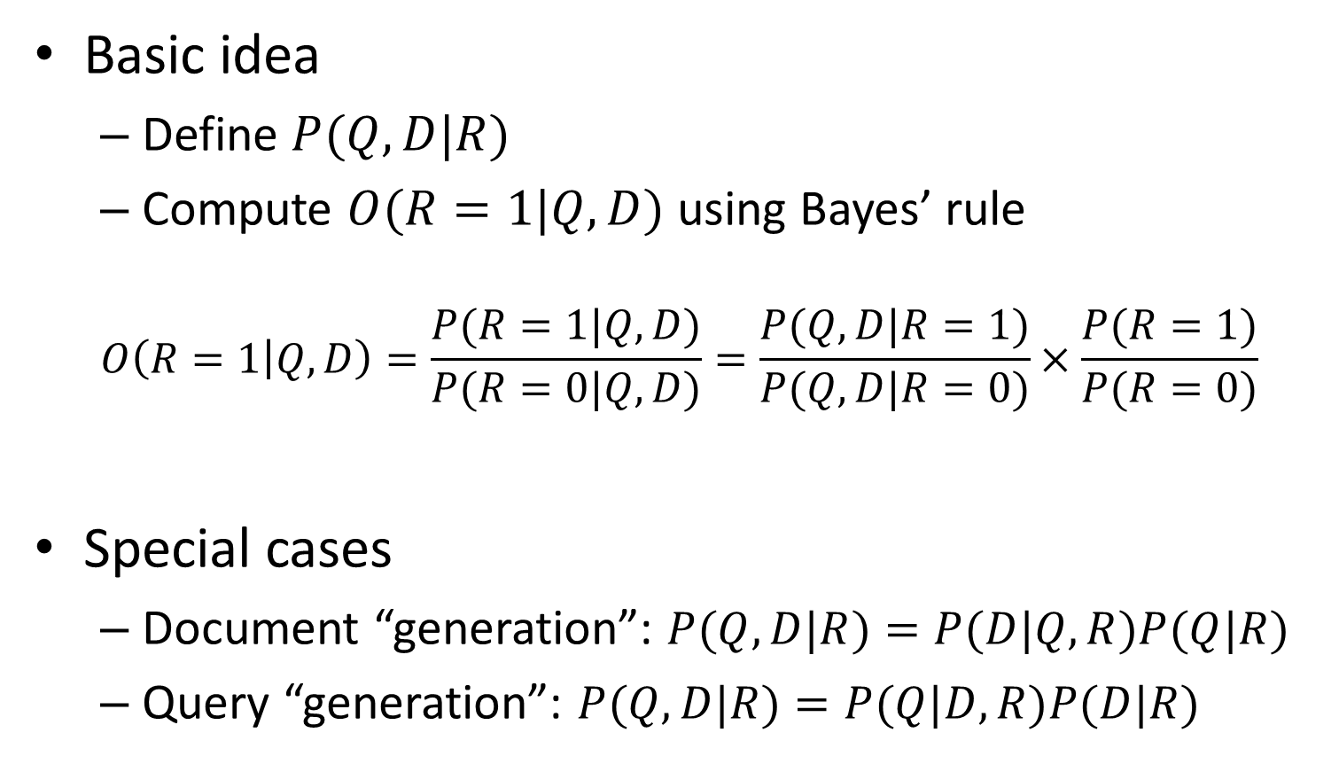
Refining $P(R=1|Q,D)$ Method 2: generative models
Basic idea
Define $P(Q,D|R)$
Compute $O(R=1|Q,D)$ using Bayes’ rule
$$O\left(R=1 | Q,D\right)=\frac{P(R=1|Q,D)}{P(R=0|Q, D)}=\frac{P(Q,D|R=1)}{P(Q,D|R=0)}×\frac{P(R=1)}{P(R=0)}$$
Special cases
Document “generation”: $P(Q,D|R)=P(D|Q,R)P(Q|R)$
Query “generation”: $P(Q,D|R)=P(Q|D,R)P(D|R)$
Ignored for ranking D

Slide 15
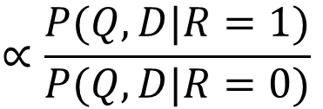
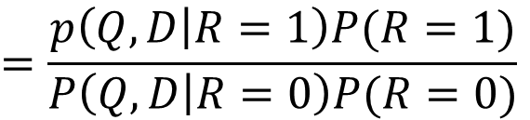
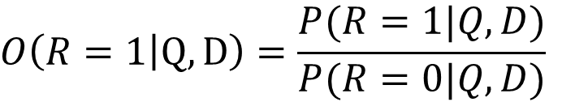
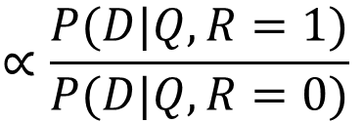
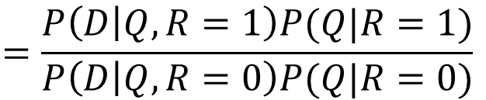
Document Generation
$$O\left(R=1 | Q,D\right)=\frac{P(R=1|Q,D)}{P(R=0|Q,D)}$$
$$=\frac{p\left(Q,D | R=1\right)P(R=1)}{P\left(Q,D | R=0\right)P(R=0)}$$
$$∝\frac{P(Q,D|R=1)}{P(Q,D|R=0)}$$
$$=\frac{P\left(D | Q,R=1\right)P(Q|R=1)}{P\left(D | Q,R=0\right)P(Q|R=0)}$$
$$∝\frac{P(D|Q,R=1)}{P(D|Q,R=0)}$$
Model of relevant docs for Q
Model of non-relevant docs for Q

Slide 16

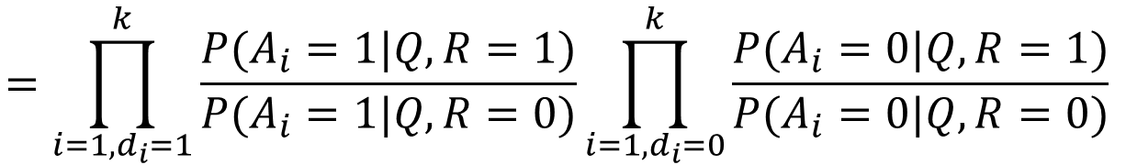
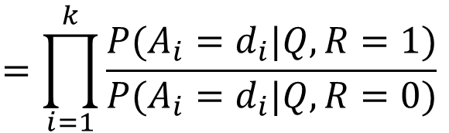
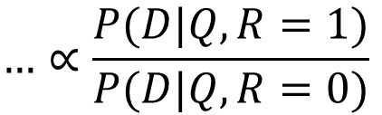
Document Generation (cont’d)
Assume independent attributes $A1…Ak$
Let $D=d1…dk$, where $d_{i}∈\{0,1\}$ is the value of attribute $A_{i}$ (Similarly $Q=q1…qk$ )
$$…∝\frac{P(D|Q,R=1)}{P(D|Q,R=0)}$$
$$=\prod_{i=1}^{k}{\frac{P(A_{i}=d_{i}|Q,R=1)}{P(A_{i}=d_{i}|Q,R=0)}}$$
$$=\prod_{i=1, d_{i}=1}^{k}{\frac{P(A_{i}=1|Q,R=1)}{P(A_{i}=1|Q,R=0)}}\prod_{i=1, d_{i}=0}^{k}{\frac{P(A_{i}=0|Q,R=1)}{P(A_{i}=0|Q,R=0)}}$$

Slide 17
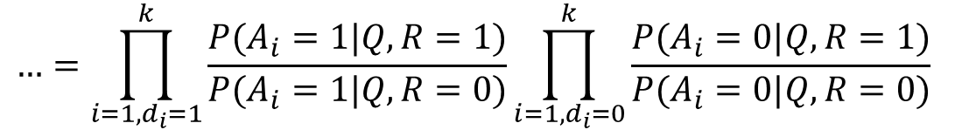
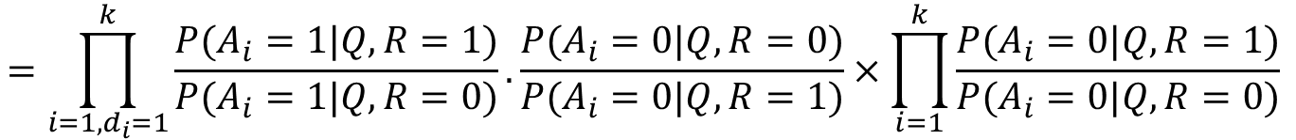
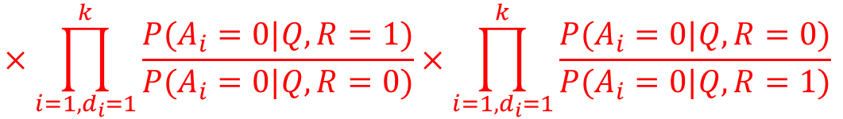
Document Generation (cont’d)
$$…=\prod_{i=1, d_{i}=1}^{k}{\frac{P(A_{i}=1|Q,R=1)}{P(A_{i}=1|Q,R=0)}}\prod_{i=1, d_{i}=0}^{k}{\frac{P(A_{i}=0|Q,R=1)}{P(A_{i}=0|Q,R=0)}}$$
$$×\prod_{i=1, d_{i}=1}^{k}{\frac{P(A_{i}=0|Q,R=1)}{P(A_{i}=0|Q,R=0)}×\prod_{i=1, d_{i}=1}^{k}{\frac{P(A_{i}=0|Q,R=0)}{P(A_{i}=0|Q,R=1)}}}$$
$$=\prod_{i=1, d_{i}=1}^{k}{\frac{P(A_{i}=1|Q,R=1)}{P(A_{i}=1|Q,R=0)}.\frac{P(A_{i}=0|Q,R=0)}{P(A_{i}=0|Q,R=1)}×\prod_{i=1}^{k}{\frac{P(A_{i}=0|Q,R=1)}{P(A_{i}=0|Q,R=0)}}}$$
Ignore for ranking

Slide 18

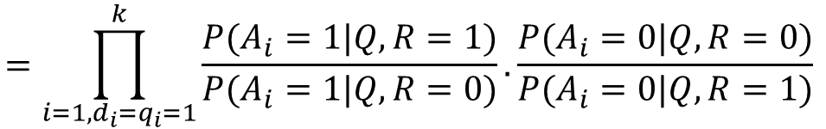
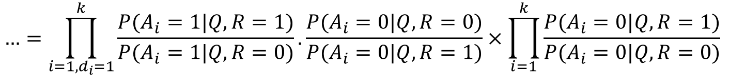
Document Generation (cont’d)
Assume $P\left(A_{i}=1 | Q,R=1\right)=P\left(A_{i}=1 | Q,R=0\right)$ if the term does not appear in the query ($q_{i}=0$)
$$…=\prod_{i=1, d_{i}=1}^{k}{\frac{P(A_{i}=1|Q,R=1)}{P(A_{i}=1|Q,R=0)}.\frac{P(A_{i}=0|Q,R=0)}{P(A_{i}=0|Q,R=1)}×\prod_{i=1}^{k}{\frac{P(A_{i}=0|Q,R=1)}{P(A_{i}=0|Q,R=0)}}}$$
Ignore for ranking
$$=\prod_{i=1, d_{i}=q_{i}=1}^{k}{\frac{P(A_{i}=1|Q,R=1)}{P(A_{i}=1|Q,R=0)}.\frac{P(A_{i}=0|Q,R=0)}{P(A_{i}=0|Q,R=1)}}$$

Slide 19
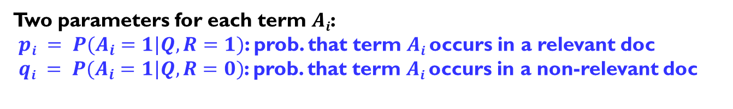
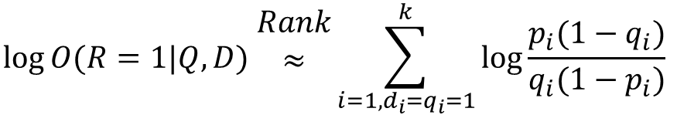
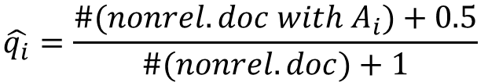
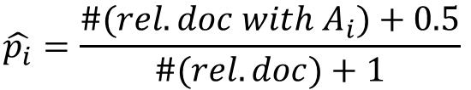
Robertson-Sparck Jones Model (Robertson & Sparck Jones 76)
$$\log{O(R=1|Q,D) \begin{matrix}Rank \\ ≈ \\ \end{matrix}\sum_{i=1, d_{i}=q_{i}=1}^{k}{\log{\frac{p_{i}(1−q_{i})}{q_{i}(1−p_{i})}}}}$$
(RSJ model)
Two parameters for each term $Ai$:
$pi = P(A_{i}=1|Q,R=1)$: prob. that term $Ai$ occurs in a relevant doc
$qi = P(A_{i}=1|Q,R=0)$: prob. that term $Ai$ occurs in a non-relevant doc
How to estimate parameters?
Suppose we have relevance judgments,
$$\hat{p_{i}}=\frac{\#(rel. doc with A_{i})+0.5}{\#(rel. doc)+1}$$
$$\hat{q_{i}}=\frac{\#(nonrel. doc with A_{i})+0.5}{\#(nonrel. doc)+1}$$

Slide 20
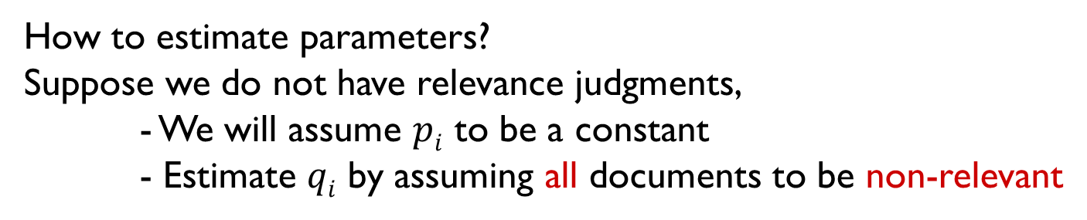
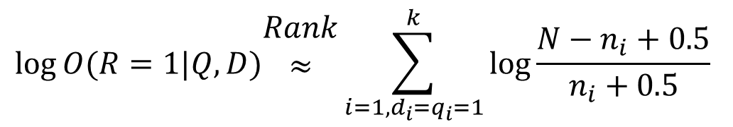
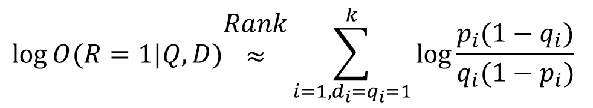

RSJ Model: No Relevance Info (Croft & Harper 79)
$$\log{O(R=1|Q,D)\begin{matrix}Rank \\ ≈ \\ \end{matrix}\sum_{i=1,d_{i}=q_{i}=1}^{k}{\log{\frac{p_{i}(1−q_{i})}{q_{i}(1−p_{i})}}}}$$
(RSJ model)
How to estimate parameters?
Suppose we do not have relevance judgments,
- We will assume $pi$ to be a constant
- Estimate $qi$ by assuming all documents to be non-relevant
$$\log{O(R=1|Q,D)\begin{matrix}Rank \\ ≈ \\ \end{matrix}\sum_{i=1,d_{i}=q_{i}=1}^{k}{\log{\frac{N−n_{i}+0.5}{n_{i}+0.5}}}}$$
$N$: # documents in collection
$ni$: # documents in which term $Ai$ occurs

Slide 21
RSJ Model: Summary
The most important classic prob. IR model
Use only term presence/absence, thus also referred to as Binary Independence Model
Essentially Naïve Bayes for doc ranking
Most natural for relevance/pseudo feedback
When without relevance judgments, the model parameters must be estimated in an ad hoc way
Performance isn’t as good as tuned VS model

Slide 22
Improving RSJ: Adding TF
Basic doc. generation model:
Let $D=d1…dk$, where $dk$ is the frequency count of term $Ak$
2-Poisson mixture model
Many more parameters to estimate!

Slide 23
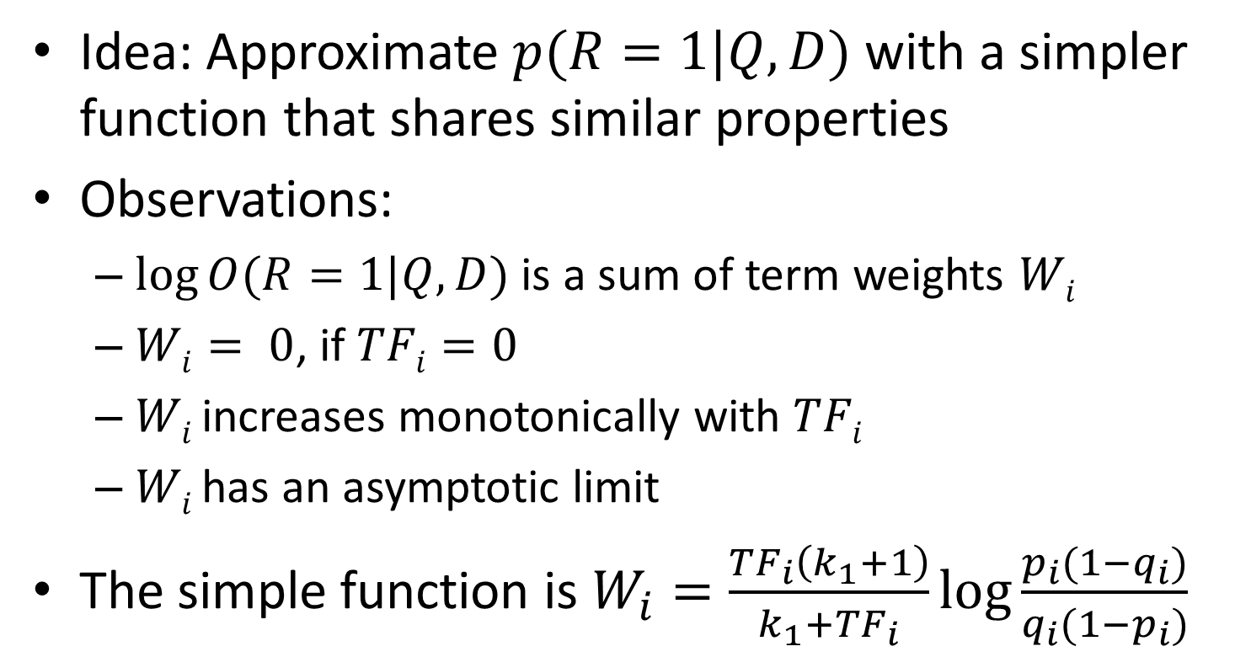
BM25/Okapi Approximation (Robertson et al. 94)
Idea: Approximate $p(R=1|Q,D)$ with a simpler function that shares similar properties
Observations:
$log⁡O(R=1|Q,D)$ is a sum of term weights $Wi$
$Wi= 0$, if $TFi=0$
$Wi$ increases monotonically with $TFi$
$Wi$ has an asymptotic limit
The simple function is $W_{i}=\frac{TF_{i}\left(k_{1}+1\right)}{k_{1}+TF_{i}}\log{\frac{p_{i}(1−q_{i})}{q_{i}(1−p_{i})}}$

Slide 24
Adding Doc. Length & Query TF
Incorporating doc length
“Carefully” penalize long doc
Incorporating query TF
A similar TF transformation
The final formula is called BM25, achieving top TREC performance

Slide 25
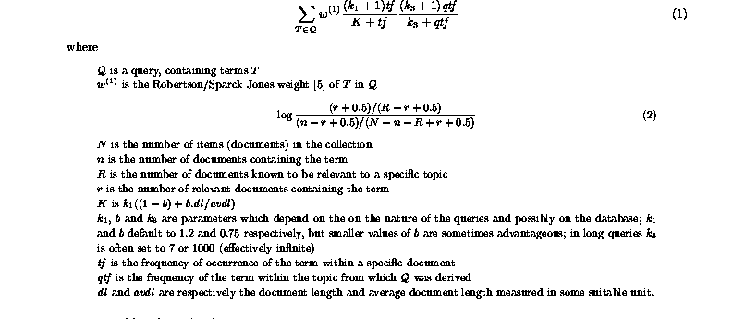
The BM25 Formula
“Okapi TF/BM25 TF”

Slide 26
Extensions of “Doc Generation” Models
Capture term dependence (Rijsbergen & Harper 78)
Alternative ways to incorporate TF (Croft 83, Kalt96)
Feature/term selection for feedback (Okapi’s TREC reports)
Estimate of the relevance model based on pseudo feedback [Lavrenko & Croft 01]

Slide 27
Questions?

