Slide 1
Information Retrieval Evaluation
Intelligent Information Retrieval

Slide 2
Why Evaluation?
Reason 1: So that we can assess how useful an IR system/technology would be (for an application)
Measures should reflect the utility to users in a real application
Usually done through user studies (interactive IR evaluation)
Reason 2: So that we can compare different systems and methods (to advance the state of the art)
Measures only need to be correlated with the utility to actual users, thus don’t have to accurately reflect the exact utility to users
Usually done through test collections (test set IR evaluation)

Slide 3
What to measure?
Incomplete list (Cleverdon 66):
1. “The ability of the system to present all relevant documents
2. The ability of the system to withhold non-relevant documents
3. The interval between the demand being made and the answer being given (i.e. time)
4. The physical form of the output (i.e. presentation)
5. The effort, intellectual or physical, demanded of the user (i.e. effort).”
IR evaluation has so far focused more on 1. & 2. (unique challenges for IR)

Slide 4
History of Test Set Evaluation: Pre-TREC
Early 1950s – 1960s (Cranfield): Establishment of the test collection evaluation methodology
1960s- early1990s (Pre-TREC): Initial development of test collections and measures
Documents: mostly catalogue information about academic papers; later, full text news articles
Measures were strongly focused on high recall search: finding as many relevant items as possible.

Slide 5
History of Test Evaluation: The TREC Era
Early 1990s – early 2000s (“TREC ad hoc” period): Larger-scale and standardization of evaluation
Documents: mostly news articles
Measures: still focused on high-recall search
A variety of retrieval tasks that go beyond standard ad hoc task
Early 2000s – present (Post TREC ad hoc period): Diverse search applications + Larger scale
Documents: beyond news articles (web pages,…)
Measures: more reflecting a user’s common preference for finding a small number of relevant item
A new form of evaluation research: studying test collection methodologies

Slide 6
Cranfield Test Methodology
Specify a retrieval task
Create a collection of sample documents
Create a set of topics/queries appropriate for the retrieval task
Create a set of relevance judgments (i.e., judgments about which document is relevant to which query)
Define a set of measures
Apply a method to (or run a system on) the collection to obtain performance figures

Slide 7
Sample Test Collections (1960s-1970s)
Name | Docs. | Qrys. | Year | Size, Mb | Source document
Cranfield 2 | 1,400 | 225 | 1962 | 1.6 | Title, authors, source, abstract of scientific papers from the aeronautic research field, largely ranging from 1945-1962.
ADI | 82 | 35 | 1968 | 0.04 | A set of short papers from the 1963 Annual Meeting of the American Documentation Institute.
IRE-3 | 780 | 34 | 1968 | - | A set of abstracts of computer science documents, published in 1959-1961.
NPL | 11,571 | 93 | 1970 | 3.1 | Title, abstract of journal papers
MEDLARS | 450 | 29 | 1973 | - | The first page of a set of MEDLARS documents copied at the National Library of Medicine.
Time | 425 | 83 | 1973 | 1.5 | Full text articles from the 1963 edition of Time magazine.

Slide 8
Evaluating a Boolean Retrieval System
Cleverdon and Keen (1966, p. 34)
 | Relevant | Not-relevant
Retrieved | a (w) | b | a+b (m)
Not retrieved | c | d | c+d
 | a+c (x) | b+d | a+b+c+d (n)

Slide 9
Summarizing precision and recall to a single value
Why summarizing?
How to summarize?
What’s the implied tradeoff between precision and recall in the F measure?
F-measure [Rijsbergen 79]

Slide 10
How to measure a ranking?
Compute the precision at every recall point
Plot a precision-recall (PR) curve
Which is better?
precision
x
precision
x
x
x
x
x
x
x
recall
recall

Slide 11
Evaluating ranked retrieval results: Precision-Recall curve
Need interpolation: why & how?

Slide 12
Keen’s semi-Cranfield (neo-Cleverdon) interpolation
The interpolated value of precision measured at any recall level (r_{i}) was defined to be the highest precision measured at any level ( r’) greater than or equal to r_{i}.
Advantages?
[Manning et al. 08]
After interpolation
Average P-R curve over
2 topics

Slide 13
Cooper’s Expected Search Length (ESL) [Cooper 68]
Motivation:
“most measures do not take into account a crucial variable: the amount of material relevant to [the user’s] query which the user actually needs”
“the importance of including user needs as a variable in a performance measure seems to have been largely overlooked”
ESL = the amount of a ranking that had to be observed by a searcher in order to locate a pre-specified quantity of relevant documents
ESL for finding one relevant document = rank-of-the-1st-rel-doc
ESL motivated cumulative gain measures, which are now quite influential

Slide 14
Challenging assumptions in early collections
Assumption 1: queries sent to a computer system would be the same as those sent to a librarian (i.e., sentence-length request), and users want to have high recall
Fairthorne (63): query can be an ambiguous phrase
Assumption 2: relevance = independent topical relevance
Verhoeff et al (1961): different users may judge different documents as relevant for the same query
Goffman (64): redundant information is useless
Cooper (71): utility vs. topical relevance (include other factors: credibility of sources, recency of docs, writing styles,…)
Saracevic’s well known survey about relevance (1975)
These suggestions mostly overlooked until recently

Slide 15
Assessor consistency
Relevance judgments are subjective: is inconsistency of assessors a concern?
Studies mostly concluded that the inconsistency didn’t affect relative ranking of systems
Lesk & Salton (1968): assessors mostly disagree on documents at lower ranks, but measures are more affected by top-ranked documents
Cleverdon (1970), Burgin (1992): similar conclusions
Harman (1994): 80% agreement between TREC assessors
Judgments on relative ranking of documents are more consistent (Schultz 67)

Slide 16

Challenges in creating early test collections
Challenges in obtaining documents:
Salton had students to manually transcribe Time magazine articles
Not a problem now!
Challenges in distributing a collection
TREC started when CD-ROMs were available
Not a problem now!
Challenge of scale – limited by qrels (relevance judgments)
The idea of “pooling” (Sparck Jones & Rijsbergen 75)

Slide 17
Larger collections created in 1980s
Name | Docs. | Qrys. | Year | Size, Mb | Source document
INSPEC | 12,684 | 77 | 1981 | - | Title, authors, source, abstract and indexing information from Sep-Dec 1979 issues of Computer and Control Abstracts.
CACM | 3,204 | 64 | 1983 | 2.2 | Title, abstract, author, keywords and bibliographic information from articles of Communications of the ACM, 1958-1979.
CISI | 1,460 | 112 | 1983 | 2.2 | Author, title/abstract, and co-citation data for the 1460 most highly cited articles and manuscripts in information science, 1969-1977.
LISA | 6,004 | 35 | 1983 | 3.4 | Taken from the Library and Information Science Abstracts database.
Commercial systems then routinely support searching over
millions of documents
➔ Pressure for researchers to use larger collections for evaluation

Slide 18
The Ideal Test Collection Report [Sparck Jones & Rijsbergen 75]
Introduced the idea of pooling
Have assessors to judge only a pool of top-ranked documents returned by various retrieval systems
Other recommendations (the vision was later implemented in TREC)
that an ideal test collection be set up to facilitate and promote research;
that the collection be of sufficient size to constitute an adequate test bed for experiments relevant to modern IR systems…
that the collection(s) be set up by a special purpose project carried out by an experienced worker, called the Builder;
that the collection(s) be maintained in a well-designed and documented machine form and distributed to users, by a Curator;
that the curating (sic) project be encouraged to, promote research via the ideal collection(s), and also via the common use of other collection(s) acquired from independent projects.”

Slide 19
TREC (Text REtrieval Conference)
1990: DARPA funded NIST to build a large test collection
1991: NIST proposed to distribute the data set through TREC (leader: Donna Harman)
Nov. 1992: First TREC meeting
Goals of TREC:
create test collections for a set of retrieval tasks;
promote as widely as possible research in those tasks;
organize a conference for participating researchers to meet and disseminate their research work using TREC collections.

Slide 20
The “TREC Vision” (mass collaboration for creating a pool)
“Harman and her colleagues appear to be the first to realize that if the documents and topics of a collection were distributed for little or no cost, a large number of groups would be willing to load that data into their search systems and submit runs back to TREC to form a pool, all for no costs to TREC. TREC would use assessors to judge the pool. The effectiveness of each run would then be measured and reported back to the groups. Finally, TREC could hold a conference where an overall ranking of runs would be published and participating groups would meet to present work and interact. It was hoped that a slight competitive element would emerge between groups to produce the best possible runs for the pool.” (Sanderson 10)

Slide 21
The TREC Ad Hoc Retrieval Task
Simulate an information analyst (high recall)
Multi-field topic description
News documents + Government documents
Relevance criteria: “a document is judged relevant if any piece of it is relevant (regardless of how small the piece is in relation to the rest of the document)”
Each run submitted returns 1000 documents for evaluation with various measures
Top 100 documents were taken to form a pool
All the documents in the pool were judged

Slide 22
An example TREC topic

Slide 23
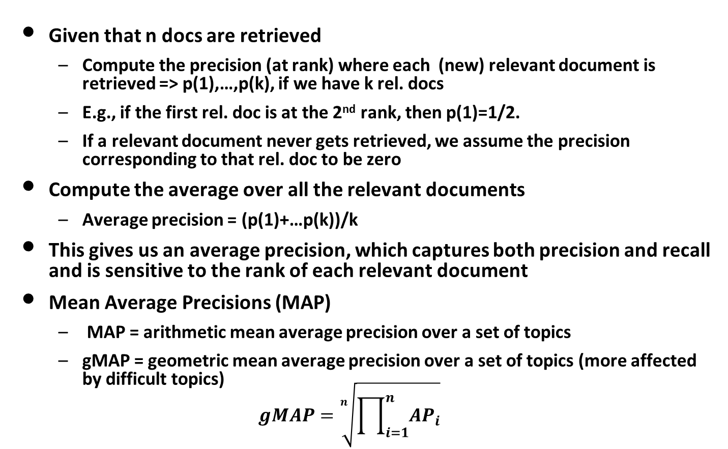
Main TREC ad hoc retrieval measure: Mean Average Precision
Given that n docs are retrieved
Compute the precision (at rank) where each (new) relevant document is retrieved => p(1),…,p(k), if we have k rel. docs
E.g., if the first rel. doc is at the 2nd rank, then p(1)=1/2.
If a relevant document never gets retrieved, we assume the precision corresponding to that rel. doc to be zero
Compute the average over all the relevant documents
Average precision = (p(1)+…p(k))/k
This gives us an average precision, which captures both precision and recall and is sensitive to the rank of each relevant document
Mean Average Precisions (MAP)
MAP = arithmetic mean average precision over a set of topics
gMAP = geometric mean average precision over a set of topics (more affected by difficult topics)
$$gMAP=\sqrt[n]{\prod_{i=1}^{n}{AP_{i}}}$$
 | S1 | S2
Q1 AP | 0.02 | 0.04
Q2 AP | 0.4 | 0.38
MAP | 0.21 | 0.21
gMAP | 0.089 | 0.123

Slide 24
Other TREC Measures
Precision at k documents (e.g., prec@10doc):
more meaningful to users than MAP
tends to be higher for a larger collection
also called breakeven precision (R-precision) when k is the same as the number of relevant documents
Mean Reciprocal Rank (MRR):
Same as MAP when there’s only 1 relevant document
Reciprocal Rank = 1/Rank-of-the-relevant-doc
R-precision: Precision at the rank that is equal to the total number of relevant documents

Slide 25
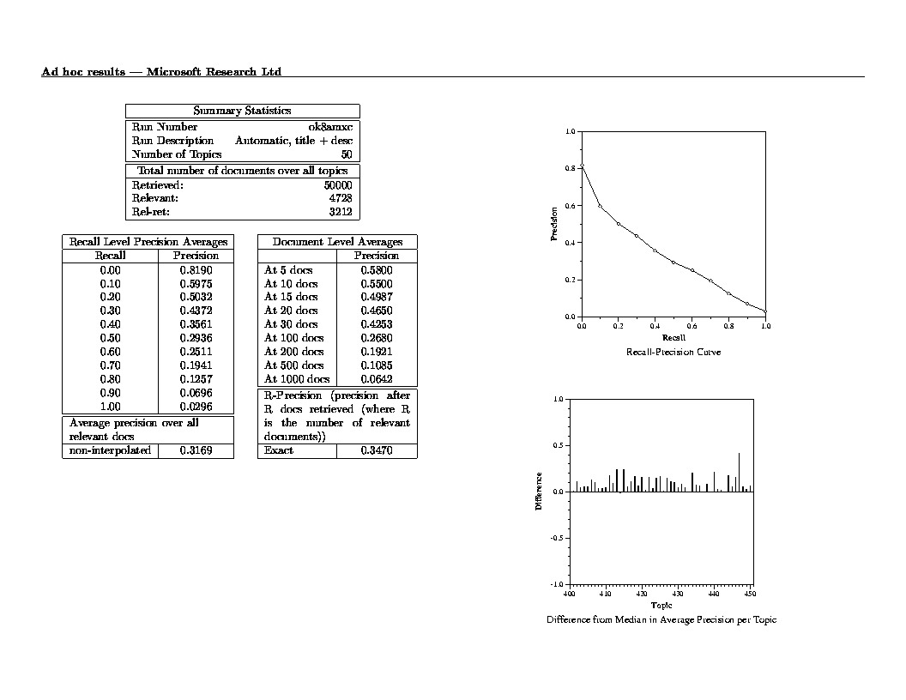
Typical TREC Evaluation Result (from “trec_eval”)
Precion-Recall Curve
Out of 4728 rel docs,
we’ve got 3212
Precision@10docs
about 5.5 docs
in the top 10 docs
are relevant
Breakeven Precision
(precision when prec=recall)
Mean Avg. Precision (MAP)
D1 +
D2 +
D3 –
D4 –
D5 +
D6 -
Total # rel docs = 4
System returns 6 docs
Average Prec = (1/1+2/2+3/5+0)/4

Slide 26
What Query Averaging Hides
Slide from Doug Oard’s presentation, originally from Ellen Voorhees’ presentation

Slide 27
Statistical Significance Tests
How sure can you be that an observed difference doesn’t simply result from the particular queries you chose?
Experiment 1
Experiment 2
Query
System A
System B
Query
System A
System B
1
2
3
4
5
6
7
0.20
0.21
0.22
0.19
0.17
0.20
0.21
0.40
0.41
0.42
0.39
0.37
0.40
0.41
1
2
3
4
5
6
7
0.02
0.39
0.16
0.58
0.04
0.09
0.12
0.76
0.07
0.37
0.21
0.02
0.91
0.46
Average
0.20
0.40
Average
0.20
0.40
Slide from Doug Oard

Slide 28
Statistical Significance Testing
Query
System A
System B
Sign Test
Wilcoxon
1
2
3
4
5
6
7
0.02
0.39
0.16
0.58
0.04
0.09
0.12
0.76
0.07
0.37
0.21
0.02
0.91
0.46
+
-
+
-
-
+
-
+0.74
- 0.32
+0.21
- 0.37
- 0.02
+0.82
- 0.38
Average
0.20
0.40
p=1.0
p=0.9375
95% of outcomes
0
Slide from Doug Oard
Try some out at: http://www.fon.hum.uva.nl/Service/Statistics.html

Slide 29
Other TREC-like Initiatives
CLEF – The annual Cross Language Evaluation Forum
Initially European languages; later Persian and others
imageCLEF: image retrieval, medical retrieval
NTCIR – The NII Test Collection for IR Systems
Asian languages such as Japanese, Chinese and Korean
Patent search
TDT – Topic Detection and Tracking
the automatic detection and tracking of important emerging stories in streaming text
INEX – The INitiative for the Evaluation of XML Retrieval
retrieval of document fragments
TRECVID – an evaluation exercise focused on video retrieval
A number of other smaller and/or newer evaluation exercises

Slide 30
Post Ad Hoc Collections and Measures
Many new tasks leading to new collections, new topic sets, new measures
Major issues addressed
Beyond binary judgments
Diversity
Managing unjudged documents
Relevance applied to parts of a document
Are all topics equal?
All still current research topics in IR Evaluation

Slide 31
Multi-level relevance judgments: nDCG
What if relevance judgments are in a scale of [1,r]? r>2
Cumulative Gain (CG) at rank n
Let the ratings of the n documents be r₁, r₂, …r_{n} (in ranked order)
CG = r₁+r₂+…+r_{n}
Discounted Cumulative Gain (DCG) at rank n
DCG = r₁+r₂/log₂2+ r₃/log₂3+ … r_{n}/log₂n
We may use any base for the logarithm, e.g., base=b
For rank positions above b, do not discount
Normalized Cumulative Gain (nDCG) at rank n
Normalize DCG at rank n by the DCG value at rank n of the ideal ranking so that all nDCG values would be within [0,1].
The ideal ranking would first return the documents with the highest relevance level, then the next highest relevance level, etc

Slide 32
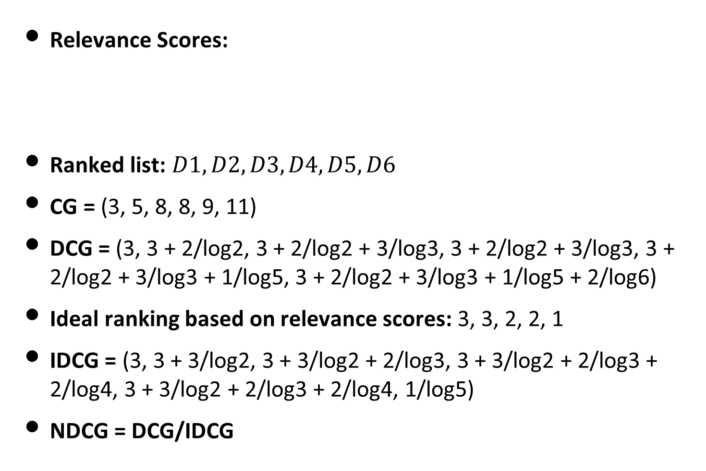
nDCG Example
Relevance Scores:
Ranked list: $D1, D2, D3, D4, D5, D6$
CG = (3, 5, 8, 8, 9, 11)
DCG = (3, 3 + 2/log2, 3 + 2/log2 + 3/log3, 3 + 2/log2 + 3/log3, 3 + 2/log2 + 3/log3 + 1/log5, 3 + 2/log2 + 3/log3 + 1/log5 + 2/log6)
Ideal ranking based on relevance scores: 3, 3, 2, 2, 1
IDCG = (3, 3 + 3/log2, 3 + 3/log2 + 2/log3, 3 + 3/log2 + 2/log3 + 2/log4, 3 + 3/log2 + 2/log3 + 2/log4, 1/log5)
NDCG = DCG/IDCG
D1 | D2 | D3 | D4 | D5 | D6
3 | 2 | 3 | 0 | 1 | 2

Slide 33
More on new measures later in the course…

Slide 34
Questions?

