Slide 1
Statistical Language Models
Intelligent Information Retrieval

Slide 2

What is a Statistical LM?
A probability distribution over word sequences
p(“Today is Wednesday”) ≈ 0.001
p(“Today Wednesday is”) ≈ 0.0000000000001
p(“The equation has a solution”) ≈ 0.00001
Context-dependent!
Can also be regarded as a probabilistic mechanism for “generating” text, thus also called a “generative” model
Today is Wednesday
Today Wednesday is
…
The eigenvalue is positive

Slide 3
Why is a LM Useful?
Provides a principled way to quantify the uncertainties associated with natural language
Allows us to answer questions like:
Given that we see “John” and “feels”, how likely will we see “happy” as opposed to “habit” as the next word? (speech recognition)
Given that we observe “baseball” three times and “game” once in a news article, how likely is it about “sports”? (text categorization, information retrieval)
Given that a user is interested in sports news, how likely would the user use “baseball” in a query? (information retrieval)

Slide 4
Source-Channel Framework (Communication System)
Source
Transmitter
(encoder)
Noisy
Channel
Receiver
(decoder)
Destination
X
Y
X’
P(X)
P(Y|X)
P(X|Y)=?
When X is text, p(X) is a language model

Slide 5
Speech Recognition
Acoustic
signal (A)
Words (W)
Speaker
Noisy
Channel
Recognizer
Recognized
words
P(W)
P(A|W)
P(W|A)=?
Acoustic model
Language model
Given acoustic signal A, find the word sequence W

Slide 6
Machine Translation
Chinese
Words(C)
English
Words (E)
English
Speaker
Noisy
Channel
Translator
English
Translation
P(E)
P(C|E)
P(E|C)=?
English->Chinese
Translation model
English
Language model
Given Chinese sentence C, find its English translation E

Slide 7
Spelling/OCR Error Correction
Original
Words (O)
“Erroneous”
Words(E)
Original
Text
Noisy
Channel
Corrector
Corrected
Text
P(O)
P(E|O)
P(O|E)=?
“Normal”
Language model
Spelling/OCR Error model
Given corrupted text E, find the original text O

Slide 8
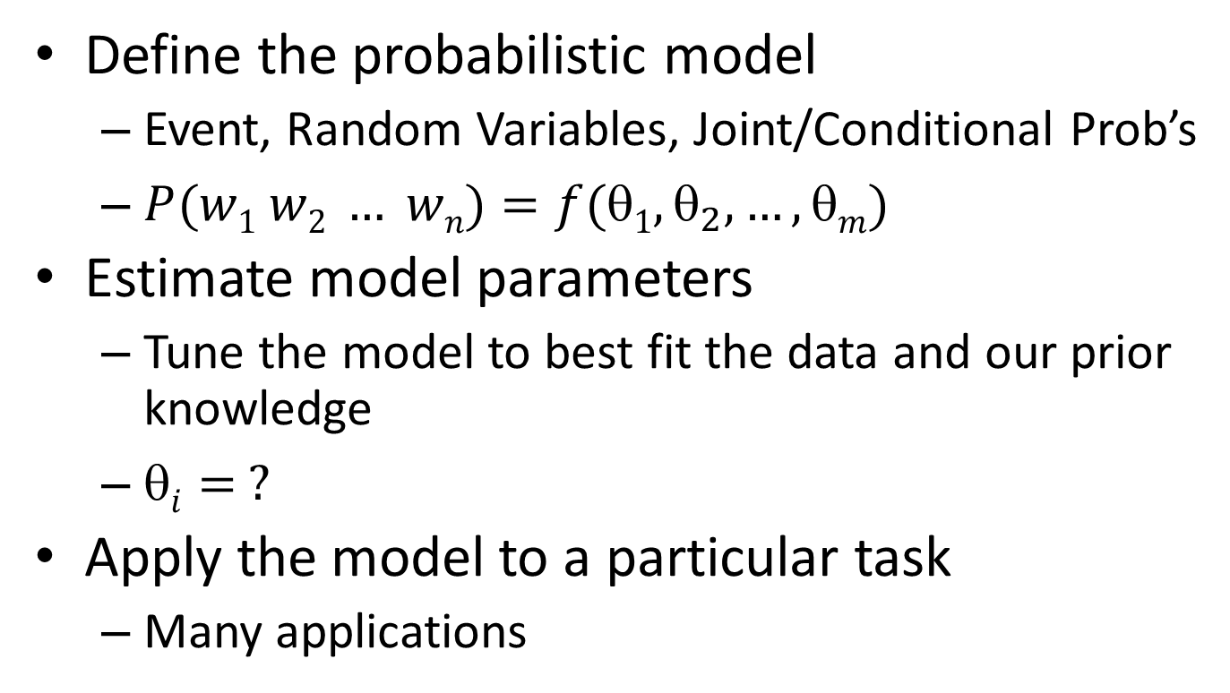
Basic Issues
Define the probabilistic model
Event, Random Variables, Joint/Conditional Prob’s
$P(w1 w2 … wn)=f(1, _{2}, …,m)$
Estimate model parameters
Tune the model to best fit the data and our prior knowledge
$i= ?$
Apply the model to a particular task
Many applications

Slide 9

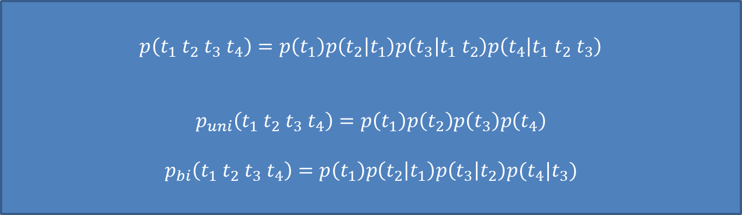
The Simplest Language Model (Unigram Model)
Generate a piece of text by generating each word INDEPENDENTLY
Thus, $p(w1 w2 … wn)=p(w1)p(w2)…p(wn)$
Parameters: $\{p(wi)\} p(w1)+…+p(wN)=1$($N$ is voc. size)
Essentially a multinomial distribution over words
A piece of text can be regarded as a sample drawn according to this word distribution
$$p\left(t_{1} t_{2} t_{3} t_{4}\right)=p\left(t_{1}\right)p\left(t_{2} | t_{1}\right)p\left(t_{3} | t_{1}{ t}_{2}\right)p\left(t_{4} | t_{1} t_{2} t_{3}\right)$$
$$p_{uni}\left(t_{1} t_{2} t_{3} t_{4}\right)=p\left(t_{1}\right)p\left(t_{2}\right)p\left(t_{3}\right)p\left(t_{4}\right)$$
$$p_{bi}\left(t_{1} t_{2} t_{3} t_{4}\right)=p\left(t_{1}\right)p\left(t_{2} | t_{1}\right)p\left(t_{3} | t_{2}\right)p(t_{4}|t_{3})$$
Wednesday
P(“today is Wednesday”)
= P(“today)P(“is”)P(“Wednesday”)
= 0.0002 × 0.001 × 0.000015
today
…
eigenvalue

Slide 10
Text Generation with Unigram LM
(Unigram) Language Model θ
p(w| θ)
Sampling
Document=?
…
text 0.2
mining 0.1
association 0.01
clustering 0.02
…
food 0.00001
…
Text mining
paper
Topic 1:
Text mining
…
food 0.25
nutrition 0.1
healthy 0.05
diet 0.02
…
Topic 2:
Health
Food nutrition
paper

Slide 11
Estimation of Unigram LM
(Unigram) Language Model θ
p(w| θ)=?
Estimation
Document
…
text ?
mining ?
association ?
database ?
…
query ?
…
text 10
mining 5
association 3
database 3
algorithm 2
…
query 1
efficient 1
10/100
5/100
3/100
3/100
1/100
A “text mining paper”
(total #words=100)

Slide 12
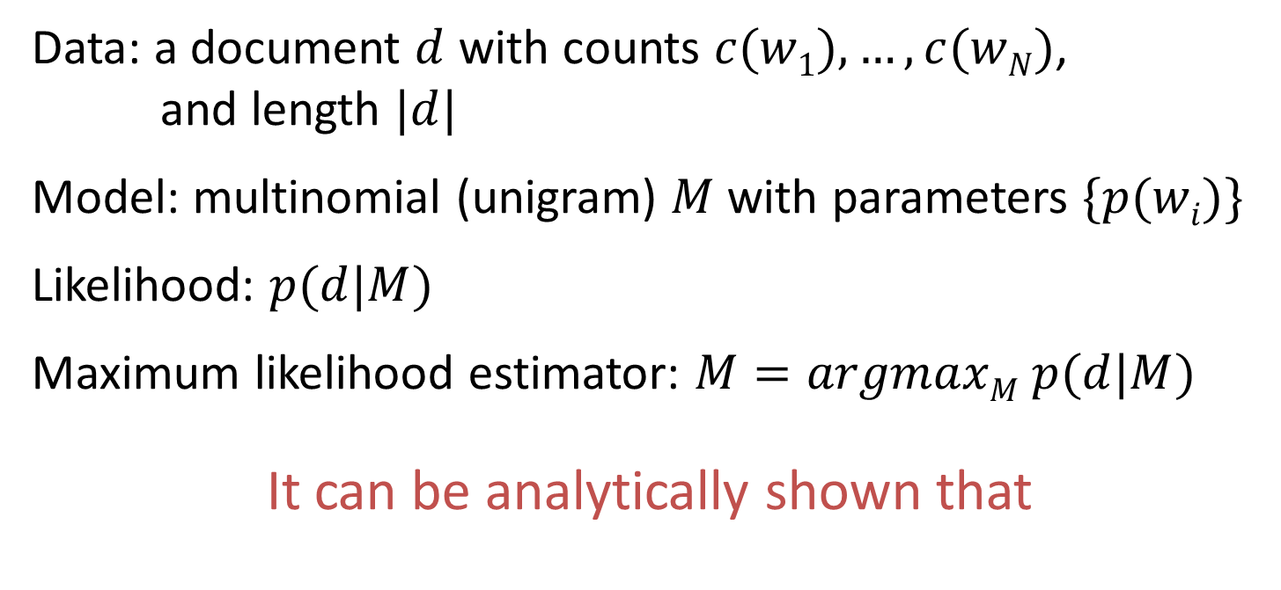
Maximum Likelihood Estimate
Data: a document $d$ with counts $c(w1), …, c(wN)$,
and length $|d|$
Model: multinomial (unigram) $M$ with parameters $\{p(wi)\}$
Likelihood: $p(d|M)$
Maximum likelihood estimator: $M=argmaxM p(d|M)$
It can be analytically shown that
ML estimate

Slide 13



LMs for Topic Representation
d
General Background English Text
C
B
Computer Science Papers
Text Mining Paper
the 0.031
…
text 0.04
mining 0.035
association 0.03
clustering 0.005
computer 0.0009
…
food 0.000001
…
the 0.03
a 0.02
is 0.015
we 0.01
…
food 0.003
computer 0.00001
…
text 0.000006
…
the 0.032
a 0.019
is 0.014
we 0.011
…
computer 0.004
software 0.0001
…
text 0.00006
…
Document LM: $p(w|d)$
Background LM: $p(w|B)$
Collection LM: $p(w|C)$

Slide 14
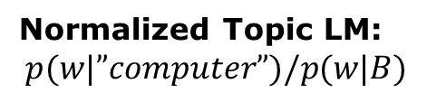


LMs for Association Analysis
What words are semantically related to “computer”?
Topic LM: $p(w|”computer”)$
Normalized Topic LM:
$$p(w|”computer”)/p(w|B)$$
the 0.032
a 0.019
is 0.014
we 0.011
computer 0.004
software 0.0001
…
text 0.00006
All the documents containing word “computer”
computer 400
software 150
program 104
…
text 3.0
…
the 1.1
a 0.99
is 0.9
we 0.8
Background LM: $p(w|B)$
the 0.03
a 0.02
is 0.015
we 0.01
…
computer 0.00001
…
B
General Background English Text

Slide 15
Empirical distribution of words
There are stable language-independent patterns in how people use natural languages
A few words occur very frequently; most occur rarely. E.g., in news articles,
Top 4 words: 10~15% word occurrences
Top 50 words: 35~40% word occurrences
The most frequent word in one corpus may be rare in another

Slide 16
Zipf’s Law
rank * frequency ≈ constant
Word
Freq.
Most useful words (Luhn 57)
Biggest
data structure
(stop words)
rare words
Word Rank (by Freq)

Slide 17
Problem with the ML Estimator
What if a word doesn’t appear in the text?
In general, what probability should we give a word that has not been observed?
If we want to assign non-zero probabilities to such words, we’ll have to discount the probabilities of observed words
This is what “smoothing” is about …

Slide 18
Language Model Smoothing (Illustration)
P(w)
Max. Likelihood Estimate
Smoothed LM
w

Slide 19
How to Smooth?
All smoothing methods try to
discount the probability of words seen in a document
re-allocate the extra counts so that unseen words will have a non-zero count
Method 1 (Additive smoothing)
Add a constant δ to the counts of each word
Problems?
Counts of w in d
“Add one”, Laplace smoothing
Vocabulary size
Length of d (total counts)

Slide 20
How to Smooth? (cont.)
Should all unseen words get equal probs?
We can use a reference model to discriminate unseen words
Discounted ML estimate
Reference language model

Slide 21
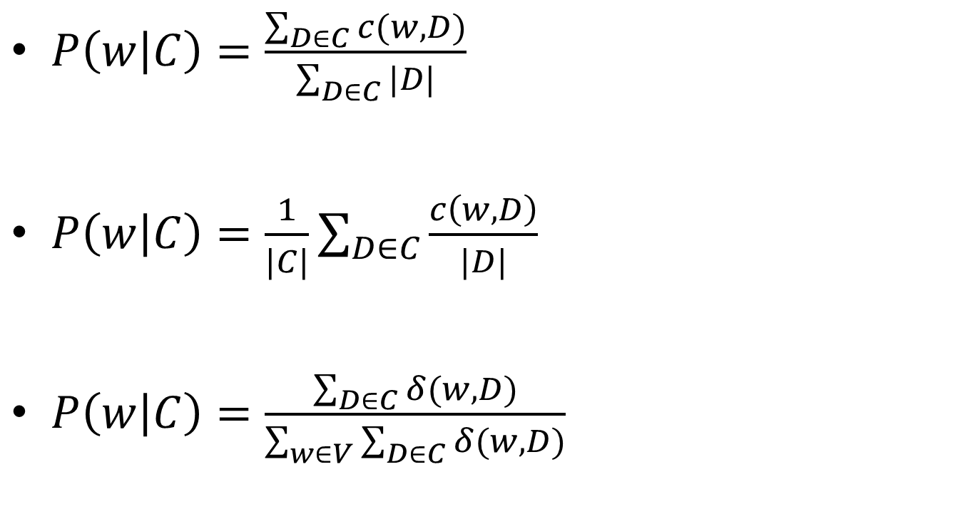
How to Estimate P(w|C)?
$P\left(w | C\right)=\frac{\sum_{D∈C}{c(w,D)}}{\sum_{D∈C}{|D|}}$
$P\left(w | C\right)=\frac{1}{|C|}\sum_{D∈C}{\frac{c\left(w,D\right)}{|D|}}$
$P\left(w | C\right)=\frac{\sum_{D∈C}{δ(w,D)}}{\sum_{w∈V}{\sum_{D∈C}{δ(w,D)}}}$

Slide 22

Other Smoothing Methods
Method 2 (Absolute discounting)
Subtract a constant δ from the counts of each word
Method 3 (Linear interpolation, Jelinek-Mercer)
“Shrink” uniformly toward $p(w|REF)$
# unique words in document d
parameter
ML estimate

Slide 23

Other Smoothing Methods (cont.)
Method 4 (Dirichlet Prior/Bayesian)
Assume pseudo counts $p(w|REF)$
parameter

Slide 24
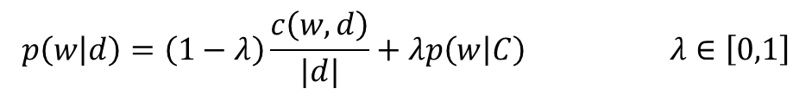
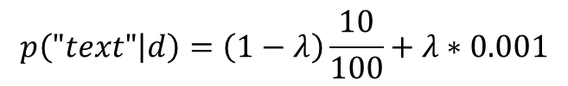

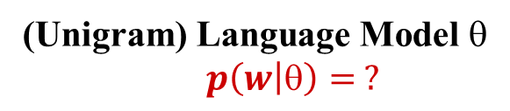
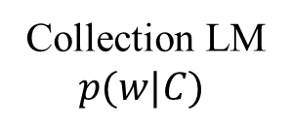
Linear Interpolation (Jelinek-Mercer) Smoothing
(Unigram) Language Model $$
$p\left(w | \right)= ?$
Document d
Total # words=100
Collection LM
$$p(w|C)$$
Estimation
…
text ?
mining ?
association ?
database ?
…
query ?
…
network?
text 10
mining 5
association 3
database 3
algorithm 2
…
query 1
efficient 1
the 0.1
a 0.08
…
computer 0.02
database 0.01
…
text 0.001
network 0.001
mining 0.0009
…
10/100
5/100
3/100
3/100
1/100
0/100

Slide 25
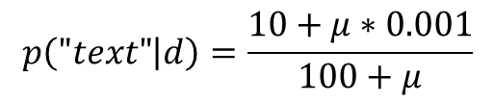
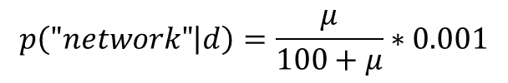
Dirichlet Prior (Bayesian) Smoothing
(Unigram) Language Model $$
$p\left(w | \right)= ?$
Document d
Total # words=100
Collection LM
$$p(w|C)$$
Estimation
…
text ?
mining ?
association ?
database ?
…
query ?
…
network?
text 10
mining 5
association 3
database 3
algorithm 2
…
query 1
efficient 1
the 0.1
a 0.08
…
computer 0.02
database 0.01
…
text 0.001
network 0.001
mining 0.0009
…
10/100
5/100
3/100
3/100
1/100
0/100

Slide 26
So, which method is the best?
It depends on the data and the task!
Many other sophisticated smoothing methods have been proposed…
Cross validation is generally used to choose the best method and/or set the smoothing parameters…
For retrieval, Dirichlet prior performs well…
Smoothing will be discussed further in the course…

Slide 27
Questions?

