Slide 1
Language Models for TR

Slide 2
Text Generation with Unigram LM
(Unigram) Language Model θ
p(w| θ)
Sampling
Document
…
text 0.2
mining 0.1
assocation 0.01
clustering 0.02
…
food 0.00001
…
Text mining
paper
Topic 1:
Text mining
…
food 0.25
nutrition 0.1
healthy 0.05
diet 0.02
…
Topic 2:
Health
Food nutrition
paper

Slide 3
Estimation of Unigram LM
(Unigram) Language Model θ
p(w| θ)=?
Estimation
Document
…
text ?
mining ?
assocation ?
database ?
…
query ?
…
text 10
mining 5
association 3
database 3
algorithm 2
…
query 1
efficient 1
10/100
5/100
3/100
3/100
1/100
A “text mining paper”
(total #words=100)

Slide 4

Query Likelihood Retrieval Model
Assumption:
A user formulates a query based on an “imaginary relevant document”

Slide 5
Which Doc is Most Likely the “Imaginary Relevant Doc”?
Query = “news about presidential campaign”
p(q|d1)
d1
… news about …
d2
… news about organic food campaign …
d3
… news of presidential campaign …
…
d4
… news of presidential campaign …
… presidential candidate…
d5
… news of organic food campaign …
… campaign …. campaign … campaign …
p(q|d5)

Slide 6

Query Generation by Sampling Words from Doc
…news of presidential
campaign … presidential
candidate
p(q=“presidential campaign”|d= )
“campaign”
presidential
“presidential”
campaign
If the user is thinking of this doc,
how likely would she pose this query?

Slide 7
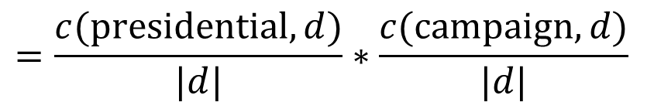
Unigram Query Likelihood
…news of presidential
campaign … presidential
candidate
Assumption:
Each query word is generated independently

Slide 8
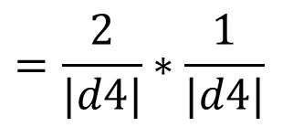
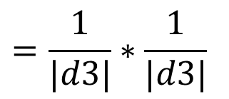
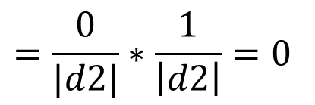
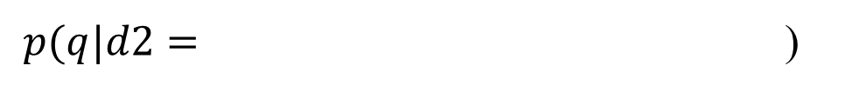
Does Query Likelihood Make Sense?
$$p\left(q=\text{"}\text{presidential} \text{campaign}\text{"} | d\right)=\frac{c(\text{"}\text{presidential}", d)}{|d|}×\frac{c(\text{"}\text{campaign}\text{"},d)}{|d|}$$
… news of presidential campaign … presidential candidate …
… news of presidential campaign …
… news about organic food campaign …
d4 > d3 > d2 as we expected

Slide 9
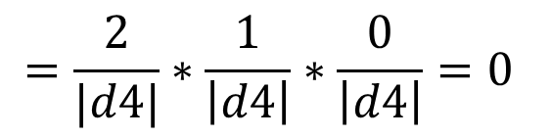
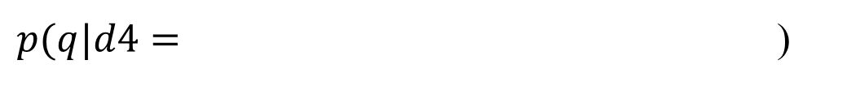
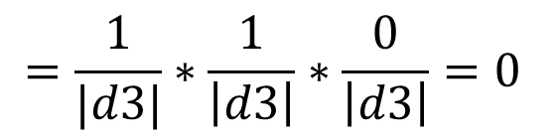
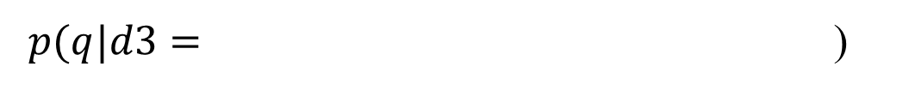
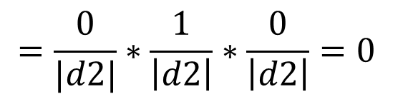
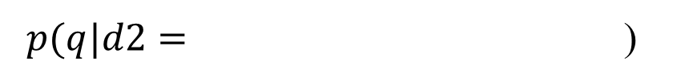
Try a Different Query?
q = “presidential campaign update”
… news of presidential campaign … presidential candidate …
… news of presidential campaign …
… news about organic food campaign …
What assumption has caused this problem? How do we fix it?

Slide 10
Improved Model: Sampling Words from a Doc Model
How likely would we observe this query from this doc model?
…news of presidential
campaign … presidential
candidate
p(q=“presidential campaign”|d= )
“campaign”
…
presidential 0.2
campaign 0.1
news 0.01
candidate 0.02
…
update 0.00001
…
“presidential”
presidential
campaign
“update”
update

Slide 11








Computation of Query Likelihood
Language Model
p(w|d1)
Query =
“data mining algorithms”
Document
…
text 0.2
mining 0.1
association 0.01
clustering 0.02
…
food 0.00001
…
Text mining
paper
p(w|d2)
Food nutrition
paper
…
food 0.25
nutrition 0.1
healthy 0.05
diet 0.02
…

Slide 12
Ranking Docs by Query Likelihood
Doc LM
Query likelihood
d₁
θ_{d1}
p(q| θ_{d1})
q
d₂
θ_{d2}
p(q| θ_{d2})
p(q| θ_{dN})
d_{N}
θ_{dN}

Slide 13
Retrieval as Language Model Estimation
Document ranking based on query likelihood
Document language model
Retrieval problem ≈ Estimation of p(w_{i}|d)
Smoothing is an important issue, and distinguishes different approaches

Slide 14
How to Estimate p(w|d)?
Simplest solution: Maximum Likelihood Estimator
P(w|d) = relative frequency of word w in d
What if a word doesn’t appear in the text? P(w|d)=0
In general, what probability should we give a word that has not been observed?
If we want to assign non-zero probabilities to such words, we’ll have to discount the probabilities of observed words
This is what “smoothing” is about …

Slide 15
Language Model Smoothing (Illustration)
P(w)
Max. Likelihood Estimate
Smoothed LM
Word w

Slide 16
A General Smoothing Scheme
All smoothing methods try to
discount the probability of words seen in a doc
re-allocate the extra probability so that unseen words will have a non-zero probability
Most use a reference model (collection language model) to discriminate unseen words
Discounted ML estimate
Collection language model

Slide 17
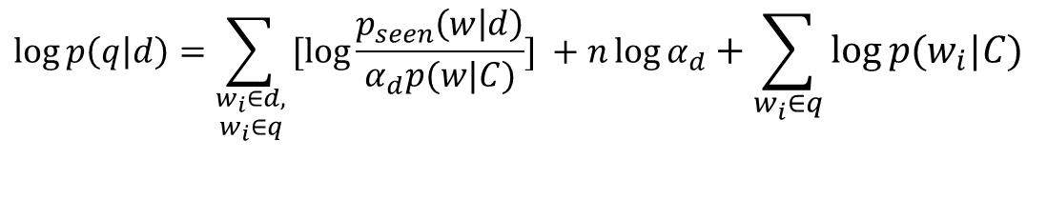
Smoothing & TF-IDF Weighting
Plug in the general smoothing scheme to the query likelihood retrieval formula, we obtain
Doc length normalization
(long doc is expected to have a smaller α_{d})
TF weighting
$$\log{p\left(q | d\right)}=\sum_{\begin{aligned}w_{i}∈d, \\ w_{i}∈q\end{aligned}}{[log{\frac{p_{seen}\left(w | d\right)}{α_{d}p(w|C)}] }}+n\log{α_{d}}+\sum_{w_{i}∈q}{\log{p(w_{i}|C)}}$$
IDF weighting
Ignore for ranking
Smoothing with p(w|C) ≈ TF-IDF + length norm.

Slide 18
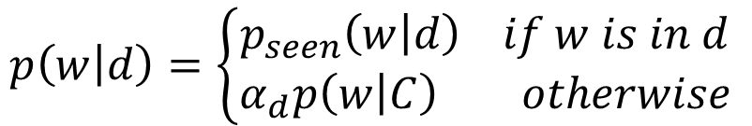
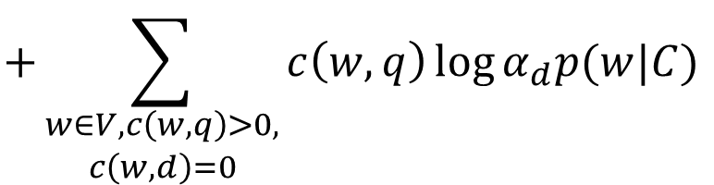
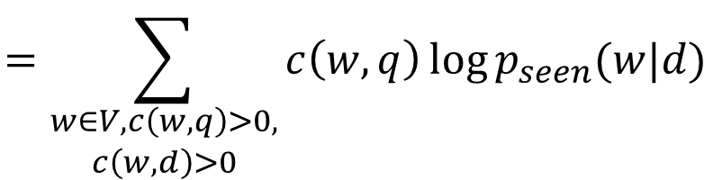
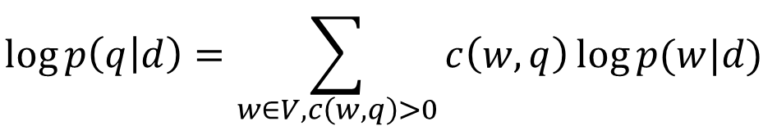
Derivation of the QL Retrieval Formula
$$p\left(w | d\right)=\left\{\begin{matrix}p_{seen}\left(w | d\right) if w is in d \\ α_{d}p\left(w | C\right) otherwise\end{matrix}\right.$$
Retrieval formula using the general smoothing scheme:
$$\log{p\left(q | d\right)=\sum_{w∈V, c\left(w, q\right)>0}{c\left(w,q\right)\log{p(w|d)}}}$$
$$=\sum_{\begin{aligned}w∈V, c\left(w,q\right)>0, \\ c\left(w,d\right)>0\end{aligned}}{c\left(w,q\right)\log{p_{seen}(w|d)}}$$
$$+\sum_{\begin{aligned}w∈V, c\left(w,q\right)>0, \\ c\left(w,d\right)=0\end{aligned}}{c\left(w,q\right)\log{α_{d}p(w|C)}}$$

Slide 19
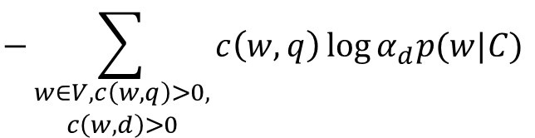

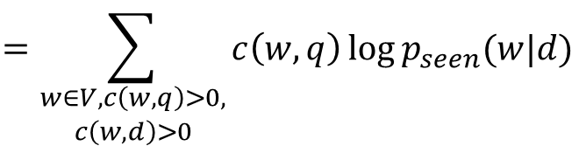
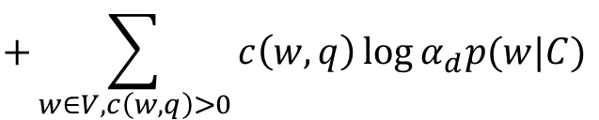
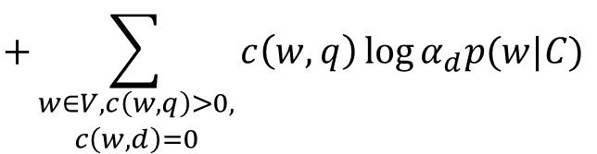
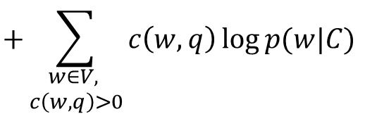
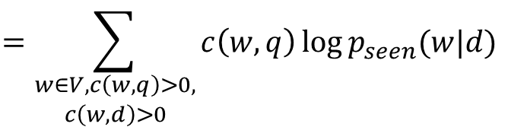
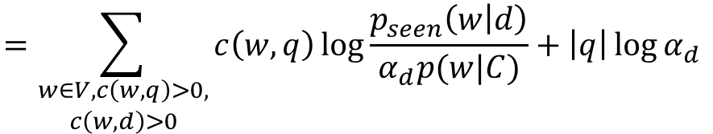
Derivation of the QL Retrieval Formula (cond’t)
$$\log{p\left(q | d\right)=…}$$
$$=\sum_{\begin{aligned}w∈V, c\left(w,q\right)>0, \\ c\left(w,d\right)>0\end{aligned}}{c\left(w,q\right)\log{p_{seen}(w|d)}}$$
$$+\sum_{\begin{aligned}w∈V, c\left(w,q\right)>0, \\ c\left(w,d\right)=0\end{aligned}}{c\left(w,q\right)\log{α_{d}p(w|C)}}$$
$$=\sum_{\begin{aligned}w∈V, c\left(w,q\right)>0, \\ c\left(w,d\right)>0\end{aligned}}{c\left(w,q\right)\log{p_{seen}(w|d)}}$$
$$+\sum_{w∈V, c\left(w,q\right)>0}{c\left(w,q\right)\log{α_{d}p(w|C)}}$$
$$−\sum_{\begin{aligned}w∈V, c\left(w,q\right)>0, \\ c\left(w,d\right)>0\end{aligned}}{c\left(w,q\right)\log{α_{d}p(w|C)}}$$
Key rewriting step
Similar rewritings are very common when using LMs for IR…
$$=\sum_{\begin{aligned}w∈V, c\left(w,q\right)>0, \\ c\left(w,d\right)>0\end{aligned}}{c\left(w,q\right)\log{\frac{p_{seen}\left(w | d\right)}{α_{d}p(w|C)}}}+\left|q\right|\log{α_{d}}$$
$$+\sum_{\begin{aligned}w∈V, \\ c\left(w,q\right)>0\end{aligned}}{c\left(w,q\right)\log{p(w|C)}}$$

Slide 20
Three Smoothing Methods (Zhai & Lafferty 01)
Simplified Jelinek-Mercer: Shrink uniformly toward p(w|C)
Dirichlet prior (Bayesian): Assume pseudo counts μp(w|C)
Absolute discounting: Subtract a constant δ

Slide 21
Comparison of Three Methods

Slide 22
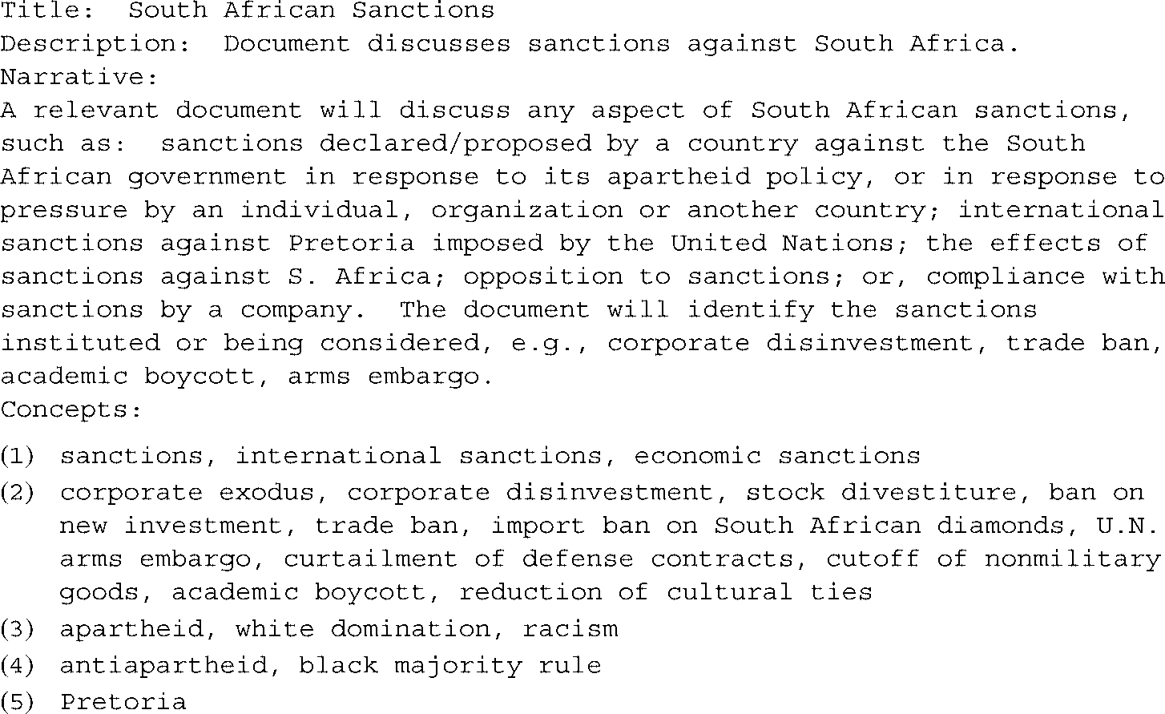
Long verbose
Short keyword
Short verbose
long keyword

Slide 23
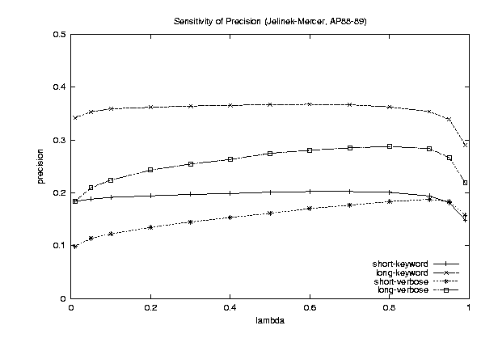
The Need of Query-Modeling (Dual-Role of Smoothing)
Keyword
queries
Verbose
queries
Why does query type affect smoothing sensitivity?

Slide 24
Another Reason for Smoothing
Content words
Query = “the algorithms for data mining”
p_{DML}(w|d1): 0.04 0.001 0.02 0.002 0.003
p_{DML}(w|d2): 0.02 0.001 0.01 0.003 0.004
p( “algorithms”|d1) = p(“algorithm”|d2)
p( “data”|d1) < p(“data”|d2)
p( “mining”|d1) < p(“mining”|d2)
Intuitively, d2 should have a higher score,
but p(q|d1)>p(q|d2)…
So we should make p(“the”) and p(“for”) less different for all docs,
and smoothing helps achieve this goal…
Query = “the algorithms for data mining”
P(w|REF) 0.2 0.00001 0.2 0.00001 0.00001
Smoothed p(w|d1): 0.184 0.000109 0.182 0.000209 0.000309
Smoothed p(w|d2): 0.182 0.000109 0.181 0.000309 0.000409

Slide 25
Two-stage Smoothing
Stage-1
-Explain unseen words
-Dirichlet prior(Bayesian)
Stage-2
-Explain noise in query
μ
λ
c(w,d)
+μp(w|C)
P(w|d) =
(1-λ)
+ λp(w|Noise)
|d|
+μ
Query noise model
λ and μ can be automatically set through statistical estimation

Slide 26
But, where is the relevance?
And, what’s good about this approach?

Slide 27
The Notion of Relevance
Relevance
Relevance constraints
(Fang et al. 04)
Δ(Rep(q), Rep(d))
Similarity
P(r=1|q,d) r ∈{0,1}
Probability of Relevance
P(d →q) or P(q →d)
Probabilistic inference
Regression
Model
(Fox 83)
Generative
Model
Different
inference system
Different
rep & similarity
Doc
generation
Query
generation
…
Prob. concept
space model
(Wong & Yao, 95)
Inference
network
model
(Turtle & Croft, 91)
Vector space
model
(Salton et al., 75)
Prob. distr.
model
(Wong & Yao, 89)
Classical
prob. Model
(Robertson &
Sparck Jones, 76)
LM
approach
(Ponte & Croft, 98)
(Lafferty & Zhai, 01a)

Slide 28
Probabilistic Retrieval Models: Computing p(R|Q,D)
Basic idea
Define P(Q,D|R)
Compute P(R|Q,D) using Bayes’ rule
Special cases
Document “generation”: P(Q,D|R)=P(D|Q,R)P(Q|R)
Query “generation”: P(Q,D|R)=P(Q|D,R)P(D|R)
Ignored for ranking D

Slide 29
Query Generation
Query likelihood p(q| θ_{d})
Document prior
Assuming uniform prior, we have
Computing P(Q|D, R=1) generally involves two steps:
(1) estimate a language model based on D
(2) compute the query likelihood according to the estimated model
P(Q|D)=P(Q|D, R=1)! Prob. that a user who likes D would pose query Q
Relevance-based interpretation of the so-called
“document language model”

Slide 30
Question?

