Slide 1
Implementation Issues & IR Systems

Slide 2
Lecture Plan
How to implement a simple IR system
Index construction
Scoring
Open source IR toolkits

Slide 3
IR System Architecture
docs
INDEXING
Doc
Rep
Query
Rep
query
User
Ranking
SEARCHING
results
INTERFACE
Feedback
judgments
QUERY MODIFICATION

Slide 4
Indexing
Indexing = Convert documents to data structures that enable fast search

Slide 5
Unstructured data
Which plays of Shakespeare contain the words Brutus and Caesar, but not Calpurnia?
One could grep all of Shakespeare’s plays for Brutus and Caesar, then strip out lines containing Calpurnia.
Why is grep not the solution?
Slow (for large collections)
“not Calpurnia” is non-trivial
Other operations (e.g., find the word Romans near countryman) not feasible
Ranked retrieval (best documents to return)

Slide 6
Term-document incidence matrix
 | Anthony and Cleopatra | Julius Caesar | The Tempest | Hamlet | Othello | Macbeth | …
Anthony | 1 | 1 | 0 | 0 | 0 | 1
Brutus | 1 | 1 | 0 | 1 | 0 | 0
Caesar | 1 | 1 | 0 | 1 | 1 | 1
Calpurnia | 0 | 1 | 0 | 0 | 0 | 0
…
Entry is 1 if term occurs. Example: Calpurnia occurs in Julius Caesar.
Entry is 0 if term doesn’t occur. Example: Calpurnia doesn’t occur in The
tempest.

Slide 7
Incidence vectors
So we have a 0/1 vector for each term.
To answer the query Brutus and Caesar and not Calpurnia:
Take the vectors for Brutus, Caesar, and Calpurnia
Complement the vector of Calpurnia
Do a (bitwise) AND on the three vectors
110100 AND 110111 AND 101111 = 100100

Slide 8
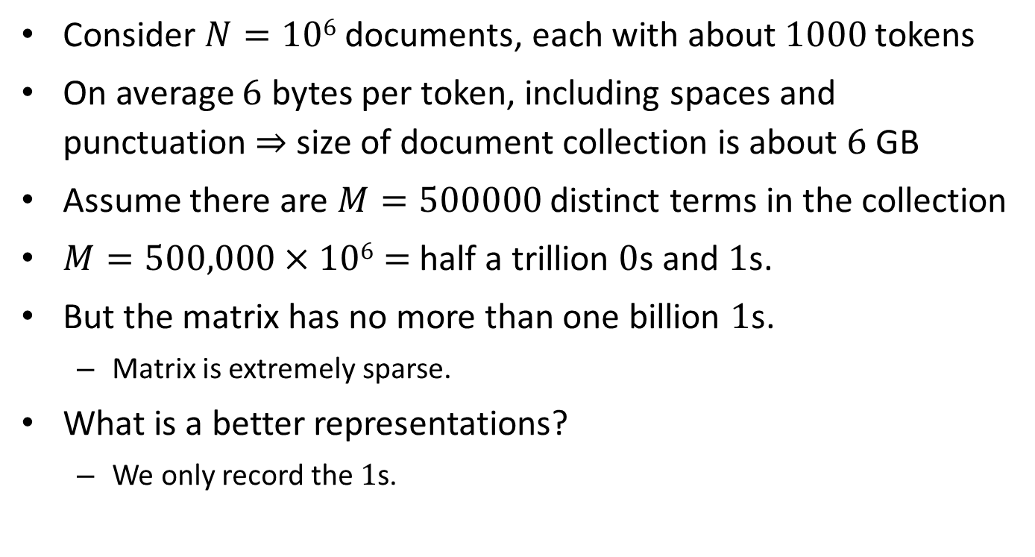
Bigger collections
Consider $N=106$documents, each with about $1000$ tokens
On average $6$ bytes per token, including spaces and punctuation ⇒ size of document collection is about $6$ GB
Assume there are $M=500000$ distinct terms in the collection
$M=500,000×106=$ half a trillion $0$s and $1$s.
But the matrix has no more than one billion $1$s.
Matrix is extremely sparse.
What is a better representations?
We only record the $1$s.

Slide 9
Indexing
Inverted index is the dominating indexing method (used by all search engines)
Other indices (e.g., document index) may be needed for feedback

Slide 10
Inverted Index
Fast access to all docs containing a given term (along with freq and pos information)
For each term, we get a list of tuples (docID, freq, pos).
Given a query, we can fetch the lists for all query terms and work on the involved documents.
Boolean query: set operation
Natural language query: term weight summing

Slide 11
Inverted Index Example
Dictionary
(or Lexicon)
Doc 1
Postings
… news about
Term | # docs | Total freq
news | 3 | 3
campaign | 2 | 2
presidential | 1 | 2
food | 1 | 1
… | … | …
Doc id | Freq
1 | 1
2 | 1
3 | 1
2 | 1
3 | 1
2 | 2
2 | 1
… | …
… | …
Position
p1
p2
p3
p4
p5
p6, p7
P8
Doc 2
... news about organic food campaign
Doc 3
... news of presidential campaign … presidential candidate …

Slide 12
Inverted Index for Fast Search?
Single-term query?
Multi-term Boolean query?
Must match term “A” AND term “B”
Must match term “A” OR term “B”
Multi-term keyword query
Similar to disjunctive Boolean query (“A” OR “B”)
Aggregate term weights
More efficient than sequentially scanning documents (why?)

Slide 13

Empirical Distribution of Words – Zipf’s Law
$rank×frequency  constant$
Word
Freq.
Intermediate frequency words
Highest frequency
Biggest
data structure
(stop words)
rare words
Word Rank (by Freq)

Slide 14
Data Structures for Inverted Index
Dictionary: modest size
Needs fast random access
Preferred to be in memory
Hash table, B-tree, trie, …
Postings: huge
Sequential access is expected
Can stay on disk
May contain docID, term freq., term pos, etc
Compression is desirable

Slide 15
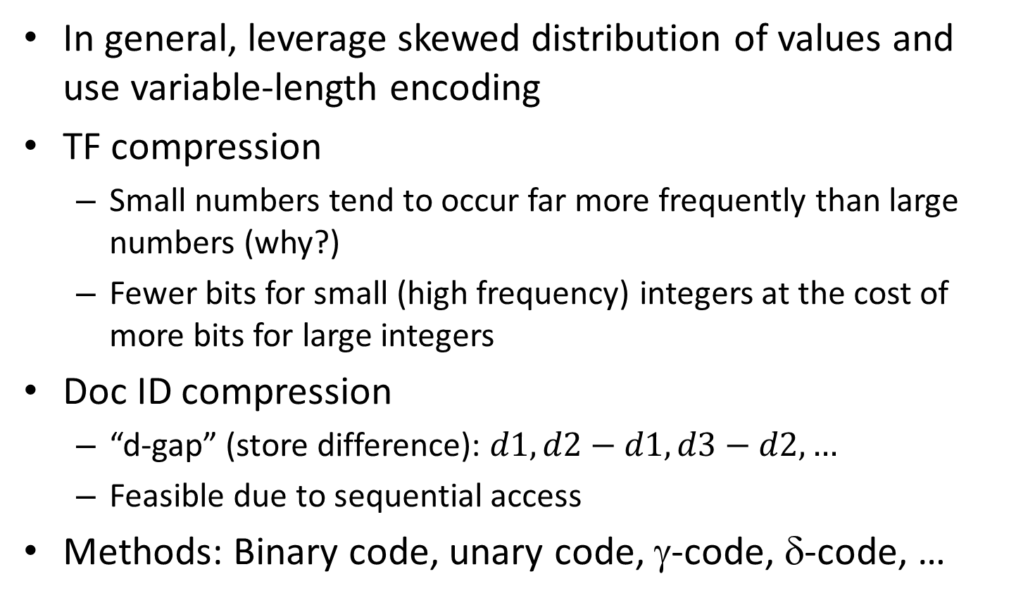
Inverted Index Compression
In general, leverage skewed distribution of values and use variable-length encoding
TF compression
Small numbers tend to occur far more frequently than large numbers (why?)
Fewer bits for small (high frequency) integers at the cost of more bits for large integers
Doc ID compression
“d-gap” (store difference): $d1, d2−d1, d3−d2,…$
Feasible due to sequential access
Methods: Binary code, unary code, γ-code, δ-code, …

Slide 16
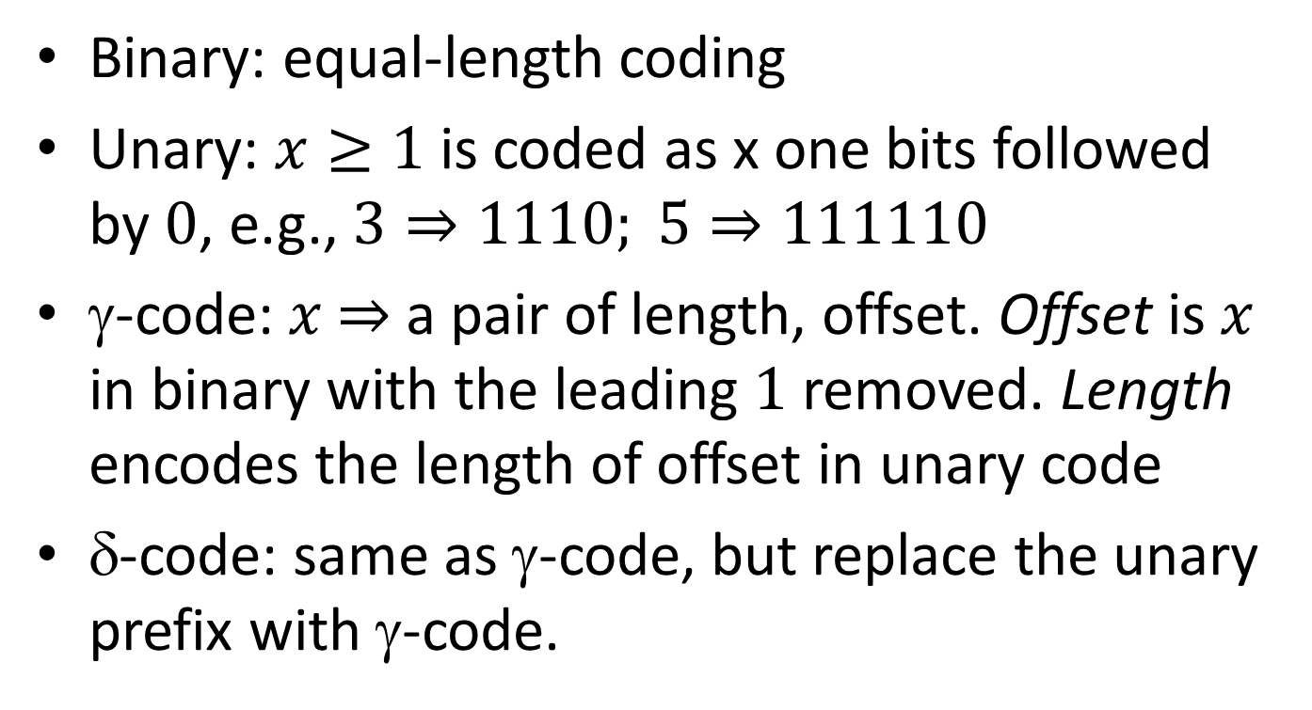
Integer Compression Methods
Binary: equal-length coding
Unary: $x≥1$ is coded as x one bits followed by $0$, e.g., $3⇒1110; 5⇒111110$
γ-code: $x$ $⇒$ a pair of length, offset. Offset is $x$ in binary with the leading $1$ removed. Length encodes the length of offset in unary code
δ-code: same as γ-code, but replace the unary prefix with γ-code.

Slide 17
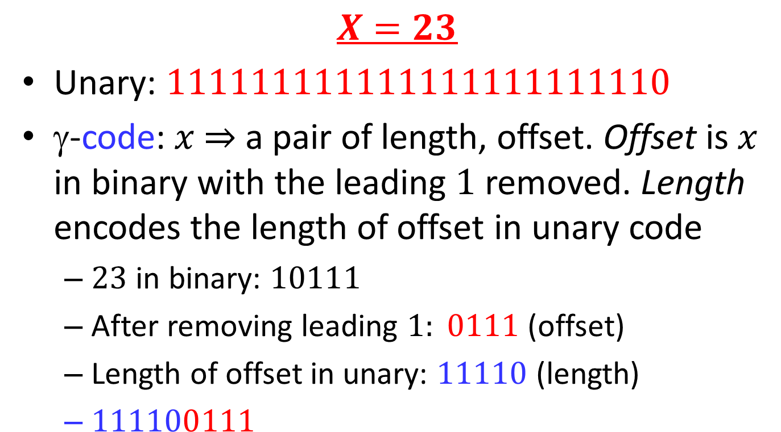
Integer Compression Methods - Example
$$X=23$$
Unary: $111111111111111111111110$
γ-code: $x$ $⇒$ a pair of length, offset. Offset is $x$ in binary with the leading $1$ removed. Length encodes the length of offset in unary code
$23$ in binary: $10111$
After removing leading $1: 0111$ (offset)
Length of offset in unary: $11110$ (length)
$111100111$

Slide 18
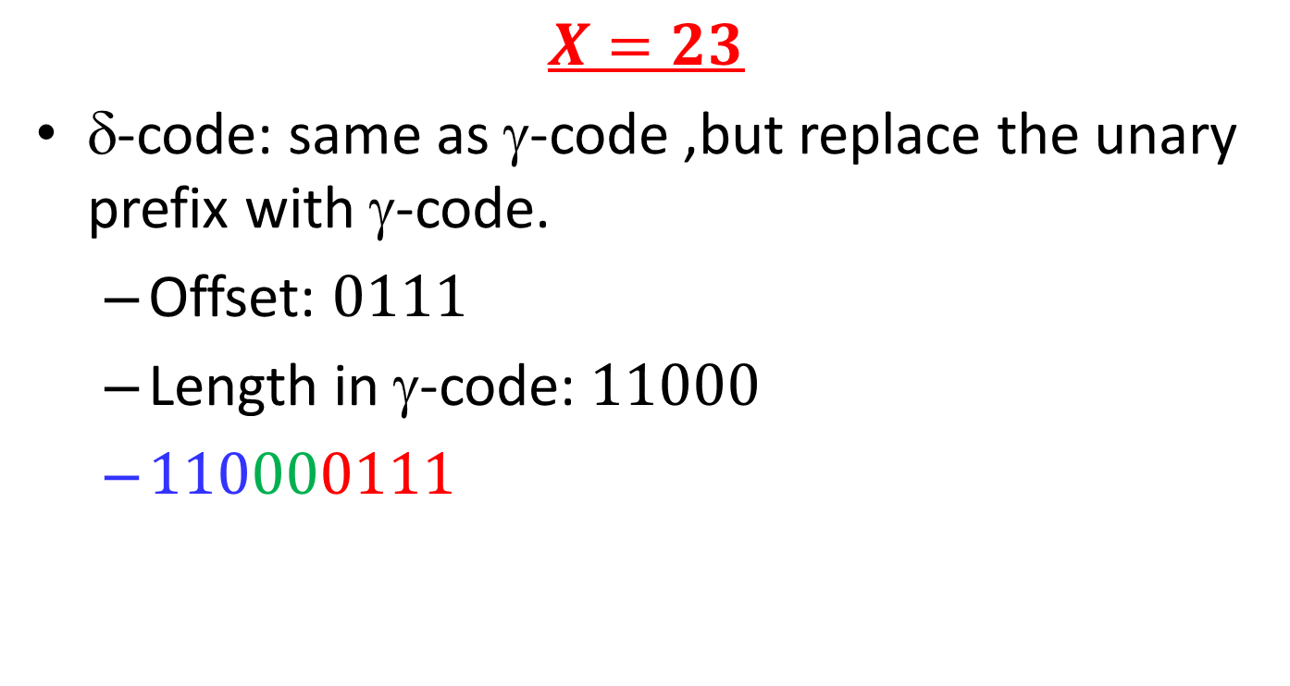
Integer Compression Methods - Example
$$X=23$$
δ-code: same as γ-code ,but replace the unary prefix with γ-code.
Offset: $0111$
Length in γ-code: $11000$
$110000111$

Slide 19
Constructing Inverted Index
The main difficulty is to build a huge index with limited memory
Memory-based methods: not usable for large collections
Sort-based methods:
Step 1: collect local (termID, docID, freq) tuples
Step 2: sort local tuples (to make “runs”)
Step 3: pair-wise merge runs
Step 4: Output inverted file

Slide 20
Sort-based Inversion
Sort by doc-id
Sort by term-id
All info about term 1
Term Lexicon:
the 1
campaign 2
news 3
a 4
...
doc1
<1,1,3>
<2,1,2>
<3,1,1>
...
<1,2,2>
<3,2,3>
<4,2,2>
…
<1,300,3>
<3,300,1>
...
<1,1,3>
<1,2,2>
<2,1,2>
<2,4,3>
...
<1,5,3>
<1,6,2>
…
<1,299,3>
<1,300,1>
...
<1,1,3>
<1,2,2>
<1,5,2>
<1,6,3>
...
<1,300,3>
<2,1,2>
…
<5000,299,1>
<5000,300,1>
...
doc2
...
DocID
Lexicon:
doc1 1
doc2 2
doc3 3
...
doc300
Parse & Count
“Local” sort
Merge sort

Slide 21
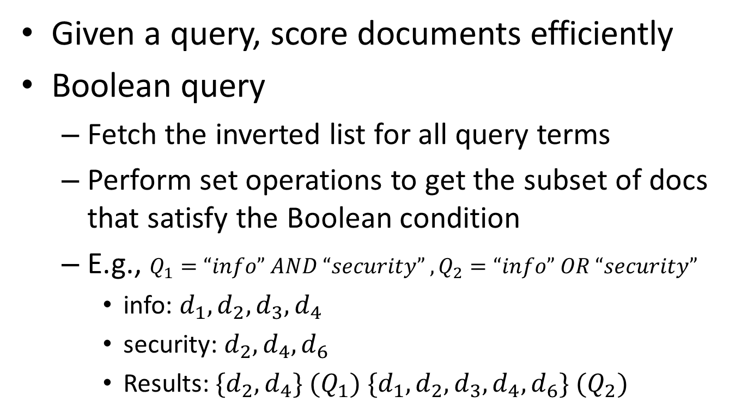
Searching
Given a query, score documents efficiently
Boolean query
Fetch the inverted list for all query terms
Perform set operations to get the subset of docs that satisfy the Boolean condition
E.g., $Q_{1}=“info” AND “security” , Q_{2}=“info” OR “security”$
info: $d_{1}, d_{2}, d_{3}, d_{4}$
security: $d_{2}, d_{4}, d_{6}$
Results: $\{d_{2},d_{4}\} (Q_{1}) \{d_{1},d_{2},d_{3},d_{4},d_{6}\} (Q_{2})$

Slide 22
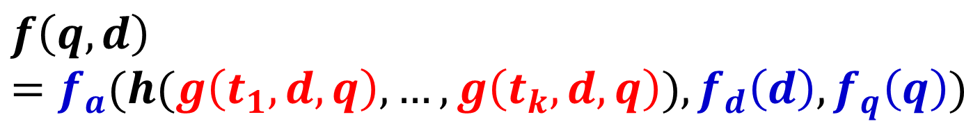
How to Score Documents Quickly?
General form of scoring functions
Final score adjustment
$$f\left(q,d\right)=f_{a}(h(g\left(t_{1}, d, q\right), …, g\left(t_{k}, d, q\right)), f_{d}\left(d\right), f_{q}\left(q\right))$$
Weight aggregation
Weight of a matched query term in d

Slide 23
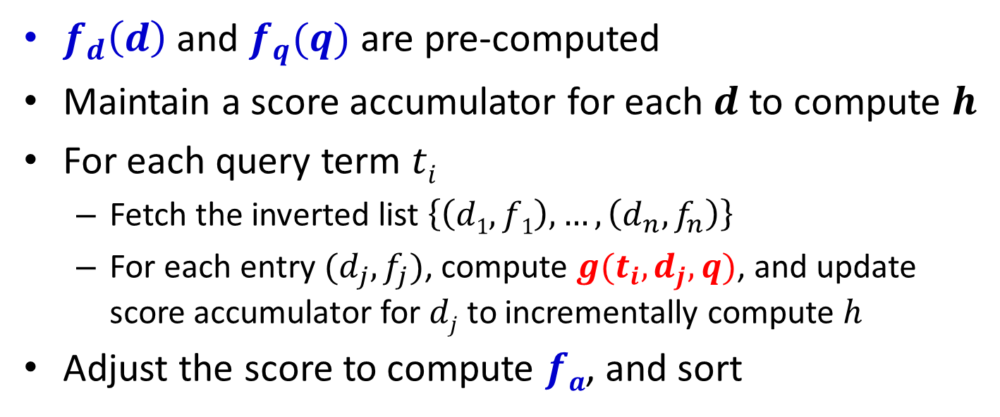
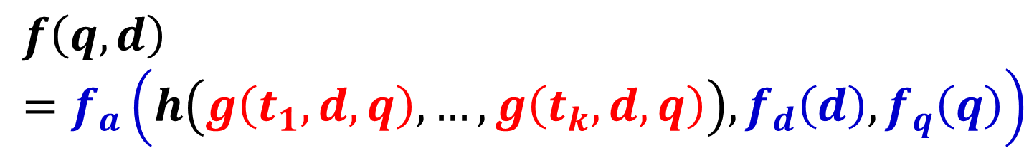
A General Algorithm for Ranking Documents
$$f\left(q,d\right)=f_{a}\left(h\left(g\left(t_{1}, d, q\right), …, g\left(t_{k}, d, q\right)\right), f_{d}\left(d\right), f_{q}\left(q\right)\right)$$
$f_{d}\left(d\right)$ and $f_{q}(q)$ are pre-computed
Maintain a score accumulator for each $d$ to compute $h$
For each query term $ti$
Fetch the inverted list $\left\{\left(d1, f1\right), …, \left(d_{n}, f_{n}\right)\right\}$
For each entry $(d_{j}, f_{j})$, compute $g(t_{i}, d_{j}, q)$, and update score accumulator for $dj$ to incrementally compute $h$
Adjust the score to compute $fa$, and sort

Slide 24
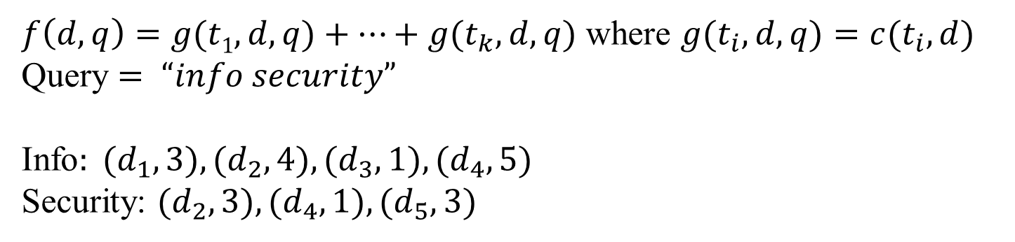
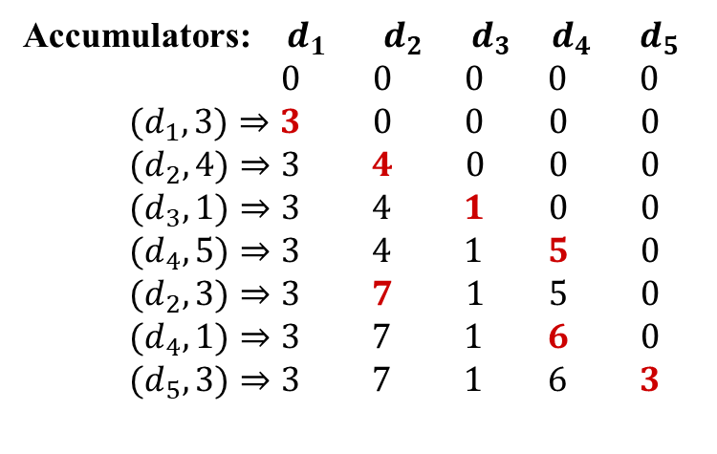
Ranking Documents: Example
$f\left(d, q\right)=g(t1, d, q)+…+g(t_{k}, d, q)$ where $g(t_{i}, d, q)=c(t_{i}, d)$
Query $= “info security”$
Info$: (d_{1}, 3), (d_{2}, 4), (d_{3}, 1), (d_{4}, 5)$
Security: $(d_{2}, 3), (d_{4},1), (d_{5}, 3)$
Accumulators: $d_{1} d_{2} d_{3} d_{4} d_{5}$
$$0 0 0 0 0$$
$$(d_{1},3)⇒3 0 0 0 0$$
$$(d_{2},4)⇒3 4 0 0 0$$
$$(d_{3},1)⇒3 4 1 0 0$$
$$(d_{4},5)⇒3 4 1 5 0$$
$$(d_{2},3)⇒3 7 1 5 0$$
$$(d_{4},1)⇒3 7 1 6 0$$
$$(d_{5},3)⇒3 7 1 6 3$$
info
security

Slide 25
Further Improving Efficiency
Caching (e.g., query results, list of inverted index)
Keep only the most promising accumulators
Sort the inverted list in decreasing order of weights and fetch only N entries with the highest weights
Scaling up to the Web-scale (more about this later)

Slide 26
Some Text Retrieval Toolkits
Smart (Cornell) (no longer popular)
Lucene (http://lucene.apache.org/)
Lemur/Indri (http://lemurproject.org/)
Galago
Terrier (http://terrier.org/)
MeTA (http://meta-toolkit.github.io/meta/)

Slide 27
Questions?

