Slide 1
Chapter 9b: Encoder-Decoder Models, RNN Attention - a sample of Neural Machine Translation

Slide 2
Machine Translation
- 1990s
Rule Based MT
1990s – 2014
Statistical MT
2014 – 2018
Encoder-Decoder RNN with Attention
Neural MT
2018 - …
Encoder-Decoder Transformer

Slide 3
RNN
RNN is used for including language modeling, contextual generation, and sequence labeling
input sequences being transformed into output sequences in a one-to-one fashion.
More flexible networks: encoder-decoder networks, or sequence-to-sequence models
Used in very wide range of applications
Machine translation
Summarization
question answering
dialogue modelling …
Key idea: use of an encoder network that takes an input and creates a contextualized representation of it.

Slide 4
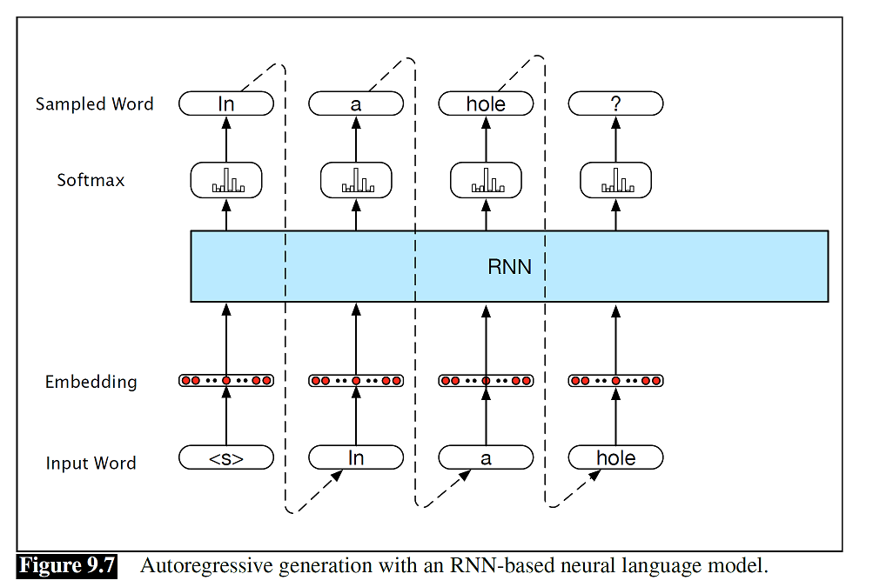
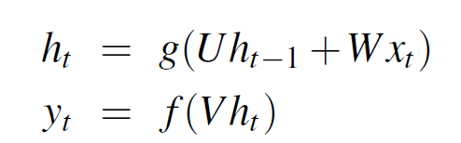
Neural Language Model and Generation
LSTM, GRU

Slide 5

Autoregressive NL generation model
Given a trained model
ask the network to generate novel sequences
randomly sampling an appropriate word as the beginning of a sequence
condition the generation of subsequent words on the hidden state from the previous time step
sample a particular word, y_{i} from
The process continues until the end of sentence token <\s> is generated
Instead of having the language model generate a sentence from scratch, we have it complete a sequence given a specified prefix.

Slide 6
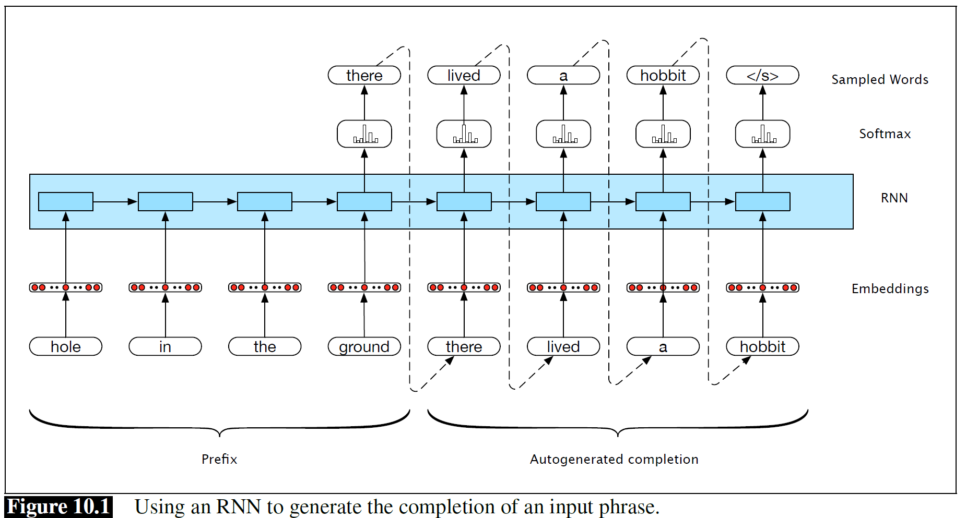

Slide 7
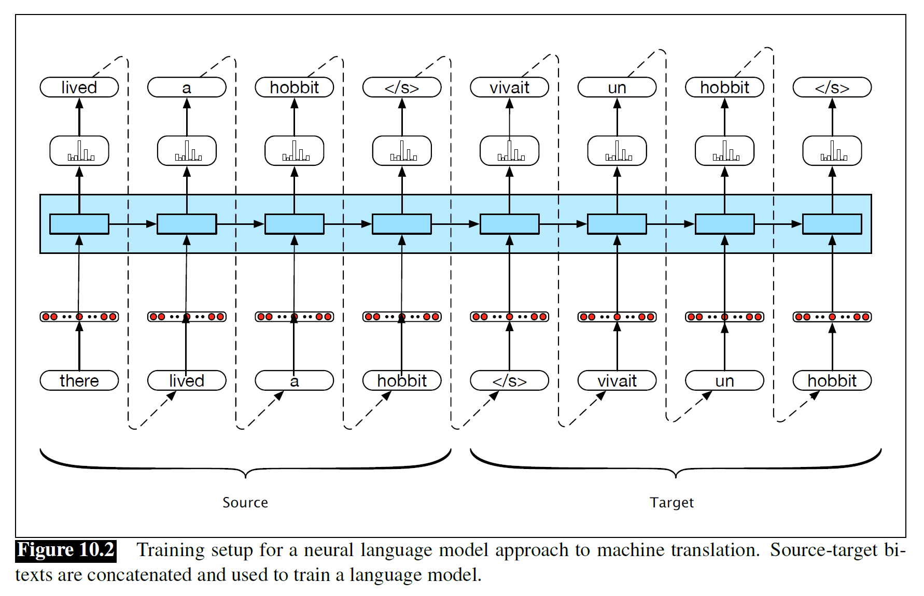
Other applications: MT, summarization, dialog system, chatbot, ….
The primary resources used to train modern translation systems are known parallel texts, or bitexts

Slide 8
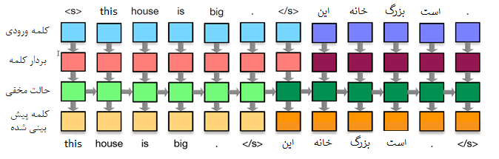
MT using Encoder-decoder

Slide 9
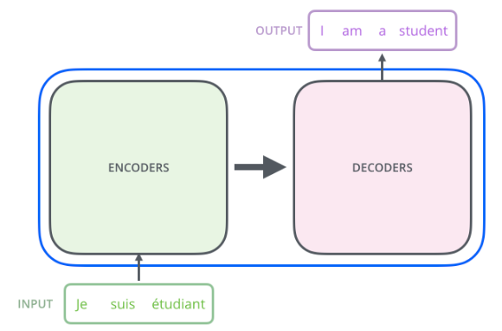
Encoder-decoder networks
Encoder-decoder networks
Used in a wide range of applications including machine translation, summarization, question answering, and dialogue modeling.
RNNs were the most widely-used and successful architecture for both the encoder and decoder.
Other architectures (transformers) also suitable for Encoder-decoder networks

Slide 10
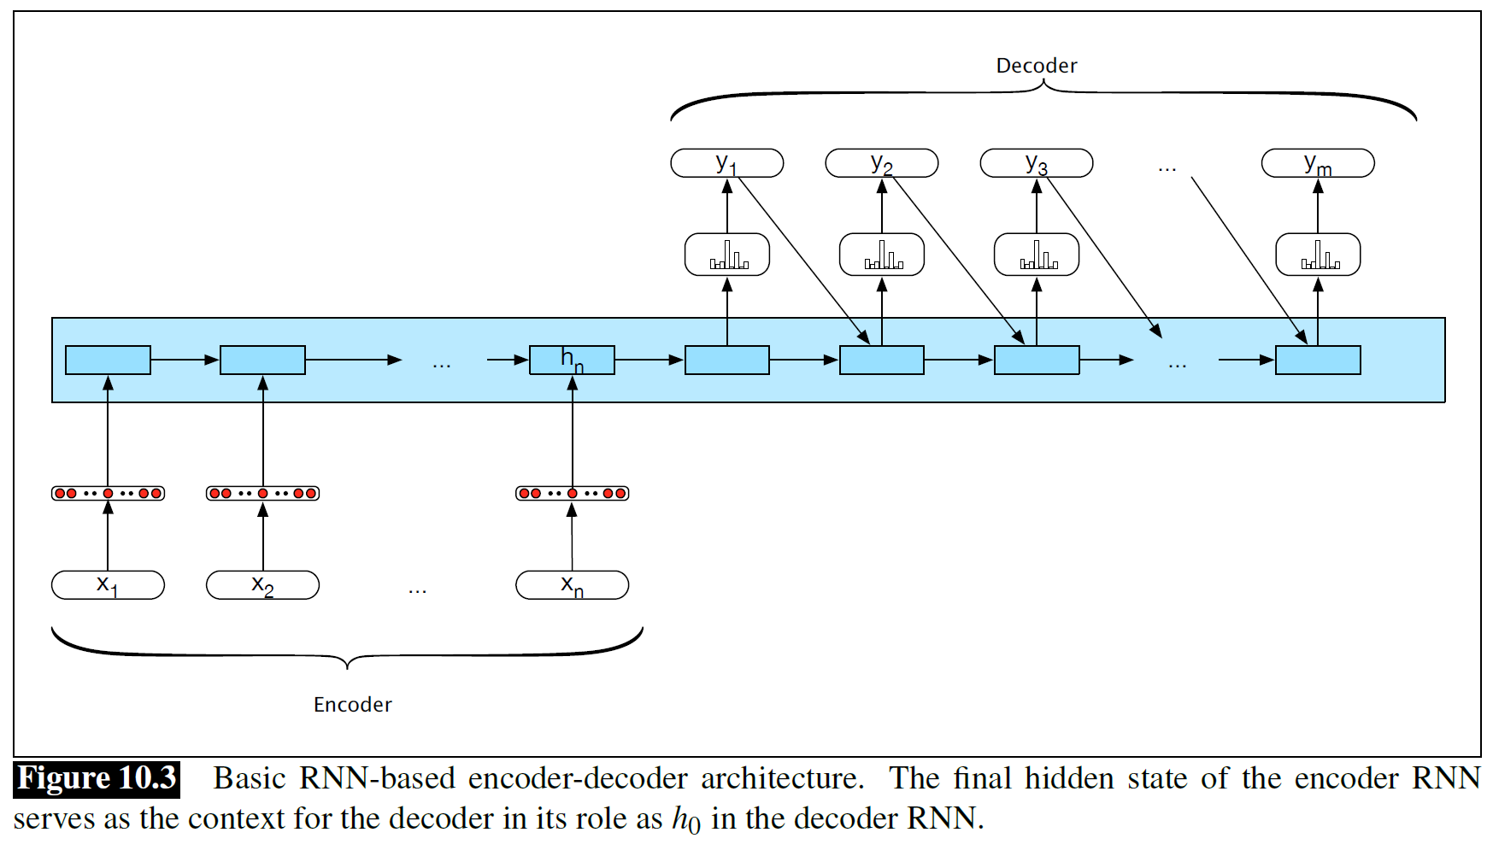
Encoder-decoder networks

Slide 11
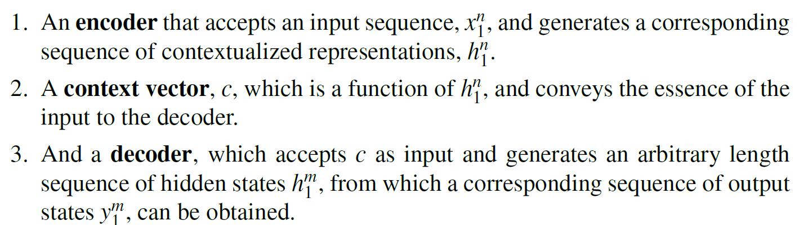
Encoder-decoder network components:

Slide 12
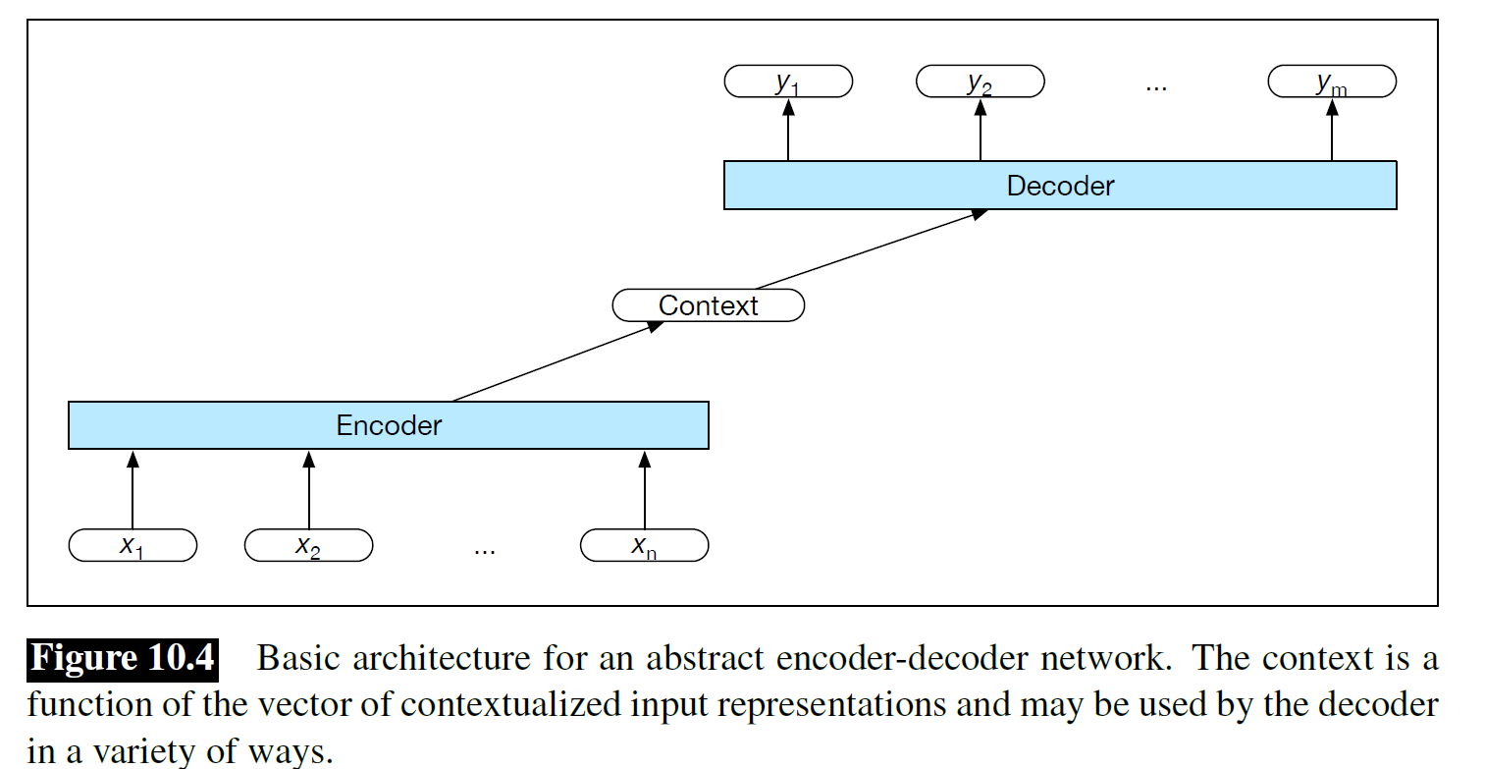

Slide 13
Encoder
Can be RNNs, LSTMs, GRUs, convolutional networks, as well as transformer networks
Stacked architectures are the norm:
output states from the top layer of the stack are taken as the final representation
Stacked Bi-LSTMs, Stacked Transformers , ….

Slide 14
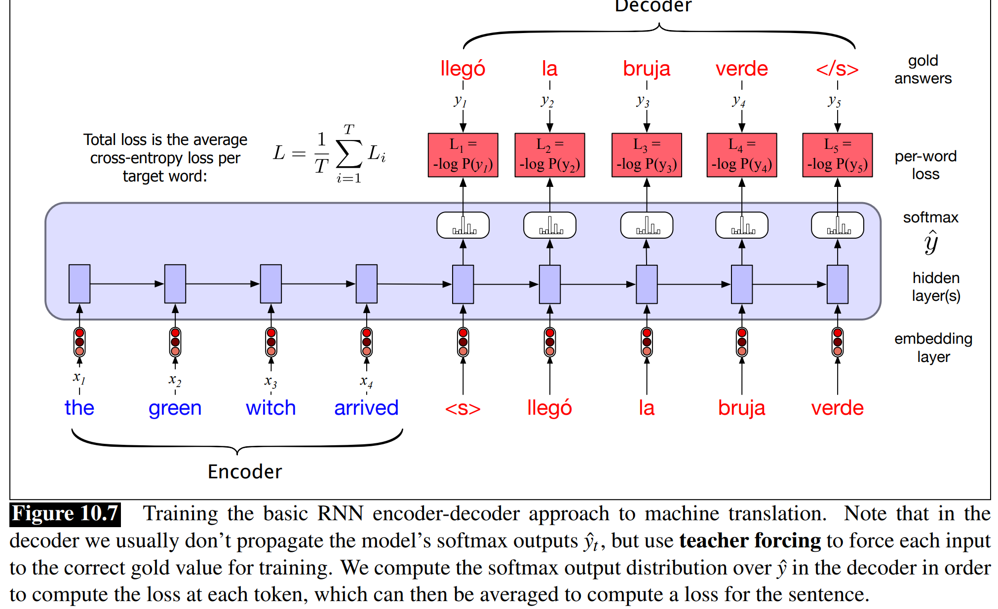
Training

Slide 15
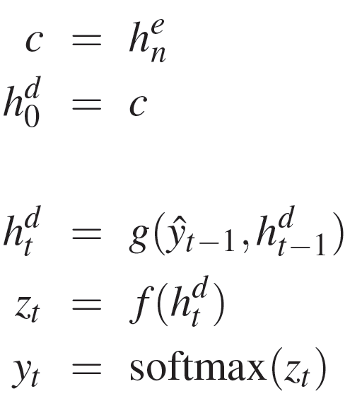
Decoder
Autoregressive generation is used to produce the output sequence
typical approach is to use an LSTM or GRU-based RNN
context consists of the final hidden state of the encoder,
weakness is context vector (c)
Is only directly available at the beginning of the process
its influence will wane as the output sequence is generated.

Slide 16
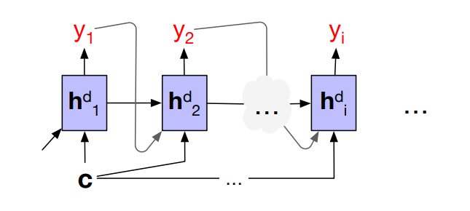
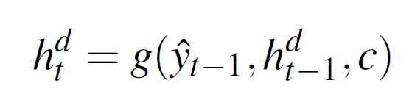
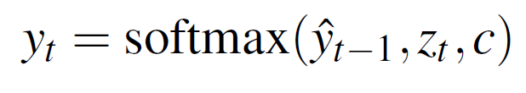
Decoder
Adding the context as a parameter to the computation of the current hidden state
Condition the output on both the newly generated hidden state, the output generated at the previous state, and the encoder context

Slide 17
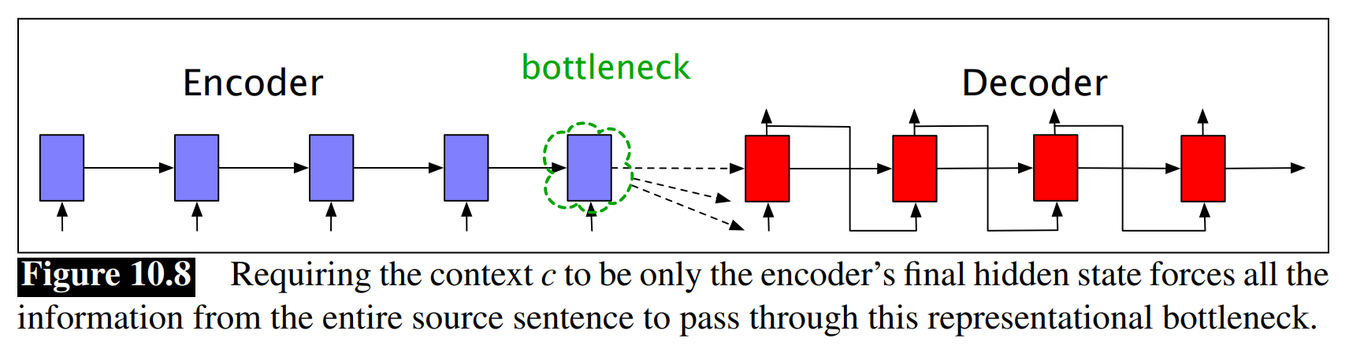
Why need attention?
The idea of attention is instead to create the single fixed-length vector c by taking a weighted sum of all the encoder hidden states

Slide 18
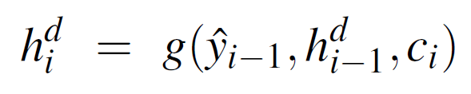
Attention
A mechanism that can take the entire encoder context into account
Dynamically updates during the course of decoding
embodied in a fixed-size vector
First Step: replace the static context vector with one that is dynamically derived from the encoder hidden states at each point during decoding
In decoding step i, c_{i} is the context that takes all of the encoder hidden states into account in its derivation

Slide 19
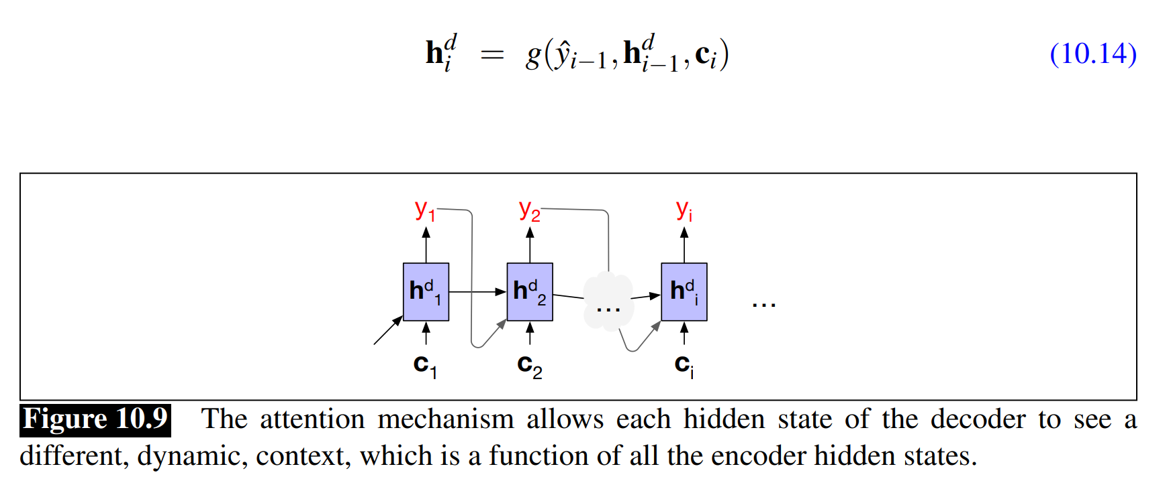
Attention

Slide 20


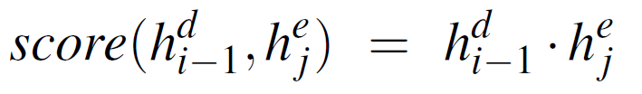
Attentional Context (c_{i})
a vector of scores that capture the relevance of each encoder hidden state to the decoder state
: relevancy of decoder hidden state in step i-1 to encoder hidden state in step j

Slide 21
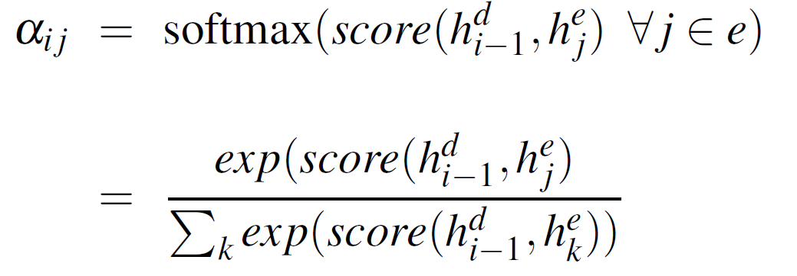
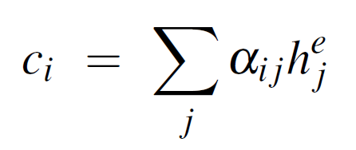
Attentional Context (c_{i})
α_{ij} : proportional relevance encoder hidden state j decoder state i:
C_{i}: fixed-length context vector for the current decoder state by taking a weighted average over all the encoder hidden states

Slide 22
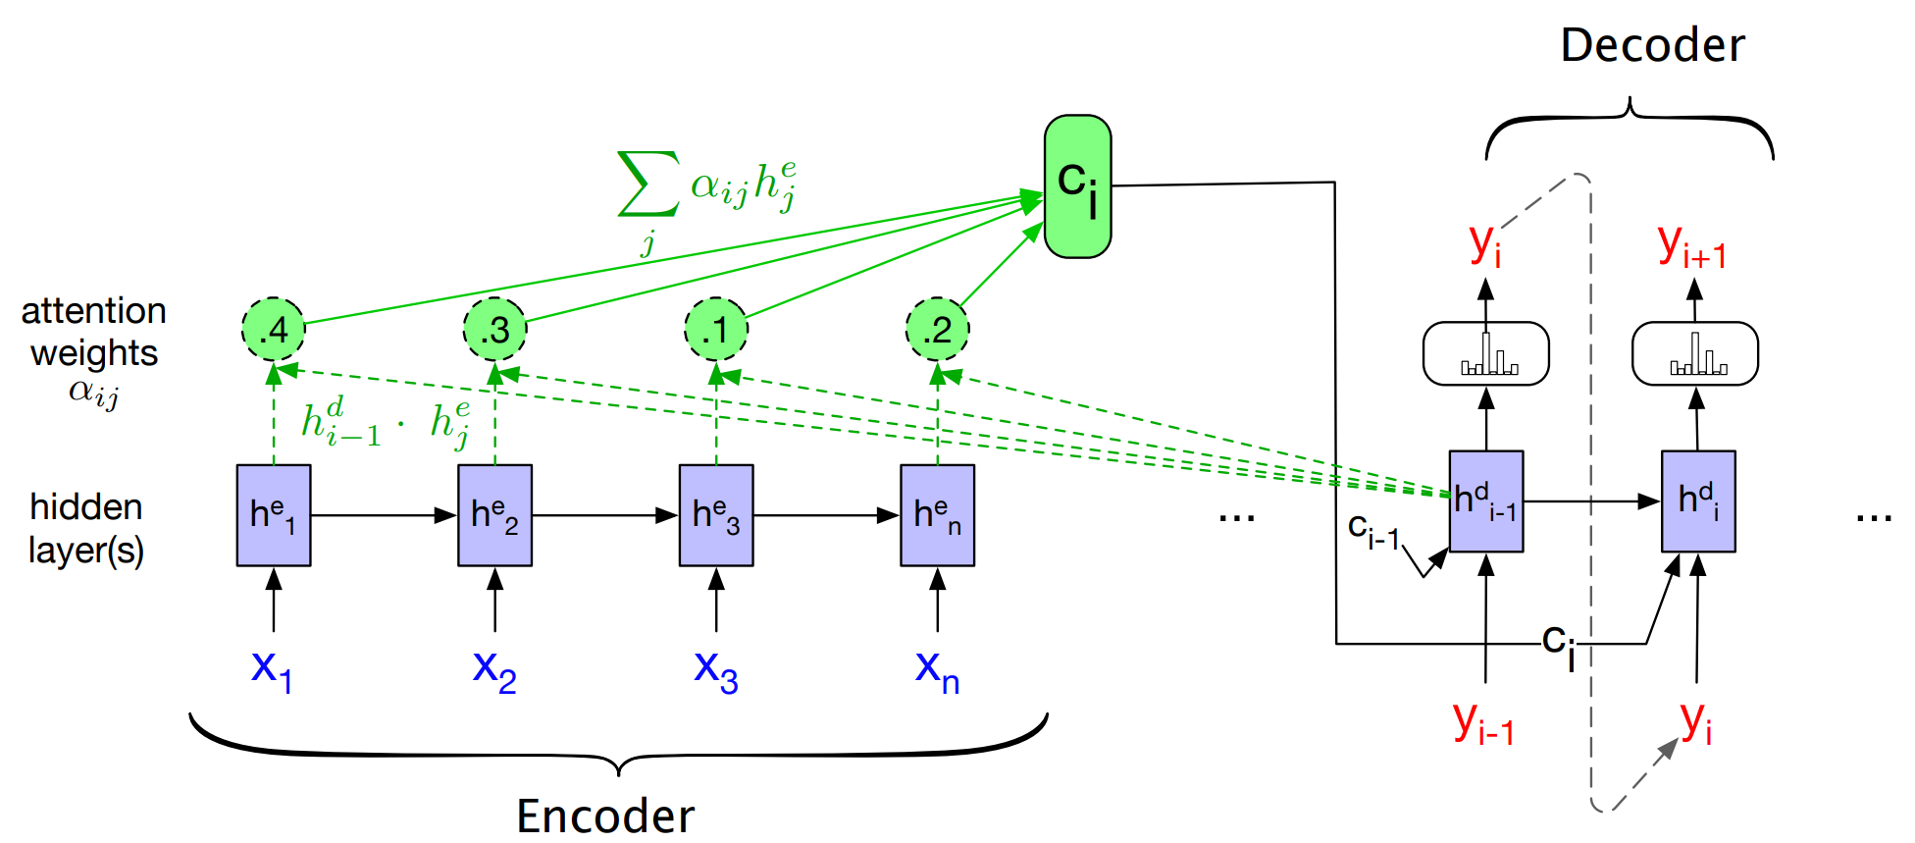
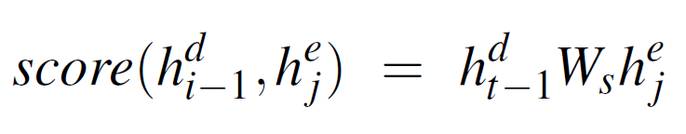
by parameterizing the score with its own set of weights, W_{s}

Slide 23
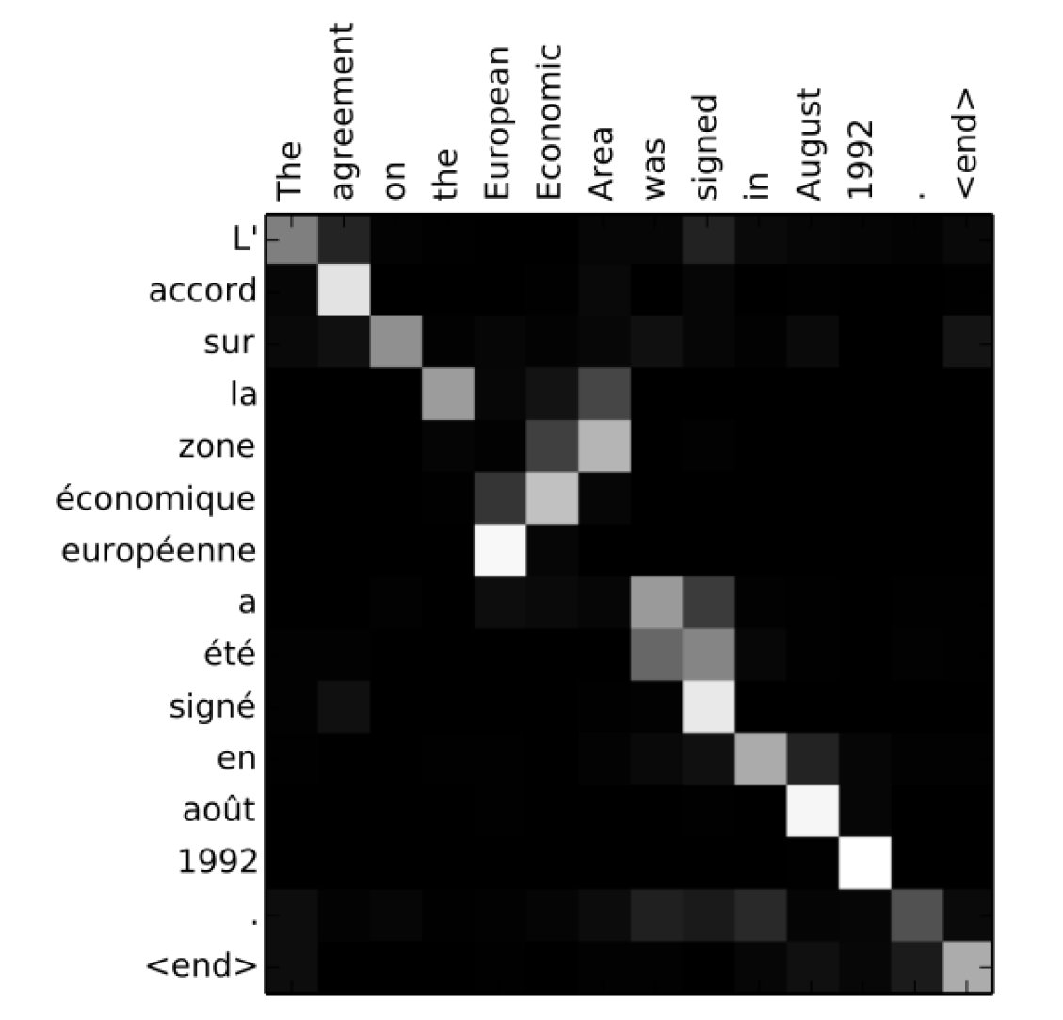
attention vector

Slide 24
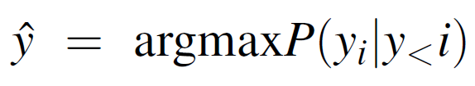
Output layer in Decoder
output y at each time consists of a softmax computation
Output generation is task-specific
several of the possible options for output generation:
Simply sample from the softmax distribution (NLG)-not suitable for MT …
choose the most likely output
Using CRF-layer with Viterbi: not suitable because DP invariant is not hold
Using Beam Search

Slide 25
Beam Search
problem as a heuristic state-space search
Combining a breadth-first-search strategy with a heuristic filter that scores each option and prunes the search space to stay within a fixed-size memory footprint, called the beam width
Hypotheses
continues until a <\s> is generated
At this point, the completed hypothesis is removed from the frontier and the size of the beam is reduced by one
Select the best hypotheses with length normalization because probabilities prefer shorter hypotheses

Slide 26
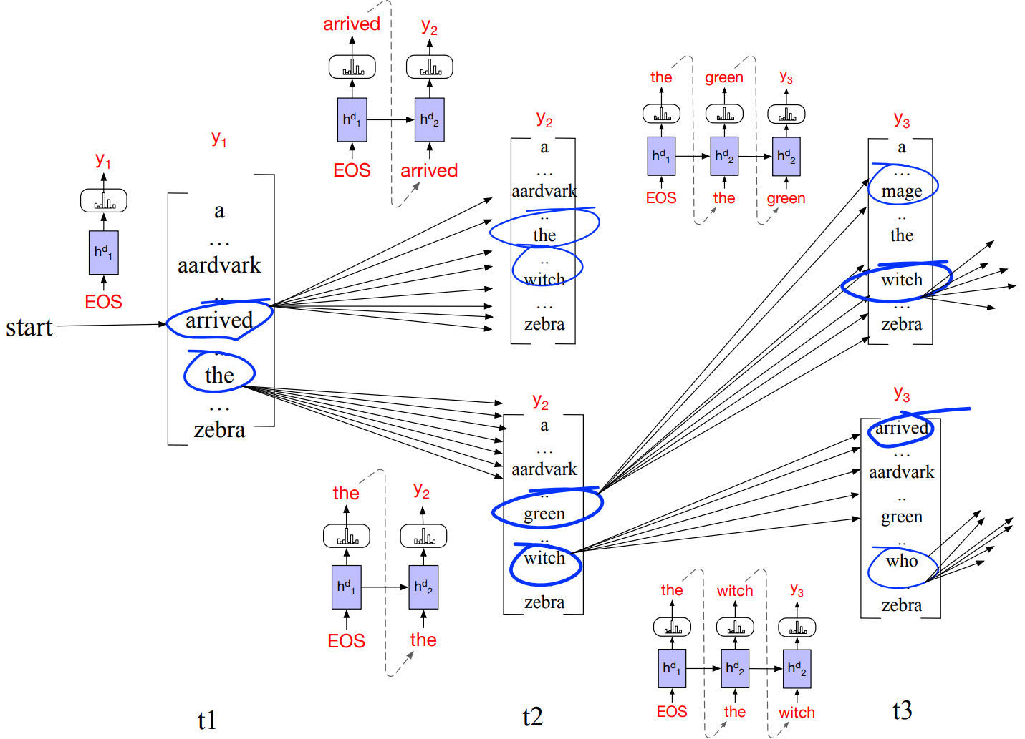

Slide 27
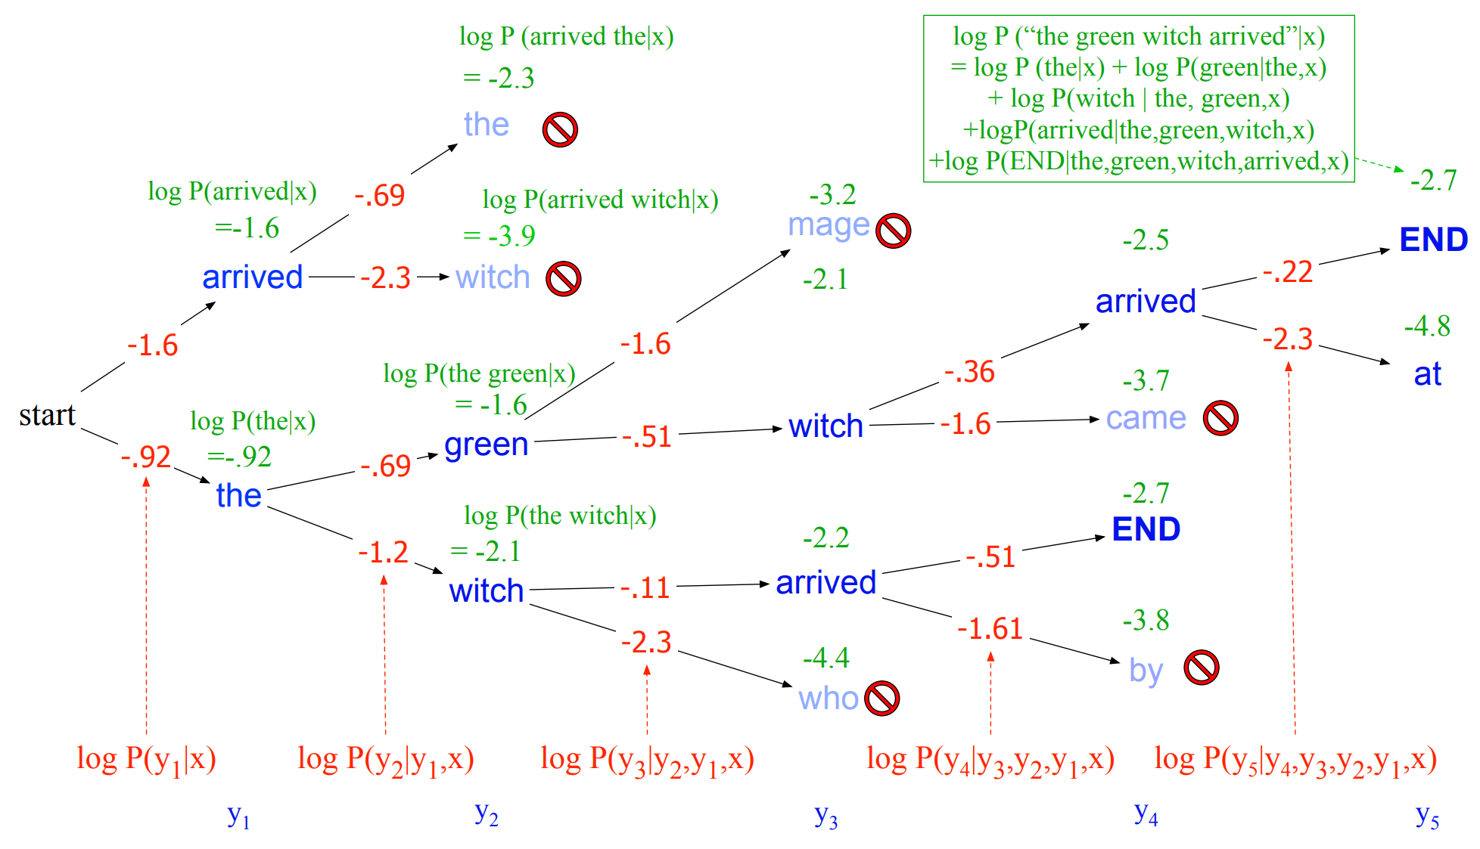

Slide 28
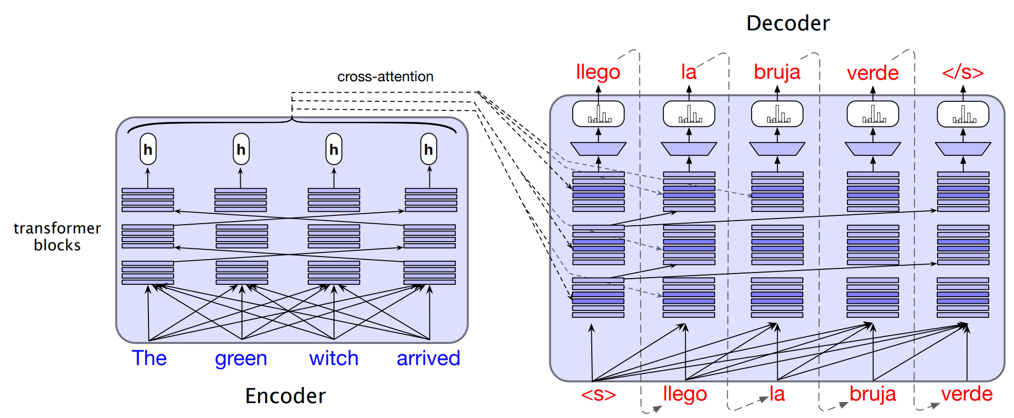
Encoder-Decoder with Transformers

Slide 29
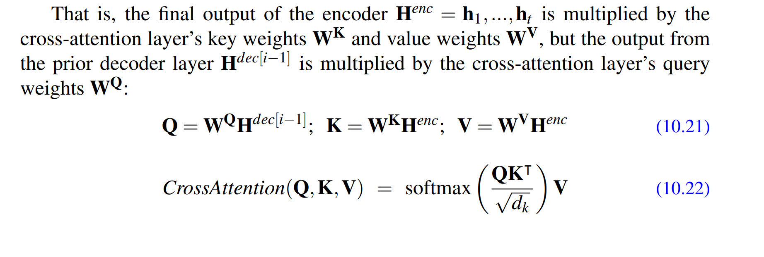
Encoder-Decoder with Transformers

Slide 30
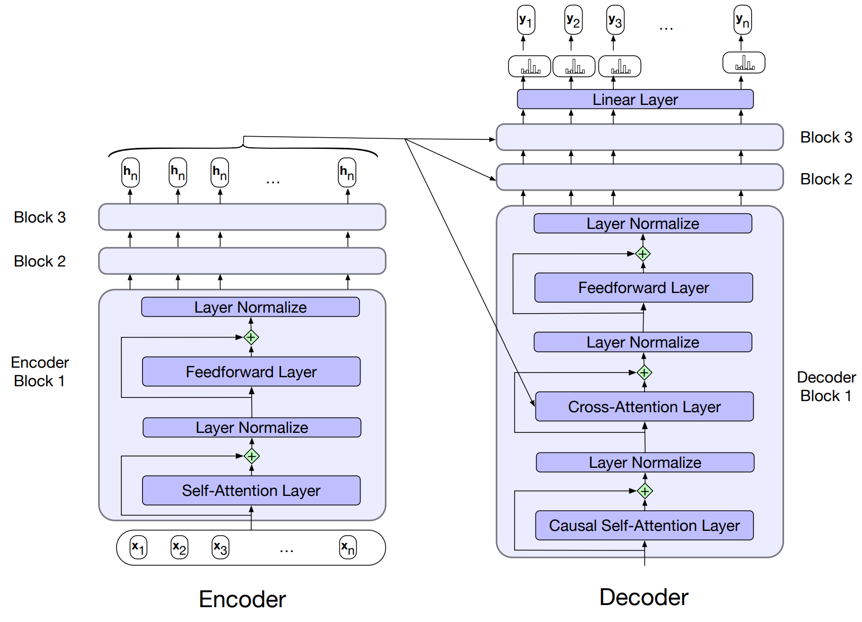

Slide 31
Persian-English Parallel Corpus
پیکره‌ی میزان
پیکره انگلیسی-فارسی تهران (TEP)
پیکره فارسی-انگلیسی امیرکبیر (AFEC)
پیکره‌ی حوزه‌ی خبری
پیکره‌ی تنزیل
پیکره OpenSubtitles
پیکره ویکی‌پدیا
پیکره OPUS

