Slide 1
Cicirello’s Benchmark Problem
OPTIMIZATION TECHNIQUES
Razeen Hussain
4273095
EMARO 2015-2017

Slide 2
The Problem
Single Machine Total Weighted Tardiness Scheduling Problem with Sequence Dependent Setup Times
A set of jobs ‘J’ is to be scheduled on a single machine without preemption
Each job has a
Process Time (P_{j} )
Deadline (D_{j})
Weight (W_{j})
Sequence dependent setup time (S_{ij})
The objective is to minimize the total weighted tardiness

Slide 3

The Problem
The decisions to be made are
The sequence of the jobs
Time tabling
The starting time of each job (s_{j})
The completion time of each job (c_{j})
Tardiness of each job $(t_{i})=max\left(0,c_{i}−D_{i}\right)$
The cost function ‘f’ is defined as
$$f= \sum_{i=1}^{n}{t_{i}W_{i}}$$
The goal is to minimize the above cost function

Slide 4
Approaches
MIP Formulation
Local Search
Local Solver
Constraint Programming
Hybrid Approach

Slide 5

MIP Formulation
Programming Language: Gurobi with MATLAB
The formulation is:
$c_{j}≥0$
$t_{j}≥0$
$t_{j}≥c_{j}−D_{j}$
$\sum_{pεP}{X_{jp}=1}$
$\sum_{jεJ}{X_{jp}=1}$
$X_{jp}= f\left(x\right)=\left\{\begin{aligned}1, if job{{}_{}^{′}j}^{′}is in position ′p′ \\ &0, otherwise\end{aligned}\right.$
$c_{i}≥P_{i}+S_{0j}−M\left(1 −X_{i1}\right)$
$c_{j}≥P_{j}+S_{ij}+c_{i}−M\left(2 −X_{i,p−1}−X_{jp}\right)$

Slide 6
MIP Formulation
Instance | 5min | 10min | 15min | 30min | 1hr
1 | 123,963 | 82,062 | 81,612 | 77,037 | 74,951
60 | 642,347 | 542,298 | 499,589 | 468,815 | MATLAB crashes after 46min
120 | 1,145,102 | 1,007,417 | 1,007,417 | 853,125 | 841,743

Slide 7
Local Search
Programming Language: MATLAB
Different techniques applied
Swap
Insertion
Subsequence inversion
Variable neighborhood search (VNS)
The approaches were deterministic

Slide 8
Local Search
Instance | Swap | Insertion | Inversion | VNS
1 | 2,012 | 1,330 | 21,267 | 894
60 | 104,912 | 98,248 | 374,939 | 83,501
120 | 451,981 | 436,719 | 826,086 | 435,162

Slide 9
Local Solver
Programming Language: LSP
Implemented the list variable to define the sequence
The length of the list variable was 61
The first dummy job was included and constraint put for it being the first job
The rest was just the implementation of the basic formulae for completion time, tardiness and objective function.

Slide 10
Local Solver
The model used is :
// sequence variable
sequence <- list(61);
constraint count(sequence) == 61;
constraint sequence[0] == 0;
// completion time constraint
completionTimes[0] = 0;
completionTimes[i in 1..60] <- setupTimes[sequence[i-1]][sequence[i]] +processTimes[sequence[i]]+completionTimes[i-1];
// tardiness constraint
tardiness[i in 0..60] <- max(0,(completionTimes[i] - deadlines[sequence[i]]));
// minimize value
objectiveValue <- sum[i in 0..60](weights[sequence[i]] * tardiness[i]);
minimize objectiveValue;

Slide 11
Local Solver
Instance | 30s | 1min | 5min | 10min
1 | 890 | 870 | 842 | 738
60 | 71,896 | 71,896 | 71,896 | 68,956
120 | 421,659 | 416,635 | 415,787 | 415,787

Slide 12
Constraint Programming
Programming Language: MiniZinc + Gecode
The model used is :
array[1..nJobs] of int: pTime;
array[1..nJobs] of int: weight;
array[1..nJobs] of int: dTime;
array[0..nJobs, 1..nJobs] of int: sTime;
array[1..nJobs] of var 1..nJobs: jobs;
array[1..nJobs] of var int: cTime;
array[1..nJobs] of var int: tardiness;
var int: cost;
solve minimize cost;
constraint
all_different(jobs) /\
cTime[1]=pTime[jobs[1]]+sTime[0,jobs[1]] /\
forall(j in 2..nJobs)(cTime[j] = pTime[jobs[j]]+cTime[j-1]+sTime[jobs[j-1], jobs[j]]) /\
forall(k in 1..nJobs)(tardiness[k] = max(0,cTime[k]-dTime[jobs[k]])) /\
cost = sum(n in jobs)(tardiness[n]*weight[jobs[n]])
;

Slide 13
Constraint Programming
Instance | 30s | 1min | 5min | 10min
1 | 111,721 | 108,521 | 101,985 | 99,357
60 | 654,057 | 594,790 | 573,482 | 552,085
120 | 1,245,421 | 1,174,241 | 1,151,311 | 1,127,704

Slide 14
Hybrid Approach
Iterative greedy combined with the simulated annealing technique to determine the best acceptance criteria
Programming Language: MATLAB
The algorithm is explained below:
Determine an initial feasible solution (for experimental purposes, the sequences obtained from previous approaches were used as initial seeds)
Random four jobs were removed from the current solution, dividing the jobs into two sub-sequences
One by one the removed jobs are added back into the bigger subsequence at places where they are least costly in the order they were removed
This is done until a complete sequence is obtained

Slide 15
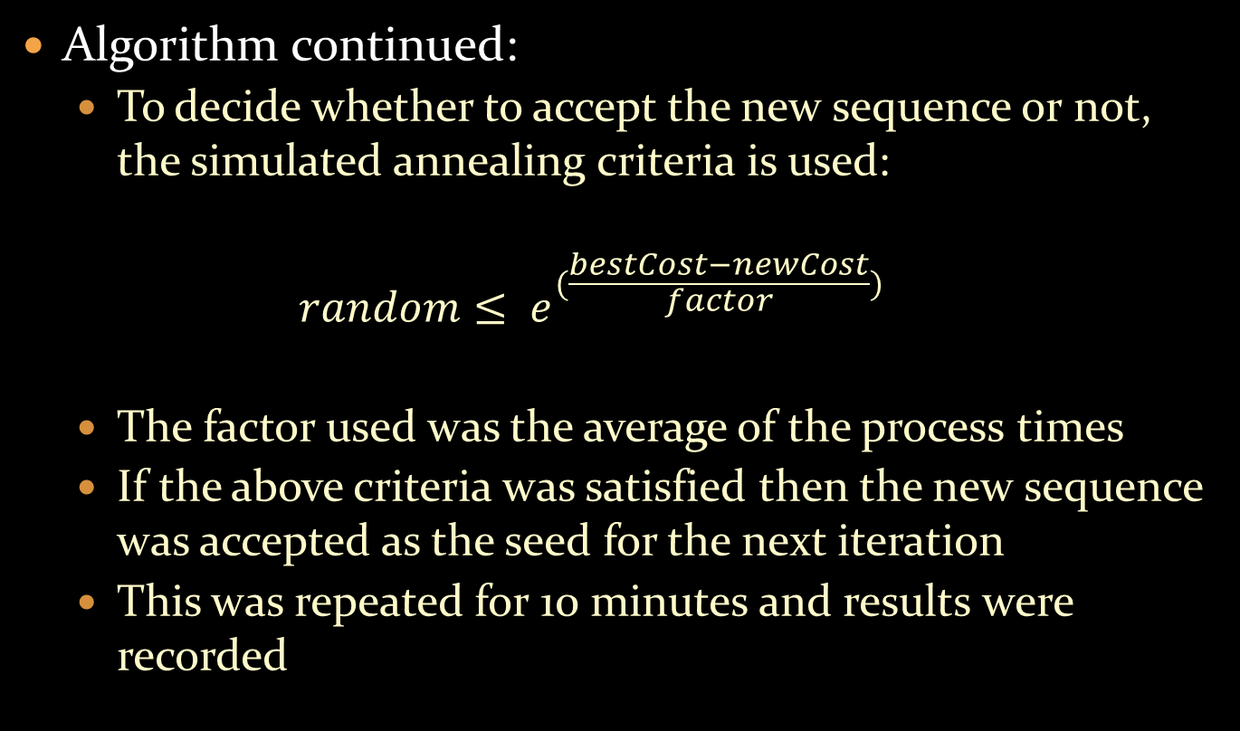
Algorithm continued:
To decide whether to accept the new sequence or not, the simulated annealing criteria is used:
$$random≤ e^{(\frac{bestCost−newCost}{factor})}$$
The factor used was the average of the process times
If the above criteria was satisfied then the new sequence was accepted as the seed for the next iteration
This was repeated for 10 minutes and results were recorded

Slide 16
Hybrid Approach
Instance | Average | Best
1 | 780 | 705
60 | 68,824 | 63,512
120 | 536,815 | 410,475

Slide 17
Comparison
Instance | Tanaka | MIP | Local Search | Local Solver | CP | IG + AS
1 | 453 | 74,951 | 894 | 738 | 99,357 | 705
60 | 60,765 | 468,815 | 83,501 | 68,956 | 552,085 | 63,512
120 | 396,183 | 841,743 | 435,162 | 415,787 | 1,127,704 | 410,475

Slide 18
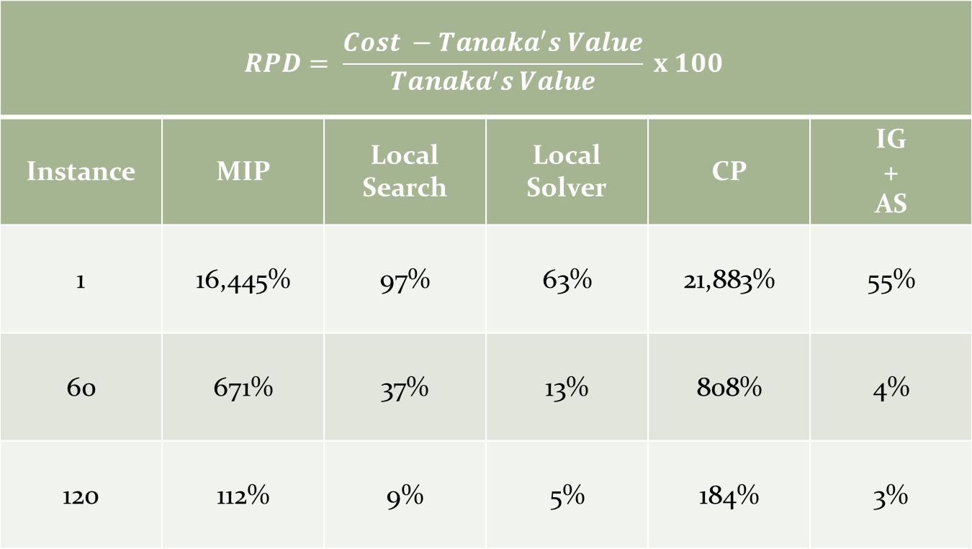
Comparison
$$RPD= \frac{Cost −Tanaka^{′}s Value}{Tanaka^{′}s Value} x 100$$
Instance | MIP | Local Search | Local Solver | CP | IG + AS
1 | 16,445% | 97% | 63% | 21,883% | 55%
60 | 671% | 37% | 13% | 808% | 4%
120 | 112% | 9% | 5% | 184% | 3%

Slide 19
Best Found Sequences
Instance | Sequence
1 | 57, 25, 33, 1, 31, 13, 7, 5, 23, 48, 9, 54, 30, 60, 37, 40, 6, 24, 2, 11, 36, 3, 50, 56, 15, 59, 8, 28, 21, 10, 19, 52, 45, 27, 18, 32, 44, 26, 29, 4, 43, 12, 39, 47, 58, 38, 46, 51, 53, 49, 35, 14, 42, 22, 17, 20, 55, 16, 34, 41
60 | 43, 32, 17, 40, 50, 11, 53, 59, 37, 23, 9, 36, 48, 2, 41, 49, 1, 44, 45, 56, 27, 15, 22, 19, 12, 38, 18, 10, 7, 51, 57, 24, 20, 3, 60, 21, 58, 47, 34, 28, 31, 26, 52, 35, 25, 4, 33, 6, 29, 55, 42, 14, 13, 8, 46, 30, 39, 16, 54, 5
120 | 25, 15, 52, 44, 28, 31, 27, 20, 9, 53, 33, 16, 45, 22, 18, 13, 55, 35, 14, 39, 24, 34, 41, 36, 49, 56, 42, 23, 50, 19, 6, 7, 30, 10, 1, 26, 3, 38, 51, 21, 54, 60, 2, 5, 11, 4, 48, 37, 12, 40, 8, 29, 32, 43, 59, 17, 46, 58, 47, 57

Slide 20
Conclusion
Gurobi with MATLAB most tedious to program
More flexibility with gurobi
Heuristic’s output dependent on initial seed
Easily stuck in local minima is deterministic approach used instead of a stochastic one
Technical documentation for local solver and CP solvers not good
Worst Performance: Constraint Programming
Best Performance: Heuristic Approaches

