Slide 1

Dan Gomm, Tristen Terracciano, Joe St. Pierre, Zach Major, Ryan Feldman, Kunal Pandey, Drew Graham

Slide 2

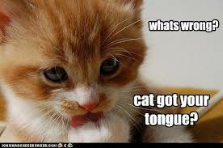
Meeting a new person
Nervous
It’s hard to bring up a topic sometimes

Slide 3
Conversation Starter
The tool gives a random topic to talk about. There are sections if the user wants to talk about a certain topic
The tool should give ideas to start a conversation with another person
Most of the topics should be recent, and hot topics/trends.

Slide 4
U.S.
World
Ice Breakers!
Business
Science
Random
Technology
Health
Politics
Sports

